Slide 1
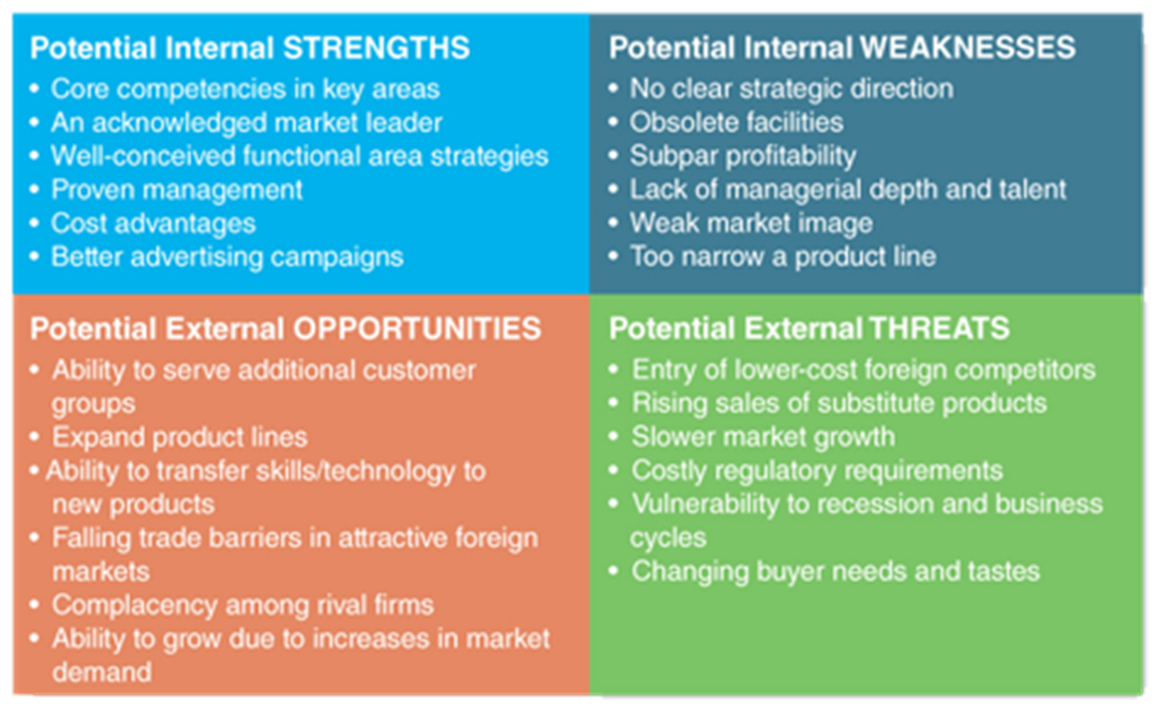
SWOT MATRIX

Slide 2
Strengths
What advantages does your organization have?
What do you do better than anyone else?
What unique or lowest-cost resources can you draw upon that others can't?
What do people in your market see as your strengths?
What factors mean that you "get the sale"?
What is your organization's Unique Selling Proposition (USP)?

Slide 3
Weaknesses
What could you improve?
What should you avoid?
What are people in your market likely to see as weaknesses?
What factors lose you sales?

Slide 4
Opportunities
What good opportunities can you spot?
What interesting trends are you aware of?
Useful opportunities can come from such things as:
Changes in technology and markets on both a broad and narrow scale.
Changes in government policy related to your field.
Changes in social patterns, population profiles, lifestyle changes, and so on.
Local events.

Slide 5
Threats
What obstacles do you face?
What are your competitors doing?
Are quality standards or specifications for your job, products or services changing?
Is changing technology threatening your position?
Do you have bad debt or cash-flow problems?
Could any of your weaknesses seriously threaten your business?

