Slide 1
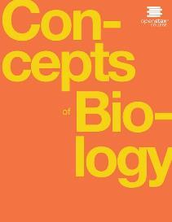
Concepts of Biology
Chapter 1 INTRODUCTION TO BIOLOGY
PowerPoint Image Slideshow

Slide 2
Learning objectives
After successfully completing this learning module, students will be able to:
Identify and describe the properties of life.
Describe the levels of organization among living organisms.
Compare inductive reasoning with deductive reasoning.
Apply the process of scientific inquiry to questions.

Slide 3
Learning Objective Identify & describe the properties of life
Life has order and structure
Life senses and responds to stimuli
Life requires reproduction
Life adapts to its environment through natural selection
Life grows and develops over time
Life requires mechanisms for self-regulation to maintain homeostasis
Life needs and uses energy

Slide 4
Properties of Life: Order & Structure
A toad represents a highly organized structure consisting of cells, tissues, organs, and organ systems. (credit: “Ivengo(RUS)”/Wikimedia Commons)
This OpenStax ancillary resource is © Rice University under a CC-BY 4.0 International license; it may be reproduced or modified but must be attributed to OpenStax, Rice University and any changes must be noted. Any images credited to other sources are similarly available for reproduction, but must be attributed to their sources.

Slide 5
Properties of life: Sense and response to stimuli
The leaves of this sensitive plant (Mimosa pudica) will instantly droop and fold when touched. After a few minutes, the plant returns to its normal state. (credit: Alex Lomas)
This OpenStax ancillary resource is © Rice University under a CC-BY 4.0 International license; it may be reproduced or modified but must be attributed to OpenStax, Rice University and any changes must be noted. Any images credited to other sources are similarly available for reproduction, but must be attributed to their sources.

Slide 6
Properties of life: reproduction
Although no two look alike, these kittens have inherited genes from both parents and share many of the same characteristics. (credit: Pieter & Renée Lanser)
This OpenStax ancillary resource is © Rice University under a CC-BY 4.0 International license; it may be reproduced or modified but must be attributed to OpenStax, Rice University and any changes must be noted. Any images credited to other sources are similarly available for reproduction, but must be attributed to their sources.

Slide 7
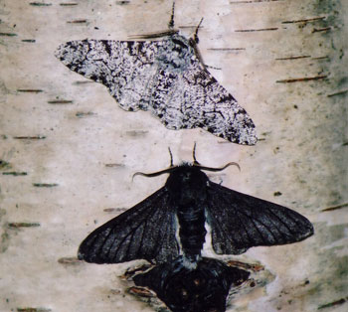
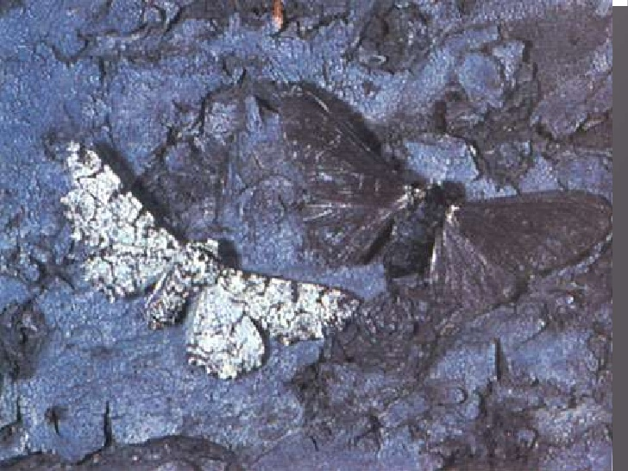
Properties of life: adaptation through natural selection
Image from coolantarctica.com
Image from slideshare.net
As the environment changes, variations give different individuals reproductive advantages over others causing a change in the next generation’s population.

Slide 8
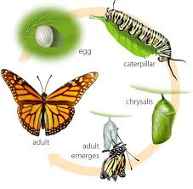
Properties of life: growth & development
Image from NJ.gov

Slide 9
Properties of life: regulation & homeostasis
Polar bears and other mammals living in ice-covered regions maintain their body temperature by generating heat and reducing heat loss through thick fur and a dense layer of fat under their skin. (credit: “longhorndave”/Flickr)
This OpenStax ancillary resource is © Rice University under a CC-BY 4.0 International license; it may be reproduced or modified but must be attributed to OpenStax, Rice University and any changes must be noted. Any images credited to other sources are similarly available for reproduction, but must be attributed to their sources.

Slide 10
Properties of life: energy Need & use
A lot of energy is required for a California condor to fly. Chemical energy derived from food is used to power flight. California condors are an endangered species; scientists have strived to place a wing tag on each bird to help them identify and locate each individual bird. (credit: Pacific Southwest Region U.S. Fish and Wildlife)
This OpenStax ancillary resource is © Rice University under a CC-BY 4.0 International license; it may be reproduced or modified but must be attributed to OpenStax, Rice University and any changes must be noted. Any images credited to other sources are similarly available for reproduction, but must be attributed to their sources.

Slide 11
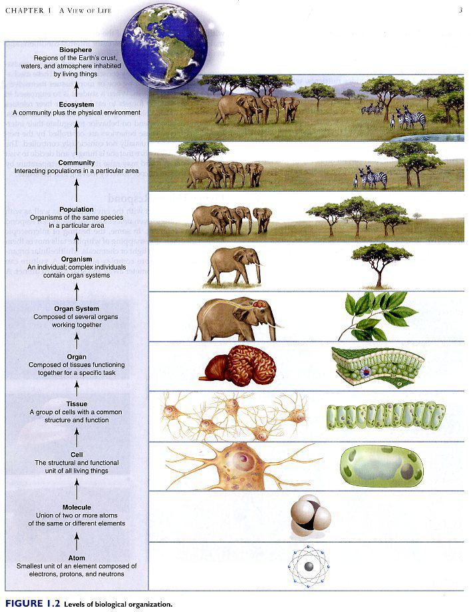
Learning objective: describe the levels of organization in living organisms
Image from https://organicyajinke.blogspot.com/2015/10/levels-of-biological-organization.html

Slide 12
Figure 1.9
This diagram shows the levels of taxonomic hierarchy for a dog, from the broadest category—domain—to the most specific—species.
This OpenStax ancillary resource is © Rice University under a CC-BY 4.0 International license; it may be reproduced or modified but must be attributed to OpenStax, Rice University and any changes must be noted. Any images credited to other sources are similarly available for reproduction, but must be attributed to their sources.

Slide 13
Figure 1.10
These images represent different domains. The scanning electron micrograph shows (a) bacterial cells belong to the domain Bacteria, while the (b) extremophiles, seen all together as colored mats in this hot spring, belong to domain Archaea. Both the (c) sunflower and (d) lion are part of domain Eukarya. (credit a: modification of work by Rocky Mountain Laboratories, NIAID, NIH; credit b: modification of work by Steve Jurvetson; credit c: modification of work by Michael Arrighi; credit d: modification of work by Frank Vassen)
This OpenStax ancillary resource is © Rice University under a CC-BY 4.0 International license; it may be reproduced or modified but must be attributed to OpenStax, Rice University and any changes must be noted. Any images credited to other sources are similarly available for reproduction, but must be attributed to their sources.

Slide 14
Figure 1.11
This phylogenetic tree was constructed by microbiologist Carl Woese using genetic relationships. The tree shows the separation of living organisms into three domains: Bacteria, Archaea, and Eukarya. Bacteria and Archaea are organisms without a nucleus or other organelles surrounded by a membrane and, therefore, are prokaryotes. (credit: modification of work by Eric Gaba)
This OpenStax ancillary resource is © Rice University under a CC-BY 4.0 International license; it may be reproduced or modified but must be attributed to OpenStax, Rice University and any changes must be noted. Any images credited to other sources are similarly available for reproduction, but must be attributed to their sources.

Slide 15
Learning objective: Compare inductive reasoning with deductive reasoning
Discovery Science Hypothesis Testing
Image from https://7esl.com/inductive-vs-deductive-reasoning/

Slide 16
Learning objective: apply the process of scientific inquiry to questions
Science is one of many tools that should be used to explore our world.
Image from extranewsfeed.com

Slide 17
Figure 1.18
The scientific method is a series of defined steps that include experiments and careful observation. If a hypothesis is not supported by data, a new hypothesis can be proposed.
This OpenStax ancillary resource is © Rice University under a CC-BY 4.0 International license; it may be reproduced or modified but must be attributed to OpenStax, Rice University and any changes must be noted. Any images credited to other sources are similarly available for reproduction, but must be attributed to their sources.

Slide 18
The Scientific method in action

