Slide 1
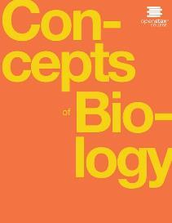
Concepts of Biology
Chapter 3 CELL STRUCTURE AND FUNCTION
PowerPoint Image Slideshow

Slide 2
Learning objectives
After successfully completing this learning module, students will be able to:
Summarize the cell theory.
Describe the relative sizes of different types of cells.
Use a Venn Diagram to compare and contrast prokaryotic cells with eukaryotic cells.
Describe the structure and function of the cell membrane and organelles of eukaryotic cells.
Use a concept map to describe movement across membranes in a cell.

Slide 3
Figure 3.2
Most light microscopes used in a college biology lab can magnify cells up to approximately 400 times.
Dissecting microscopes have a lower magnification than light microscopes and are used to examine larger objects, such as tissues.
This OpenStax ancillary resource is © Rice University under a CC-BY 4.0 International license; it may be reproduced or modified but must be attributed to OpenStax, Rice University and any changes must be noted. Any images credited to other sources are similarly available for reproduction, but must be attributed to their sources.

Slide 4
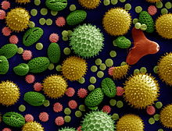
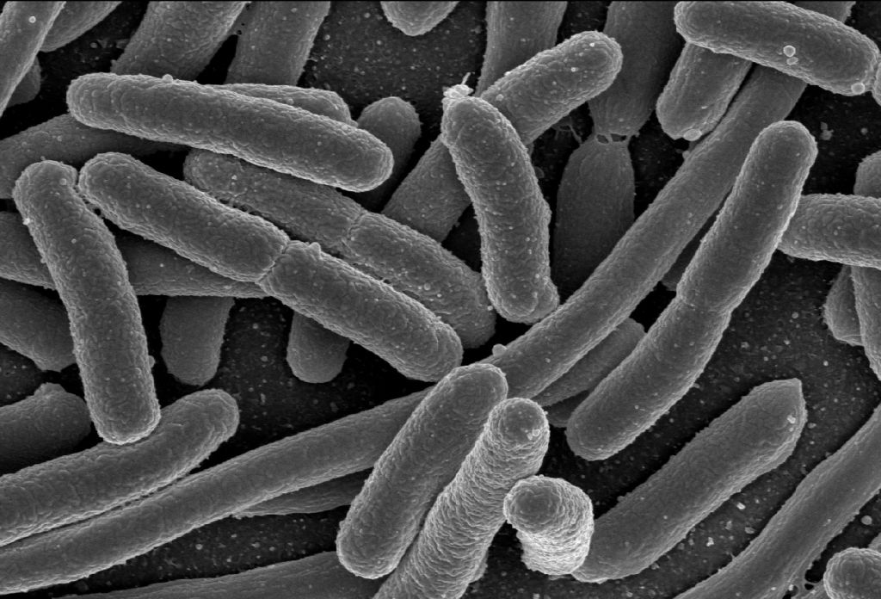
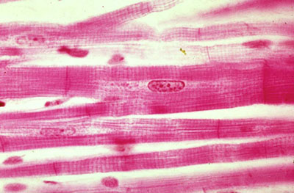
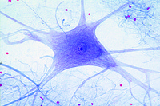
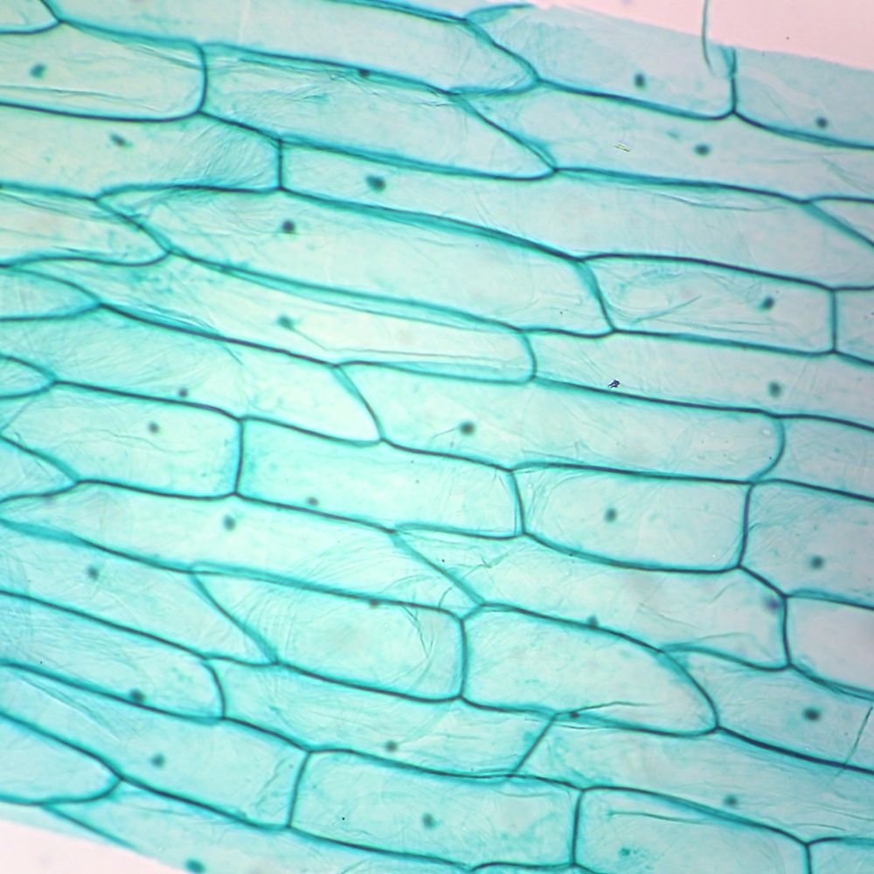
Learning objective: Summarize the cell theory
All living things are composed of cells.
The cell is the basic unit of life.
All cells come from pre-existing cells.

Slide 5
Figure 3.6
This figure shows the relative sizes of different kinds of cells and cellular components. An adult human is shown for comparison.
Cells Alive!
This OpenStax ancillary resource is © Rice University under a CC-BY 4.0 International license; it may be reproduced or modified but must be attributed to OpenStax, Rice University and any changes must be noted. Any images credited to other sources are similarly available for reproduction, but must be attributed to their sources.

Slide 6
Learning objective: use a venn diagram to compare & contrast prokaryotic cells with eukaryotic cells
Prokaryotic Cells
Eukaryotic Cells
Both
Venn Diagrams: One of many visual ways to organize the relationships between two things

Slide 7
The general structure of a prokaryotic cell
This OpenStax ancillary resource is © Rice University under a CC-BY 4.0 International license; it may be reproduced or modified but must be attributed to OpenStax, Rice University and any changes must be noted. Any images credited to other sources are similarly available for reproduction, but must be attributed to their sources.

Slide 8
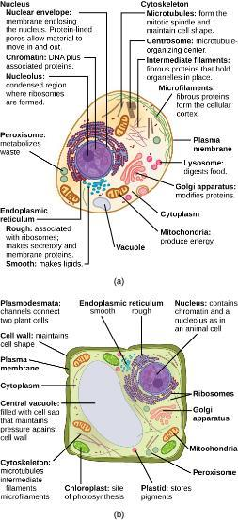
The general structure of eukaryotic cells
This OpenStax ancillary resource is © Rice University under a CC-BY 4.0 International license; it may be reproduced or modified but must be attributed to OpenStax, Rice University and any changes must be noted. Any images credited to other sources are similarly available for reproduction, but must be attributed to their sources.

Slide 9
Learning objective: use a venn diagram to compare & contrast prokaryotic cells with eukaryotic cells
Prokaryotic Cells
Eukaryotic Cells
Both
What can be added to this diagram from the readings?

Slide 10
Learning objective: describe the structure & function of the cell membrane and organelles of eukaryotic cells
The plasma membrane is a phospholipid bilayer with embedded proteins. There are other components, such as cholesterol and carbohydrates, which can be found in the membrane in addition to phospholipids and protein.

Slide 11
The cytoskeleton
Structure: Microfilaments, intermediate filaments, and microtubules compose a cell’s cytoskeleton.
Function: support the structure of the cell overall. Facilitate movement within the cell.
This OpenStax ancillary resource is © Rice University under a CC-BY 4.0 International license; it may be reproduced or modified but must be attributed to OpenStax, Rice University and any changes must be noted. Any images credited to other sources are similarly available for reproduction, but must be attributed to their sources.

Slide 12
Nucleus & Rough Endoplasmic reticulum
The outermost boundary of the nucleus is the nuclear envelope. Notice that the nuclear envelope consists of two phospholipid bilayers (membranes)—an outer membrane and an inner membrane—in contrast to the plasma membrane (Figure 3.8), which consists of only one phospholipid bilayer. (credit: modification of work by NIGMS, NIH)
This OpenStax ancillary resource is © Rice University under a CC-BY 4.0 International license; it may be reproduced or modified but must be attributed to OpenStax, Rice University and any changes must be noted. Any images credited to other sources are similarly available for reproduction, but must be attributed to their sources.

Slide 13
Golgi apparatus
The Golgi apparatus in this transmission electron micrograph of a white blood cell is visible as a stack of semicircular flattened rings in the lower portion of this image. Several vesicles can be seen near the Golgi apparatus. (credit: modification of work by Louisa Howard; scale-bar data from Matt Russell)
This OpenStax ancillary resource is © Rice University under a CC-BY 4.0 International license; it may be reproduced or modified but must be attributed to OpenStax, Rice University and any changes must be noted. Any images credited to other sources are similarly available for reproduction, but must be attributed to their sources.

Slide 14
Mitochondria
This transmission electron micrograph shows a mitochondrion as viewed with an electron microscope. Notice the inner and outer membranes, the cristae, and the mitochondrial matrix. (credit: modification of work by Matthew Britton; scale-bar data from Matt Russell)
This OpenStax ancillary resource is © Rice University under a CC-BY 4.0 International license; it may be reproduced or modified but must be attributed to OpenStax, Rice University and any changes must be noted. Any images credited to other sources are similarly available for reproduction, but must be attributed to their sources.

Slide 15
Chloroplast
This OpenStax ancillary resource is © Rice University under a CC-BY 4.0 International license; it may be reproduced or modified but must be attributed to OpenStax, Rice University and any changes must be noted. Any images credited to other sources are similarly available for reproduction, but must be attributed to their sources.

Slide 16
Figure 3.12
A macrophage has phagocytized a potentially pathogenic bacterium into a vesicle, which then fuses with a lysosome within the cell so that the pathogen can be destroyed. Other organelles are present in the cell, but for simplicity, are not shown.
This OpenStax ancillary resource is © Rice University under a CC-BY 4.0 International license; it may be reproduced or modified but must be attributed to OpenStax, Rice University and any changes must be noted. Any images credited to other sources are similarly available for reproduction, but must be attributed to their sources.

Slide 17
Figure 3.13
The endomembrane system works to modify, package, and transport lipids and proteins. (credit: modification of work by Magnus Manske)
This OpenStax ancillary resource is © Rice University under a CC-BY 4.0 International license; it may be reproduced or modified but must be attributed to OpenStax, Rice University and any changes must be noted. Any images credited to other sources are similarly available for reproduction, but must be attributed to their sources.

Slide 18
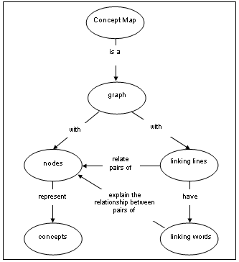
Learning objective: use a concept map to describe movement across membranes in a cell
Concept Map: A diagram that suggests relationships among multiple concepts

Slide 19
Movement Across Membranes

Slide 20
Simple Diffusion
Simple diffusion through a permeable membrane follows the concentration gradient of a substance, moving the substance from an area of high concentration to one of low concentration. (credit: modification of work by Mariana Ruiz Villarreal)
This is common for nonpolar hydrophobic molecules.
This OpenStax ancillary resource is © Rice University under a CC-BY 4.0 International license; it may be reproduced or modified but must be attributed to OpenStax, Rice University and any changes must be noted. Any images credited to other sources are similarly available for reproduction, but must be attributed to their sources.

Slide 21
Facilitated Diffusion
Movement of solutes across a membrane from a high concentration to a low concentration that requires a channel. This is the type of movement for hydrophilic substances.
This OpenStax ancillary resource is © Rice University under a CC-BY 4.0 International license; it may be reproduced or modified but must be attributed to OpenStax, Rice University and any changes must be noted. Any images credited to other sources are similarly available for reproduction, but must be attributed to their sources.

Slide 22
Movement Across Membranes
Energy not required (think rolling downhill)
Passive Transport
Passive Transport of Solutes
Hydrophobic Substances
Hydrophilic Substances
Facilitated Diffusion
Simple Diffusion

Slide 23
Osmosis
In osmosis, water always moves from an area of higher concentration (of water) to one of lower concentration (of water).
This OpenStax ancillary resource is © Rice University under a CC-BY 4.0 International license; it may be reproduced or modified but must be attributed to OpenStax, Rice University and any changes must be noted. Any images credited to other sources are similarly available for reproduction, but must be attributed to their sources.

Slide 24
Osmosis in red blood cells
Osmotic pressure changes the shape of red blood cells in hypertonic, isotonic, and hypotonic solutions. (credit: modification of work by Mariana Ruiz Villarreal)
This OpenStax ancillary resource is © Rice University under a CC-BY 4.0 International license; it may be reproduced or modified but must be attributed to OpenStax, Rice University and any changes must be noted. Any images credited to other sources are similarly available for reproduction, but must be attributed to their sources.

Slide 25
Osmosis in plant cells
The turgor pressure within a plant cell depends on the tonicity of the solution that it is bathed in. (credit: modification of work by Mariana Ruiz Villarreal)
This OpenStax ancillary resource is © Rice University under a CC-BY 4.0 International license; it may be reproduced or modified but must be attributed to OpenStax, Rice University and any changes must be noted. Any images credited to other sources are similarly available for reproduction, but must be attributed to their sources.

Slide 26
Movement Across Membranes
Energy not required (think rolling downhill)
Passive Transport
Passive Transport of Solutes
Passive Transport of Solvent
Hydrophobic Substances
Hydrophilic Substances
Osmosis
Facilitated Diffusion
Simple Diffusion

Slide 27
Active transport
The movement of molecules across a membrane AGAINST their gradient. Energy is required. Integral membrane proteins are required.
(credit: modification of work by Mariana Ruiz Villarreal)
This OpenStax ancillary resource is © Rice University under a CC-BY 4.0 International license; it may be reproduced or modified but must be attributed to OpenStax, Rice University and any changes must be noted. Any images credited to other sources are similarly available for reproduction, but must be attributed to their sources.

Slide 28
Movement Across Membranes
Energy not required (think rolling downhill)
Energy required (think rolling uphill)
Passive Transport
Molecules pumped against their gradients
Passive Transport of Solutes
Passive Transport of Solvent
Active Transport
Hydrophobic Substances
Hydrophilic Substances
Osmosis
Facilitated Diffusion
Simple Diffusion

Slide 29
Endocytosis
Three variations of endocytosis are shown.
In one form of endocytosis, phagocytosis, the cell membrane surrounds the particle and pinches off to form an intracellular vacuole.
In another type of endocytosis, pinocytosis, the cell membrane surrounds a small volume of fluid and pinches off, forming a vesicle.
In receptor-mediated endocytosis, uptake of substances by the cell is targeted to a single type of substance that binds at the receptor on the external cell membrane. (credit: modification of work by Mariana Ruiz Villarreal)
This OpenStax ancillary resource is © Rice University under a CC-BY 4.0 International license; it may be reproduced or modified but must be attributed to OpenStax, Rice University and any changes must be noted. Any images credited to other sources are similarly available for reproduction, but must be attributed to their sources.

Slide 30
Exocytosis
In exocytosis, a vesicle migrates to the plasma membrane, binds, and releases its contents to the outside of the cell. (credit: modification of work by Mariana Ruiz Villarreal)
This OpenStax ancillary resource is © Rice University under a CC-BY 4.0 International license; it may be reproduced or modified but must be attributed to OpenStax, Rice University and any changes must be noted. Any images credited to other sources are similarly available for reproduction, but must be attributed to their sources.

Slide 31
Movement Across Membranes
Energy not required (think rolling downhill)
Energy required (think rolling uphill)
Energy required (think on a flat surface)
Molecules pumped against their gradients
Molecules brought into or out of cell using vesicles
Passive Transport
Passive Transport of Solutes
Passive Transport of Solvent
Active Transport
Hydrophobic Substances
Hydrophilic Substances
Osmosis
Endocytosis
Exocytosis
Facilitated Diffusion
Simple Diffusion

Slide 32
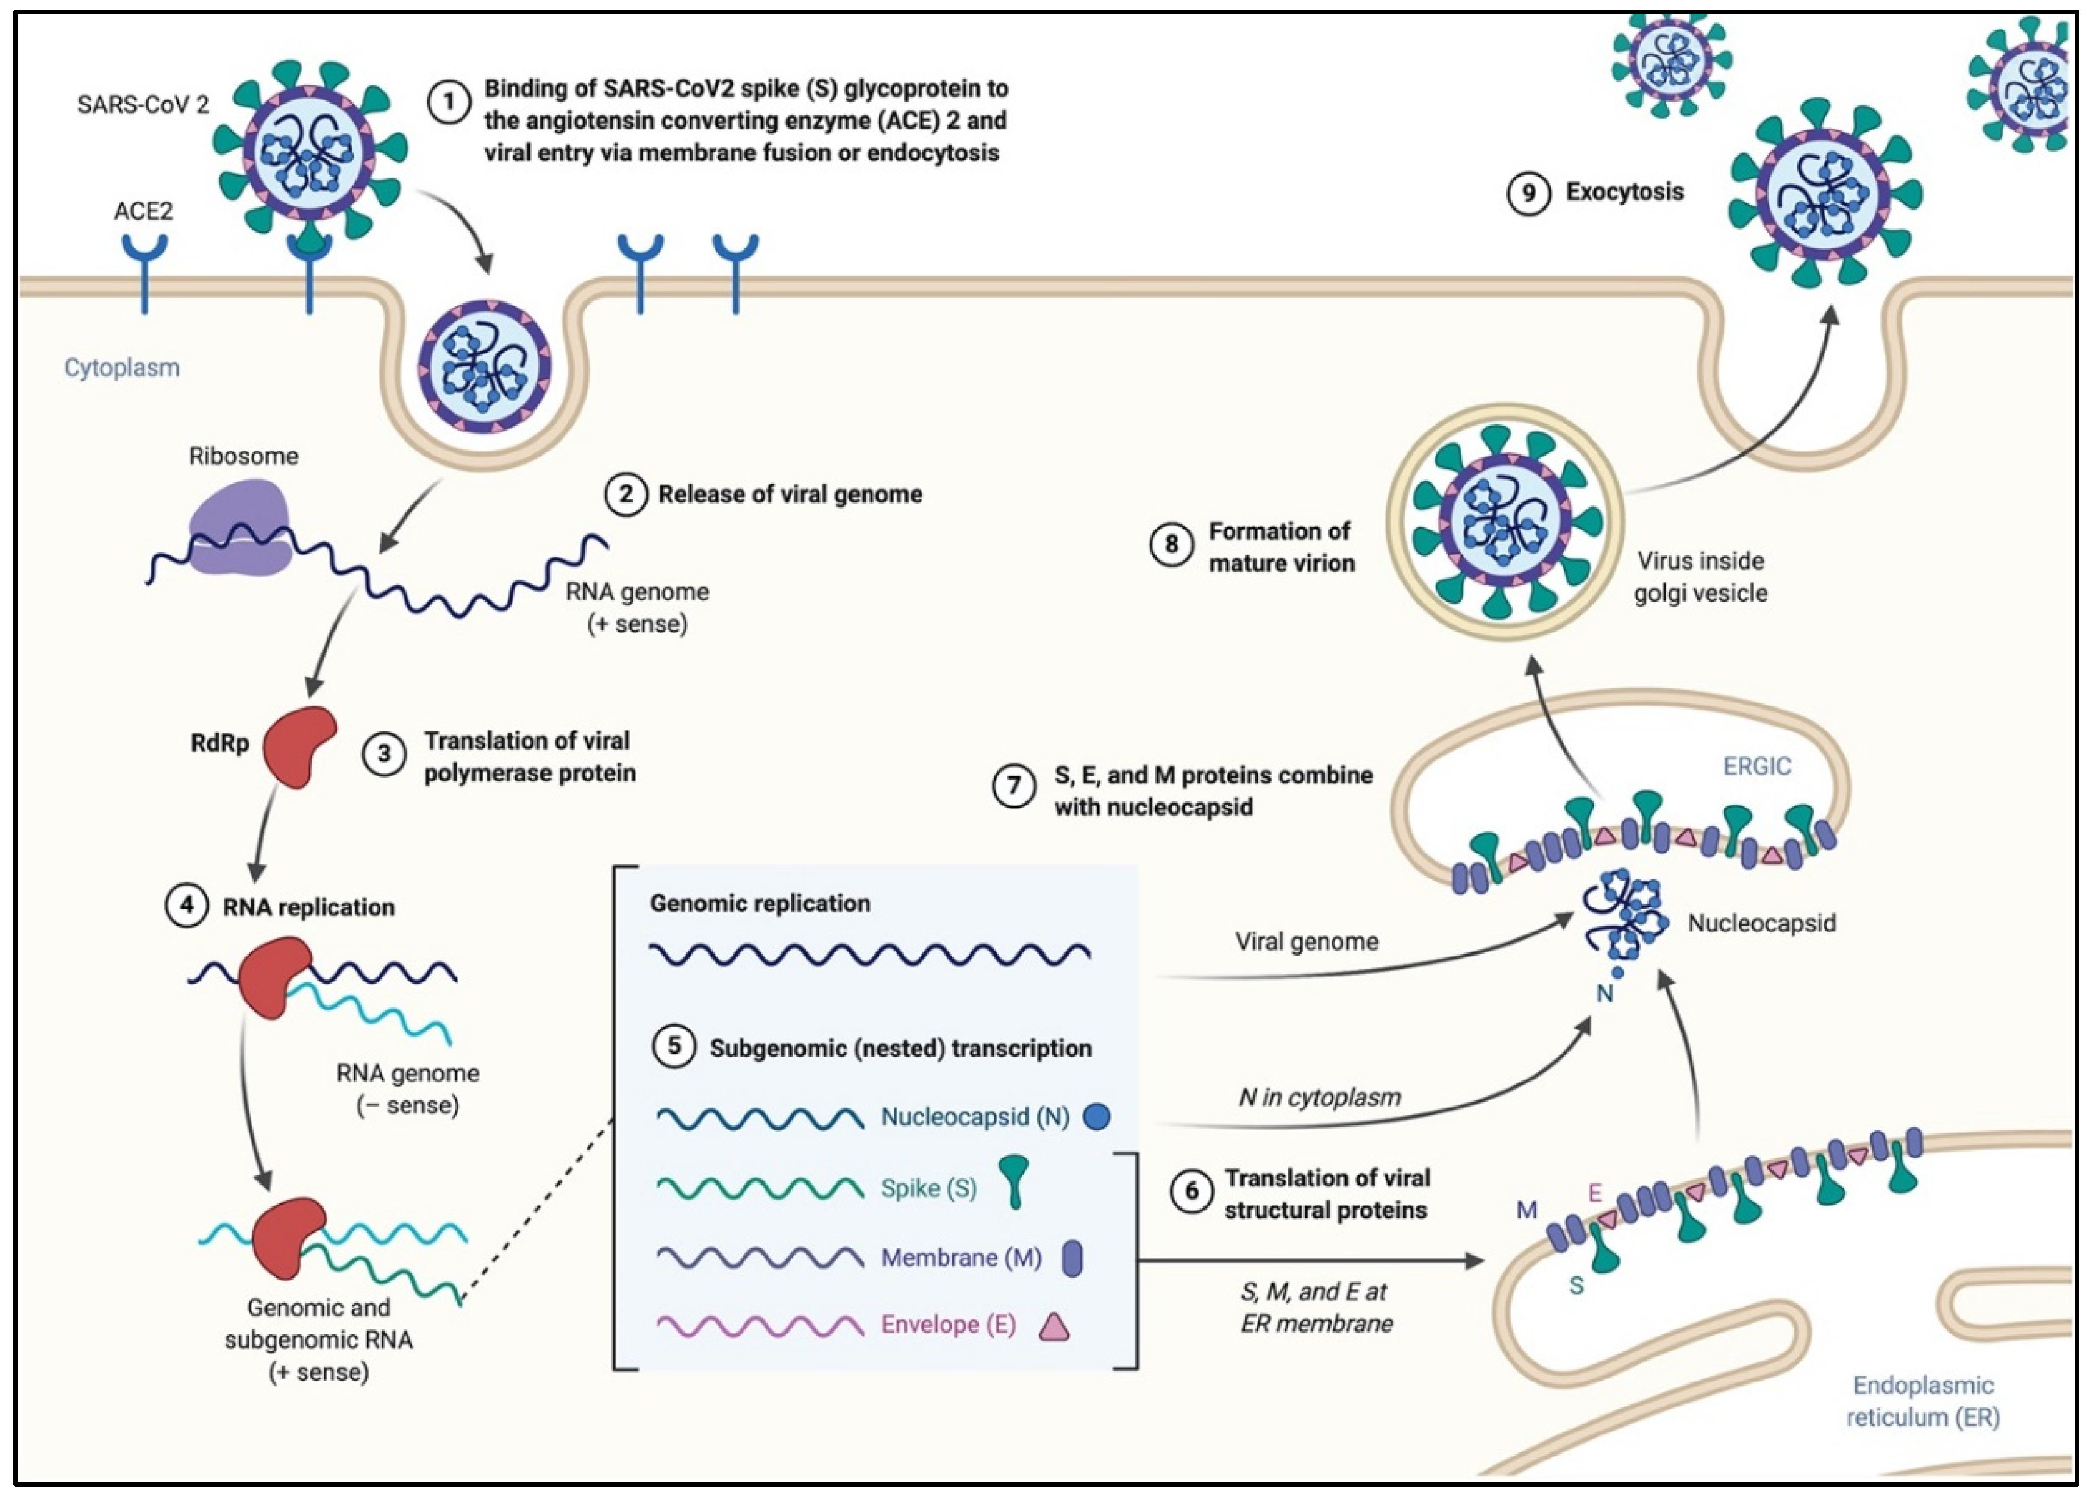
Vesicle Movement and Coronavirus

