Slide 1
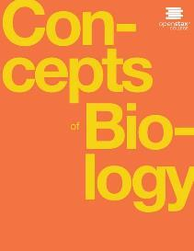
Concepts of Biology
Chapter 4 HOW CELLS OBTAIN ENERGY
PowerPoint Image Slideshow

Slide 2
Learning objectives
After successfully completing this learning module, students will be able to:
Distinguish between anabolic and catabolic metabolic pathways.
Relate the first and second laws of thermodynamics to an understanding of life.
Explain the difference between potential and kinetic energy.
Relate endergonic and exergonic reactions to metabolic pathways.
Explain how enzymes catalyze chemical reactions.
Explain how ATP is used by the cell as an energy source.
Describe the location and general process of glycolysis, citric acid cycle, and oxidative phosphorylation.
Distinguish between the type of fermentation that occurs in animal cells with the type of fermentation that occurs in yeast cells.
Appreciate that proteins and lipids can also be metabolized as energy sources.

Slide 3
Figure 4.1
A hummingbird needs energy to maintain prolonged flight. The bird obtains its energy from taking in food and transforming the energy contained in food molecules into forms of energy to power its flight through a series of biochemical reactions. (credit: modification of work by Cory Zanker)
This OpenStax ancillary resource is © Rice University under a CC-BY 4.0 International license; it may be reproduced or modified but must be attributed to OpenStax, Rice University and any changes must be noted. Any images credited to other sources are similarly available for reproduction, but must be attributed to their sources.

Slide 4
Figure 4.2
Ultimately, most life forms get their energy from the sun. Plants use photosynthesis to capture sunlight, and herbivores eat the plants to obtain energy. Carnivores eat the herbivores, and eventual decomposition of plant and animal material contributes to the nutrient pool.
This OpenStax ancillary resource is © Rice University under a CC-BY 4.0 International license; it may be reproduced or modified but must be attributed to OpenStax, Rice University and any changes must be noted. Any images credited to other sources are similarly available for reproduction, but must be attributed to their sources.

Slide 5
Learning objective: distinguish between anabolic & catabolic metabolic reactions
Metabolic pathways are a series of reactions catalyzed by multiple enzymes. Feedback inhibition, where the end product of the pathway inhibits an upstream process, is an important regulatory mechanism in cells.
This OpenStax ancillary resource is © Rice University under a CC-BY 4.0 International license; it may be reproduced or modified but must be attributed to OpenStax, Rice University and any changes must be noted. Any images credited to other sources are similarly available for reproduction, but must be attributed to their sources.

Slide 6
Learning Objective: Distinguish between anabolic & catabolic metabolic pathways
Catabolic pathways are those that generate energy by breaking down larger molecules.
Anabolic pathways are those that require energy to synthesize larger molecules.
Both types of pathways are required for maintaining the cell’s energy balance.
This OpenStax ancillary resource is © Rice University under a CC-BY 4.0 International license; it may be reproduced or modified but must be attributed to OpenStax, Rice University and any changes must be noted. Any images credited to other sources are similarly available for reproduction, but must be attributed to their sources.

Slide 7
Learning objective: relate the 1st & 2nd laws of thermodynamics to an understanding of life
1st Law of Thermodynamics
Energy is not created or destroyed. It changes forms.
2nd Law of Thermodynamics
Energy transformations are inefficient. Some energy is transformed into heat energy that is not able to do work.
Order to disorder. BUT…. One of life’s characteristics is order, so life spends energy to slow the 2nd law.
(credit “ice cream”: modification of work by D. Sharon Pruitt; credit “kids”: modification of work by Max from Providence; credit “leaf”: modification of work by Cory Zanker)
Heat
This OpenStax ancillary resource is © Rice University under a CC-BY 4.0 International license; it may be reproduced or modified but must be attributed to OpenStax, Rice University and any changes must be noted. Any images credited to other sources are similarly available for reproduction, but must be attributed to their sources.

Slide 8
Learning objective: explain the difference between potential energy & kinetic energy
Still water has potential energy; moving water, such as in a waterfall or a rapidly flowing river, has kinetic energy. (credit “dam”: modification of work by “Pascal”/Flickr; credit “waterfall”: modification of work by Frank Gualtieri)
This OpenStax ancillary resource is © Rice University under a CC-BY 4.0 International license; it may be reproduced or modified but must be attributed to OpenStax, Rice University and any changes must be noted. Any images credited to other sources are similarly available for reproduction, but must be attributed to their sources.

Slide 9
Learning objective: relate endergonic and exergonic reactions to metabolic pathways
This OpenStax ancillary resource is © Rice University under a CC-BY 4.0 International license; it may be reproduced or modified but must be attributed to OpenStax, Rice University and any changes must be noted. Any images credited to other sources are similarly available for reproduction, but must be attributed to their sources.

Slide 10
Learning objective: explain how enzymes catalyze chemical reactions
Enzymes lower the activation energy of the reaction but do not change the free energy of the reaction.
This OpenStax ancillary resource is © Rice University under a CC-BY 4.0 International license; it may be reproduced or modified but must be attributed to OpenStax, Rice University and any changes must be noted. Any images credited to other sources are similarly available for reproduction, but must be attributed to their sources.

Slide 11
Learning objective: explain how enzymes catalyze chemical reactions
The induced-fit model is an adjustment to the lock-and-key model and explains how enzymes and substrates undergo dynamic modifications during the transition state to increase the affinity of the substrate for the active site.
This OpenStax ancillary resource is © Rice University under a CC-BY 4.0 International license; it may be reproduced or modified but must be attributed to OpenStax, Rice University and any changes must be noted. Any images credited to other sources are similarly available for reproduction, but must be attributed to their sources.

Slide 12
Learning objective: explain how atp is used by the cell as an energy source
The structure of ATP shows the basic components of a two-ring adenine, five-carbon ribose, and three phosphate groups.
From slide player.com
This OpenStax ancillary resource is © Rice University under a CC-BY 4.0 International license; it may be reproduced or modified but must be attributed to OpenStax, Rice University and any changes must be noted. Any images credited to other sources are similarly available for reproduction, but must be attributed to their sources.

Slide 13
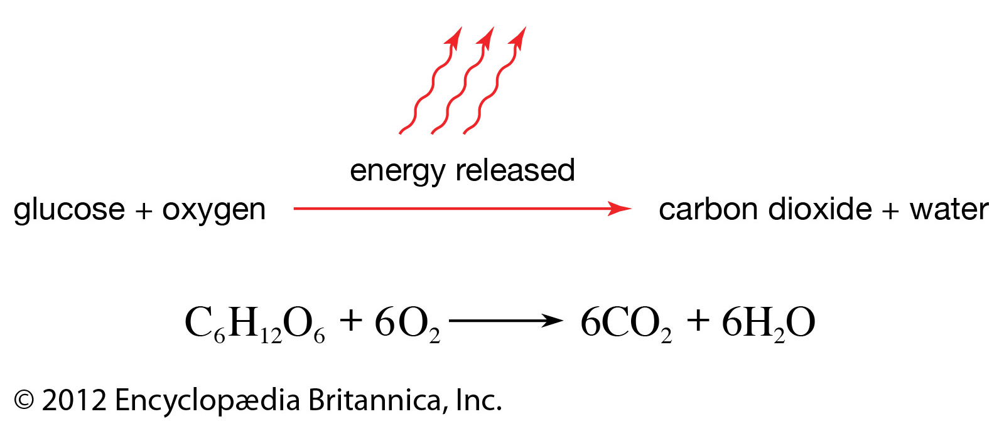
Learning objective: describe the location & general process of cellular respiration – glycolysis, citric acid cycle, and oxidative phosphorylation

Slide 14
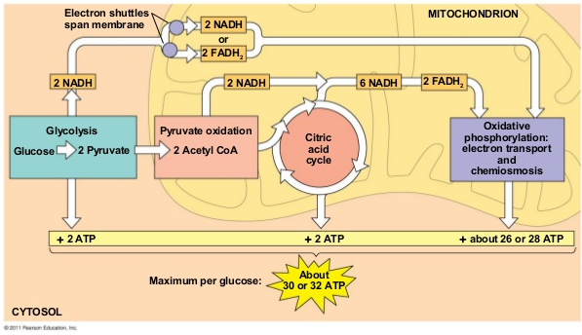
Roadmap of cellular respiration

Slide 15
Glycolysis
In glycolysis, a glucose molecule is converted into two pyruvate molecules.
Energy is invested
Energy is transferred
Energy is produced
This OpenStax ancillary resource is © Rice University under a CC-BY 4.0 International license; it may be reproduced or modified but must be attributed to OpenStax, Rice University and any changes must be noted. Any images credited to other sources are similarly available for reproduction, but must be attributed to their sources.

Slide 16
The Citric acid cycle
Pyruvate is converted into acetyl-CoA before entering the citric acid cycle.
The citric acid cycle takes place in the mitochondria.
A little ATP is produced, but pay attention to the NADH and FADH2!
This OpenStax ancillary resource is © Rice University under a CC-BY 4.0 International license; it may be reproduced or modified but must be attributed to OpenStax, Rice University and any changes must be noted. Any images credited to other sources are similarly available for reproduction, but must be attributed to their sources.

Slide 17
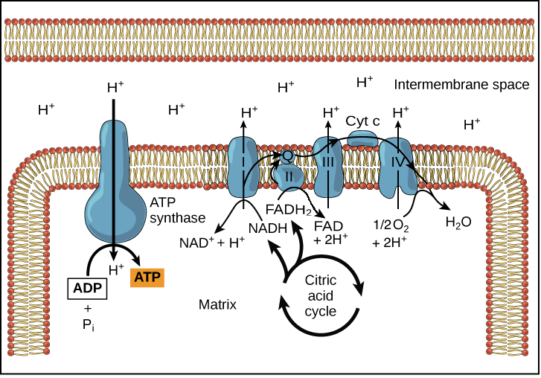
OXIDATIVE PHOSPHORYLATION
Cytoplasm
outer membrane of mitochondria
This takes place in the mitochondria.
Potential energy from electrons in NADH and FADH2 is transformed to kinetic energy to push hydrogen ions to the space between the two membranes of the mitochondria. This is the oxidation part, and is called the electron transport chain.
The Hydrogen ions move back into the innermost part of the mitochondria by facilitated diffusion through a protein called ATP synthase.
The kinetic energy of the hydrogen ions’ diffusion is captured to make ATP through a phosphorylation reaction.
The used up electrons and the diffused hydrogen ions combine with oxygen to form water. This is the number one reason you need oxygen!
This OpenStax ancillary resource is © Rice University under a CC-BY 4.0 International license; it may be reproduced or modified but must be attributed to OpenStax, Rice University and any changes must be noted. Any images credited to other sources are similarly available for reproduction, but must be attributed to their sources.

Slide 18
Why do I need to know this?
Cellular respiration is how your body gets energy from food AND why you need to keep inhaling Oxygen!

Slide 19
Learning objective: distinguish between fermentation in animal cells & yeast cells
What is fermentation?
A way to scavenge a bit of ATP when oxygen levels are low.
Oxidative phosphorylation cant function without oxygen. When it stops, a traffic jam forms in the citric acid cycle because there is not enough substrate around to make NADH and FADH2.
Glycolysis also needs NADH. Fermentation makes enough NADH for glycolysis to continue in the low oxygen environment.

Slide 20
Fermentation in animal cells: lactic acid fermentation
Lactic acid fermentation is common in muscles that have exhausted their oxygen supplies, and the cardiovascular system is not delivering oxygen fast enough.
Lactic acid causes the burn you feel during strenuous exercise!
This OpenStax ancillary resource is © Rice University under a CC-BY 4.0 International license; it may be reproduced or modified but must be attributed to OpenStax, Rice University and any changes must be noted. Any images credited to other sources are similarly available for reproduction, but must be attributed to their sources.

Slide 21
Yeast ferment differently than animals
The reaction resulting in alcohol fermentation is shown.
This OpenStax ancillary resource is © Rice University under a CC-BY 4.0 International license; it may be reproduced or modified but must be attributed to OpenStax, Rice University and any changes must be noted. Any images credited to other sources are similarly available for reproduction, but must be attributed to their sources.

Slide 22
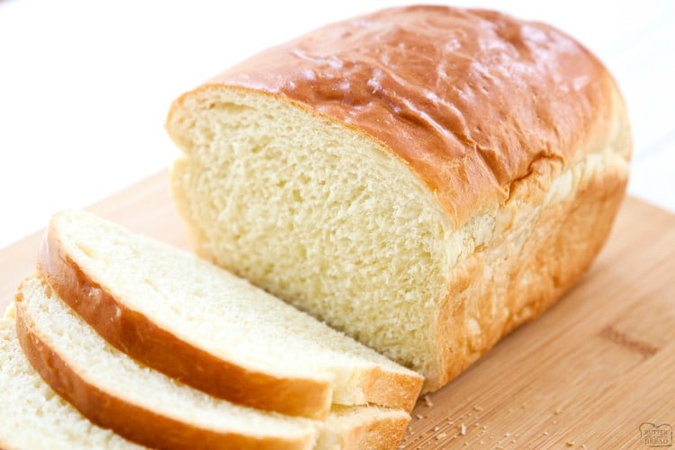
Humans take advantage of yeast fermentation
Fermentation of grape juice to make wine produces CO₂ and ethanol as a byproduct. Fermentation tanks have valves so that pressure inside the tanks can be released.
The fluffiness of bread is due to the CO2 pockets that form from yeast doing fermentation! The small amounts of alcohol evaporate during the baking process.
This OpenStax ancillary resource is © Rice University under a CC-BY 4.0 International license; it may be reproduced or modified but must be attributed to OpenStax, Rice University and any changes must be noted. Any images credited to other sources are similarly available for reproduction, but must be attributed to their sources.

Slide 23
Food energy: it’s not just carbs
Glycogen from the liver and muscles, together with fats, can feed into the catabolic pathways for carbohydrates.
This OpenStax ancillary resource is © Rice University under a CC-BY 4.0 International license; it may be reproduced or modified but must be attributed to OpenStax, Rice University and any changes must be noted. Any images credited to other sources are similarly available for reproduction, but must be attributed to their sources.

