Slide 1
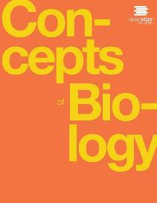
Concepts of Biology
Chapter 5 PHOTOSYNTHESIS
PowerPoint Image Slideshow

Slide 2
Learning objectives
After successfully completing this learning module, students will be able to:
Summarize the process of photosynthesis.
Describe the main structures involved in photosynthesis.
Explain the relevance of photosynthesis to other living things.

Slide 3
Learning objective: summarize the process of photosynthesis
What does photosynthesis?
Organisms with chloroplasts or at least chlorophyll
Autotrophs = self-feeders
(credit a: Steve Hillebrand, U.S. Fish and Wildlife Service; credit b: “eutrophication&hypoxia”/Flickr; credit c: NASA; scale-bar data from Matt Russell)
This OpenStax ancillary resource is © Rice University under a CC-BY 4.0 International license; it may be reproduced or modified but must be attributed to OpenStax, Rice University and any changes must be noted. Any images credited to other sources are similarly available for reproduction, but must be attributed to their sources.

Slide 4
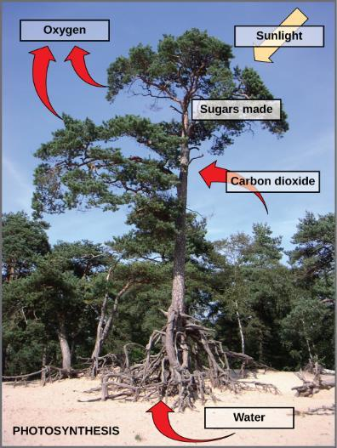
Figure 5.5
Photosynthesis uses solar energy, carbon dioxide, and water to release oxygen and to produce energy-storing sugar molecules.
This OpenStax ancillary resource is © Rice University under a CC-BY 4.0 International license; it may be reproduced or modified but must be attributed to OpenStax, Rice University and any changes must be noted. Any images credited to other sources are similarly available for reproduction, but must be attributed to their sources.

Slide 5
The summary equation of photosynthesis
The process of photosynthesis can be represented by an equation, wherein carbon dioxide and water produce sugar and oxygen using energy from sunlight.
This OpenStax ancillary resource is © Rice University under a CC-BY 4.0 International license; it may be reproduced or modified but must be attributed to OpenStax, Rice University and any changes must be noted. Any images credited to other sources are similarly available for reproduction, but must be attributed to their sources.

Slide 6
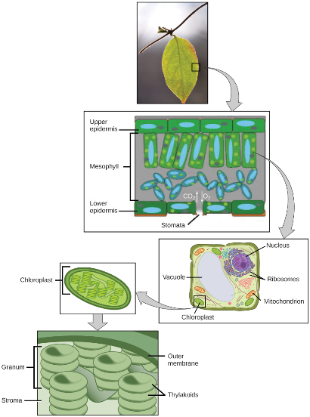
Where does photosynthesis take place?
Photo = light
The Light Reactions
Synthesis = to make
The Calvin Cycle
This OpenStax ancillary resource is © Rice University under a CC-BY 4.0 International license; it may be reproduced or modified but must be attributed to OpenStax, Rice University and any changes must be noted. Any images credited to other sources are similarly available for reproduction, but must be attributed to their sources.

Slide 7
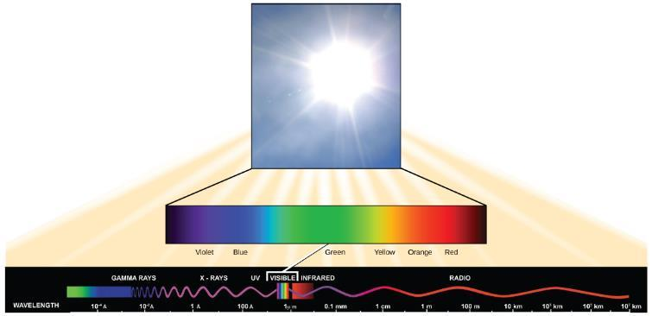
The Light Reactions: What is light energy?
The sun emits energy in the form of electromagnetic radiation. This radiation exists in different wavelengths, each of which has its own characteristic energy. Visible light is one type of energy emitted from the sun.
This OpenStax ancillary resource is © Rice University under a CC-BY 4.0 International license; it may be reproduced or modified but must be attributed to OpenStax, Rice University and any changes must be noted. Any images credited to other sources are similarly available for reproduction, but must be attributed to their sources.

Slide 8
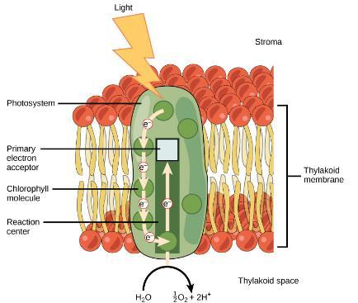
How is light energy captured by chlorophyll?
Light energy is absorbed by a chlorophyll molecule and is passed along a pathway to other chlorophyll molecules. The energy culminates in a molecule of chlorophyll found in the reaction center. The energy “excites” one of its electrons enough to leave the molecule and be transferred to a nearby primary electron acceptor. A molecule of water splits to release an electron, which is needed to replace the one donated. Oxygen and hydrogen ions are also formed from the splitting of water.
This OpenStax ancillary resource is © Rice University under a CC-BY 4.0 International license; it may be reproduced or modified but must be attributed to OpenStax, Rice University and any changes must be noted. Any images credited to other sources are similarly available for reproduction, but must be attributed to their sources.

Slide 9
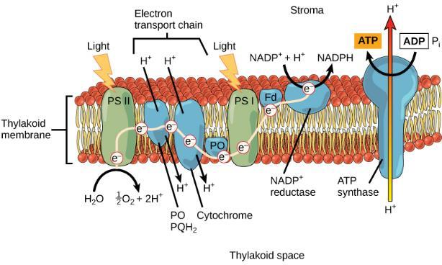
The light reactions: More oxidative phosphorylation
From photosystem II, the excited electron travels along a series of proteins. This electron transport system uses the energy from the electron to pump hydrogen ions into the interior of the thylakoid. A pigment molecule in photosystem I accepts the electron.
This OpenStax ancillary resource is © Rice University under a CC-BY 4.0 International license; it may be reproduced or modified but must be attributed to OpenStax, Rice University and any changes must be noted. Any images credited to other sources are similarly available for reproduction, but must be attributed to their sources.

Slide 10
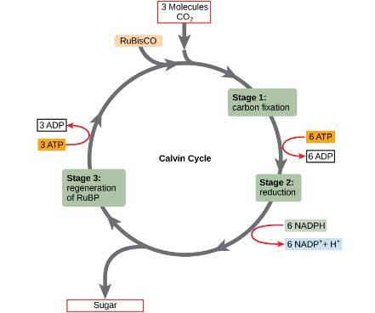
The Calvin Cycle: Sugar Synthesis
From the Light Reactions
From the Light Reactions
The Calvin cycle has three stages. In stage 1, the enzyme RuBisCO incorporates carbon dioxide into an organic molecule. In stage 2, the organic molecule is reduced. In stage 3, RuBP, the molecule that starts the cycle, is regenerated so that the cycle can continue.
This OpenStax ancillary resource is © Rice University under a CC-BY 4.0 International license; it may be reproduced or modified but must be attributed to OpenStax, Rice University and any changes must be noted. Any images credited to other sources are similarly available for reproduction, but must be attributed to their sources.

Slide 11
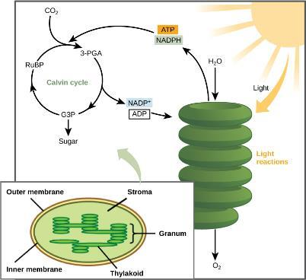
Summary of the Photosynthesis Process
Light-dependent reactions harness energy from the sun to produce ATP and NADPH. These energy-carrying molecules travel into the stroma where the Calvin cycle reactions take place.
This OpenStax ancillary resource is © Rice University under a CC-BY 4.0 International license; it may be reproduced or modified but must be attributed to OpenStax, Rice University and any changes must be noted. Any images credited to other sources are similarly available for reproduction, but must be attributed to their sources.

Slide 12
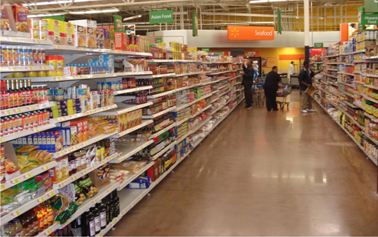
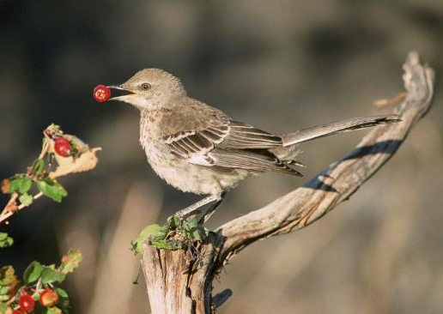
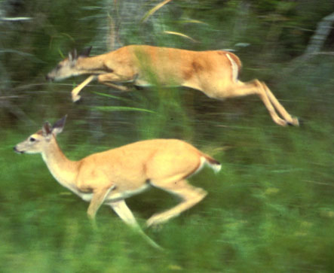
Learning objective: explain the relevance of photosynthesis to other living things
(credit: modification of work by Dave Menke, U.S. Fish and Wildlife Service)
(credit: Steve VanRiper, U.S. Fish and Wildlife Service)
(credit: Associação Brasileira de Supermercados)
This OpenStax ancillary resource is © Rice University under a CC-BY 4.0 International license; it may be reproduced or modified but must be attributed to OpenStax, Rice University and any changes must be noted. Any images credited to other sources are similarly available for reproduction, but must be attributed to their sources.

Slide 13
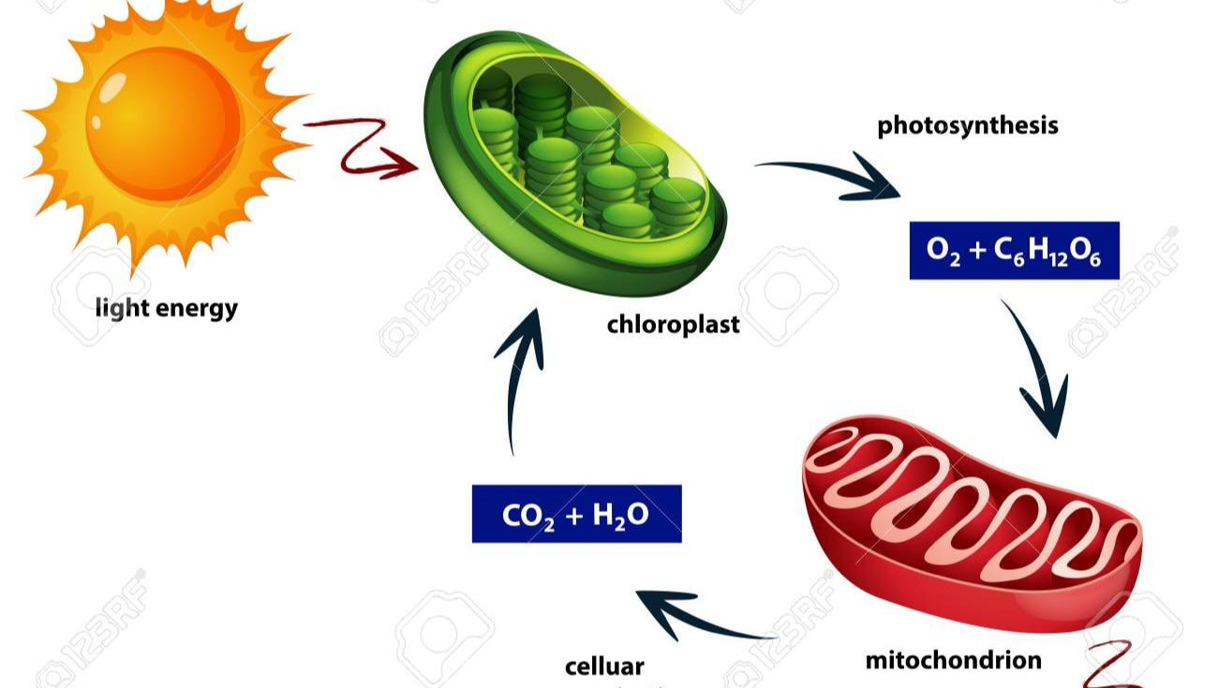
Photosynthesis & the energy cycle & The carbon cycle
Cytoplasm
From http://mrszeches.weebly.com/cellular-energy-and-nutrients.html

