Slide 1
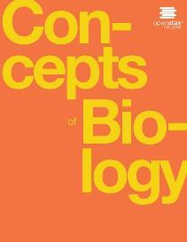
Concepts of Biology
Chapter 6 REPRODUCTION AT THE CELLULAR LEVEL
PowerPoint Image Slideshow

Slide 2
Learning objectives
After successfully completing this learning module, students will be able to:
Describe the prokaryotic and eukaryotic genome.
Describe the key events in each phase of the cell cycle.
Define the quiescent G₀ phase.
Explain how cancer is caused by uncontrolled cell division.
Describe the role of proto-oncogenes and tumor suppressors in the development of cancer.

Slide 3
Cell Division causes Growth & Development: A characteristic of life
A sea urchin begins life as a single cell that (a) divides to form two cells, visible by scanning electron microscopy. After four rounds of cell division, (b) there are 16 cells, as seen in this SEM image. After many rounds of cell division, the individual develops into a complex, multicellular organism, as seen in this (c) mature sea urchin. (credit a: modification of work by Evelyn Spiegel, Louisa Howard; credit b: modification of work by Evelyn Spiegel, Louisa Howard; credit c: modification of work by Marco Busdraghi; scale-bar data from Matt Russell)
This OpenStax ancillary resource is © Rice University under a CC-BY 4.0 International license; it may be reproduced or modified but must be attributed to OpenStax, Rice University and any changes must be noted. Any images credited to other sources are similarly available for reproduction, but must be attributed to their sources.

Slide 4
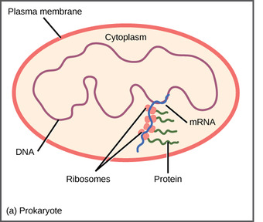
Prokaryotic Genomes
One circle of double-stranded DNA
Image from Lumen Learning

Slide 5
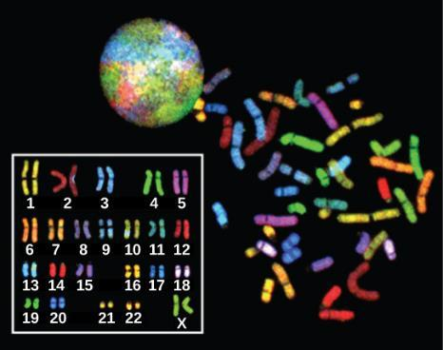
Eukaryotic Genomes
Composed of several linear double-stranded DNA molecules
There are 23 pairs of homologous chromosomes in a female human somatic cell. These chromosomes are viewed within the nucleus (top), removed from a cell in mitosis (right), and arranged according to length (left) in an arrangement called a karyotype. In this image, the chromosomes were exposed to fluorescent stains to distinguish them. (credit: “718 Bot”/Wikimedia Commons, National Human Genome Research)
This OpenStax ancillary resource is © Rice University under a CC-BY 4.0 International license; it may be reproduced or modified but must be attributed to OpenStax, Rice University and any changes must be noted. Any images credited to other sources are similarly available for reproduction, but must be attributed to their sources.

Slide 6
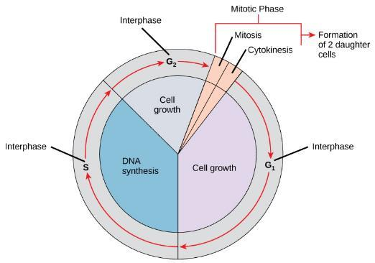
The Cell Cycle is the Life Cycle of a Cell
Interphase
G₁ Phase: Cell Growth & Protein Synthesis
S Phase: DNA Replication
G₂ Phase: Further growth & protein synthesis.
Mitotic Phase
Mitosis: Separation of DNA chromosomes
Cytokinesis: Physical separation into 2 cells
This OpenStax ancillary resource is © Rice University under a CC-BY 4.0 International license; it may be reproduced or modified but must be attributed to OpenStax, Rice University and any changes must be noted. Any images credited to other sources are similarly available for reproduction, but must be attributed to their sources.

Slide 7
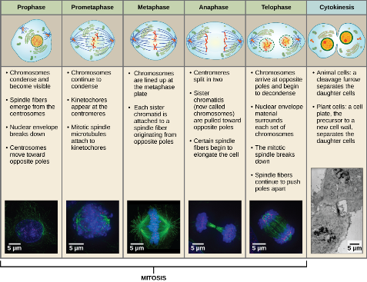
The mitotic phase in detail
credit “diagrams”: modification of work by Mariana Ruiz Villareal; credit “mitosis micrographs”: modification of work by Roy van Heesbeen; credit “cytokinesis micrograph”: modification of work by the Wadsworth Center, NY State Department of Health; donated to the Wikimedia foundation; scale-bar data from Matt Russell
This OpenStax ancillary resource is © Rice University under a CC-BY 4.0 International license; it may be reproduced or modified but must be attributed to OpenStax, Rice University and any changes must be noted. Any images credited to other sources are similarly available for reproduction, but must be attributed to their sources.

Slide 8
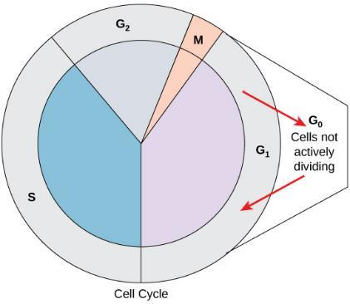
What is G₀ Phase?
Cells that are not actively preparing to divide enter an alternate phase called G₀. In some cases, this is a temporary condition until triggered to enter G₁. In other cases, the cell will remain in G₀ permanently.
Which cells in your body go into G₀ phase?
This OpenStax ancillary resource is © Rice University under a CC-BY 4.0 International license; it may be reproduced or modified but must be attributed to OpenStax, Rice University and any changes must be noted. Any images credited to other sources are similarly available for reproduction, but must be attributed to their sources.

Slide 9
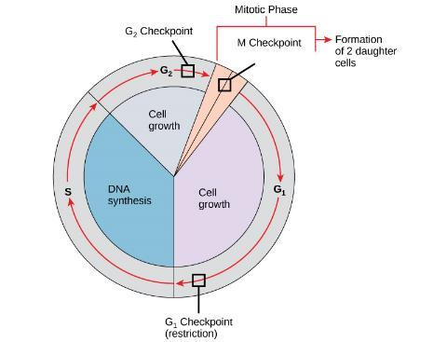
Checkpoints prevent uncontrolled cell division
The cell cycle is controlled at three checkpoints. Integrity of the DNA is assessed at the G₁ checkpoint. Proper chromosome duplication is assessed at the G₂ checkpoint. Attachment of each kinetochore to a spindle fiber is assessed at the M checkpoint.
This OpenStax ancillary resource is © Rice University under a CC-BY 4.0 International license; it may be reproduced or modified but must be attributed to OpenStax, Rice University and any changes must be noted. Any images credited to other sources are similarly available for reproduction, but must be attributed to their sources.

Slide 10
Cancer is the result of uncontrolled cell division
Image from http://bio1100.nicerweb.com/Locked/src/chap08.htm

Slide 11
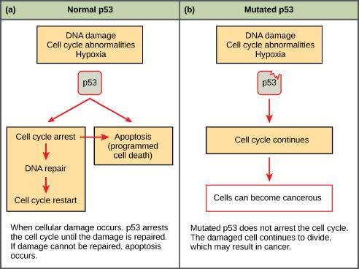
Proto-oncogenes & tumor suppressors
Protooncogenes & tumor suppressors control the checkpoints.
If DNA mutations occur in the genetic instructions for these proteins, then regulation of the cell cycle is lost
One example of these genes is p53.
(credit: modification of work by Thierry Soussi)
This OpenStax ancillary resource is © Rice University under a CC-BY 4.0 International license; it may be reproduced or modified but must be attributed to OpenStax, Rice University and any changes must be noted. Any images credited to other sources are similarly available for reproduction, but must be attributed to their sources.

