Slide 1
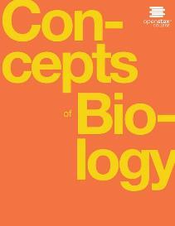
Concepts of Biology
Chapter 7 THE CELLULAR BASIS OF INHERITANCE
PowerPoint Image Slideshow

Slide 2
Learning objectives
After successfully completing this learning module, students will be able to:
Describe the evolutionary advantages of sexual reproduction.
Describe different life-cycle strategies among sexual multicellular organisms.
Describe the process of meiosis.
Describe 3 ways to increase genetic diversity in sexual reproduction.
Compare and contrast mitosis and meiosis.
Explain how nondisjunction leads to changes in chromosome number.

Slide 3
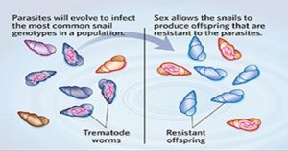
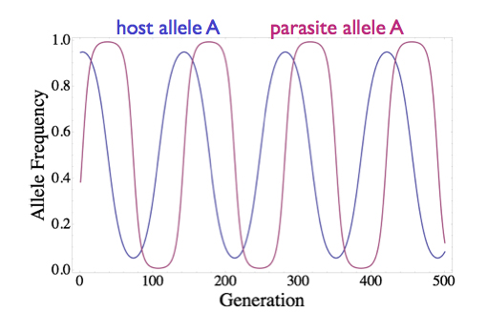
Describe the evolutionary advantages of sex
The host and its pathogens are locked in an arm’s race. The pathogen tends to win with the slower change that occurs in asexual reproduction (cloning). Sexual reproduction causes genetic diversity in the population increasing the likelihood that someone is the population is resistant.
Images from www.sls.iub.edu, https://engelstaedterlab.org/research/host-parasite-coevolution/,

Slide 4
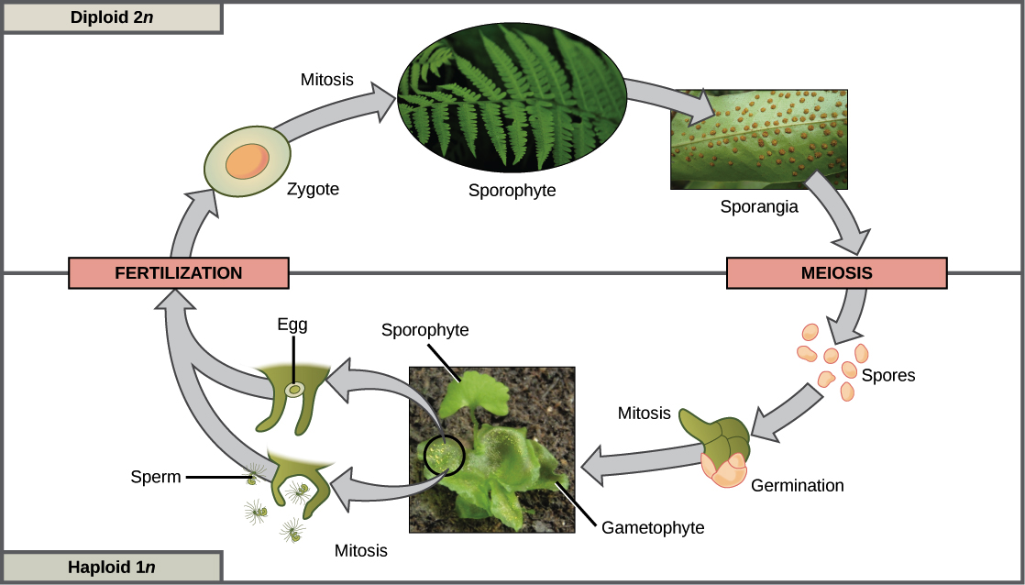
3 Different life cycle strategies: alternation of generations
The life alternates between a diploid state (2n) and a haploid state (1n).

Slide 5
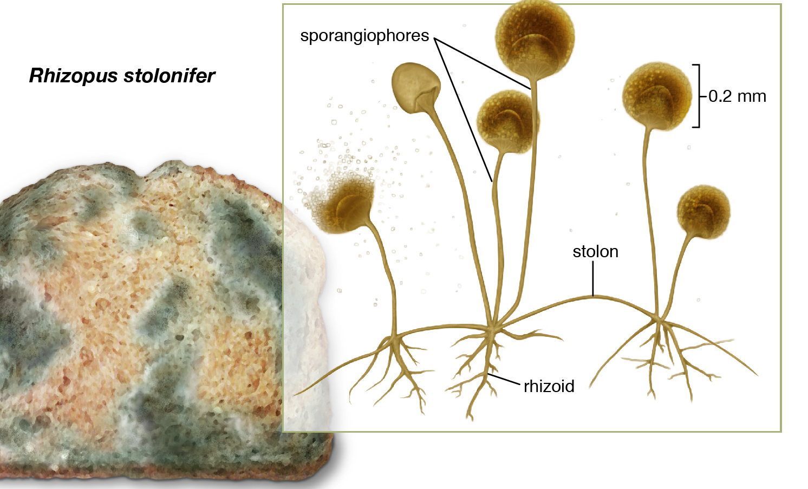
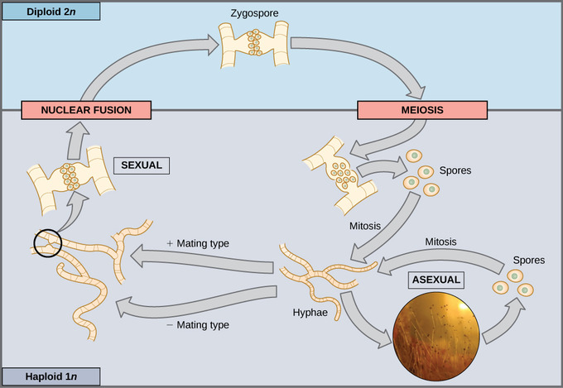
3 different life cycle strategies: haploid dominant
Much of the life is spent in the haploid state. Haploid means the cells have one copy of each chromosome – one from the mother OR one from the father. 1n

Slide 6
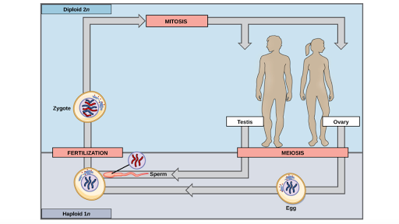
3 different life cycle strategies: Diploid Dominant
Most of the life is spent as a diploid meaning the body cells have two copies of each chromosome: one from the mother and one from the father. This is also called 2n.

Slide 7
Describe the process of meiosis
Meiosis I
Meiosis II
Meiosis is similar to doing mitosis twice which reduces the chromosome copy number from 2n to 1n.

Slide 8
Crossing over is one way to increase genetic variation
In this illustration of the effects of crossing over, the blue chromosome came from the individual’s father and the red chromosome came from the individual’s mother. Crossover occurs between non-sister chromatids of homologous chromosomes. The result is an exchange of genetic material between homologous chromosomes. The chromosomes that have a mixture of maternal and paternal sequence are called recombinant and the chromosomes that are completely paternal or maternal are called non-recombinant.
This OpenStax ancillary resource is © Rice University under a CC-BY 4.0 International license; it may be reproduced or modified but must be attributed to OpenStax, Rice University and any changes must be noted. Any images credited to other sources are similarly available for reproduction, but must be attributed to their sources.

Slide 9
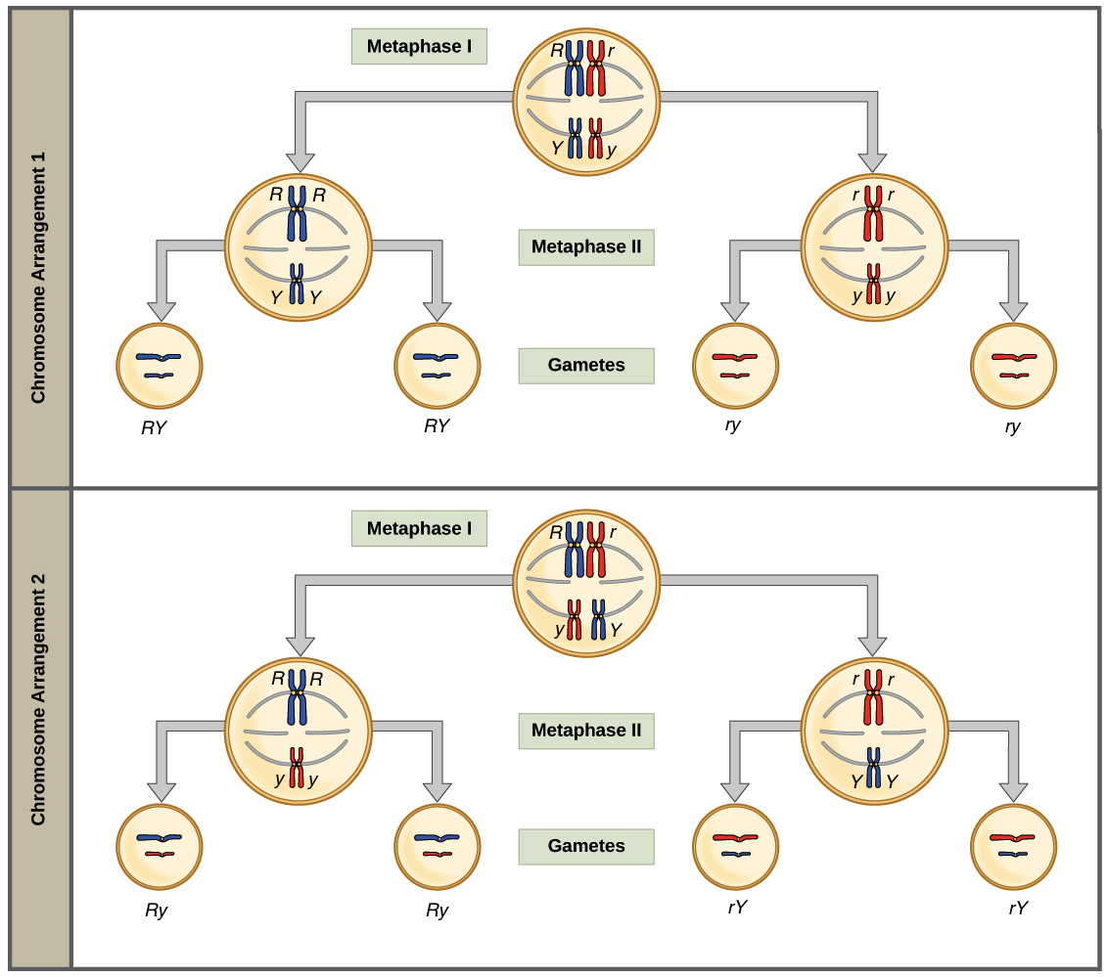
Independent assortment also increases genetic diversity
Notice the different combinations of chromosomes in each gamete!
This OpenStax ancillary resource is © Rice University under a CC-BY 4.0 International license; it may be reproduced or modified but must be attributed to OpenStax, Rice University and any changes must be noted. Any images credited to other sources are similarly available for reproduction, but must be attributed to their sources.

Slide 10
Fertilization is another way to add genetic variation
Your parents could each make 8,388,608 genetically unique gametes
You are 1 out of 70,368,744,177,664 (70 TRILLION) possible offspring between your mom and your dad!!!! Image from dailymail.co.uk

Slide 11
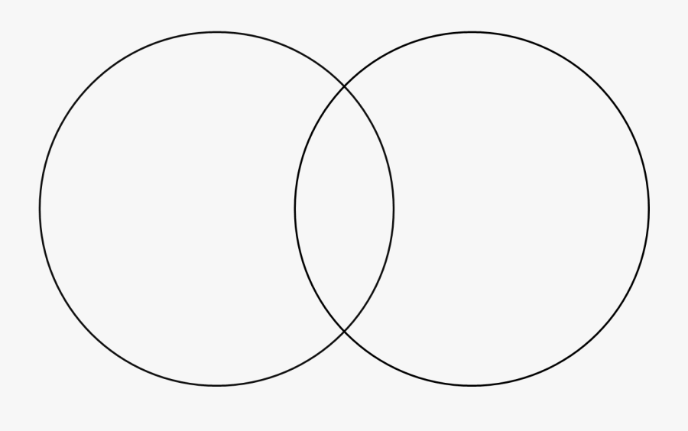
Compare & contrast mitosis with meiosis
Practice using a Venn diagram to find all the ways that mitosis and meiosis and similar and different
This OpenStax ancillary resource is © Rice University under a CC-BY 4.0 International license; it may be reproduced or modified but must be attributed to OpenStax, Rice University and any changes must be noted. Any images credited to other sources are similarly available for reproduction, but must be attributed to their sources.

Slide 12
Nondisjunction
Following meiosis, each gamete has one copy of each chromosome. Nondisjunction occurs when homologous chromosomes (meiosis I) or sister chromatids (meiosis II) fail to separate during meiosis.
Down Syndrome is the most commonly known result of nondisjunction
This OpenStax ancillary resource is © Rice University under a CC-BY 4.0 International license; it may be reproduced or modified but must be attributed to OpenStax, Rice University and any changes must be noted. Any images credited to other sources are similarly available for reproduction, but must be attributed to their sources.

Slide 13
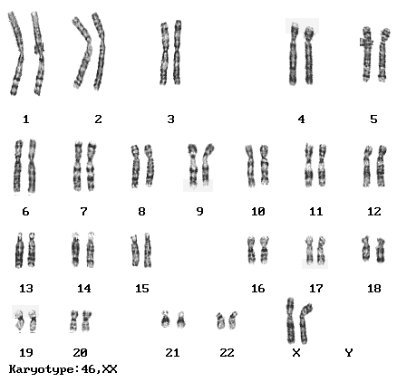
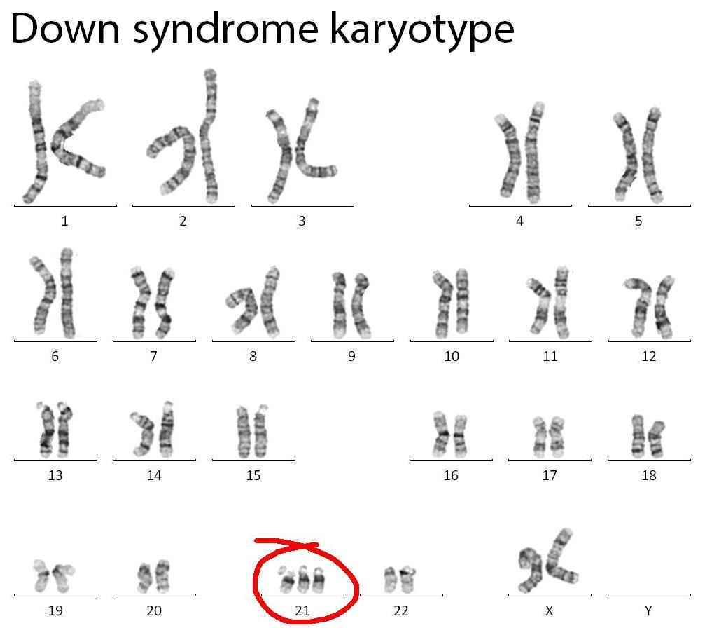
Down syndrome & nondisjunction
Images from www.iupui.edu

