Slide 1
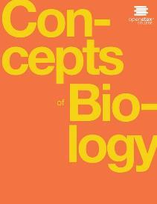
Concepts of Biology
Chapter 8 PATTERNS OF INHERITANCE
PowerPoint Image Slideshow

Slide 2
Learning objectives
After successfully completing this learning module, students will be able to:
Explain the relationship between genotypes and phenotypes.
Relate genetic patterns of inheritance to the events of meiosis.
Use Punnett Squares to calculate the expected outcomes of Monohybrid and Dihybrid crosses.
Distinguish between complete dominance, incomplete dominance, and codominance patterns of inheritance.
Describe the phenotypic outcomes of epistasis among genes.
Describe the genotypic and phenotypic effects of X-linked genes.

Slide 3
Genotypes & Phenotypes
Genotype
The pair of alleles for a specific gene that you inherited from your parents.
Allele: Different forms of the same gene.
Locus: The physical location of a gene on a chromosome.
Phenotype
The physical trait you have as a result of your genotype.
The Genotype is the set of instructions to create the phenotype

Slide 4
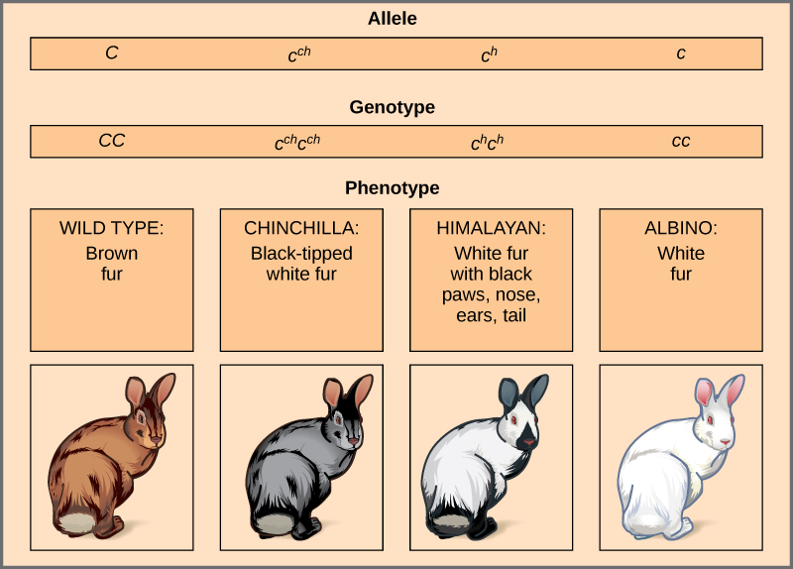
Image from Lumen Learning

Slide 5
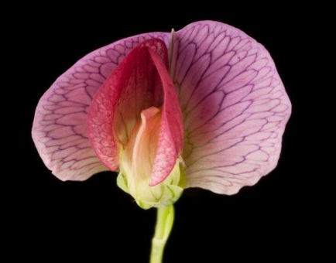
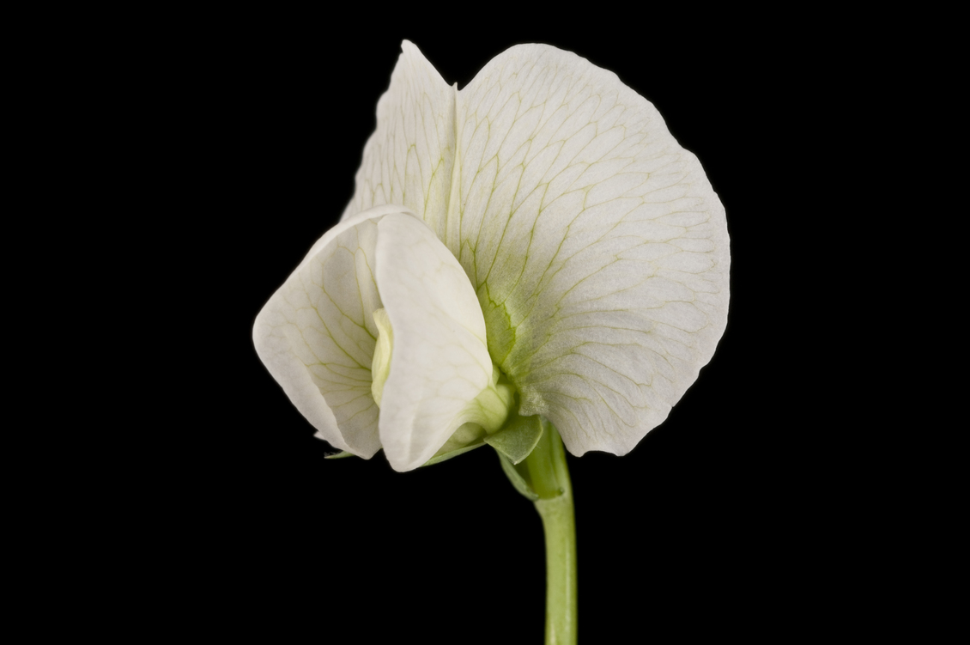
Genetics, Mendel, and Peas
Parental Generation
RR
rr
Johann Gregor Mendel set the framework for the study of genetics.
F₁ Generation
R
r
F₂ Generation
Images from Science Learning Hub, John Innes Centre
This OpenStax ancillary resource is © Rice University under a CC-BY 4.0 International license; it may be reproduced or modified but must be attributed to OpenStax, Rice University and any changes must be noted. Any images credited to other sources are similarly available for reproduction, but must be attributed to their sources.

Slide 6
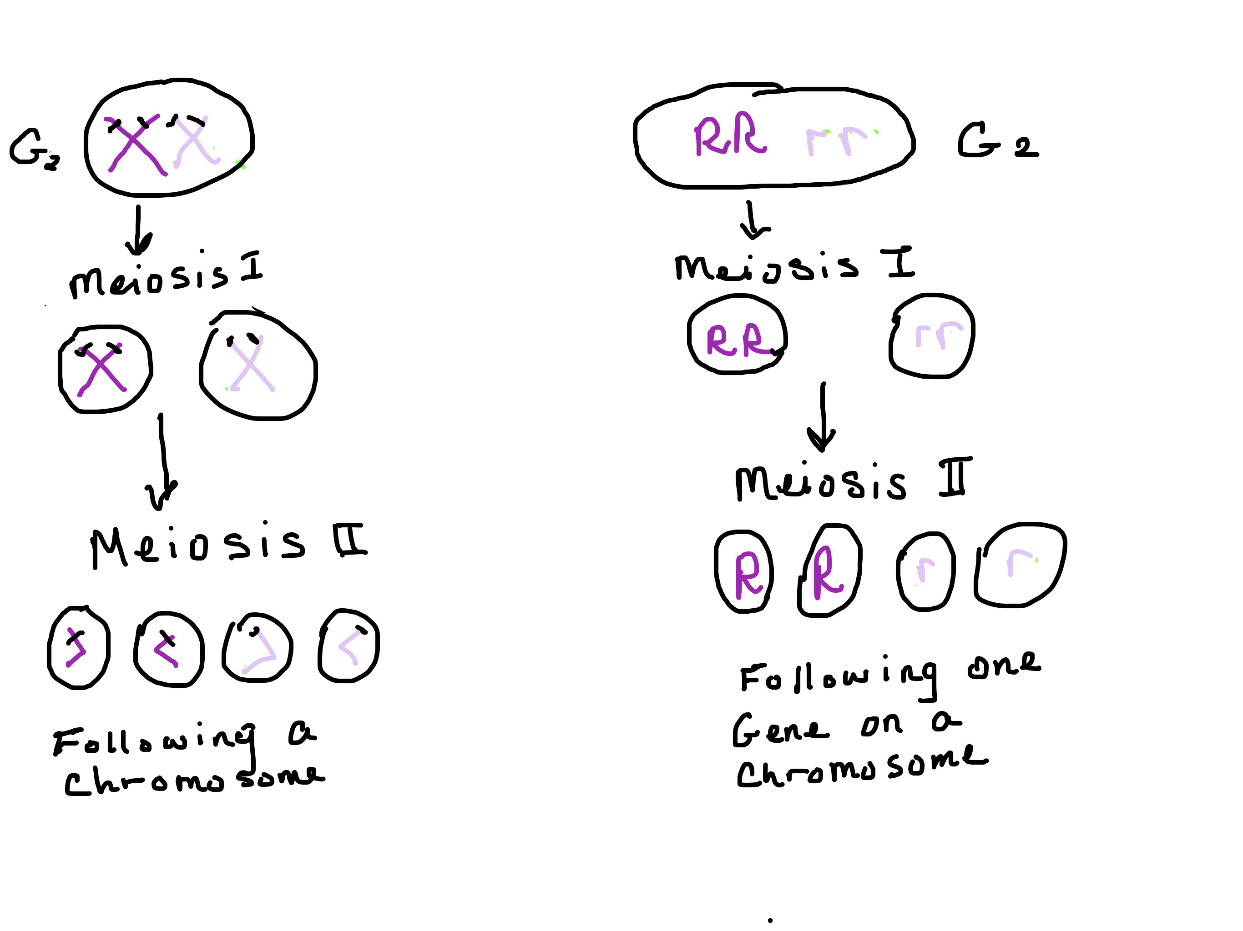
Relate genetic patterns of inheritance to the events of meiosis
F₁ Generation
Gametes of the F₁ Generation

Slide 7
The top and side of the Punnett Square are the gametes produced by meiosis.
The boxes of the Punnett Square represent the predicted offspring after fertilization
Fertilization

Slide 8
Practice Question
The allele for albinism, expressed here in humans, is recessive. Both of this child’s parents carried the recessive allele.
Draw a Punnett Square representing this family.
This OpenStax ancillary resource is © Rice University under a CC-BY 4.0 International license; it may be reproduced or modified but must be attributed to OpenStax, Rice University and any changes must be noted. Any images credited to other sources are similarly available for reproduction, but must be attributed to their sources.

Slide 9
Dihybrid Crosses: Tracking 2 Traits
A dihybrid cross in pea plants involves the genes for seed color and texture. The P cross produces F₁ offspring that are all heterozygous for both characteristics. The resulting 9:3:3:1 F₂ phenotypic ratio is obtained using a Punnett square.
This OpenStax ancillary resource is © Rice University under a CC-BY 4.0 International license; it may be reproduced or modified but must be attributed to OpenStax, Rice University and any changes must be noted. Any images credited to other sources are similarly available for reproduction, but must be attributed to their sources.

Slide 10
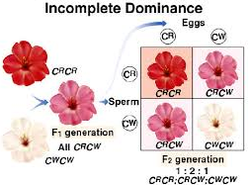
Incomplete Dominance
Incomplete Dominance occurs when neither allele is dominant over the other allele
(credit: “storebukkebruse”/Flickr, and toppr.com)
This OpenStax ancillary resource is © Rice University under a CC-BY 4.0 International license; it may be reproduced or modified but must be attributed to OpenStax, Rice University and any changes must be noted. Any images credited to other sources are similarly available for reproduction, but must be attributed to their sources.

Slide 11
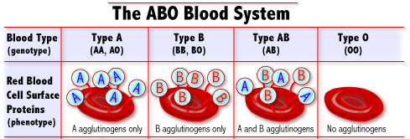
Codominance
Alleles I^{A} and I^{B} are codominant to each other. Allele i is recessive to both.
Codominance occurs when two alleles are equally dominant, such as in the Inheritance of the ABO blood system in humans.
This OpenStax ancillary resource is © Rice University under a CC-BY 4.0 International license; it may be reproduced or modified but must be attributed to OpenStax, Rice University and any changes must be noted. Any images credited to other sources are similarly available for reproduction, but must be attributed to their sources.

Slide 12
Codominance Practice Question
This Punnet square shows an AB/AB blood type cross
This OpenStax ancillary resource is © Rice University under a CC-BY 4.0 International license; it may be reproduced or modified but must be attributed to OpenStax, Rice University and any changes must be noted. Any images credited to other sources are similarly available for reproduction, but must be attributed to their sources.

Slide 13
Epistasis
Epistasis occurs when one gene controls the effects of another gene. In labradors, black and brown coats are controlled by the B gene. However, if the Labrador is homozygous recessive at another gene called E, then the Labrador will be yellow.
Image from slideshare.net

Slide 14
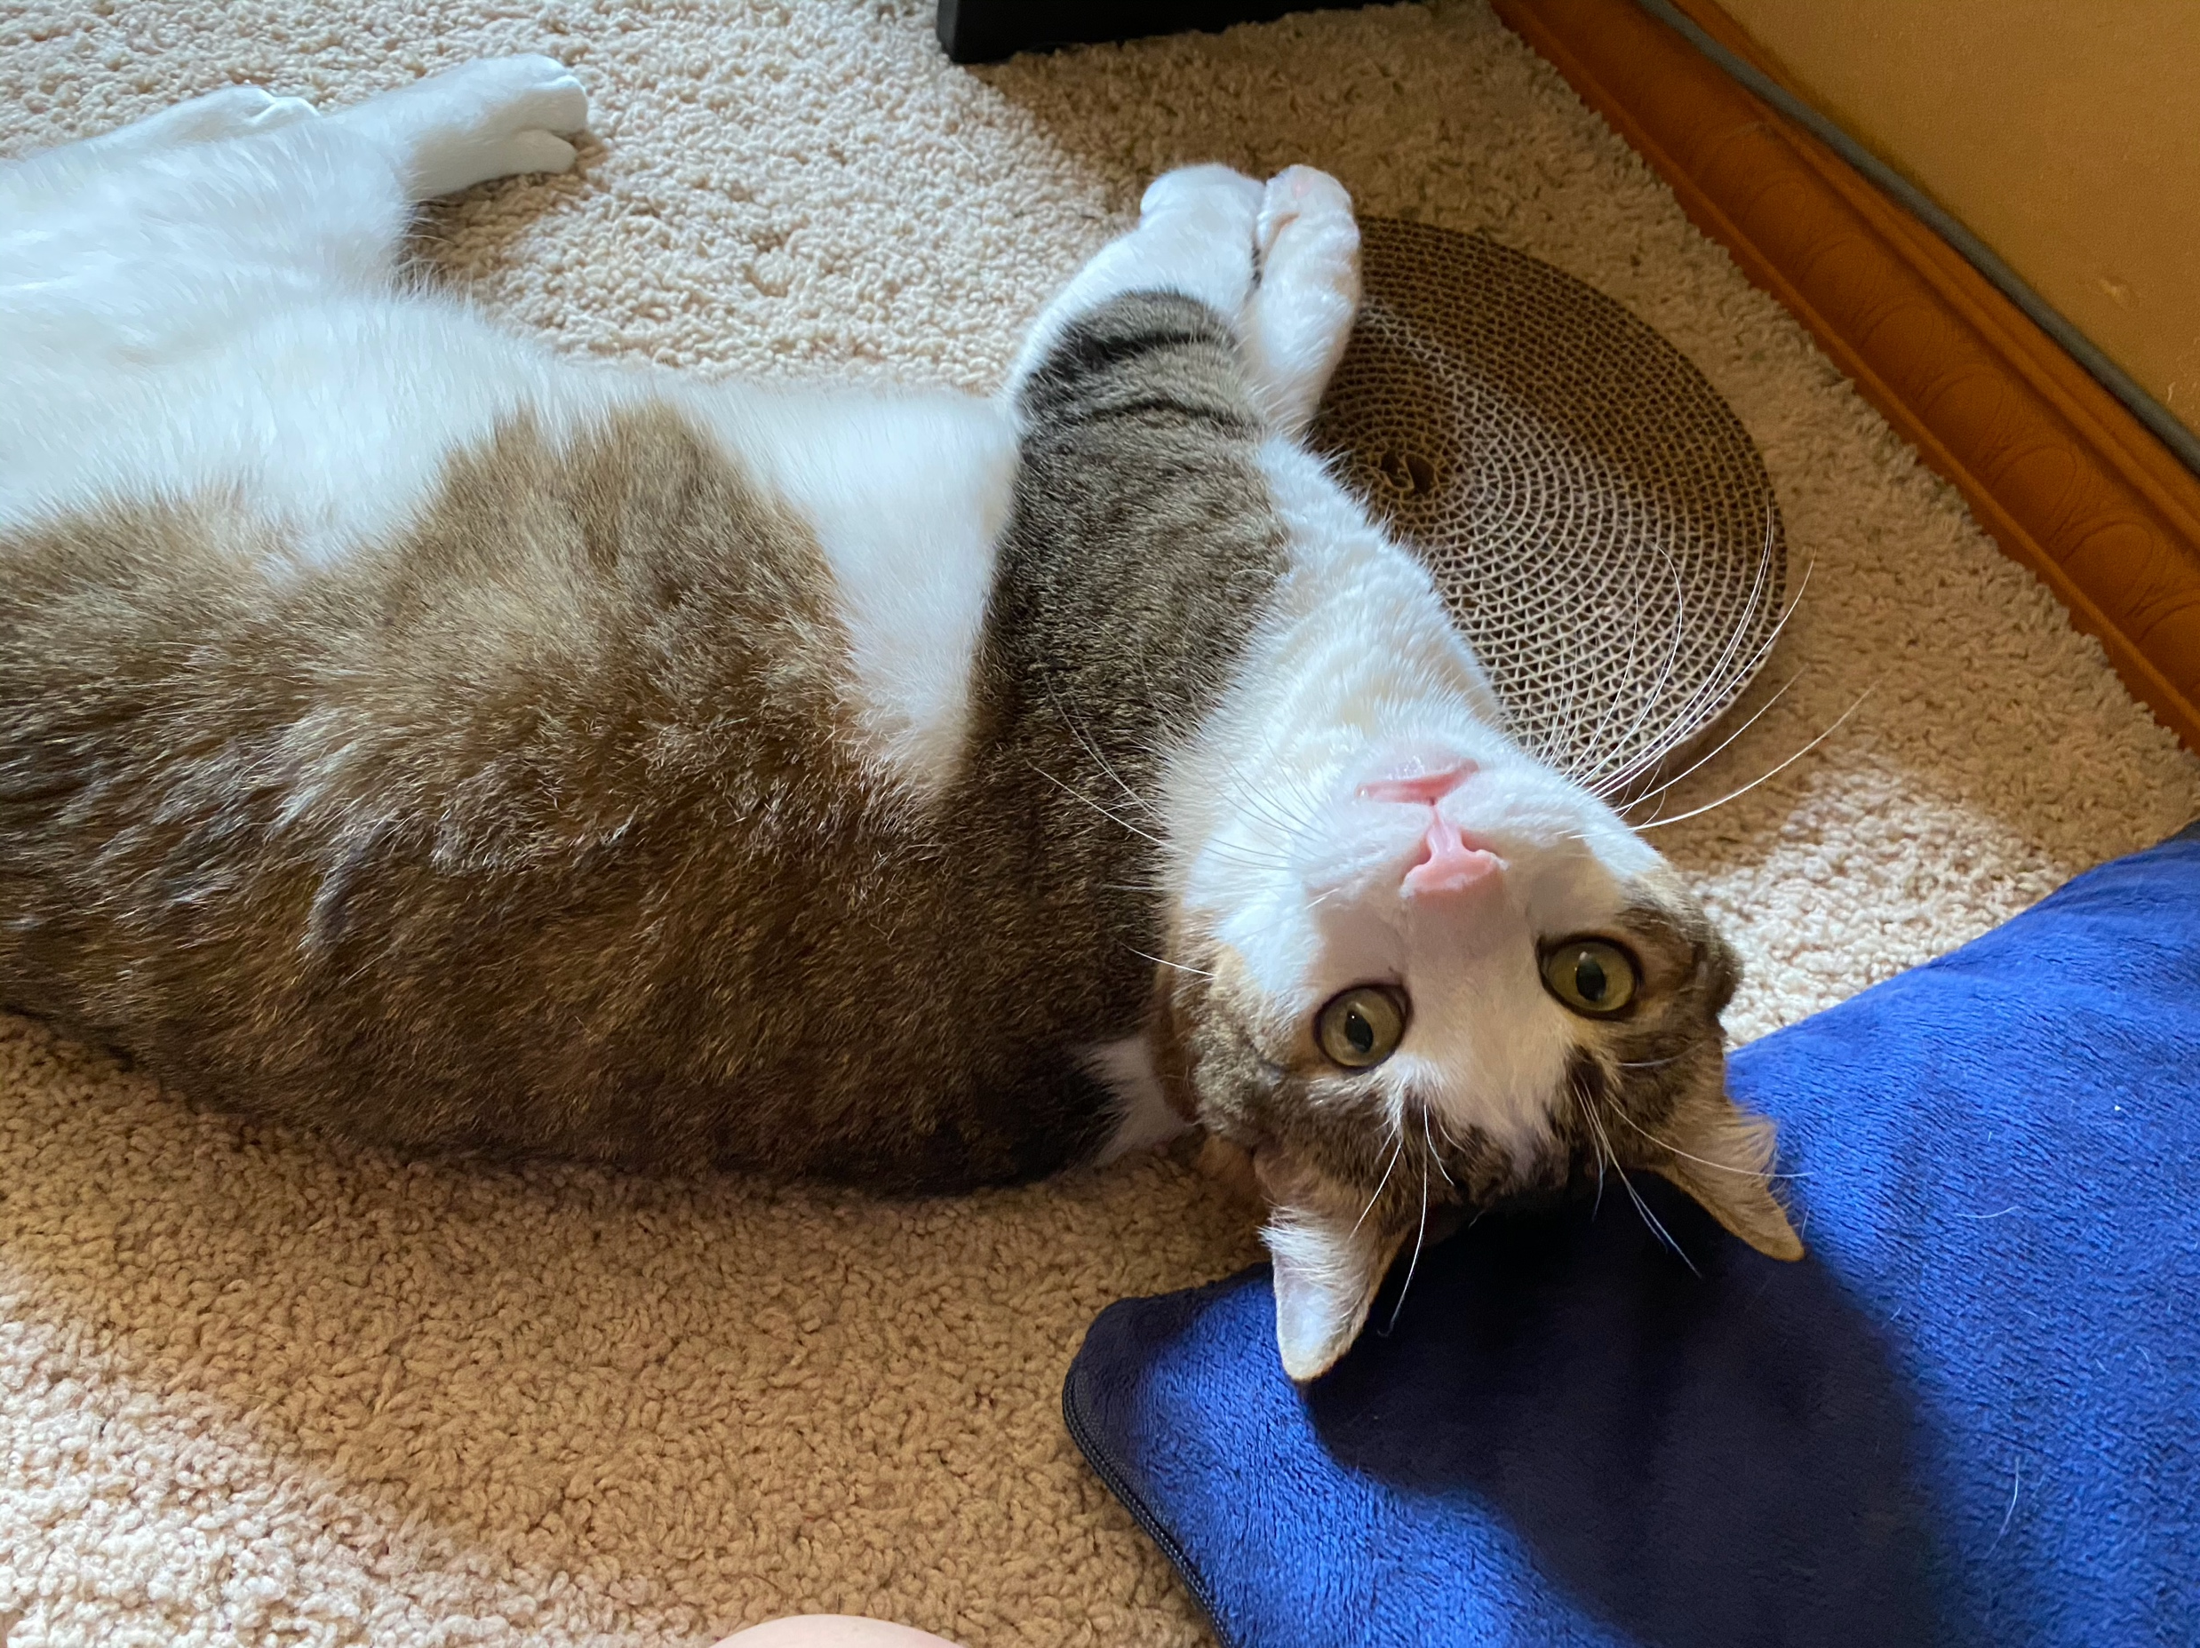
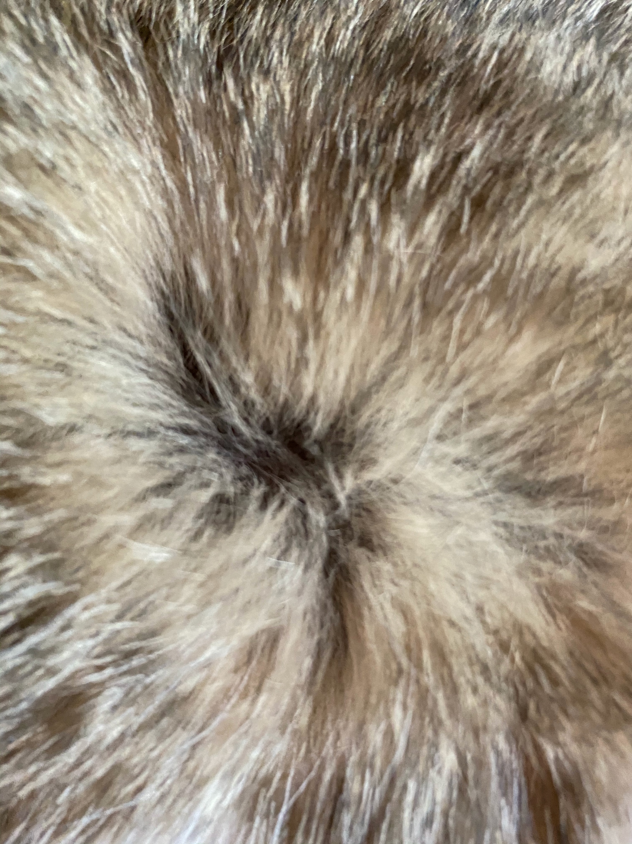
Another epistasis example
Gene (C) masks the expression of another (A) for coat color. When the C allele is present, coat color is expressed; when it is absent (cc), no coat color is expressed.
This OpenStax ancillary resource is © Rice University under a CC-BY 4.0 International license; it may be reproduced or modified but must be attributed to OpenStax, Rice University and any changes must be noted. Any images credited to other sources are similarly available for reproduction, but must be attributed to their sources.

Slide 15
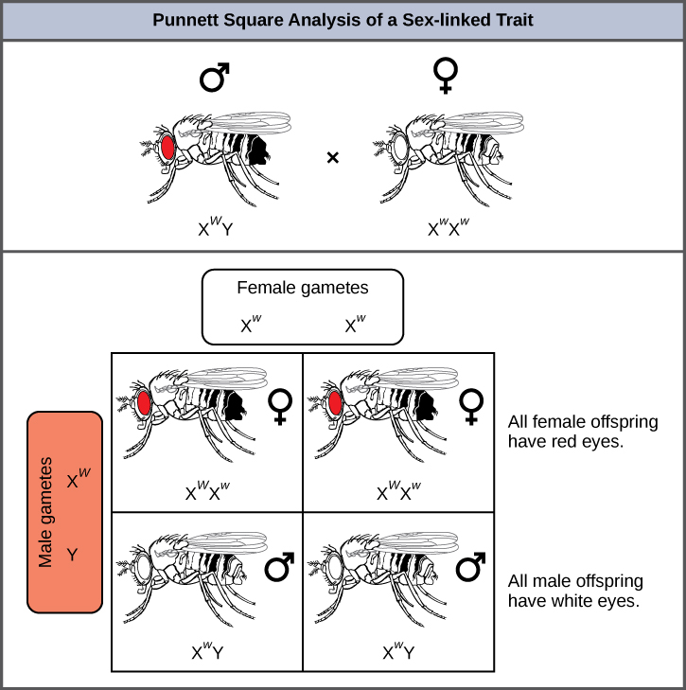
X-Linked Genes: genes on the x-chromosome
Genes on the X-Chromosome show different inheritance patterns based on how many X Chromosomes an individual has. In Drosophila, the gene for eye color is located on the X chromosome. Red eye color is wild-type and is dominant to white eye color.
This OpenStax ancillary resource is © Rice University under a CC-BY 4.0 International license; it may be reproduced or modified but must be attributed to OpenStax, Rice University and any changes must be noted. Any images credited to other sources are similarly available for reproduction, but must be attributed to their sources.

Slide 16
Figure 8.16
Crosses involving sex-linked traits often give rise to different phenotypes for the different sexes of offspring, as is the case for this cross involving red and white eye color in Drosophila. In the diagram, w is the white-eye mutant allele and W is the wild-type, red-eye allele.
This OpenStax ancillary resource is © Rice University under a CC-BY 4.0 International license; it may be reproduced or modified but must be attributed to OpenStax, Rice University and any changes must be noted. Any images credited to other sources are similarly available for reproduction, but must be attributed to their sources.

