Slide 1
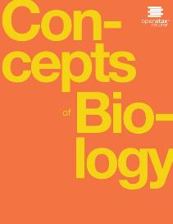
CONCEPTS OF BIOLOGY
Chapter 9 MOLECULAR BIOLOGY
PowerPoint Image Slideshow

Slide 2
Learning objectives
After successfully completing this learning module, students will be able to:
Describe the structure of DNA.
Describe the process of gene expression.
Describe the relationship between the language of nucleic acids and the language of proteins.
Explain why every cell does not express all of its genes.

Slide 3
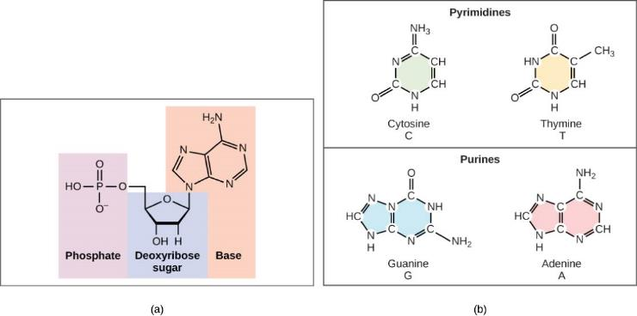
DNA Structure
(a) Each DNA nucleotide is made up of a sugar, a phosphate group, and a base.
(b) Cytosine and thymine are pyrimidines. Guanine and adenine are purines.
This OpenStax ancillary resource is © Rice University under a CC-BY 4.0 International license; it may be reproduced or modified but must be attributed to OpenStax, Rice University and any changes must be noted. Any images credited to other sources are similarly available for reproduction, but must be attributed to their sources.

Slide 4
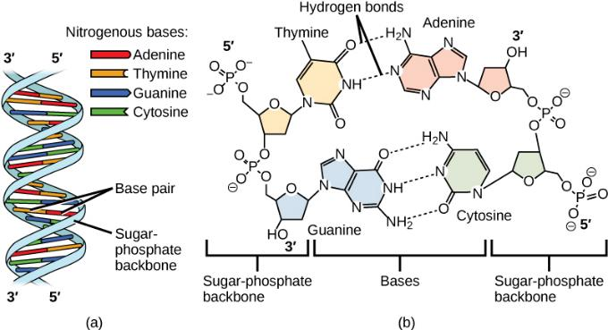
DNA Structure
DNA (a) forms a double stranded helix, and (b) adenine pairs with thymine and cytosine pairs with guanine. (credit a: modification of work by Jerome Walker, Dennis Myts)
This OpenStax ancillary resource is © Rice University under a CC-BY 4.0 International license; it may be reproduced or modified but must be attributed to OpenStax, Rice University and any changes must be noted. Any images credited to other sources are similarly available for reproduction, but must be attributed to their sources.

Slide 5
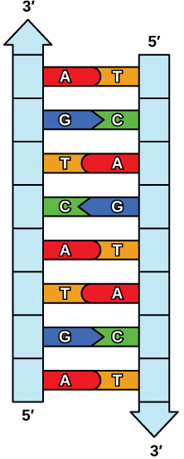
DNA is complementary & antiparallel
The two strands of DNA are complementary, meaning the sequence of bases in one strand can be used to create the correct sequence of bases in the other strand. The two strands run in opposite directions to each other.
This OpenStax ancillary resource is © Rice University under a CC-BY 4.0 International license; it may be reproduced or modified but must be attributed to OpenStax, Rice University and any changes must be noted. Any images credited to other sources are similarly available for reproduction, but must be attributed to their sources.

Slide 6
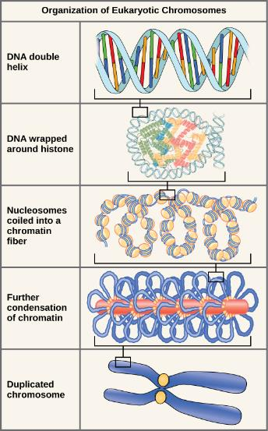
DNA is packaged into chromosomes
These figures illustrate the compaction of the eukaryotic chromosome.
This OpenStax ancillary resource is © Rice University under a CC-BY 4.0 International license; it may be reproduced or modified but must be attributed to OpenStax, Rice University and any changes must be noted. Any images credited to other sources are similarly available for reproduction, but must be attributed to their sources.

Slide 7
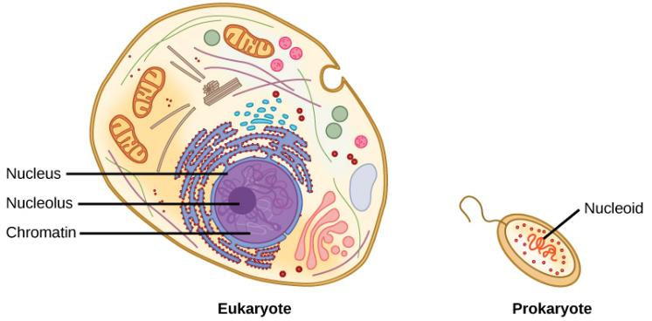
DNA is stored in the nucleus of eukaryotes
A eukaryote contains a well-defined nucleus, whereas in prokaryotes, the chromosome lies in the cytoplasm in an area called the nucleoid.
This OpenStax ancillary resource is © Rice University under a CC-BY 4.0 International license; it may be reproduced or modified but must be attributed to OpenStax, Rice University and any changes must be noted. Any images credited to other sources are similarly available for reproduction, but must be attributed to their sources.

Slide 8
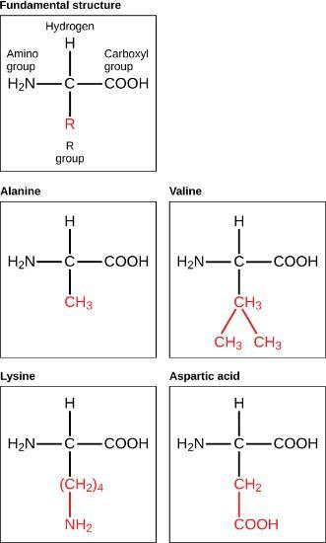
Proteins: Enzymes, energy storage, movement, immunity…
Amino acids are made up of a central carbon bonded to an amino group (–NH₂), a carboxyl group (–COOH), and a hydrogen atom. The central carbon’s fourth bond varies among the different amino acids, as seen in these examples of alanine, valine, lysine, and aspartic acid.
Amino acids form long chains that fold into proteins
Figure 2.20
This OpenStax ancillary resource is © Rice University under a CC-BY 4.0 International license; it may be reproduced or modified but must be attributed to OpenStax, Rice University and any changes must be noted. Any images credited to other sources are similarly available for reproduction, but must be attributed to their sources.

Slide 9
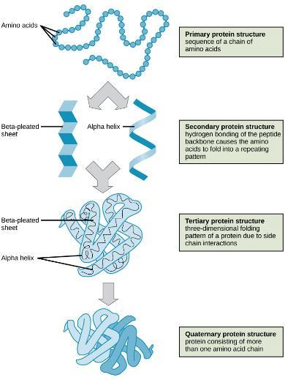
Proteins use an orderly process to fold into functional structures
Figure 2.21
This OpenStax ancillary resource is © Rice University under a CC-BY 4.0 International license; it may be reproduced or modified but must be attributed to OpenStax, Rice University and any changes must be noted. Any images credited to other sources are similarly available for reproduction, but must be attributed to their sources.

Slide 10
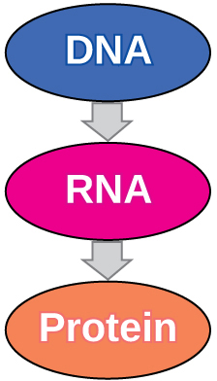
Gene Expression
Gene expression is the process of transcription and translation to produce a protein.
Transcription is the process of making an RNA copy of DNA.
Translation is the process of making a protein according to the RNA instructions.
Transcription
Translation
This OpenStax ancillary resource is © Rice University under a CC-BY 4.0 International license; it may be reproduced or modified but must be attributed to OpenStax, Rice University and any changes must be noted. Any images credited to other sources are similarly available for reproduction, but must be attributed to their sources.

Slide 11
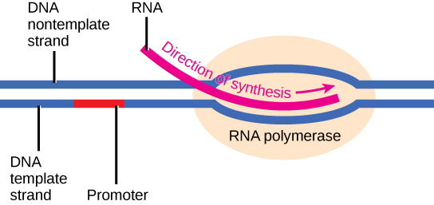
Transcription
The initiation of transcription begins when DNA is unwound, forming a transcription bubble. Enzymes and other proteins involved in transcription bind at the promoter.
This OpenStax ancillary resource is © Rice University under a CC-BY 4.0 International license; it may be reproduced or modified but must be attributed to OpenStax, Rice University and any changes must be noted. Any images credited to other sources are similarly available for reproduction, but must be attributed to their sources.

Slide 12
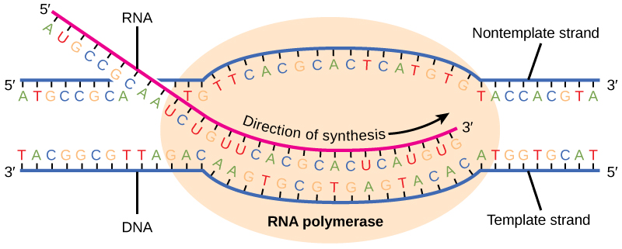
Transcription
During elongation, RNA polymerase tracks along the DNA template, synthesizes mRNA in the 5' to 3' direction, and unwinds then rewinds the DNA as it is read.
This OpenStax ancillary resource is © Rice University under a CC-BY 4.0 International license; it may be reproduced or modified but must be attributed to OpenStax, Rice University and any changes must be noted. Any images credited to other sources are similarly available for reproduction, but must be attributed to their sources.

Slide 13
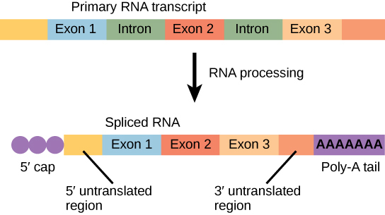
Eukaryotic RNA is processed before Translation
Eukaryotic mRNA contains introns that must be spliced out. A 5' cap and 3' tail are also added. Then, the mRNA is transported to the cytoplasm.
This OpenStax ancillary resource is © Rice University under a CC-BY 4.0 International license; it may be reproduced or modified but must be attributed to OpenStax, Rice University and any changes must be noted. Any images credited to other sources are similarly available for reproduction, but must be attributed to their sources.

Slide 14
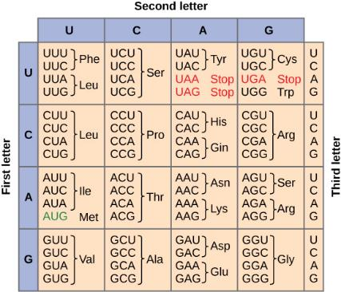
Translation: translating between nucleic acid language and protein language
This figure shows the genetic code for translating each nucleotide triplet, or codon, in mRNA into an amino acid or a termination signal in a protein. (credit: modification of work by NIH)
This OpenStax ancillary resource is © Rice University under a CC-BY 4.0 International license; it may be reproduced or modified but must be attributed to OpenStax, Rice University and any changes must be noted. Any images credited to other sources are similarly available for reproduction, but must be attributed to their sources.

Slide 15
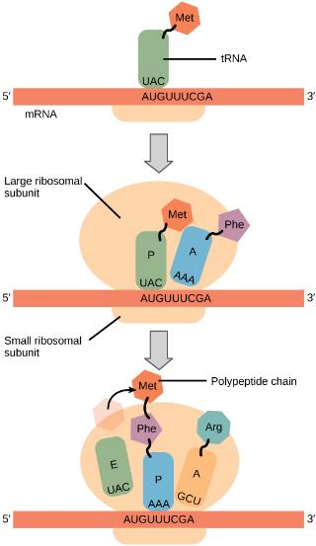
Translation
Translation begins when a tRNA anticodon recognizes a codon on the mRNA. The large ribosomal subunit joins the small subunit, and a second tRNA is recruited. As the mRNA moves relative to the ribosome, the polypeptide chain is formed. Entry of a release factor into the A site terminates translation and the components dissociate.
This OpenStax ancillary resource is © Rice University under a CC-BY 4.0 International license; it may be reproduced or modified but must be attributed to OpenStax, Rice University and any changes must be noted. Any images credited to other sources are similarly available for reproduction, but must be attributed to their sources.

Slide 16
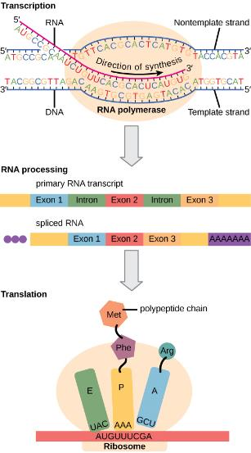
Gene Expression Summary
Eukaryotic gene expression is regulated during transcription and RNA processing, which take place in the nucleus, as well as during protein translation, which takes place in the cytoplasm. Further regulation may occur through post-translational modifications of proteins.
This OpenStax ancillary resource is © Rice University under a CC-BY 4.0 International license; it may be reproduced or modified but must be attributed to OpenStax, Rice University and any changes must be noted. Any images credited to other sources are similarly available for reproduction, but must be attributed to their sources.

Slide 17
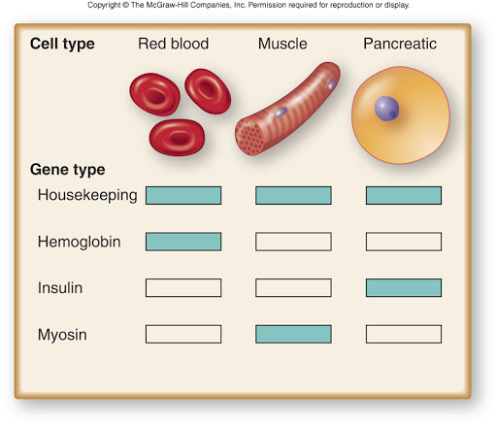
Why don’t cells express all the genes all the time?
All the cells in your body have the same library of genes. What makes them different is the specific set of genes each cell expresses (each cell type is checking out different genes from the library.

