Slide 1
CONCEPTS OF BIOLOGY
Chapter 10 BIOTECHNOLOGY
PowerPoint Image Slideshow

Slide 2
Learning objectives
After successfully completing this learning module, students will be able to:
Describe the process of Polymerase Chain Reaction, and explain how it is used in testing for COVID-19.

Slide 3
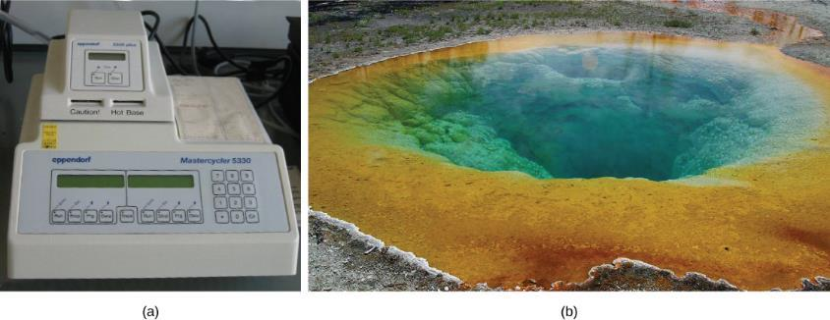
Introduction to polymerase chain reaction (PCR)
(a) A thermal cycler, such as the one shown here, is a basic tool used to study DNA in a process called the polymerase chain reaction (PCR). The polymerase enzyme most often used with PCR comes from a strain of bacteria that lives in (b) the hot springs of Yellowstone National Park. (credit a: modification of work by Magnus Manske; credit b: modification of work by Jon Sullivan)
This OpenStax ancillary resource is © Rice University under a CC-BY 4.0 International license; it may be reproduced or modified but must be attributed to OpenStax, Rice University and any changes must be noted. Any images credited to other sources are similarly available for reproduction, but must be attributed to their sources.

Slide 4
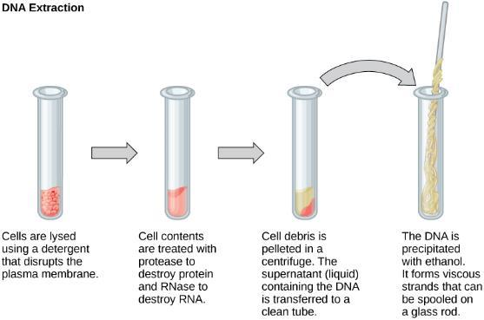
DNA extraction
This diagram shows the basic method used for the extraction of DNA.
This OpenStax ancillary resource is © Rice University under a CC-BY 4.0 International license; it may be reproduced or modified but must be attributed to OpenStax, Rice University and any changes must be noted. Any images credited to other sources are similarly available for reproduction, but must be attributed to their sources.

Slide 5
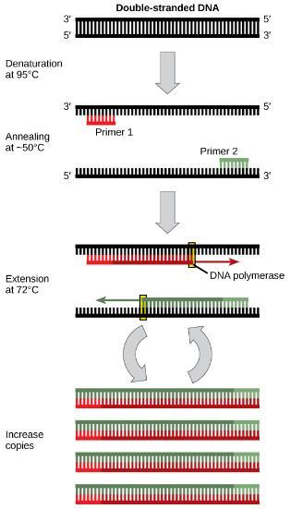
The PCR process
Polymerase chain reaction, or PCR, is used to produce many copies of a specific sequence of DNA using a special form of DNA polymerase.
This OpenStax ancillary resource is © Rice University under a CC-BY 4.0 International license; it may be reproduced or modified but must be attributed to OpenStax, Rice University and any changes must be noted. Any images credited to other sources are similarly available for reproduction, but must be attributed to their sources.

Slide 6
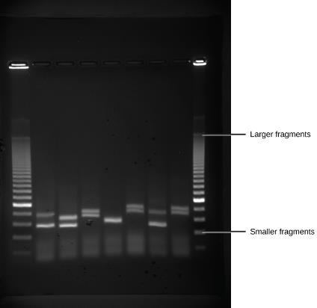
The dna can be separated and viewed
Shown are DNA fragments from six samples run on a gel, stained with a fluorescent dye and viewed under UV light. (credit: modification of work by James Jacob, Tompkins Cortland Community College)
This OpenStax ancillary resource is © Rice University under a CC-BY 4.0 International license; it may be reproduced or modified but must be attributed to OpenStax, Rice University and any changes must be noted. Any images credited to other sources are similarly available for reproduction, but must be attributed to their sources.

Slide 7
The COVID-19 testing process
Swab is collected from back of patient’s nose and throat where the virus aggregates.
The swab contains human cells, bacterial cells, and viruses of many types.
RNA is extracted from the swab because COVID-19 is an RNA virus meaning its genetic material is RNA instead of DNA.
An enzyme called reverse transcriptase is used to do reverse transcription – make a DNA molecule from a strand of RNA.
PCR is used to specifically make millions of copies of a specific Coronavirus gene – if it is present…
The PCR product is examined for presence of the copies of the gene.

Slide 8
Covid-19 testing
COVID-19 Testing
https://discoverysedge.mayo.edu/2020/03/27/the-science-behind-the-test-for-the-covid-19-virus/
https://www.livescience.com/how-coronavirus-tests-work.html
https://www.scientificamerican.com/video/the-science-behind-how-coronavirus-tests-work/
https://youtu.be/Vd38iS_W7ww

