Slide 1
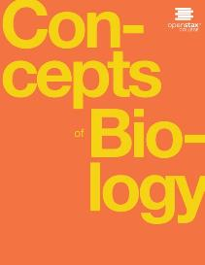
CONCEPTS OF BIOLOGY
Chapter 11 EVOLUTION AND ITS PROCESSES
PowerPoint Image Slideshow

Slide 2
Study guide (learning objectives)
After successfully completing this learning module, students will be able to:
Describe the present day theory of evolution.
Describe the 4 basic causes of evolution: natural selection, mutation, genetic drift, and gene flow.
Describe how each evolutionary force can influence the allele frequencies of a population.
Describe sources of evidence for evolution.
Identify common misconceptions about evolution.
Identify common criticisms of evolution.
Describe the evolution of COVID-19

Slide 3
Describe the present day theory of evolution – The modern synthesis
The relationship between cell division, sexual reproduction, genetics, and evolution
DNA Mutations cause genetic variation that lead to overall changes in a population through differential reproductive success.
The diversity of life on Earth is the result of evolution, a continuous process that is still occurring. (credit “wolf”: modification of work by Gary Kramer, USFWS; credit “coral”: modification of work by William Harrigan, NOAA; credit “river”: modification of work by Vojtěch Dost.l; credit “protozoa”: modification of work by Sharon Franklin, Stephen Ausmus, USDA ARS; credit “fish” modification of work by Christian Mehlführer; credit “mushroom”, “bee”: modification of work by Cory Zanker; credit “tree”: modification of work by Joseph Kranak)
This OpenStax ancillary resource is © Rice University under a CC-BY 4.0 International license; it may be reproduced or modified but must be attributed to OpenStax, Rice University and any changes must be noted. Any images credited to other sources are similarly available for reproduction, but must be attributed to their sources.

Slide 4
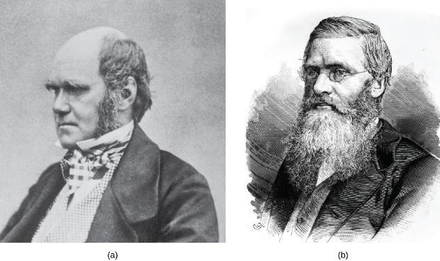
Darwin, Beagles, Finches…. And wallace
Darwin observed that beak shape varies among finch species. He postulated that the beak of an ancestral species had adapted over time to equip the finches to acquire different food sources. This illustration shows the beak shapes for four species of ground finch: 1. Geospiza magnirostris (the large ground finch), 2. G. fortis (the medium ground finch), 3. G. parvula (the small tree finch), and 4. Certhidea olivacea (the green-warbler finch).
(a) Charles Darwin and (b) Alfred Wallace wrote scientific papers on natural selection that were presented together before the Linnean Society in 1858.
This OpenStax ancillary resource is © Rice University under a CC-BY 4.0 International license; it may be reproduced or modified but must be attributed to OpenStax, Rice University and any changes must be noted. Any images credited to other sources are similarly available for reproduction, but must be attributed to their sources.

Slide 5
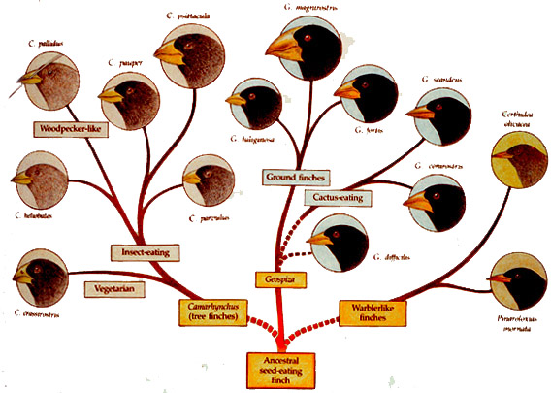
Galapagos finches
Image from Galapagos Conservation Trust

Slide 6
Beak size continues to evolve in the galapagos
A drought on the Galápagos island of Daphne Major in 1977 reduced the number of small seeds available to finches, causing many of the small-beaked finches to die. This caused an increase in the finches’ average beak size between 1976 and 1978.
This OpenStax ancillary resource is © Rice University under a CC-BY 4.0 International license; it may be reproduced or modified but must be attributed to OpenStax, Rice University and any changes must be noted. Any images credited to other sources are similarly available for reproduction, but must be attributed to their sources.

Slide 7
Study guide (learning objectives)
After successfully completing this learning module, students will be able to:
Describe the present day theory of evolution.
Describe the 4 basic causes of evolution: natural selection, mutation, genetic drift, and gene flow.
Describe how each evolutionary force can influence the allele frequencies of a population.
Describe sources of evidence for evolution.
Identify common misconceptions about evolution.
Identify common criticisms of evolution.
Describe the evolution of COVID-19

Slide 8
Describe the 4 basic causes of evolution
Mutation
Changes in the DNA sequence of a gene that lead to a change in the structure & function of the protein that is produced
A change in genotype leading to a change in phenotype
Natural Selection
The relationship between the environment and the population that leads to evolution
Genetic Drift
Luck, random chance
Gene Flow
The flow of alleles in and out of a population due to the migration of individuals.

Slide 9
Natural selection
Living organisms produce more offspring than the environment can support.
Genetic variation exists in a population due to mutation and sexual reproduction/exchange of genetic material.
Different genetic traits have different effects on an individual’s reproductive success.
Different reproductive success due to unique genetic traits changes the next generation of the population.

Slide 10
The Peppered Moth example of natural selection
As the Industrial Revolution caused trees to darken from soot, darker colored peppered moths were better camouflaged than the lighter colored ones, which caused there to be more of the darker colored moths in the population.
This OpenStax ancillary resource is © Rice University under a CC-BY 4.0 International license; it may be reproduced or modified but must be attributed to OpenStax, Rice University and any changes must be noted. Any images credited to other sources are similarly available for reproduction, but must be attributed to their sources.

Slide 11
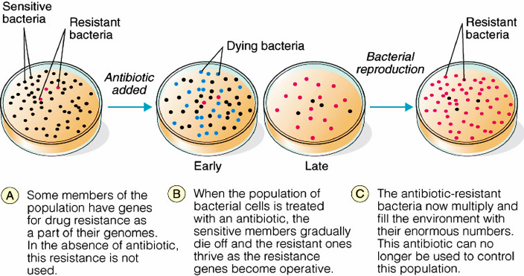
How does natural selection affect your life? Antibiotic resistant pathogens
Image from Research Gate

Slide 12
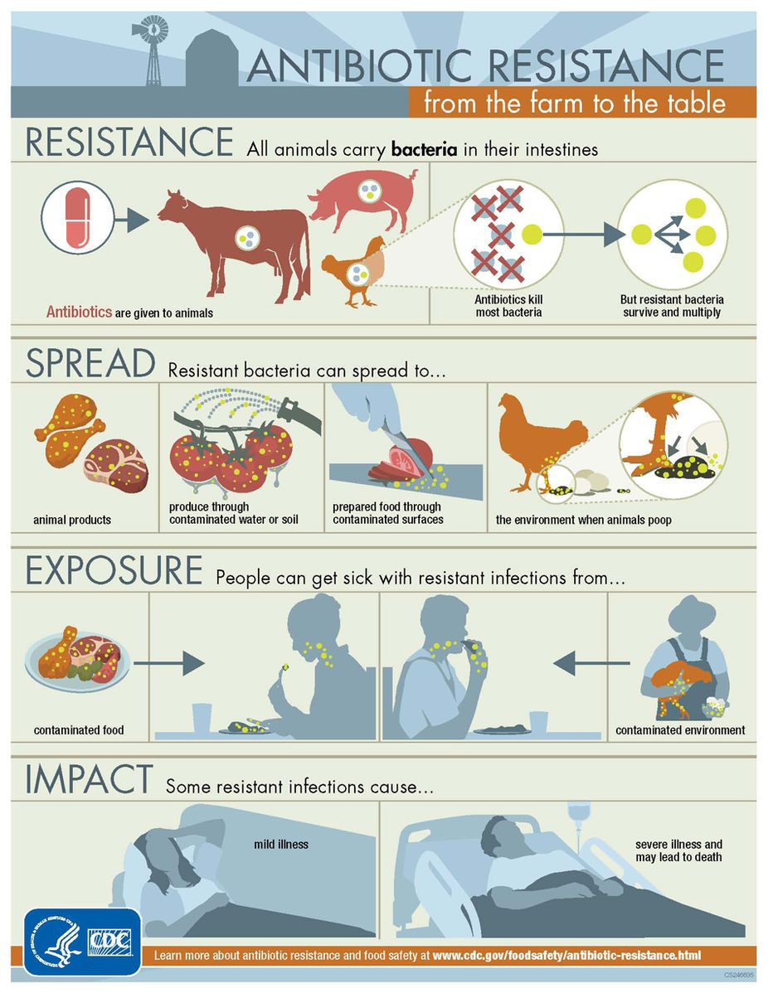

Slide 13
Genetic drift
Genetic drift in a population can lead to the elimination of an allele from a population by chance. In each generation, a random set of individuals reproduces to produce the next generation. The frequency of alleles in the next generation is equal to the frequency of alleles among the individuals reproducing.
This OpenStax ancillary resource is © Rice University under a CC-BY 4.0 International license; it may be reproduced or modified but must be attributed to OpenStax, Rice University and any changes must be noted. Any images credited to other sources are similarly available for reproduction, but must be attributed to their sources.

Slide 14
Genetic Drift: bottleneck effects & founder effects
A chance event or catastrophe can reduce the genetic variability within a population.
This OpenStax ancillary resource is © Rice University under a CC-BY 4.0 International license; it may be reproduced or modified but must be attributed to OpenStax, Rice University and any changes must be noted. Any images credited to other sources are similarly available for reproduction, but must be attributed to their sources.

Slide 16
Opportunities for Founder effects: colonizing mars
Mars-one.com (bankrupt in 2019)

Slide 17
Gene flow
Gene flow can occur when an individual travels from one geographic location to another and joins a different population of the species. In the example shown here, the brown allele is introduced into the green population.
This OpenStax ancillary resource is © Rice University under a CC-BY 4.0 International license; it may be reproduced or modified but must be attributed to OpenStax, Rice University and any changes must be noted. Any images credited to other sources are similarly available for reproduction, but must be attributed to their sources.

Slide 18
Study guide (learning objectives)
After successfully completing this learning module, students will be able to:
Describe the present day theory of evolution.
Describe the 4 basic causes of evolution: natural selection, mutation, genetic drift, and gene flow.
Describe how each evolutionary force can influence the allele frequencies of a population.
Describe sources of evidence for evolution.
Identify common misconceptions about evolution.
Identify common criticisms of evolution.
Describe the evolution of COVID-19

Slide 19
Evidence of evolution
Fossils
Anatomy
Embryology
Biogeography
Molecular Biology

Slide 20
Fossil evidence of evolution
This illustration shows an artist’s renderings of these species derived from fossils of the evolutionary history of the horse and its ancestors. The species depicted are only four from a very diverse lineage that contains many branches, dead ends, and adaptive radiations. One of the trends, depicted here is the evolutionary tracking of a drying climate and increase in prairie versus forest habitat reflected in forms that are more adapted to grazing and predator escape through running. Przewalski's horse is one of a few living species of horse.
This OpenStax ancillary resource is © Rice University under a CC-BY 4.0 International license; it may be reproduced or modified but must be attributed to OpenStax, Rice University and any changes must be noted. Any images credited to other sources are similarly available for reproduction, but must be attributed to their sources.

Slide 21
Anatomy evidence of evolution
The similar construction of these appendages indicates that these organisms share a common ancestor.
This OpenStax ancillary resource is © Rice University under a CC-BY 4.0 International license; it may be reproduced or modified but must be attributed to OpenStax, Rice University and any changes must be noted. Any images credited to other sources are similarly available for reproduction, but must be attributed to their sources.

Slide 22
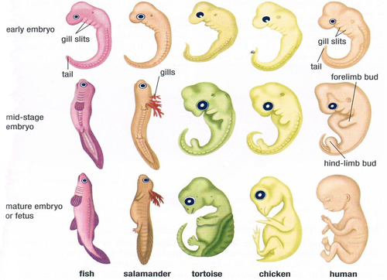
Embryology Evidence of evolution
Image from Microbe Notes

Slide 23
Biogeography evidence of evolution
The Proteacea family of plants evolved before the supercontinent Gondwana broke up. Today, members of this plant family are found throughout the southern hemisphere (shown in red). (credit “Proteacea flower”: modification of work by “dorofofoto”/Flickr)
This OpenStax ancillary resource is © Rice University under a CC-BY 4.0 International license; it may be reproduced or modified but must be attributed to OpenStax, Rice University and any changes must be noted. Any images credited to other sources are similarly available for reproduction, but must be attributed to their sources.

Slide 24
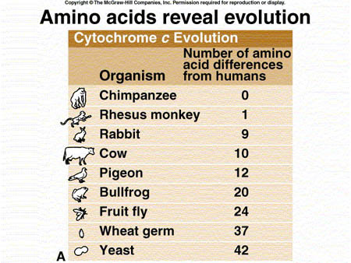
Molecular evidence of evolution
Image from Evidence for Evolution

Slide 25
Study guide (learning objectives)
After successfully completing this learning module, students will be able to:
Describe the present day theory of evolution.
Describe the 4 basic causes of evolution: natural selection, mutation, genetic drift, and gene flow.
Describe how each evolutionary force can influence the allele frequencies of a population.
Describe sources of evidence for evolution.
Identify common misconceptions about evolution.
Identify common criticisms of evolution.
Describe the evolution of COVID-19

Slide 26
Common misconceptions & Criticisms of evolution
Evolution is just a theory
Theory in science language means that there is so much evidence to support it that disproving it is nearly impossible. Different from how it’s used on TV, right?
Individuals evolve
Populations evolve through differential reproductive success.
Evolution explains the origin of life
It indicates that all life has a common ancestor.
Organisms evolve on purpose
Wouldn’t that be nice?
Evolution is controversial among scientists
It’s one of the few things we do agree on.
Other theories should be taught?
This is the only one based on the scientific method. It’s the only one we are qualified to teach.

Slide 27
Study guide (learning objectives)
After successfully completing this learning module, students will be able to:
Describe the present day theory of evolution.
Describe the 4 basic causes of evolution: natural selection, mutation, genetic drift, and gene flow.
Describe how each evolutionary force can influence the allele frequencies of a population.
Describe sources of evidence for evolution.
Identify common misconceptions about evolution.
Identify common criticisms of evolution.
Describe the evolution of COVID-19.

Slide 28
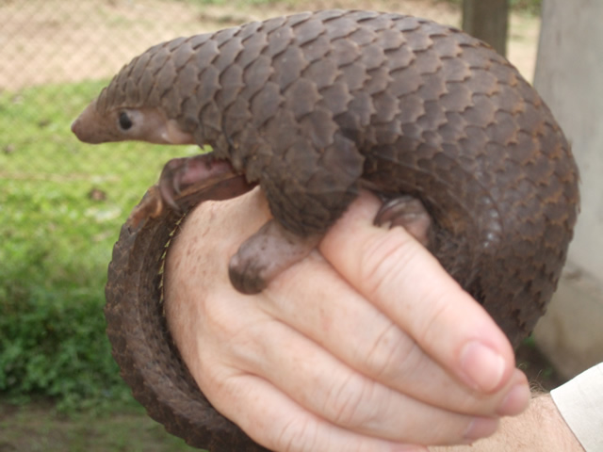
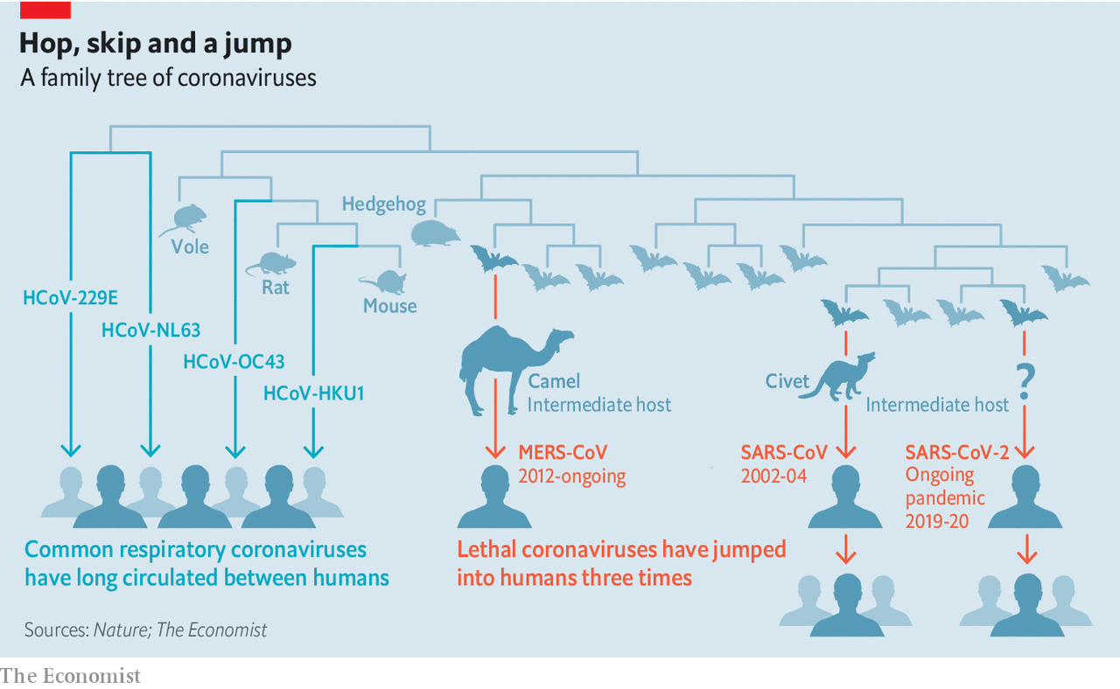
Evolution of COVID-19
Pangolin
Mutation
Images from The Economist and World Pangolin Day

