Slide 1
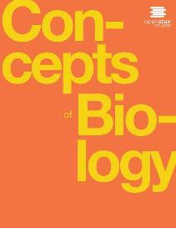
Concepts of Biology
Chapter 12 DIVERSITY OF LIFE
PowerPoint Image Slideshow

Slide 2
Study guide (learning objectives)
After successfully completing this learning module, students will be able to:
Discuss the need for a comprehensive classification system and the study of phylogenetics.
List the different levels of the taxonomic classification system.
Construct a phylogenetic tree using morphological data and using molecular data.
Compare homologous and analogous traits.

Slide 3
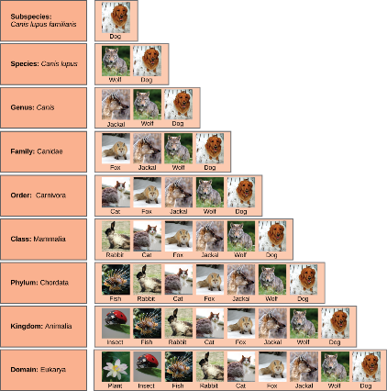
The Scientific Classification System
At each sublevel in the taxonomic classification system, organisms become more similar. Dogs and wolves are the same species because they can breed and produce viable offspring, but they are different enough to be classified as different subspecies.
(credit “plant”: modification of work by "berduchwal"/Flickr; credit “insect”: modification of work by Jon Sullivan; credit “fish”: modification of work by Christian Mehlführer; credit “rabbit”: modification of work by Aidan Wojtas; credit “cat”: modification of work by Jonathan Lidbeck; credit “fox”: modification of work by Kevin Bacher, NPS; credit “jackal”: modification of work by Thomas A. Hermann, NBII, USGS; credit “wolf” modification of work by Robert Dewar; credit “dog”: modification of work by "digital_image_fan"/Flickr)
This OpenStax ancillary resource is © Rice University under a CC-BY 4.0 International license; it may be reproduced or modified but must be attributed to OpenStax, Rice University and any changes must be noted. Any images credited to other sources are similarly available for reproduction, but must be attributed to their sources.

Slide 4
Why is it important to have a classification system?
Ensure we are all talking about the same organisms (clear language)
Establish a starting point for understanding relatedness among organisms (phylogeny)

Slide 5
Study guide (learning objectives)
After successfully completing this learning module, students will be able to:
Discuss the need for a comprehensive classification system and the study of phylogenetics.
List the different levels of the taxonomic classification system.
Construct a phylogenetic tree using morphological data and using molecular data.
Compare homologous and analogous traits.

Slide 6
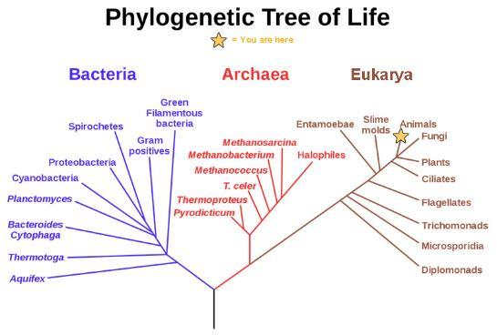
Phylogenetics: Studying the evolutionary relatedness of living organisms.
In the evolution of life on Earth, the three domains of life—Archaea, Bacteria, and Eukarya—branch from a single point. (credit: modification of work by Eric Gaba)
This OpenStax ancillary resource is © Rice University under a CC-BY 4.0 International license; it may be reproduced or modified but must be attributed to OpenStax, Rice University and any changes must be noted. Any images credited to other sources are similarly available for reproduction, but must be attributed to their sources.

Slide 7
Phylogenetic trees can have different forms
A phylogenetic tree is rooted and shows how different organisms, in this case the species and subspecies of living apes, evolved from a common ancestor.
This OpenStax ancillary resource is © Rice University under a CC-BY 4.0 International license; it may be reproduced or modified but must be attributed to OpenStax, Rice University and any changes must be noted. Any images credited to other sources are similarly available for reproduction, but must be attributed to their sources.

Slide 8
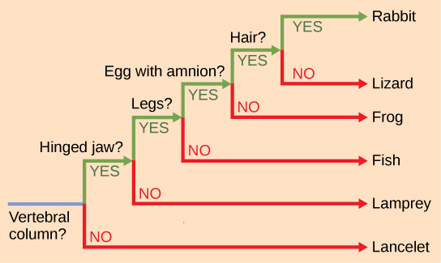
Phylogenetic trees can be made from different types of data
Phylogenetic trees can be made using morphological (structure) data or from molecular (DNA or Protein sequence data). This phylogenetic tree is rooted by an organism that lacked a vertebral column. At each branch point, organisms with different characters are placed in different groups.
This OpenStax ancillary resource is © Rice University under a CC-BY 4.0 International license; it may be reproduced or modified but must be attributed to OpenStax, Rice University and any changes must be noted. Any images credited to other sources are similarly available for reproduction, but must be attributed to their sources.

Slide 9
Constructing a Phylogenetic tree from molecular data

Slide 10
How are phylogenetic trees useful in general society?
Medicine
Tracing routes of pathogen evolution & transmission in epidemics
H1N1 Influenza
COVID-19
Criminal Justice
Proving intentional spread of disease
HIV
https://molevol.mbl.edu/images/f/f7/MolEvol_Phylodynamics_2017.pdf

Slide 11
Study guide (learning objectives)
After successfully completing this learning module, students will be able to:
Discuss the need for a comprehensive classification system and the study of phylogenetics.
List the different levels of the taxonomic classification system.
Construct a phylogenetic tree using morphological data and using molecular data.
Compare homologous and analogous traits.

Slide 12
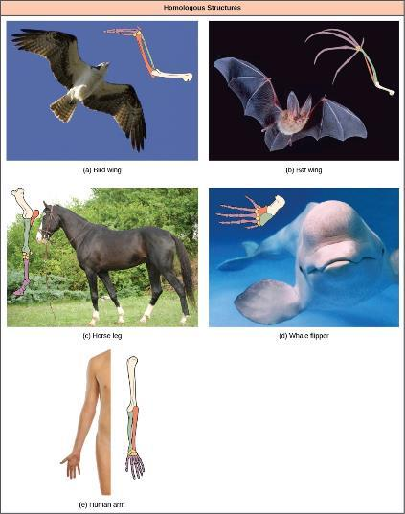
Homologous structures: structures that are similar due to evolutionary relatedness
Bat and bird wings, the foreleg of a horse, the flipper of a whale, and the arm of a human are homologous structures, indicating that bats, birds, horses, whales, and humans share a common evolutionary past. (credit a photo: modification of work by Steve Hillebrand, USFWS; credit b photo: modification of work by U.S. BLM; credit c photo: modification of work by Virendra Kankariya; credit d photo: modification of work by Russian Gov./Wikimedia Commons)
This OpenStax ancillary resource is © Rice University under a CC-BY 4.0 International license; it may be reproduced or modified but must be attributed to OpenStax, Rice University and any changes must be noted. Any images credited to other sources are similarly available for reproduction, but must be attributed to their sources.

Slide 13
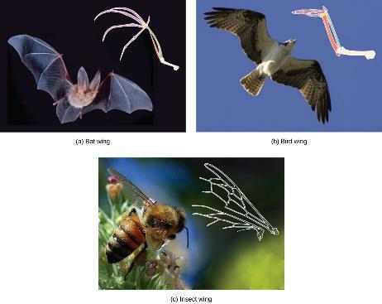
Analogous structures: structures that came about independently in evolution
The wing of a honey bee is similar in shape to a bird wing and a bat wing and serves the same function (flight). The bird and bat wings are homologous structures. However, the honey bee wing has a different structure (it is made of a chitinous exoskeleton, not a boney endoskeleton) and embryonic origin. The bee and bird or bat wing types illustrate an analogy—similar structures that do not share an evolutionary history. (credit a photo: modification of work by U.S. BLM; credit b: modification of work by Steve Hillebrand, USFWS; credit c: modification of work by Jon Sullivan)
This OpenStax ancillary resource is © Rice University under a CC-BY 4.0 International license; it may be reproduced or modified but must be attributed to OpenStax, Rice University and any changes must be noted. Any images credited to other sources are similarly available for reproduction, but must be attributed to their sources.

