Slide 1
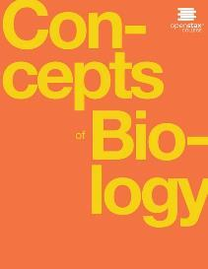
Concepts of Biology
Chapter 17 THE IMMUNE SYSTEM AND DISEASE
PowerPoint Image Slideshow

Slide 2
Study Guide (Learning Objectives)
After successfully completing this learning module, students will be able to:
Describe the structure of a virus.
Explain the steps of viral replication.
Describe how vaccines are used in the prevention of viral diseases.
Describe the body’s innate physical and chemical defenses.
Describe immediate and delayed hypersensitivities.
Describe autoimmunity and give examples of autoimmune diseases.

Slide 3
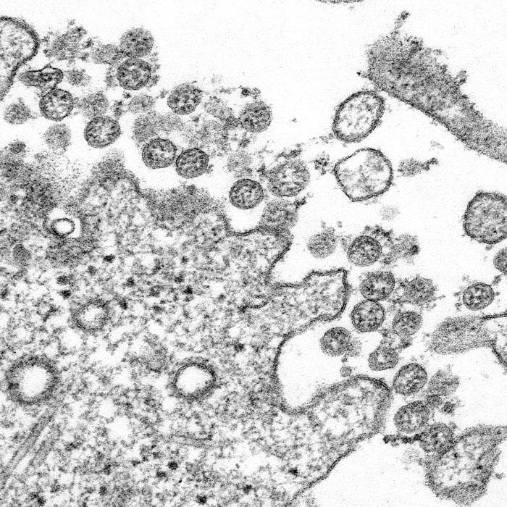
Viruses are small
The size of a virus is very small relative to the size of cells and organelles. Microscopy image from CDC
This OpenStax ancillary resource is © Rice University under a CC-BY 4.0 International license; it may be reproduced or modified but must be attributed to OpenStax, Rice University and any changes must be noted. Any images credited to other sources are similarly available for reproduction, but must be attributed to their sources.

Slide 4
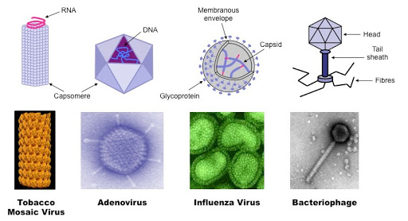
Structural Diversity of Viruses
Viruses can be complex in shape or relatively simple. This figure shows three relatively complex virions: the bacteriophage T4, with its DNA-containing head group and tail fibers that attach to host cells; adenovirus, which uses spikes from its capsid to bind to the host cells; and HIV, which uses glycoproteins embedded in its envelope to do so. Notice that HIV has proteins called matrix proteins, internal to the envelope, which help stabilize virion shape. HIV is a retrovirus, which means it reverse transcribes its RNA genome into DNA, which is then spliced into the host’s DNA. (Image from Bioninja
This OpenStax ancillary resource is © Rice University under a CC-BY 4.0 International license; it may be reproduced or modified but must be attributed to OpenStax, Rice University and any changes must be noted. Any images credited to other sources are similarly available for reproduction, but must be attributed to their sources.

Slide 5
General Structure of a virus
Image from Slide Share

Slide 6
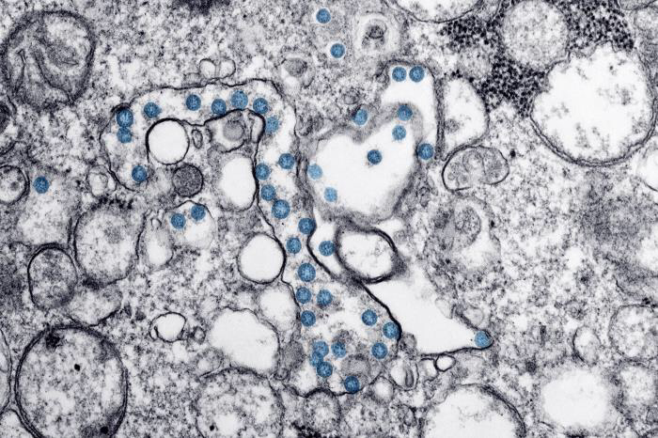
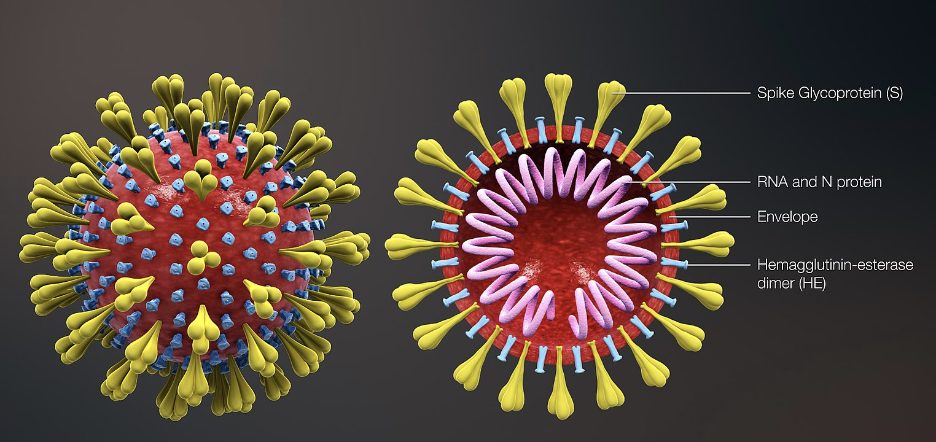
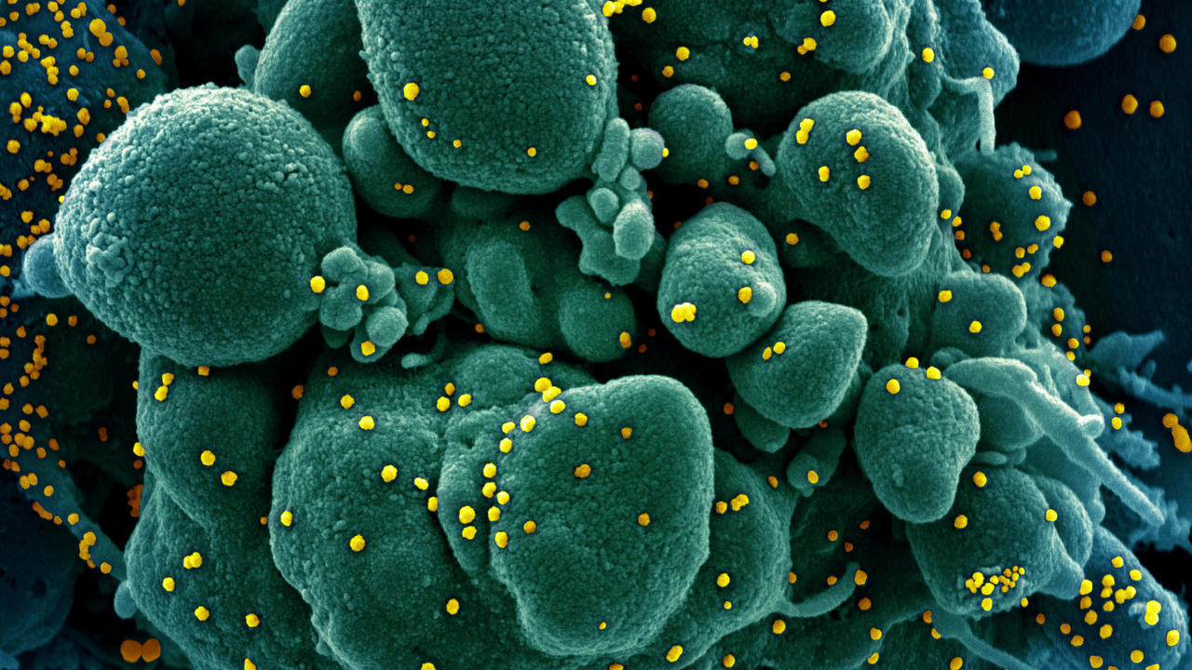
The Structure of COVID-19
Dying eukaryotic cell (green) COVID-19 (yellow)
Structure of COVID-19 Virus Particle from American Society of Microbiology, CDC, and France 24

Slide 7
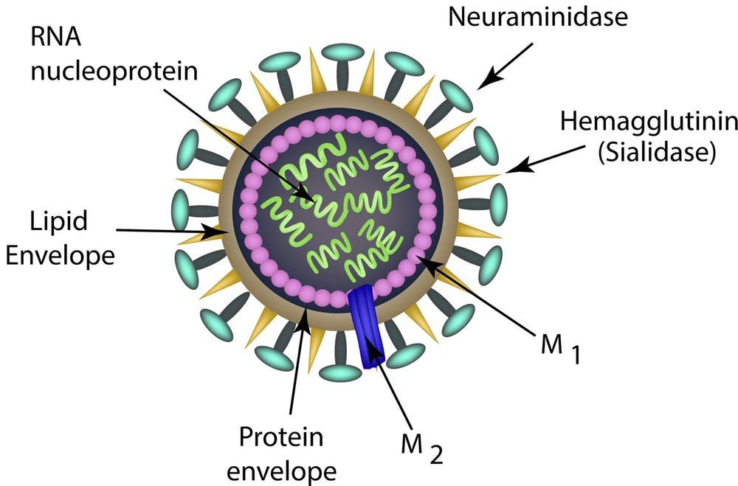
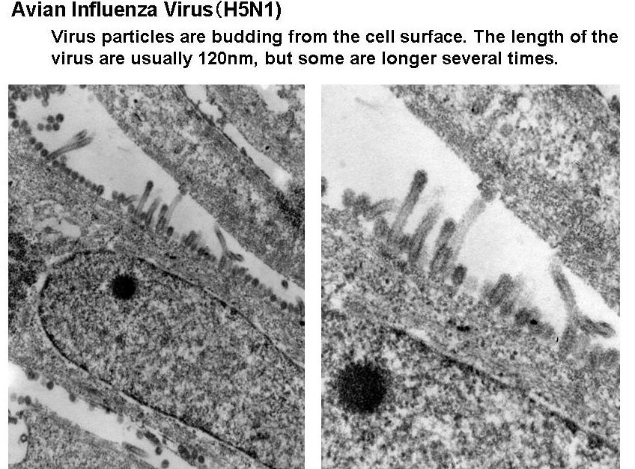
Structure of Influenza Virus
Image from Medical Xpress

Slide 8
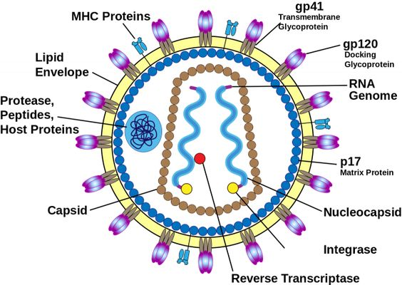
Structure of Human Immunodeficiency Virus (HIV)
HIV Infecting Host Cells
HIV (green) is shown budding from a lymphocyte cell (red) in culture. (credit: modification of work by C. Goldsmith, CDC; scale-bar data from Matt Russell)
Image from toppr

Slide 9
The Structure of Ebola virus
The ebola virus is shown here as visualized through (a) a scanning electron micrograph and (b) a transmission electron micrograph. (credit a: modification of work by Cynthia Goldsmith, CDC; credit b: modification of work by Thomas W. Geisbert, Boston University School of Medicine; scale-bar data from Matt Russell)
This OpenStax ancillary resource is © Rice University under a CC-BY 4.0 International license; it may be reproduced or modified but must be attributed to OpenStax, Rice University and any changes must be noted. Any images credited to other sources are similarly available for reproduction, but must be attributed to their sources.

Slide 10
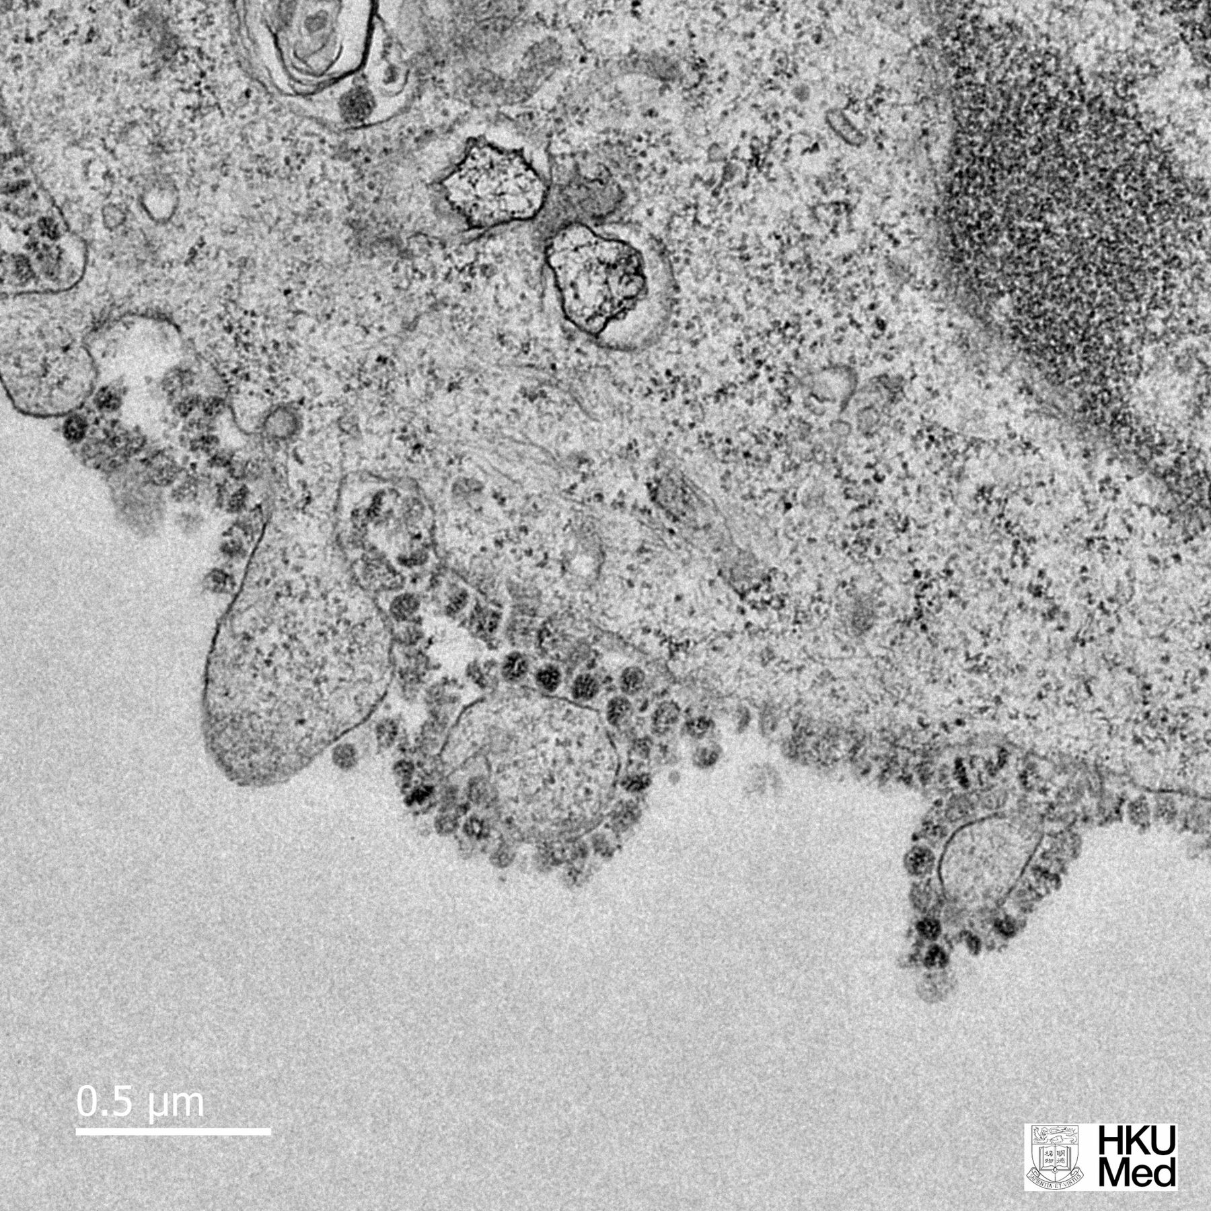
The process of viral replication
In influenza virus infection, glycoproteins attach to a host epithelial cell. As a result, the virus is engulfed. RNA and proteins are made and assembled into new virions.
This OpenStax ancillary resource is © Rice University under a CC-BY 4.0 International license; it may be reproduced or modified but must be attributed to OpenStax, Rice University and any changes must be noted. Any images credited to other sources are similarly available for reproduction, but must be attributed to their sources.

Slide 11
How does the immune system protect an organism from viruses?
There are two main parts to the vertebrate immune system. The innate immune system, which is made up of physical barriers and internal defenses, responds to all pathogens. The adaptive immune system is highly specific.
This OpenStax ancillary resource is © Rice University under a CC-BY 4.0 International license; it may be reproduced or modified but must be attributed to OpenStax, Rice University and any changes must be noted. Any images credited to other sources are similarly available for reproduction, but must be attributed to their sources.

Slide 12
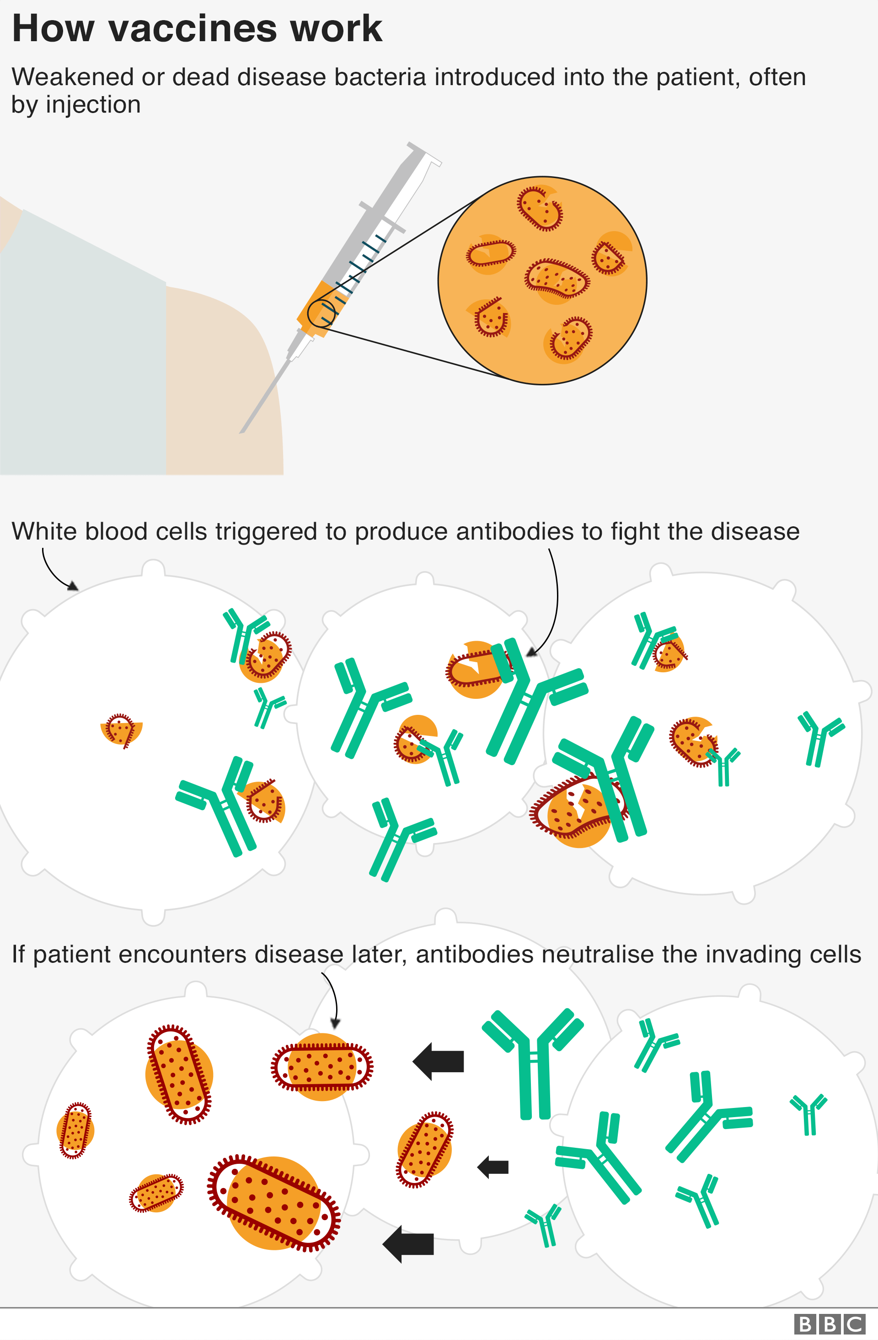
How do vaccines prevent and treat infection?
Vaccine: A weakened solution of virus components, virus or other agents that produce an immune response leading to future immunity to the virus.
Image from BBC

Slide 13
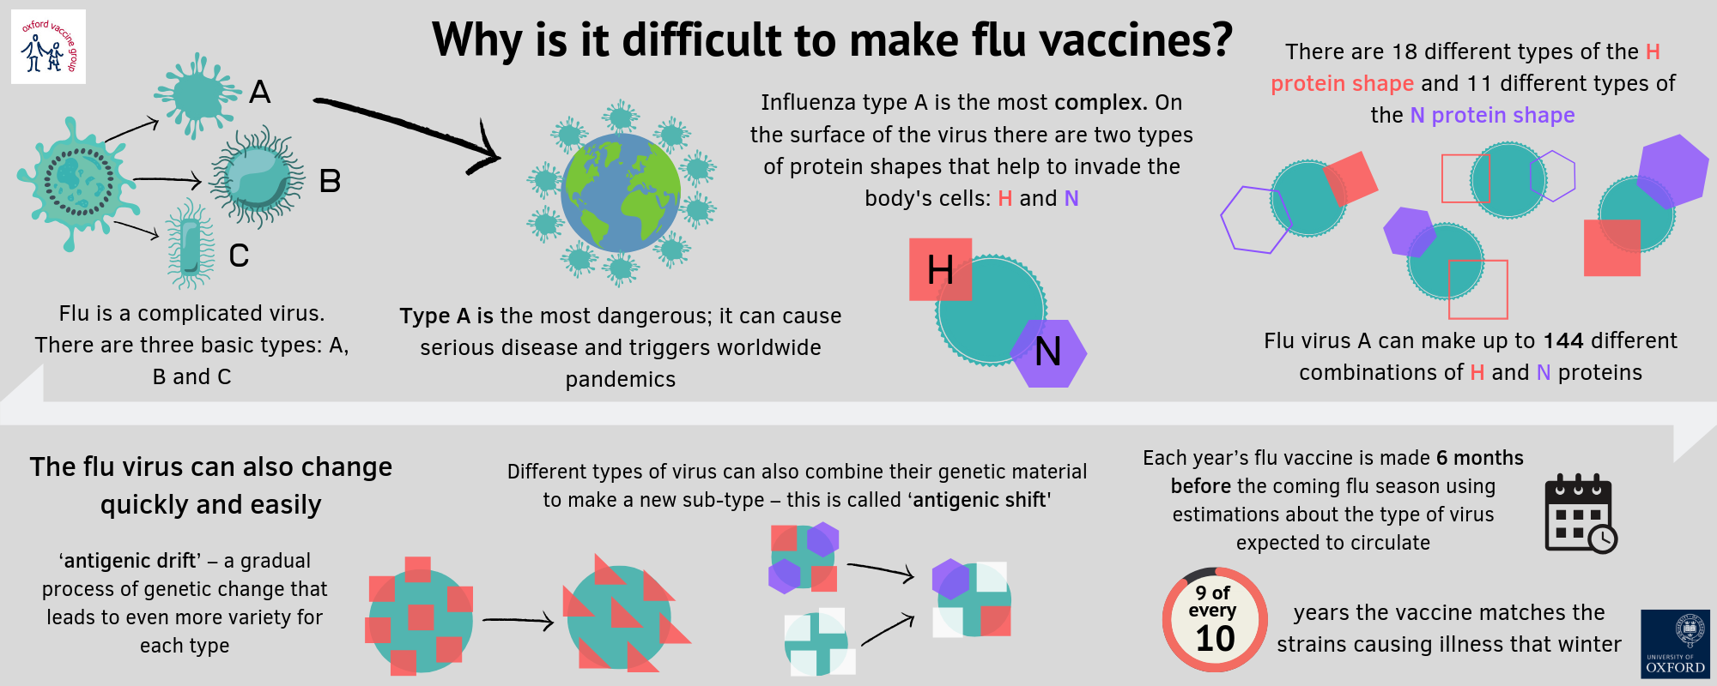
The relationship between evolution and the annual flu shot
Image from Vaccine Knowledge

Slide 14
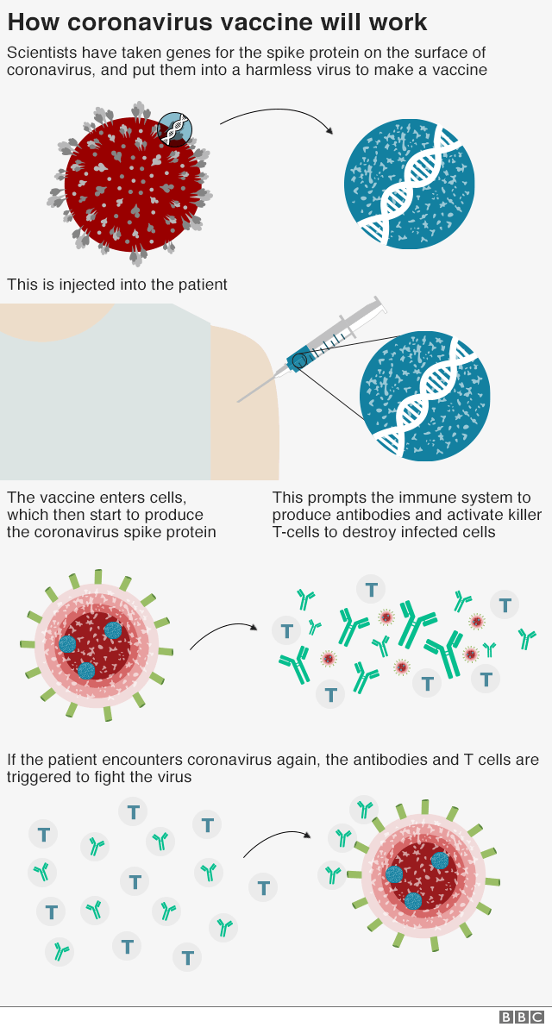
Image from BBC

Slide 15
Effects of Herd Immunity animation

Slide 16
Allergies Immediate and delayed hypersensitivities
On first exposure to an allergen, an antibody is synthesized by plasma cells in response to a harmless antigen. The antibodies bind to mast cells, and on secondary exposure, the mast cells release histamines and other modulators that cause the symptoms of allergy. (credit: modification of work by NIH)
This OpenStax ancillary resource is © Rice University under a CC-BY 4.0 International license; it may be reproduced or modified but must be attributed to OpenStax, Rice University and any changes must be noted. Any images credited to other sources are similarly available for reproduction, but must be attributed to their sources.

Slide 17
Autoimmunity: Hypersensitivity to yourself
Image from Scientific Animations

