Slide 1
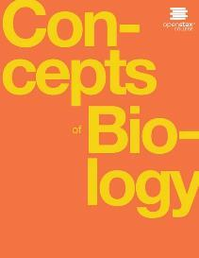
Concepts of Biology
Chapter 19 POPULATION AND COMMUNITY ECOLOGY
PowerPoint Image Slideshow

Slide 2
Study Guide (Learning objectives)
After successfully completing this learning module, students will be able to:
Describe population size, density, and distribution.
Describe the use of demography in population ecology.
Explain the differences between exponential and logistic growth patterns.
Distinguish between types of symbiotic relationships observed in nature: Commensalism; mutualism; parasitism; competition; predation
Discuss the predator-prey cycle and describe how it can lead to evolution of defense mechanisms.

Slide 3
Invasive species disrupt populations and communities
Asian carp jump out of the water in response to electrofishing. The Asian carp in the inset photograph were harvested from the Little Calumet River in Illinois in May, 2010, using rotenone, a toxin often used as an insecticide, in an effort to learn more about the population of the species. (credit main image: modification of work by USGS; credit inset: modification of work by Lt. David French, USCG)
This OpenStax ancillary resource is © Rice University under a CC-BY 4.0 International license; it may be reproduced or modified but must be attributed to OpenStax, Rice University and any changes must be noted. Any images credited to other sources are similarly available for reproduction, but must be attributed to their sources.

Slide 4
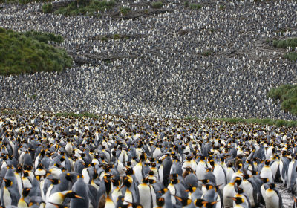
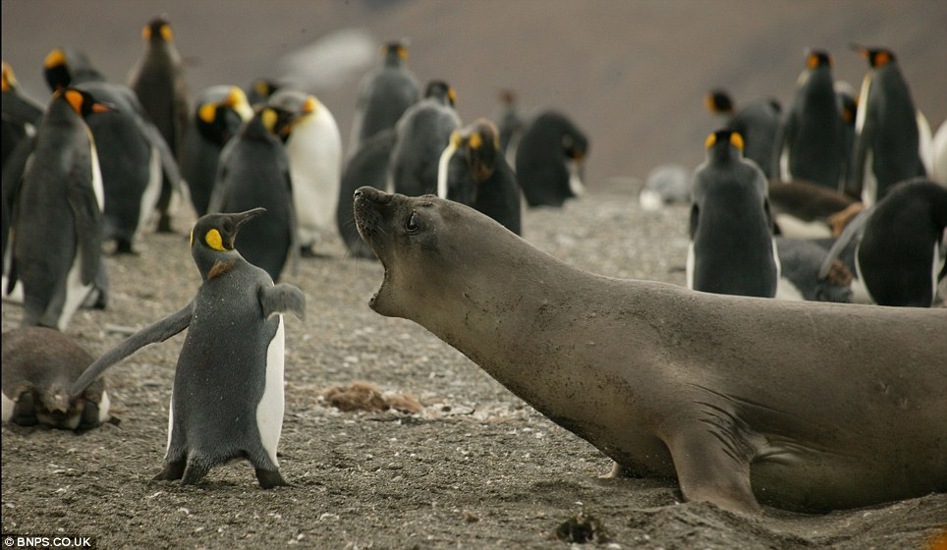
What is a population? What is a community?
Population: Individuals of a species that live in a given area.
Community: All the different species living in a given area. Healthy communities are have a wide diversity of species present.
Left image from The Scientist showing the largest King Penguin colony in the world which lost 88% of its population in 2018. Right image from Daily Mail

Slide 5
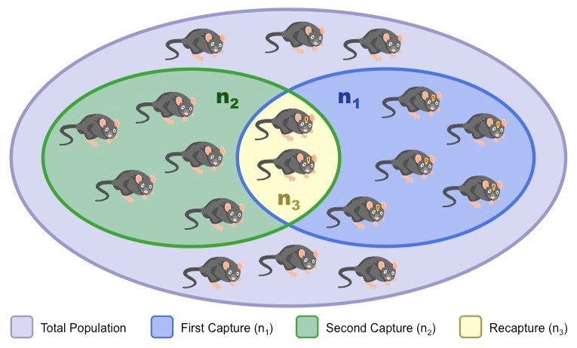
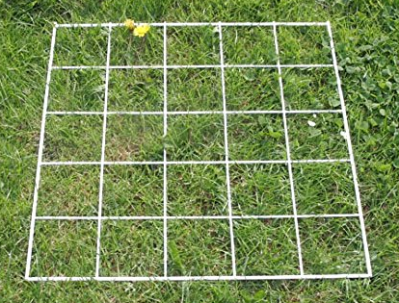
Population size
Population Size: Total number of individuals in the population.
How is population size measured?
Quadrat Method: Count individuals in an area. Great for slow or non-moving populations
Mark and Recapture Method: Capture and mark individuals, release, capture again, and compare marked/unmarked in second capture – for very mobile populations
Image from Amazon & Bioninja
This OpenStax ancillary resource is © Rice University under a CC-BY 4.0 International license; it may be reproduced or modified but must be attributed to OpenStax, Rice University and any changes must be noted. Any images credited to other sources are similarly available for reproduction, but must be attributed to their sources.

Slide 6
Population Density & distribution
Population Density: Number of individuals per unit area
Species may have a random, clumped, or uniform distribution.
Plants such as (a) dandelions with wind-dispersed seeds tend to be randomly distributed. Animals such as (b) elephants that travel in groups exhibit a clumped distribution. Territorial birds such as (c) penguins tend to have a uniform distribution.
(credit a: modification of work by Rosendahl; credit b: modification of work by Rebecca Wood; credit c: modification of work by Ben Tubby)
This OpenStax ancillary resource is © Rice University under a CC-BY 4.0 International license; it may be reproduced or modified but must be attributed to OpenStax, Rice University and any changes must be noted. Any images credited to other sources are similarly available for reproduction, but must be attributed to their sources.

Slide 7
Study Guide (Learning objectives)
After successfully completing this learning module, students will be able to:
Describe population size, density, and distribution.
Describe the use of demography in population ecology.
Explain the differences between exponential and logistic growth patterns.
Distinguish between types of symbiotic relationships observed in nature: Commensalism; mutualism; parasitism; competition; predation
Discuss the predator-prey cycle and describe how it can lead to evolution of defense mechanisms.

Slide 8
Demography: How does a population change over time?
Demography: The statistical study of population changes over time
Life Tables: Describe the life expectancy of individuals at each age
Mortality Rates: Percent of death in a population
Survivorship Curves: Likelihood of survival at each age of an individual’s life
Type I: Death is more likely in older ages
Type II: Death is equally likely throughout lifespan
Type III: Death is more likely in younger ages

Slide 9
Study Guide (Learning objectives)
After successfully completing this learning module, students will be able to:
Describe population size, density, and distribution.
Describe the use of demography in population ecology.
Explain the differences between exponential and logistic growth patterns.
Distinguish between types of symbiotic relationships observed in nature: Commensalism; mutualism; parasitism; competition; predation
Discuss the predator-prey cycle and describe how it can lead to evolution of defense mechanisms.

Slide 10
Figure 19.5
When resources are unlimited, populations exhibit (a) exponential growth, shown in a J-shaped curve. When resources are limited, populations exhibit (b) logistic growth. In logistic growth, population expansion decreases as resources become scarce, and it levels off when the carrying capacity of the environment is reached. The logistic growth curve is S-shaped.
This OpenStax ancillary resource is © Rice University under a CC-BY 4.0 International license; it may be reproduced or modified but must be attributed to OpenStax, Rice University and any changes must be noted. Any images credited to other sources are similarly available for reproduction, but must be attributed to their sources.

Slide 11
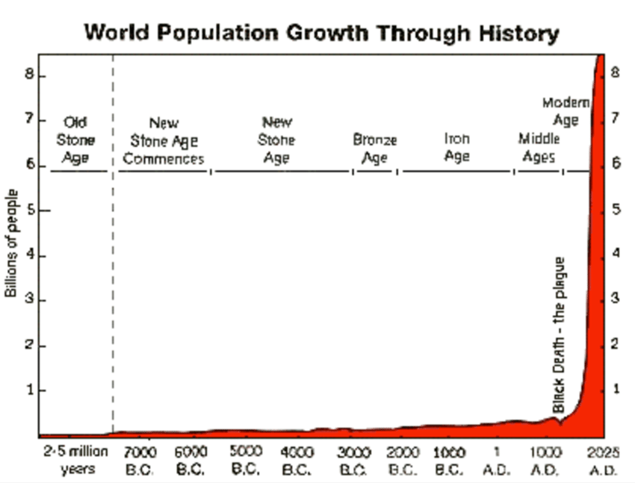
Examples of Exponential & Logistic growth
(a) Yeast grown in ideal conditions in a test tube shows a classical S-shaped logistic growth curve, whereas (b) a natural population of seals shows real-world fluctuation. The yeast is visualized using differential interference contrast light micrography. (credit a: scale-bar data from Matt Russell)
Humans
This OpenStax ancillary resource is © Rice University under a CC-BY 4.0 International license; it may be reproduced or modified but must be attributed to OpenStax, Rice University and any changes must be noted. Any images credited to other sources are similarly available for reproduction, but must be attributed to their sources.

Slide 12
Study Guide (Learning objectives)
After successfully completing this learning module, students will be able to:
Describe population size, density, and distribution.
Describe the use of demography in population ecology.
Explain the differences between exponential and logistic growth patterns.
Distinguish between types of symbiotic relationships observed in nature: Commensalism; mutualism; parasitism; competition; predation
Discuss the predator-prey cycle and describe how it can lead to evolution of defense mechanisms.

Slide 13
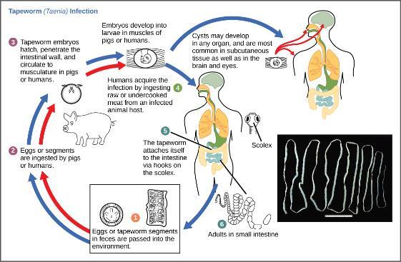
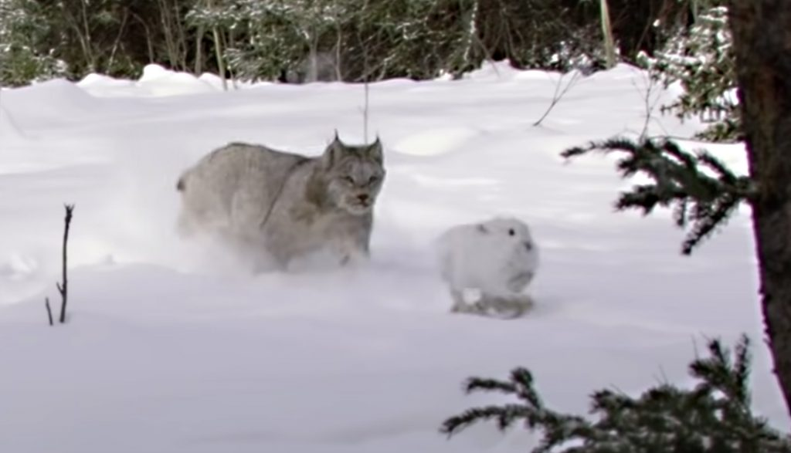
Symbiotic Relationships observed in nature
Commensalism
One species benefits while the other is unaffected.
Birds in trees
Mutualism
Both species benefit.
Termites & gut protozoa
Parasitism
One benefits while the other is harmed.
Predation
One benefits while the other is killed.
Images from Hanay”/Wikimedia Commons; modification of work by Scott Bauer, USDA ; CDC

Slide 14
Study Guide (Learning objectives)
After successfully completing this learning module, students will be able to:
Describe population size, density, and distribution.
Describe the use of demography in population ecology.
Explain the differences between exponential and logistic growth patterns.
Distinguish between types of symbiotic relationships observed in nature: Commensalism; mutualism; parasitism; competition; predation
Discuss the predator-prey cycle and describe how it can lead to evolution of defense mechanisms.

Slide 15
The predator-prey cycle
The cycling of snowshoe hare and lynx populations in Northern Ontario is an example of predator-prey dynamics.
This OpenStax ancillary resource is © Rice University under a CC-BY 4.0 International license; it may be reproduced or modified but must be attributed to OpenStax, Rice University and any changes must be noted. Any images credited to other sources are similarly available for reproduction, but must be attributed to their sources.

Slide 16
Evolution of plant defenses
The (a) honey locust tree uses thorns, a mechanical defense, against herbivores, while the (b) foxglove uses a chemical defense: toxins produces by the plant can cause nausea, vomiting, hallucinations, convulsions, or death when consumed. (credit a: modification of work by Huw Williams; credit b: modification of work by Philip Jägenstedt)
This OpenStax ancillary resource is © Rice University under a CC-BY 4.0 International license; it may be reproduced or modified but must be attributed to OpenStax, Rice University and any changes must be noted. Any images credited to other sources are similarly available for reproduction, but must be attributed to their sources.

Slide 17
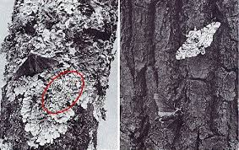
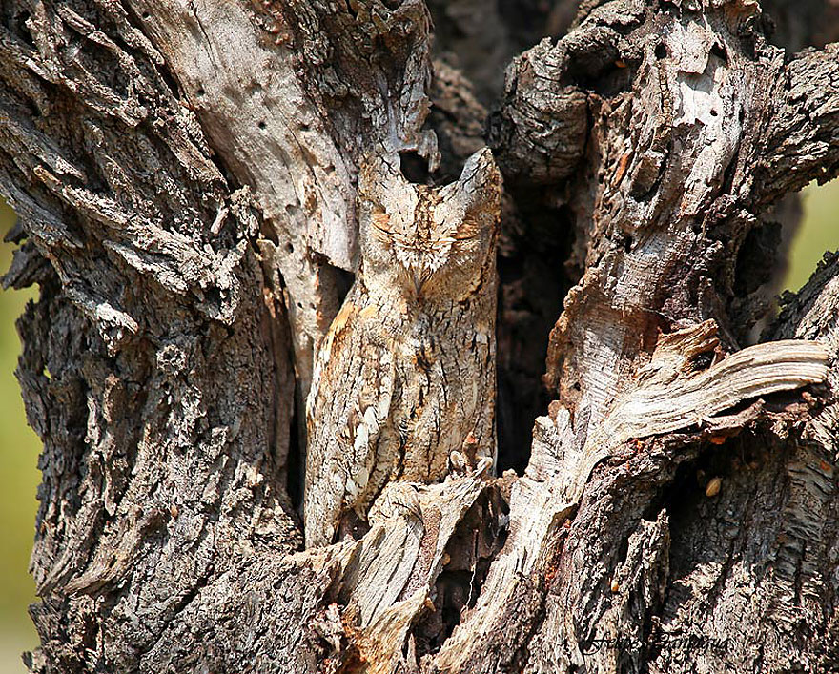
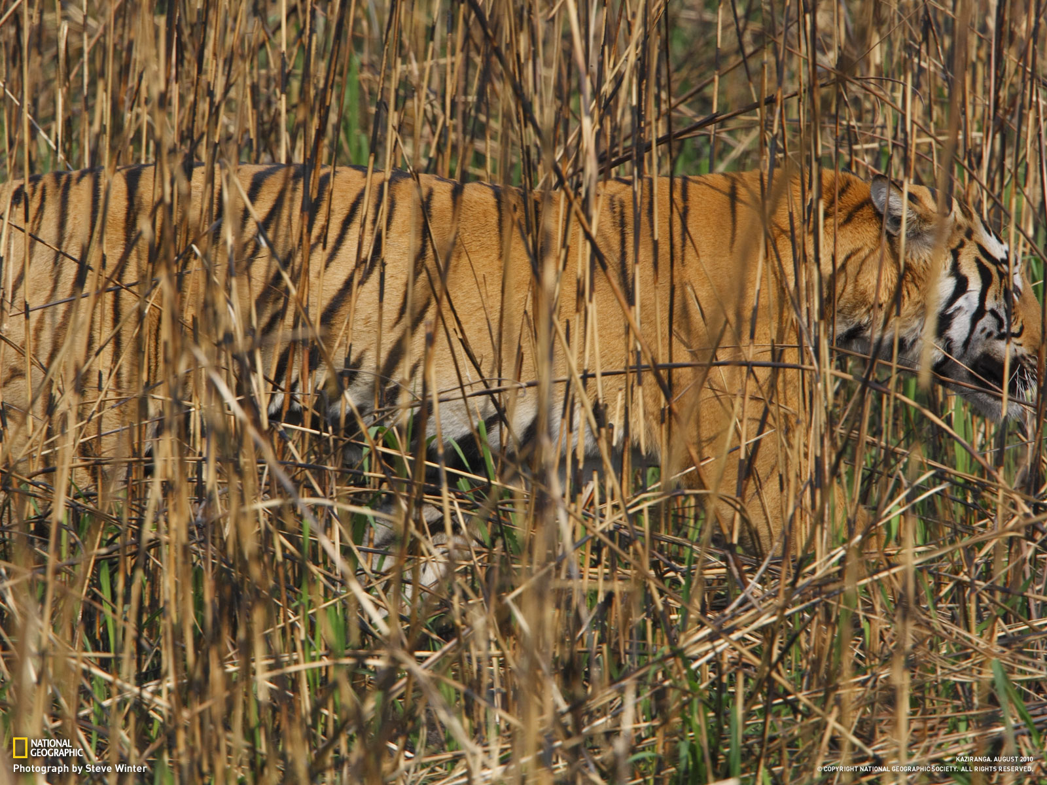
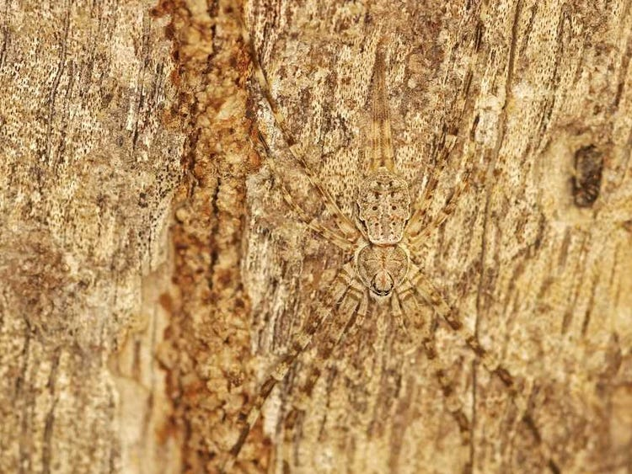
Evolution of camouflage as a defense mechanism
Many prey evolved to use their body shape and/or coloration to prevent detection by predators…. And vice versa!!!!
(credit a: modification of work by Linda Tanner; credit b: modification of work by Frank Vassen; other images from Cal State Fullerton; Bored Panda; Mrs. Bursk’s Class Business Insider)
This OpenStax ancillary resource is © Rice University under a CC-BY 4.0 International license; it may be reproduced or modified but must be attributed to OpenStax, Rice University and any changes must be noted. Any images credited to other sources are similarly available for reproduction, but must be attributed to their sources.

Slide 18
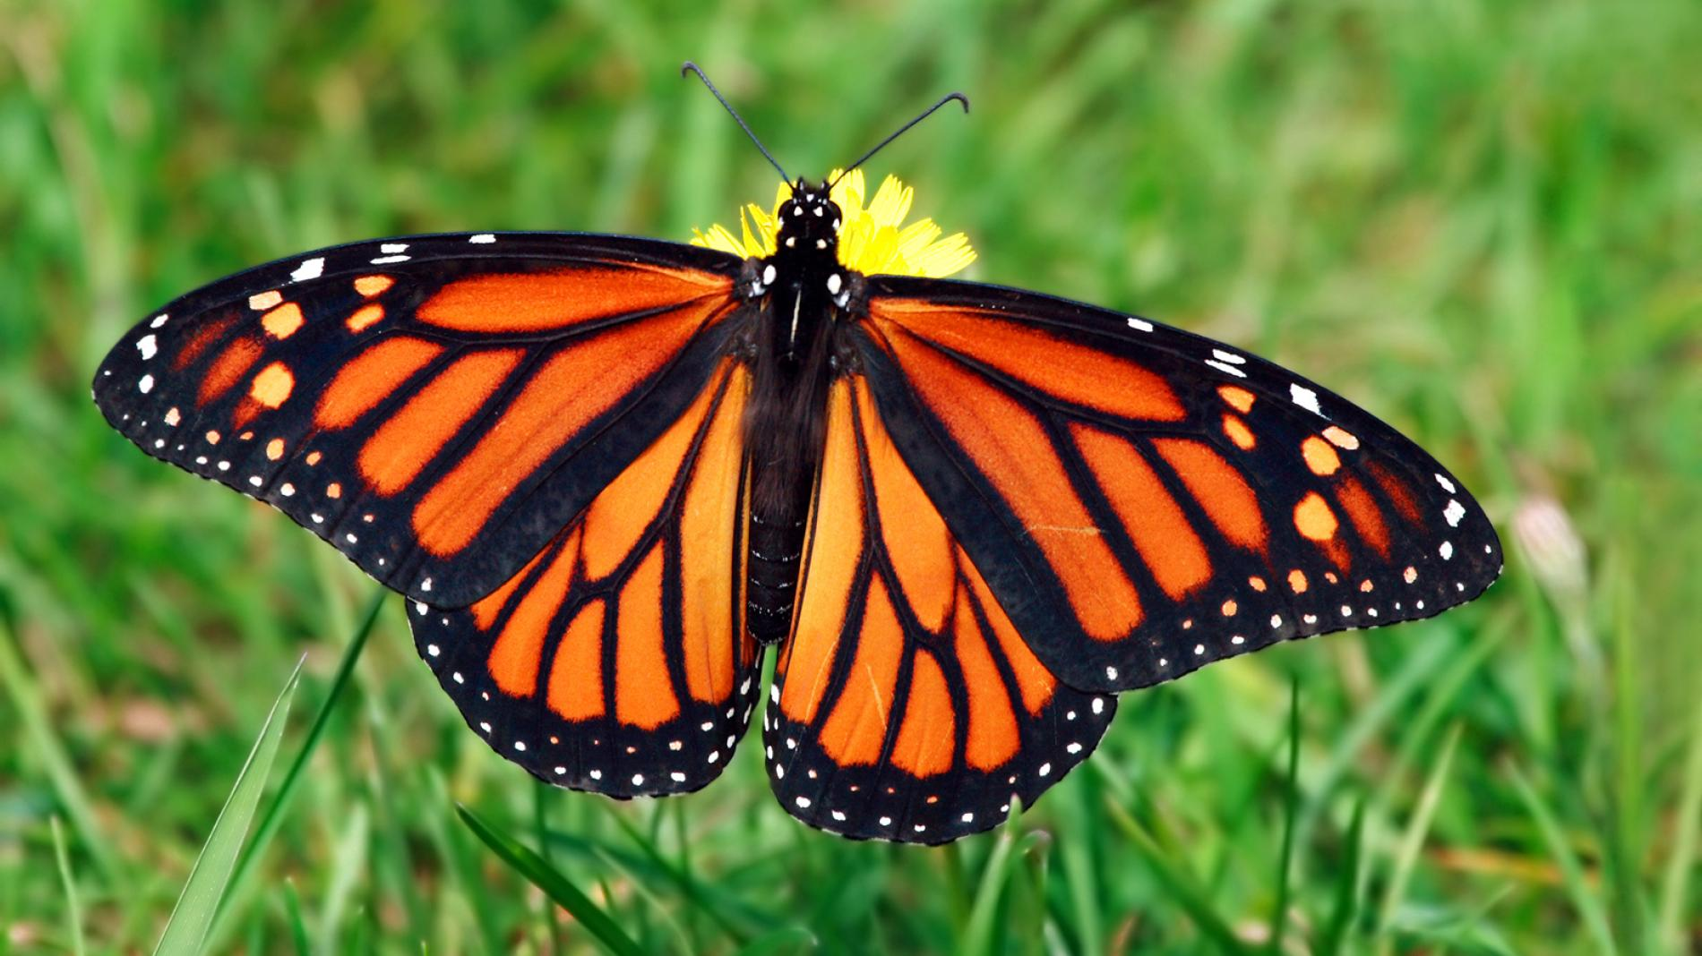
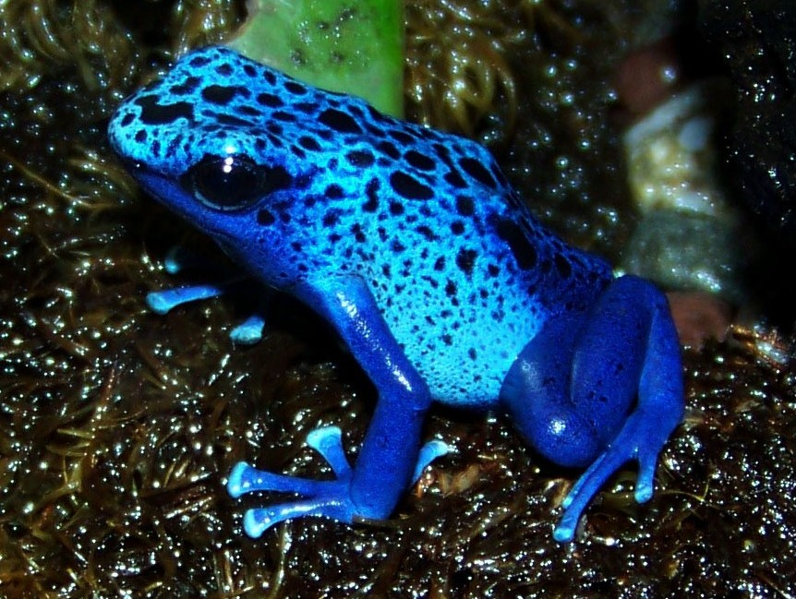
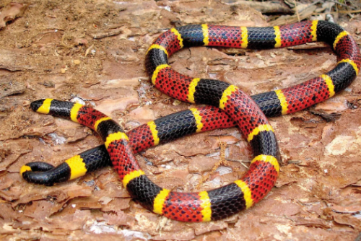
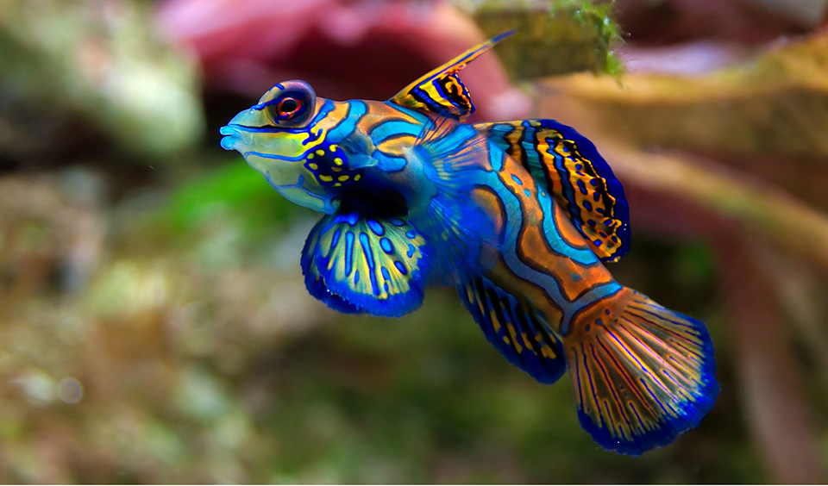
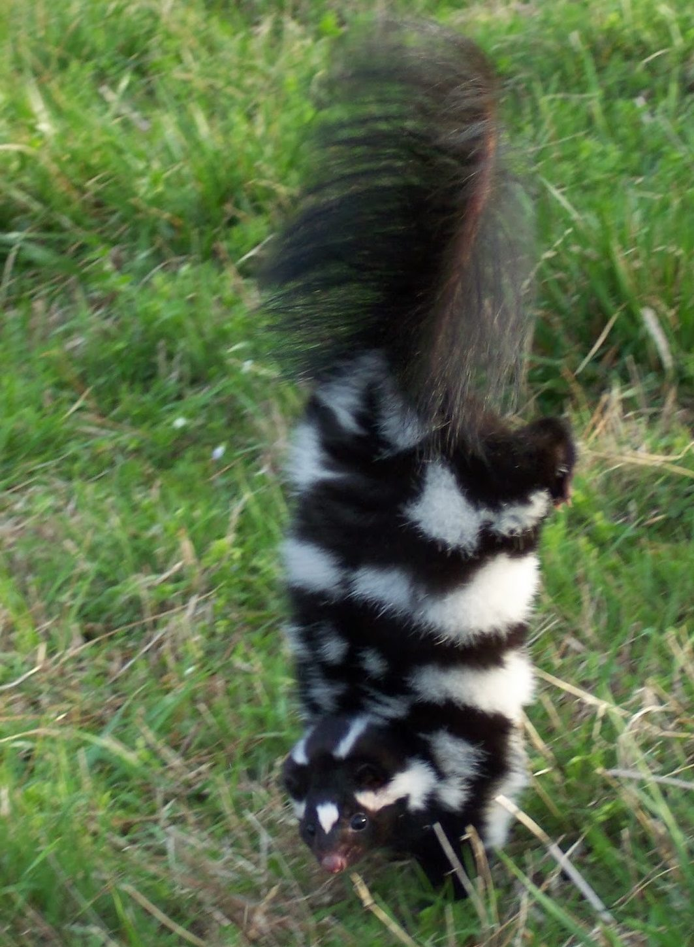
Evolution of toxic warning signs
Some prey have evolved bright coloration that serves to warn potential predators that it is toxic.
(credit: modification of work by Roberto Verzo; Kid’s National Geographic; Seneca Park Zoo; Tumblr; Australian Geographic; National Wildlife Federation)
This OpenStax ancillary resource is © Rice University under a CC-BY 4.0 International license; it may be reproduced or modified but must be attributed to OpenStax, Rice University and any changes must be noted. Any images credited to other sources are similarly available for reproduction, but must be attributed to their sources.

Slide 19
Evolution of plagiarism in nature!
One form of mimicry is when a harmless species mimics the coloration of a harmful species, as is seen with the (a) wasp (Polistes sp.) and the (b) hoverfly (Syrphus sp.). (credit: modification of work by Tom Ings)
This OpenStax ancillary resource is © Rice University under a CC-BY 4.0 International license; it may be reproduced or modified but must be attributed to OpenStax, Rice University and any changes must be noted. Any images credited to other sources are similarly available for reproduction, but must be attributed to their sources.

Slide 20
Figure 19.18
Several unpleasant-tasting Heliconius butterfly species share a similar color pattern with better-tasting varieties, an example of mimicry. (credit: Joron M, Papa R, Beltrán M, Chamberlain N, MaváLrez J, et al.)
This OpenStax ancillary resource is © Rice University under a CC-BY 4.0 International license; it may be reproduced or modified but must be attributed to OpenStax, Rice University and any changes must be noted. Any images credited to other sources are similarly available for reproduction, but must be attributed to their sources.

