Slide 1
Concepts of Biology
Chapter 21 CONSERVATION AND BIODIVERSITY
PowerPoint Image Slideshow

Slide 2
Figure 21.14
The dodo bird was hunted to extinction around 1662. (credit: Ed Uthman, taken in Natural History Museum, London, England)
This OpenStax ancillary resource is © Rice University under a CC-BY 4.0 International license; it may be reproduced or modified but must be attributed to OpenStax, Rice University and any changes must be noted. Any images credited to other sources are similarly available for reproduction, but must be attributed to their sources.

Slide 3
Study Guide (Learning Objectives)
Identify benefits of biodiversity to humans.
Identify significant threats to biodiversity.
Describe examples of the legislative framework for conservation.
Identify the role of zoos & aquariums in biodiversity conservation.
Identify the factors that influence the size of an individual’s ecological footprint

Slide 4
Benefits of Biodiversity to Humans Human Health
Human Health
Preserving chemical diversity as sources of novel medications and treatments
Catharanthus roseus, the Madagascar periwinkle, has various medicinal properties. Among other uses, it is a source of vincristine, a drug used in the treatment of lymphomas. (credit: Forest and Kim Starr)

Slide 5
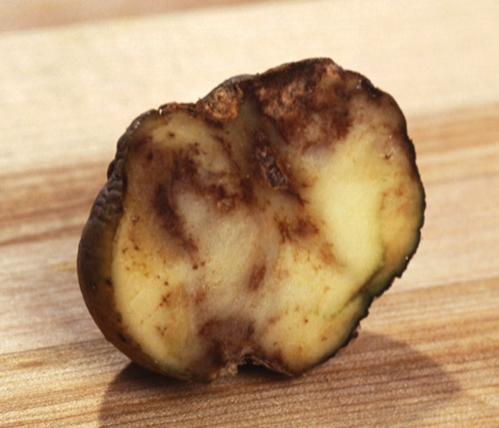
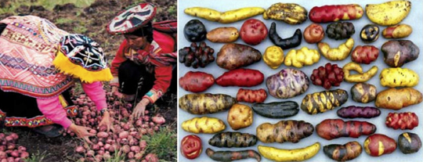
Benefits of Biodiversity to humans Agriculture
Larger gene pools provide greater opportunity for resistance to disease in crops and herds.
A threat is the industrialization of agriculture
Agriculture in Ireland focused on one variety of potato which was susceptible to a fungal infection called Blight. One million people died as a result.
Agriculture in the Andes mountains focused on maintaining diversity of potatoes.
Smithsonian Magazine; World Public health Nutrition Association

Slide 6
Protecting biodiversity
The Svalbard Global Seed Vault is a storage facility for seeds of Earth’s diverse crops. (credit: Mari Tefre, Svalbard Global Seed Vault)
This OpenStax ancillary resource is © Rice University under a CC-BY 4.0 International license; it may be reproduced or modified but must be attributed to OpenStax, Rice University and any changes must be noted. Any images credited to other sources are similarly available for reproduction, but must be attributed to their sources.

Slide 7
Benefits of Biodiversity to Humans Food Sources
The oceans provide an abundant source of food when properly managed
Overharvesting and overfishing is a threat
Fish and seafood are being harvested to extinction
Report from National Geographic

Slide 8
Benefits of biodiversity to humans aesthetics & life enrichment

Slide 9
significant threats to biodiversity Habitat destruction
Habitat destruction through deforestation, especially of tropical rainforests as seen in this satellite view of Amazon rainforests in Brazil, is a major cause of the current decline in biodiversity. (credit: modification of work by Jesse Allen and Robert Simmon, NASA Earth Observatory)
This OpenStax ancillary resource is © Rice University under a CC-BY 4.0 International license; it may be reproduced or modified but must be attributed to OpenStax, Rice University and any changes must be noted. Any images credited to other sources are similarly available for reproduction, but must be attributed to their sources.

Slide 10
Figure 21.2
This tropical lowland rainforest in Madagascar is an example of a high biodiversity habitat. This particular location is protected within a national forest, yet only 10 percent of the original coastal lowland forest remains, and research suggests half the original biodiversity has been lost. (credit: Frank Vassen)
This OpenStax ancillary resource is © Rice University under a CC-BY 4.0 International license; it may be reproduced or modified but must be attributed to OpenStax, Rice University and any changes must be noted. Any images credited to other sources are similarly available for reproduction, but must be attributed to their sources.

Slide 11
Figure 21.8
An oil palm plantation in Sabah province Borneo, Malaysia, replaces native forest habitat that a variety of species depended on to live. (credit: Lian Pin Koh)
This OpenStax ancillary resource is © Rice University under a CC-BY 4.0 International license; it may be reproduced or modified but must be attributed to OpenStax, Rice University and any changes must be noted. Any images credited to other sources are similarly available for reproduction, but must be attributed to their sources.

Slide 12
Figure 21.4
This map illustrates the number of amphibian species across the globe and shows the trend toward higher biodiversity at lower latitudes. A similar pattern is observed for most taxonomic groups.
This OpenStax ancillary resource is © Rice University under a CC-BY 4.0 International license; it may be reproduced or modified but must be attributed to OpenStax, Rice University and any changes must be noted. Any images credited to other sources are similarly available for reproduction, but must be attributed to their sources.

Slide 13
Invasive species are also a threat to biodiversity
The brown tree snake, Boiga irregularis, is an exotic species that has caused numerous extinctions on the island of Guam since its accidental introduction in 1950. (credit: NPS)
This OpenStax ancillary resource is © Rice University under a CC-BY 4.0 International license; it may be reproduced or modified but must be attributed to OpenStax, Rice University and any changes must be noted. Any images credited to other sources are similarly available for reproduction, but must be attributed to their sources.

Slide 14
Figure 21.10
This Limosa harlequin frog (Atelopus limosus), an endangered species from Panama, died from a fungal disease called chytridiomycosis. The red lesions are symptomatic of the disease. (credit: Brian Gratwicke)
This OpenStax ancillary resource is © Rice University under a CC-BY 4.0 International license; it may be reproduced or modified but must be attributed to OpenStax, Rice University and any changes must be noted. Any images credited to other sources are similarly available for reproduction, but must be attributed to their sources.

Slide 15
Figure 21.11
This little brown bat in Greeley Mine, Vermont, March 26, 2009, was found to have white-nose syndrome. (credit: modification of work by Marvin Moriarty, USFWS)
This OpenStax ancillary resource is © Rice University under a CC-BY 4.0 International license; it may be reproduced or modified but must be attributed to OpenStax, Rice University and any changes must be noted. Any images credited to other sources are similarly available for reproduction, but must be attributed to their sources.

Slide 16
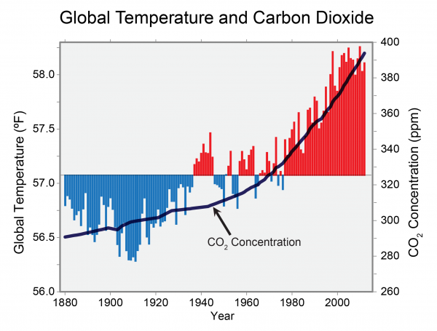
Another Significant threat to biodiversity global climate change
Atmospheric carbon dioxide levels fluctuate in a cyclical manner. However, the burning of fossil fuels in recent history has caused a dramatic increase in the levels of carbon dioxide in the Earth’s atmosphere, which have now reached levels never before seen on Earth. Scientists predict that the addition of this “greenhouse gas” to the atmosphere is resulting in climate change that will significantly impact biodiversity in the coming century.
U.S. Global Change Research Program Global Change.gov

Slide 17
Figure 21.12
The effect of global warming can be seen in the continuing retreat of Grinnell Glacier. The mean annual temperature in Glacier National Park has increased 1.33°C since 1900. The loss of a glacier results in the loss of summer meltwaters, sharply reducing seasonal water supplies and severely affecting local ecosystems. (credit: USGS, GNP Archives)
This OpenStax ancillary resource is © Rice University under a CC-BY 4.0 International license; it may be reproduced or modified but must be attributed to OpenStax, Rice University and any changes must be noted. Any images credited to other sources are similarly available for reproduction, but must be attributed to their sources.

Slide 18
Explain the legislative framework for protecting biodiversity
International Treaties
The Convention on International Trade of Endangered Species of Wild Fauna and Flora Treaty (CITES)
Enacted in 1975 to address international movement or transactions involving endangered species
Learn more at What is CITES?
USA Legislation
The Endangered Species Act
Enacted in 1973 to develop management plans of endangered species that will bring their population sizes back to sustainable levels
Learn more at US Fish & Wildlife Service

Slide 19
Figure 21.16
National parks, such as Grand Teton National Park in Wyoming, help conserve biodiversity. (credit: Don DeBold)
This OpenStax ancillary resource is © Rice University under a CC-BY 4.0 International license; it may be reproduced or modified but must be attributed to OpenStax, Rice University and any changes must be noted. Any images credited to other sources are similarly available for reproduction, but must be attributed to their sources.

Slide 20
The Role of Zoos & Aquariums in preserving biodiversity
Zoos and captive breeding programs help preserve many endangered species, such as this golden lion tamarin. (credit: Garrett Ziegler)
This OpenStax ancillary resource is © Rice University under a CC-BY 4.0 International license; it may be reproduced or modified but must be attributed to OpenStax, Rice University and any changes must be noted. Any images credited to other sources are similarly available for reproduction, but must be attributed to their sources.

Slide 21
What is your contribution?
Calculate your Ecological Footprint at Ecological Footprint Calculator

