Slide 1
Marketing: Building Profitable Customer Connections

Slide 2
Learning Outcomes
Discuss the objectives, the process, and the scope of marketing
Identify the role of the customer in marketing
Explain each element of marketing strategy
Describe the consumer and business decision-making process
Discuss the key elements of marketing research
Explain the roles of social responsibility and technology in marketing

Slide 3
Marketing and Utility
LO 1
Marketing: Organizational function and a set of processes for:
Creating, communicating, and delivering value to customers
Managing customer relationships in ways that benefit the organization and its stakeholders
Utility: Ability of goods and services to satisfy wants

Slide 4
Utility - Types
LO 1
Form utility
Satisfies wants by converting inputs into a finished form
Time utility
Satisfies wants by providing goods and services at a convenient time for customers
Place utility
Satisfies wants by providing goods and services at a convenient place for customers
Ownership utility
Satisfies wants by smoothly transferring ownership of goods and services from seller to buyer

Slide 5
Scope of Marketing
LO 1
People marketing
Place marketing
Event marketing
Idea marketing

Slide 6
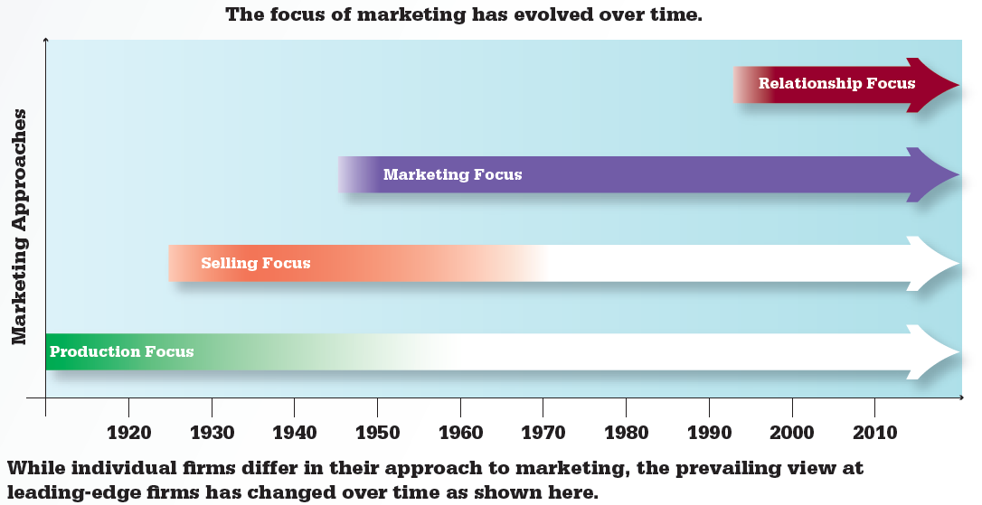
11.1 The Evolution of Marketing
LO 1

Slide 7
Customer Relationship Management (CRM)
LO 2
Ongoing process of acquiring, maintaining, and growing profitable customer relationships by delivering unmatched value
Companies can either have limited relationships or pursue full partnerships with clients

Slide 8
Customer Satisfaction and Loyalty
LO 2
Customer satisfaction
Customers’ perception that a good or service delivers value above and beyond their expectations
Customer loyalty
Customers repeatedly buy certain products

Slide 9
Marketing Plan
LO 3
Formal document that defines marketing objectives and the specific strategies for achieving those objectives
Involves:
Deciding where to target efforts
Market segmentation: Dividing potential customers into groups of similar people, or segments

Slide 10
Marketing Plan (continued)
LO 3
Determining strategies to reach the target market
Anticipating and responding to changes in the external environment

Slide 11
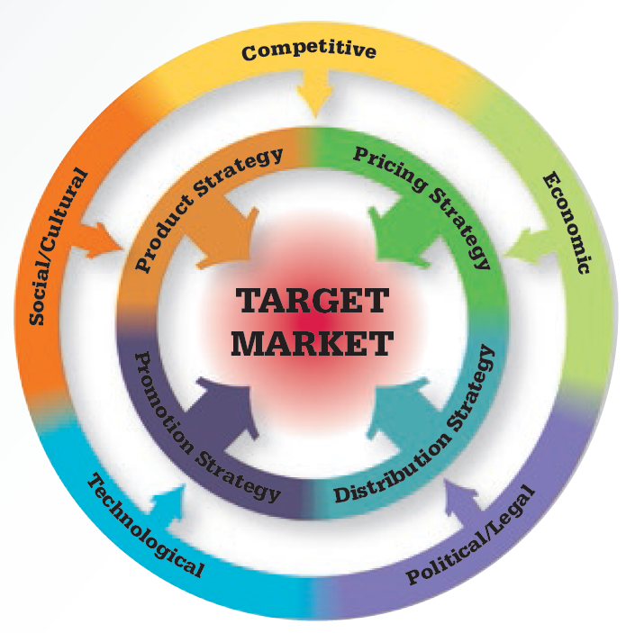
11.2 Marketing Strategy
LO 3

Slide 12
Target Market
LO 3
Group of people who are most likely to buy a particular product
Characteristics of a well-chosen target market
Size
Profitability
Accessibility
Limited competition

Slide 13
Consumer and Business Marketers
LO 3
Consumer marketers (business-to-consumer or B2C)
Direct their efforts toward people who are buying products for personal consumption
Business marketers (business-to-business or B2B)
Direct their efforts toward people who are buying products to use either directly or indirectly to produce other products

Slide 14
Consumer Market Segmentation
LO 3
Demographic
Dividing the market based on characteristics about people such as age, income, ethnicity, and gender
Geographic
Dividing the market based on where consumers live

Slide 15
Consumer Market Segmentation (continued)
LO 3
Psychographic
Dividing the market based on consumer attitudes, interests, values, and lifestyles
Behavioral
Dividing the market based on how people behave toward various products

Slide 16
Categories of Business Market Segmentation
LO 3
Geographic
Customer-based
Product-use–based

Slide 17
Marketing Mix
LO 3
Blend of marketing strategies for:
Product
Price
Distribution
Promotion
Firms need to reevaluate their marketing mix for each new country they enter

Slide 18
Elements of the External Marketing Environment
LO 3
Competitive
Economic
Social or cultural
Technological
Political or legal

Slide 19
11.5 Elements That Influence the Consumer Decision-Making Process
LO 3
Influence | Description
Cultural | Culture: The values, attitudes, and customs shared by members of a society Subculture: A smaller division of the broader culture Social Class: Societal position driven largely by income and occupation
Social | Family: A powerful force in consumption choices Friends: Another powerful force, especially for high-profile purchases Reference Groups: Groups that give consumers a point of comparison

Slide 20
11.5 Elements That Influence the Consume Decision-Making Process (continued)
LO 3
Influence | Description
Personal | Demographics: Measurable characteristics such as age, gender, or income Personality: The mix of traits that determines who you are
Psychological | Motivation: Pressing needs that tend to generate action Attitudes: Lasting evaluations of (or feelings about) objects or ideas Perceptions: How people select, organize, and interpret information Learning: Changes in behavior based on experience

Slide 21
Consumer Behavior
LO 4
People's actions when they are buying, using, and discarding goods and services for their personal consumption
Explores the reasons behind people’s actions

Slide 22
Steps in Consumer Decision Process
LO 4
Need recognition
Information search
Evaluation of alternatives
Purchase decision
Post-purchase behavior
Cognitive dissonance: Consumer discomfort with a purchase decision, typically for a higher-priced item

Slide 23
Business Buyer Behavior
LO 4
Describes people’s behavior when they are buying products to use directly or indirectly to produce other products
Decision-making process is based on purchasing training and application of rational criteria
Input is integrated from a number of internal sources based on a formal process
Customers seek highly customized goods, services, and prices

Slide 24
Marketing Research
LO 5
Process of gathering, interpreting, and applying information to:
Uncover opportunities and challenges
Make better decisions
Used to:
Identify external opportunities and threats
Monitor and predict customer behavior
Evaluate and improve each area of the marketing mix

Slide 25
Marketing Research - Types of Data
LO 5
Secondary data: Existing data that marketers gather or purchase for a research project
Primary data: New data that marketers compile for a specific research project

Slide 26
Categories of Primary Research
LO 5
Observation
Does not require the researcher to interact with the research subject
Survey
Requires that the researcher interact with the research subject

Slide 27
11.7 Research Data Comparison
LO 5
Secondary data | Primary data
Existing data that marketers gather or purchase | New data that marketers compile for the first time
Tends to be lower cost | Tends to be more expensive
May not meet your specific needs | Customized to meet your needs
Frequently outdated | Fresh, new data
Available to your competitors | Proprietary—no one else has it
Examples: U.S. Census, the Wall Street Journal, Time magazine, your product sales history | Examples: Your own surveys, focus groups, customer comments, mall interviews

Slide 28
Social Responsibility and Technology
LO 6
Marketers setting standards to protect the environment, abolish sweatshops, and give back to the local community
Companies are employing green marketing when they promote ecological benefits of a product
Technology has revolutionized marketing elements and has enabled mass customization

Slide 29
Key Terms
Marketing
Utility
Marketing concept
Customer relationship management (CRM)
Value
Customer satisfaction
Customer loyalty
Marketing plan
Market segmentation
Target market
Consumer marketers (business-to-consumer or B2C)
Business marketers (business-to-business or B2B)
Demographic segmentation

Slide 30
Key Terms (continued)
Geographic segmentation
Psychographic segmentation
Behavioral segmentation
Marketing mix
Environmental scanning
Market share
Consumer behavior
Cognitive dissonance
Business buyer behavior
Marketing research
Secondary data
Primary data
Observation research
Survey research
Green marketing
Mass customization

Slide 31
Summary
Marketing involves creating, communicating, and delivering value to customers
Information is an integral part of CRM
Elements of marketing strategy include product, price, distribution, and promotion
Understanding customer needs includes studying consumer and business buyer behavior

Slide 32
Summary (continued)
Categories of marketing research data include secondary and primary data
Social responsibility movement and technology have impacted marketing in the last two decades

Slide 33
End of Chapter

