Slide 1
Basics Review
Categorize the genotypes:
heterozygote (HE), homozygote (HO)
dominant (dom), recessive (Rec)
AA
hh
Tt
rr
RR
HO – dom
HO – rec
HE
HO – rec
HO – dom

Slide 2
Basics Review
Purple flowers are dominant to white
What is the character?
flower color
What are the possible phenotypes?
purple & white
What are the alleles symbols?
dom. (P), rec. (p)
What are the phenotypes given the genotypes?
PP
Pp
pp
purple
purple
white

Slide 3
Given the description of the traits below write up an appropriate schematic for the genetic system. Use upper case letters to indicated the dominant allele and lower case letters to indicated the recessive allele.
brown hair dominant to red hair
 | allele symbol brown
 | allele symbol red
 | genotype brown(homozygous)
 | genotype brown (heterozygous)
 | genotype red

Slide 4
Given the description of the traits below write up an appropriate schematic for the genetic system. Use upper case letters to indicated the dominant allele and lower case letters to indicated the recessive allele.
brown hair dominant to red hair
B | allele symbol brown
 | allele symbol red
 | genotype brown(homozygous)
 | genotype brown (heterozygous)
 | genotype red

Slide 5
Given the description of the traits below write up an appropriate schematic for the genetic system. Use upper case letters to indicated the dominant allele and lower case letters to indicated the recessive allele.
brown hair dominant to red hair
B | allele symbol brown
b | allele symbol red
 | genotype brown(homozygous)
 | genotype brown (heterozygous)
 | genotype red

Slide 6
Given the description of the traits below write up an appropriate schematic for the genetic system. Use upper case letters to indicated the dominant allele and lower case letters to indicated the recessive allele.
brown hair dominant to red hair
B | allele symbol brown
b | allele symbol red
BB | genotype brown(homozygous)
 | genotype brown (heterozygous)
 | genotype red

Slide 7
Given the description of the traits below write up an appropriate schematic for the genetic system. Use upper case letters to indicated the dominant allele and lower case letters to indicated the recessive allele.
brown hair dominant to red hair
B | allele symbol brown
b | allele symbol red
BB | genotype brown(homozygous)
Bb | genotype brown (heterozygous)
 | genotype red

Slide 8
Given the description of the traits below write up an appropriate schematic for the genetic system. Use upper case letters to indicated the dominant allele and lower case letters to indicated the recessive allele.
brown hair dominant to red hair
B | allele symbol brown
b | allele symbol red
BB | genotype brown(homozygous)
Bb | genotype brown (heterozygous)
bb | genotype red

Slide 9
If you flip a coin twice how many possible out comes are there?
4
 | first roll , second roll
 | heads, heads
 | heads, tails
 | tails, heads
 | tails, tails
If you flip a coin twice, what is the chance you will get a heads and a tails?
50 % chance

Slide 10
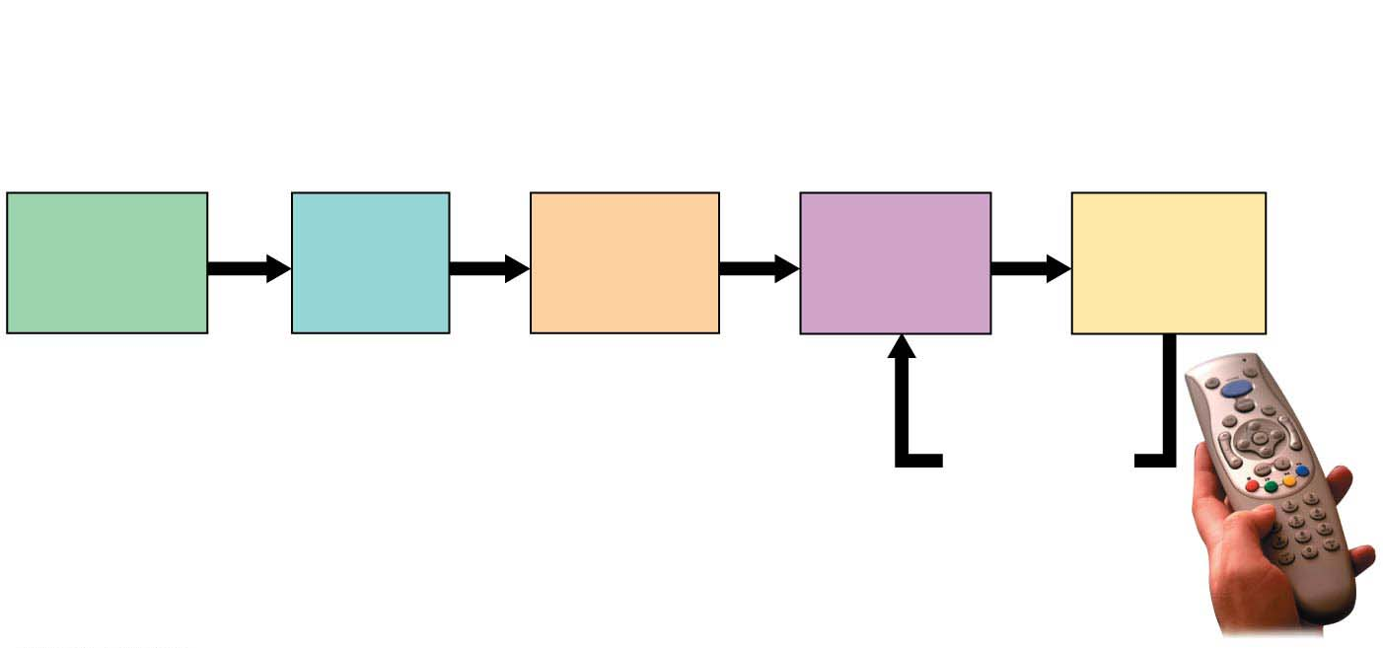
The Scientific Method
Observation
The remote
doesn’t
work.
Question
What’s
wrong?
Hypothesis
The
batteries
are dead.
Prediction
With new
batteries, it
will work.
Experiment
Replace
batteries.
Experiment
supports
hypothesis;
make more
predictions
and test.
Notes:
Figure 1.3-s4 Applying the scientific method to a common problem (step 4)

Slide 11
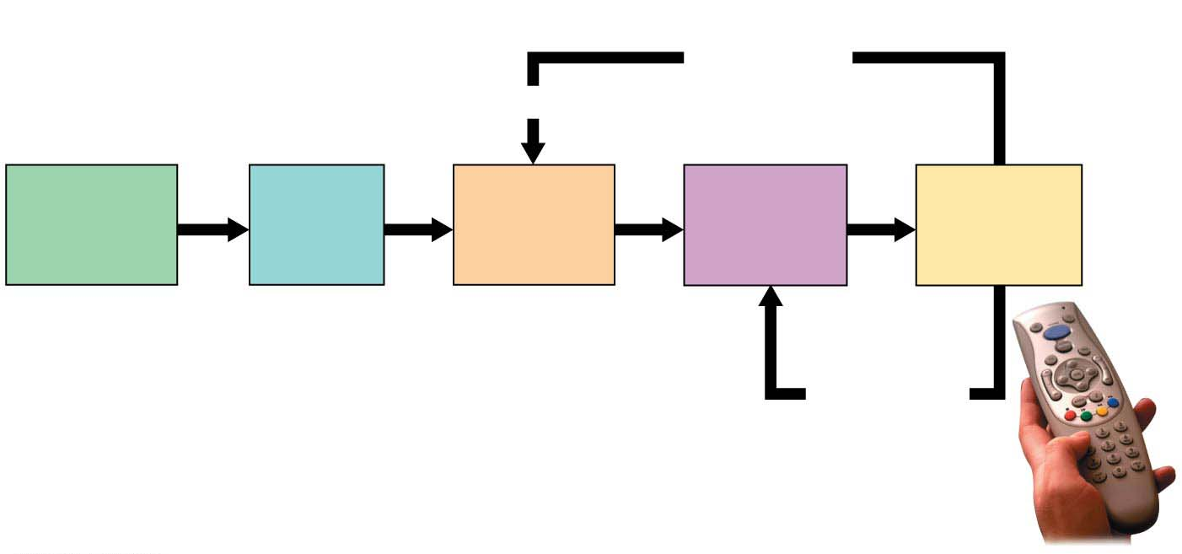
The Scientific Method
Experiment
does not
support
hypothesis.
Revise.
Observation
The remote
doesn’t
work.
Question
What’s
wrong?
Hypothesis
The
batteries
are dead.
Prediction
With new
batteries, it
will work.
Experiment
Replace
batteries.
Experiment
supports
hypothesis;
make more
predictions
and test.
Maybe a button is stuck or internal wiring need to be fixed
New prediction, new experiment
Notes:
Figure 1.3-s5 Applying the scientific method to a common problem (step 5)

Slide 12
Scientific Method
Observation > question > hypothesis > prediction > experiment
You are inspired to be more carbon neutral, so you decide to start riding your bike to work (again)… You dust off your bike and notice the front tire is flat. How did that happen? You’re not sure because you can’t remember the last time you’ve ridden it.
Observation – The bike tire is flat
Question – Why is the tire not holding air?
Hypothesis - Come up with a hypothesis for why the tire is flat
Prediction(s) - What are the expectations given your hypothesis?
Experiment - How will you test the hypothesis?
Do the people around you have the same hypothesis, prediction(s) and experiment?

Slide 13
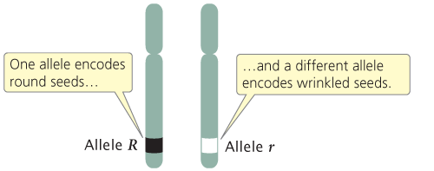
Molecular Nature of Alleles
How exactly does an allele control phenotype?
The seed coat character is encoded by a gene on Chromosome 5 of the pea genome
R- dominant – starch branching enzyme (SBEI)
r – recessive – non-functional starch enzyme, so the seeds accumulates simples sugars instead of starch

Slide 14
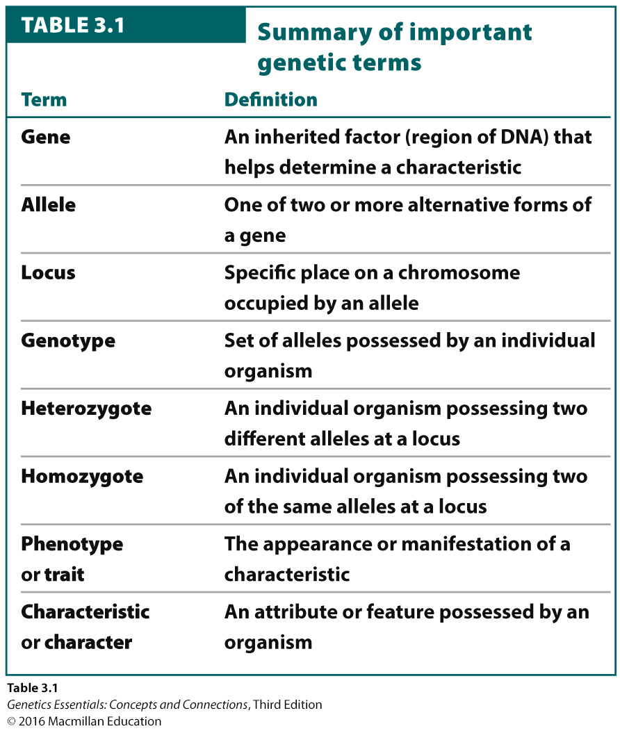

Slide 15
Test Cross
What is a test cross? A way to find the genotype of an organism that has the dominant phenotype.
The ability to roll the tongue is caused by a dominant allele. A woman is a “roller,” but one of her parents is not. What is the woman's genotype? (Hint: This is a test cross)
Rr

Slide 16
Question – In Mendel’s pea plants, seed shape as two alleles, round (R) and wrinkled (r). When gametes form one gamete gets a round allele, the other gets a wrinkled allele. Which of Mendel’s principles is being demonstrated?
independent assortment
principle of segregation
dominance
chi-squared
epistasis
Notes:
Question – In Mendel’s pea plants, seed shape as two alleles, round (R) and wrinkled (r). When gametes form, one gamete gets a round allele, the other gets a wrinkled allele. Which of Mendel’s principles is being demonstrated?
independent assortment
principle of segregation
dominance
chi-squared
epistasis

Slide 17
Question – In Mendel’s pea plants, seed shape as two alleles, round (R) and wrinkled (r). When gametes form one gamete gets a round allele, the other gets a wrinkled allele. Which of Mendel’s principles is being demonstrated?
independent assortment
principle of segregation
dominance
chi-squared
epistasis
Notes:
Question – In Mendel’s pea plants, seed shape as two alleles, round (R) and wrinkled (r). When gametes form one gamete gets a round allele, the other gets a wrinkled allele. Which of Mendel’s principles is being demonstrated?
independent assortment
principle of segregation
dominance
chi-squared
epistasis

Slide 18
possibility 1
possibility 2
R r
R r
Y y
y Y
meiosis
R
r
R
r
Y
y
y
Y
Notes:
Question – In Mendel’s pea plants, seed shape as two alleles, round (R) and wrinkled (r). Seed color also has two allele, yellow (Y) and green (y). The image below shows the possible gametes formed from an individual pea plant that is heterozygous (RrYy) for both seed shape and seed color. During meiosis the allele for the two different characters segregate independently of each other. Which of Mendel’s principles is being demonstrated?
independent assortment
principle of segregation
dominance
chi-squared
epistasis

Slide 19
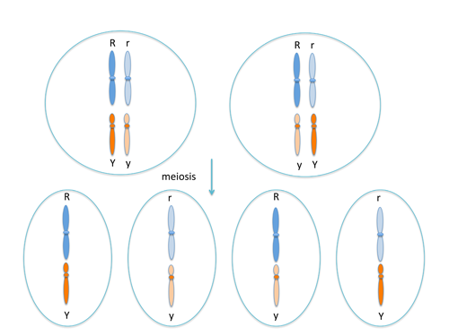
Question – In Mendel’s pea plants, seed shape as two alleles, round (R) and wrinkled (r). Seed color also has two allele, yellow (Y) and green (y). The image below shows the possible gametes formed from an individual pea plant that is heterozygous (RrYy) for both seed shape and seed color. During meiosis the allele for the two different characters segregate independently of each other. Which of Mendel’s principles is being demonstrated?
independent assortment
principle of segregation
dominance
chi-squared
epistasis

Slide 20
Question – In Mendel’s pea plants, seed shape as two alleles, round (R) and wrinkled (r). Seed color also has two allele, yellow (Y) and green (y). The image below shows the possible gametes formed from an individual pea plant that is heterozygous (RrYy) for both seed shape and seed color. During meiosis the allele for the two different characters segregate independently of each other. Which of Mendel’s principles is being demonstrated?
independent assortment
principle of segregation
dominance
chi-squared
epistasis

Slide 21
A pea plant has seeds that are round and yellow (RrYy). What gametes can be produced by this pea plant?
What fraction of them will Ry?
1/4

Slide 22
In Mendel’s peas the round allele is dominant to the wrinkled allele. Round and wrinkled are ____________ for the ______________ seed shape.
dominant, recessive
epistasis, epigenetics
penetrance, expressivity
phenotypes, genotypes
traits, character

Slide 23
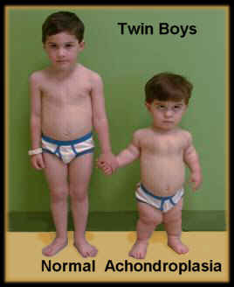
Dominant Traits
does NOT skip generations.
Can inherit genes from only one parents to display trait
Normally appear with equal frequency in both sexes
Achondroplasia (form of Dwarfism)
Heterozygous genotype (Tt)
Huntington’s disease (Hh)

Slide 24
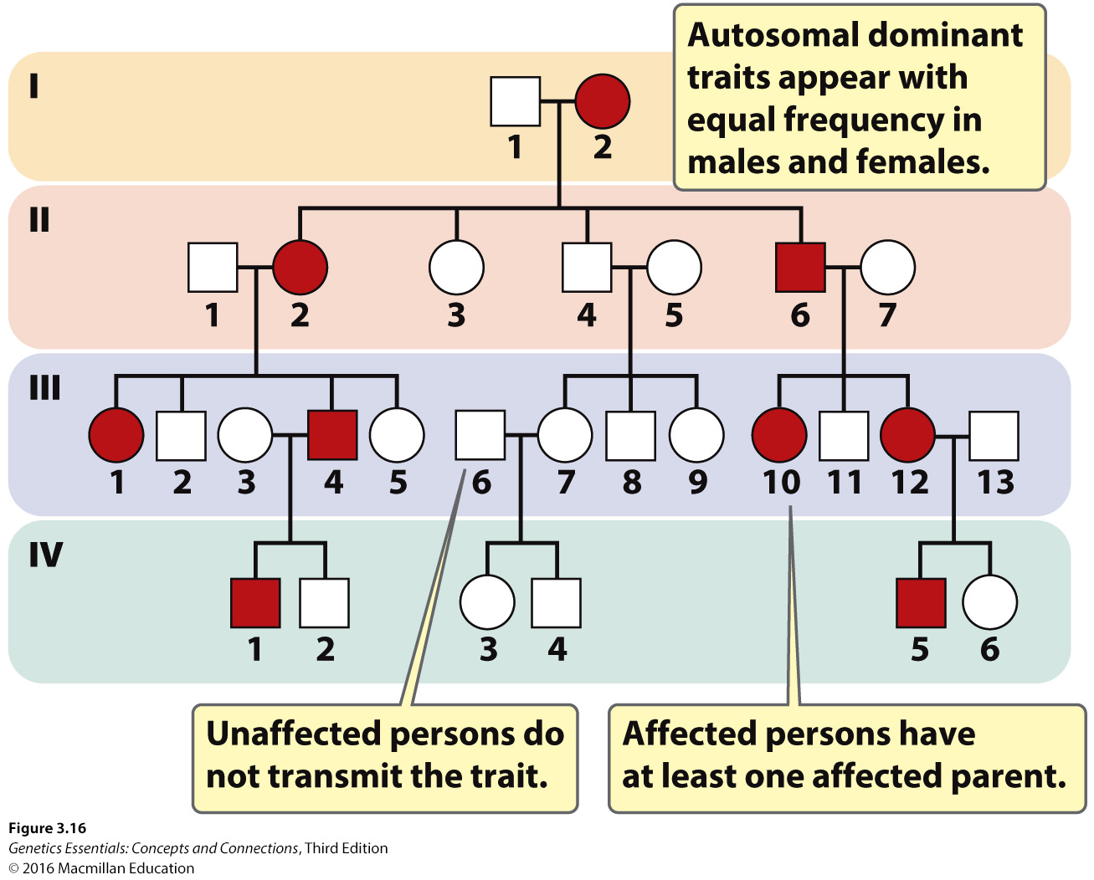

Slide 25
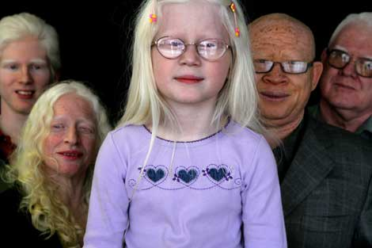
Recessive Traits
Must inherit alleles from both parents to display trait.
Normally appear with equal frequency in both sexes and often skip generations.
Albinism (aa)
Cystic Fibrosis (cc)

Slide 26
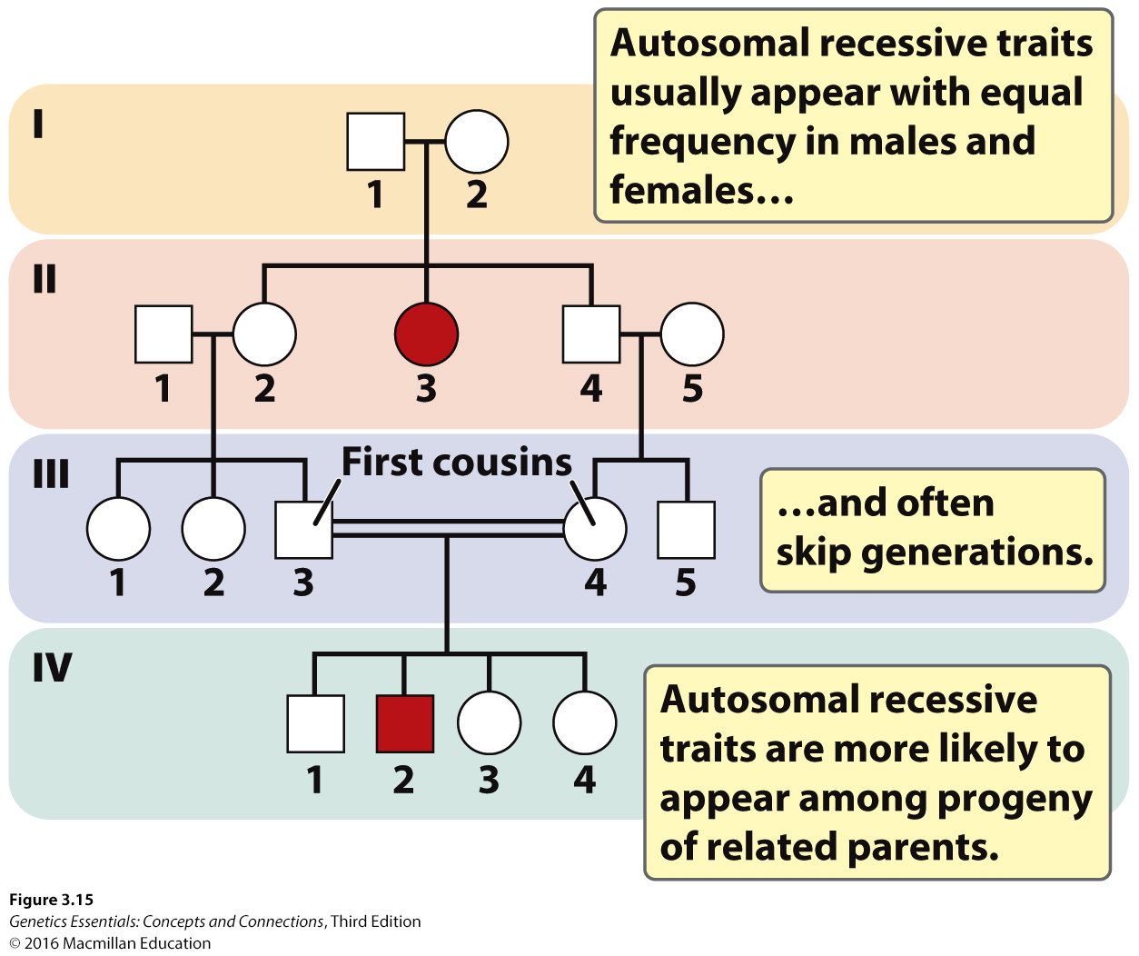
What pattern do you notice about the trait?
skips a generation
What does the double horizontal line mean?
close relatives have children

Slide 27
Recessive Traits
Recessive traits often appear in pedigrees when two people within the same family have children together
a. tend to skip generations.
b. appear only when both parents carry a copy of the allele for the trait, which is more likely when the parents are related.
c. usually arise in children born to parents who are unaffected.
d. appear equally in males and females
e. if the allele is rare, most outsiders are HO dominant
Notes:
"When a recessive trait is rare, most people outside the family are homozygous for the normal allele. Thus, when an affected person mates with someone outside the family (aa × AA), usually none of the children will display the trait, although all will be carriers (i.e., heterozygous)."

Slide 28
X-linked Recessive Pedigree
x-linked recessive is passed from carrier/affected mother to son
affected man will have affected grandson, through is daughters, but will not pass it to his own sons
expression alternates between sexes among generations
males are more likely to be affected

Slide 29
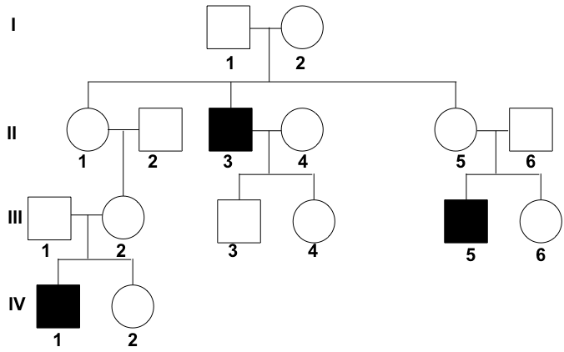
X-linked Recessive Diseases and Pedigree

Slide 30
In pedigree analysis, consanguinity refers to:
mating between two closely related parents
cousins usually

Slide 31
In a germ-line cell from a human male that is dividing, when do the X and Y chromosomes segregate?
In humans, occasionally a baby is found that has the XX chromosomal karyotype but is phenotypically male. Which of the following statements might be a CORRECT explanation for at least some of these unusual cases?

Slide 32
Red-green color blindness is an X-linked recessive disorder. Betty has normal vision, but her mother is color-blind. Bill is color-blind. If Bill and Betty marry and have a child together, what is the chance that the child will be color-blind?

Slide 33
Early french geneticist, Cuenot, was trying to reproduce Mendels ratios for a monohygrid cross in a mouse model. It looked like he had the correct ratio if the yellow coat allele (Y) was dominant to the gray allele (y). One thing bothered him. He could never get a pure-breeding line of yellow mice (YY).
Why was Cuenot unable to produce a pure-breeding line of yellow mice?
Cuenot's yellow mice were crossed (Yy x Yy). What faction of the resulting offspring were gray? Don't forget that individuals with YY genotypes do not survive.

Slide 34
Proteins M and N express themselves equal on the surface of red blood cells in humans. Because both alleles are expressed equally the alleles are said to be
codominant

Slide 35
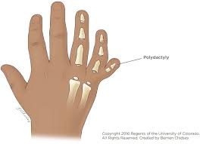
incomplete penetrance - A case in which individuals with a particular genotype do not always express the expected phenotype.
Polydactyly
38/42=0.90
90% penetrance

