Slide 1
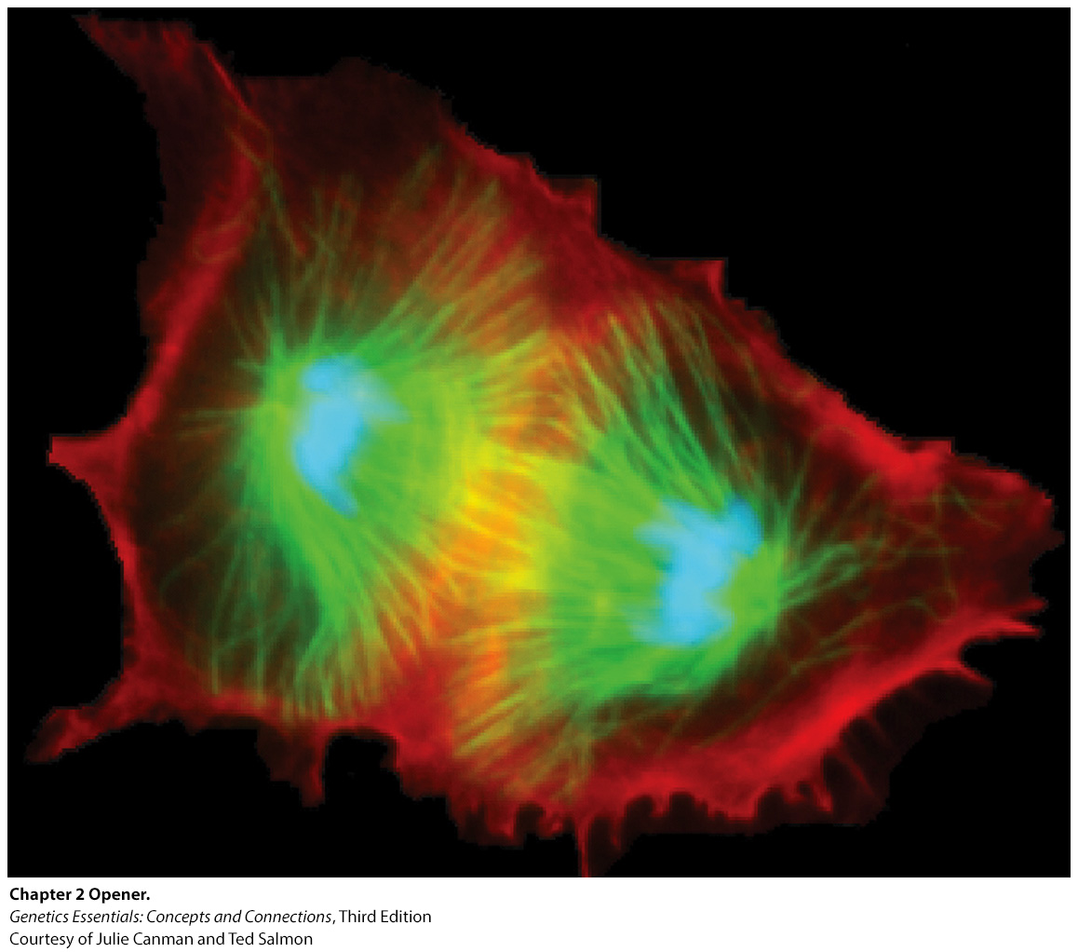
Chromosomes & The Cell Cycle

Slide 2
Goals
Learn how cells generate copies of themselves
Learn how DNA is copied exactly and distributed equally during cell replication

Slide 3
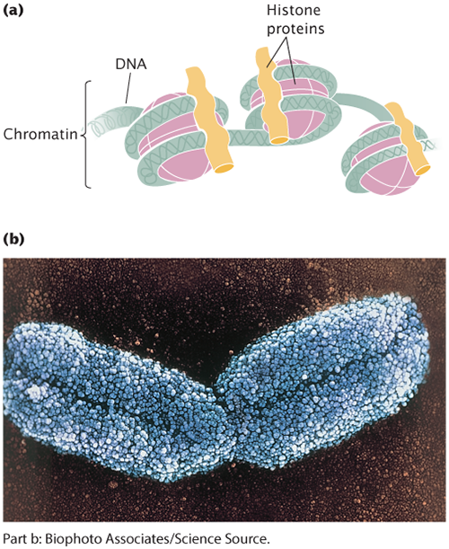
What is a Chromosome
Chromosome
DNA molecule with part or all of the genetic material of an organism.
DNA
double stranded nucleic acid molecule made of nucleotides

Slide 4
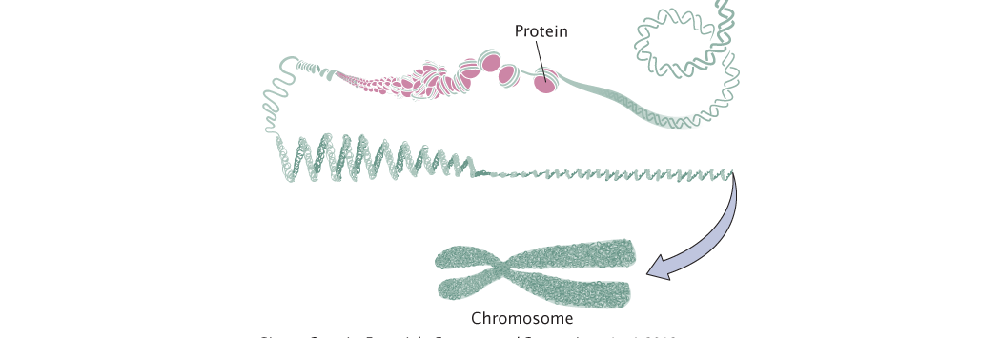
How is there so much DNA packed in there?
Histones
In Eukaryotes – DNA is packed and organized by proteins called histones
Chromatin
DNA plus associated histone proteins found in eukaryote nucleus

Slide 5
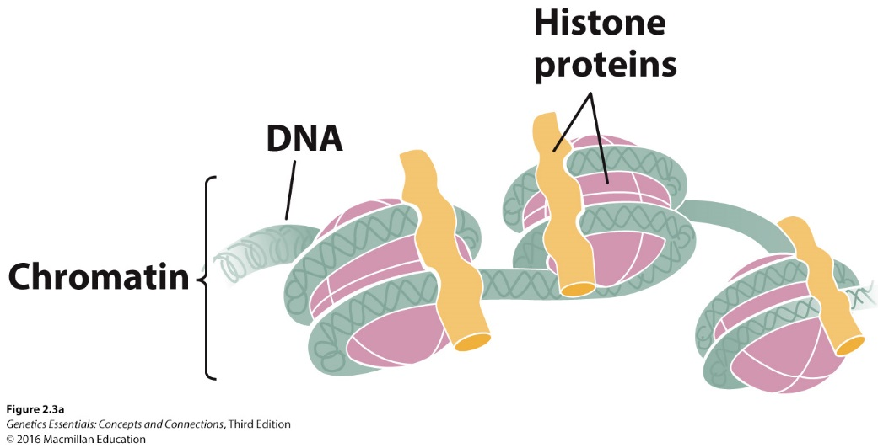
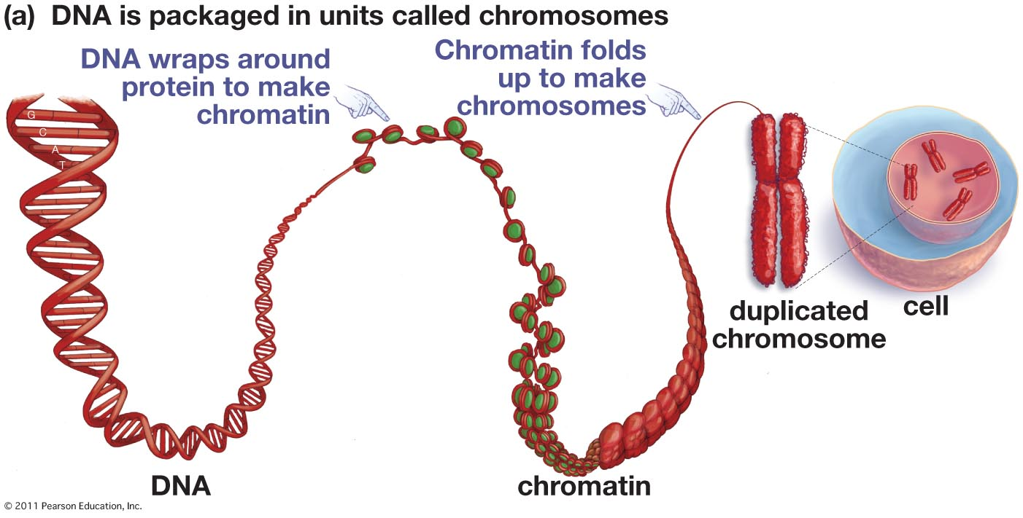
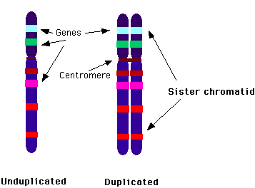
Chromatin to Chromosomes
Notes:
Histones – proteins that helps organize DNA into Chromatin

Slide 6
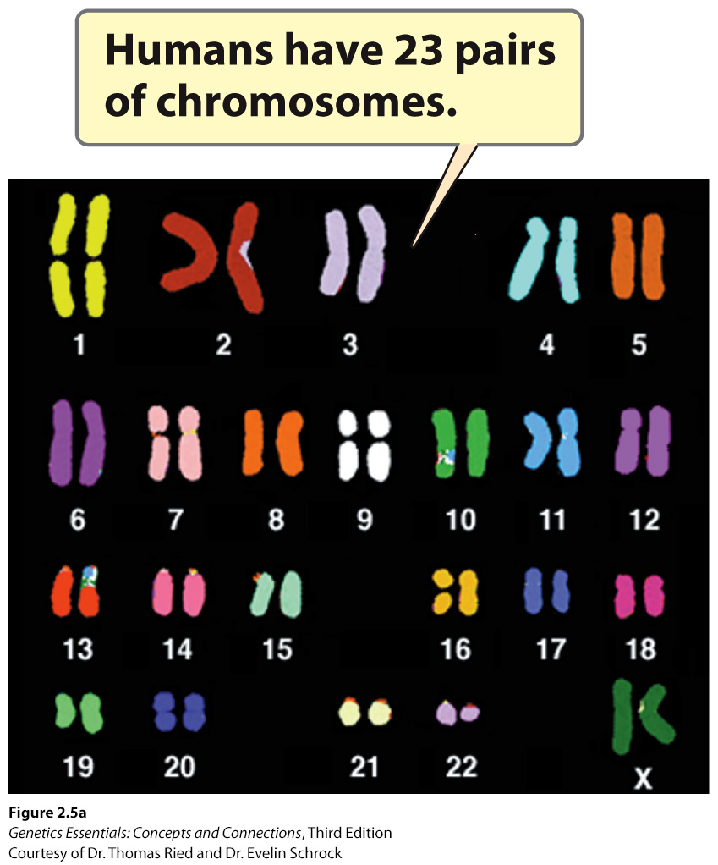
Diploid vs Haploid Cells
Diploid (2n) cells carry two sets of chromosomes.
Humans = 2n = 2(23) = 46
Examples = somatic cells = skin, muscle, etc
Two full copies of the organism’s genes.
Haploid (n) cells carry one set of chromosomes.
one full copy of the organism’s genes
Humans: n = 23
Examples: sex cells = sperm & egg
Notes:
Diploid (2n) cells carry two sets of chromosomes.
Humans = 2n = 2(23) = 46
Examples = somatic cells = skin, muscle, etc
Two full copies of the organisms genes and accessory DNA...
Haploid (n) cells carry one set of chromosomes.
one full copy of the organism’s genes
Humans: n = 23
Examples: sex cells = sperm & egg

Slide 7
Homologous Chromosomes
Blood Type Gene
Type A Type O
What is the third allele for blood type?
Can a person have all three blood types?
Notes:
Homologous Chromosomes
Two chromosomes that are alike in structure and size
carry genetic information for the same set of hereditary characteristics.
One chromosome from female, the other from the male parent
Example - Each of us has two copies of the gene for blood type on chromosome pair number 9. One copy is inherited from our mother, the other from our father. There are three versions (called “alleles”) of this gene: A, B, and O. A person's blood type is determined by which allele he/she inherits from each parent
alleles – two forms of a gene

Slide 8
Chromosome Structure
Notes:
Before cell div. chromosomes double
Chromatids are the identical DNA molecules, each arm is connected by a sister chromatid
Centromere: connects the constricted region, attachment point for spindle microtubules during cell division
handle

Slide 9
Chromosome Structure
Telomeres: tips of a linear chromosome
Like cap of shoe laces
Protect chromosome ends during DNA replication
Kinetochore: protein complex that forms at the centromere during cell division

Slide 10
Concept Check
Diploid cells have
two chromosomes.
two sets of chromosomes.
one set of chromosomes.
two pairs of homologous chromosomes.

Slide 11
Concept Check
What are homologous chromosomes?
Two chromosomes that are alike in structure and size
carry genetic information for the same set of hereditary characteristics.
One chromosome from female, the other from the male parent

Slide 12
The Cell Cycle Overview

Slide 13
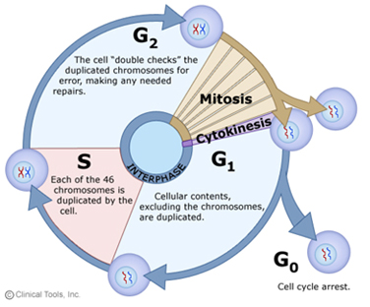
The Cell Life Cycle
Stages cells go thru during one generation, one division to the next.
Parent ell → daughter cells
Includes two major stages:
Interphase
G1
S
G2
G0
M phase
mitosis
cytokinesis
Notes:
Includes two major stages:
Interphase (G1, S, G2)
Cell grows
Carries out metabolic processes
M Phase (Mitosis + Cytokinesis)
sister chromatids separate
cell physically divides in half

Slide 14
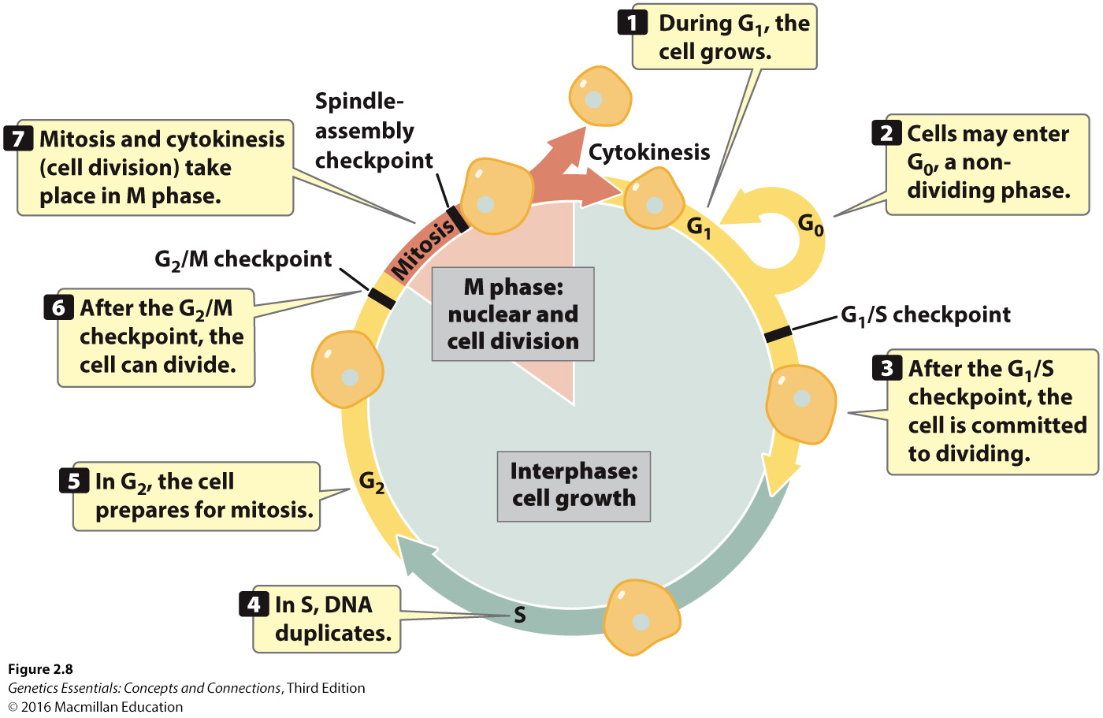
Notes:
Figure 2.9 The cell cycle consists of interphase and M phase.

Slide 15
Events and checkpoints: Interphase
Begins after a parent cell has divided into daughter cells.
G₁ = Gap 1, Growth
Growth, proteins, & organelles duplicate
G₁/S checkpoint: checks for size & proteins for DNA replication, cell commits to division
G₀: non-dividing phase, cell maintains size & metabolic activities)
S = Synthesis, DNA Replication
Chromosomes are copied, but not visible. Two sister chromatids/chromosome
G₂ = Gap 2, Growth
Makes proteins for M-phase
G₂/M checkpoint: checks DNA replication proteins & that DNA is undamaged
Notes:
G₁ = Gap 1, Growth
Growth, proteins, & organelles duplicate
G₁/S checkpoint: checks for size & proteins for DNA replication, cell commits to division
G₀: non-dividing phase, cell maintains size & metabolic activities)
S = Synthesis, DNA Replication
Chromosomes are copied, but not visible. Two sister chromatids/ chromosome
G₂ = Gap 2, Growth
Makes proteins for M-phase
G₂/M checkpoint: checks DNA replication proteins & that DNA is undamaged

Slide 16
M Phase / Cell Division Major events
Mitosis
Cytokinesis
Notes:
Mitosis –
Chromosomes separate
division of the nucleus
Results in the formation of two daughter nuclei
Cytokinesis - division of the cytoplasm
Begins when mitosis is near completion
Results in the formation of two daughter cells

Slide 17
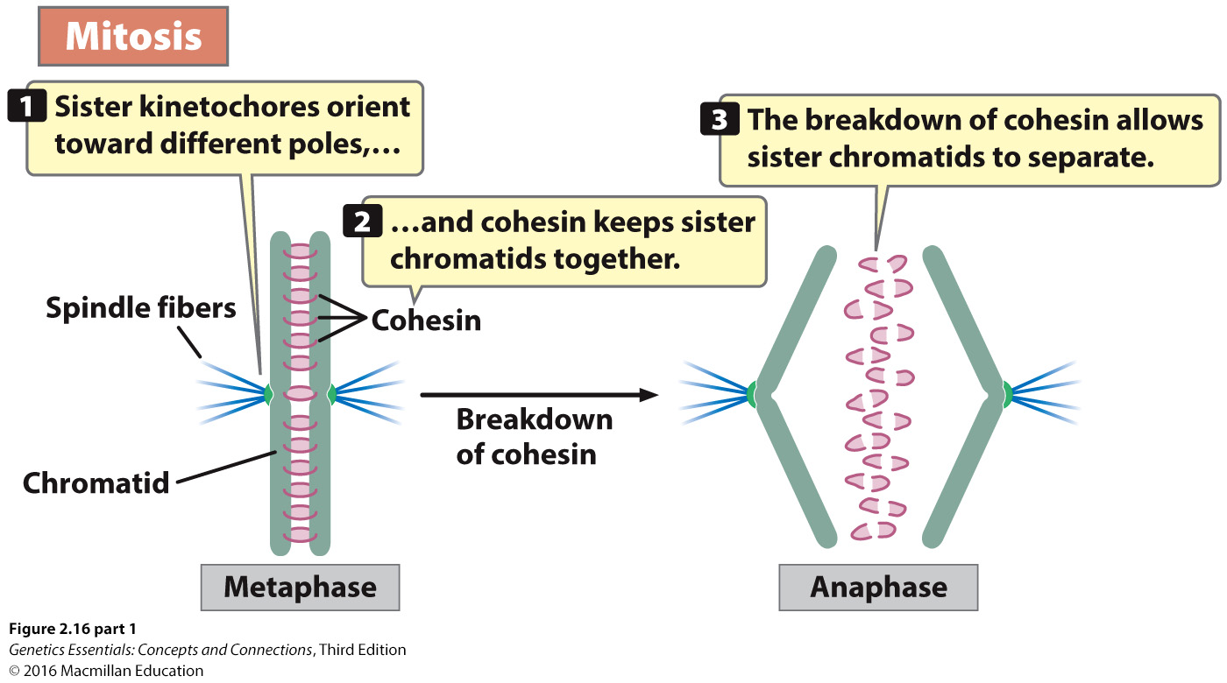

Slide 18
Cell Division Overview

Slide 19
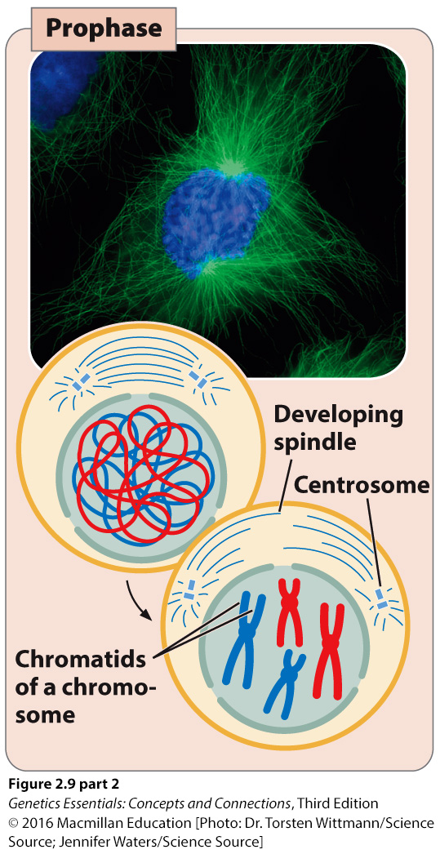
Prophase
Notes:
Centrosome move to opposite sides of the cell
Mitotic spindle begins to form
DNA is already doubled, but condenses = visible, X-shaped
Each arm = sister chromatid = chromosome copy

Slide 20
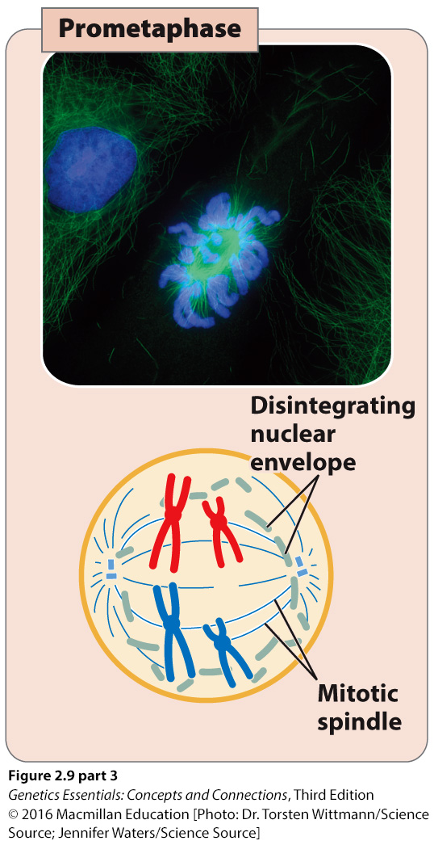
Prometaphase
Notes:
Nuclear membrane breaks down
chromosomes are free
Mitotic spindles grow from centrosome into the nuclear region
Spindle microtubules attach to chromosome kinetochore & stabilize
Kinetochore has microtubule on each side
Each sister chromatid has a spindle attached

Slide 21
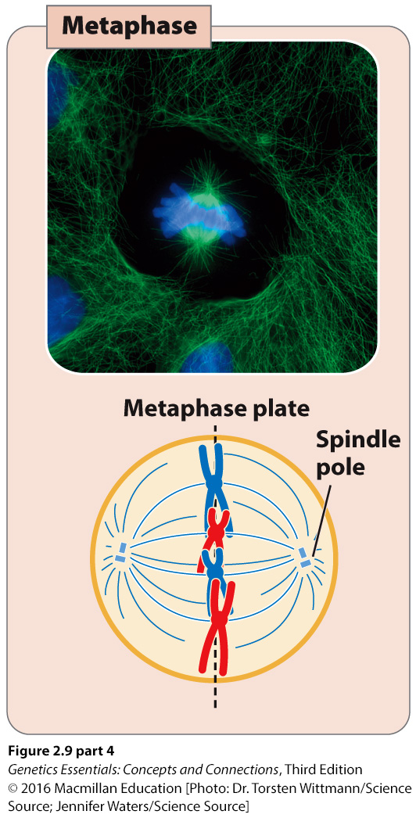
Metaphase
Notes:
Chromosomes line up in the center of the cell on the metaphase plate
Each sister chromatid is directed toward a centrosome.
Cohesin protein holds sister chromatids together.
Spindle-assembly checkpoint: ensures each chromosome is aligned correctly on the metaphase plate.

Slide 22
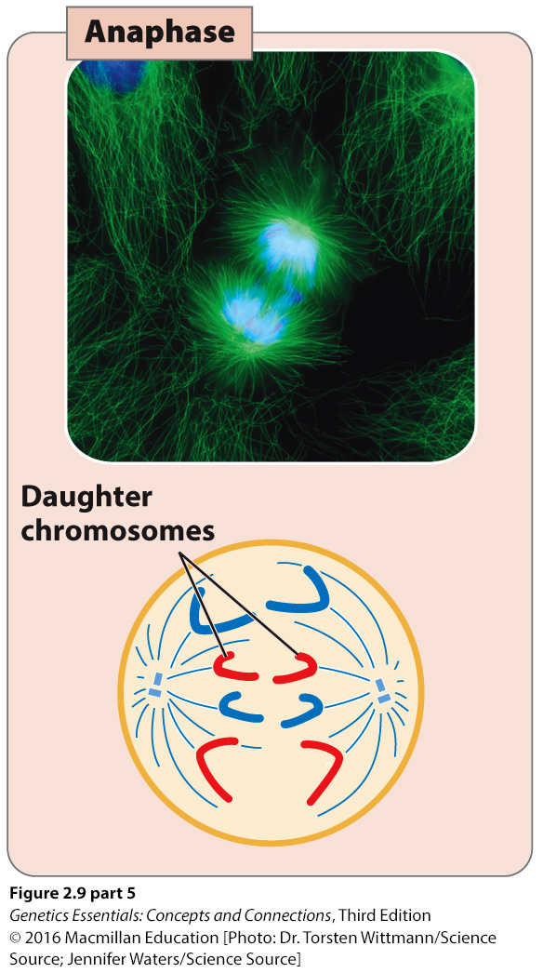
Anaphase
Notes:
Sister chromatids separate.
Separase, an enzyme breaks the cohesin proteins.
spindle microtubules pull each sister chromatid is pulled toward the centrosome
Cell begins to elongate
Directed by mitotic spindle growth

Slide 23
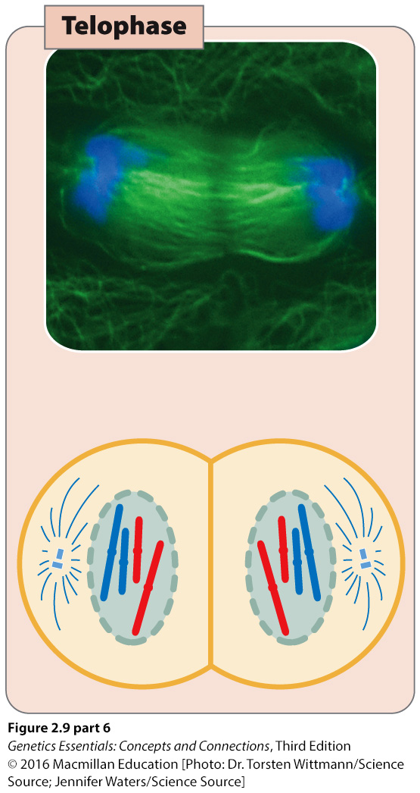
Telophase & Cytokinesis
Notes:
Chromosomes arrive at the centrosome poles.
Chromosomes uncoil
Not in X shape
Nuclear membrane reforms around the DNA
Spindles break down and disappear
A cleavage furrow forms to pinch the cells into two
Plasma membrane around each cell

Slide 24
Outcome of Mitosis
Parent cell produces two daughter cells
Genetically identical to each other and with the cell that gave rise to them.
Newly formed cells contain a full complement of chromosomes.
2n chromosomes → 2n chromosomes
Each newly formed cell contains approximately half the cytoplasm and organelle content of the original parental cell.

Slide 25
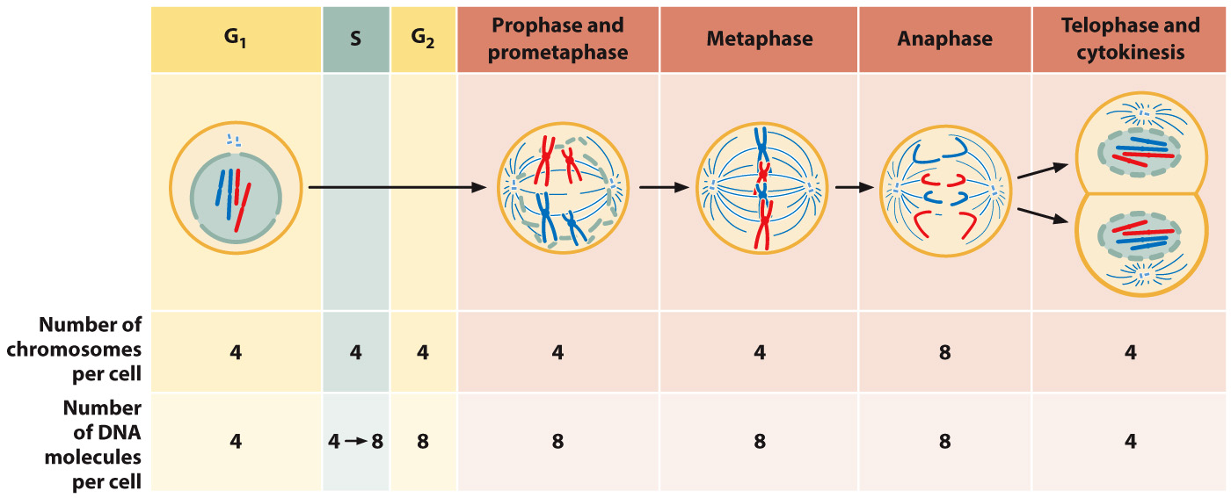
Notes:
Figure 2.13. Meiosis includes two cell divisions.

Slide 26
Microtubules
https://www.youtube.com/watch?v=FzcTgrxMzZk

