Slide 1
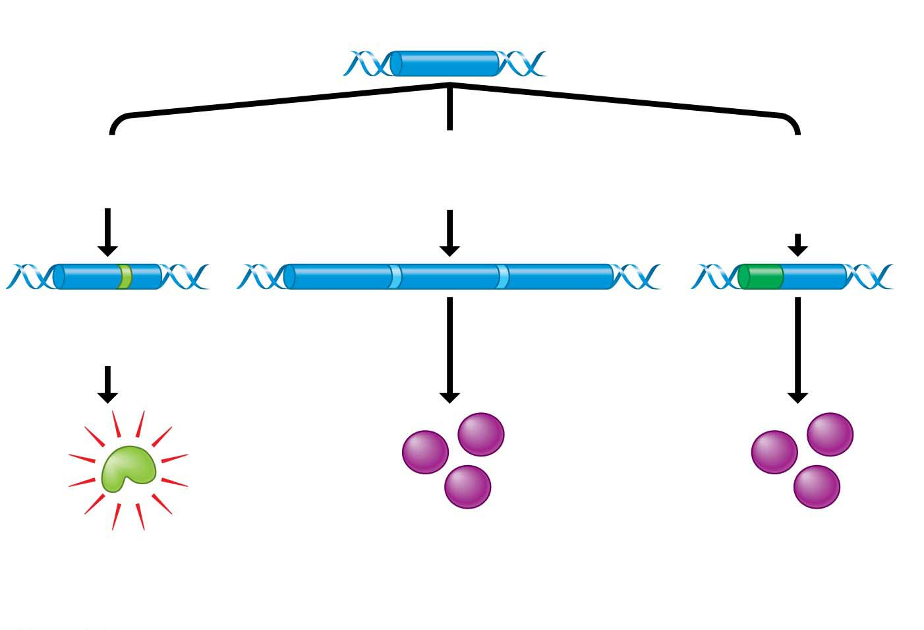
Figure 11.16
Proto-oncogene
DNA
Mutation within
the gene
Multiple copies
of the gene
Gene moved to
new DNA position,
under new controls
Oncogene
New promoter
Hyperactive
growth-stimulating
protein
Normal growth-stimulating
protein in excess
Notes:
Figure 11.16 How a proto-oncogene can become an oncogene

Slide 2
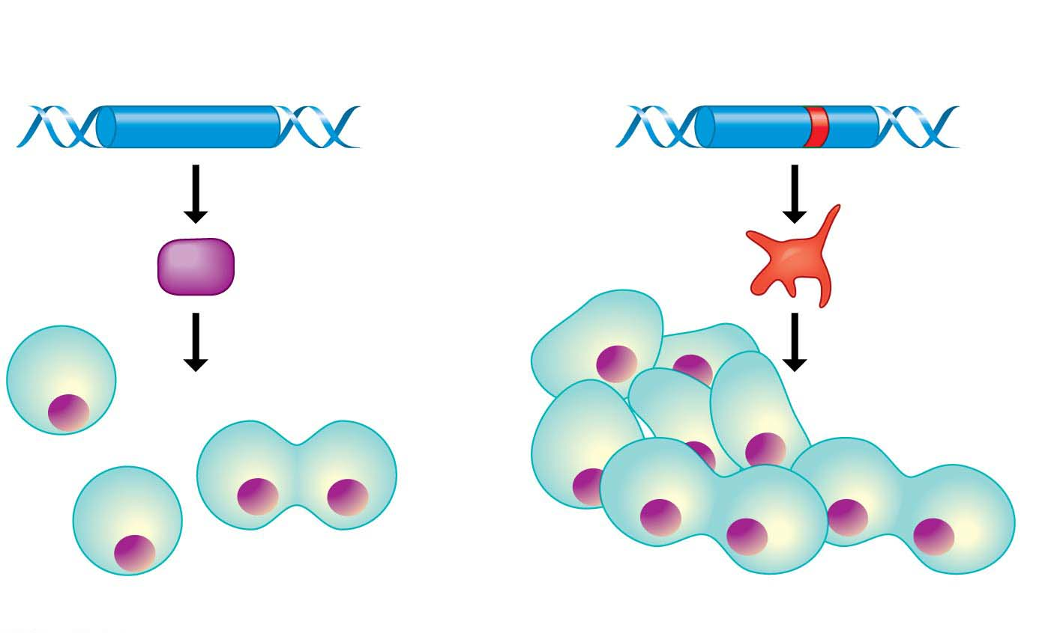
Figure 11.17
Tumor-suppressor gene
Mutated tumor-suppressor gene
Defective,
nonfunctioning
protein
Normal growth-
inhibiting protein
Cell division
under control
Cell division not
under control
(a) Normal cell growth
(b) Uncontrolled cell growth (cancer)
Notes:
Figure 11.17 Tumor-suppressor genes

Slide 3

Ch12 pdf DNA Technology
Biol12
11.13.18
Notes:
Student Misconceptions and Concerns
1. Television programs might lead some students to expect that DNA profiling is quick and easy. Ask students to consider why DNA profiling actually takes many days or weeks to complete.
2. Students might expect DNA profiling for criminal investigations to involve an analysis of the entire human genome. Consider explaining why such an analysis is unrealistic and unnecessary.
3. The many forms of DNA technology discussed in this chapter provide powerful evidence of evolution. Although not addressed regularly in this chapter, consider reminding students that these techniques continue to reinforce and inform our understandings of the common descent of life on Earth.
Teaching Tips
1. Although the statistical odds of a DNA-profiling match can exceed one in 10 billion, the odds of a mistake in the collecting and testing procedures can be much greater. This is an important distinction. An error as simple as mislabeling a sample can confuse the results. Unfortunately, the odds of human error will vary and are difficult to determine.
2. In PCR, the product becomes another master copy. Imagine that while you are photocopying, every copy is used as a master at another copy machine. (This would require many copy machines.)
3. Students might need a little more practice understanding the products of restriction enzymes. Consider the two words, equilibrium and equalibrium. Imagine that a mutation produced the spelling error in the second word. If we used a “restriction enzyme” that splits these words between “u” and “i,” how will the fragments compare in size and number?
equilibrium = equ ilibri um (three fragments of three, six, and two letters)
equalibrium = equalibri um (two fragments of nine and two letters)
Active Lecture Tips
1. In most legal cases, the probability of two people having identical DNA profiles can be one in 10 billion or more. However, eyewitness testimony has been a standard part of the justice system. If you want to make the point about the unreliability of eyewitnesses in a trial, compared to techniques such as genetic profiling, consider this exercise. Arrange for a person who is not well known to the class to run into your classroom, take something you have placed near you (perhaps a bag, stack of papers, box), and leave quickly. You need to take care that no one in the class is so alarmed as to do something dangerous. Once the “thief” is gone, tell the class that this was planned but not to speak. Have them each write a description of the person, including height, hair color, clothing, facial hair, behavior, and so on. Many students will be accurate, but some will likely get details wrong. This is also an effective exercise to demonstrate the need for large sample sizes and accurate recording devices for good scientific technique.

Slide 4
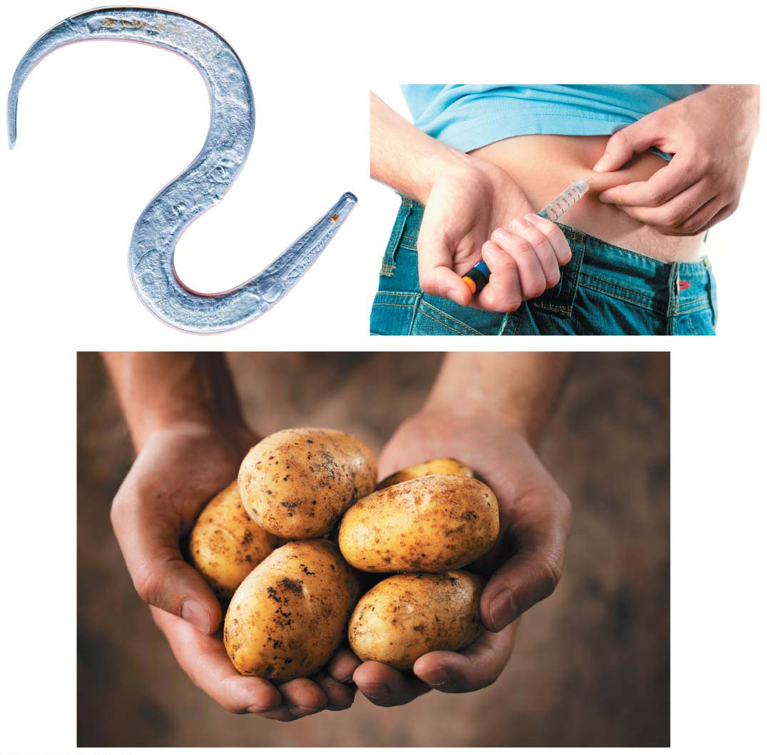
Why DNA Technology Matters
Notes:
Genetically modified potatoes prevent children from dying of cholera
You have the same number of genes as this worm (C. elegans).
Millions of people in industrialized nations can live longer lives because of human insulin made by bacteria.

Slide 5
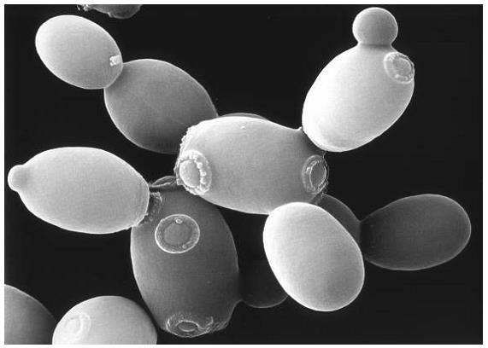
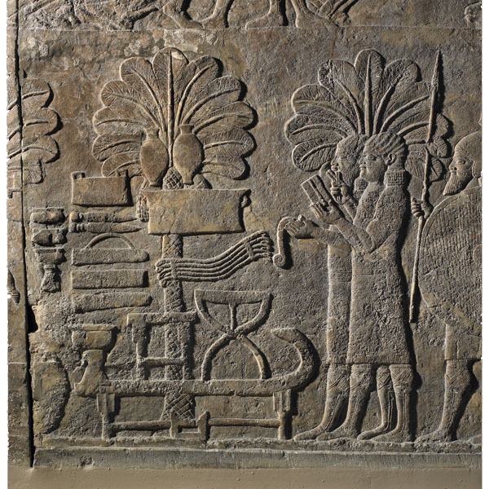
Early Genetic Manipulation
  dates back to the dawn of civilization
    yeast to make bread and beer and selectively bred livestock.
    Date palms - one of the oldest domesticated plants
    selective breeding 8000 years ago by humans
Saccharomyces cerevisiae
Notes:
5
There is archaeological evidence of date cultivation in Arabia from the 6th millennium BCE.

Slide 6

Biotechnology
Biotechnology today means the use of DNA technology, modern laboratory techniques for studying and manipulating genetic material.
  the manipulation of organisms to make useful products
Notes:
6
Student Misconceptions and Concerns
1. Student comprehension of restriction enzymes and many other aspects of recombinant DNA techniques depends upon a comfortable understanding of basic molecular genetics. Consider addressing Chapter 12 after an exam that addresses the content in Chapters 10 and 11.
2. The genetic engineering of organisms can be controversial, creating various degrees of social unease and resistance. Yet many debates about scientific issues are confused by misinformation. This provides an opportunity for you to ask students to research an issue before taking firm positions. Students might debate whether a food or drug made from GM/transgenic organisms should be labeled as such, or discuss the risks and advantages of producing GM organisms. Consider starting class with a headline addressing one of these issues. The recent process of FDA approval for raising genetically engineered salmon (AquAdvantage) for food might be particularly useful and relevant.
3. The fact that the technologies described in this chapter can be used to swap genes between prokaryotes and eukaryotes reveals the fundamental similarities in genetic mechanisms shared by all forms of life. This very strong evidence of common descent is evidence of evolution that may be missed by your students.
4. Using gene therapy to “fix” genetic problems relies on a thorough understanding of the roles of genes and alleles. Students might benefit from a discussion of the extent to which we as a society might want to consider directing our own genetics.
Teaching Tips
1. Annual flu vaccinations are a common example of using vaccines to prevent diseases that cannot be easily cured. However, students might not understand why many people receive the vaccine every year. A new annual vaccine is necessary because the flu viruses keep evolving.
2. The origin of the name “restriction enzymes” may be of interest. In nature, these enzymes protect bacterial cells against foreign DNA. Thus, these enzymes “restrict” the invasion of foreign genetic material.
3. Students might think you are just making a bad joke by noting that laboratory synthesized genes are “designer genes,” but this is a common term. Search the Internet using the keywords “designer genes,” and many scientific (and unscientific) sites will be found.
4. Separating marker ink using paper chromatography is a simple experiment that approximates some of what occurs in gel electrophoresis. Consider doing this as a class demonstration while addressing electrophoresis. Cut a large piece of filter paper into a rectangle or square. Use markers to color large dots about 2 cm away from the edge of the paper. Separate the dots from each other by 3–4 cm. Place the paper on edge, dots down, into a beaker containing about 1 cm of ethanol or isopropyl alcohol (50% or higher will do). The dots should not be in contact with the pool of alcohol in the bottom of the beaker. As the alcohol is drawn up the filter paper by capillary action, the alcohol will dissolve the ink dots. As the alcohol continues up the paper, the ink follows. Not all of the ink components move at the same speed, based on their size and chemical properties. If you begin the process at the start of class, you should have some degree of separation by the end of a 50-minute period. Experiment with the technique a day or two before class to fine-tune the demonstration, and experiment with different types of ink. (Save and air-dry these samples for your class.) Consider using brown, green, and black markers, as these colors are often made by color combinations.
5. Roundup Ready Corn, a product of Monsanto, is resistant to the herbicide Roundup. The general strategy for farmers is to spray fields of Roundup Ready Corn with the herbicide Roundup, killing weeds but not the corn. A search of the Internet will quickly reveal the controversy associated with this and other genetically modified organisms (GMOs), which can encourage interesting discussions and promote critical thinking skills.
6. As gene therapy technology expands, our ability to modify the genome in human embryos through in vitro fertilization permits genetic modification at the earliest stages of life. Future generations of humans, like our crops today, may include those with and without a genetically modified ancestry. The benefits and challenges of these technologies raise issues many students have never considered. Our students, and the generations soon to follow, may face the potential of directed human evolution.
7. Ethical, legal, and social issues related to the Human Genome Project are directly addressed at the Department of Energy Human Genome website at http://web.ornl.gov/sci/techresources/Human_Genome/elsi/index.shtml.
8. The Biology and Society end-of-chapter textbook questions address some of the issues raised in this chapter section.
Active Lecture Tips
1. As you begin to address genetic engineering and GMO foods, ask students to work in small groups to discuss what they know about genetically engineered food. Have each group create a list of statements that can be short or long, reflecting their impressions of the technology. The results may surprise you and help you address some common misunderstandings and concerns.
2. If you have already addressed basic transcription and translation in your course, consider asking small groups of students in your class to explain the following. DNA technology is primarily used to produce proteins. Why aren’t lipids and carbohydrates typically produced by these processes?

Slide 7
Genetic Engineering
Using the methods of DNA technology, scientists can modify specific genes and move them between organisms as different as bacteria, plants, and animals.
  Organisms that have acquired one or more genes by artificial means are called genetically modified (GM) organisms.
  If the newly acquired gene is from another organism, typically of another species, the recombinant organism is called a transgenic organism.
Notes:
7

Slide 8
Genetic Engineering
Scientists construct recombinant DNA by combining pieces of DNA from two different sources—often from different species—to form a single DNA molecule.
Recombinant DNA technology is widely used in genetic engineering, the direct manipulation of genes for practical purposes.
Notes:
8

Slide 9
Genetic Engineering
Scientists have
  genetically engineered bacteria to mass-produce a variety of useful chemicals, from cancer drugs to pesticides, and
  transferred genes from bacteria to plants and from one animal species to another.
Notes:
9

Slide 10
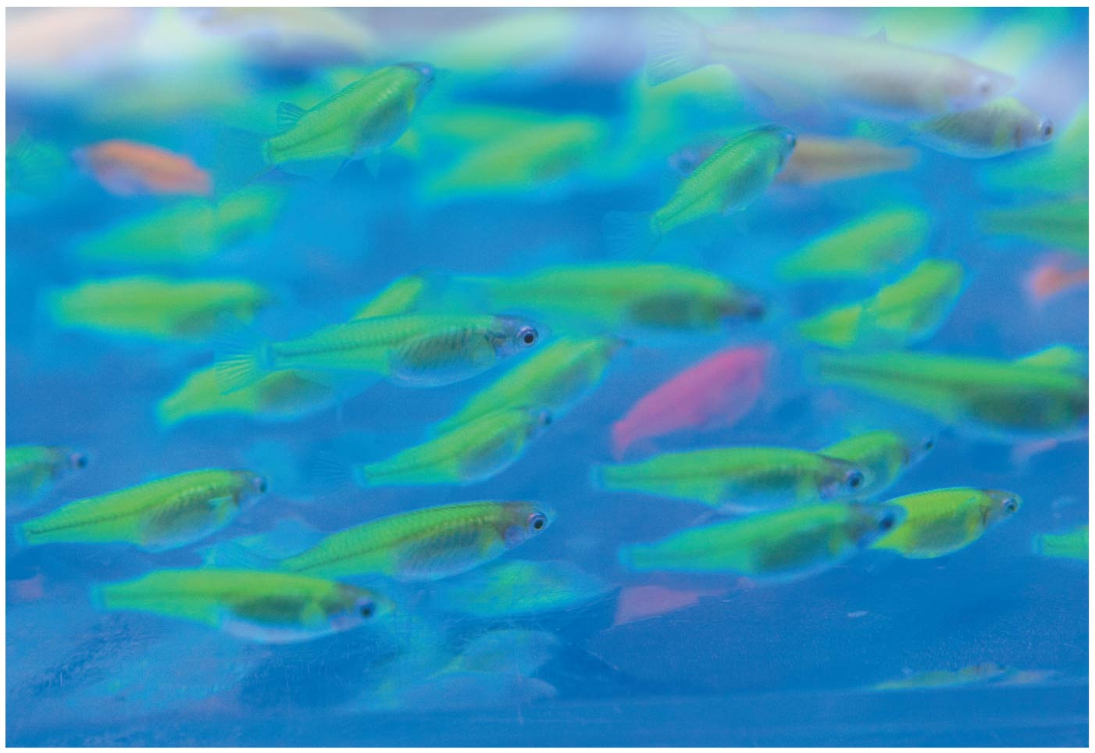
Glowing fish produced by transferring a gene for a fluorescent protein from jellyfish
Let’s go look at some fluorescent fish

Slide 11
Genetically Modified Fish
Original GloFish - zebrafish (Danio rerio) is a native of rivers in India and Bangladesh.
Why make fish glow?
To study environmental toxins
Scientists at the National University of Singapore were working with a gene that encodes the green fluorescent protein (GFP),
GFP - originally extracted from a jellyfish & naturally produces bright green fluorescence.
‘Inserted’ the gene into a zebrafish embryo
  Reproductive cloning
fish fluoresce under both natural white light and ultraviolet light.
Fish that could detect pollution by selectively fluorescing in the presence of environmental toxins.

Slide 12
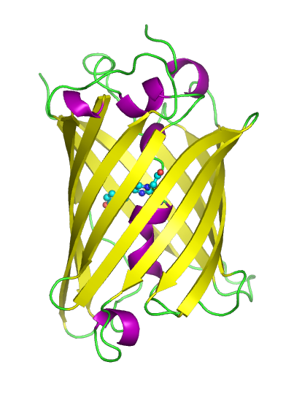
Reporter Genes
In cell and molecular biology, the GFP gene is frequently used as a reporter of expression
green fluorescent protein (GFP) – is a gene indicator that allows researches to know that other genes of interest are being expressed
What does it mean for a gene to be expressed?
Notes:
GFP has been expressed in many species, including bacteria, yeasts, fungi, fish and mammals, including in human cells.
Scientists Roger Y. Tsien, Osamu Shimomura, and Martin Chalfie were awarded the 2008 Nobel Prize in Chemistry on 10 October 2008 for their discovery and development of the green fluorescent protein.

Slide 13
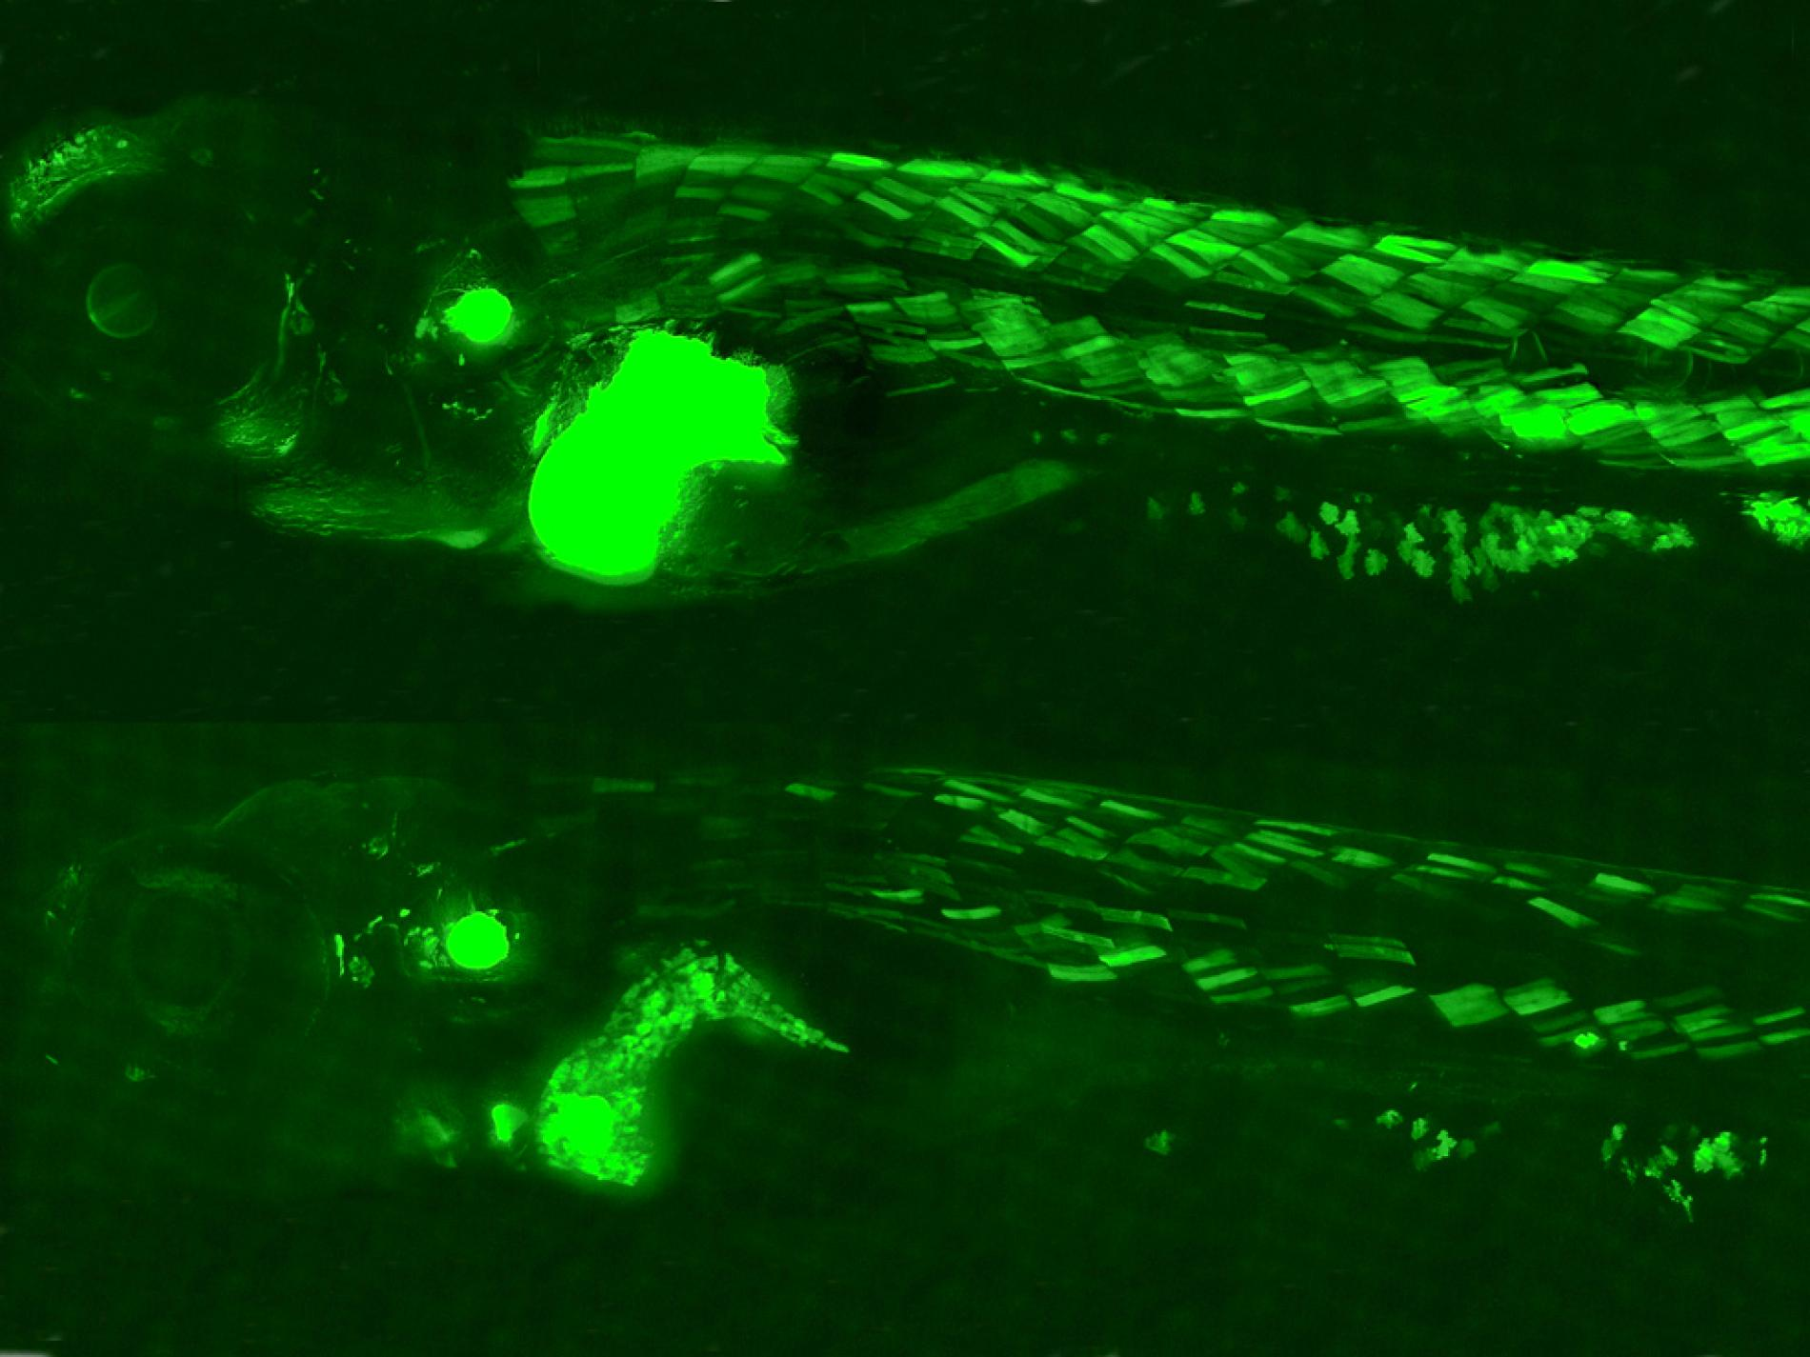
Endocrine Toxin Indicator
GFP is expressed when the toxin is processed in the fish organ
Notes:
https://news.nationalgeographic.com/news/2012/04/120423-fish-glowing-pollution-bpa-environment-science/

Slide 14
Genetically Modified Fish
Glowing fish at Chaffey’s Zimmermann Hall –
colored tetra (Gymnocorymbus ternetzi) – no stripe
Tiger barb (Puntius tetrazona) – strong black stripe
The constantly expressing fish was developed in the process of developing the indicator fish
It is sold only in the United States, where it remains the only genetically modified animal to be publicly available

Slide 15
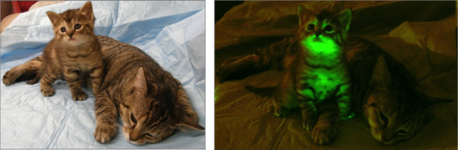
Glow Cats in class Exercise

Slide 16
Recombinant DNA Techniques
Bacteria are the workhorses of modern biotechnology.
To manipulate genes in the laboratory, biologists often use bacterial plasmids, which are small, circular DNA molecules that duplicate separately from the larger bacterial chromosome.
Notes:
16
Student Misconceptions and Concerns
1. Student comprehension of restriction enzymes and many other aspects of recombinant DNA techniques depends upon a comfortable understanding of basic molecular genetics. Consider addressing Chapter 12 after an exam that addresses the content in Chapters 10 and 11.
2. The genetic engineering of organisms can be controversial, creating various degrees of social unease and resistance. Yet many debates about scientific issues are confused by misinformation. This provides an opportunity for you to ask students to research an issue before taking firm positions. Students might debate whether a food or drug made from GM/transgenic organisms should be labeled as such, or discuss the risks and advantages of producing GM organisms. Consider starting class with a headline addressing one of these issues. The recent process of FDA approval for raising genetically engineered salmon (AquAdvantage) for food might be particularly useful and relevant.
3. The fact that the technologies described in this chapter can be used to swap genes between prokaryotes and eukaryotes reveals the fundamental similarities in genetic mechanisms shared by all forms of life. This very strong evidence of common descent is evidence of evolution that may be missed by your students.
4. Using gene therapy to “fix” genetic problems relies on a thorough understanding of the roles of genes and alleles. Students might benefit from a discussion of the extent to which we as a society might want to consider directing our own genetics.
Teaching Tips
1. Annual flu vaccinations are a common example of using vaccines to prevent diseases that cannot be easily cured. However, students might not understand why many people receive the vaccine every year. A new annual vaccine is necessary because the flu viruses keep evolving.
2. The origin of the name “restriction enzymes” may be of interest. In nature, these enzymes protect bacterial cells against foreign DNA. Thus, these enzymes “restrict” the invasion of foreign genetic material.
3. Students might think you are just making a bad joke by noting that laboratory synthesized genes are “designer genes,” but this is a common term. Search the Internet using the keywords “designer genes,” and many scientific (and unscientific) sites will be found.
4. Separating marker ink using paper chromatography is a simple experiment that approximates some of what occurs in gel electrophoresis. Consider doing this as a class demonstration while addressing electrophoresis. Cut a large piece of filter paper into a rectangle or square. Use markers to color large dots about 2 cm away from the edge of the paper. Separate the dots from each other by 3–4 cm. Place the paper on edge, dots down, into a beaker containing about 1 cm of ethanol or isopropyl alcohol (50% or higher will do). The dots should not be in contact with the pool of alcohol in the bottom of the beaker. As the alcohol is drawn up the filter paper by capillary action, the alcohol will dissolve the ink dots. As the alcohol continues up the paper, the ink follows. Not all of the ink components move at the same speed, based on their size and chemical properties. If you begin the process at the start of class, you should have some degree of separation by the end of a 50-minute period. Experiment with the technique a day or two before class to fine-tune the demonstration, and experiment with different types of ink. (Save and air-dry these samples for your class.) Consider using brown, green, and black markers, as these colors are often made by color combinations.
5. Roundup Ready Corn, a product of Monsanto, is resistant to the herbicide Roundup. The general strategy for farmers is to spray fields of Roundup Ready Corn with the herbicide Roundup, killing weeds but not the corn. A search of the Internet will quickly reveal the controversy associated with this and other genetically modified organisms (GMOs), which can encourage interesting discussions and promote critical thinking skills.
6. As gene therapy technology expands, our ability to modify the genome in human embryos through in vitro fertilization permits genetic modification at the earliest stages of life. Future generations of humans, like our crops today, may include those with and without a genetically modified ancestry. The benefits and challenges of these technologies raise issues many students have never considered. Our students, and the generations soon to follow, may face the potential of directed human evolution.
7. Ethical, legal, and social issues related to the Human Genome Project are directly addressed at the Department of Energy Human Genome website at http://web.ornl.gov/sci/techresources/Human_Genome/elsi/index.shtml.
8. The Biology and Society end-of-chapter textbook questions address some of the issues raised in this chapter section.
Active Lecture Tips
1. As you begin to address genetic engineering and GMO foods, ask students to work in small groups to discuss what they know about genetically engineered food. Have each group create a list of statements that can be short or long, reflecting their impressions of the technology. The results may surprise you and help you address some common misunderstandings and concerns.
2. If you have already addressed basic transcription and translation in your course, consider asking small groups of students in your class to explain the following. DNA technology is primarily used to produce proteins. Why aren’t lipids and carbohydrates typically produced by these processes?

Slide 17
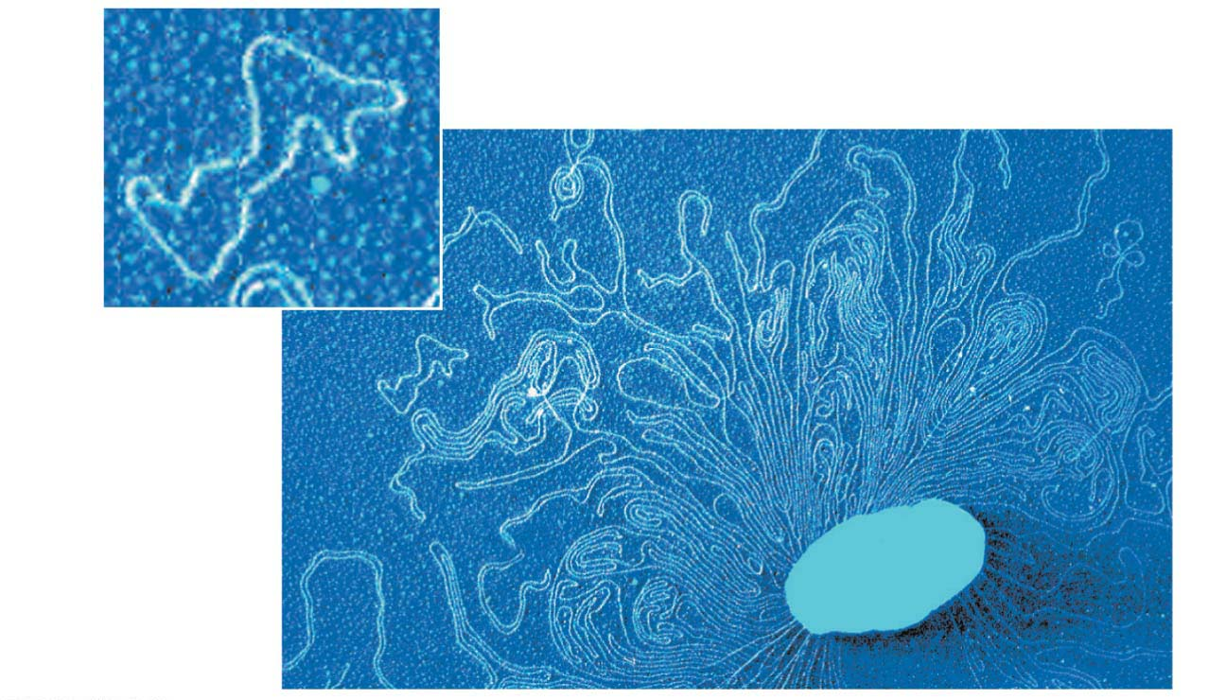
Figure 12.2
Plasmids
Bacterial
chromosome
Remnant of
bacterium
Colorized TEM
Notes:
Figure 12.2 Bacterial plasmids

Slide 18
Recombinant DNA Techniques
Plasmids
  are small, circular DNA molecules that duplicate separately from the larger bacterial chromosome,
  can carry virtually any gene and are passed from one generation of bacteria to the next, and
  are key tools for gene cloning, the production of multiple identical copies of a gene-carrying piece of DNA. Gene cloning methods are central to the production of useful products from genetically engineered organisms.
Notes:
18
Student Misconceptions and Concerns
1. Student comprehension of restriction enzymes and many other aspects of recombinant DNA techniques depends upon a comfortable understanding of basic molecular genetics. Consider addressing Chapter 12 after an exam that addresses the content in Chapters 10 and 11.
2. The genetic engineering of organisms can be controversial, creating various degrees of social unease and resistance. Yet many debates about scientific issues are confused by misinformation. This provides an opportunity for you to ask students to research an issue before taking firm positions. Students might debate whether a food or drug made from GM/transgenic organisms should be labeled as such, or discuss the risks and advantages of producing GM organisms. Consider starting class with a headline addressing one of these issues. The recent process of FDA approval for raising genetically engineered salmon (AquAdvantage) for food might be particularly useful and relevant.
3. The fact that the technologies described in this chapter can be used to swap genes between prokaryotes and eukaryotes reveals the fundamental similarities in genetic mechanisms shared by all forms of life. This very strong evidence of common descent is evidence of evolution that may be missed by your students.
4. Using gene therapy to “fix” genetic problems relies on a thorough understanding of the roles of genes and alleles. Students might benefit from a discussion of the extent to which we as a society might want to consider directing our own genetics.
Teaching Tips
1. Annual flu vaccinations are a common example of using vaccines to prevent diseases that cannot be easily cured. However, students might not understand why many people receive the vaccine every year. A new annual vaccine is necessary because the flu viruses keep evolving.
2. The origin of the name “restriction enzymes” may be of interest. In nature, these enzymes protect bacterial cells against foreign DNA. Thus, these enzymes “restrict” the invasion of foreign genetic material.
3. Students might think you are just making a bad joke by noting that laboratory synthesized genes are “designer genes,” but this is a common term. Search the Internet using the keywords “designer genes,” and many scientific (and unscientific) sites will be found.
4. Separating marker ink using paper chromatography is a simple experiment that approximates some of what occurs in gel electrophoresis. Consider doing this as a class demonstration while addressing electrophoresis. Cut a large piece of filter paper into a rectangle or square. Use markers to color large dots about 2 cm away from the edge of the paper. Separate the dots from each other by 3–4 cm. Place the paper on edge, dots down, into a beaker containing about 1 cm of ethanol or isopropyl alcohol (50% or higher will do). The dots should not be in contact with the pool of alcohol in the bottom of the beaker. As the alcohol is drawn up the filter paper by capillary action, the alcohol will dissolve the ink dots. As the alcohol continues up the paper, the ink follows. Not all of the ink components move at the same speed, based on their size and chemical properties. If you begin the process at the start of class, you should have some degree of separation by the end of a 50-minute period. Experiment with the technique a day or two before class to fine-tune the demonstration, and experiment with different types of ink. (Save and air-dry these samples for your class.) Consider using brown, green, and black markers, as these colors are often made by color combinations.
5. Roundup Ready Corn, a product of Monsanto, is resistant to the herbicide Roundup. The general strategy for farmers is to spray fields of Roundup Ready Corn with the herbicide Roundup, killing weeds but not the corn. A search of the Internet will quickly reveal the controversy associated with this and other genetically modified organisms (GMOs), which can encourage interesting discussions and promote critical thinking skills.
6. As gene therapy technology expands, our ability to modify the genome in human embryos through in vitro fertilization permits genetic modification at the earliest stages of life. Future generations of humans, like our crops today, may include those with and without a genetically modified ancestry. The benefits and challenges of these technologies raise issues many students have never considered. Our students, and the generations soon to follow, may face the potential of directed human evolution.
7. Ethical, legal, and social issues related to the Human Genome Project are directly addressed at the Department of Energy Human Genome website at http://web.ornl.gov/sci/techresources/Human_Genome/elsi/index.shtml.
8. The Biology and Society end-of-chapter textbook questions address some of the issues raised in this chapter section.
Active Lecture Tips
1. As you begin to address genetic engineering and GMO foods, ask students to work in small groups to discuss what they know about genetically engineered food. Have each group create a list of statements that can be short or long, reflecting their impressions of the technology. The results may surprise you and help you address some common misunderstandings and concerns.
2. If you have already addressed basic transcription and translation in your course, consider asking small groups of students in your class to explain the following. DNA technology is primarily used to produce proteins. Why aren’t lipids and carbohydrates typically produced by these processes?

Slide 19
How to Clone a Gene
Consider a typical genetic engineering challenge:
  A genetic engineer at a pharmaceutical company identifies a gene of interest that codes for a valuable protein, such as a potential new drug.
  The biologist wants to manufacture the protein on a large scale.
  Figure 12.3 illustrates a way to accomplish this by using recombinant DNA techniques.
Notes:
19
Student Misconceptions and Concerns
1. Student comprehension of restriction enzymes and many other aspects of recombinant DNA techniques depends upon a comfortable understanding of basic molecular genetics. Consider addressing Chapter 12 after an exam that addresses the content in Chapters 10 and 11.
2. The genetic engineering of organisms can be controversial, creating various degrees of social unease and resistance. Yet many debates about scientific issues are confused by misinformation. This provides an opportunity for you to ask students to research an issue before taking firm positions. Students might debate whether a food or drug made from GM/transgenic organisms should be labeled as such, or discuss the risks and advantages of producing GM organisms. Consider starting class with a headline addressing one of these issues. The recent process of FDA approval for raising genetically engineered salmon (AquAdvantage) for food might be particularly useful and relevant.
3. The fact that the technologies described in this chapter can be used to swap genes between prokaryotes and eukaryotes reveals the fundamental similarities in genetic mechanisms shared by all forms of life. This very strong evidence of common descent is evidence of evolution that may be missed by your students.
4. Using gene therapy to “fix” genetic problems relies on a thorough understanding of the roles of genes and alleles. Students might benefit from a discussion of the extent to which we as a society might want to consider directing our own genetics.
Teaching Tips
1. Annual flu vaccinations are a common example of using vaccines to prevent diseases that cannot be easily cured. However, students might not understand why many people receive the vaccine every year. A new annual vaccine is necessary because the flu viruses keep evolving.
2. The origin of the name “restriction enzymes” may be of interest. In nature, these enzymes protect bacterial cells against foreign DNA. Thus, these enzymes “restrict” the invasion of foreign genetic material.
3. Students might think you are just making a bad joke by noting that laboratory synthesized genes are “designer genes,” but this is a common term. Search the Internet using the keywords “designer genes,” and many scientific (and unscientific) sites will be found.
4. Separating marker ink using paper chromatography is a simple experiment that approximates some of what occurs in gel electrophoresis. Consider doing this as a class demonstration while addressing electrophoresis. Cut a large piece of filter paper into a rectangle or square. Use markers to color large dots about 2 cm away from the edge of the paper. Separate the dots from each other by 3–4 cm. Place the paper on edge, dots down, into a beaker containing about 1 cm of ethanol or isopropyl alcohol (50% or higher will do). The dots should not be in contact with the pool of alcohol in the bottom of the beaker. As the alcohol is drawn up the filter paper by capillary action, the alcohol will dissolve the ink dots. As the alcohol continues up the paper, the ink follows. Not all of the ink components move at the same speed, based on their size and chemical properties. If you begin the process at the start of class, you should have some degree of separation by the end of a 50-minute period. Experiment with the technique a day or two before class to fine-tune the demonstration, and experiment with different types of ink. (Save and air-dry these samples for your class.) Consider using brown, green, and black markers, as these colors are often made by color combinations.
5. Roundup Ready Corn, a product of Monsanto, is resistant to the herbicide Roundup. The general strategy for farmers is to spray fields of Roundup Ready Corn with the herbicide Roundup, killing weeds but not the corn. A search of the Internet will quickly reveal the controversy associated with this and other genetically modified organisms (GMOs), which can encourage interesting discussions and promote critical thinking skills.
6. As gene therapy technology expands, our ability to modify the genome in human embryos through in vitro fertilization permits genetic modification at the earliest stages of life. Future generations of humans, like our crops today, may include those with and without a genetically modified ancestry. The benefits and challenges of these technologies raise issues many students have never considered. Our students, and the generations soon to follow, may face the potential of directed human evolution.
7. Ethical, legal, and social issues related to the Human Genome Project are directly addressed at the Department of Energy Human Genome website at http://web.ornl.gov/sci/techresources/Human_Genome/elsi/index.shtml.
8. The Biology and Society end-of-chapter textbook questions address some of the issues raised in this chapter section.
Active Lecture Tips
1. As you begin to address genetic engineering and GMO foods, ask students to work in small groups to discuss what they know about genetically engineered food. Have each group create a list of statements that can be short or long, reflecting their impressions of the technology. The results may surprise you and help you address some common misunderstandings and concerns.
2. If you have already addressed basic transcription and translation in your course, consider asking small groups of students in your class to explain the following. DNA technology is primarily used to produce proteins. Why aren’t lipids and carbohydrates typically produced by these processes?

Slide 20
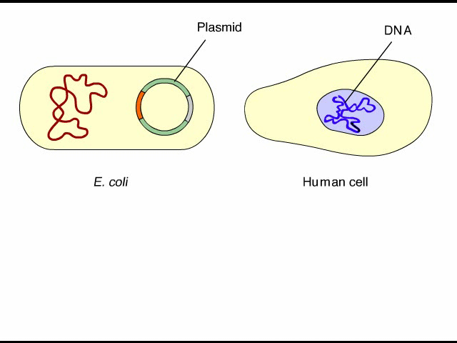
Animation: Cloning a Gene

Slide 21
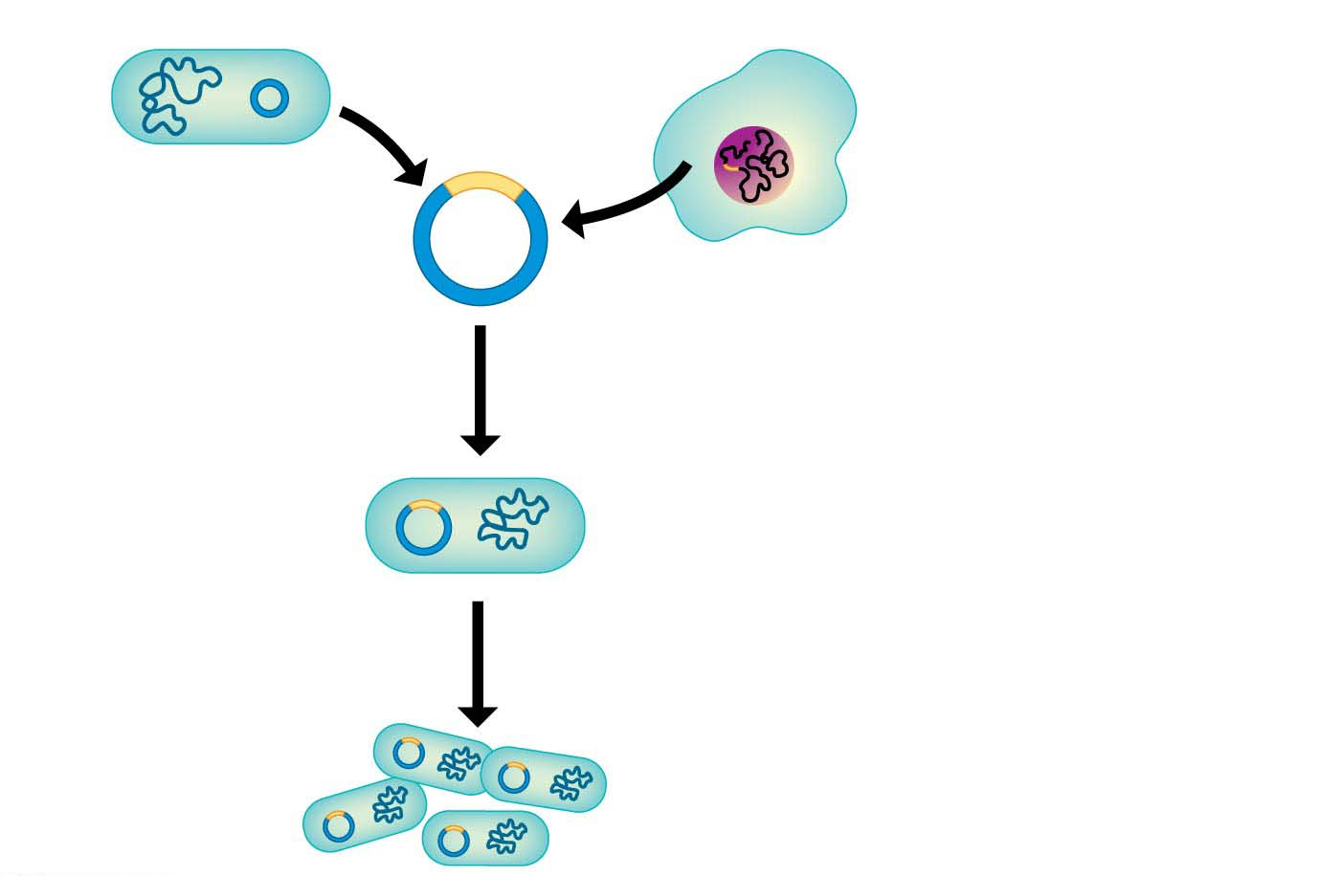
Figure 12.3-1
Bacterium
Cell containing gene
of interest
Bacterial
chromosome
Plasmid
1
Gene inserted
Into plasmid
Recombinant
DNA (plasmid)
Gene of
interest
DNA of chromosome
(“foreign” DNA)
2
Plasmid put into
bacterial cell
Recombinant
bacterium
3
Host cell grown
In culture to form
a clone of cells
Notes:
Figure 12.3-1 Using recombinant DNA technology to produce useful products (part 1: recombinant bacterium)
Insulin as the example

Slide 22
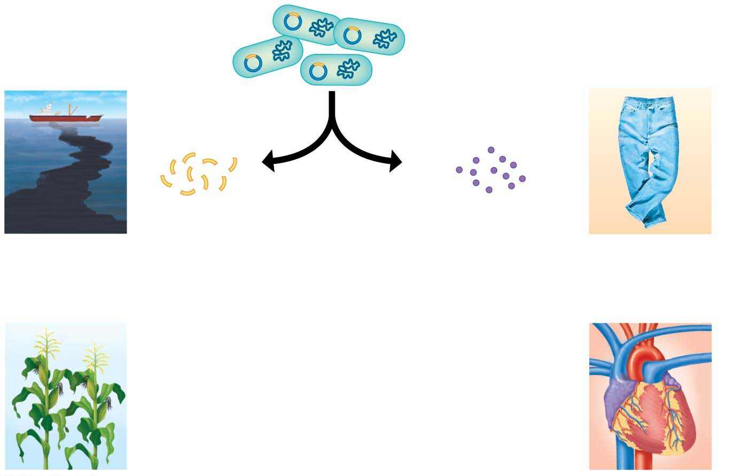
Figure 12.3-2
Clone of cells
containing the
gene of interest
Some uses
of genes
Some uses
of proteins
4
The gene
and protein
of interest
are isolated
from the
bacteria.
Genes may
be inserted
into other
organisms.
Harvested
proteins may
be used
directly
Genes for
cleaning up
toxic waste
Protein for
“stone-washing”
jeans
Protein for
dissolving
clots
Gene for pest
resistance
Notes:
Figure 12.3-2 Using recombinant DNA technology to produce useful products (part 2: useful products)

Slide 23
Cutting and Pasting DNA with Restriction Enzymes
Recombinant DNA is produced by combining two ingredients:
  a bacterial plasmid and
  the gene of interest.
To understand how these DNA molecules are spliced together, you need to learn how enzymes cut and paste DNA.
Notes:
23
Student Misconceptions and Concerns
1. Student comprehension of restriction enzymes and many other aspects of recombinant DNA techniques depends upon a comfortable understanding of basic molecular genetics. Consider addressing Chapter 12 after an exam that addresses the content in Chapters 10 and 11.
2. The genetic engineering of organisms can be controversial, creating various degrees of social unease and resistance. Yet many debates about scientific issues are confused by misinformation. This provides an opportunity for you to ask students to research an issue before taking firm positions. Students might debate whether a food or drug made from GM/transgenic organisms should be labeled as such, or discuss the risks and advantages of producing GM organisms. Consider starting class with a headline addressing one of these issues. The recent process of FDA approval for raising genetically engineered salmon (AquAdvantage) for food might be particularly useful and relevant.
3. The fact that the technologies described in this chapter can be used to swap genes between prokaryotes and eukaryotes reveals the fundamental similarities in genetic mechanisms shared by all forms of life. This very strong evidence of common descent is evidence of evolution that may be missed by your students.
4. Using gene therapy to “fix” genetic problems relies on a thorough understanding of the roles of genes and alleles. Students might benefit from a discussion of the extent to which we as a society might want to consider directing our own genetics.
Teaching Tips
1. Annual flu vaccinations are a common example of using vaccines to prevent diseases that cannot be easily cured. However, students might not understand why many people receive the vaccine every year. A new annual vaccine is necessary because the flu viruses keep evolving.
2. The origin of the name “restriction enzymes” may be of interest. In nature, these enzymes protect bacterial cells against foreign DNA. Thus, these enzymes “restrict” the invasion of foreign genetic material.
3. Students might think you are just making a bad joke by noting that laboratory synthesized genes are “designer genes,” but this is a common term. Search the Internet using the keywords “designer genes,” and many scientific (and unscientific) sites will be found.
4. Separating marker ink using paper chromatography is a simple experiment that approximates some of what occurs in gel electrophoresis. Consider doing this as a class demonstration while addressing electrophoresis. Cut a large piece of filter paper into a rectangle or square. Use markers to color large dots about 2 cm away from the edge of the paper. Separate the dots from each other by 3–4 cm. Place the paper on edge, dots down, into a beaker containing about 1 cm of ethanol or isopropyl alcohol (50% or higher will do). The dots should not be in contact with the pool of alcohol in the bottom of the beaker. As the alcohol is drawn up the filter paper by capillary action, the alcohol will dissolve the ink dots. As the alcohol continues up the paper, the ink follows. Not all of the ink components move at the same speed, based on their size and chemical properties. If you begin the process at the start of class, you should have some degree of separation by the end of a 50-minute period. Experiment with the technique a day or two before class to fine-tune the demonstration, and experiment with different types of ink. (Save and air-dry these samples for your class.) Consider using brown, green, and black markers, as these colors are often made by color combinations.
5. Roundup Ready Corn, a product of Monsanto, is resistant to the herbicide Roundup. The general strategy for farmers is to spray fields of Roundup Ready Corn with the herbicide Roundup, killing weeds but not the corn. A search of the Internet will quickly reveal the controversy associated with this and other genetically modified organisms (GMOs), which can encourage interesting discussions and promote critical thinking skills.
6. As gene therapy technology expands, our ability to modify the genome in human embryos through in vitro fertilization permits genetic modification at the earliest stages of life. Future generations of humans, like our crops today, may include those with and without a genetically modified ancestry. The benefits and challenges of these technologies raise issues many students have never considered. Our students, and the generations soon to follow, may face the potential of directed human evolution.
7. Ethical, legal, and social issues related to the Human Genome Project are directly addressed at the Department of Energy Human Genome website at http://web.ornl.gov/sci/techresources/Human_Genome/elsi/index.shtml.
8. The Biology and Society end-of-chapter textbook questions address some of the issues raised in this chapter section.
Active Lecture Tips
1. As you begin to address genetic engineering and GMO foods, ask students to work in small groups to discuss what they know about genetically engineered food. Have each group create a list of statements that can be short or long, reflecting their impressions of the technology. The results may surprise you and help you address some common misunderstandings and concerns.
2. If you have already addressed basic transcription and translation in your course, consider asking small groups of students in your class to explain the following. DNA technology is primarily used to produce proteins. Why aren’t lipids and carbohydrates typically produced by these processes?

Slide 24
Cutting and Pasting DNA with Restriction Enzymes
The cutting tools used for making recombinant DNA are bacterial enzymes called restriction enzymes.
  The DNA sequence recognized by a particular restriction enzyme is called a restriction site.
  After a restriction enzyme binds to its restriction site, it cuts the two strands of the DNA by breaking chemical bonds at specific points within the sequence, like a pair of highly specific molecular scissors.
  The top of Figure 12.4 shows a piece of DNA (blue) that contains one restriction site for a particular restriction enzyme.
Notes:
24

Slide 25
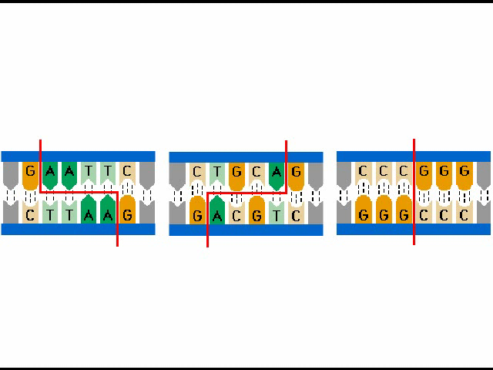
Animation: Restriction Enzymes

Slide 26

Figure 12.4-s1
Recognition site (recognition sequence)
for a restriction enzyme
DNA
1
A restriction enzyme cuts the
DNA into fragments.
Restriction
enzyme
Sticky end
Sticky end
Notes:
Figure 12.4-s1 Cutting and pasting DNA (step 1)

Slide 27
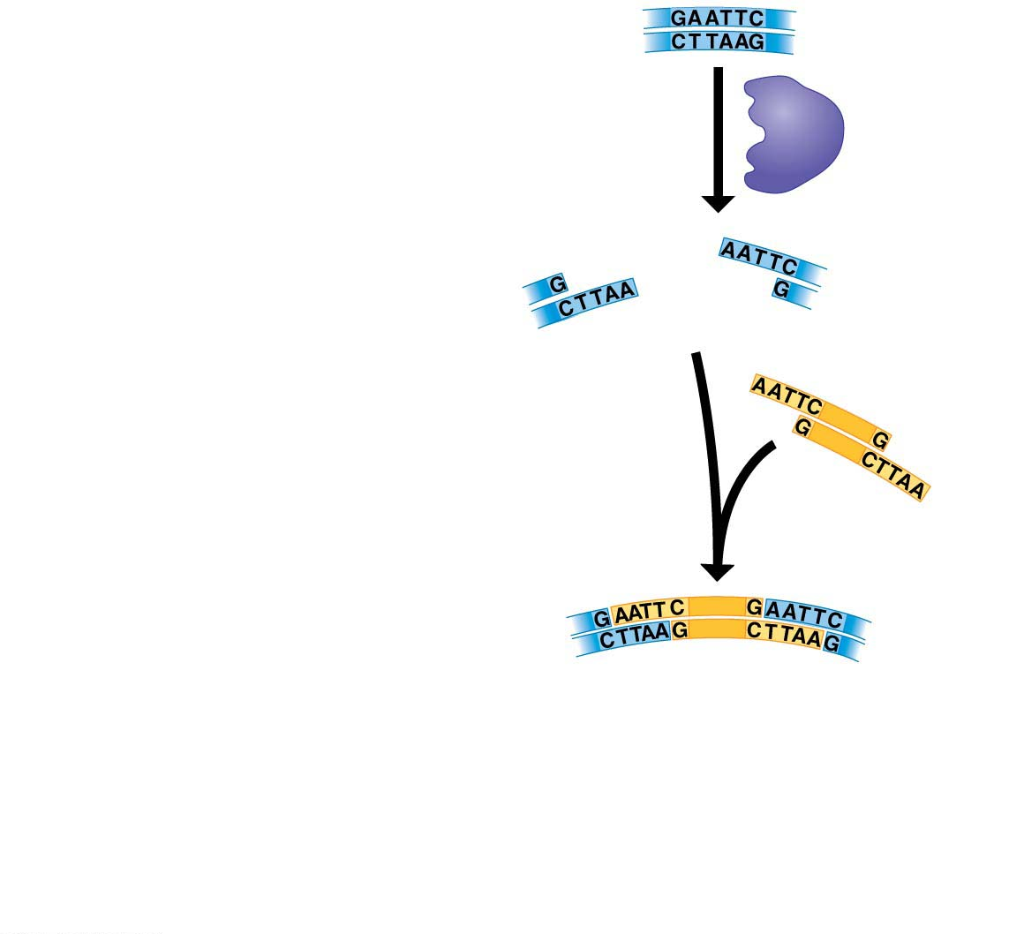
Figure 12.4-s2
Recognition site (recognition sequence)
for a restriction enzyme
DNA
1
A restriction enzyme cuts the
DNA into fragments.
Restriction
enzyme
Sticky end
Sticky end
2
A DNA fragment is added from
another source.
3
Fragments stick together by
base pairing.
Notes:
Figure 12.4-s2 Cutting and pasting DNA (step 2)

Slide 28
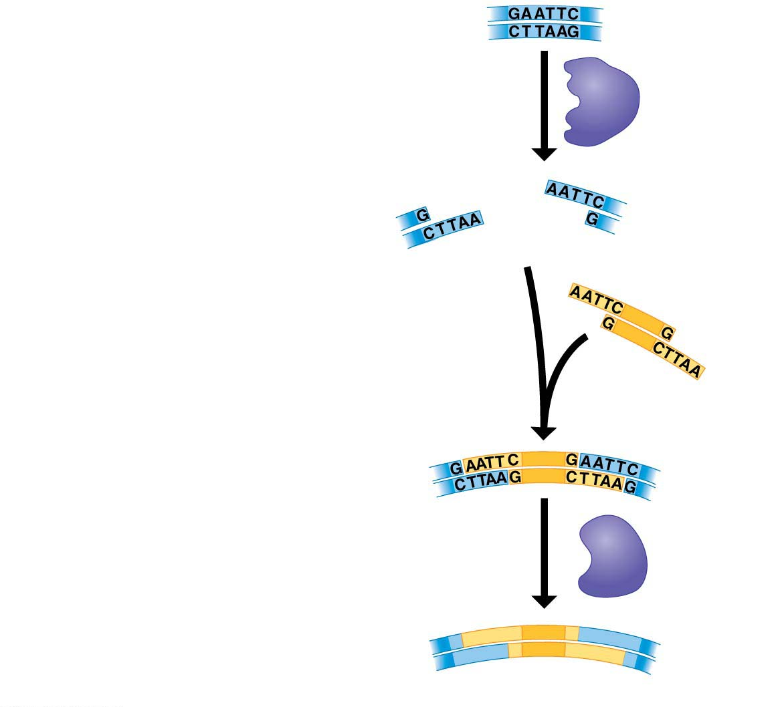
Figure 12.4-s3
Recognition site (recognition sequence)
for a restriction enzyme
DNA
1
A restriction enzyme cuts the
DNA into fragments.
Restriction
enzyme
Sticky end
Sticky end
2
A DNA fragment is added from
another source.
3
Fragments stick together by
base pairing.
4
DNA ligase joins the fragments
into strands.
DNA
ligase
Recombinant DNA molecule
Notes:
Figure 12.4-s3 Cutting and pasting DNA (step 3)

Slide 29
What if you added GFP to the bacterial plasmid?
The cell would fluoresce...

Slide 30
Stopped here on 11.13.18

Slide 31
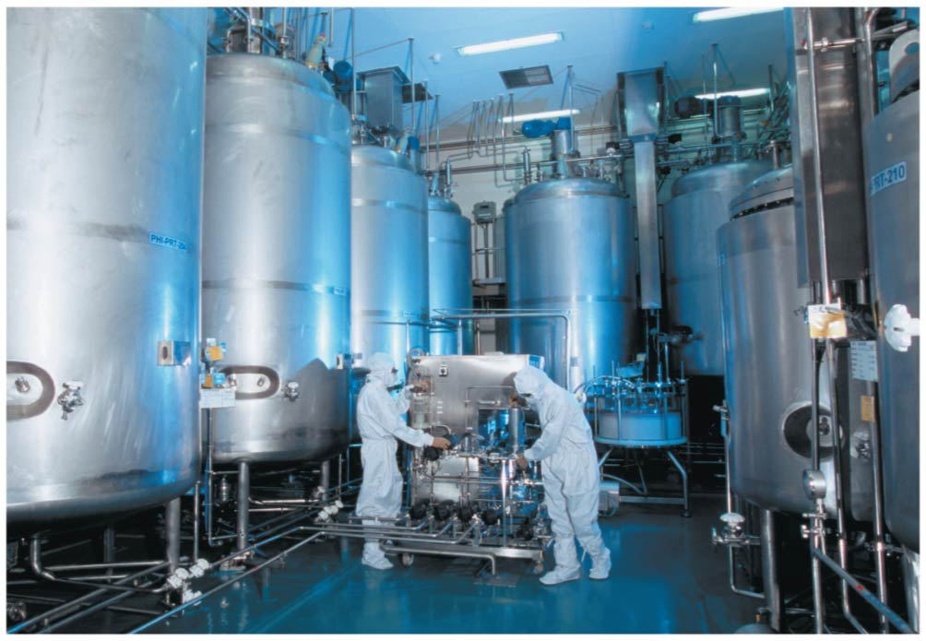
Figure 12.7
Pharmaceutical Applications
gene for a desired protein into a bacterium or yeast,
grow cultures in large vats
produce large amounts of proteins otherwise impossible to synthesis
Notes:
Figure 12.7 A factory that produces genetically engineered insulin

Slide 32
Pharmaceutical Applications
Humulin is human insulin produced by genetically modified bacteria.
  insulin is a protein made in the pancreas.
  we cannot synthesize insulin using chemistry onlne
  originally diabetics used insulin from cows and pigs.
  The meat industry couldn’t keep up...
  In 1978, scientists working at a biotechnology company chemically synthesized DNA fragments and linked them to form the two genes that code for the two polypeptides that make up human insulin.
Notes:
32
Student Misconceptions and Concerns
1. Student comprehension of restriction enzymes and many other aspects of recombinant DNA techniques depends upon a comfortable understanding of basic molecular genetics. Consider addressing Chapter 12 after an exam that addresses the content in Chapters 10 and 11.
2. The genetic engineering of organisms can be controversial, creating various degrees of social unease and resistance. Yet many debates about scientific issues are confused by misinformation. This provides an opportunity for you to ask students to research an issue before taking firm positions. Students might debate whether a food or drug made from GM/transgenic organisms should be labeled as such, or discuss the risks and advantages of producing GM organisms. Consider starting class with a headline addressing one of these issues. The recent process of FDA approval for raising genetically engineered salmon (AquAdvantage) for food might be particularly useful and relevant.
3. The fact that the technologies described in this chapter can be used to swap genes between prokaryotes and eukaryotes reveals the fundamental similarities in genetic mechanisms shared by all forms of life. This very strong evidence of common descent is evidence of evolution that may be missed by your students.
4. Using gene therapy to “fix” genetic problems relies on a thorough understanding of the roles of genes and alleles. Students might benefit from a discussion of the extent to which we as a society might want to consider directing our own genetics.
Teaching Tips
1. Annual flu vaccinations are a common example of using vaccines to prevent diseases that cannot be easily cured. However, students might not understand why many people receive the vaccine every year. A new annual vaccine is necessary because the flu viruses keep evolving.
2. The origin of the name “restriction enzymes” may be of interest. In nature, these enzymes protect bacterial cells against foreign DNA. Thus, these enzymes “restrict” the invasion of foreign genetic material.
3. Students might think you are just making a bad joke by noting that laboratory synthesized genes are “designer genes,” but this is a common term. Search the Internet using the keywords “designer genes,” and many scientific (and unscientific) sites will be found.
4. Separating marker ink using paper chromatography is a simple experiment that approximates some of what occurs in gel electrophoresis. Consider doing this as a class demonstration while addressing electrophoresis. Cut a large piece of filter paper into a rectangle or square. Use markers to color large dots about 2 cm away from the edge of the paper. Separate the dots from each other by 3–4 cm. Place the paper on edge, dots down, into a beaker containing about 1 cm of ethanol or isopropyl alcohol (50% or higher will do). The dots should not be in contact with the pool of alcohol in the bottom of the beaker. As the alcohol is drawn up the filter paper by capillary action, the alcohol will dissolve the ink dots. As the alcohol continues up the paper, the ink follows. Not all of the ink components move at the same speed, based on their size and chemical properties. If you begin the process at the start of class, you should have some degree of separation by the end of a 50-minute period. Experiment with the technique a day or two before class to fine-tune the demonstration, and experiment with different types of ink. (Save and air-dry these samples for your class.) Consider using brown, green, and black markers, as these colors are often made by color combinations.
5. Roundup Ready Corn, a product of Monsanto, is resistant to the herbicide Roundup. The general strategy for farmers is to spray fields of Roundup Ready Corn with the herbicide Roundup, killing weeds but not the corn. A search of the Internet will quickly reveal the controversy associated with this and other genetically modified organisms (GMOs), which can encourage interesting discussions and promote critical thinking skills.
6. As gene therapy technology expands, our ability to modify the genome in human embryos through in vitro fertilization permits genetic modification at the earliest stages of life. Future generations of humans, like our crops today, may include those with and without a genetically modified ancestry. The benefits and challenges of these technologies raise issues many students have never considered. Our students, and the generations soon to follow, may face the potential of directed human evolution.
7. Ethical, legal, and social issues related to the Human Genome Project are directly addressed at the Department of Energy Human Genome website at http://web.ornl.gov/sci/techresources/Human_Genome/elsi/index.shtml.
8. The Biology and Society end-of-chapter textbook questions address some of the issues raised in this chapter section.
Active Lecture Tips
1. As you begin to address genetic engineering and GMO foods, ask students to work in small groups to discuss what they know about genetically engineered food. Have each group create a list of statements that can be short or long, reflecting their impressions of the technology. The results may surprise you and help you address some common misunderstandings and concerns.
2. If you have already addressed basic transcription and translation in your course, consider asking small groups of students in your class to explain the following. DNA technology is primarily used to produce proteins. Why aren’t lipids and carbohydrates typically produced by these processes?

Slide 33
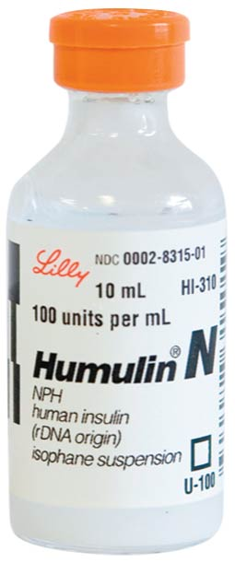
Figure 12.6
Human insulin produced in E. coli cells.
Notes:
Figure 12.6 Humulin, human insulin produced by genetically modified bacteria

Slide 34
Pharmaceutical Applications
In 1978, scientists working at a biotechnology company chemically synthesized DNA fragments and linked them to form the two genes that code for the two polypeptides that make up human insulin.
  They then inserted these artificial genes into E. coli host cells.
  Under proper growing conditions, the transgenic bacteria cranked out large quantities of the human protein.
  In 1982, Humulin hit the market as the world’s first genetically engineered pharmaceutical product.
Notes:
34
Student Misconceptions and Concerns
1. Student comprehension of restriction enzymes and many other aspects of recombinant DNA techniques depends upon a comfortable understanding of basic molecular genetics. Consider addressing Chapter 12 after an exam that addresses the content in Chapters 10 and 11.
2. The genetic engineering of organisms can be controversial, creating various degrees of social unease and resistance. Yet many debates about scientific issues are confused by misinformation. This provides an opportunity for you to ask students to research an issue before taking firm positions. Students might debate whether a food or drug made from GM/transgenic organisms should be labeled as such, or discuss the risks and advantages of producing GM organisms. Consider starting class with a headline addressing one of these issues. The recent process of FDA approval for raising genetically engineered salmon (AquAdvantage) for food might be particularly useful and relevant.
3. The fact that the technologies described in this chapter can be used to swap genes between prokaryotes and eukaryotes reveals the fundamental similarities in genetic mechanisms shared by all forms of life. This very strong evidence of common descent is evidence of evolution that may be missed by your students.
4. Using gene therapy to “fix” genetic problems relies on a thorough understanding of the roles of genes and alleles. Students might benefit from a discussion of the extent to which we as a society might want to consider directing our own genetics.
Teaching Tips
1. Annual flu vaccinations are a common example of using vaccines to prevent diseases that cannot be easily cured. However, students might not understand why many people receive the vaccine every year. A new annual vaccine is necessary because the flu viruses keep evolving.
2. The origin of the name “restriction enzymes” may be of interest. In nature, these enzymes protect bacterial cells against foreign DNA. Thus, these enzymes “restrict” the invasion of foreign genetic material.
3. Students might think you are just making a bad joke by noting that laboratory synthesized genes are “designer genes,” but this is a common term. Search the Internet using the keywords “designer genes,” and many scientific (and unscientific) sites will be found.
4. Separating marker ink using paper chromatography is a simple experiment that approximates some of what occurs in gel electrophoresis. Consider doing this as a class demonstration while addressing electrophoresis. Cut a large piece of filter paper into a rectangle or square. Use markers to color large dots about 2 cm away from the edge of the paper. Separate the dots from each other by 3–4 cm. Place the paper on edge, dots down, into a beaker containing about 1 cm of ethanol or isopropyl alcohol (50% or higher will do). The dots should not be in contact with the pool of alcohol in the bottom of the beaker. As the alcohol is drawn up the filter paper by capillary action, the alcohol will dissolve the ink dots. As the alcohol continues up the paper, the ink follows. Not all of the ink components move at the same speed, based on their size and chemical properties. If you begin the process at the start of class, you should have some degree of separation by the end of a 50-minute period. Experiment with the technique a day or two before class to fine-tune the demonstration, and experiment with different types of ink. (Save and air-dry these samples for your class.) Consider using brown, green, and black markers, as these colors are often made by color combinations.
5. Roundup Ready Corn, a product of Monsanto, is resistant to the herbicide Roundup. The general strategy for farmers is to spray fields of Roundup Ready Corn with the herbicide Roundup, killing weeds but not the corn. A search of the Internet will quickly reveal the controversy associated with this and other genetically modified organisms (GMOs), which can encourage interesting discussions and promote critical thinking skills.
6. As gene therapy technology expands, our ability to modify the genome in human embryos through in vitro fertilization permits genetic modification at the earliest stages of life. Future generations of humans, like our crops today, may include those with and without a genetically modified ancestry. The benefits and challenges of these technologies raise issues many students have never considered. Our students, and the generations soon to follow, may face the potential of directed human evolution.
7. Ethical, legal, and social issues related to the Human Genome Project are directly addressed at the Department of Energy Human Genome website at http://web.ornl.gov/sci/techresources/Human_Genome/elsi/index.shtml.
8. The Biology and Society end-of-chapter textbook questions address some of the issues raised in this chapter section.
Active Lecture Tips
1. As you begin to address genetic engineering and GMO foods, ask students to work in small groups to discuss what they know about genetically engineered food. Have each group create a list of statements that can be short or long, reflecting their impressions of the technology. The results may surprise you and help you address some common misunderstandings and concerns.
2. If you have already addressed basic transcription and translation in your course, consider asking small groups of students in your class to explain the following. DNA technology is primarily used to produce proteins. Why aren’t lipids and carbohydrates typically produced by these processes?

Slide 35
Pharmaceutical Applications
DNA technology is used to produce medically valuable molecules in bacteria, including
  human growth hormone (HGH)- previously only available from human cadavers
  vaccines
    a harmless variant or derivative of a disease-causing microbe—such as a bacterium or virus—
    that is used to prevent an infectious disease.
Notes:
35
Student Misconceptions and Concerns
1. Student comprehension of restriction enzymes and many other aspects of recombinant DNA techniques depends upon a comfortable understanding of basic molecular genetics. Consider addressing Chapter 12 after an exam that addresses the content in Chapters 10 and 11.
2. The genetic engineering of organisms can be controversial, creating various degrees of social unease and resistance. Yet many debates about scientific issues are confused by misinformation. This provides an opportunity for you to ask students to research an issue before taking firm positions. Students might debate whether a food or drug made from GM/transgenic organisms should be labeled as such, or discuss the risks and advantages of producing GM organisms. Consider starting class with a headline addressing one of these issues. The recent process of FDA approval for raising genetically engineered salmon (AquAdvantage) for food might be particularly useful and relevant.
3. The fact that the technologies described in this chapter can be used to swap genes between prokaryotes and eukaryotes reveals the fundamental similarities in genetic mechanisms shared by all forms of life. This very strong evidence of common descent is evidence of evolution that may be missed by your students.
4. Using gene therapy to “fix” genetic problems relies on a thorough understanding of the roles of genes and alleles. Students might benefit from a discussion of the extent to which we as a society might want to consider directing our own genetics.
Teaching Tips
1. Annual flu vaccinations are a common example of using vaccines to prevent diseases that cannot be easily cured. However, students might not understand why many people receive the vaccine every year. A new annual vaccine is necessary because the flu viruses keep evolving.
2. The origin of the name “restriction enzymes” may be of interest. In nature, these enzymes protect bacterial cells against foreign DNA. Thus, these enzymes “restrict” the invasion of foreign genetic material.
3. Students might think you are just making a bad joke by noting that laboratory synthesized genes are “designer genes,” but this is a common term. Search the Internet using the keywords “designer genes,” and many scientific (and unscientific) sites will be found.
4. Separating marker ink using paper chromatography is a simple experiment that approximates some of what occurs in gel electrophoresis. Consider doing this as a class demonstration while addressing electrophoresis. Cut a large piece of filter paper into a rectangle or square. Use markers to color large dots about 2 cm away from the edge of the paper. Separate the dots from each other by 3–4 cm. Place the paper on edge, dots down, into a beaker containing about 1 cm of ethanol or isopropyl alcohol (50% or higher will do). The dots should not be in contact with the pool of alcohol in the bottom of the beaker. As the alcohol is drawn up the filter paper by capillary action, the alcohol will dissolve the ink dots. As the alcohol continues up the paper, the ink follows. Not all of the ink components move at the same speed, based on their size and chemical properties. If you begin the process at the start of class, you should have some degree of separation by the end of a 50-minute period. Experiment with the technique a day or two before class to fine-tune the demonstration, and experiment with different types of ink. (Save and air-dry these samples for your class.) Consider using brown, green, and black markers, as these colors are often made by color combinations.
5. Roundup Ready Corn, a product of Monsanto, is resistant to the herbicide Roundup. The general strategy for farmers is to spray fields of Roundup Ready Corn with the herbicide Roundup, killing weeds but not the corn. A search of the Internet will quickly reveal the controversy associated with this and other genetically modified organisms (GMOs), which can encourage interesting discussions and promote critical thinking skills.
6. As gene therapy technology expands, our ability to modify the genome in human embryos through in vitro fertilization permits genetic modification at the earliest stages of life. Future generations of humans, like our crops today, may include those with and without a genetically modified ancestry. The benefits and challenges of these technologies raise issues many students have never considered. Our students, and the generations soon to follow, may face the potential of directed human evolution.
7. Ethical, legal, and social issues related to the Human Genome Project are directly addressed at the Department of Energy Human Genome website at http://web.ornl.gov/sci/techresources/Human_Genome/elsi/index.shtml.
8. The Biology and Society end-of-chapter textbook questions address some of the issues raised in this chapter section.
Active Lecture Tips
1. As you begin to address genetic engineering and GMO foods, ask students to work in small groups to discuss what they know about genetically engineered food. Have each group create a list of statements that can be short or long, reflecting their impressions of the technology. The results may surprise you and help you address some common misunderstandings and concerns.
2. If you have already addressed basic transcription and translation in your course, consider asking small groups of students in your class to explain the following. DNA technology is primarily used to produce proteins. Why aren’t lipids and carbohydrates typically produced by these processes?

Slide 36
Beyond Bacteria
Eukaryotic cells are used for bioengineering
What are eukaryotes?
fungi, animals, and plants
Yeast Produce -
  Hepatitis B vaccine, antimalarial drugs, interferon-cancer drugs
  Sugar into Hydrocodone – 23 genes from bacteria, plants and animals
    4,400 gallons of bioengineered yeast to produce a single dose of the opioid
  the hormone erythropoietin (EPO), which stimulates production of red blood cells – treats anemia

Slide 37
Pharmaceutical Applications
Genetically modified whole animals are also used to produce drugs.
Figure 12.8 shows a transgenic goat that carries a gene for an enzyme called lysozyme.
as antibacterial properties.
What other type of transgenic goat has been produced?
What type of cloning is used? reproductive or therapeutic?
Notes:
37
Student Misconceptions and Concerns
1. Student comprehension of restriction enzymes and many other aspects of recombinant DNA techniques depends upon a comfortable understanding of basic molecular genetics. Consider addressing Chapter 12 after an exam that addresses the content in Chapters 10 and 11.
2. The genetic engineering of organisms can be controversial, creating various degrees of social unease and resistance. Yet many debates about scientific issues are confused by misinformation. This provides an opportunity for you to ask students to research an issue before taking firm positions. Students might debate whether a food or drug made from GM/transgenic organisms should be labeled as such, or discuss the risks and advantages of producing GM organisms. Consider starting class with a headline addressing one of these issues. The recent process of FDA approval for raising genetically engineered salmon (AquAdvantage) for food might be particularly useful and relevant.
3. The fact that the technologies described in this chapter can be used to swap genes between prokaryotes and eukaryotes reveals the fundamental similarities in genetic mechanisms shared by all forms of life. This very strong evidence of common descent is evidence of evolution that may be missed by your students.
4. Using gene therapy to “fix” genetic problems relies on a thorough understanding of the roles of genes and alleles. Students might benefit from a discussion of the extent to which we as a society might want to consider directing our own genetics.
Teaching Tips
1. Annual flu vaccinations are a common example of using vaccines to prevent diseases that cannot be easily cured. However, students might not understand why many people receive the vaccine every year. A new annual vaccine is necessary because the flu viruses keep evolving.
2. The origin of the name “restriction enzymes” may be of interest. In nature, these enzymes protect bacterial cells against foreign DNA. Thus, these enzymes “restrict” the invasion of foreign genetic material.
3. Students might think you are just making a bad joke by noting that laboratory synthesized genes are “designer genes,” but this is a common term. Search the Internet using the keywords “designer genes,” and many scientific (and unscientific) sites will be found.
4. Separating marker ink using paper chromatography is a simple experiment that approximates some of what occurs in gel electrophoresis. Consider doing this as a class demonstration while addressing electrophoresis. Cut a large piece of filter paper into a rectangle or square. Use markers to color large dots about 2 cm away from the edge of the paper. Separate the dots from each other by 3–4 cm. Place the paper on edge, dots down, into a beaker containing about 1 cm of ethanol or isopropyl alcohol (50% or higher will do). The dots should not be in contact with the pool of alcohol in the bottom of the beaker. As the alcohol is drawn up the filter paper by capillary action, the alcohol will dissolve the ink dots. As the alcohol continues up the paper, the ink follows. Not all of the ink components move at the same speed, based on their size and chemical properties. If you begin the process at the start of class, you should have some degree of separation by the end of a 50-minute period. Experiment with the technique a day or two before class to fine-tune the demonstration, and experiment with different types of ink. (Save and air-dry these samples for your class.) Consider using brown, green, and black markers, as these colors are often made by color combinations.
5. Roundup Ready Corn, a product of Monsanto, is resistant to the herbicide Roundup. The general strategy for farmers is to spray fields of Roundup Ready Corn with the herbicide Roundup, killing weeds but not the corn. A search of the Internet will quickly reveal the controversy associated with this and other genetically modified organisms (GMOs), which can encourage interesting discussions and promote critical thinking skills.
6. As gene therapy technology expands, our ability to modify the genome in human embryos through in vitro fertilization permits genetic modification at the earliest stages of life. Future generations of humans, like our crops today, may include those with and without a genetically modified ancestry. The benefits and challenges of these technologies raise issues many students have never considered. Our students, and the generations soon to follow, may face the potential of directed human evolution.
7. Ethical, legal, and social issues related to the Human Genome Project are directly addressed at the Department of Energy Human Genome website at http://web.ornl.gov/sci/techresources/Human_Genome/elsi/index.shtml.
8. The Biology and Society end-of-chapter textbook questions address some of the issues raised in this chapter section.
Active Lecture Tips
1. As you begin to address genetic engineering and GMO foods, ask students to work in small groups to discuss what they know about genetically engineered food. Have each group create a list of statements that can be short or long, reflecting their impressions of the technology. The results may surprise you and help you address some common misunderstandings and concerns.
2. If you have already addressed basic transcription and translation in your course, consider asking small groups of students in your class to explain the following. DNA technology is primarily used to produce proteins. Why aren’t lipids and carbohydrates typically produced by these processes?

Slide 38
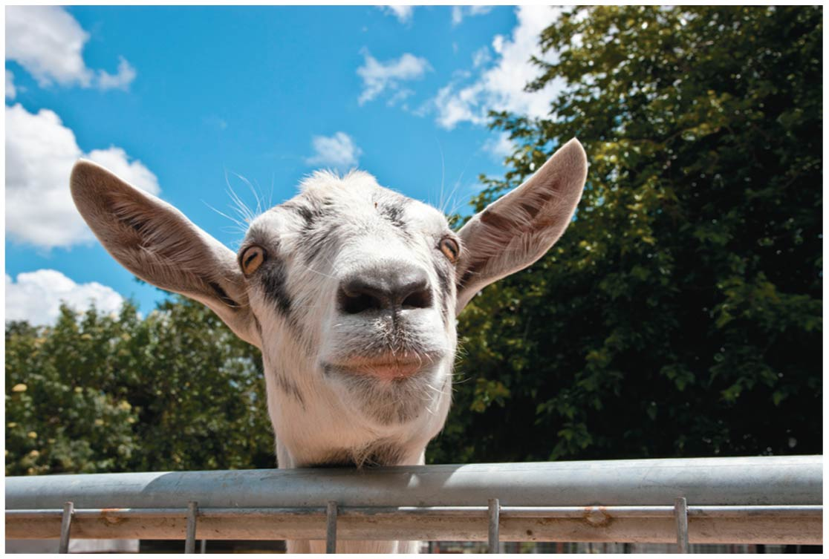
Figure 12.8
Notes:
Figure 12.8 A genetically modified goat -

Slide 39
Genetically Modified Organisms in Agriculture
Since ancient times, people have selectively bred agricultural crops to make them more useful.
Today, DNA technology is quickly replacing traditional breeding programs as scientists work to improve the productivity of agriculturally important plants and animals.
Notes:
39
Student Misconceptions and Concerns
1. Student comprehension of restriction enzymes and many other aspects of recombinant DNA techniques depends upon a comfortable understanding of basic molecular genetics. Consider addressing Chapter 12 after an exam that addresses the content in Chapters 10 and 11.
2. The genetic engineering of organisms can be controversial, creating various degrees of social unease and resistance. Yet many debates about scientific issues are confused by misinformation. This provides an opportunity for you to ask students to research an issue before taking firm positions. Students might debate whether a food or drug made from GM/transgenic organisms should be labeled as such, or discuss the risks and advantages of producing GM organisms. Consider starting class with a headline addressing one of these issues. The recent process of FDA approval for raising genetically engineered salmon (AquAdvantage) for food might be particularly useful and relevant.
3. The fact that the technologies described in this chapter can be used to swap genes between prokaryotes and eukaryotes reveals the fundamental similarities in genetic mechanisms shared by all forms of life. This very strong evidence of common descent is evidence of evolution that may be missed by your students.
4. Using gene therapy to “fix” genetic problems relies on a thorough understanding of the roles of genes and alleles. Students might benefit from a discussion of the extent to which we as a society might want to consider directing our own genetics.
Teaching Tips
1. Annual flu vaccinations are a common example of using vaccines to prevent diseases that cannot be easily cured. However, students might not understand why many people receive the vaccine every year. A new annual vaccine is necessary because the flu viruses keep evolving.
2. The origin of the name “restriction enzymes” may be of interest. In nature, these enzymes protect bacterial cells against foreign DNA. Thus, these enzymes “restrict” the invasion of foreign genetic material.
3. Students might think you are just making a bad joke by noting that laboratory synthesized genes are “designer genes,” but this is a common term. Search the Internet using the keywords “designer genes,” and many scientific (and unscientific) sites will be found.
4. Separating marker ink using paper chromatography is a simple experiment that approximates some of what occurs in gel electrophoresis. Consider doing this as a class demonstration while addressing electrophoresis. Cut a large piece of filter paper into a rectangle or square. Use markers to color large dots about 2 cm away from the edge of the paper. Separate the dots from each other by 3–4 cm. Place the paper on edge, dots down, into a beaker containing about 1 cm of ethanol or isopropyl alcohol (50% or higher will do). The dots should not be in contact with the pool of alcohol in the bottom of the beaker. As the alcohol is drawn up the filter paper by capillary action, the alcohol will dissolve the ink dots. As the alcohol continues up the paper, the ink follows. Not all of the ink components move at the same speed, based on their size and chemical properties. If you begin the process at the start of class, you should have some degree of separation by the end of a 50-minute period. Experiment with the technique a day or two before class to fine-tune the demonstration, and experiment with different types of ink. (Save and air-dry these samples for your class.) Consider using brown, green, and black markers, as these colors are often made by color combinations.
5. Roundup Ready Corn, a product of Monsanto, is resistant to the herbicide Roundup. The general strategy for farmers is to spray fields of Roundup Ready Corn with the herbicide Roundup, killing weeds but not the corn. A search of the Internet will quickly reveal the controversy associated with this and other genetically modified organisms (GMOs), which can encourage interesting discussions and promote critical thinking skills.
6. As gene therapy technology expands, our ability to modify the genome in human embryos through in vitro fertilization permits genetic modification at the earliest stages of life. Future generations of humans, like our crops today, may include those with and without a genetically modified ancestry. The benefits and challenges of these technologies raise issues many students have never considered. Our students, and the generations soon to follow, may face the potential of directed human evolution.
7. Ethical, legal, and social issues related to the Human Genome Project are directly addressed at the Department of Energy Human Genome website at http://web.ornl.gov/sci/techresources/Human_Genome/elsi/index.shtml.
8. The Biology and Society end-of-chapter textbook questions address some of the issues raised in this chapter section.
Active Lecture Tips
1. As you begin to address genetic engineering and GMO foods, ask students to work in small groups to discuss what they know about genetically engineered food. Have each group create a list of statements that can be short or long, reflecting their impressions of the technology. The results may surprise you and help you address some common misunderstandings and concerns.
2. If you have already addressed basic transcription and translation in your course, consider asking small groups of students in your class to explain the following. DNA technology is primarily used to produce proteins. Why aren’t lipids and carbohydrates typically produced by these processes?

Slide 40
Genetically Modified Organisms in Agriculture
In the United States today, more than 80% of the corn crop, more than 90% of the soybean crop, and about 75% of the cotton crop are genetically modified.
Figure 12.9 shows corn that has been genetically engineered to resist attack by an insect (moth larva) called the European corn borer.
Growing insect-resistant plants reduces the need for chemical insecticides.
Notes:
40
Student Misconceptions and Concerns
1. Student comprehension of restriction enzymes and many other aspects of recombinant DNA techniques depends upon a comfortable understanding of basic molecular genetics. Consider addressing Chapter 12 after an exam that addresses the content in Chapters 10 and 11.
2. The genetic engineering of organisms can be controversial, creating various degrees of social unease and resistance. Yet many debates about scientific issues are confused by misinformation. This provides an opportunity for you to ask students to research an issue before taking firm positions. Students might debate whether a food or drug made from GM/transgenic organisms should be labeled as such, or discuss the risks and advantages of producing GM organisms. Consider starting class with a headline addressing one of these issues. The recent process of FDA approval for raising genetically engineered salmon (AquAdvantage) for food might be particularly useful and relevant.
3. The fact that the technologies described in this chapter can be used to swap genes between prokaryotes and eukaryotes reveals the fundamental similarities in genetic mechanisms shared by all forms of life. This very strong evidence of common descent is evidence of evolution that may be missed by your students.
4. Using gene therapy to “fix” genetic problems relies on a thorough understanding of the roles of genes and alleles. Students might benefit from a discussion of the extent to which we as a society might want to consider directing our own genetics.
Teaching Tips
1. Annual flu vaccinations are a common example of using vaccines to prevent diseases that cannot be easily cured. However, students might not understand why many people receive the vaccine every year. A new annual vaccine is necessary because the flu viruses keep evolving.
2. The origin of the name “restriction enzymes” may be of interest. In nature, these enzymes protect bacterial cells against foreign DNA. Thus, these enzymes “restrict” the invasion of foreign genetic material.
3. Students might think you are just making a bad joke by noting that laboratory synthesized genes are “designer genes,” but this is a common term. Search the Internet using the keywords “designer genes,” and many scientific (and unscientific) sites will be found.
4. Separating marker ink using paper chromatography is a simple experiment that approximates some of what occurs in gel electrophoresis. Consider doing this as a class demonstration while addressing electrophoresis. Cut a large piece of filter paper into a rectangle or square. Use markers to color large dots about 2 cm away from the edge of the paper. Separate the dots from each other by 3–4 cm. Place the paper on edge, dots down, into a beaker containing about 1 cm of ethanol or isopropyl alcohol (50% or higher will do). The dots should not be in contact with the pool of alcohol in the bottom of the beaker. As the alcohol is drawn up the filter paper by capillary action, the alcohol will dissolve the ink dots. As the alcohol continues up the paper, the ink follows. Not all of the ink components move at the same speed, based on their size and chemical properties. If you begin the process at the start of class, you should have some degree of separation by the end of a 50-minute period. Experiment with the technique a day or two before class to fine-tune the demonstration, and experiment with different types of ink. (Save and air-dry these samples for your class.) Consider using brown, green, and black markers, as these colors are often made by color combinations.
5. Roundup Ready Corn, a product of Monsanto, is resistant to the herbicide Roundup. The general strategy for farmers is to spray fields of Roundup Ready Corn with the herbicide Roundup, killing weeds but not the corn. A search of the Internet will quickly reveal the controversy associated with this and other genetically modified organisms (GMOs), which can encourage interesting discussions and promote critical thinking skills.
6. As gene therapy technology expands, our ability to modify the genome in human embryos through in vitro fertilization permits genetic modification at the earliest stages of life. Future generations of humans, like our crops today, may include those with and without a genetically modified ancestry. The benefits and challenges of these technologies raise issues many students have never considered. Our students, and the generations soon to follow, may face the potential of directed human evolution.
7. Ethical, legal, and social issues related to the Human Genome Project are directly addressed at the Department of Energy Human Genome website at http://web.ornl.gov/sci/techresources/Human_Genome/elsi/index.shtml.
8. The Biology and Society end-of-chapter textbook questions address some of the issues raised in this chapter section.
Active Lecture Tips
1. As you begin to address genetic engineering and GMO foods, ask students to work in small groups to discuss what they know about genetically engineered food. Have each group create a list of statements that can be short or long, reflecting their impressions of the technology. The results may surprise you and help you address some common misunderstandings and concerns.
2. If you have already addressed basic transcription and translation in your course, consider asking small groups of students in your class to explain the following. DNA technology is primarily used to produce proteins. Why aren’t lipids and carbohydrates typically produced by these processes?

Slide 41
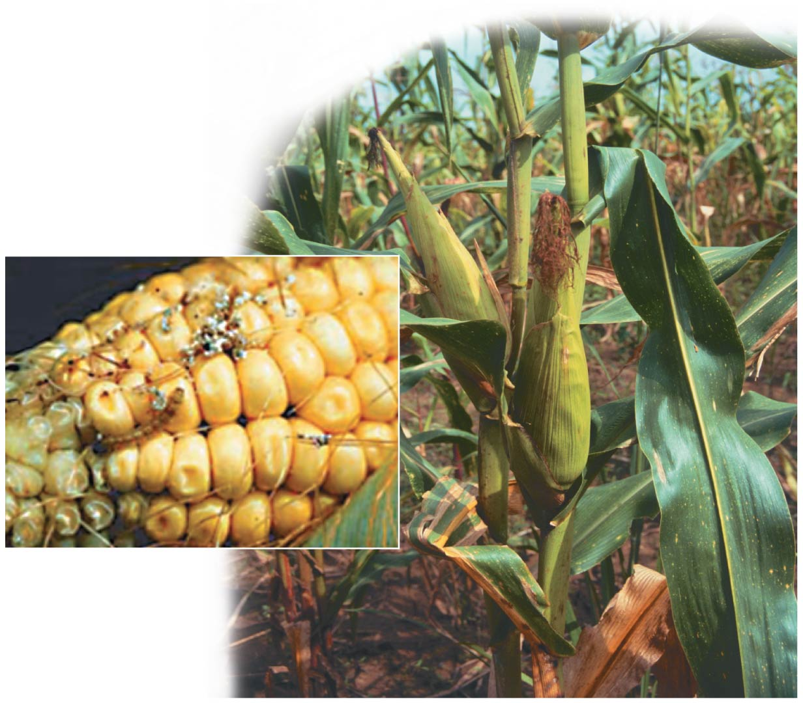
Figure 12.9
Notes:
Figure 12.9 Genetically modified corn

Slide 42
Genetically Modified Organisms in Agriculture
Scientists are also using genetic engineering to improve the nutritional value of crop plants.
  “Golden rice 2” is a transgenic variety of rice that carries genes from daffodils and corn. This rice could help prevent vitamin A deficiency and resulting blindness, especially in developing nations that depend on rice as a staple crop.
  Cassava (Yuca, Manihot esculenta) - a starchy root crop that is a staple for nearly 1 billion people in developing nations, has similarly been modified to produce increased levels of iron and beta-carotene (which is converted to vitamin A in the body).
Notes:
42
Student Misconceptions and Concerns
1. Student comprehension of restriction enzymes and many other aspects of recombinant DNA techniques depends upon a comfortable understanding of basic molecular genetics. Consider addressing Chapter 12 after an exam that addresses the content in Chapters 10 and 11.
2. The genetic engineering of organisms can be controversial, creating various degrees of social unease and resistance. Yet many debates about scientific issues are confused by misinformation. This provides an opportunity for you to ask students to research an issue before taking firm positions. Students might debate whether a food or drug made from GM/transgenic organisms should be labeled as such, or discuss the risks and advantages of producing GM organisms. Consider starting class with a headline addressing one of these issues. The recent process of FDA approval for raising genetically engineered salmon (AquAdvantage) for food might be particularly useful and relevant.
3. The fact that the technologies described in this chapter can be used to swap genes between prokaryotes and eukaryotes reveals the fundamental similarities in genetic mechanisms shared by all forms of life. This very strong evidence of common descent is evidence of evolution that may be missed by your students.
4. Using gene therapy to “fix” genetic problems relies on a thorough understanding of the roles of genes and alleles. Students might benefit from a discussion of the extent to which we as a society might want to consider directing our own genetics.
Teaching Tips
1. Annual flu vaccinations are a common example of using vaccines to prevent diseases that cannot be easily cured. However, students might not understand why many people receive the vaccine every year. A new annual vaccine is necessary because the flu viruses keep evolving.
2. The origin of the name “restriction enzymes” may be of interest. In nature, these enzymes protect bacterial cells against foreign DNA. Thus, these enzymes “restrict” the invasion of foreign genetic material.
3. Students might think you are just making a bad joke by noting that laboratory synthesized genes are “designer genes,” but this is a common term. Search the Internet using the keywords “designer genes,” and many scientific (and unscientific) sites will be found.
4. Separating marker ink using paper chromatography is a simple experiment that approximates some of what occurs in gel electrophoresis. Consider doing this as a class demonstration while addressing electrophoresis. Cut a large piece of filter paper into a rectangle or square. Use markers to color large dots about 2 cm away from the edge of the paper. Separate the dots from each other by 3–4 cm. Place the paper on edge, dots down, into a beaker containing about 1 cm of ethanol or isopropyl alcohol (50% or higher will do). The dots should not be in contact with the pool of alcohol in the bottom of the beaker. As the alcohol is drawn up the filter paper by capillary action, the alcohol will dissolve the ink dots. As the alcohol continues up the paper, the ink follows. Not all of the ink components move at the same speed, based on their size and chemical properties. If you begin the process at the start of class, you should have some degree of separation by the end of a 50-minute period. Experiment with the technique a day or two before class to fine-tune the demonstration, and experiment with different types of ink. (Save and air-dry these samples for your class.) Consider using brown, green, and black markers, as these colors are often made by color combinations.
5. Roundup Ready Corn, a product of Monsanto, is resistant to the herbicide Roundup. The general strategy for farmers is to spray fields of Roundup Ready Corn with the herbicide Roundup, killing weeds but not the corn. A search of the Internet will quickly reveal the controversy associated with this and other genetically modified organisms (GMOs), which can encourage interesting discussions and promote critical thinking skills.
6. As gene therapy technology expands, our ability to modify the genome in human embryos through in vitro fertilization permits genetic modification at the earliest stages of life. Future generations of humans, like our crops today, may include those with and without a genetically modified ancestry. The benefits and challenges of these technologies raise issues many students have never considered. Our students, and the generations soon to follow, may face the potential of directed human evolution.
7. Ethical, legal, and social issues related to the Human Genome Project are directly addressed at the Department of Energy Human Genome website at http://web.ornl.gov/sci/techresources/Human_Genome/elsi/index.shtml.
8. The Biology and Society end-of-chapter textbook questions address some of the issues raised in this chapter section.
Active Lecture Tips
1. As you begin to address genetic engineering and GMO foods, ask students to work in small groups to discuss what they know about genetically engineered food. Have each group create a list of statements that can be short or long, reflecting their impressions of the technology. The results may surprise you and help you address some common misunderstandings and concerns.
2. If you have already addressed basic transcription and translation in your course, consider asking small groups of students in your class to explain the following. DNA technology is primarily used to produce proteins. Why aren’t lipids and carbohydrates typically produced by these processes?

Slide 43
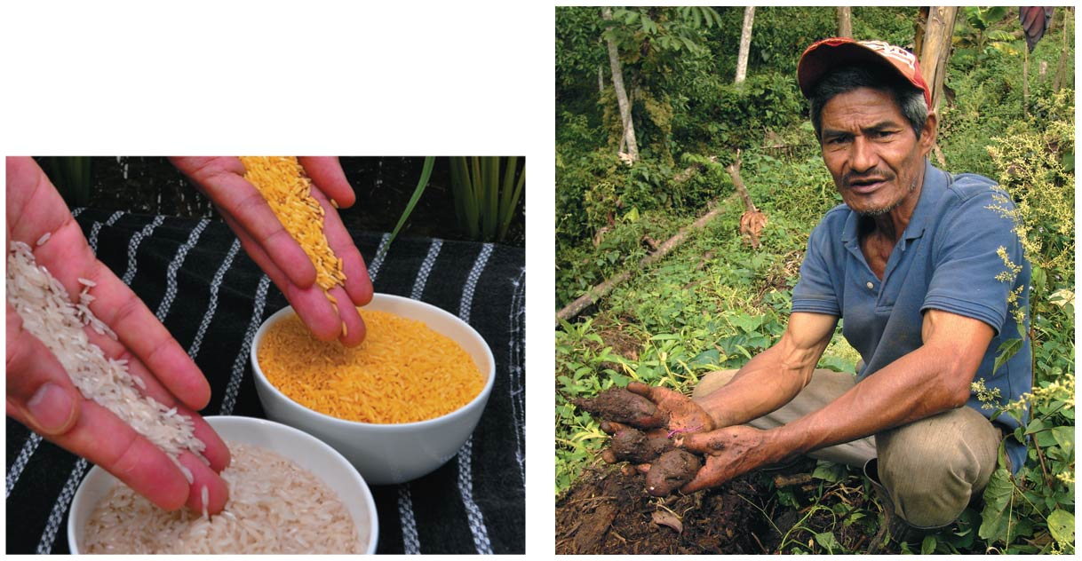
Figure 12.10
Notes:
Figure 12.10 Genetically modified staple crops

Slide 44
Genetically Modified Organisms in Agriculture
Genetic engineers are targeting agricultural animals as well as plant crops.
  A gene that causes the development of larger muscles and transfer it to other cattle or even to chickens. – not yet approved by US Food and Drug Administration (FDA)
Notes:
44
Student Misconceptions and Concerns
1. Student comprehension of restriction enzymes and many other aspects of recombinant DNA techniques depends upon a comfortable understanding of basic molecular genetics. Consider addressing Chapter 12 after an exam that addresses the content in Chapters 10 and 11.
2. The genetic engineering of organisms can be controversial, creating various degrees of social unease and resistance. Yet many debates about scientific issues are confused by misinformation. This provides an opportunity for you to ask students to research an issue before taking firm positions. Students might debate whether a food or drug made from GM/transgenic organisms should be labeled as such, or discuss the risks and advantages of producing GM organisms. Consider starting class with a headline addressing one of these issues. The recent process of FDA approval for raising genetically engineered salmon (AquAdvantage) for food might be particularly useful and relevant.
3. The fact that the technologies described in this chapter can be used to swap genes between prokaryotes and eukaryotes reveals the fundamental similarities in genetic mechanisms shared by all forms of life. This very strong evidence of common descent is evidence of evolution that may be missed by your students.
4. Using gene therapy to “fix” genetic problems relies on a thorough understanding of the roles of genes and alleles. Students might benefit from a discussion of the extent to which we as a society might want to consider directing our own genetics.
Teaching Tips
1. Annual flu vaccinations are a common example of using vaccines to prevent diseases that cannot be easily cured. However, students might not understand why many people receive the vaccine every year. A new annual vaccine is necessary because the flu viruses keep evolving.
2. The origin of the name “restriction enzymes” may be of interest. In nature, these enzymes protect bacterial cells against foreign DNA. Thus, these enzymes “restrict” the invasion of foreign genetic material.
3. Students might think you are just making a bad joke by noting that laboratory synthesized genes are “designer genes,” but this is a common term. Search the Internet using the keywords “designer genes,” and many scientific (and unscientific) sites will be found.
4. Separating marker ink using paper chromatography is a simple experiment that approximates some of what occurs in gel electrophoresis. Consider doing this as a class demonstration while addressing electrophoresis. Cut a large piece of filter paper into a rectangle or square. Use markers to color large dots about 2 cm away from the edge of the paper. Separate the dots from each other by 3–4 cm. Place the paper on edge, dots down, into a beaker containing about 1 cm of ethanol or isopropyl alcohol (50% or higher will do). The dots should not be in contact with the pool of alcohol in the bottom of the beaker. As the alcohol is drawn up the filter paper by capillary action, the alcohol will dissolve the ink dots. As the alcohol continues up the paper, the ink follows. Not all of the ink components move at the same speed, based on their size and chemical properties. If you begin the process at the start of class, you should have some degree of separation by the end of a 50-minute period. Experiment with the technique a day or two before class to fine-tune the demonstration, and experiment with different types of ink. (Save and air-dry these samples for your class.) Consider using brown, green, and black markers, as these colors are often made by color combinations.
5. Roundup Ready Corn, a product of Monsanto, is resistant to the herbicide Roundup. The general strategy for farmers is to spray fields of Roundup Ready Corn with the herbicide Roundup, killing weeds but not the corn. A search of the Internet will quickly reveal the controversy associated with this and other genetically modified organisms (GMOs), which can encourage interesting discussions and promote critical thinking skills.
6. As gene therapy technology expands, our ability to modify the genome in human embryos through in vitro fertilization permits genetic modification at the earliest stages of life. Future generations of humans, like our crops today, may include those with and without a genetically modified ancestry. The benefits and challenges of these technologies raise issues many students have never considered. Our students, and the generations soon to follow, may face the potential of directed human evolution.
7. Ethical, legal, and social issues related to the Human Genome Project are directly addressed at the Department of Energy Human Genome website at http://web.ornl.gov/sci/techresources/Human_Genome/elsi/index.shtml.
8. The Biology and Society end-of-chapter textbook questions address some of the issues raised in this chapter section.
Active Lecture Tips
1. As you begin to address genetic engineering and GMO foods, ask students to work in small groups to discuss what they know about genetically engineered food. Have each group create a list of statements that can be short or long, reflecting their impressions of the technology. The results may surprise you and help you address some common misunderstandings and concerns.
2. If you have already addressed basic transcription and translation in your course, consider asking small groups of students in your class to explain the following. DNA technology is primarily used to produce proteins. Why aren’t lipids and carbohydrates typically produced by these processes?

Slide 45
Genetically Modified Organisms in Agriculture
AquAdvantage is a trade name for Atlantic salmon that have been genetically modified to reach market size in half the normal time (18 months vs. 3 years).
  The US Food and Drug Administration (FDA) approved AquAdvantage salmon in 2015
  The first GM animal approved for consumption in the United States.
Notes:
45
Student Misconceptions and Concerns
1. Student comprehension of restriction enzymes and many other aspects of recombinant DNA techniques depends upon a comfortable understanding of basic molecular genetics. Consider addressing Chapter 12 after an exam that addresses the content in Chapters 10 and 11.
2. The genetic engineering of organisms can be controversial, creating various degrees of social unease and resistance. Yet many debates about scientific issues are confused by misinformation. This provides an opportunity for you to ask students to research an issue before taking firm positions. Students might debate whether a food or drug made from GM/transgenic organisms should be labeled as such, or discuss the risks and advantages of producing GM organisms. Consider starting class with a headline addressing one of these issues. The recent process of FDA approval for raising genetically engineered salmon (AquAdvantage) for food might be particularly useful and relevant.
3. The fact that the technologies described in this chapter can be used to swap genes between prokaryotes and eukaryotes reveals the fundamental similarities in genetic mechanisms shared by all forms of life. This very strong evidence of common descent is evidence of evolution that may be missed by your students.
4. Using gene therapy to “fix” genetic problems relies on a thorough understanding of the roles of genes and alleles. Students might benefit from a discussion of the extent to which we as a society might want to consider directing our own genetics.
Teaching Tips
1. Annual flu vaccinations are a common example of using vaccines to prevent diseases that cannot be easily cured. However, students might not understand why many people receive the vaccine every year. A new annual vaccine is necessary because the flu viruses keep evolving.
2. The origin of the name “restriction enzymes” may be of interest. In nature, these enzymes protect bacterial cells against foreign DNA. Thus, these enzymes “restrict” the invasion of foreign genetic material.
3. Students might think you are just making a bad joke by noting that laboratory synthesized genes are “designer genes,” but this is a common term. Search the Internet using the keywords “designer genes,” and many scientific (and unscientific) sites will be found.
4. Separating marker ink using paper chromatography is a simple experiment that approximates some of what occurs in gel electrophoresis. Consider doing this as a class demonstration while addressing electrophoresis. Cut a large piece of filter paper into a rectangle or square. Use markers to color large dots about 2 cm away from the edge of the paper. Separate the dots from each other by 3–4 cm. Place the paper on edge, dots down, into a beaker containing about 1 cm of ethanol or isopropyl alcohol (50% or higher will do). The dots should not be in contact with the pool of alcohol in the bottom of the beaker. As the alcohol is drawn up the filter paper by capillary action, the alcohol will dissolve the ink dots. As the alcohol continues up the paper, the ink follows. Not all of the ink components move at the same speed, based on their size and chemical properties. If you begin the process at the start of class, you should have some degree of separation by the end of a 50-minute period. Experiment with the technique a day or two before class to fine-tune the demonstration, and experiment with different types of ink. (Save and air-dry these samples for your class.) Consider using brown, green, and black markers, as these colors are often made by color combinations.
5. Roundup Ready Corn, a product of Monsanto, is resistant to the herbicide Roundup. The general strategy for farmers is to spray fields of Roundup Ready Corn with the herbicide Roundup, killing weeds but not the corn. A search of the Internet will quickly reveal the controversy associated with this and other genetically modified organisms (GMOs), which can encourage interesting discussions and promote critical thinking skills.
6. As gene therapy technology expands, our ability to modify the genome in human embryos through in vitro fertilization permits genetic modification at the earliest stages of life. Future generations of humans, like our crops today, may include those with and without a genetically modified ancestry. The benefits and challenges of these technologies raise issues many students have never considered. Our students, and the generations soon to follow, may face the potential of directed human evolution.
7. Ethical, legal, and social issues related to the Human Genome Project are directly addressed at the Department of Energy Human Genome website at http://web.ornl.gov/sci/techresources/Human_Genome/elsi/index.shtml.
8. The Biology and Society end-of-chapter textbook questions address some of the issues raised in this chapter section.
Active Lecture Tips
1. As you begin to address genetic engineering and GMO foods, ask students to work in small groups to discuss what they know about genetically engineered food. Have each group create a list of statements that can be short or long, reflecting their impressions of the technology. The results may surprise you and help you address some common misunderstandings and concerns.
2. If you have already addressed basic transcription and translation in your course, consider asking small groups of students in your class to explain the following. DNA technology is primarily used to produce proteins. Why aren’t lipids and carbohydrates typically produced by these processes?

Slide 46
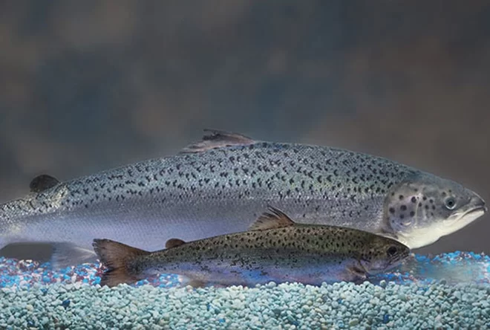

Slide 47
Human Gene Therapy
Human gene therapy is intended to treat disease by introducing genes into an afflicted person.
  In cases where a single defective gene causes a disorder, the mutant version of a gene may be replaced or supplemented with the normal allele.
  This could potentially correct a genetic disorder, perhaps permanently.
  In other cases, genes are inserted and expressed only long enough to treat a medical problem.
  Figure 12.11 summarizes one approach to human gene therapy.
Notes:
47

Slide 48
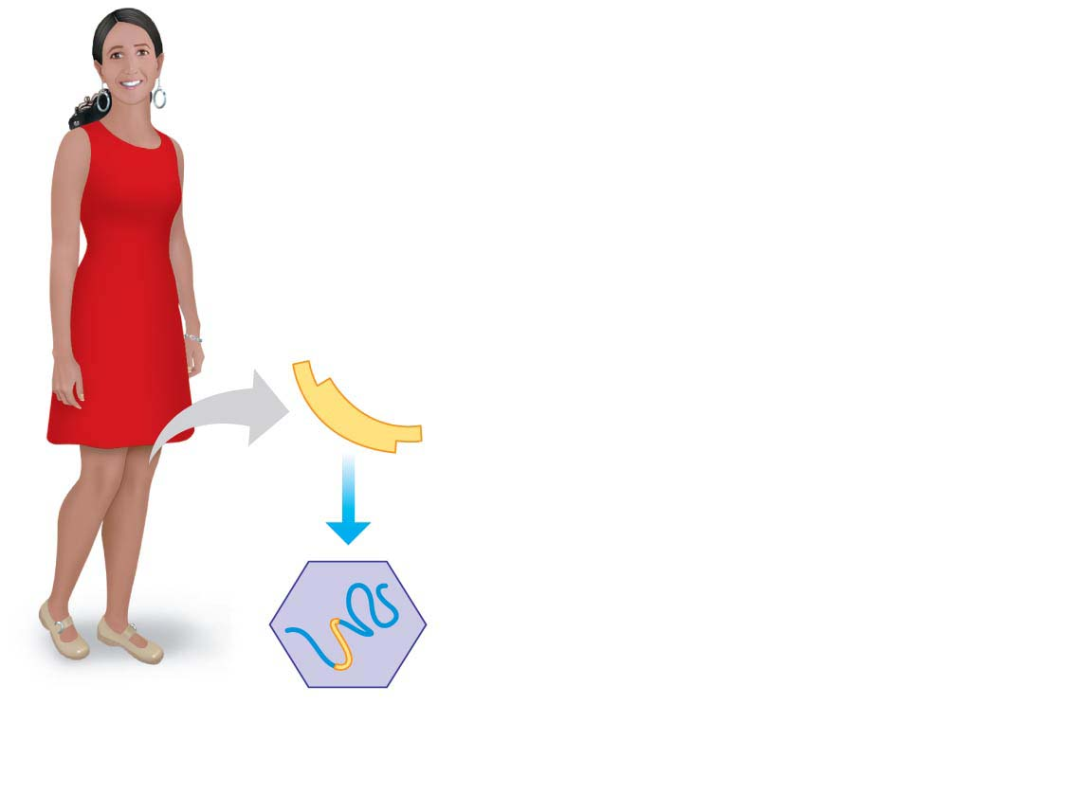
Figure 12.11-1
Normal
human gene
1
An RNA version is
inserted into a virus
RNA genome of virus
Inserted human RNA
Healthy
person
Notes:
Figure 12.11-1 One approach to human gene therapy (part 1: virus with inserted human RNA)

Slide 49
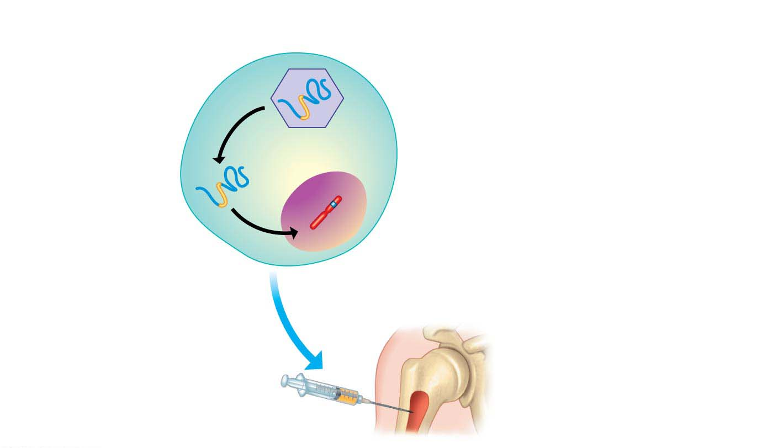
Figure 12.11-2
2
Bone marrow
cells are infected
3
Viral DNA inserts into
the cell’s chromosome
Human chromosome
Bone marrow
cell from the patient
Bone of person
with disease
4
The engineered
cells are injected
Bone marrow
Notes:
Figure 12.11-2 One approach to human gene therapy (part 2: engineered bone marrow cells)

Slide 50
Human Gene Therapy
The promise of gene therapy thus far exceeds actual results, but there have been some successes.
Notes:
50

Slide 51
Human Gene Therapy
In 2009, an international research team conducted a trial that focused on a form of progressive blindness linked to a defect in a gene responsible for producing light-detecting pigments in the eye.
  The researchers found that a single injection of a virus carrying the normal gene into one eye of affected children improved vision in that eye, sometimes enough to allow normal functioning, without significant side effects.
  The other eye was left untreated as a control.
Notes:
51
Student Misconceptions and Concerns
1. Student comprehension of restriction enzymes and many other aspects of recombinant DNA techniques depends upon a comfortable understanding of basic molecular genetics. Consider addressing Chapter 12 after an exam that addresses the content in Chapters 10 and 11.
2. The genetic engineering of organisms can be controversial, creating various degrees of social unease and resistance. Yet many debates about scientific issues are confused by misinformation. This provides an opportunity for you to ask students to research an issue before taking firm positions. Students might debate whether a food or drug made from GM/transgenic organisms should be labeled as such, or discuss the risks and advantages of producing GM organisms. Consider starting class with a headline addressing one of these issues. The recent process of FDA approval for raising genetically engineered salmon (AquAdvantage) for food might be particularly useful and relevant.
3. The fact that the technologies described in this chapter can be used to swap genes between prokaryotes and eukaryotes reveals the fundamental similarities in genetic mechanisms shared by all forms of life. This very strong evidence of common descent is evidence of evolution that may be missed by your students.
4. Using gene therapy to “fix” genetic problems relies on a thorough understanding of the roles of genes and alleles. Students might benefit from a discussion of the extent to which we as a society might want to consider directing our own genetics.
Teaching Tips
1. Annual flu vaccinations are a common example of using vaccines to prevent diseases that cannot be easily cured. However, students might not understand why many people receive the vaccine every year. A new annual vaccine is necessary because the flu viruses keep evolving.
2. The origin of the name “restriction enzymes” may be of interest. In nature, these enzymes protect bacterial cells against foreign DNA. Thus, these enzymes “restrict” the invasion of foreign genetic material.
3. Students might think you are just making a bad joke by noting that laboratory synthesized genes are “designer genes,” but this is a common term. Search the Internet using the keywords “designer genes,” and many scientific (and unscientific) sites will be found.
4. Separating marker ink using paper chromatography is a simple experiment that approximates some of what occurs in gel electrophoresis. Consider doing this as a class demonstration while addressing electrophoresis. Cut a large piece of filter paper into a rectangle or square. Use markers to color large dots about 2 cm away from the edge of the paper. Separate the dots from each other by 3–4 cm. Place the paper on edge, dots down, into a beaker containing about 1 cm of ethanol or isopropyl alcohol (50% or higher will do). The dots should not be in contact with the pool of alcohol in the bottom of the beaker. As the alcohol is drawn up the filter paper by capillary action, the alcohol will dissolve the ink dots. As the alcohol continues up the paper, the ink follows. Not all of the ink components move at the same speed, based on their size and chemical properties. If you begin the process at the start of class, you should have some degree of separation by the end of a 50-minute period. Experiment with the technique a day or two before class to fine-tune the demonstration, and experiment with different types of ink. (Save and air-dry these samples for your class.) Consider using brown, green, and black markers, as these colors are often made by color combinations.
5. Roundup Ready Corn, a product of Monsanto, is resistant to the herbicide Roundup. The general strategy for farmers is to spray fields of Roundup Ready Corn with the herbicide Roundup, killing weeds but not the corn. A search of the Internet will quickly reveal the controversy associated with this and other genetically modified organisms (GMOs), which can encourage interesting discussions and promote critical thinking skills.
6. As gene therapy technology expands, our ability to modify the genome in human embryos through in vitro fertilization permits genetic modification at the earliest stages of life. Future generations of humans, like our crops today, may include those with and without a genetically modified ancestry. The benefits and challenges of these technologies raise issues many students have never considered. Our students, and the generations soon to follow, may face the potential of directed human evolution.
7. Ethical, legal, and social issues related to the Human Genome Project are directly addressed at the Department of Energy Human Genome website at http://web.ornl.gov/sci/techresources/Human_Genome/elsi/index.shtml.
8. The Biology and Society end-of-chapter textbook questions address some of the issues raised in this chapter section.
Active Lecture Tips
1. As you begin to address genetic engineering and GMO foods, ask students to work in small groups to discuss what they know about genetically engineered food. Have each group create a list of statements that can be short or long, reflecting their impressions of the technology. The results may surprise you and help you address some common misunderstandings and concerns.
2. If you have already addressed basic transcription and translation in your course, consider asking small groups of students in your class to explain the following. DNA technology is primarily used to produce proteins. Why aren’t lipids and carbohydrates typically produced by these processes?

Slide 52
Human Gene Therapy
From 2000 to 2011, gene therapy also cured 22 children with severe combined immunodeficiency (SCID), a fatal inherited disease caused by a defective gene that prevents development of the immune system, requiring patients to remain isolated within protective “bubbles.”
The treatment cured the patients of SCID, but there have been some serious side effects:
  Four of the treated patients developed leukemia, and one died after the inserted gene activated an oncogene, creating cancerous blood cells.
Notes:
52

Slide 53
stopped here on 11/15

Slide 54
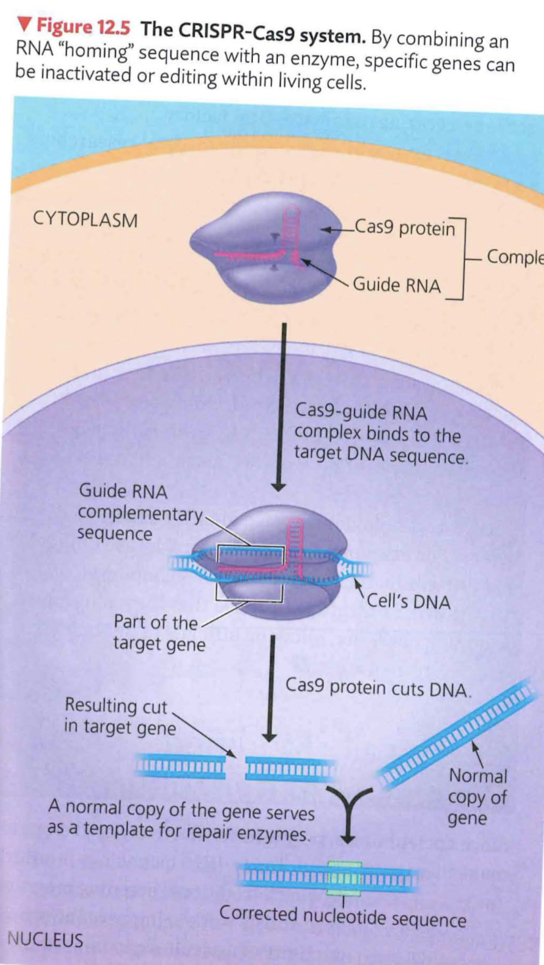
CRISPR-CAS9
CAS9 – protein that is able to cut through the double stranded backbone of DNA.
Guide RNA – tells CAS9 where to cut

Slide 55

RadioLab Part 2
https://www.wnycstudios.org/shows/radiolab/podcasts
‘antibodies part1’ – CRISPR-Cas9 (12th page back)
second part – start at 25:30

Slide 56
DNA Profiling and Forensic Science
DNA profiling
  is the analysis of DNA samples to determine whether they come from the same individual and
  has rapidly transformed the field of forensics, the scientific analysis of evidence for crime scene investigations and other legal proceedings.
To produce a DNA profile, scientists compare sequences in the genome that vary from person to person.
Figure 12.12 presents an overview of a typical investigation using DNA profiling.
Notes:
56

Slide 57
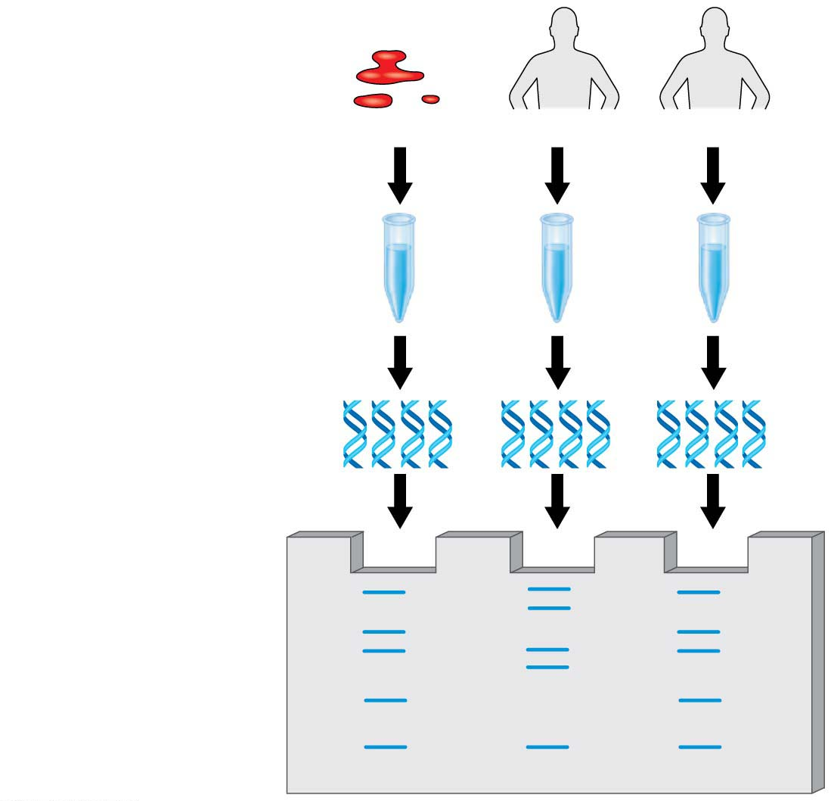
Figure 12.12
Crime scene
Suspect 1
Suspect 2
1
DNA isolated
2
DNA amplified
3
DNA compared
Notes:
Figure 12.12 Overview of DNA profiling

Slide 58
DNA Profiling Techniques
The Polymerase Chain Reaction (PCR)
The polymerase chain reaction (PCR)
  is a technique by which a specific segment of DNA can be amplified: targeted and copied quickly and precisely, and
  permits a scientist to obtain enough DNA from even minute amounts of blood or other tissue to allow a DNA profile to be constructed.
Notes:
58
Student Misconceptions and Concerns
1. Television programs might lead some students to expect that DNA profiling is quick and easy. Ask students to consider why DNA profiling actually takes many days or weeks to complete.
2. Students might expect DNA profiling for criminal investigations to involve an analysis of the entire human genome. Consider explaining why such an analysis is unrealistic and unnecessary.
3. The many forms of DNA technology discussed in this chapter provide powerful evidence of evolution. Although not addressed regularly in this chapter, consider reminding students that these techniques continue to reinforce and inform our understandings of the common descent of life on Earth.
Teaching Tips
1. Although the statistical odds of a DNA-profiling match can exceed one in 10 billion, the odds of a mistake in the collecting and testing procedures can be much greater. This is an important distinction. An error as simple as mislabeling a sample can confuse the results. Unfortunately, the odds of human error will vary and are difficult to determine.
2. In PCR, the product becomes another master copy. Imagine that while you are photocopying, every copy is used as a master at another copy machine. (This would require many copy machines.)
3. Students might need a little more practice understanding the products of restriction enzymes. Consider the two words, equilibrium and equalibrium. Imagine that a mutation produced the spelling error in the second word. If we used a “restriction enzyme” that splits these words between “u” and “i,” how will the fragments compare in size and number?
equilibrium = equ ilibri um (three fragments of three, six, and two letters)
equalibrium = equalibri um (two fragments of nine and two letters)
Active Lecture Tips
1. In most legal cases, the probability of two people having identical DNA profiles can be one in 10 billion or more. However, eyewitness testimony has been a standard part of the justice system. If you want to make the point about the unreliability of eyewitnesses in a trial, compared to techniques such as genetic profiling, consider this exercise. Arrange for a person who is not well known to the class to run into your classroom, take something you have placed near you (perhaps a bag, stack of papers, box), and leave quickly. You need to take care that no one in the class is so alarmed as to do something dangerous. Once the “thief” is gone, tell the class that this was planned but not to speak. Have them each write a description of the person, including height, hair color, clothing, facial hair, behavior, and so on. Many students will be accurate, but some will likely get details wrong. This is also an effective exercise to demonstrate the need for large sample sizes and accurate recording devices for good scientific technique.

Slide 59
The Polymerase Chain Reaction (PCR)
In principle, PCR is simple.
  A DNA sample is mixed with nucleotides, the DNA replication enzyme DNA polymerase, and a few other ingredients.
  The solution is then exposed to cycles of heating (to separate the DNA strands) and cooling (to allow double-stranded DNA to re-form).
  During these cycles, specific regions of each molecule of DNA are replicated, doubling the amount of that DNA.
  The result of this chain reaction is an exponentially growing population of identical DNA molecules.
Notes:
59
Student Misconceptions and Concerns
1. Television programs might lead some students to expect that DNA profiling is quick and easy. Ask students to consider why DNA profiling actually takes many days or weeks to complete.
2. Students might expect DNA profiling for criminal investigations to involve an analysis of the entire human genome. Consider explaining why such an analysis is unrealistic and unnecessary.
3. The many forms of DNA technology discussed in this chapter provide powerful evidence of evolution. Although not addressed regularly in this chapter, consider reminding students that these techniques continue to reinforce and inform our understandings of the common descent of life on Earth.
Teaching Tips
1. Although the statistical odds of a DNA-profiling match can exceed one in 10 billion, the odds of a mistake in the collecting and testing procedures can be much greater. This is an important distinction. An error as simple as mislabeling a sample can confuse the results. Unfortunately, the odds of human error will vary and are difficult to determine.
2. In PCR, the product becomes another master copy. Imagine that while you are photocopying, every copy is used as a master at another copy machine. (This would require many copy machines.)
3. Students might need a little more practice understanding the products of restriction enzymes. Consider the two words, equilibrium and equalibrium. Imagine that a mutation produced the spelling error in the second word. If we used a “restriction enzyme” that splits these words between “u” and “i,” how will the fragments compare in size and number?
equilibrium = equ ilibri um (three fragments of three, six, and two letters)
equalibrium = equalibri um (two fragments of nine and two letters)
Active Lecture Tips
1. In most legal cases, the probability of two people having identical DNA profiles can be one in 10 billion or more. However, eyewitness testimony has been a standard part of the justice system. If you want to make the point about the unreliability of eyewitnesses in a trial, compared to techniques such as genetic profiling, consider this exercise. Arrange for a person who is not well known to the class to run into your classroom, take something you have placed near you (perhaps a bag, stack of papers, box), and leave quickly. You need to take care that no one in the class is so alarmed as to do something dangerous. Once the “thief” is gone, tell the class that this was planned but not to speak. Have them each write a description of the person, including height, hair color, clothing, facial hair, behavior, and so on. Many students will be accurate, but some will likely get details wrong. This is also an effective exercise to demonstrate the need for large sample sizes and accurate recording devices for good scientific technique.

Slide 60
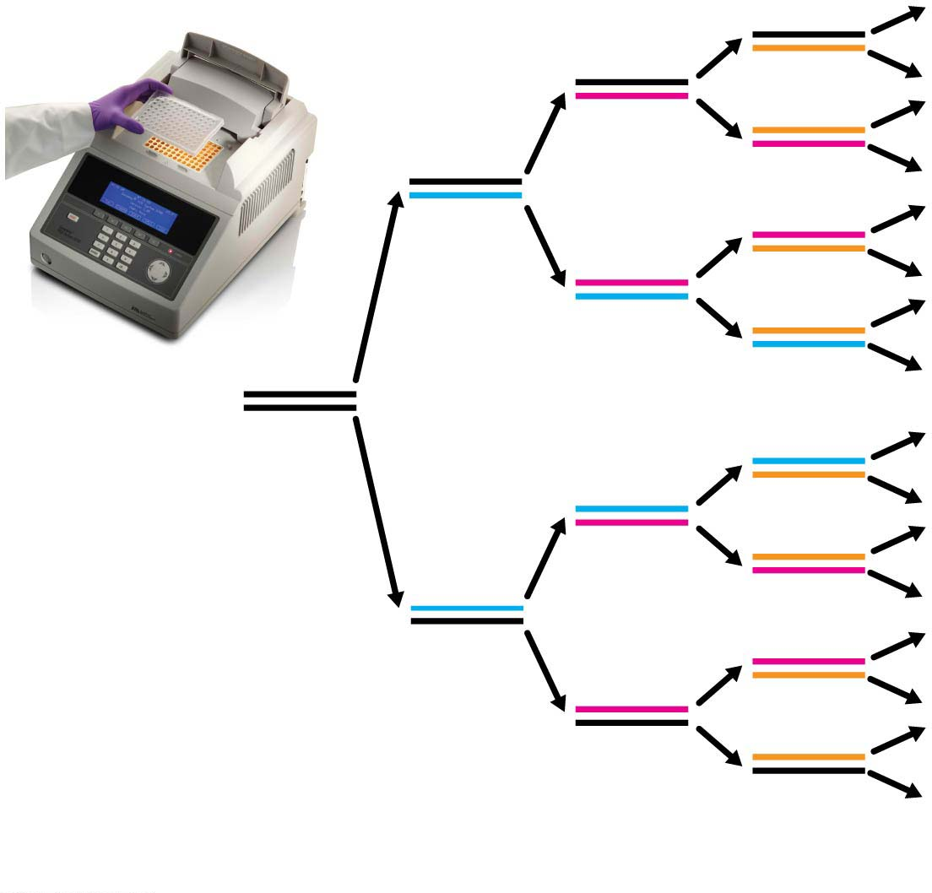
Figure 12.13
Initial
DNA
segment
1
2
4
8
Number of DNA molecules
Notes:
Figure 12.13 DNA amplification by PCR

Slide 61
The Polymerase Chain Reaction (PCR)
A DNA molecule within a starting sample is likely to be very long. But, most often, only a very small target region of that large DNA molecule needs to be amplified.
The key to amplifying one particular segment of DNA and no others is the use of primers, short (usually 15–20 nucleotides long), chemically synthesized single-stranded DNA molecules.
The primers bind to sequences that flank the target sequence, marking the start and end points for the segment of DNA to be amplified.
Notes:
61
Student Misconceptions and Concerns
1. Television programs might lead some students to expect that DNA profiling is quick and easy. Ask students to consider why DNA profiling actually takes many days or weeks to complete.
2. Students might expect DNA profiling for criminal investigations to involve an analysis of the entire human genome. Consider explaining why such an analysis is unrealistic and unnecessary.
3. The many forms of DNA technology discussed in this chapter provide powerful evidence of evolution. Although not addressed regularly in this chapter, consider reminding students that these techniques continue to reinforce and inform our understandings of the common descent of life on Earth.
Teaching Tips
1. Although the statistical odds of a DNA-profiling match can exceed one in 10 billion, the odds of a mistake in the collecting and testing procedures can be much greater. This is an important distinction. An error as simple as mislabeling a sample can confuse the results. Unfortunately, the odds of human error will vary and are difficult to determine.
2. In PCR, the product becomes another master copy. Imagine that while you are photocopying, every copy is used as a master at another copy machine. (This would require many copy machines.)
3. Students might need a little more practice understanding the products of restriction enzymes. Consider the two words, equilibrium and equalibrium. Imagine that a mutation produced the spelling error in the second word. If we used a “restriction enzyme” that splits these words between “u” and “i,” how will the fragments compare in size and number?
equilibrium = equ ilibri um (three fragments of three, six, and two letters)
equalibrium = equalibri um (two fragments of nine and two letters)
Active Lecture Tips
1. In most legal cases, the probability of two people having identical DNA profiles can be one in 10 billion or more. However, eyewitness testimony has been a standard part of the justice system. If you want to make the point about the unreliability of eyewitnesses in a trial, compared to techniques such as genetic profiling, consider this exercise. Arrange for a person who is not well known to the class to run into your classroom, take something you have placed near you (perhaps a bag, stack of papers, box), and leave quickly. You need to take care that no one in the class is so alarmed as to do something dangerous. Once the “thief” is gone, tell the class that this was planned but not to speak. Have them each write a description of the person, including height, hair color, clothing, facial hair, behavior, and so on. Many students will be accurate, but some will likely get details wrong. This is also an effective exercise to demonstrate the need for large sample sizes and accurate recording devices for good scientific technique.

Slide 62
The Polymerase Chain Reaction (PCR)
In addition to forensic applications, PCR can be used in the treatment and diagnosis of disease. PCR can be used to
  amplify, and thus detect, HIV in blood or tissue samples and
  diagnose hundreds of human genetic disorders by being used with primers that target the genes associated with these disorders.
Notes:
62
Student Misconceptions and Concerns
1. Television programs might lead some students to expect that DNA profiling is quick and easy. Ask students to consider why DNA profiling actually takes many days or weeks to complete.
2. Students might expect DNA profiling for criminal investigations to involve an analysis of the entire human genome. Consider explaining why such an analysis is unrealistic and unnecessary.
3. The many forms of DNA technology discussed in this chapter provide powerful evidence of evolution. Although not addressed regularly in this chapter, consider reminding students that these techniques continue to reinforce and inform our understandings of the common descent of life on Earth.
Teaching Tips
1. Although the statistical odds of a DNA-profiling match can exceed one in 10 billion, the odds of a mistake in the collecting and testing procedures can be much greater. This is an important distinction. An error as simple as mislabeling a sample can confuse the results. Unfortunately, the odds of human error will vary and are difficult to determine.
2. In PCR, the product becomes another master copy. Imagine that while you are photocopying, every copy is used as a master at another copy machine. (This would require many copy machines.)
3. Students might need a little more practice understanding the products of restriction enzymes. Consider the two words, equilibrium and equalibrium. Imagine that a mutation produced the spelling error in the second word. If we used a “restriction enzyme” that splits these words between “u” and “i,” how will the fragments compare in size and number?
equilibrium = equ ilibri um (three fragments of three, six, and two letters)
equalibrium = equalibri um (two fragments of nine and two letters)
Active Lecture Tips
1. In most legal cases, the probability of two people having identical DNA profiles can be one in 10 billion or more. However, eyewitness testimony has been a standard part of the justice system. If you want to make the point about the unreliability of eyewitnesses in a trial, compared to techniques such as genetic profiling, consider this exercise. Arrange for a person who is not well known to the class to run into your classroom, take something you have placed near you (perhaps a bag, stack of papers, box), and leave quickly. You need to take care that no one in the class is so alarmed as to do something dangerous. Once the “thief” is gone, tell the class that this was planned but not to speak. Have them each write a description of the person, including height, hair color, clothing, facial hair, behavior, and so on. Many students will be accurate, but some will likely get details wrong. This is also an effective exercise to demonstrate the need for large sample sizes and accurate recording devices for good scientific technique.

Slide 63
Gel Electrophoresis
To separate and visualize DNA fragments of different lengths, researchers carry out a technique called gel electrophoresis, a method for sorting macromolecules, usually proteins or nucleic acids, primarily by their electrical charge and size.
Figure 12.5 shows how gel electrophoresis separates DNA fragments obtained from different sources.
Notes:
63
Student Misconceptions and Concerns
1. Student comprehension of restriction enzymes and many other aspects of recombinant DNA techniques depends upon a comfortable understanding of basic molecular genetics. Consider addressing Chapter 12 after an exam that addresses the content in Chapters 10 and 11.
2. The genetic engineering of organisms can be controversial, creating various degrees of social unease and resistance. Yet many debates about scientific issues are confused by misinformation. This provides an opportunity for you to ask students to research an issue before taking firm positions. Students might debate whether a food or drug made from GM/transgenic organisms should be labeled as such, or discuss the risks and advantages of producing GM organisms. Consider starting class with a headline addressing one of these issues. The recent process of FDA approval for raising genetically engineered salmon (AquAdvantage) for food might be particularly useful and relevant.
3. The fact that the technologies described in this chapter can be used to swap genes between prokaryotes and eukaryotes reveals the fundamental similarities in genetic mechanisms shared by all forms of life. This very strong evidence of common descent is evidence of evolution that may be missed by your students.
4. Using gene therapy to “fix” genetic problems relies on a thorough understanding of the roles of genes and alleles. Students might benefit from a discussion of the extent to which we as a society might want to consider directing our own genetics.
Teaching Tips
1. Annual flu vaccinations are a common example of using vaccines to prevent diseases that cannot be easily cured. However, students might not understand why many people receive the vaccine every year. A new annual vaccine is necessary because the flu viruses keep evolving.
2. The origin of the name “restriction enzymes” may be of interest. In nature, these enzymes protect bacterial cells against foreign DNA. Thus, these enzymes “restrict” the invasion of foreign genetic material.
3. Students might think you are just making a bad joke by noting that laboratory synthesized genes are “designer genes,” but this is a common term. Search the Internet using the keywords “designer genes,” and many scientific (and unscientific) sites will be found.
4. Separating marker ink using paper chromatography is a simple experiment that approximates some of what occurs in gel electrophoresis. Consider doing this as a class demonstration while addressing electrophoresis. Cut a large piece of filter paper into a rectangle or square. Use markers to color large dots about 2 cm away from the edge of the paper. Separate the dots from each other by 3–4 cm. Place the paper on edge, dots down, into a beaker containing about 1 cm of ethanol or isopropyl alcohol (50% or higher will do). The dots should not be in contact with the pool of alcohol in the bottom of the beaker. As the alcohol is drawn up the filter paper by capillary action, the alcohol will dissolve the ink dots. As the alcohol continues up the paper, the ink follows. Not all of the ink components move at the same speed, based on their size and chemical properties. If you begin the process at the start of class, you should have some degree of separation by the end of a 50-minute period. Experiment with the technique a day or two before class to fine-tune the demonstration, and experiment with different types of ink. (Save and air-dry these samples for your class.) Consider using brown, green, and black markers, as these colors are often made by color combinations.
5. Roundup Ready Corn, a product of Monsanto, is resistant to the herbicide Roundup. The general strategy for farmers is to spray fields of Roundup Ready Corn with the herbicide Roundup, killing weeds but not the corn. A search of the Internet will quickly reveal the controversy associated with this and other genetically modified organisms (GMOs), which can encourage interesting discussions and promote critical thinking skills.
6. As gene therapy technology expands, our ability to modify the genome in human embryos through in vitro fertilization permits genetic modification at the earliest stages of life. Future generations of humans, like our crops today, may include those with and without a genetically modified ancestry. The benefits and challenges of these technologies raise issues many students have never considered. Our students, and the generations soon to follow, may face the potential of directed human evolution.
7. Ethical, legal, and social issues related to the Human Genome Project are directly addressed at the Department of Energy Human Genome website at http://web.ornl.gov/sci/techresources/Human_Genome/elsi/index.shtml.
8. The Biology and Society end-of-chapter textbook questions address some of the issues raised in this chapter section.
Active Lecture Tips
1. As you begin to address genetic engineering and GMO foods, ask students to work in small groups to discuss what they know about genetically engineered food. Have each group create a list of statements that can be short or long, reflecting their impressions of the technology. The results may surprise you and help you address some common misunderstandings and concerns.
2. If you have already addressed basic transcription and translation in your course, consider asking small groups of students in your class to explain the following. DNA technology is primarily used to produce proteins. Why aren’t lipids and carbohydrates typically produced by these processes?

Slide 64
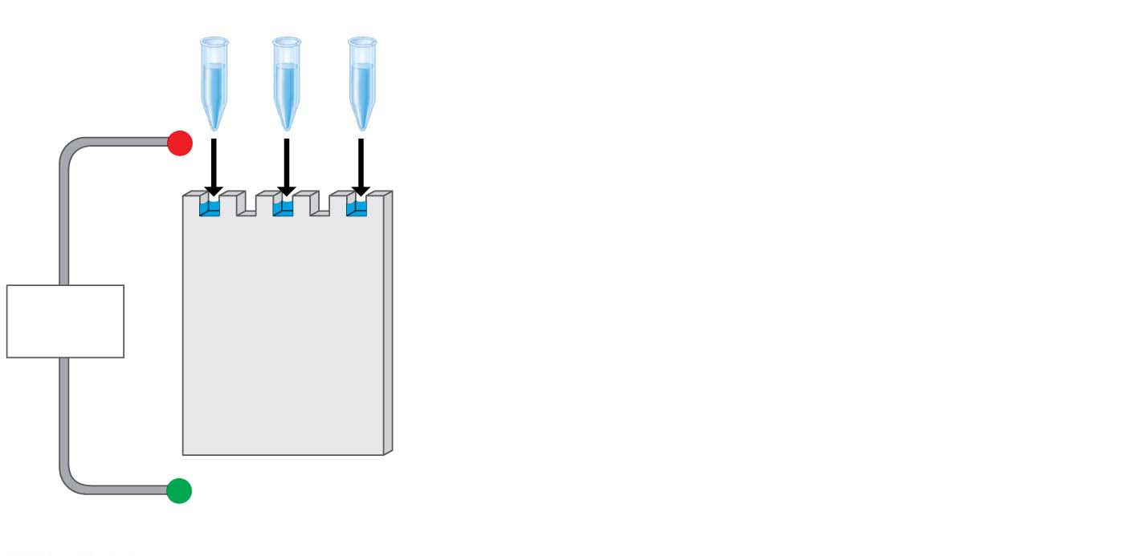
Figure 12.5-s1
Mixture of DNA
fragments of
different sizes
−
Power
source
+
Notes:
Figure 12.5-s1 Gel electrophoresis of DNA molecules (step 1)

Slide 65
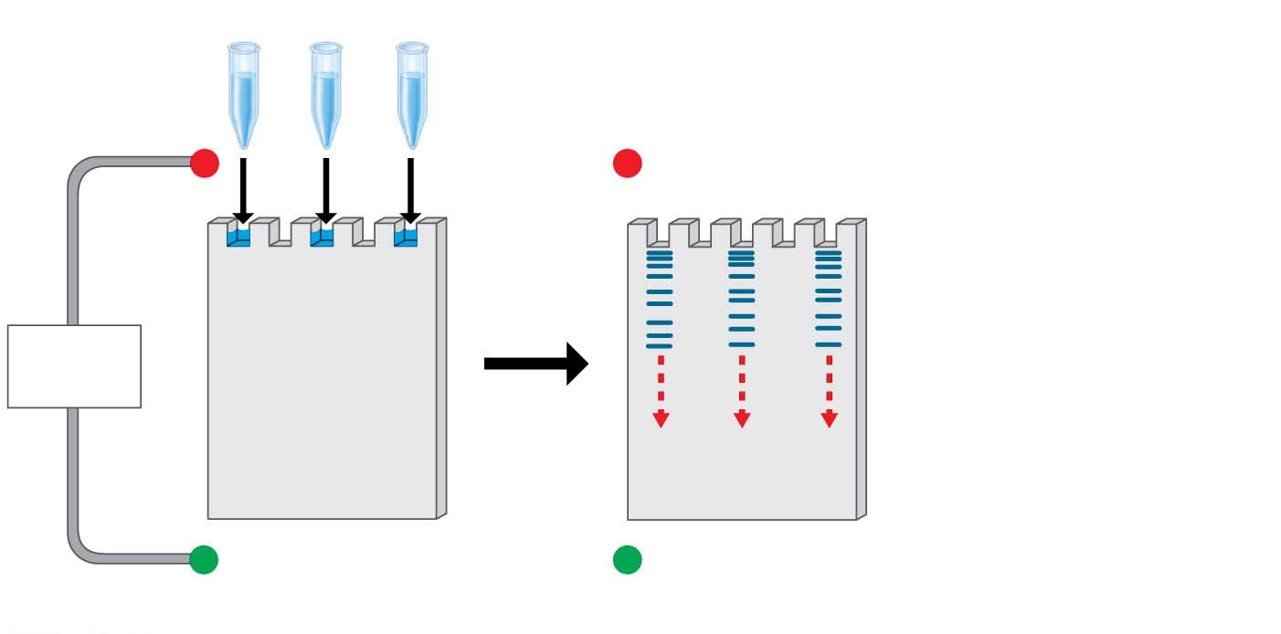
Figure 12.5-s2
Mixture of DNA
fragments of
different sizes
−
−
Power
source
+
+
Notes:
Figure 12.5-s2 Gel electrophoresis of DNA molecules (step 2)

Slide 66
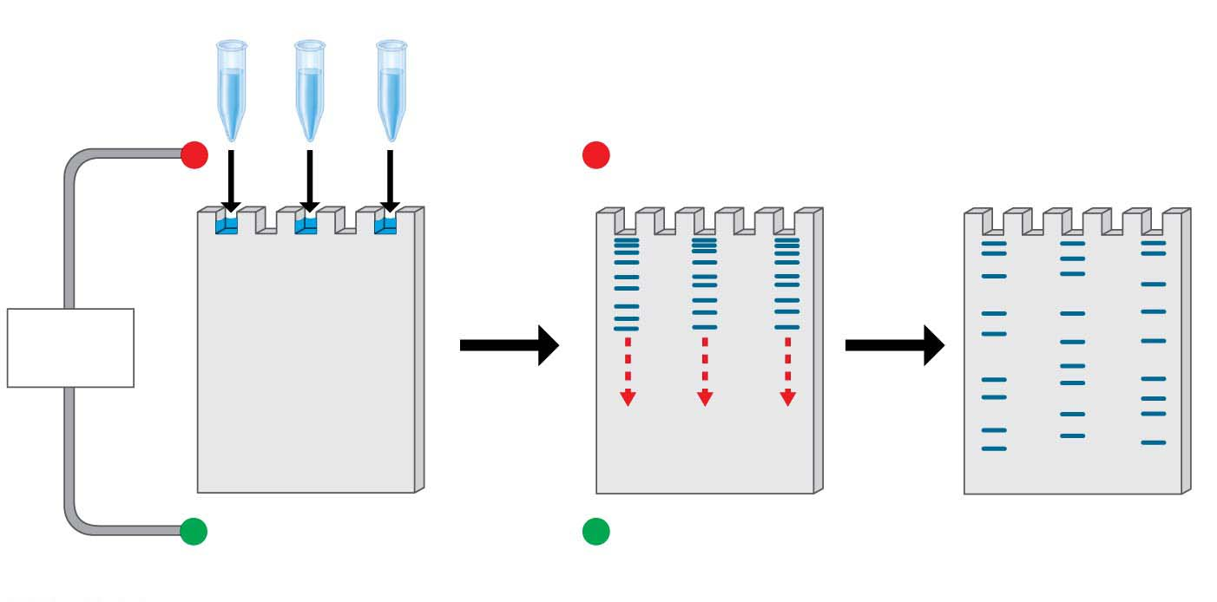
Figure 12.5-s3
Mixture of DNA
fragments of
different sizes
Band of longest
(slowest) fragments
−
−
Power
source
+
+
Band of shortest
(fastest) fragments
Notes:
Figure 12.5-s3 Gel electrophoresis of DNA molecules (step 3)

Slide 67
Short Tandem Repeat (STR) Analysis
How do you prove that two samples of DNA come from the same person?
Repetitive DNA
  makes up much of the DNA that lies between genes in humans and
  consists of nucleotide sequences that are present in multiple copies in the genome.
Notes:
67
Student Misconceptions and Concerns
1. Television programs might lead some students to expect that DNA profiling is quick and easy. Ask students to consider why DNA profiling actually takes many days or weeks to complete.
2. Students might expect DNA profiling for criminal investigations to involve an analysis of the entire human genome. Consider explaining why such an analysis is unrealistic and unnecessary.
3. The many forms of DNA technology discussed in this chapter provide powerful evidence of evolution. Although not addressed regularly in this chapter, consider reminding students that these techniques continue to reinforce and inform our understandings of the common descent of life on Earth.
Teaching Tips
1. Although the statistical odds of a DNA-profiling match can exceed one in 10 billion, the odds of a mistake in the collecting and testing procedures can be much greater. This is an important distinction. An error as simple as mislabeling a sample can confuse the results. Unfortunately, the odds of human error will vary and are difficult to determine.
2. In PCR, the product becomes another master copy. Imagine that while you are photocopying, every copy is used as a master at another copy machine. (This would require many copy machines.)
3. Students might need a little more practice understanding the products of restriction enzymes. Consider the two words, equilibrium and equalibrium. Imagine that a mutation produced the spelling error in the second word. If we used a “restriction enzyme” that splits these words between “u” and “i,” how will the fragments compare in size and number?
equilibrium = equ ilibri um (three fragments of three, six, and two letters)
equalibrium = equalibri um (two fragments of nine and two letters)
Active Lecture Tips
1. In most legal cases, the probability of two people having identical DNA profiles can be one in 10 billion or more. However, eyewitness testimony has been a standard part of the justice system. If you want to make the point about the unreliability of eyewitnesses in a trial, compared to techniques such as genetic profiling, consider this exercise. Arrange for a person who is not well known to the class to run into your classroom, take something you have placed near you (perhaps a bag, stack of papers, box), and leave quickly. You need to take care that no one in the class is so alarmed as to do something dangerous. Once the “thief” is gone, tell the class that this was planned but not to speak. Have them each write a description of the person, including height, hair color, clothing, facial hair, behavior, and so on. Many students will be accurate, but some will likely get details wrong. This is also an effective exercise to demonstrate the need for large sample sizes and accurate recording devices for good scientific technique.

Slide 68
Short Tandem Repeat (STR) Analysis
Short tandem repeats (STRs) are short sequences of DNA repeated many times, tandemly (one after another), in the genome.
STR analysis
  is a method of DNA profiling and
  compares the lengths of STR sequences at specific sites in the genome.
Notes:
68
Student Misconceptions and Concerns
1. Television programs might lead some students to expect that DNA profiling is quick and easy. Ask students to consider why DNA profiling actually takes many days or weeks to complete.
2. Students might expect DNA profiling for criminal investigations to involve an analysis of the entire human genome. Consider explaining why such an analysis is unrealistic and unnecessary.
3. The many forms of DNA technology discussed in this chapter provide powerful evidence of evolution. Although not addressed regularly in this chapter, consider reminding students that these techniques continue to reinforce and inform our understandings of the common descent of life on Earth.
Teaching Tips
1. Although the statistical odds of a DNA-profiling match can exceed one in 10 billion, the odds of a mistake in the collecting and testing procedures can be much greater. This is an important distinction. An error as simple as mislabeling a sample can confuse the results. Unfortunately, the odds of human error will vary and are difficult to determine.
2. In PCR, the product becomes another master copy. Imagine that while you are photocopying, every copy is used as a master at another copy machine. (This would require many copy machines.)
3. Students might need a little more practice understanding the products of restriction enzymes. Consider the two words, equilibrium and equalibrium. Imagine that a mutation produced the spelling error in the second word. If we used a “restriction enzyme” that splits these words between “u” and “i,” how will the fragments compare in size and number?
equilibrium = equ ilibri um (three fragments of three, six, and two letters)
equalibrium = equalibri um (two fragments of nine and two letters)
Active Lecture Tips
1. In most legal cases, the probability of two people having identical DNA profiles can be one in 10 billion or more. However, eyewitness testimony has been a standard part of the justice system. If you want to make the point about the unreliability of eyewitnesses in a trial, compared to techniques such as genetic profiling, consider this exercise. Arrange for a person who is not well known to the class to run into your classroom, take something you have placed near you (perhaps a bag, stack of papers, box), and leave quickly. You need to take care that no one in the class is so alarmed as to do something dangerous. Once the “thief” is gone, tell the class that this was planned but not to speak. Have them each write a description of the person, including height, hair color, clothing, facial hair, behavior, and so on. Many students will be accurate, but some will likely get details wrong. This is also an effective exercise to demonstrate the need for large sample sizes and accurate recording devices for good scientific technique.

Slide 69
Short Tandem Repeat (STR) Analysis
Consider the two samples of DNA shown in Figure 12.14.
  Imagine that the top DNA segment was obtained at a crime scene and the bottom from a suspect’s blood.
  The two segments have the same number of repeats at the first site: 7 repeats of the four-nucleotide DNA sequence AGAT (in orange).
Notes:
69
Student Misconceptions and Concerns
1. Television programs might lead some students to expect that DNA profiling is quick and easy. Ask students to consider why DNA profiling actually takes many days or weeks to complete.
2. Students might expect DNA profiling for criminal investigations to involve an analysis of the entire human genome. Consider explaining why such an analysis is unrealistic and unnecessary.
3. The many forms of DNA technology discussed in this chapter provide powerful evidence of evolution. Although not addressed regularly in this chapter, consider reminding students that these techniques continue to reinforce and inform our understandings of the common descent of life on Earth.
Teaching Tips
1. Although the statistical odds of a DNA-profiling match can exceed one in 10 billion, the odds of a mistake in the collecting and testing procedures can be much greater. This is an important distinction. An error as simple as mislabeling a sample can confuse the results. Unfortunately, the odds of human error will vary and are difficult to determine.
2. In PCR, the product becomes another master copy. Imagine that while you are photocopying, every copy is used as a master at another copy machine. (This would require many copy machines.)
3. Students might need a little more practice understanding the products of restriction enzymes. Consider the two words, equilibrium and equalibrium. Imagine that a mutation produced the spelling error in the second word. If we used a “restriction enzyme” that splits these words between “u” and “i,” how will the fragments compare in size and number?
equilibrium = equ ilibri um (three fragments of three, six, and two letters)
equalibrium = equalibri um (two fragments of nine and two letters)
Active Lecture Tips
1. In most legal cases, the probability of two people having identical DNA profiles can be one in 10 billion or more. However, eyewitness testimony has been a standard part of the justice system. If you want to make the point about the unreliability of eyewitnesses in a trial, compared to techniques such as genetic profiling, consider this exercise. Arrange for a person who is not well known to the class to run into your classroom, take something you have placed near you (perhaps a bag, stack of papers, box), and leave quickly. You need to take care that no one in the class is so alarmed as to do something dangerous. Once the “thief” is gone, tell the class that this was planned but not to speak. Have them each write a description of the person, including height, hair color, clothing, facial hair, behavior, and so on. Many students will be accurate, but some will likely get details wrong. This is also an effective exercise to demonstrate the need for large sample sizes and accurate recording devices for good scientific technique.

Slide 70
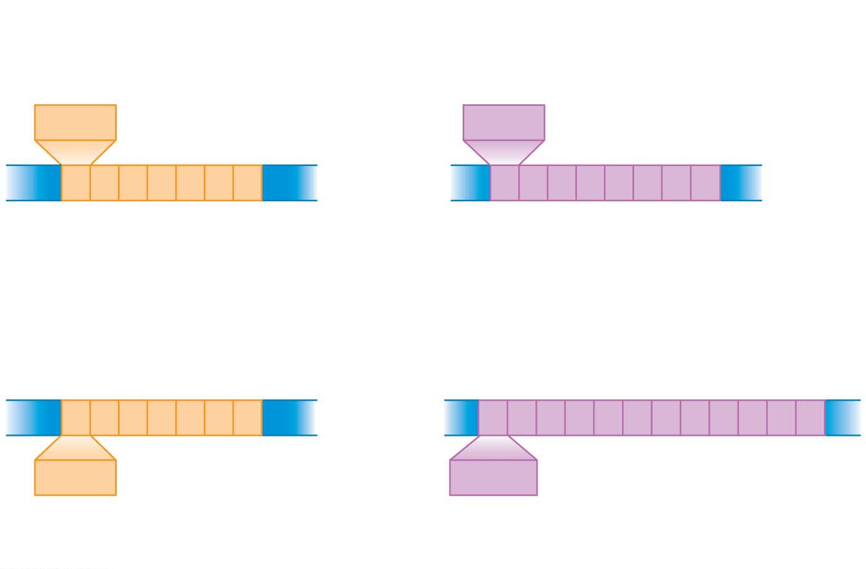
Figure 12.14
Crime scene DNA
STR site 1
STR site 2
AGAT
GATA
Same number of
short tandem repeats
Different numbers of
short tandem repeats
AGAT
GATA
Suspect’s DNA
Notes:
Figure 12.14 Short tandem repeat (STR) sites

Slide 71
Short Tandem Repeat (STR) Analysis
  Notice, however, that they differ in the number of repeats at the second site: 8 repeats of GATA (in purple) in the crime scene DNA compared with 12 repeats in the suspect’s DNA.
  To create a DNA profile, a scientist uses PCR to specifically amplify the regions of DNA that include these STR sites. The resulting fragments are then compared.
  Figure 12.15 shows the gel that would result from using gel electrophoresis to separate the DNA fragments from the example in Figure 12.14.
Notes:
71
Student Misconceptions and Concerns
1. Television programs might lead some students to expect that DNA profiling is quick and easy. Ask students to consider why DNA profiling actually takes many days or weeks to complete.
2. Students might expect DNA profiling for criminal investigations to involve an analysis of the entire human genome. Consider explaining why such an analysis is unrealistic and unnecessary.
3. The many forms of DNA technology discussed in this chapter provide powerful evidence of evolution. Although not addressed regularly in this chapter, consider reminding students that these techniques continue to reinforce and inform our understandings of the common descent of life on Earth.
Teaching Tips
1. Although the statistical odds of a DNA-profiling match can exceed one in 10 billion, the odds of a mistake in the collecting and testing procedures can be much greater. This is an important distinction. An error as simple as mislabeling a sample can confuse the results. Unfortunately, the odds of human error will vary and are difficult to determine.
2. In PCR, the product becomes another master copy. Imagine that while you are photocopying, every copy is used as a master at another copy machine. (This would require many copy machines.)
3. Students might need a little more practice understanding the products of restriction enzymes. Consider the two words, equilibrium and equalibrium. Imagine that a mutation produced the spelling error in the second word. If we used a “restriction enzyme” that splits these words between “u” and “i,” how will the fragments compare in size and number?
equilibrium = equ ilibri um (three fragments of three, six, and two letters)
equalibrium = equalibri um (two fragments of nine and two letters)
Active Lecture Tips
1. In most legal cases, the probability of two people having identical DNA profiles can be one in 10 billion or more. However, eyewitness testimony has been a standard part of the justice system. If you want to make the point about the unreliability of eyewitnesses in a trial, compared to techniques such as genetic profiling, consider this exercise. Arrange for a person who is not well known to the class to run into your classroom, take something you have placed near you (perhaps a bag, stack of papers, box), and leave quickly. You need to take care that no one in the class is so alarmed as to do something dangerous. Once the “thief” is gone, tell the class that this was planned but not to speak. Have them each write a description of the person, including height, hair color, clothing, facial hair, behavior, and so on. Many students will be accurate, but some will likely get details wrong. This is also an effective exercise to demonstrate the need for large sample sizes and accurate recording devices for good scientific technique.

Slide 72
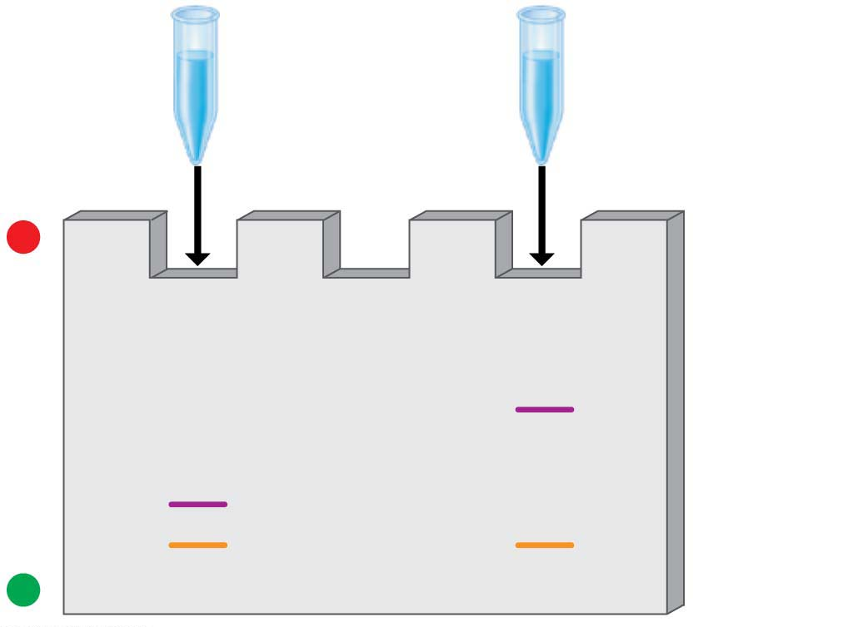
Figure 12.15
Amplified
crime scene
DNA
Amplified
suspect’s
DNA
−
Longer
fragments
Shorter
fragments
+
Notes:
Figure 12.15 Visualizing STR fragment patterns

Slide 73
Short Tandem Repeat (STR) Analysis
DNA profiling can provide evidence of either guilt or innocence.
  As of 2014, lawyers at the Innocence Project, a nonprofit legal organization located in New York City, have helped to exonerate more than 310 convicted criminals in 35 states, including 18 who were on death row.
  The average sentence served by those who were exonerated was 14 years.
Notes:
73

Slide 74
Short Tandem Repeat (STR) Analysis
  In nearly half of these cases, DNA profiling has also identified the true perpetrators.
  Figure 12.16 presents some data from a real case in which STR analysis proved a convicted man innocent and also helped identify the true perpetrator.
  error rate 1 in 10 billion chance of a mistake
Notes:
74

Slide 75
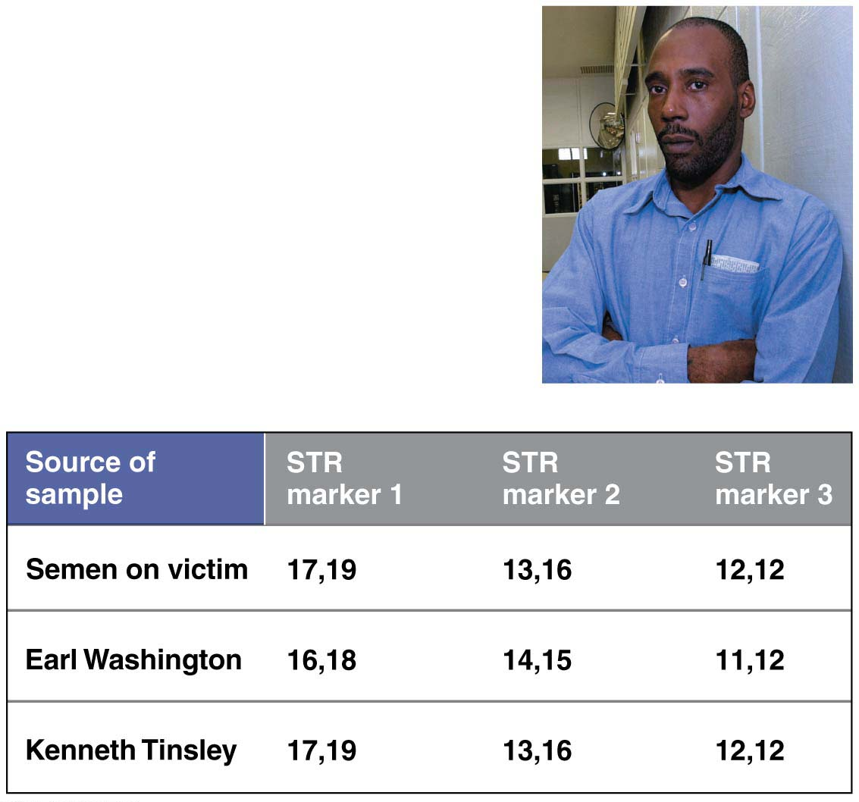
Figure 12.16
Notes:
Figure 12.16 DNA profiling: proof of innocence and guilt

Slide 76
Short Tandem Repeat (STR) Analysis
In forensic cases using STR analysis with the 13 standard markers, the probability of two people having identical DNA profiles is somewhere between one chance in 10 billion and one in several trillion.
Thus, despite problems that can still arise from insufficient data, human error, or flawed evidence, genetic profiles are now accepted as compelling evidence by legal experts and scientists alike.
Notes:
76

Slide 77
Bioinformatics
In the past decade, new experimental techniques have generated enormous volumes of data related to DNA sequences.
The need to make sense of an ever-increasing flood of information has spawned the field of bioinformatics, the application of computational methods to the storage and analysis of biological data.
Notes:
77

Slide 78
DNA Sequencing
Researchers can exploit the principle of complementary base pairing to determine the complete nucleotide sequence of a DNA molecule, a process called DNA sequencing.
In one standard procedure, the DNA is first cut into fragments, and then each fragment is sequenced.
Notes:
78
Student Misconceptions and Concerns
1. There are 24 chromosomes in the human genome. Students might initially find this confusing, as it is common knowledge that humans have 23 pairs of chromosomes. Consider making the statement that we have 24 different types of chromosomes and asking your students to explain why this is true.
2. The similarities of the genotypes and phenotypes of members of a human family tree are expected and understood by most students. Yet for many students, these same relationships are often poorly extrapolated to phylogenetic relationships of other groups. The use of genomics to test phylogenetic relationships is an enormously powerful tool used in modern systematics. Genomics is a significant test of the other overwhelming types of evidence for evolution.
Teaching Tips
1. The first targets of genomics were prokaryotic pathogenic organisms. Consider asking your students in class to suggest why this was a good choice. Students may note that the genomes of these organisms are smaller than eukaryotes and that many of these organisms are of great medical significance.
2. The authors note that there are about 3 billion nucleotide pairs in the human genome. There are about 3 billion seconds in about 95 years. This simple reference might add meaning to the significance of these large numbers.
3. The main U.S. Department of Energy Office website in support of the Human Genome Project is found at genomics.energy.gov.
4. The website for the National Center for Biotechnology Information is www.ncbi.nlm.nih.gov. The center, established in 1988, serves as a national resource for biomedical information related to genomic data.
5. Challenge students to explain why a complete understanding of an organism’s genome and the resulting proteins produced is still not enough to understand the full biology of an organism. Challenge them to consider the role of the environment in development and physiology. (One striking example of the influence of the environment is that the sex of some reptiles is determined not by genetics, but by egg incubation temperature!)
6. With a better understanding of the diverse and still unknown roles of many sections of DNA, consider discussing some of the difficulties of “resurrecting” extinct organisms from incomplete DNA sequences.
Active Lecture Tips
1. See the Activity Personal Genomics: Would You Give Your DNA Away? on the Instructor Exchange. Visit the Instructor Exchange in the MasteringBiology instructor resource area for a description of this activity.
2. See the Media Review: “Learn.Genetics” Genetic Science Learning Center from the University of Utah on the Instructor Exchange. Visit the Instructor Exchange in the MasteringBiology instructor resource area for a description of this activity.

Slide 79
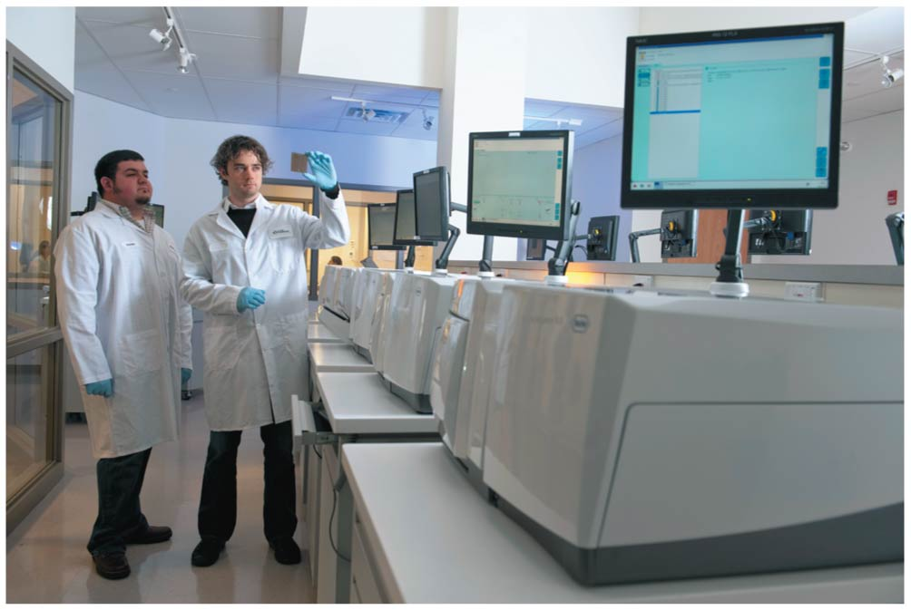
Figure 12.18
Notes:
Figure 12.18 A DNA sequencer

Slide 80
Genomics
Genomics is the study of complete sets of genes (genomes).
The first targets of genomics research were bacteria, which have relatively little DNA.
Notes:
80
Student Misconceptions and Concerns
1. There are 24 chromosomes in the human genome. Students might initially find this confusing, as it is common knowledge that humans have 23 pairs of chromosomes. Consider making the statement that we have 24 different types of chromosomes and asking your students to explain why this is true.
2. The similarities of the genotypes and phenotypes of members of a human family tree are expected and understood by most students. Yet for many students, these same relationships are often poorly extrapolated to phylogenetic relationships of other groups. The use of genomics to test phylogenetic relationships is an enormously powerful tool used in modern systematics. Genomics is a significant test of the other overwhelming types of evidence for evolution.
Teaching Tips
1. The first targets of genomics were prokaryotic pathogenic organisms. Consider asking your students in class to suggest why this was a good choice. Students may note that the genomes of these organisms are smaller than eukaryotes and that many of these organisms are of great medical significance.
2. The authors note that there are about 3 billion nucleotide pairs in the human genome. There are about 3 billion seconds in about 95 years. This simple reference might add meaning to the significance of these large numbers.
3. The main U.S. Department of Energy Office website in support of the Human Genome Project is found at genomics.energy.gov.
4. The website for the National Center for Biotechnology Information is www.ncbi.nlm.nih.gov. The center, established in 1988, serves as a national resource for biomedical information related to genomic data.
5. Challenge students to explain why a complete understanding of an organism’s genome and the resulting proteins produced is still not enough to understand the full biology of an organism. Challenge them to consider the role of the environment in development and physiology. (One striking example of the influence of the environment is that the sex of some reptiles is determined not by genetics, but by egg incubation temperature!)
6. With a better understanding of the diverse and still unknown roles of many sections of DNA, consider discussing some of the difficulties of “resurrecting” extinct organisms from incomplete DNA sequences.
Active Lecture Tips
1. See the Activity Personal Genomics: Would You Give Your DNA Away? on the Instructor Exchange. Visit the Instructor Exchange in the MasteringBiology instructor resource area for a description of this activity.
2. See the Media Review: “Learn.Genetics” Genetic Science Learning Center from the University of Utah on the Instructor Exchange. Visit the Instructor Exchange in the MasteringBiology instructor resource area for a description of this activity.

Slide 81
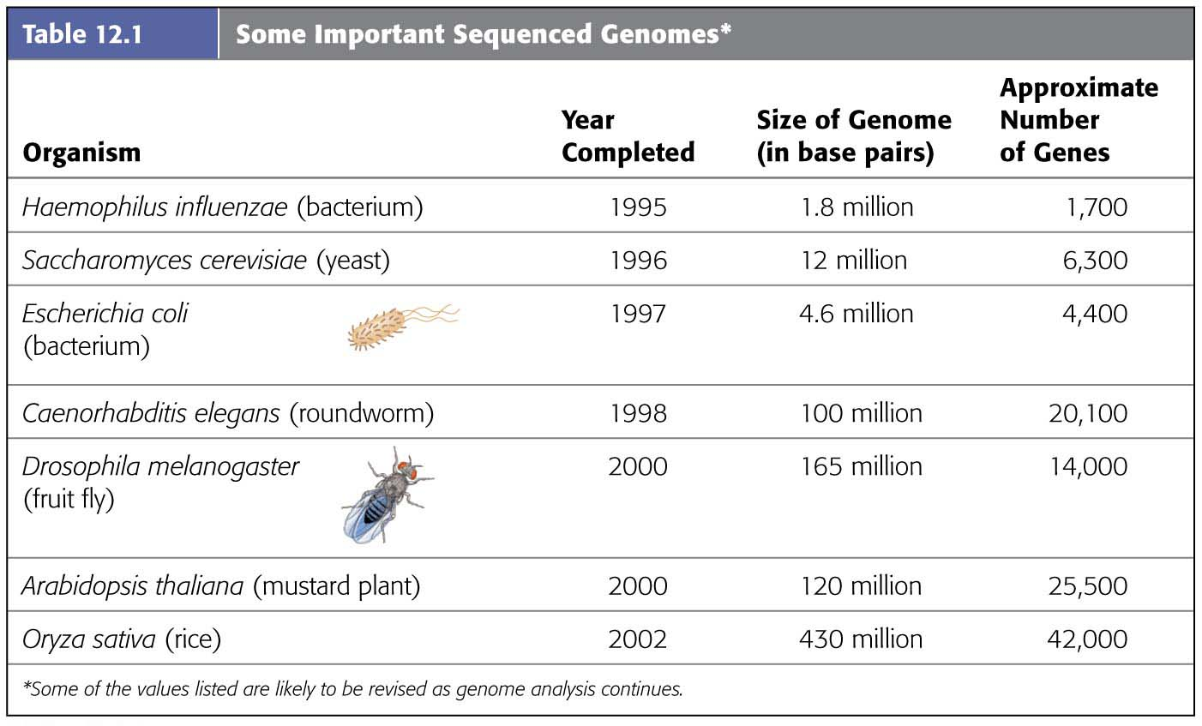
Table 12.1-1
Notes:
Table 12.1-1 Some important sequenced genomes (part 1)

Slide 82
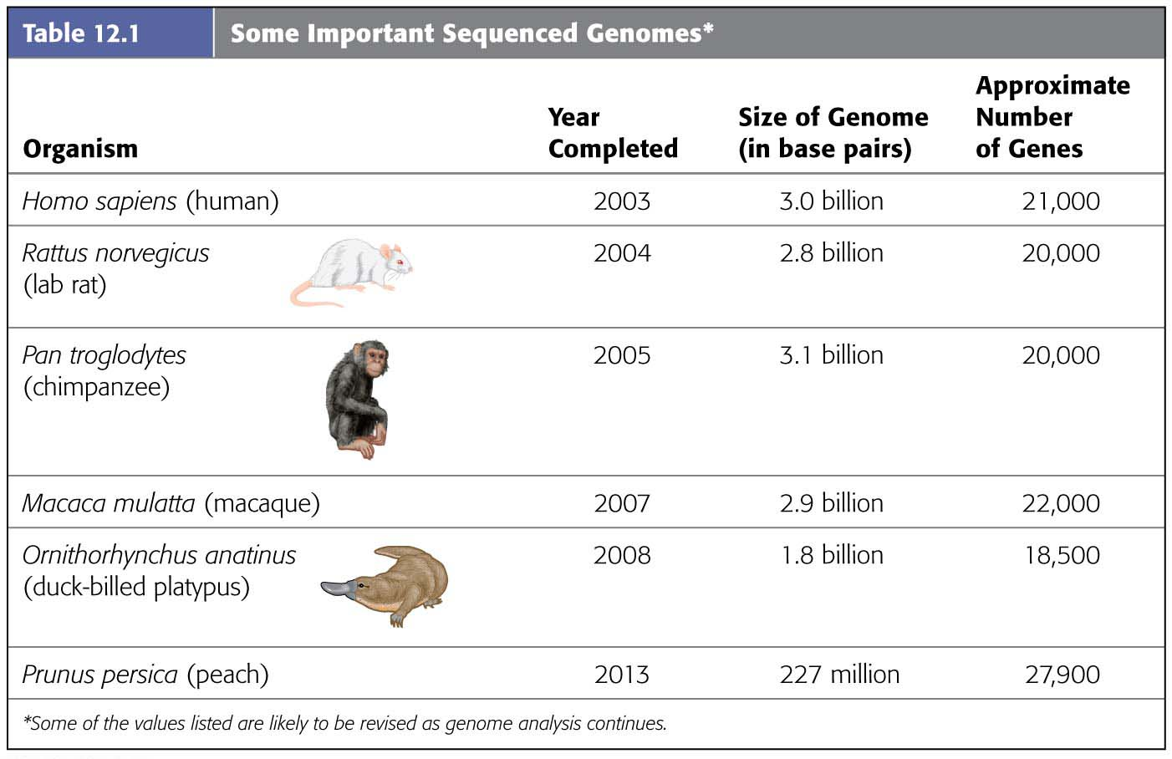
Table 12.1-2
Notes:
Table 12.1-2 Some important sequenced genomes (part 2)

Slide 83
Genomics
As of 2014, the genomes of thousands of species have been published, and tens of thousands more are in progress.
  The majority of organisms sequenced to date are prokaryotes, including over 4,000 bacterial species and nearly 200 archaea.
Notes:
83
Student Misconceptions and Concerns
1. There are 24 chromosomes in the human genome. Students might initially find this confusing, as it is common knowledge that humans have 23 pairs of chromosomes. Consider making the statement that we have 24 different types of chromosomes and asking your students to explain why this is true.
2. The similarities of the genotypes and phenotypes of members of a human family tree are expected and understood by most students. Yet for many students, these same relationships are often poorly extrapolated to phylogenetic relationships of other groups. The use of genomics to test phylogenetic relationships is an enormously powerful tool used in modern systematics. Genomics is a significant test of the other overwhelming types of evidence for evolution.
Teaching Tips
1. The first targets of genomics were prokaryotic pathogenic organisms. Consider asking your students in class to suggest why this was a good choice. Students may note that the genomes of these organisms are smaller than eukaryotes and that many of these organisms are of great medical significance.
2. The authors note that there are about 3 billion nucleotide pairs in the human genome. There are about 3 billion seconds in about 95 years. This simple reference might add meaning to the significance of these large numbers.
3. The main U.S. Department of Energy Office website in support of the Human Genome Project is found at genomics.energy.gov.
4. The website for the National Center for Biotechnology Information is www.ncbi.nlm.nih.gov. The center, established in 1988, serves as a national resource for biomedical information related to genomic data.
5. Challenge students to explain why a complete understanding of an organism’s genome and the resulting proteins produced is still not enough to understand the full biology of an organism. Challenge them to consider the role of the environment in development and physiology. (One striking example of the influence of the environment is that the sex of some reptiles is determined not by genetics, but by egg incubation temperature!)
6. With a better understanding of the diverse and still unknown roles of many sections of DNA, consider discussing some of the difficulties of “resurrecting” extinct organisms from incomplete DNA sequences.
Active Lecture Tips
1. See the Activity Personal Genomics: Would You Give Your DNA Away? on the Instructor Exchange. Visit the Instructor Exchange in the MasteringBiology instructor resource area for a description of this activity.
2. See the Media Review: “Learn.Genetics” Genetic Science Learning Center from the University of Utah on the Instructor Exchange. Visit the Instructor Exchange in the MasteringBiology instructor resource area for a description of this activity.

Slide 84
Genomics
  Hundreds of eukaryotic genomes—including protists, fungi, plants, and animals both invertebrate and vertebrate—have also been completed.
  Genome sequences have been determined for cells from several cancers, for ancient humans, and for the many bacteria that live in the human intestine.
Notes:
84

Slide 85
Genome-Mapping Techniques
Genomes are most often sequenced using a technique called the whole-genome shotgun method.
  The first step in this method is to chop the entire genome into fragments using restriction enzymes.
  Next, all the fragments are cloned and sequenced.
  Finally, computers running specialized mapping software reassemble the millions of overlapping short sequences into a single continuous sequence for every chromosome—an entire genome.
Notes:
85
Student Misconceptions and Concerns
1. There are 24 chromosomes in the human genome. Students might initially find this confusing, as it is common knowledge that humans have 23 pairs of chromosomes. Consider making the statement that we have 24 different types of chromosomes and asking your students to explain why this is true.
2. The similarities of the genotypes and phenotypes of members of a human family tree are expected and understood by most students. Yet for many students, these same relationships are often poorly extrapolated to phylogenetic relationships of other groups. The use of genomics to test phylogenetic relationships is an enormously powerful tool used in modern systematics. Genomics is a significant test of the other overwhelming types of evidence for evolution.
Teaching Tips
1. The first targets of genomics were prokaryotic pathogenic organisms. Consider asking your students in class to suggest why this was a good choice. Students may note that the genomes of these organisms are smaller than eukaryotes and that many of these organisms are of great medical significance.
2. The authors note that there are about 3 billion nucleotide pairs in the human genome. There are about 3 billion seconds in about 95 years. This simple reference might add meaning to the significance of these large numbers.
3. The main U.S. Department of Energy Office website in support of the Human Genome Project is found at genomics.energy.gov.
4. The website for the National Center for Biotechnology Information is www.ncbi.nlm.nih.gov. The center, established in 1988, serves as a national resource for biomedical information related to genomic data.
5. Challenge students to explain why a complete understanding of an organism’s genome and the resulting proteins produced is still not enough to understand the full biology of an organism. Challenge them to consider the role of the environment in development and physiology. (One striking example of the influence of the environment is that the sex of some reptiles is determined not by genetics, but by egg incubation temperature!)
6. With a better understanding of the diverse and still unknown roles of many sections of DNA, consider discussing some of the difficulties of “resurrecting” extinct organisms from incomplete DNA sequences.
Active Lecture Tips
1. See the Activity Personal Genomics: Would You Give Your DNA Away? on the Instructor Exchange. Visit the Instructor Exchange in the MasteringBiology instructor resource area for a description of this activity.
2. See the Media Review: “Learn.Genetics” Genetic Science Learning Center from the University of Utah on the Instructor Exchange. Visit the Instructor Exchange in the MasteringBiology instructor resource area for a description of this activity.

Slide 86
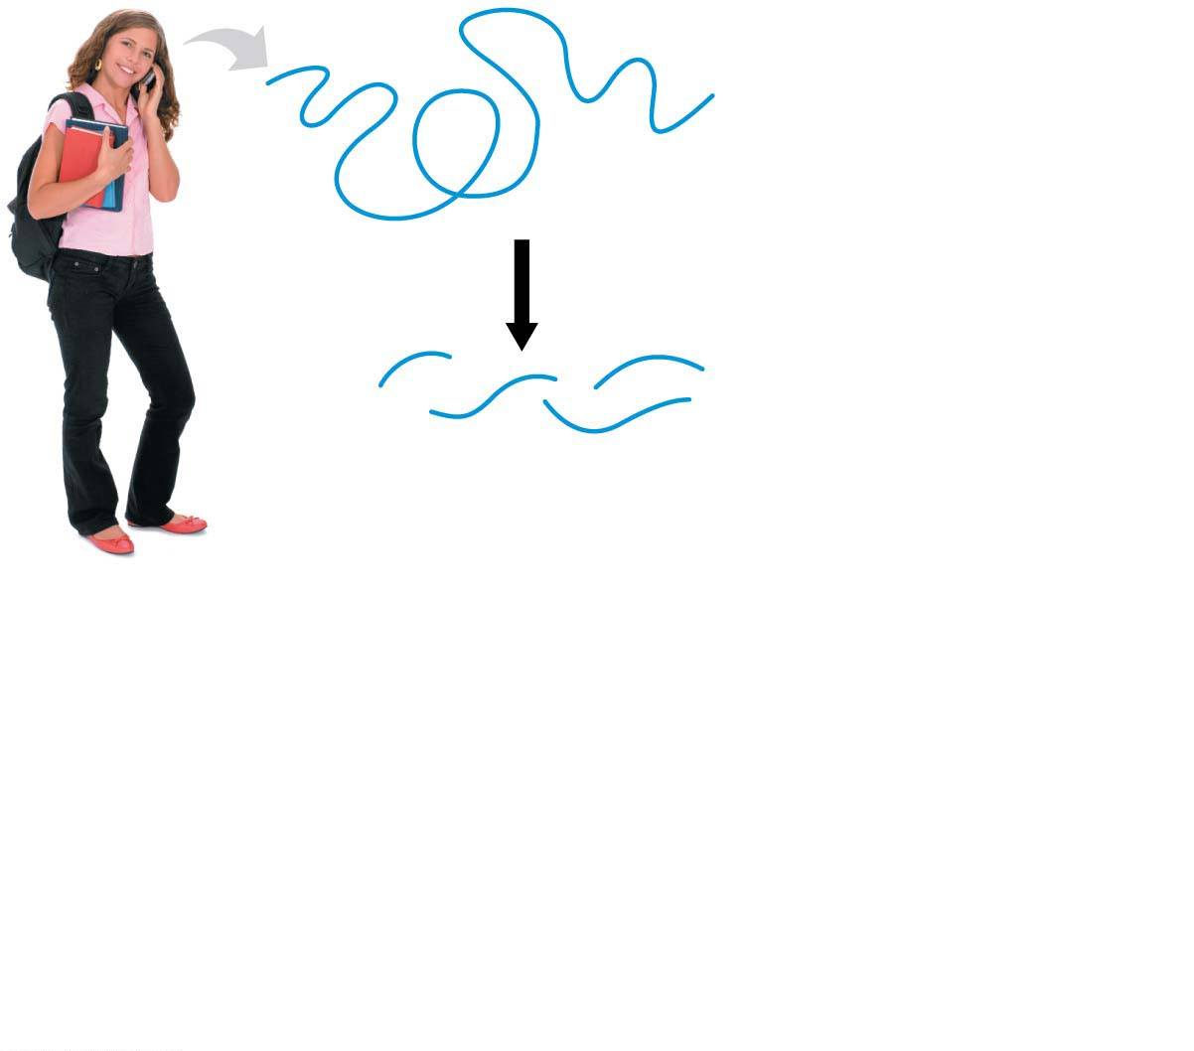
Figure 12.19-s1
Chromosome
Chop up with
restriction enzyme
DNA fragments
Notes:
Figure 12.19-s1 Genome sequencing (step 1)

Slide 87
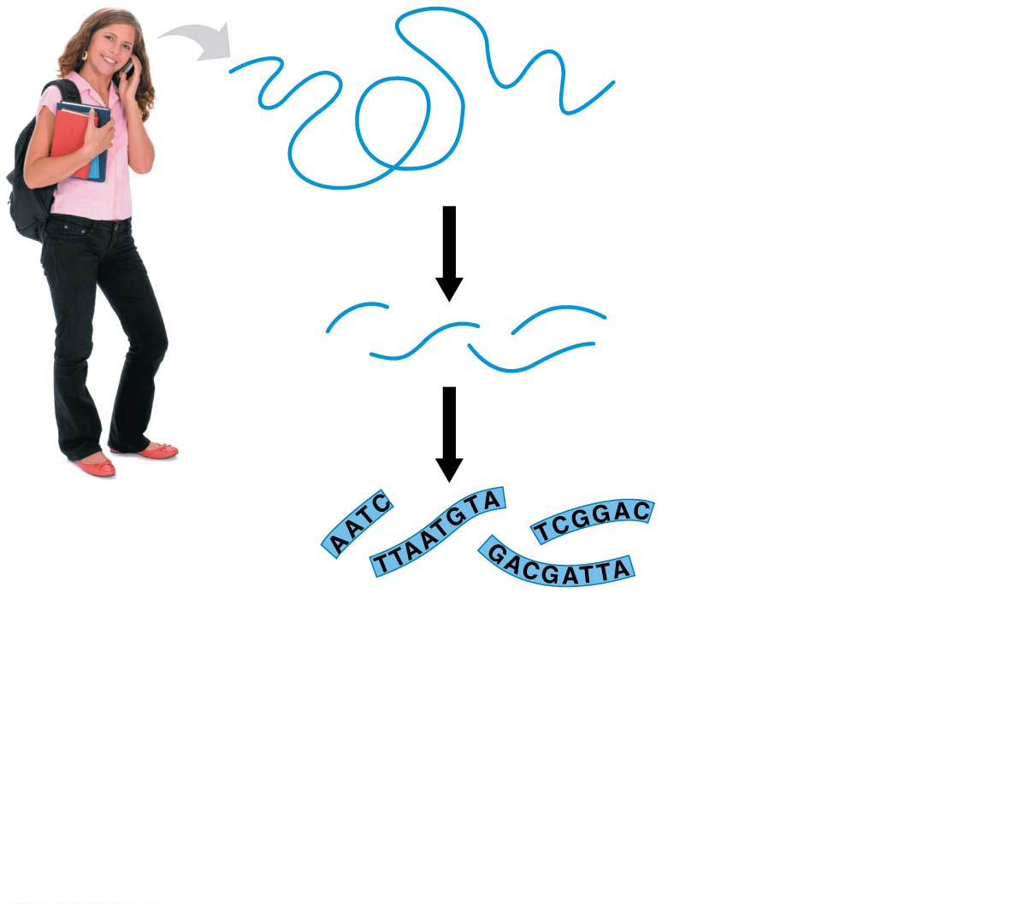
Figure 12.19-s2
Chromosome
Chop up with
restriction enzyme
DNA fragments
Sequence fragments
Notes:
Figure 12.19-s2 Genome sequencing (step 2)

Slide 88
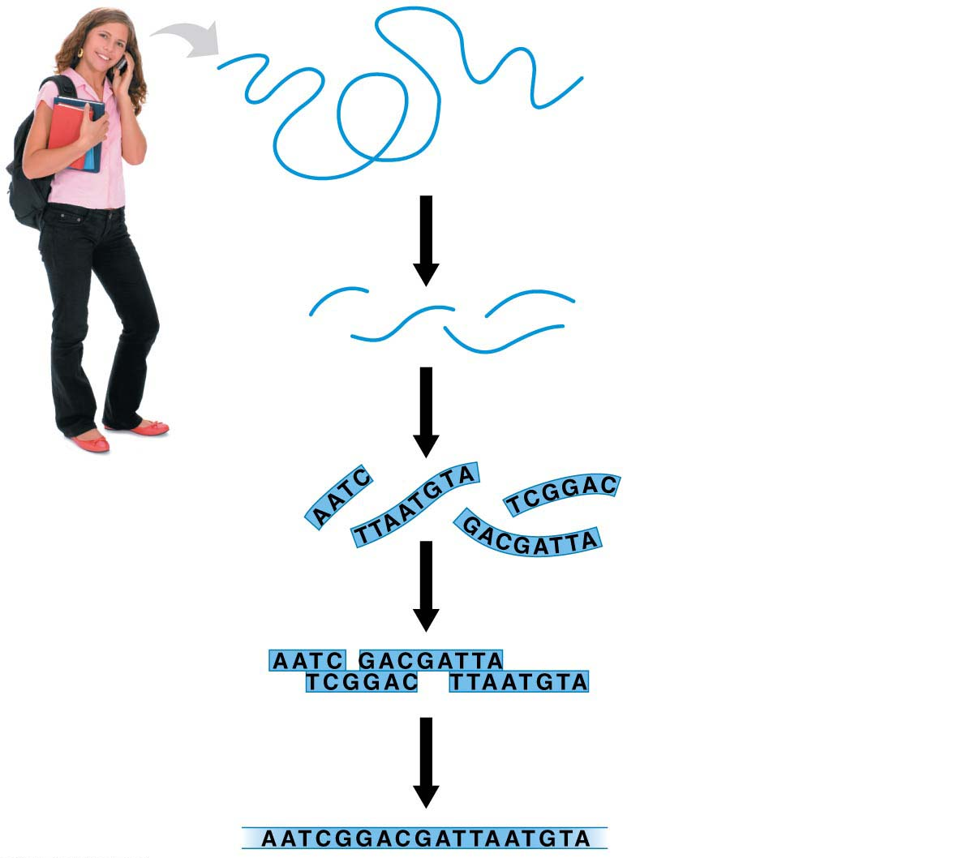
Figure 12.19-s3
Chromosome
Chop up with
restriction enzyme
DNA fragments
Sequence fragments
Align fragments
Reassemble
full sequence
Notes:
Figure 12.19-s3 Genome sequencing (step 3)

Slide 89
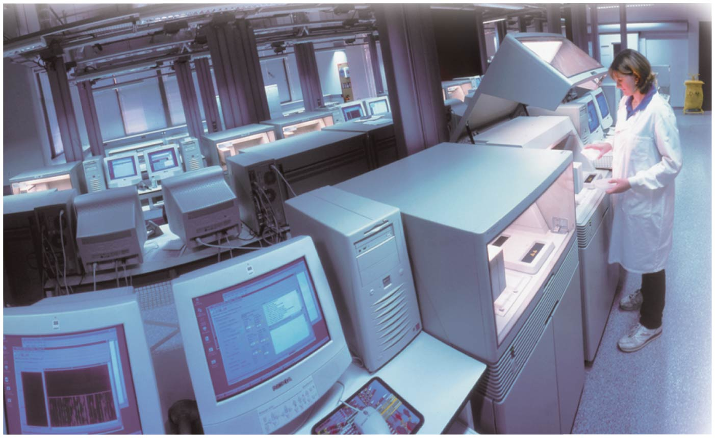
Figure 12.19-1
Notes:
Figure 12.19-1 Genome sequencing (part 1: photo)

Slide 90
Genome-Mapping Techniques
The DNA sequences determined by many research groups in the United States are deposited in GenBank, a database that is available to anyone via the Internet.
You can browse it yourself at the website for the National Center for Biotechnology Information: www.ncbi.nlm.nih.gov.
Notes:
90
Student Misconceptions and Concerns
1. There are 24 chromosomes in the human genome. Students might initially find this confusing, as it is common knowledge that humans have 23 pairs of chromosomes. Consider making the statement that we have 24 different types of chromosomes and asking your students to explain why this is true.
2. The similarities of the genotypes and phenotypes of members of a human family tree are expected and understood by most students. Yet for many students, these same relationships are often poorly extrapolated to phylogenetic relationships of other groups. The use of genomics to test phylogenetic relationships is an enormously powerful tool used in modern systematics. Genomics is a significant test of the other overwhelming types of evidence for evolution.
Teaching Tips
1. The first targets of genomics were prokaryotic pathogenic organisms. Consider asking your students in class to suggest why this was a good choice. Students may note that the genomes of these organisms are smaller than eukaryotes and that many of these organisms are of great medical significance.
2. The authors note that there are about 3 billion nucleotide pairs in the human genome. There are about 3 billion seconds in about 95 years. This simple reference might add meaning to the significance of these large numbers.
3. The main U.S. Department of Energy Office website in support of the Human Genome Project is found at genomics.energy.gov.
4. The website for the National Center for Biotechnology Information is www.ncbi.nlm.nih.gov. The center, established in 1988, serves as a national resource for biomedical information related to genomic data.
5. Challenge students to explain why a complete understanding of an organism’s genome and the resulting proteins produced is still not enough to understand the full biology of an organism. Challenge them to consider the role of the environment in development and physiology. (One striking example of the influence of the environment is that the sex of some reptiles is determined not by genetics, but by egg incubation temperature!)
6. With a better understanding of the diverse and still unknown roles of many sections of DNA, consider discussing some of the difficulties of “resurrecting” extinct organisms from incomplete DNA sequences.
Active Lecture Tips
1. See the Activity Personal Genomics: Would You Give Your DNA Away? on the Instructor Exchange. Visit the Instructor Exchange in the MasteringBiology instructor resource area for a description of this activity.
2. See the Media Review: “Learn.Genetics” Genetic Science Learning Center from the University of Utah on the Instructor Exchange. Visit the Instructor Exchange in the MasteringBiology instructor resource area for a description of this activity.

Slide 91
Genome-Mapping Techniques
The database is constantly updated, and the amount of data it contains doubles every 18 months.
Bioinformatics has revolutionized evolutionary biology by opening a vast new reservoir of data that can test evolutionary hypotheses.
Notes:
91
Student Misconceptions and Concerns
1. There are 24 chromosomes in the human genome. Students might initially find this confusing, as it is common knowledge that humans have 23 pairs of chromosomes. Consider making the statement that we have 24 different types of chromosomes and asking your students to explain why this is true.
2. The similarities of the genotypes and phenotypes of members of a human family tree are expected and understood by most students. Yet for many students, these same relationships are often poorly extrapolated to phylogenetic relationships of other groups. The use of genomics to test phylogenetic relationships is an enormously powerful tool used in modern systematics. Genomics is a significant test of the other overwhelming types of evidence for evolution.
Teaching Tips
1. The first targets of genomics were prokaryotic pathogenic organisms. Consider asking your students in class to suggest why this was a good choice. Students may note that the genomes of these organisms are smaller than eukaryotes and that many of these organisms are of great medical significance.
2. The authors note that there are about 3 billion nucleotide pairs in the human genome. There are about 3 billion seconds in about 95 years. This simple reference might add meaning to the significance of these large numbers.
3. The main U.S. Department of Energy Office website in support of the Human Genome Project is found at genomics.energy.gov.
4. The website for the National Center for Biotechnology Information is www.ncbi.nlm.nih.gov. The center, established in 1988, serves as a national resource for biomedical information related to genomic data.
5. Challenge students to explain why a complete understanding of an organism’s genome and the resulting proteins produced is still not enough to understand the full biology of an organism. Challenge them to consider the role of the environment in development and physiology. (One striking example of the influence of the environment is that the sex of some reptiles is determined not by genetics, but by egg incubation temperature!)
6. With a better understanding of the diverse and still unknown roles of many sections of DNA, consider discussing some of the difficulties of “resurrecting” extinct organisms from incomplete DNA sequences.
Active Lecture Tips
1. See the Activity Personal Genomics: Would You Give Your DNA Away? on the Instructor Exchange. Visit the Instructor Exchange in the MasteringBiology instructor resource area for a description of this activity.
2. See the Media Review: “Learn.Genetics” Genetic Science Learning Center from the University of Utah on the Instructor Exchange. Visit the Instructor Exchange in the MasteringBiology instructor resource area for a description of this activity.

Slide 92
Start Here on 11/27

Slide 94
Flip Class - Questions
Has CRISPR been used to modify a human embryo?
  yes, at least one and maybe up to four labs in China have modified a human embryo with CRISPR
Have humans been reproductively cloned?
Do you think we will modify human embryos with CRISPR in the future and then allow those embryos to develop?
What is in vitro fertilization?

Slide 95
DNA Profiling
Crime scene
Suspect 1
Suspect 2
1
DNA isolated
2
DNA amplified
3
DNA compared
Notes:
Figure 12.12 Overview of DNA profiling

Slide 96
PCR - amplify
Initial
DNA
segment
1
2
4
8
Number of DNA molecules
Notes:
Figure 12.13 DNA amplification by PCR

Slide 97
Gel Electrophoresis
To separate and visualize DNA fragments of different lengths, researchers carry out a technique called gel electrophoresis, a method for sorting macromolecules, usually proteins or nucleic acids, primarily by their electrical charge and size.
Figure 12.5 shows how gel electrophoresis separates DNA fragments obtained from different sources.
Notes:
97
Student Misconceptions and Concerns
1. Student comprehension of restriction enzymes and many other aspects of recombinant DNA techniques depends upon a comfortable understanding of basic molecular genetics. Consider addressing Chapter 12 after an exam that addresses the content in Chapters 10 and 11.
2. The genetic engineering of organisms can be controversial, creating various degrees of social unease and resistance. Yet many debates about scientific issues are confused by misinformation. This provides an opportunity for you to ask students to research an issue before taking firm positions. Students might debate whether a food or drug made from GM/transgenic organisms should be labeled as such, or discuss the risks and advantages of producing GM organisms. Consider starting class with a headline addressing one of these issues. The recent process of FDA approval for raising genetically engineered salmon (AquAdvantage) for food might be particularly useful and relevant.
3. The fact that the technologies described in this chapter can be used to swap genes between prokaryotes and eukaryotes reveals the fundamental similarities in genetic mechanisms shared by all forms of life. This very strong evidence of common descent is evidence of evolution that may be missed by your students.
4. Using gene therapy to “fix” genetic problems relies on a thorough understanding of the roles of genes and alleles. Students might benefit from a discussion of the extent to which we as a society might want to consider directing our own genetics.
Teaching Tips
1. Annual flu vaccinations are a common example of using vaccines to prevent diseases that cannot be easily cured. However, students might not understand why many people receive the vaccine every year. A new annual vaccine is necessary because the flu viruses keep evolving.
2. The origin of the name “restriction enzymes” may be of interest. In nature, these enzymes protect bacterial cells against foreign DNA. Thus, these enzymes “restrict” the invasion of foreign genetic material.
3. Students might think you are just making a bad joke by noting that laboratory synthesized genes are “designer genes,” but this is a common term. Search the Internet using the keywords “designer genes,” and many scientific (and unscientific) sites will be found.
4. Separating marker ink using paper chromatography is a simple experiment that approximates some of what occurs in gel electrophoresis. Consider doing this as a class demonstration while addressing electrophoresis. Cut a large piece of filter paper into a rectangle or square. Use markers to color large dots about 2 cm away from the edge of the paper. Separate the dots from each other by 3–4 cm. Place the paper on edge, dots down, into a beaker containing about 1 cm of ethanol or isopropyl alcohol (50% or higher will do). The dots should not be in contact with the pool of alcohol in the bottom of the beaker. As the alcohol is drawn up the filter paper by capillary action, the alcohol will dissolve the ink dots. As the alcohol continues up the paper, the ink follows. Not all of the ink components move at the same speed, based on their size and chemical properties. If you begin the process at the start of class, you should have some degree of separation by the end of a 50-minute period. Experiment with the technique a day or two before class to fine-tune the demonstration, and experiment with different types of ink. (Save and air-dry these samples for your class.) Consider using brown, green, and black markers, as these colors are often made by color combinations.
5. Roundup Ready Corn, a product of Monsanto, is resistant to the herbicide Roundup. The general strategy for farmers is to spray fields of Roundup Ready Corn with the herbicide Roundup, killing weeds but not the corn. A search of the Internet will quickly reveal the controversy associated with this and other genetically modified organisms (GMOs), which can encourage interesting discussions and promote critical thinking skills.
6. As gene therapy technology expands, our ability to modify the genome in human embryos through in vitro fertilization permits genetic modification at the earliest stages of life. Future generations of humans, like our crops today, may include those with and without a genetically modified ancestry. The benefits and challenges of these technologies raise issues many students have never considered. Our students, and the generations soon to follow, may face the potential of directed human evolution.
7. Ethical, legal, and social issues related to the Human Genome Project are directly addressed at the Department of Energy Human Genome website at http://web.ornl.gov/sci/techresources/Human_Genome/elsi/index.shtml.
8. The Biology and Society end-of-chapter textbook questions address some of the issues raised in this chapter section.
Active Lecture Tips
1. As you begin to address genetic engineering and GMO foods, ask students to work in small groups to discuss what they know about genetically engineered food. Have each group create a list of statements that can be short or long, reflecting their impressions of the technology. The results may surprise you and help you address some common misunderstandings and concerns.
2. If you have already addressed basic transcription and translation in your course, consider asking small groups of students in your class to explain the following. DNA technology is primarily used to produce proteins. Why aren’t lipids and carbohydrates typically produced by these processes?

Slide 98
Figure 12.5-s1
Mixture of DNA
fragments of
different sizes
−
Power
source
+
Notes:
Figure 12.5-s1 Gel electrophoresis of DNA molecules (step 1)

Slide 99
Figure 12.5-s2
Mixture of DNA
fragments of
different sizes
−
−
Power
source
+
+
Notes:
Figure 12.5-s2 Gel electrophoresis of DNA molecules (step 2)

Slide 100
Figure 12.5-s3
Mixture of DNA
fragments of
different sizes
Band of longest
(slowest) fragments
−
−
Power
source
+
+
Band of shortest
(fastest) fragments
Notes:
Figure 12.5-s3 Gel electrophoresis of DNA molecules (step 3)

Slide 101
Figure 12.14
Crime scene DNA
STR site 1
STR site 2
AGAT
GATA
Same number of
short tandem repeats
Different numbers of
short tandem repeats
AGAT
GATA
Suspect’s DNA
Notes:
Figure 12.14 Short tandem repeat (STR) sites

Slide 102
Figure 12.15
Amplified
crime scene
DNA
Amplified
suspect’s
DNA
−
Longer
fragments
Shorter
fragments
+
Notes:
Figure 12.15 Visualizing STR fragment patterns

Slide 103
The Human Genome
Begun in 1990, the Human Genome Project was a massive scientific endeavor to
  determine the nucleotide sequence of all the DNA in the human genome and
  identify the location and sequence of every gene.
Notes:
103
Student Misconceptions and Concerns
1. There are 24 chromosomes in the human genome. Students might initially find this confusing, as it is common knowledge that humans have 23 pairs of chromosomes. Consider making the statement that we have 24 different types of chromosomes and asking your students to explain why this is true.
2. The similarities of the genotypes and phenotypes of members of a human family tree are expected and understood by most students. Yet for many students, these same relationships are often poorly extrapolated to phylogenetic relationships of other groups. The use of genomics to test phylogenetic relationships is an enormously powerful tool used in modern systematics. Genomics is a significant test of the other overwhelming types of evidence for evolution.
Teaching Tips
1. The first targets of genomics were prokaryotic pathogenic organisms. Consider asking your students in class to suggest why this was a good choice. Students may note that the genomes of these organisms are smaller than eukaryotes and that many of these organisms are of great medical significance.
2. The authors note that there are about 3 billion nucleotide pairs in the human genome. There are about 3 billion seconds in about 95 years. This simple reference might add meaning to the significance of these large numbers.
3. The main U.S. Department of Energy Office website in support of the Human Genome Project is found at genomics.energy.gov.
4. The website for the National Center for Biotechnology Information is www.ncbi.nlm.nih.gov. The center, established in 1988, serves as a national resource for biomedical information related to genomic data.
5. Challenge students to explain why a complete understanding of an organism’s genome and the resulting proteins produced is still not enough to understand the full biology of an organism. Challenge them to consider the role of the environment in development and physiology. (One striking example of the influence of the environment is that the sex of some reptiles is determined not by genetics, but by egg incubation temperature!)
6. With a better understanding of the diverse and still unknown roles of many sections of DNA, consider discussing some of the difficulties of “resurrecting” extinct organisms from incomplete DNA sequences.
Active Lecture Tips
1. See the Activity Personal Genomics: Would You Give Your DNA Away? on the Instructor Exchange. Visit the Instructor Exchange in the MasteringBiology instructor resource area for a description of this activity.
2. See the Media Review: “Learn.Genetics” Genetic Science Learning Center from the University of Utah on the Instructor Exchange. Visit the Instructor Exchange in the MasteringBiology instructor resource area for a description of this activity.

Slide 104
The Human Genome
At the completion of the project,
  more than 99% of the genome had been determined to 99.999% accuracy,
  about 3 billion nucleotide pairs were identified,
  about 21,000 genes were found, and
  about 98% of the human DNA was identified as noncoding.
Notes:
104
Student Misconceptions and Concerns
1. There are 24 chromosomes in the human genome. Students might initially find this confusing, as it is common knowledge that humans have 23 pairs of chromosomes. Consider making the statement that we have 24 different types of chromosomes and asking your students to explain why this is true.
2. The similarities of the genotypes and phenotypes of members of a human family tree are expected and understood by most students. Yet for many students, these same relationships are often poorly extrapolated to phylogenetic relationships of other groups. The use of genomics to test phylogenetic relationships is an enormously powerful tool used in modern systematics. Genomics is a significant test of the other overwhelming types of evidence for evolution.
Teaching Tips
1. The first targets of genomics were prokaryotic pathogenic organisms. Consider asking your students in class to suggest why this was a good choice. Students may note that the genomes of these organisms are smaller than eukaryotes and that many of these organisms are of great medical significance.
2. The authors note that there are about 3 billion nucleotide pairs in the human genome. There are about 3 billion seconds in about 95 years. This simple reference might add meaning to the significance of these large numbers.
3. The main U.S. Department of Energy Office website in support of the Human Genome Project is found at genomics.energy.gov.
4. The website for the National Center for Biotechnology Information is www.ncbi.nlm.nih.gov. The center, established in 1988, serves as a national resource for biomedical information related to genomic data.
5. Challenge students to explain why a complete understanding of an organism’s genome and the resulting proteins produced is still not enough to understand the full biology of an organism. Challenge them to consider the role of the environment in development and physiology. (One striking example of the influence of the environment is that the sex of some reptiles is determined not by genetics, but by egg incubation temperature!)
6. With a better understanding of the diverse and still unknown roles of many sections of DNA, consider discussing some of the difficulties of “resurrecting” extinct organisms from incomplete DNA sequences.
Active Lecture Tips
1. See the Activity Personal Genomics: Would You Give Your DNA Away? on the Instructor Exchange. Visit the Instructor Exchange in the MasteringBiology instructor resource area for a description of this activity.
2. See the Media Review: “Learn.Genetics” Genetic Science Learning Center from the University of Utah on the Instructor Exchange. Visit the Instructor Exchange in the MasteringBiology instructor resource area for a description of this activity.

Slide 105
The Human Genome
  Some of this noncoding DNA is made up of gene control sequences such as promoters, enhancers, and microRNAs.
  Other noncoding regions include introns and repetitive DNA (some of which is used in DNA profiling.)
  Some noncoding DNA is important to our health, with certain regions known to carry disease-causing mutations.
  But the function of most noncoding DNA remains unknown.
Notes:
105
Student Misconceptions and Concerns
1. There are 24 chromosomes in the human genome. Students might initially find this confusing, as it is common knowledge that humans have 23 pairs of chromosomes. Consider making the statement that we have 24 different types of chromosomes and asking your students to explain why this is true.
2. The similarities of the genotypes and phenotypes of members of a human family tree are expected and understood by most students. Yet for many students, these same relationships are often poorly extrapolated to phylogenetic relationships of other groups. The use of genomics to test phylogenetic relationships is an enormously powerful tool used in modern systematics. Genomics is a significant test of the other overwhelming types of evidence for evolution.
Teaching Tips
1. The first targets of genomics were prokaryotic pathogenic organisms. Consider asking your students in class to suggest why this was a good choice. Students may note that the genomes of these organisms are smaller than eukaryotes and that many of these organisms are of great medical significance.
2. The authors note that there are about 3 billion nucleotide pairs in the human genome. There are about 3 billion seconds in about 95 years. This simple reference might add meaning to the significance of these large numbers.
3. The main U.S. Department of Energy Office website in support of the Human Genome Project is found at genomics.energy.gov.
4. The website for the National Center for Biotechnology Information is www.ncbi.nlm.nih.gov. The center, established in 1988, serves as a national resource for biomedical information related to genomic data.
5. Challenge students to explain why a complete understanding of an organism’s genome and the resulting proteins produced is still not enough to understand the full biology of an organism. Challenge them to consider the role of the environment in development and physiology. (One striking example of the influence of the environment is that the sex of some reptiles is determined not by genetics, but by egg incubation temperature!)
6. With a better understanding of the diverse and still unknown roles of many sections of DNA, consider discussing some of the difficulties of “resurrecting” extinct organisms from incomplete DNA sequences.
Active Lecture Tips
1. See the Activity Personal Genomics: Would You Give Your DNA Away? on the Instructor Exchange. Visit the Instructor Exchange in the MasteringBiology instructor resource area for a description of this activity.
2. See the Media Review: “Learn.Genetics” Genetic Science Learning Center from the University of Utah on the Instructor Exchange. Visit the Instructor Exchange in the MasteringBiology instructor resource area for a description of this activity.

Slide 106
The Human Genome
As of today, the complete genomes of many individuals have been completed.
Whereas sequencing the first human genome took 13 years and cost $100 million, we are rapidly approaching the day when an individual’s genome can be sequenced in a matter of hours for less than $1,000.
Notes:
106
Student Misconceptions and Concerns
1. There are 24 chromosomes in the human genome. Students might initially find this confusing, as it is common knowledge that humans have 23 pairs of chromosomes. Consider making the statement that we have 24 different types of chromosomes and asking your students to explain why this is true.
2. The similarities of the genotypes and phenotypes of members of a human family tree are expected and understood by most students. Yet for many students, these same relationships are often poorly extrapolated to phylogenetic relationships of other groups. The use of genomics to test phylogenetic relationships is an enormously powerful tool used in modern systematics. Genomics is a significant test of the other overwhelming types of evidence for evolution.
Teaching Tips
1. The first targets of genomics were prokaryotic pathogenic organisms. Consider asking your students in class to suggest why this was a good choice. Students may note that the genomes of these organisms are smaller than eukaryotes and that many of these organisms are of great medical significance.
2. The authors note that there are about 3 billion nucleotide pairs in the human genome. There are about 3 billion seconds in about 95 years. This simple reference might add meaning to the significance of these large numbers.
3. The main U.S. Department of Energy Office website in support of the Human Genome Project is found at genomics.energy.gov.
4. The website for the National Center for Biotechnology Information is www.ncbi.nlm.nih.gov. The center, established in 1988, serves as a national resource for biomedical information related to genomic data.
5. Challenge students to explain why a complete understanding of an organism’s genome and the resulting proteins produced is still not enough to understand the full biology of an organism. Challenge them to consider the role of the environment in development and physiology. (One striking example of the influence of the environment is that the sex of some reptiles is determined not by genetics, but by egg incubation temperature!)
6. With a better understanding of the diverse and still unknown roles of many sections of DNA, consider discussing some of the difficulties of “resurrecting” extinct organisms from incomplete DNA sequences.
Active Lecture Tips
1. See the Activity Personal Genomics: Would You Give Your DNA Away? on the Instructor Exchange. Visit the Instructor Exchange in the MasteringBiology instructor resource area for a description of this activity.
2. See the Media Review: “Learn.Genetics” Genetic Science Learning Center from the University of Utah on the Instructor Exchange. Visit the Instructor Exchange in the MasteringBiology instructor resource area for a description of this activity.

Slide 107
The Human Genome
Scientists have even begun to gather sequence data from our extinct relatives.
    In 2013, scientists sequenced the entire genome of a 130,000-year-old female Neanderthal (Homo neanderthalensis).
    Using DNA extracted from a toe bone found in a Siberian cave, the resulting genome was nearly as complete as that from a modern human.
    Analysis of the Neanderthal genome revealed evidence of interbreeding with Homo sapiens.
Notes:
107
Student Misconceptions and Concerns
1. There are 24 chromosomes in the human genome. Students might initially find this confusing, as it is common knowledge that humans have 23 pairs of chromosomes. Consider making the statement that we have 24 different types of chromosomes and asking your students to explain why this is true.
2. The similarities of the genotypes and phenotypes of members of a human family tree are expected and understood by most students. Yet for many students, these same relationships are often poorly extrapolated to phylogenetic relationships of other groups. The use of genomics to test phylogenetic relationships is an enormously powerful tool used in modern systematics. Genomics is a significant test of the other overwhelming types of evidence for evolution.
Teaching Tips
1. The first targets of genomics were prokaryotic pathogenic organisms. Consider asking your students in class to suggest why this was a good choice. Students may note that the genomes of these organisms are smaller than eukaryotes and that many of these organisms are of great medical significance.
2. The authors note that there are about 3 billion nucleotide pairs in the human genome. There are about 3 billion seconds in about 95 years. This simple reference might add meaning to the significance of these large numbers.
3. The main U.S. Department of Energy Office website in support of the Human Genome Project is found at genomics.energy.gov.
4. The website for the National Center for Biotechnology Information is www.ncbi.nlm.nih.gov. The center, established in 1988, serves as a national resource for biomedical information related to genomic data.
5. Challenge students to explain why a complete understanding of an organism’s genome and the resulting proteins produced is still not enough to understand the full biology of an organism. Challenge them to consider the role of the environment in development and physiology. (One striking example of the influence of the environment is that the sex of some reptiles is determined not by genetics, but by egg incubation temperature!)
6. With a better understanding of the diverse and still unknown roles of many sections of DNA, consider discussing some of the difficulties of “resurrecting” extinct organisms from incomplete DNA sequences.
Active Lecture Tips
1. See the Activity Personal Genomics: Would You Give Your DNA Away? on the Instructor Exchange. Visit the Instructor Exchange in the MasteringBiology instructor resource area for a description of this activity.
2. See the Media Review: “Learn.Genetics” Genetic Science Learning Center from the University of Utah on the Instructor Exchange. Visit the Instructor Exchange in the MasteringBiology instructor resource area for a description of this activity.

Slide 108
The Human Genome
  A 2014 study provided evidence that many present-day humans of European and Asian descent (but not African descent) carry Neanderthal-derived genes that influence the production of keratin, a protein that is a key structural component of hair, nails, and skin.
  Modern humans appear to have inherited the gene from Neanderthals around 70,000 years ago and then passed it on to their descendants.
  Such studies provide valuable insight into our own evolutionary tree.
Notes:
108

Slide 109
The Human Genome
Bioinformatics can also provide insights into our evolutionary relationships with nonhuman animals.
  In 2005, researchers completed the genome sequence for our closest living relative on the evolutionary tree of life, the chimpanzee (Pan troglodytes).
  Comparisons with human DNA revealed that we share 96% of our genome.
  Genomic scientists are currently finding and studying the important differences, shedding scientific light on the age-old question of what makes us human.
Notes:
109

Slide 110
The Human Genome
The potential benefits of knowing many human genomes are enormous.
  Thus far, more than 2,000 disease-associated genes have been identified.
  A recent example involved Behcet’s disease, a painful and life-threatening illness that involves swelling of blood vessels throughout the body.
  Researchers have long known that this disease is found most commonly among people living along the ancient trade route in Asia called the Silk Road.
Notes:
110

Slide 111
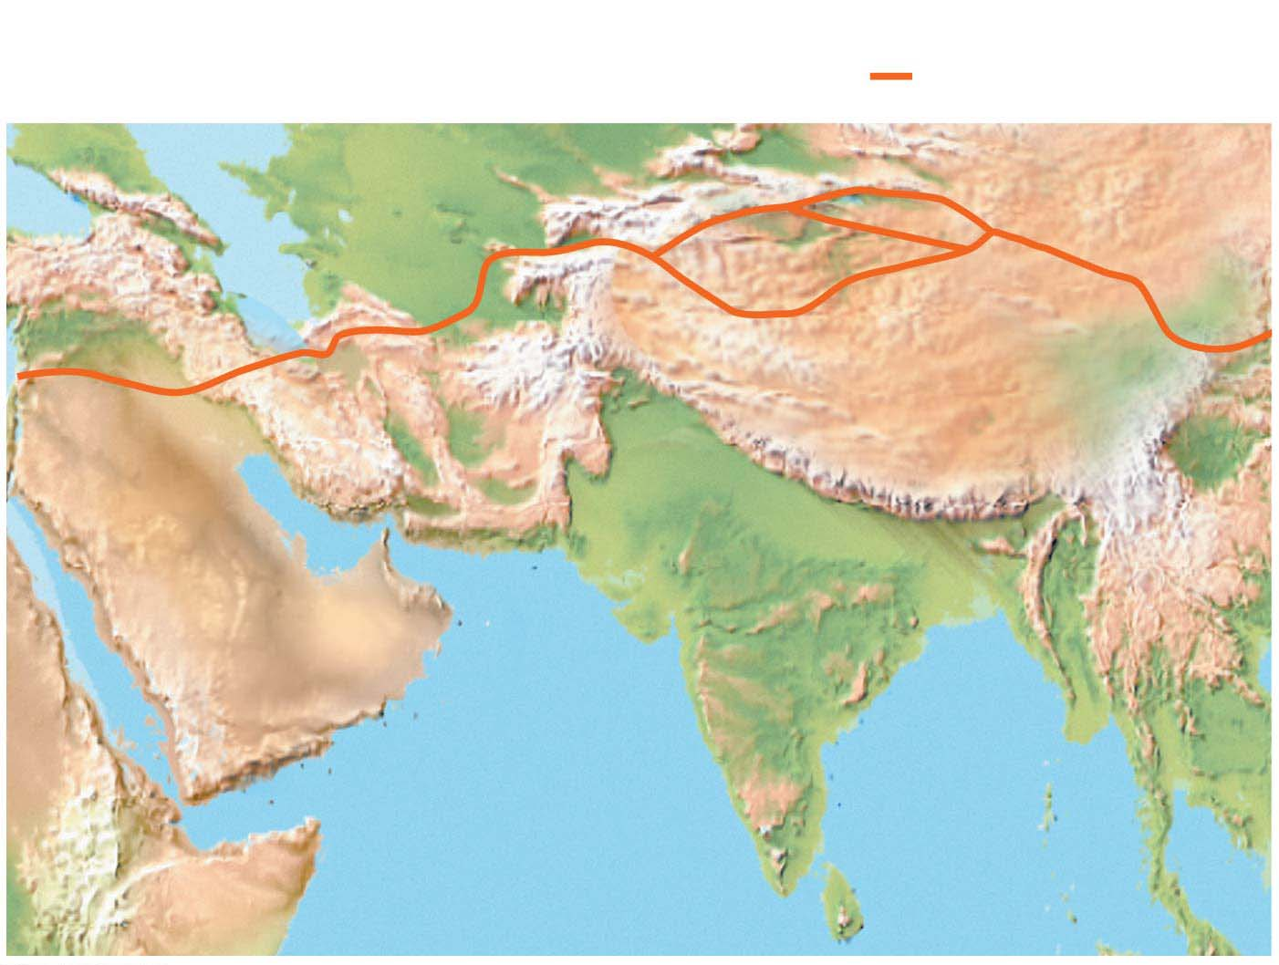
Figure 12.20
Key
= Silk Road
CASPIAN
SEA
Iraq
Afghanistan
China
Iran
Pakistan
PERSIAN
GULF
India
Saudi Arabia
Notes:
Figure 12.20 The Silk Road

Slide 112
The Human Genome
In 2013, researchers conducted a genome-wide search for genetic differences among Turkish people with and without the disease.
The nearby genes are implicated in the immune system’s ability to destroy invading microbes, to recognize infection sites, and to regulate autoimmune diseases.
Notes:
112
Student Misconceptions and Concerns
1. There are 24 chromosomes in the human genome. Students might initially find this confusing, as it is common knowledge that humans have 23 pairs of chromosomes. Consider making the statement that we have 24 different types of chromosomes and asking your students to explain why this is true.
2. The similarities of the genotypes and phenotypes of members of a human family tree are expected and understood by most students. Yet for many students, these same relationships are often poorly extrapolated to phylogenetic relationships of other groups. The use of genomics to test phylogenetic relationships is an enormously powerful tool used in modern systematics. Genomics is a significant test of the other overwhelming types of evidence for evolution.
Teaching Tips
1. The first targets of genomics were prokaryotic pathogenic organisms. Consider asking your students in class to suggest why this was a good choice. Students may note that the genomes of these organisms are smaller than eukaryotes and that many of these organisms are of great medical significance.
2. The authors note that there are about 3 billion nucleotide pairs in the human genome. There are about 3 billion seconds in about 95 years. This simple reference might add meaning to the significance of these large numbers.
3. The main U.S. Department of Energy Office website in support of the Human Genome Project is found at genomics.energy.gov.
4. The website for the National Center for Biotechnology Information is www.ncbi.nlm.nih.gov. The center, established in 1988, serves as a national resource for biomedical information related to genomic data.
5. Challenge students to explain why a complete understanding of an organism’s genome and the resulting proteins produced is still not enough to understand the full biology of an organism. Challenge them to consider the role of the environment in development and physiology. (One striking example of the influence of the environment is that the sex of some reptiles is determined not by genetics, but by egg incubation temperature!)
6. With a better understanding of the diverse and still unknown roles of many sections of DNA, consider discussing some of the difficulties of “resurrecting” extinct organisms from incomplete DNA sequences.
Active Lecture Tips
1. See the Activity Personal Genomics: Would You Give Your DNA Away? on the Instructor Exchange. Visit the Instructor Exchange in the MasteringBiology instructor resource area for a description of this activity.
2. See the Media Review: “Learn.Genetics” Genetic Science Learning Center from the University of Utah on the Instructor Exchange. Visit the Instructor Exchange in the MasteringBiology instructor resource area for a description of this activity.

Slide 113
The Process of Science: Did Nic have a deadly gene?
Background: An infant called Nic Volker went from a normal baby to having debilitating intestinal ulcers.
Hypothesis: The best explanation his doctors came up with was that Nic had a rare mutation that made his immune system attack his digestive system.
Notes:
113

Slide 114
The Process of Science: Did Nic have a deadly gene?
Method:
  Sequence Nic’s entire protein coding genome
  16000 mutations compared to other people who had also been sequenced...
developed new software to fiIlter the mutations,. eliminating ones that did not lead to malfunctioning proteins
or were not involved in the digestion or immune systems.
only rare mutations were considered
Notes:
114
Student Misconceptions and Concerns
1. There are 24 chromosomes in the human genome. Students might initially find this confusing, as it is common knowledge that humans have 23 pairs of chromosomes. Consider making the statement that we have 24 different types of chromosomes and asking your students to explain why this is true.
2. The similarities of the genotypes and phenotypes of members of a human family tree are expected and understood by most students. Yet for many students, these same relationships are often poorly extrapolated to phylogenetic relationships of other groups. The use of genomics to test phylogenetic relationships is an enormously powerful tool used in modern systematics. Genomics is a significant test of the other overwhelming types of evidence for evolution.
Teaching Tips
1. The first targets of genomics were prokaryotic pathogenic organisms. Consider asking your students in class to suggest why this was a good choice. Students may note that the genomes of these organisms are smaller than eukaryotes and that many of these organisms are of great medical significance.
2. The authors note that there are about 3 billion nucleotide pairs in the human genome. There are about 3 billion seconds in about 95 years. This simple reference might add meaning to the significance of these large numbers.
3. The main U.S. Department of Energy Office website in support of the Human Genome Project is found at genomics.energy.gov.
4. The website for the National Center for Biotechnology Information is www.ncbi.nlm.nih.gov. The center, established in 1988, serves as a national resource for biomedical information related to genomic data.
5. Challenge students to explain why a complete understanding of an organism’s genome and the resulting proteins produced is still not enough to understand the full biology of an organism. Challenge them to consider the role of the environment in development and physiology. (One striking example of the influence of the environment is that the sex of some reptiles is determined not by genetics, but by egg incubation temperature!)
6. With a better understanding of the diverse and still unknown roles of many sections of DNA, consider discussing some of the difficulties of “resurrecting” extinct organisms from incomplete DNA sequences.
Active Lecture Tips
1. See the Activity Personal Genomics: Would You Give Your DNA Away? on the Instructor Exchange. Visit the Instructor Exchange in the MasteringBiology instructor resource area for a description of this activity.
2. See the Media Review: “Learn.Genetics” Genetic Science Learning Center from the University of Utah on the Instructor Exchange. Visit the Instructor Exchange in the MasteringBiology instructor resource area for a description of this activity.

Slide 115
The Process of Science: Did Nic have a deadly gene?
Results:
XIAP gene remained
Nic had a single base substitution - tyrosine amino acid where cysteine should be in the protein
Nic's life by replacing his bone marrow with donor cells that contained functional XIAP
Notes:
115

Slide 116
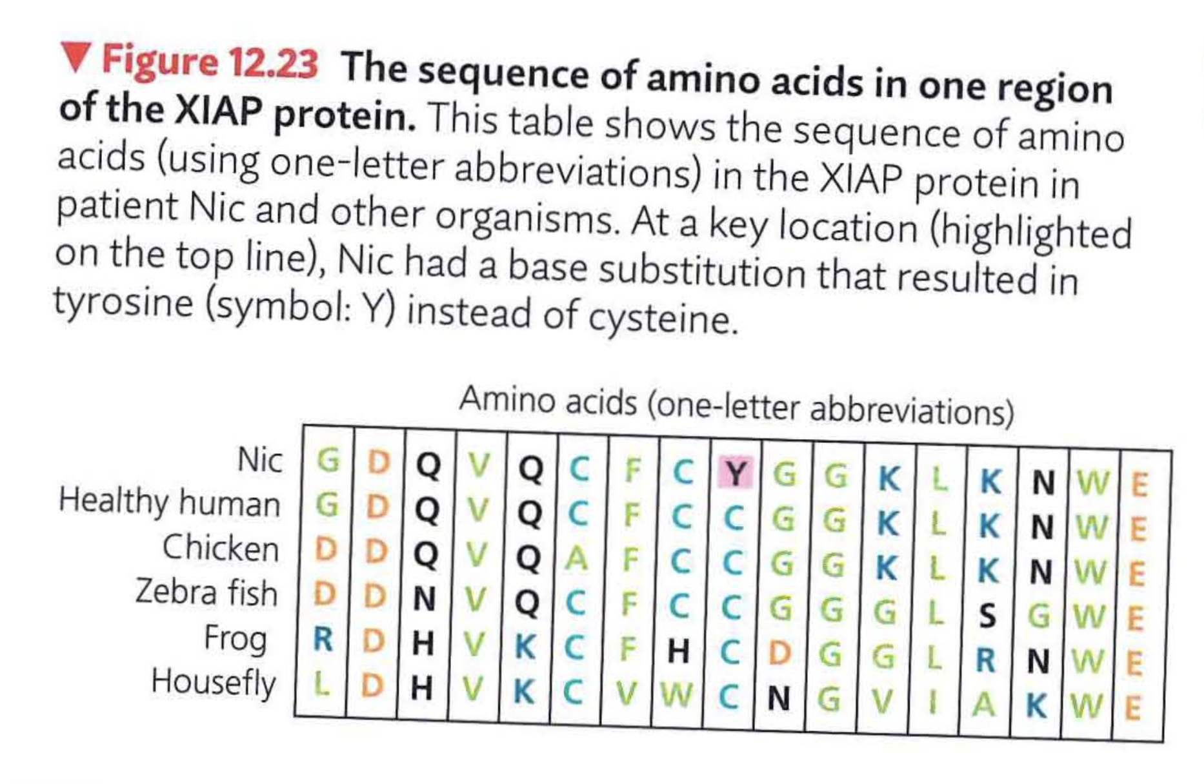
The Process of Science: Did Nic have a deadly gene?
Notes:
116
Student Misconceptions and Concerns
1. There are 24 chromosomes in the human genome. Students might initially find this confusing, as it is common knowledge that humans have 23 pairs of chromosomes. Consider making the statement that we have 24 different types of chromosomes and asking your students to explain why this is true.
2. The similarities of the genotypes and phenotypes of members of a human family tree are expected and understood by most students. Yet for many students, these same relationships are often poorly extrapolated to phylogenetic relationships of other groups. The use of genomics to test phylogenetic relationships is an enormously powerful tool used in modern systematics. Genomics is a significant test of the other overwhelming types of evidence for evolution.
Teaching Tips
1. The first targets of genomics were prokaryotic pathogenic organisms. Consider asking your students in class to suggest why this was a good choice. Students may note that the genomes of these organisms are smaller than eukaryotes and that many of these organisms are of great medical significance.
2. The authors note that there are about 3 billion nucleotide pairs in the human genome. There are about 3 billion seconds in about 95 years. This simple reference might add meaning to the significance of these large numbers.
3. The main U.S. Department of Energy Office website in support of the Human Genome Project is found at genomics.energy.gov.
4. The website for the National Center for Biotechnology Information is www.ncbi.nlm.nih.gov. The center, established in 1988, serves as a national resource for biomedical information related to genomic data.
5. Challenge students to explain why a complete understanding of an organism’s genome and the resulting proteins produced is still not enough to understand the full biology of an organism. Challenge them to consider the role of the environment in development and physiology. (One striking example of the influence of the environment is that the sex of some reptiles is determined not by genetics, but by egg incubation temperature!)
6. With a better understanding of the diverse and still unknown roles of many sections of DNA, consider discussing some of the difficulties of “resurrecting” extinct organisms from incomplete DNA sequences.
Active Lecture Tips
1. See the Activity Personal Genomics: Would You Give Your DNA Away? on the Instructor Exchange. Visit the Instructor Exchange in the MasteringBiology instructor resource area for a description of this activity.
2. See the Media Review: “Learn.Genetics” Genetic Science Learning Center from the University of Utah on the Instructor Exchange. Visit the Instructor Exchange in the MasteringBiology instructor resource area for a description of this activity.

Slide 117
Ethical Questions Raised by Human DNA Technologies: CRISPR
Genetic engineering of gametes (sperm or ova) and zygotes has been accomplished in lab animals.
From pdf Ch12: ‘It has not been attempted in humans because such a procedure raises very difficult ethical questions’
NPR story about CRISPR Twins
As of two weeks ago, this is no longer true:

Slide 118
stopped here on 11/27/18

Slide 119
Applied Genomics
In 2001, a 63-year-old Florida man died from inhalation anthrax; by the end of the year, four more people had died from inhaling anthrax.
Law enforcement officials realized that someone was sending anthrax spores through the mail.
Notes:
119
Student Misconceptions and Concerns
1. There are 24 chromosomes in the human genome. Students might initially find this confusing, as it is common knowledge that humans have 23 pairs of chromosomes. Consider making the statement that we have 24 different types of chromosomes and asking your students to explain why this is true.
2. The similarities of the genotypes and phenotypes of members of a human family tree are expected and understood by most students. Yet for many students, these same relationships are often poorly extrapolated to phylogenetic relationships of other groups. The use of genomics to test phylogenetic relationships is an enormously powerful tool used in modern systematics. Genomics is a significant test of the other overwhelming types of evidence for evolution.
Teaching Tips
1. The first targets of genomics were prokaryotic pathogenic organisms. Consider asking your students in class to suggest why this was a good choice. Students may note that the genomes of these organisms are smaller than eukaryotes and that many of these organisms are of great medical significance.
2. The authors note that there are about 3 billion nucleotide pairs in the human genome. There are about 3 billion seconds in about 95 years. This simple reference might add meaning to the significance of these large numbers.
3. The main U.S. Department of Energy Office website in support of the Human Genome Project is found at genomics.energy.gov.
4. The website for the National Center for Biotechnology Information is www.ncbi.nlm.nih.gov. The center, established in 1988, serves as a national resource for biomedical information related to genomic data.
5. Challenge students to explain why a complete understanding of an organism’s genome and the resulting proteins produced is still not enough to understand the full biology of an organism. Challenge them to consider the role of the environment in development and physiology. (One striking example of the influence of the environment is that the sex of some reptiles is determined not by genetics, but by egg incubation temperature!)
6. With a better understanding of the diverse and still unknown roles of many sections of DNA, consider discussing some of the difficulties of “resurrecting” extinct organisms from incomplete DNA sequences.
Active Lecture Tips
1. See the Activity Personal Genomics: Would You Give Your DNA Away? on the Instructor Exchange. Visit the Instructor Exchange in the MasteringBiology instructor resource area for a description of this activity.
2. See the Media Review: “Learn.Genetics” Genetic Science Learning Center from the University of Utah on the Instructor Exchange. Visit the Instructor Exchange in the MasteringBiology instructor resource area for a description of this activity.

Slide 120
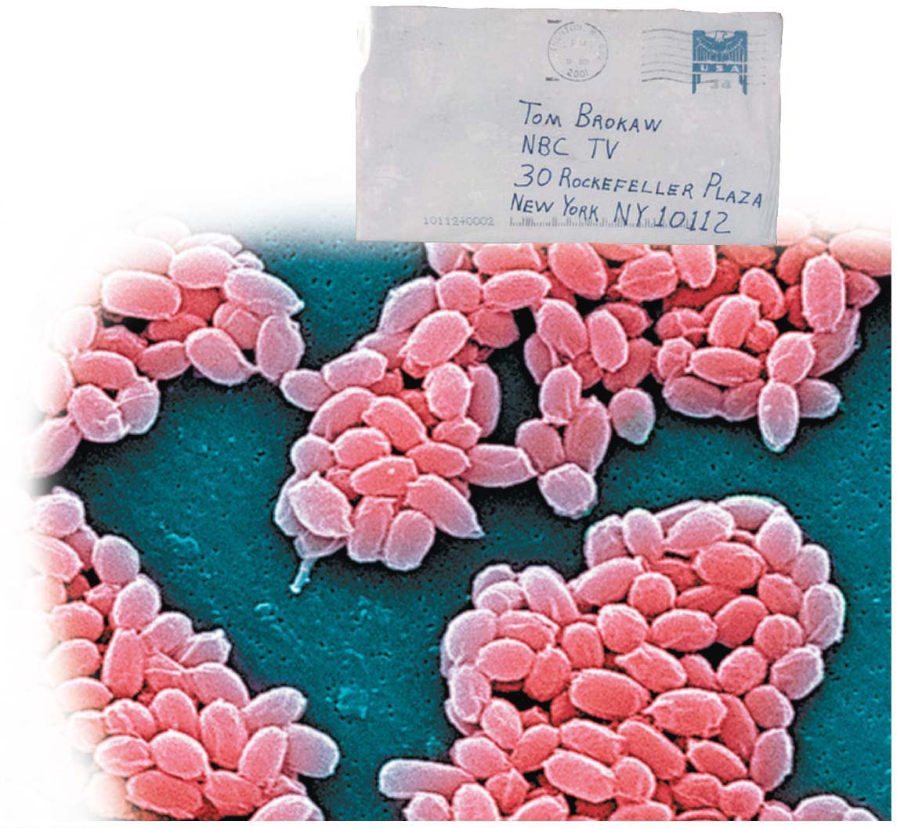
Figure 12.22
Envelope
containing
anthrax spores
Envelope
containing
anthrax spores
Anthrax
spore
Colorized SEM
Notes:
Figure 12.22 The 2001 anthrax attacks

Slide 121
Applied Genomics
Investigators sequenced the genomes of the mailed anthrax spores.
They quickly established that all of the mailed spores were genetically identical to a laboratory subtype stored in a single flask at the U.S. Army Medical Research Institute of Infectious Diseases in Fort Detrick, Maryland.
Based in part on this evidence, the FBI named an army research scientist as a suspect in the case. Although never charged, that suspect committed suicide in 2008; the case officially remains unsolved.
Notes:
121
Student Misconceptions and Concerns
1. There are 24 chromosomes in the human genome. Students might initially find this confusing, as it is common knowledge that humans have 23 pairs of chromosomes. Consider making the statement that we have 24 different types of chromosomes and asking your students to explain why this is true.
2. The similarities of the genotypes and phenotypes of members of a human family tree are expected and understood by most students. Yet for many students, these same relationships are often poorly extrapolated to phylogenetic relationships of other groups. The use of genomics to test phylogenetic relationships is an enormously powerful tool used in modern systematics. Genomics is a significant test of the other overwhelming types of evidence for evolution.
Teaching Tips
1. The first targets of genomics were prokaryotic pathogenic organisms. Consider asking your students in class to suggest why this was a good choice. Students may note that the genomes of these organisms are smaller than eukaryotes and that many of these organisms are of great medical significance.
2. The authors note that there are about 3 billion nucleotide pairs in the human genome. There are about 3 billion seconds in about 95 years. This simple reference might add meaning to the significance of these large numbers.
3. The main U.S. Department of Energy Office website in support of the Human Genome Project is found at genomics.energy.gov.
4. The website for the National Center for Biotechnology Information is www.ncbi.nlm.nih.gov. The center, established in 1988, serves as a national resource for biomedical information related to genomic data.
5. Challenge students to explain why a complete understanding of an organism’s genome and the resulting proteins produced is still not enough to understand the full biology of an organism. Challenge them to consider the role of the environment in development and physiology. (One striking example of the influence of the environment is that the sex of some reptiles is determined not by genetics, but by egg incubation temperature!)
6. With a better understanding of the diverse and still unknown roles of many sections of DNA, consider discussing some of the difficulties of “resurrecting” extinct organisms from incomplete DNA sequences.
Active Lecture Tips
1. See the Activity Personal Genomics: Would You Give Your DNA Away? on the Instructor Exchange. Visit the Instructor Exchange in the MasteringBiology instructor resource area for a description of this activity.
2. See the Media Review: “Learn.Genetics” Genetic Science Learning Center from the University of Utah on the Instructor Exchange. Visit the Instructor Exchange in the MasteringBiology instructor resource area for a description of this activity.

Slide 122
Applied Genomics
Sequence data also provided strong evidence that a Florida dentist transmitted HIV to several patients and that a single natural strain of West Nile virus can infect both birds and people.
  A 2013 study used DNA sequencing to prove that cancerous skin cells that had spread to the brain had done so after fusing with red blood cells provided by a bone marrow donor.
  These results provided researchers with new insight into how cancer spreads throughout the body.
Notes:
122
Student Misconceptions and Concerns
1. There are 24 chromosomes in the human genome. Students might initially find this confusing, as it is common knowledge that humans have 23 pairs of chromosomes. Consider making the statement that we have 24 different types of chromosomes and asking your students to explain why this is true.
2. The similarities of the genotypes and phenotypes of members of a human family tree are expected and understood by most students. Yet for many students, these same relationships are often poorly extrapolated to phylogenetic relationships of other groups. The use of genomics to test phylogenetic relationships is an enormously powerful tool used in modern systematics. Genomics is a significant test of the other overwhelming types of evidence for evolution.
Teaching Tips
1. The first targets of genomics were prokaryotic pathogenic organisms. Consider asking your students in class to suggest why this was a good choice. Students may note that the genomes of these organisms are smaller than eukaryotes and that many of these organisms are of great medical significance.
2. The authors note that there are about 3 billion nucleotide pairs in the human genome. There are about 3 billion seconds in about 95 years. This simple reference might add meaning to the significance of these large numbers.
3. The main U.S. Department of Energy Office website in support of the Human Genome Project is found at genomics.energy.gov.
4. The website for the National Center for Biotechnology Information is www.ncbi.nlm.nih.gov. The center, established in 1988, serves as a national resource for biomedical information related to genomic data.
5. Challenge students to explain why a complete understanding of an organism’s genome and the resulting proteins produced is still not enough to understand the full biology of an organism. Challenge them to consider the role of the environment in development and physiology. (One striking example of the influence of the environment is that the sex of some reptiles is determined not by genetics, but by egg incubation temperature!)
6. With a better understanding of the diverse and still unknown roles of many sections of DNA, consider discussing some of the difficulties of “resurrecting” extinct organisms from incomplete DNA sequences.
Active Lecture Tips
1. See the Activity Personal Genomics: Would You Give Your DNA Away? on the Instructor Exchange. Visit the Instructor Exchange in the MasteringBiology instructor resource area for a description of this activity.
2. See the Media Review: “Learn.Genetics” Genetic Science Learning Center from the University of Utah on the Instructor Exchange. Visit the Instructor Exchange in the MasteringBiology instructor resource area for a description of this activity.

Slide 123
Interconnections within Systems: Systems Biology
Genomics is a rich source of new insights into fundamental questions about
  genome organization,
  regulation of gene expression,
  embryonic development, and
  evolution.
Notes:
123
Student Misconceptions and Concerns
1. There are 24 chromosomes in the human genome. Students might initially find this confusing, as it is common knowledge that humans have 23 pairs of chromosomes. Consider making the statement that we have 24 different types of chromosomes and asking your students to explain why this is true.
2. The similarities of the genotypes and phenotypes of members of a human family tree are expected and understood by most students. Yet for many students, these same relationships are often poorly extrapolated to phylogenetic relationships of other groups. The use of genomics to test phylogenetic relationships is an enormously powerful tool used in modern systematics. Genomics is a significant test of the other overwhelming types of evidence for evolution.
Teaching Tips
1. The first targets of genomics were prokaryotic pathogenic organisms. Consider asking your students in class to suggest why this was a good choice. Students may note that the genomes of these organisms are smaller than eukaryotes and that many of these organisms are of great medical significance.
2. The authors note that there are about 3 billion nucleotide pairs in the human genome. There are about 3 billion seconds in about 95 years. This simple reference might add meaning to the significance of these large numbers.
3. The main U.S. Department of Energy Office website in support of the Human Genome Project is found at genomics.energy.gov.
4. The website for the National Center for Biotechnology Information is www.ncbi.nlm.nih.gov. The center, established in 1988, serves as a national resource for biomedical information related to genomic data.
5. Challenge students to explain why a complete understanding of an organism’s genome and the resulting proteins produced is still not enough to understand the full biology of an organism. Challenge them to consider the role of the environment in development and physiology. (One striking example of the influence of the environment is that the sex of some reptiles is determined not by genetics, but by egg incubation temperature!)
6. With a better understanding of the diverse and still unknown roles of many sections of DNA, consider discussing some of the difficulties of “resurrecting” extinct organisms from incomplete DNA sequences.
Active Lecture Tips
1. See the Activity Personal Genomics: Would You Give Your DNA Away? on the Instructor Exchange. Visit the Instructor Exchange in the MasteringBiology instructor resource area for a description of this activity.
2. See the Media Review: “Learn.Genetics” Genetic Science Learning Center from the University of Utah on the Instructor Exchange. Visit the Instructor Exchange in the MasteringBiology instructor resource area for a description of this activity.

Slide 124
Interconnections within Systems: Systems Biology
Technological advances have also led to metagenomics, the study of DNA from an environmental sample.
  After the whole sample is sequenced, computer software sorts out the partial sequences from different species and assembles them into the individual specific genomes.
  So far, this approach has been applied to microbial communities found in environments as diverse as the Sargasso Sea and the human intestine.
Notes:
124
Student Misconceptions and Concerns
1. There are 24 chromosomes in the human genome. Students might initially find this confusing, as it is common knowledge that humans have 23 pairs of chromosomes. Consider making the statement that we have 24 different types of chromosomes and asking your students to explain why this is true.
2. The similarities of the genotypes and phenotypes of members of a human family tree are expected and understood by most students. Yet for many students, these same relationships are often poorly extrapolated to phylogenetic relationships of other groups. The use of genomics to test phylogenetic relationships is an enormously powerful tool used in modern systematics. Genomics is a significant test of the other overwhelming types of evidence for evolution.
Teaching Tips
1. The first targets of genomics were prokaryotic pathogenic organisms. Consider asking your students in class to suggest why this was a good choice. Students may note that the genomes of these organisms are smaller than eukaryotes and that many of these organisms are of great medical significance.
2. The authors note that there are about 3 billion nucleotide pairs in the human genome. There are about 3 billion seconds in about 95 years. This simple reference might add meaning to the significance of these large numbers.
3. The main U.S. Department of Energy Office website in support of the Human Genome Project is found at genomics.energy.gov.
4. The website for the National Center for Biotechnology Information is www.ncbi.nlm.nih.gov. The center, established in 1988, serves as a national resource for biomedical information related to genomic data.
5. Challenge students to explain why a complete understanding of an organism’s genome and the resulting proteins produced is still not enough to understand the full biology of an organism. Challenge them to consider the role of the environment in development and physiology. (One striking example of the influence of the environment is that the sex of some reptiles is determined not by genetics, but by egg incubation temperature!)
6. With a better understanding of the diverse and still unknown roles of many sections of DNA, consider discussing some of the difficulties of “resurrecting” extinct organisms from incomplete DNA sequences.
Active Lecture Tips
1. See the Activity Personal Genomics: Would You Give Your DNA Away? on the Instructor Exchange. Visit the Instructor Exchange in the MasteringBiology instructor resource area for a description of this activity.
2. See the Media Review: “Learn.Genetics” Genetic Science Learning Center from the University of Utah on the Instructor Exchange. Visit the Instructor Exchange in the MasteringBiology instructor resource area for a description of this activity.

Slide 125
Interconnections within Systems: Systems Biology
The successes in genomics have encouraged scientists to begin similar systematic studies of the full protein sets that genomes encode (proteomes), an approach called proteomics.
Because proteins, not genes, actually carry out the activities of the cell, scientists must study when and where proteins are produced and how they interact to understand the functioning of cells and organisms.
Notes:
125
Student Misconceptions and Concerns
1. There are 24 chromosomes in the human genome. Students might initially find this confusing, as it is common knowledge that humans have 23 pairs of chromosomes. Consider making the statement that we have 24 different types of chromosomes and asking your students to explain why this is true.
2. The similarities of the genotypes and phenotypes of members of a human family tree are expected and understood by most students. Yet for many students, these same relationships are often poorly extrapolated to phylogenetic relationships of other groups. The use of genomics to test phylogenetic relationships is an enormously powerful tool used in modern systematics. Genomics is a significant test of the other overwhelming types of evidence for evolution.
Teaching Tips
1. The first targets of genomics were prokaryotic pathogenic organisms. Consider asking your students in class to suggest why this was a good choice. Students may note that the genomes of these organisms are smaller than eukaryotes and that many of these organisms are of great medical significance.
2. The authors note that there are about 3 billion nucleotide pairs in the human genome. There are about 3 billion seconds in about 95 years. This simple reference might add meaning to the significance of these large numbers.
3. The main U.S. Department of Energy Office website in support of the Human Genome Project is found at genomics.energy.gov.
4. The website for the National Center for Biotechnology Information is www.ncbi.nlm.nih.gov. The center, established in 1988, serves as a national resource for biomedical information related to genomic data.
5. Challenge students to explain why a complete understanding of an organism’s genome and the resulting proteins produced is still not enough to understand the full biology of an organism. Challenge them to consider the role of the environment in development and physiology. (One striking example of the influence of the environment is that the sex of some reptiles is determined not by genetics, but by egg incubation temperature!)
6. With a better understanding of the diverse and still unknown roles of many sections of DNA, consider discussing some of the difficulties of “resurrecting” extinct organisms from incomplete DNA sequences.
Active Lecture Tips
1. See the Activity Personal Genomics: Would You Give Your DNA Away? on the Instructor Exchange. Visit the Instructor Exchange in the MasteringBiology instructor resource area for a description of this activity.
2. See the Media Review: “Learn.Genetics” Genetic Science Learning Center from the University of Utah on the Instructor Exchange. Visit the Instructor Exchange in the MasteringBiology instructor resource area for a description of this activity.

Slide 126
Interconnections within Systems: Systems Biology
Genomics and proteomics enable biologists to approach the study of life from an increasingly global perspective.
  Biologists are now compiling catalogs of genes and proteins that contribute to the operation of cells, tissues, and organisms.
The number of different proteins in humans far exceeds the number of different genes (about 100,000 proteins versus about 21,000 genes
Notes:
126
Student Misconceptions and Concerns
1. There are 24 chromosomes in the human genome. Students might initially find this confusing, as it is common knowledge that humans have 23 pairs of chromosomes. Consider making the statement that we have 24 different types of chromosomes and asking your students to explain why this is true.
2. The similarities of the genotypes and phenotypes of members of a human family tree are expected and understood by most students. Yet for many students, these same relationships are often poorly extrapolated to phylogenetic relationships of other groups. The use of genomics to test phylogenetic relationships is an enormously powerful tool used in modern systematics. Genomics is a significant test of the other overwhelming types of evidence for evolution.
Teaching Tips
1. The first targets of genomics were prokaryotic pathogenic organisms. Consider asking your students in class to suggest why this was a good choice. Students may note that the genomes of these organisms are smaller than eukaryotes and that many of these organisms are of great medical significance.
2. The authors note that there are about 3 billion nucleotide pairs in the human genome. There are about 3 billion seconds in about 95 years. This simple reference might add meaning to the significance of these large numbers.
3. The main U.S. Department of Energy Office website in support of the Human Genome Project is found at genomics.energy.gov.
4. The website for the National Center for Biotechnology Information is www.ncbi.nlm.nih.gov. The center, established in 1988, serves as a national resource for biomedical information related to genomic data.
5. Challenge students to explain why a complete understanding of an organism’s genome and the resulting proteins produced is still not enough to understand the full biology of an organism. Challenge them to consider the role of the environment in development and physiology. (One striking example of the influence of the environment is that the sex of some reptiles is determined not by genetics, but by egg incubation temperature!)
6. With a better understanding of the diverse and still unknown roles of many sections of DNA, consider discussing some of the difficulties of “resurrecting” extinct organisms from incomplete DNA sequences.
Active Lecture Tips
1. See the Activity Personal Genomics: Would You Give Your DNA Away? on the Instructor Exchange. Visit the Instructor Exchange in the MasteringBiology instructor resource area for a description of this activity.
2. See the Media Review: “Learn.Genetics” Genetic Science Learning Center from the University of Utah on the Instructor Exchange. Visit the Instructor Exchange in the MasteringBiology instructor resource area for a description of this activity.

Slide 127
Interconnections within Systems: Systems Biology
  As such catalogs become complete, researchers are shifting their attention from the individual parts to how these parts function as a whole in biological systems.
  This approach, called systems biology, aims to model the dynamic behavior of whole biological systems based on the study of the interactions among the system’s parts.
Notes:
127

Slide 128
Interconnections within Systems: Systems Biology
  Such analyses may have many practical applications.
    Proteins associated with specific diseases may be used to aid diagnosis and treatment.
    The Cancer Genome Atlas project aims to determine how changes in biological systems lead to cancer.
Notes:
128

Slide 129
Safety and Ethical Issues
As soon as scientists realized the power of DNA technology, they began to worry about potential dangers such as
  the creation of hazardous new disease-causing organisms and
  the transfer of cancer-causing genes into infectious bacteria and viruses.
  Think about Zika for example...
Notes:
129

Slide 130
Safety and Ethical Issues
Strict laboratory safety procedures have been designed to
  protect researchers from infection by engineered microbes and
  prevent microbes from accidentally leaving the laboratory.
In addition, strains of microbes to be used in recombinant DNA experiments are genetically crippled to ensure that they cannot survive outside the laboratory and certain obviously dangerous experiments have been banned.
Notes:
130

Slide 131
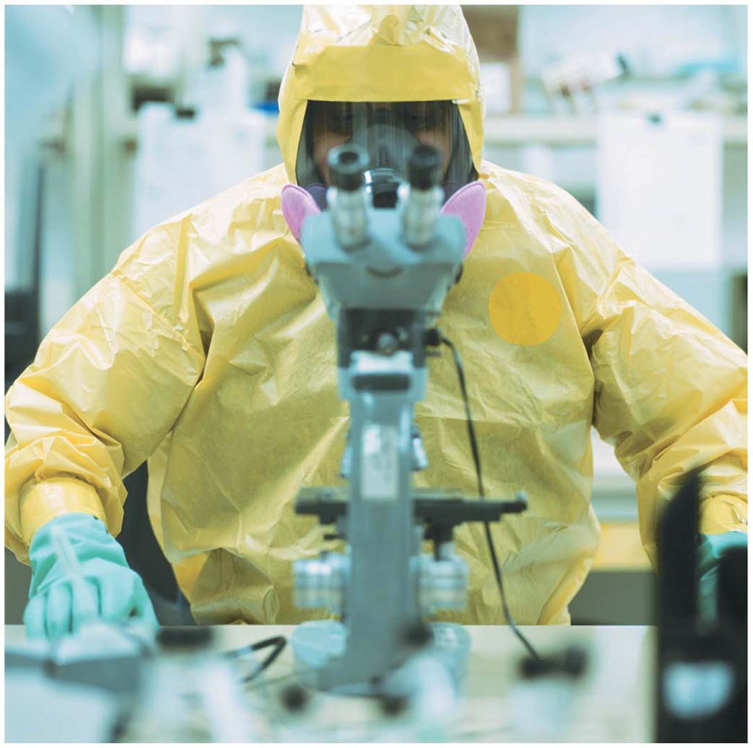
Figure 12.24
Notes:
Figure 12.24 Maximum-security laboratory

Slide 132
The Controversy over Genetically Modified Foods
Genetically modified (GM) foods account for a significant percentage of several staple crops in the United States, Argentina, and Brazil.
Controversy about the safety of these foods is an important political issue.
Notes:
132

Slide 133
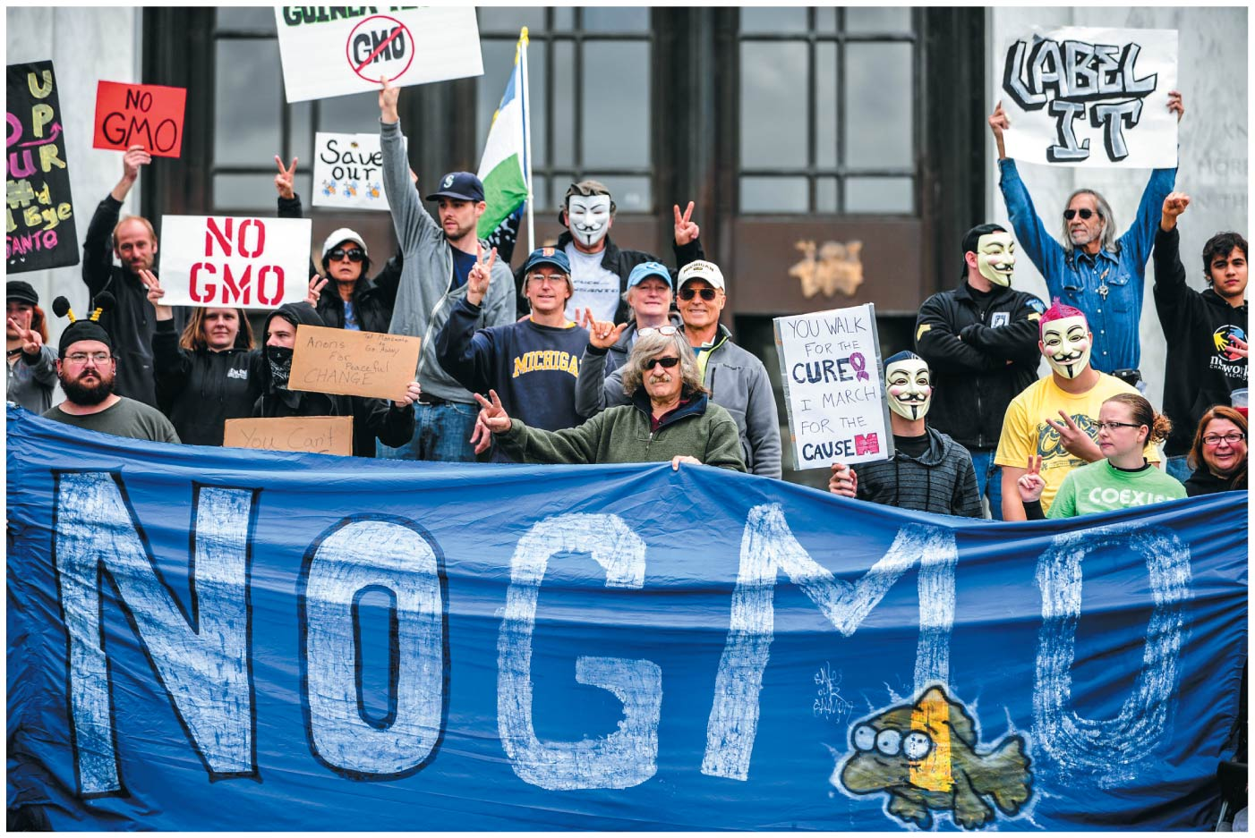
Figure 12.25
Notes:
Figure 12.25 Opposition to genetically modified organisms (GMOs)

Slide 134
The Controversy over Genetically Modified Foods
Advocates of a cautious approach are concerned that crops carrying genes from other species might harm the environment or be hazardous to human health, and/or that transgenic plants might pass their genes to close relatives in nearby wild areas.
Notes:
134

Slide 135
The Controversy over Genetically Modified Foods
Negotiators from 130 countries (including the United States) agreed on a Biosafety Protocol that
  requires exporters to identify GM organisms present in bulk food shipments and
  allows importing countries to decide whether the shipments pose environmental or health risks.
Notes:
135

Slide 136
The Controversy over Genetically Modified Foods
The United States declined to sign the agreement, but it went into effect anyway because the majority of countries were in favor of it.
Since then, European countries have, on occasion, refused crops from the United States and other countries for fear that they contain GM crops, leading to trade disputes.
Notes:
136

Slide 137
Do we eat DNA regularly?
I don’t want to eat DNA...
Why is that a ridiculous statement?

Slide 138
Round Up Ready Soy
(Glycine max) that has had DNA introduced into it using genetic engineering techniques
In 1998 the first genetically modified soybean was introduced to the U.S. market, by Monsanto.
In 2014, 90.7 million hectares of GM soy were planted worldwide, 82% of the total soy cultivation area
Glyphosate kills plants by interfering with the synthesis of the essential amino acids phenylalanine, tyrosine and tryptophan. These amino acids are called "essential" because animals cannot make them; only plants and micro-organisms can make them and animals obtain them by eating plants.[4]

Slide 139
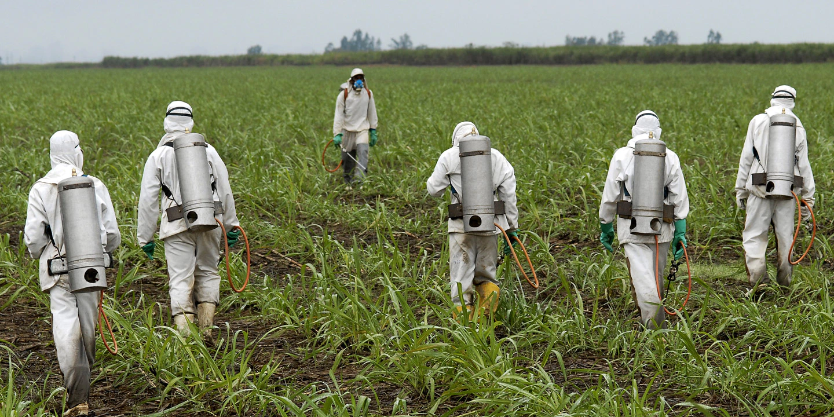

Slide 140
The Controversy over Genetically Modified Foods
Governments and regulatory agencies throughout the world are grappling with how to facilitate the use of biotechnology in agriculture, industry, and medicine while ensuring that new products and procedures are safe.
Notes:
140

Slide 141
The Controversy over Genetically Modified Foods
In the United States, all genetic engineering projects are evaluated for potential risks by a number of regulatory agencies, including the
  Food and Drug Administration,
  Environmental Protection Agency,
  National Institutes of Health, and
  Department of Agriculture.
Notes:
141

Slide 142
Ethical Questions Raised by Human DNA Technologies
Human DNA technology raises legal and ethical questions—few of which have clear answers.
  Should parents of short but hormonally normal children be able to seek HGH treatment to make their kids taller?
  Should we try to eliminate genetic defects in our children and their descendants?
Notes:
142

Slide 143
Ethical Questions Raised by Human DNA Technologies
Advances in genetic profiling raise privacy issues.
In 2014, the U.S. Supreme Court, by a 5–4 vote, upheld the practice of collecting DNA samples from suspects at the time of their arrest (before they had been convicted).
  Ruling that obtaining DNA is “like fingerprinting and photographing, a legitimate police booking procedure that is reasonable under the Fourth Amendment,” the Supreme Court decision will likely usher in an era of expanded use of DNA profiling in many aspects of police work.
Notes:
143

Slide 144
Ethical Questions Raised by Human DNA Technologies
As more information becomes available about our personal genetic makeup, some people question whether greater access to this information is always beneficial.
  For example, mail-in kits have become available that can tell healthy people their relative risk of developing various diseases later in life.
  Some argue that such information helps families to prepare.
Notes:
144

Slide 145
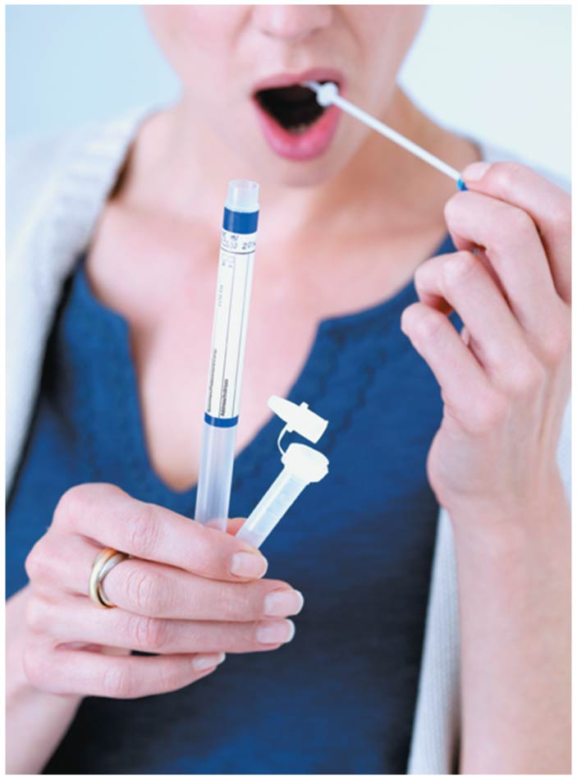
Figure 12.27
Notes:
Figure 12.27 Personalized genetic testing

Slide 146
Ethical Questions Raised by Human DNA Technologies
  Others worry that the tests prey on our fears without offering any real benefit because certain diseases, such as Parkinson’s, are not currently preventable or treatable.
  Other tests, however, such as for breast cancer risk, may help a person make changes that can prevent disease.
Notes:
146

Slide 147
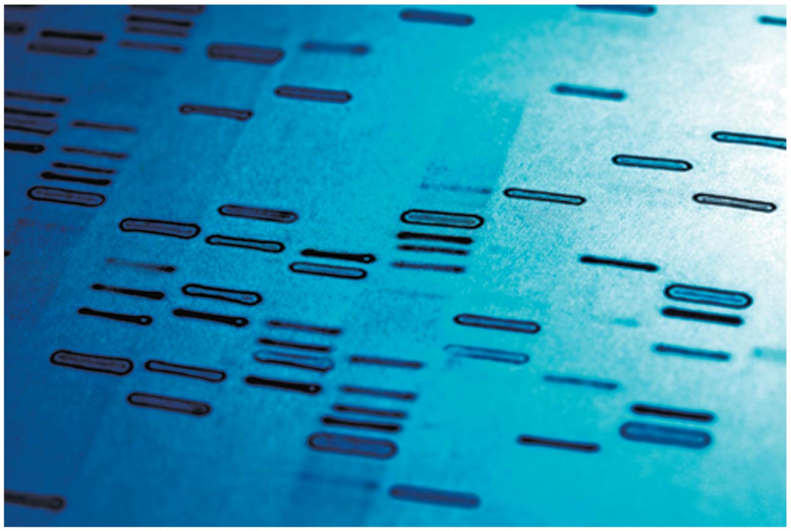
Figure 12.26
Notes:
Figure 12.26 Access to genetic information raises privacy concerns

Slide 148
Ethical Questions Raised by DNA Technology
There is also a danger that information about disease-associated genes could be abused.
One issue is the possibility of discrimination and stigmatization.
  In response, Congress passed the Genetic Information Nondiscrimination Act of 2008.
  Title I of the act prohibits insurance companies from requesting or requiring genetic information during an application for health insurance.
  Title II provides similar protections in employment.
Notes:
148

Slide 149
Ethical Questions Raised by DNA Technology
A much broader ethical question is how do we really feel about wielding one of nature’s powers—the evolution of new organisms?
  Some might ask if we have any right to alter an organism’s genes—or to create new organisms.
  DNA technologies raise many complex issues that have no easy answers.
  It is up to you, as a participating citizen, to make informed choices.
Notes:
149
Student Misconceptions and Concerns
1. The many issues raised in this chapter are of great potential significance and remain unresolved. An informed debate about rights, responsibilities, and possibilities continues regarding these scientific issues.
2. The Genetic Information Nondiscrimination Act was passed in May 2008. Details about this important legislation can be found at www.ornl.gov/sci/techresources/Human_Genome/elsi/legislat.shtml.
Teaching Tips
1. Genetically engineered organisms are controversial, creating various degrees of concern, yet many debates around issues of science are confused by misinformation. This may be an opportunity for you to make an extra credit or regular assignment for students to take a position, on one side or the other, on some aspect of genetic engineering. The science would need to be accurate. Students might debate whether a food product made from GM/transgenic organisms should be labeled as such, discuss the risks or advantages of producing GM organisms.
Active Lecture Tips
1. Consider a person who opposes GM food by stating “I do not want any DNA in my food.” You might want to have your students respond to this person’s concerns.
2. See the Activity Speed Dating with Gene Testing on the Instructor Exchange. Visit the Instructor Exchange in the MasteringBiology instructor resource area for a description of this activity.

Slide 150
Evolution Connection: The Y Chromosome as a Window on History
The human Y chromosome passes essentially intact from father to son.
By comparing Y DNA, researchers can learn about the ancestry of human males.
Notes:
150

Slide 151
Evolution Connection: The Y Chromosome as a Window on History
DNA profiling of the Y chromosome has revealed that
  nearly 16 million men currently living may be descended from Genghis Khan,
  nearly 10% of Irish men were descendants of Niall of the Nine Hostages, a warlord who lived during the 1400s, and
  the Lemba people of southern Africa are descended from ancient Jews.
Notes:
151
Student Misconceptions and Concerns
1. The many issues raised in this chapter are of great potential significance and remain unresolved. An informed debate about rights, responsibilities, and possibilities continues regarding these scientific issues.
2. The Genetic Information Nondiscrimination Act was passed in May 2008. Details about this important legislation can be found at www.ornl.gov/sci/techresources/Human_Genome/elsi/legislat.shtml.
Teaching Tips
1. Genetically engineered organisms are controversial, creating various degrees of concern, yet many debates around issues of science are confused by misinformation. This may be an opportunity for you to make an extra credit or regular assignment for students to take a position, on one side or the other, on some aspect of genetic engineering. The science would need to be accurate. Students might debate whether a food product made from GM/transgenic organisms should be labeled as such, discuss the risks or advantages of producing GM organisms.
Active Lecture Tips
1. Consider a person who opposes GM food by stating “I do not want any DNA in my food.” You might want to have your students respond to this person’s concerns.
2. See the Activity Speed Dating with Gene Testing on the Instructor Exchange. Visit the Instructor Exchange in the MasteringBiology instructor resource area for a description of this activity.

Slide 152
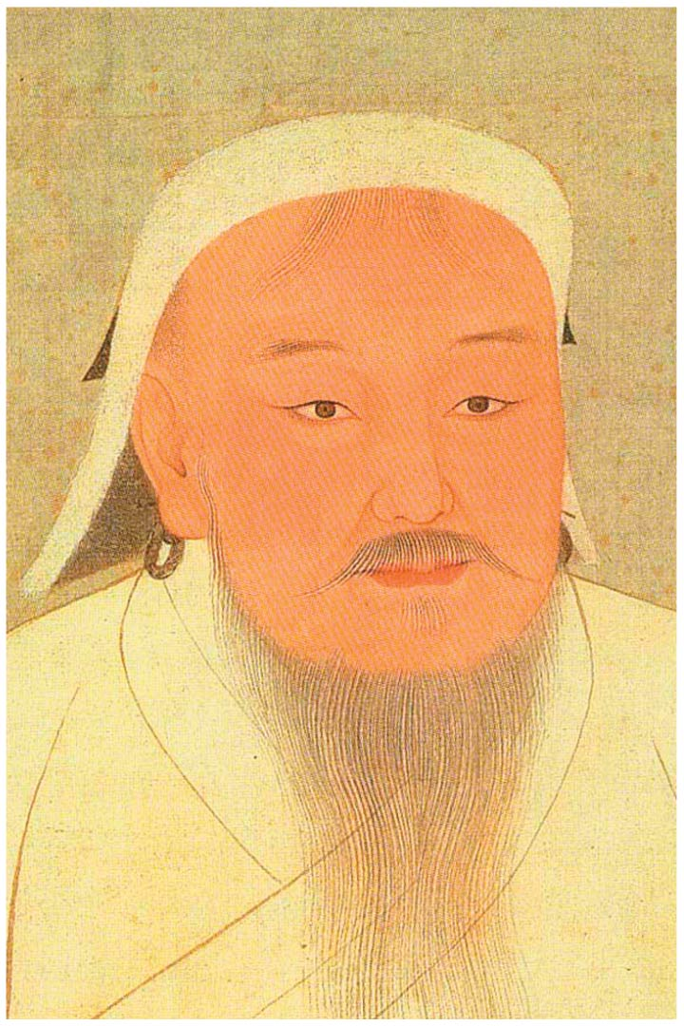
Figure 12.28
Notes:
Figure 12.28 Genghis Khan

Slide 153

Figure 12.29
Notes:
Figure 12.29 Lemba people of southern Africa

Slide 154
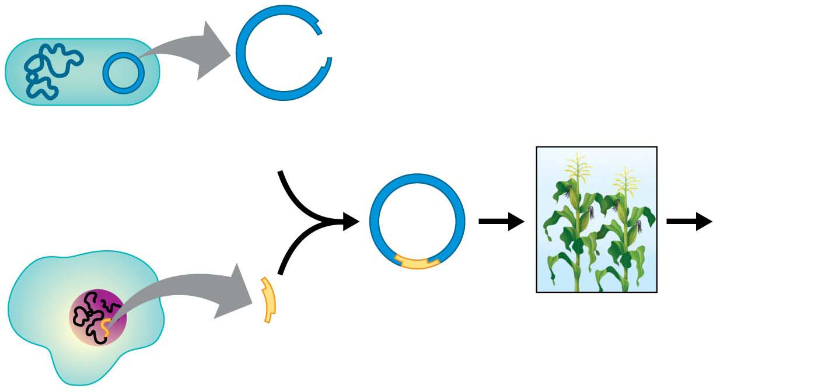
Figure 12.UN01
DNA isolated
from two sources
and cut by same
restriction enzyme
Plasmid
(vector)
Useful
products
Recombinant
DNA
Transgenic
organisms
Gene
of interest
Notes:
Figure 12.UN01 Summary of key concepts: recombinant DNA

Slide 155

Figure 12.UN02
Crime scene
Suspect 1
Suspect 2
DNA
Polymerase chain
reaction (PCR)
amplifies STR
sites
−
Longer
DNA
fragments
Gel
Shorter
DNA
fragments
+
DNA fragments compared by gel electrophoresis
(Bands of shorter fragments move faster toward the positive pole.)
Notes:
Figure 12.UN02 Summary of key concepts: DNA profiling

Slide 156

Figure 12.UN02a
Crime scene
Suspect 1
Suspect 2
DNA
Polymerase chain
reaction (PCR)
amplifies STR
sites
Notes:
Figure 12.UN02a Summary of key concepts: DNA profiling (part 1)

Slide 157

Figure 12.UN02b
Polymerase chain
reaction (PCR)
amplifies STR
sites
−
Longer
DNA
fragments
Gel
Shorter
DNA
fragments
+
DNA fragments compared by gel electrophoresis
(Bands of shorter fragments move faster toward the positive pole.)
Notes:
Figure 12.UN02b Summary of key concepts: DNA profiling (part 2)

Slide 158

Figure 12.UN03
(a)
(b)
(c)
(d)
Notes:
Figure 12.UN03 Process of science, question 12 (short tandem repeats)

