Slide 1
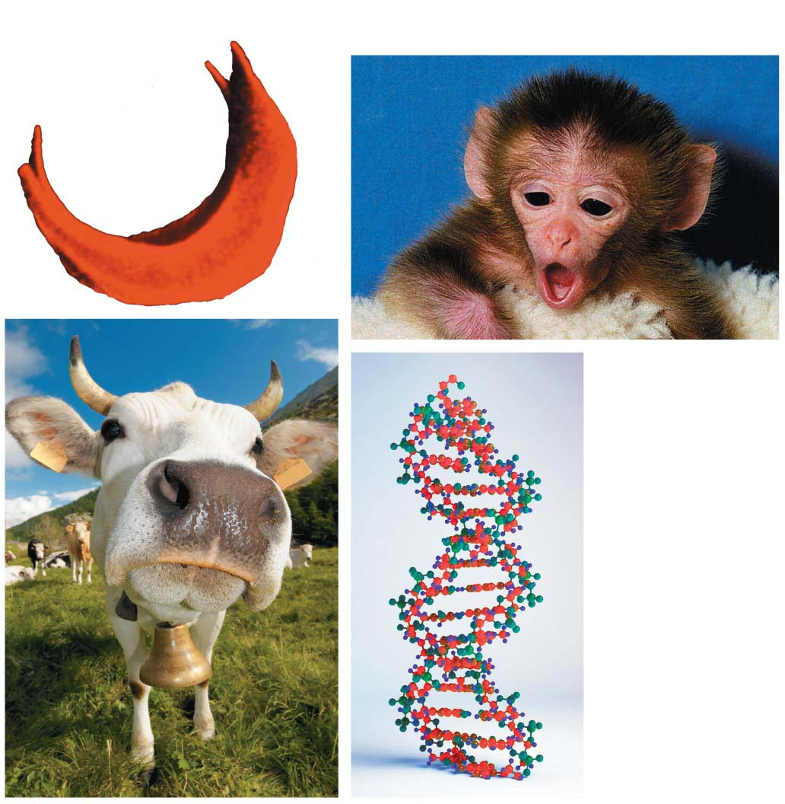
Ch10 – DNA Structure
Biol-12 read pages 171 to 185

Slide 2
The Deadliest Virus
What virus has killed more people in the last 150 years?
Flu (influenza virus)
A cluster of unusual flu cases was reported in and around Mexico City.
  young people got sick
In June 2009, the World Health Organization (WHO)
  declared H1N1 to be the first influenza pandemic (global epidemic
  18,000 people documented
  250,000 total

Slide 3
Chapter Overview
Structure of nucleic acids
  DNA & RNA compared
  Researchers show that DNA is the molecule of heredity
  Watson, Crick and Franklin unlock the double helix
  DNA replication
  DNA to RNA to protein

Slide 4
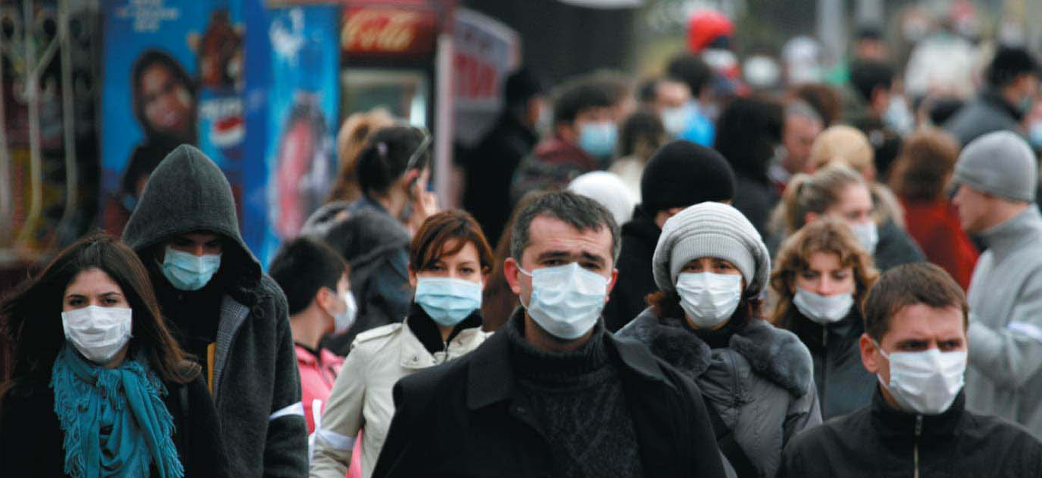
H1N1 Flu of 2009
Combination of a common strain and Asian swine flu

Slide 5
Biology and Society: The First 21st-Century Pandemic
In a typical year in the United States, more than 20,000 people die from influenza infection.
the pandemic of 1918–1919 killed 40 million people worldwide in 18 months
two times the number than died in WW1
Notes:
5

Slide 6
Biology and Society: The First 21st-Century Pandemic
The flu virus, like all viruses, consists of a relatively simple structure of
  nucleic acid (RNA in this case) and
  protein.
Combating any virus requires a detailed understanding of life at the molecular level.
Notes:
6

Slide 7
DNA: Structure and Replication
DNA was known to be a chemical component of cells by the late 1800s.
By the late 1930s, experimental studies had convinced most biologists that one specific kind of molecule is the basis of inheritance.
By the 1940s, scientists knew that chromosomes consist of two types of chemicals:
  DNA and
  protein.
Notes:
7
Student Misconceptions and Concerns
1. If your class has not yet studied Chapter 3, consider assigning the Chapter 3 section “Nucleic Acids” before addressing the contents of Chapter 10.
2. The text describes but does not specifically point out that DNA replication is semiconservative. Tell your students about an experiment in which a DNA molecule is labeled and then replicated. How will the two DNA molecules compare with regard to the location/distribution of the original DNA molecule? Will one DNA molecule be the original and the other the new copy? Or is there another possibility? Half of each of the two DNA molecules is new and half is the original; thus, it used semiconservative replication. Analogies for semiconservative replication can be a challenge. But in a sense, DNA replication is similar to parents getting divorced and then each parent remarrying someone else. The two new couples represent “half old parent and half new person.”
3. Students often confuse the terms nucleic acids, nucleotides, and bases. It helps just to note the hierarchy of relationships: Nucleic acids consist of long chains of nucleotides, and nucleotides include bases as part of their structure.
Teaching Tips
1. Consider comparing DNA, RNA, and proteins to a train (polymer). DNA and RNA are like a train of various lengths and combinations of four types of train cars (monomers). Proteins are also “trains” of various lengths but made of a combination of 20 types of train cars.
2. The descriptions of the discovery of DNA’s structure are a good time to point out that science is a collaborative effort. You might remind your class of all the prior research (identifying DNA as the genetic material and clues to its structure) that brought Watson and Crick to their historic conclusions.
3. Demonstrate the complementary base pairing within DNA. Present students with the base sequence to one side of a DNA molecule and have them work quickly at their seats to determine the sequence of the complementary strand. For some students, these sorts of quick practice are necessary to reinforce a concept and break up a lecture.
4. To explain the adaptive advantage of multiple replication sites over a single site of replication, ask your students to imagine copying, by hand, the first ten chapters of your biology textbook. The task would certainly go faster if ten students each copied a different chapter!
5. There are about 2 million characters (letters or numbers) in the Campbell Essential Biology with Physiology textbook. The accuracy of DNA replication would be like copying every letter and number in this textbook by hand 500 times and writing just one letter or number incorrectly, making one error in every 1 billion characters!
6. The information in DNA is used to direct the production of RNA, which in turn directs the production of proteins. However, in Chapter 3, four different types of biological molecules were noted as significant components of life. Students who think this through might wonder, and you could point out, that DNA does not directly control the production of carbohydrates and lipids. So how does DNA exert its influence over the synthesis of these other chemical groups? The answer is largely by way of enzymes, proteins with the ability to promote the production of carbohydrates and lipids.
Active Lecture Tips
1. The authors note that the structure of DNA is analogous to a twisted ladder. In class, challenge your students to pair up with someone nearby to explain what the parts of the ladder represent. Answer: The rungs represent pairs of nitrogenous bases joined by hydrogen bonds. Each side of the ladder represents a sugar-phosphate backbone.
2. See the Activity I’m Not Sure I Liked James Watson: Using a Video to Tell the Most Exciting Discovery in Biology on the Instructor Exchange. Visit the Instructor Exchange in the MasteringBiology instructor resource area for a description of this activity.

Slide 8
DNA: Structure and Replication
By the early 1950s, a series of discoveries had convinced the scientific world that DNA was the molecule that acts as the hereditary material.
  This breakthrough ushered in the field of molecular biology, the study of heredity at the molecular level.
Notes:
8

Slide 9
DNA: Structure and Replication
What came next was one of the most celebrated quests in the history of science: the effort to figure out the structure of DNA.
  Scientists had identified all its atoms and knew how they were bonded to one another.
  What was not understood was the specific three-dimensional arrangement of atoms that gives DNA its unique properties: the capacity to
    store genetic information,
    copy it, and
    pass it from generation to generation.
Notes:
9

Slide 10
DNA and RNA Structure
DNA and RNA are nucleic acids.
  They are long polymers.
  What are polymers made of?
    monomers of nucleotides
    A nucleotide polymer is a polynucleotide.
    Polynucleotides can be very long and may have any sequence of the four different types of nucleotides (abbreviated A, C, T, and G).
Notes:
10

Slide 11
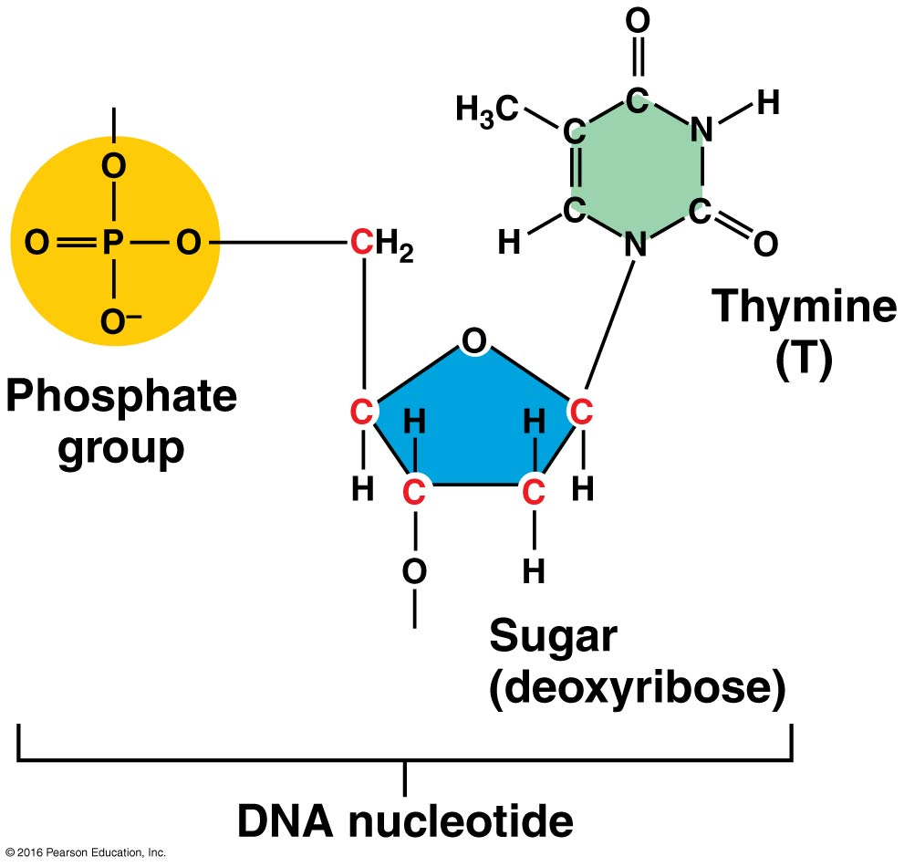
Nucleotide has three molecules
Phosphate (P, acidic)
Sugar (ribose or deoxy-ribose)
Nitrogenous base

Slide 12
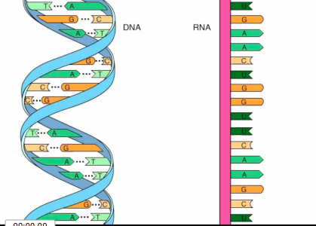
Nucleotide structure
Both DNA and RNA are made of nucleotides

Slide 13
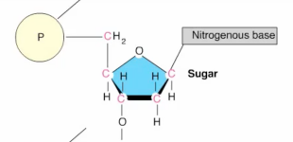
Nucleotide has three molecules
Phosphate (P, acidic)
Sugar (ribose or deoxy-ribose)
Nitrogenous base

Slide 14
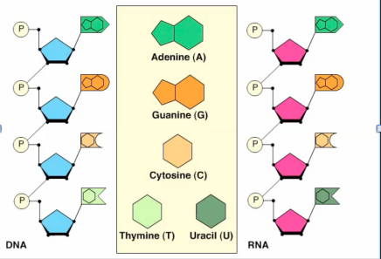
Nitrogenous Bases

Slide 15
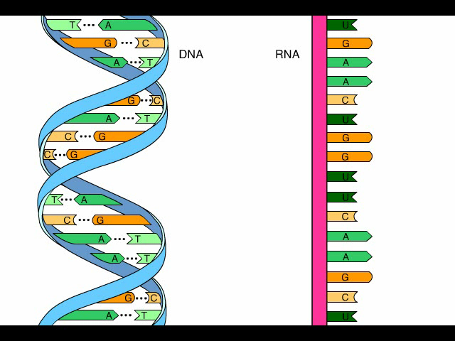
Animation: DNA and RNA Structure
start at 1:30

Slide 16
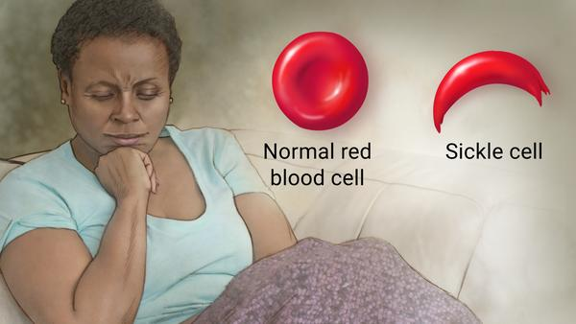
Importance of Nucleotide Sequence
The sequence of nucleotides defines the gene. If even on nucleotide changes, you
can have a non-functional enzyme or protein
Example – Sickle Cell Anemia – the protein that carries oxygen (hemoglobin) forms incorrectly because of one nucleotide change in the gene that encodes it!

Slide 17
DNA vs RNA
Deoxy ribose – Hydrogen on carbon 3 of the sugar
double stranded
Four nitrogenous bases
  adenine
  guanine
  cytosine
  thymine
ribose – oxygen group on carbon 3 of the sugar
single stranded
Four nitrogenous bases
  adenine
  guanine
  cytosine
  thymine uracil instead

Slide 18
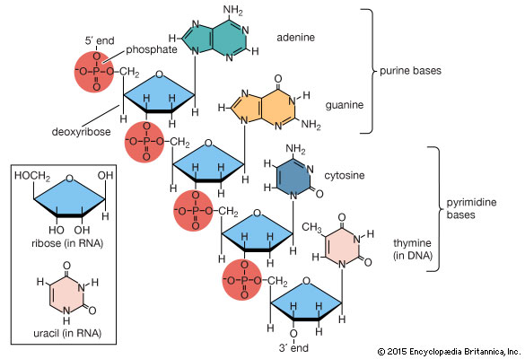
DNA and RNA Structure
DNA and RNA are nucleic acids.
  They consist of long chains (polymers) of chemical units (monomers) called nucleotides.
  A nucleotide polymer is a polynucleotide.
    Polynucleotides can be very long and may have any sequence of the four different types of nucleotides (abbreviated A, C, T, and G).
sugar-phosphate backbone – nucleotides are joined covalently create a polynucleotide
Notes:
18

Slide 19
DNA and RNA Structure
The nitrogenous bases are arranged like ribs that project from this backbone.
  You can think of a polynucleotide as a long ladder split in half longwise, with rungs that come in four colors.
  The sugars and phosphates make up the side of the ladder, with the sugars acting as the half-rungs.

Slide 20
DNA and RNA Structure
Why is the the sugar is called deoxyribose?
  because, compared with the sugar ribose, it is missing an oxygen atom.
The full name for DNA is deoxyribonucleic acid
Why is it called nucleic acid?
  In eukaryotes it is found in the nucleus of the cell.

Slide 21
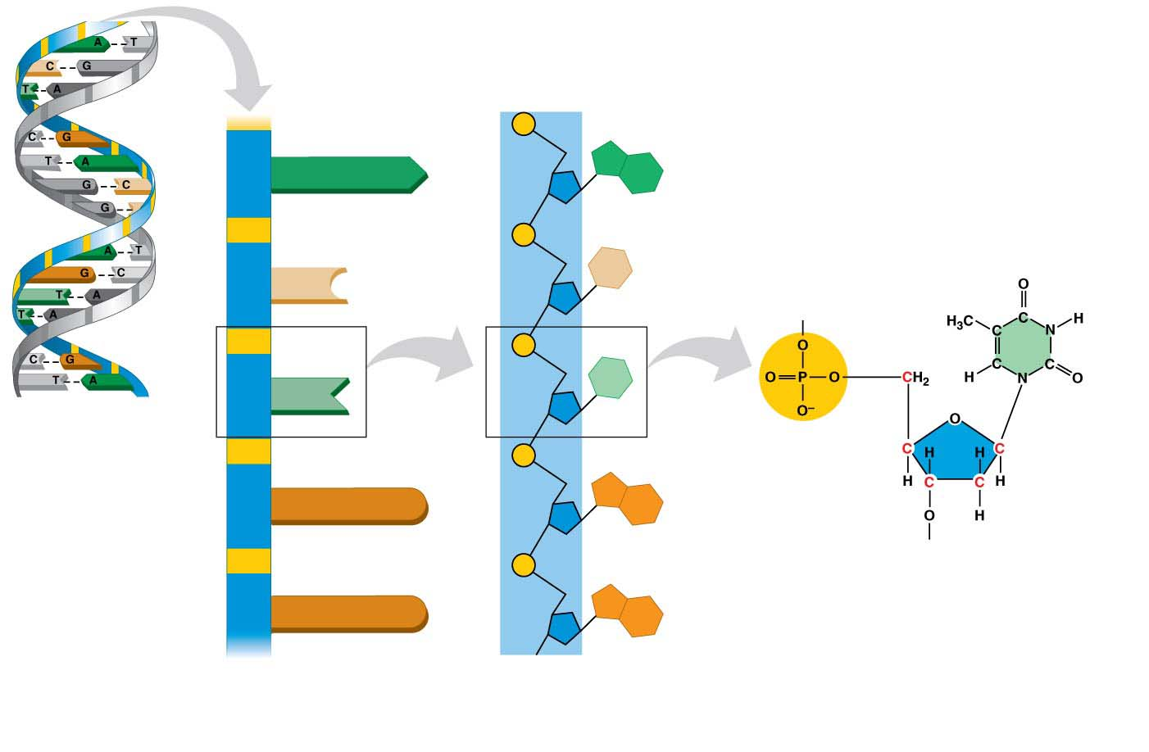
Figure 10.1
Phosphate group
Sugar
Nitrogenous base
A
A
DNA
nucleotide
C
C
T
T
DNA
double helix
Thymine
(T)
Phosphate
group
G
G
Sugar
(deoxyribose)
G
G
DNA nucleotide
Polynucleotide
Sugar-phosphate
backbone
Notes:
Figure 10.1 The chemical structure of a DNA polynucleotide

Slide 22
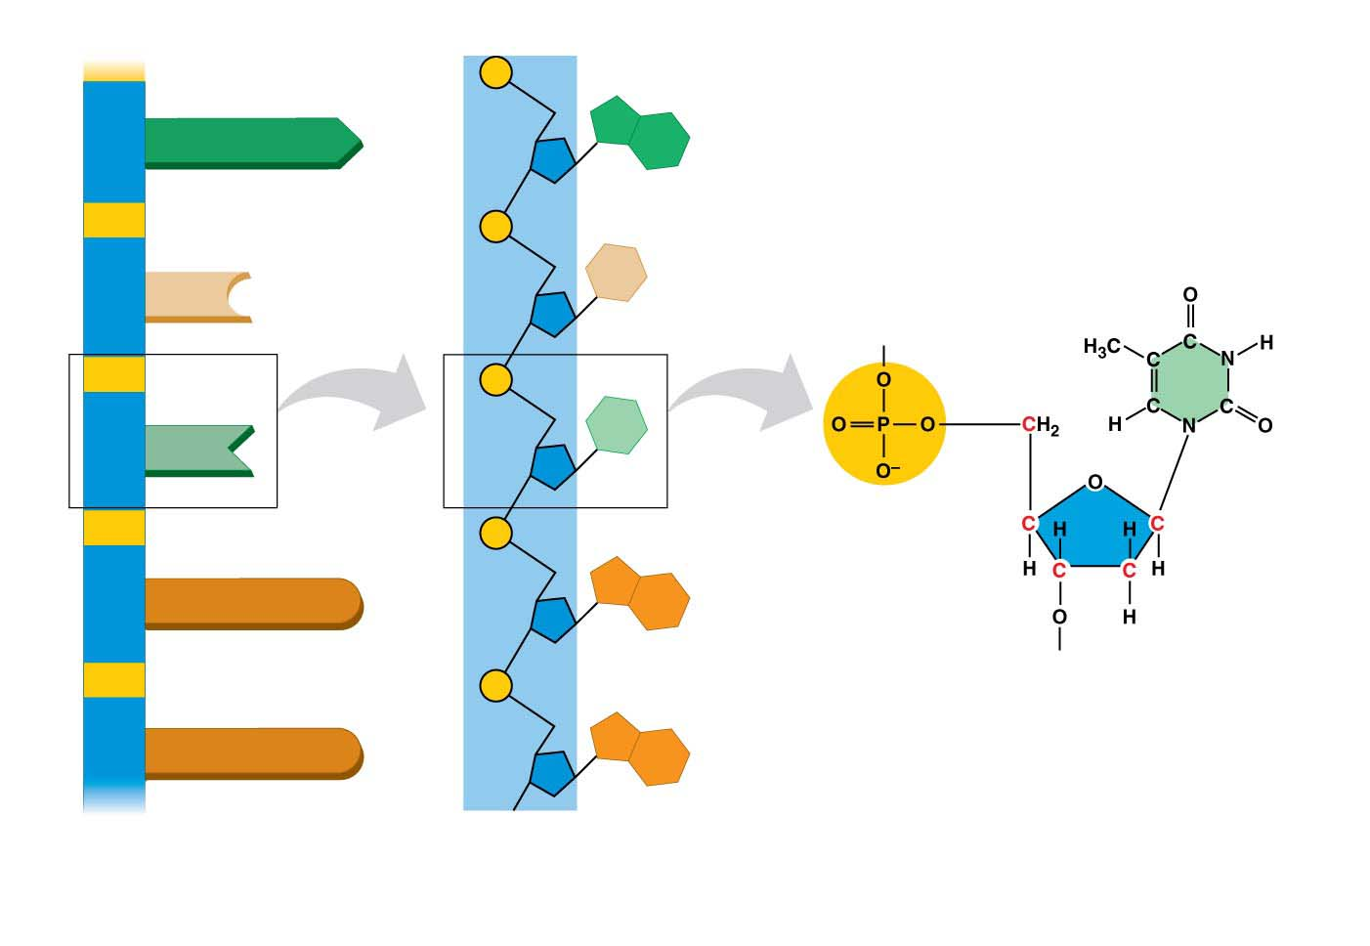
Figure 10.1-1
Phosphate group
Sugar
Nitrogenous base
A
A
DNA
nucleotide
C
C
T
Thymine
(T)
T
Phosphate
group
G
G
Sugar
(deoxyribose)
G
G
DNA nucleotide
Polynucleotide
Sugar-phosphate
backbone
Notes:
Figure 10.1-1 The chemical structure of a DNA polynucleotide (part 1: polynucleotide)

Slide 23
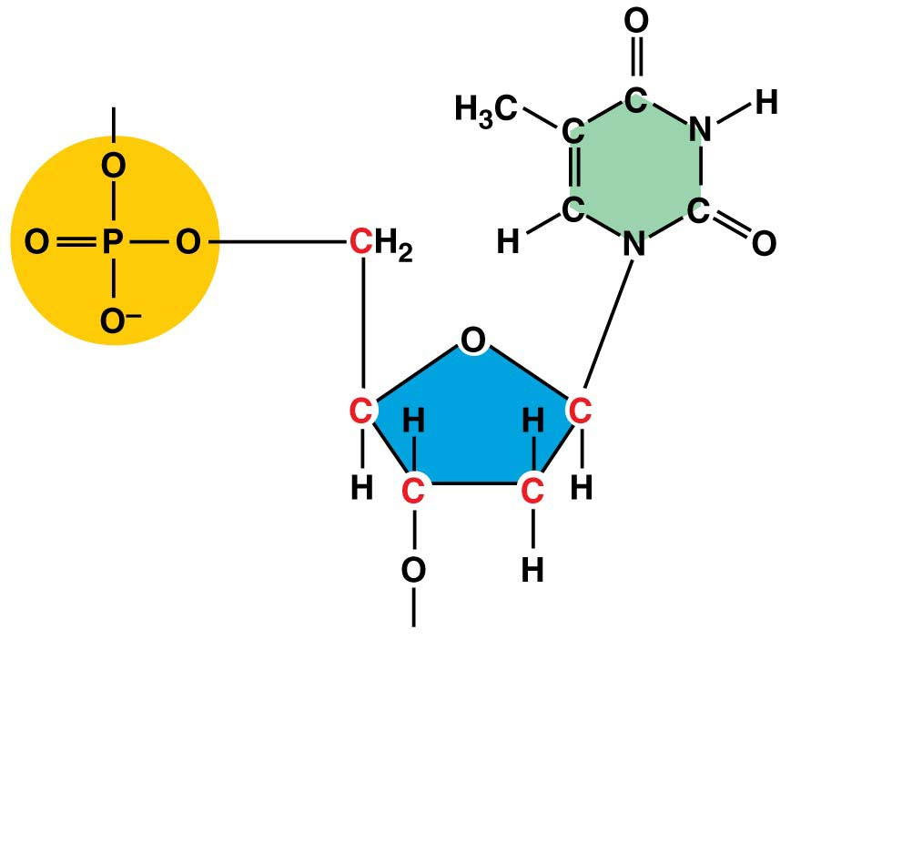
Figure 10.1-2
Thymine
(T)
Phosphate
group
Sugar
(deoxyribose)
DNA nucleotide
Notes:
Figure 10.1-2 The chemical structure of a DNA polynucleotide (part 2: nucleotide)

Slide 24
DNA and RNA Structure
The four nucleotides found in DNA differ in their nitrogenous bases. The bases can be divided into two types.
  Thymine (T) and cytosine (C) are single-ring
  structures.
  Adenine (A) and guanine (G) are larger, double-
  ring structures.
Notes:
\

Slide 25
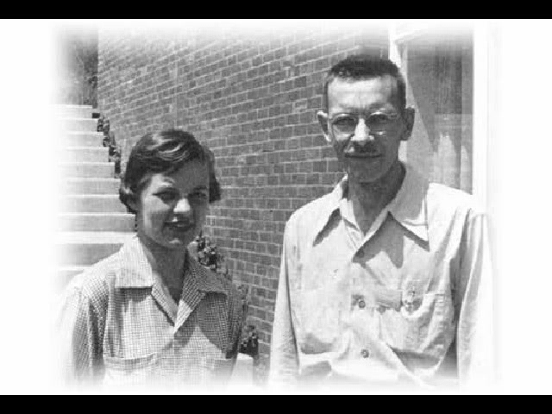
Animation: Hershey-Chase Experiment

Slide 26
Scientific Method
Observation
  Viruses have DNA and protein only
Question
  Which one is the molecule of heredity?
Hypothesis
  DNA is the molecule of heredity
  Expectation: Labeled phosphorous (P) will be passed on to the daughter bacteria (E. coli)
Experiment
  Labeled both phosphorous (DNA) and sulfur (protein)
Results
  Labeled phosphorous was in the daughter bacteria (E. coli)
  Consistent with the expectation
Notes:
26
\

Slide 27

DNA or Protein?
DNA is the molecule of heredity, because labeled DNA was passed to the next generation of E. coli in the Hershey-Chase Experiment
T4 virus passed on labeled DNA

Slide 28
DNA and RNA Structure
RNA and DNA polynucleotides have the same chemical structure except that
  instead of thymine, RNA has a similar base called uracil (U), and
  RNA contains a slightly different sugar than DNA (ribose instead of deoxyribose, accounting for the names RNA vs. DNA).

Slide 29
Ch10
Read Ch10 to page 185
HW 6 will be posted this evening and I will send an announcement when it is posted.

Slide 30
Class Scores

Slide 31
Exam Reflection (optional)
For each question you answered incorrectly, explain to me why the correct answer is a better choice.
Example:
A hypothesis is an
a) an observation
b) a question
c) a possible explanation to a question or an observation
d) a theory

Slide 32
Exam Reflection (optional)
Example:
A hypothesis is an
a) an observation
b) a question
c) a possible explanation to a question or an observation (Correct answer)
d) a theory (You chose this)
A hypothesis is a a possible explanation to a question or an observation. A theory is also an explanation, but one that is well accepted as opposed to a possibility.
For each adequately corrected response I will give you up to 0.5 points towards your exam score.
Due in one week – Thursday, Oct 18th

Slide 33
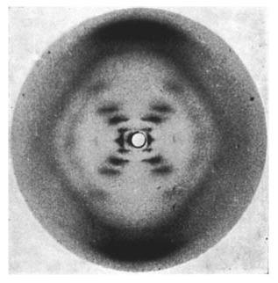
Watson and Crick’s Discovery of the Double Helix
James Watson and Francis Crick determined that DNA is a double helix,
  a helix (spiral)
  with a uniform diameter
  made up of two polynucleotide strands.
They used the X-ray image of DNA produced by Rosalind Franklin.
Notes:
33

Slide 34
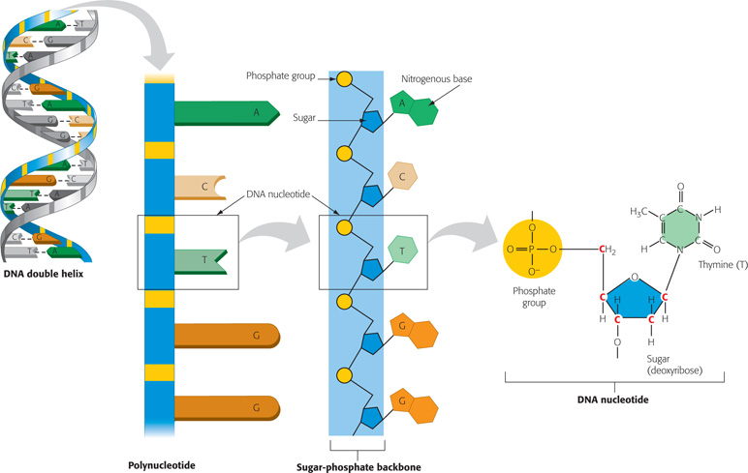
Nucleotide was know
Watson, Crick and Franklin determined the double helix

Slide 35
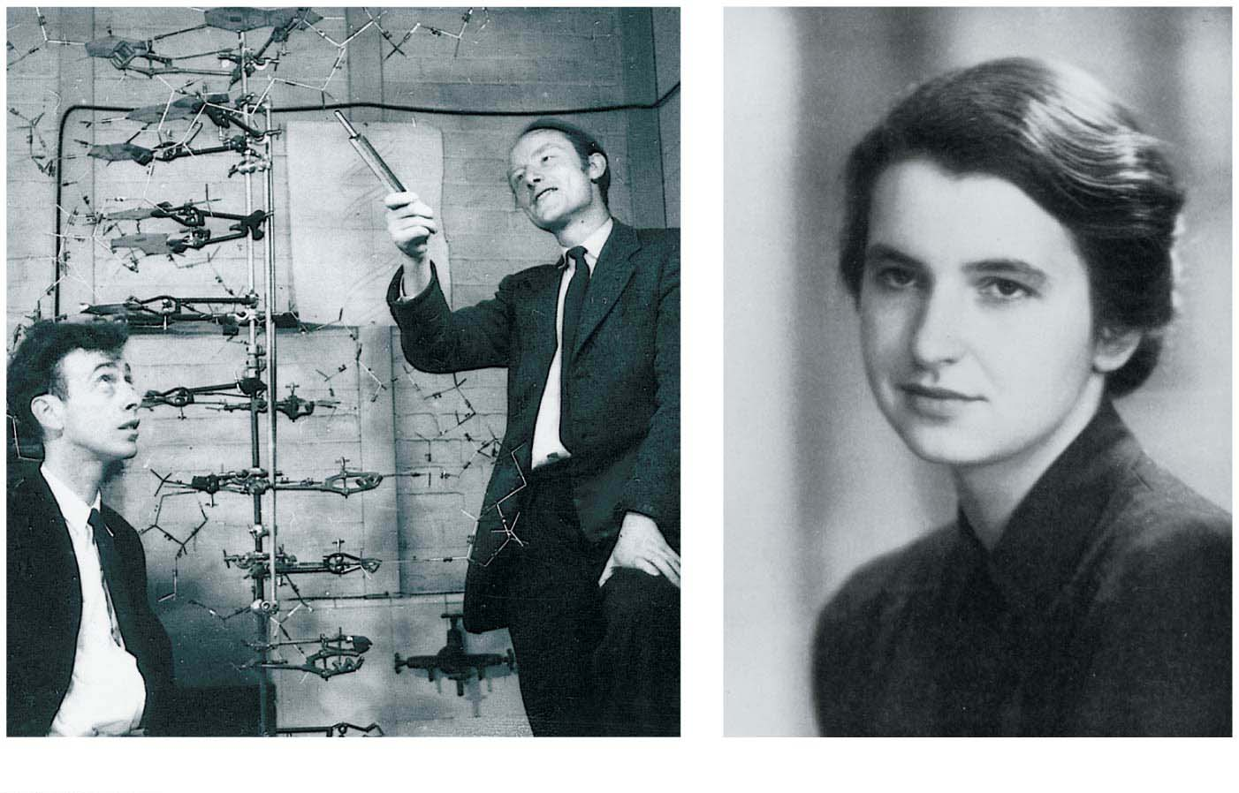
In 1962, Watson & Crick received the Nobel Prize for their work.
Franklin deserved a share of the prize, but she had died from cancer in 1958, and Nobel prizes are never granted posthumously.
James Watson (left) and Francis Crick
Rosalind Franklin
Notes:
Figure 10.3 Discoverers of the double helix

Slide 36
Watson and Crick’s Discovery of the Double Helix
The model of DNA is like a full ladder twisted into a spiral.
  The sides represent the sugar-phosphate backbones.
  Each step represents a pair of bases connected by hydrogen bonds.
  The base-pairing rules dictate the side-by-side combinations of bases that form the rungs of the double helix.
Notes:
36

Slide 37
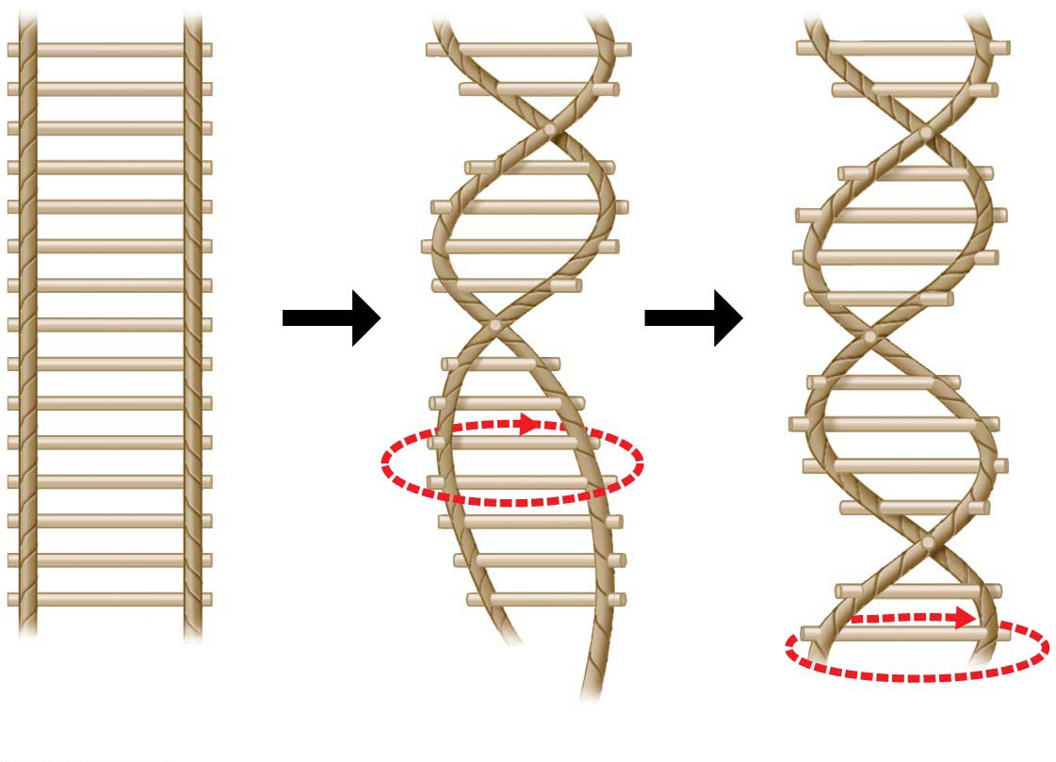
Figure 10.4
Twist
Notes:
Figure 10.4 A rope-ladder model of a double helix

Slide 38
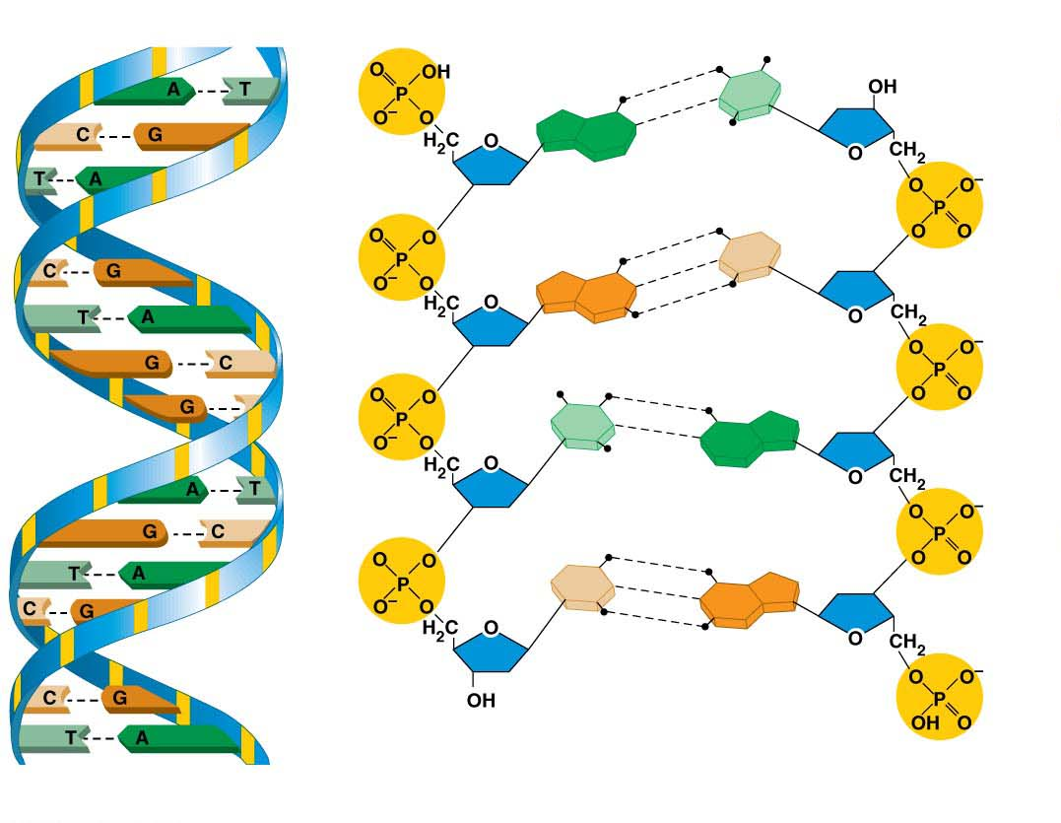
Figure 10.5
Hydrogen bond
T
A
C
G
T
A
C
G
(a) Ribbon model
(b) Atomic model
Notes:
Figure 10.5 Three representations of DNA

Slide 39
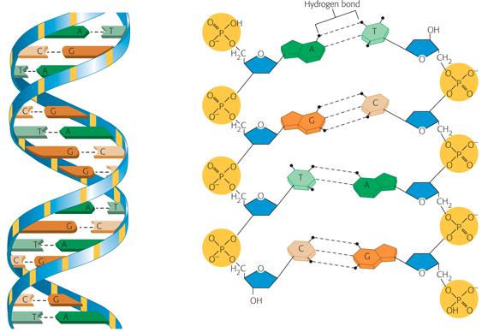
Watson, Crick, Franklin
  a helix (spiral)
  with a uniform diameter
  two polynucleotide strands.

Slide 40
Watson and Crick’s Discovery of the Double Helix
Watson and Crick (1953) wrote that the structure they proposed “immediately suggests a possible copying mechanism for the genetic material.”
The structure of DNA points toward a molecular explanation for life’s unique properties of reproduction and inheritance.
Notes:
40

Slide 41
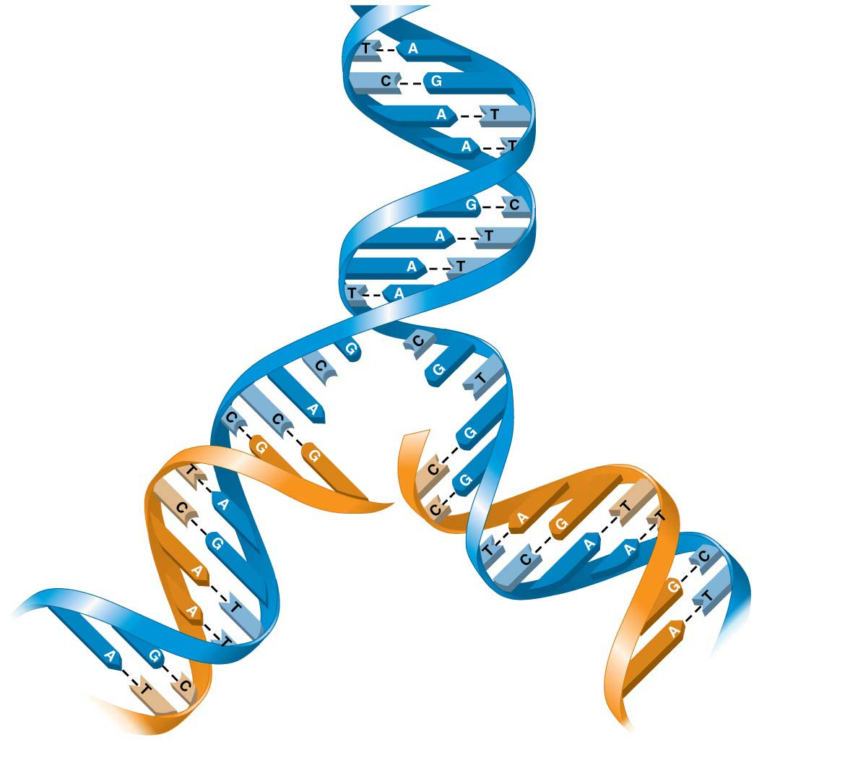
Figure 10.6
Parental (old)
DNA molecule
Daughter
(new) strand
Parental
(old) strand
Daughter DNA
molecules
(double helices)
Notes:
Figure 10.6 DNA replication

Slide 42
Structure/Function: DNA Replication
When a cell reproduces, it must duplicate this information, providing one copy to the new offspring cell while keeping one copy for itself.
Watson and Crick’s model of DNA suggests that each DNA strand serves as a mold, or template, to guide reproduction of the other strand.
Notes:
42

Slide 43
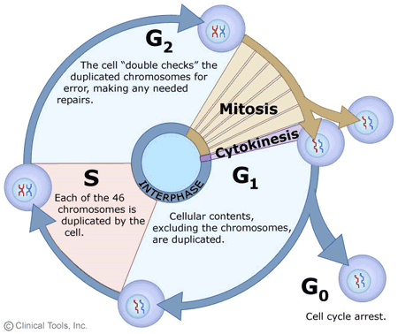
DNA Replication
When in the cell cycle does DNA replication happen?
during s-phase of interphase

Slide 44
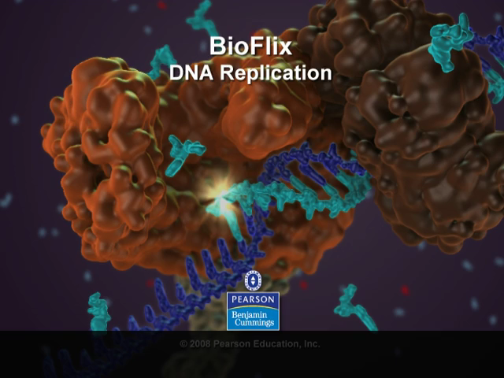
Bioflix Animation: DNA Replication

Slide 45
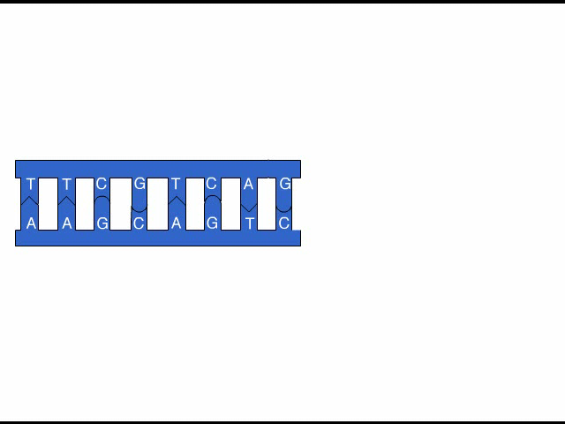
Animation: DNA Replication Overview

Slide 46
Structure/Function: DNA Replication
DNA polymerases
  are enzymes that make the covalent bonds between the nucleotides of a new DNA strand and
  can help repair DNA that has been damaged by toxic chemicals or high-energy radiation, such as
  X-rays and ultraviolet light.
  only one error in 1 billion nucleotides
Notes:
46
Student Misconceptions and Concerns
1. If your class has not yet studied Chapter 3, consider assigning the Chapter 3 section “Nucleic Acids” before addressing the contents of Chapter 10.
2. The text describes but does not specifically point out that DNA replication is semiconservative. Tell your students about an experiment in which a DNA molecule is labeled and then replicated. How will the two DNA molecules compare with regard to the location/distribution of the original DNA molecule? Will one DNA molecule be the original and the other the new copy? Or is there another possibility? Half of each of the two DNA molecules is new and half is the original; thus, it used semiconservative replication. Analogies for semiconservative replication can be a challenge. But in a sense, DNA replication is similar to parents getting divorced and then each parent remarrying someone else. The two new couples represent “half old parent and half new person.”
3. Students often confuse the terms nucleic acids, nucleotides, and bases. It helps just to note the hierarchy of relationships: Nucleic acids consist of long chains of nucleotides, and nucleotides include bases as part of their structure.
Teaching Tips
1. Consider comparing DNA, RNA, and proteins to a train (polymer). DNA and RNA are like a train of various lengths and combinations of four types of train cars (monomers). Proteins are also “trains” of various lengths but made of a combination of 20 types of train cars.
2. The descriptions of the discovery of DNA’s structure are a good time to point out that science is a collaborative effort. You might remind your class of all the prior research (identifying DNA as the genetic material and clues to its structure) that brought Watson and Crick to their historic conclusions.
3. Demonstrate the complementary base pairing within DNA. Present students with the base sequence to one side of a DNA molecule and have them work quickly at their seats to determine the sequence of the complementary strand. For some students, these sorts of quick practice are necessary to reinforce a concept and break up a lecture.
4. To explain the adaptive advantage of multiple replication sites over a single site of replication, ask your students to imagine copying, by hand, the first ten chapters of your biology textbook. The task would certainly go faster if ten students each copied a different chapter!
5. There are about 2 million characters (letters or numbers) in the Campbell Essential Biology with Physiology textbook. The accuracy of DNA replication would be like copying every letter and number in this textbook by hand 500 times and writing just one letter or number incorrectly, making one error in every 1 billion characters!
6. The information in DNA is used to direct the production of RNA, which in turn directs the production of proteins. However, in Chapter 3, four different types of biological molecules were noted as significant components of life. Students who think this through might wonder, and you could point out, that DNA does not directly control the production of carbohydrates and lipids. So how does DNA exert its influence over the synthesis of these other chemical groups? The answer is largely by way of enzymes, proteins with the ability to promote the production of carbohydrates and lipids.
Active Lecture Tips
1. The authors note that the structure of DNA is analogous to a twisted ladder. In class, challenge your students to pair up with someone nearby to explain what the parts of the ladder represent. Answer: The rungs represent pairs of nitrogenous bases joined by hydrogen bonds. Each side of the ladder represents a sugar-phosphate backbone.
2. See the Activity I’m Not Sure I Liked James Watson: Using a Video to Tell the Most Exciting Discovery in Biology on the Instructor Exchange. Visit the Instructor Exchange in the MasteringBiology instructor resource area for a description of this activity.

Slide 47
Structure/Function: DNA Replication
DNA replication
  Origin of replication – place on the double helix where replication begins
  proceeds in both directions, creating what are called replication “bubbles.”
Notes:
47
\

Slide 48
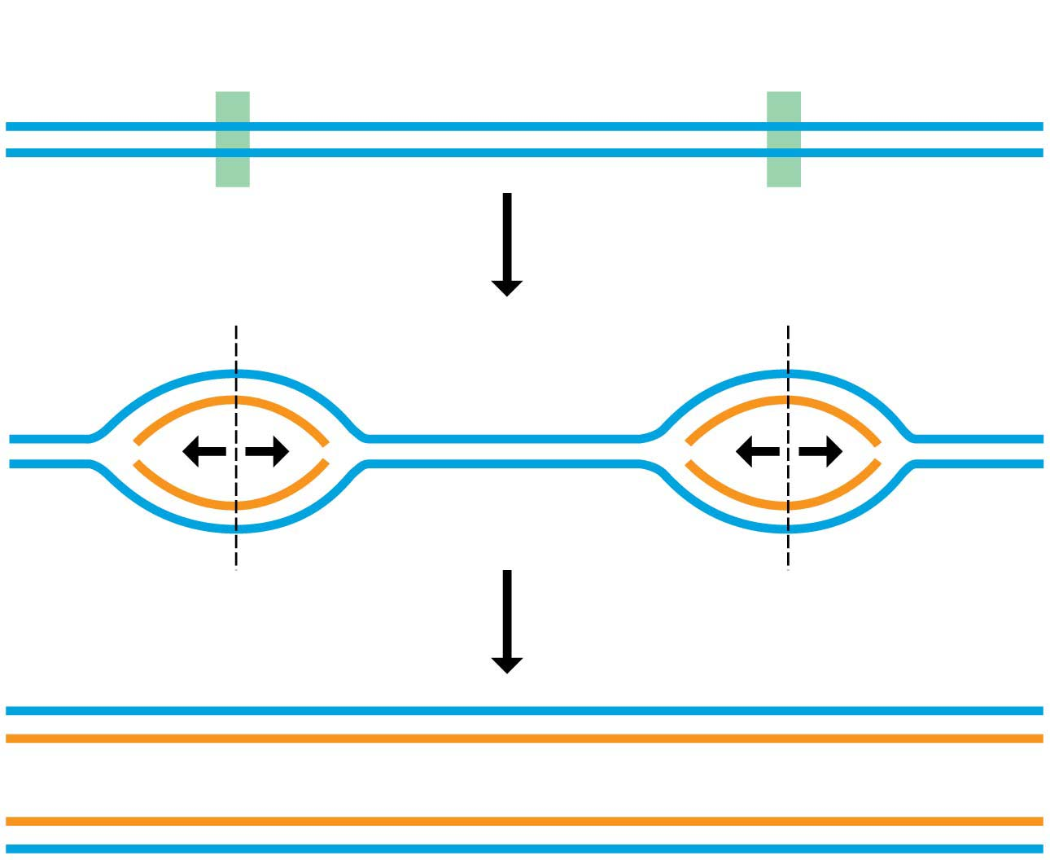
Figure 10.7
Origin of
replication
Origin of
replication
Parental strands
Origin of
replication
Parental strand
Daughter strand
Bubble
Two daughter DNA molecules
Notes:
Figure 10.7 Multiple “bubbles” in replicating DNA

Slide 49
Structure/Function: DNA Replication
DNA replication
  ensures that all the cells in a multicellular organism carry the same genetic information and
  is also the means by which genetic information is passed along to offspring
Notes:
49

Slide 50
DNA Replication Review
What enzyme adds nucleotides during DNA replication?
  DNA polymerase
Were does DNA replication start?
  at origins of replication
In what part of the cell cycle does DNA replication happen?
  S-phase of interphase

Slide 51
Information Flow: From DNA to RNA to Protein
DNA provides instructions to
  a cell and
  an organism as a whole
  is passed from generation to generation through meiosis (sexual organisms)
  is passed from cell to cell via mitosis
Notes:
51
Student Misconceptions and Concerns
1. Beginning college students are often intensely focused on writing detailed notes. The risk is that they miss the overall patterns and the broader significance of the topics discussed. Consider a gradual approach to the subjects of transcription and translation, beginning quite generally and testing comprehension before venturing into the finer mechanics of each process.
2. Consider placing on the board Figure 10.8, noting the sequence, products, and locations of transcription and translation in eukaryotic cells. This reminder can create a quick concept check for students as they learn additional detail.
3. Mutations are often discussed as part of evolution mechanisms. In this sense, mutations may be considered a part of a positive creative process. The dual nature of mutations, potentially deadly yet potentially innovative, should be clarified.
Teaching Tips
1. It has been said that “Everything about an organism is an interaction between the genome and the environment.” You might wish to challenge your students to explain the significance and validity of this statement.
2. The sequential information in DNA and RNA is analogous to the sequential information in the letters of a sentence. This analogy is also helpful when explaining the impact of insertion or deletion mutations that cause a shift in the reading frame.
3. The transcription of DNA into RNA is like a reporter who transcribes a political speech. In both situations, the language remains the same, although in the case of the reporter, it changes form from spoken to written.
4. A parallel can be drawn between the discovery in 1799 of the Rosetta Stone, which provided the key that enabled scholars to crack the previously indecipherable hieroglyphic code, and the cracking of the genetic code in 1961. Consider challenging your students to explain what part of the genetic code is similar to the Rosetta Stone. This could be a short in-class activity for small groups.
5. Another advantage to the use of RNA to direct protein synthesis is that the original code (DNA) remains safe within the nucleus, away from the many potentially damaging chemicals in the cytoplasm. This is like making photocopies of important documents for study, keeping the originals safely stored away (much like how we treat the original U.S. Constitution).
6. The production of proteins is like a machine requiring fuel. The molecular machinery (ribosomes and tRNA) used in many cellular processes also requires an input of energy in the form of ATP.
7. If you were using a train analogy for the assembly of monomers into polymers, at this point the DNA and RNA “trains” are traded in 3 for 1 for the polypeptide “train.” Thus, in general, polypeptides have about 1/3 as many monomers as the mRNA that coded for them. (It might be a good challenge to have your students explain why proteins do not have exactly a third of monomers of the corresponding mRNA. Start and stop codons, for example, are not translated into amino acids.)
8. Many analogies can be developed to represent the selective expression of a gene requiring the deletion of introns. Instructors who only assign some modules of a chapter are treating the chapters like sections of exons and introns, portions to be read and portions to be skipped. Alternately, students who highlight a chapter might be thought of as editing the book into exons, portions to be reviewed, and introns, nonhighlighted sections that will not be studied. Both analogies are imperfect, but may still convey the concept of selective reading.
9. Students might think of the A and P sites as stages in an assembly line. The A site is where a new amino acid is brought in, according to the blueprint of the codon on the mRNA. The P site is where the growing product/polypeptide is anchored as it is being built. To help them better remember details of translation, students might think of the letters for the two sites to mean “A” for addition, where an amino acid is added, and “P” for polypeptide, where the growing polypeptide is located.
10. A simple way to demonstrate the effect of a reading frame shift is to have students compare the following three sentences. The first is a simple sentence. But look what happens when a letter is added (2) or deleted (3). The “reading frame,” or triplet groupings, are re-formed into nonsense.
(1) The big red pig ate the red rag.
(2) The big res dpi gat eth ere dra g.
(3) The big rep iga tet her edr ag.
11. The authors have noted elsewhere that “A random mutation is like a shot in the dark. It is not likely to improve a genome any more than shooting a bullet through the hood of a car is likely to improve engine performance!”
Active Lecture Tips
1. After translation is addressed, consider asking your students (working in small groups) to list all of the places where base pairing is used (in the construction of a DNA molecule during DNA replication, in transcription, and during translation when the tRNA attaches).
2. See the Activity Using a Food Analogy to Think About Protein Synthesis on the Instructor Exchange. Visit the Instructor Exchange in the MasteringBiology instructor resource area for a description of this activity.
3. See the Activity Students Perform a Protein Synthesis Play on the Instructor Exchange. Visit the Instructor Exchange in the MasteringBiology instructor resource area for a description of this activity.
4. See the Media Review: “Learn.Genetics” Genetic Science Learning from the University of Utah on the Instructor Exchange. Visit the Instructor Exchange in the MasteringBiology instructor resource area for a description of this activity.
5. See the Activity Demonstrating a Frame Shift Mutation on the Instructor Exchange. Visit the Instructor Exchange in the MasteringBiology instructor resource area for a description of this activity.

Slide 52
How an Organism’s Genotype Determines Its Phenotype
An organism’s genotype, its genetic makeup, is the heritable information contained in the sequence of nucleotide bases in its DNA.
The phenotype, the organism’s physical traits, arises from the actions of a wide variety of proteins made from the instructions in DNA
Notes:
52

Slide 53
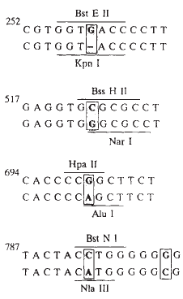
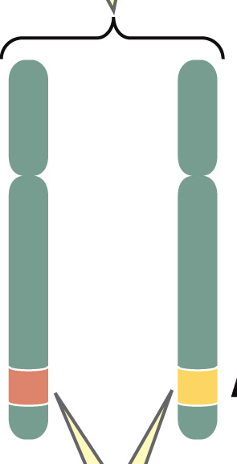
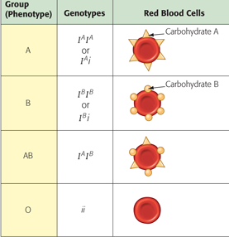
Genotype Controls Phenotype
Blood Type Gene
O
Type A
Type O
Type A
Type B
Type A
Type B
Type A
Type A Type O
Type B

Slide 54
How an Organism’s Genotype Determines Its Phenotype
DNA specifies the synthesis of proteins in two stages:
  transcription, the transfer of genetic information from DNA into an RNA molecule, and
  translation, the transfer of information from RNA into a polypeptide (protein strand).
Central Dogma of Molecular Biology
  DNA gene is to dictate the production of a protein
Notes:
54

Slide 55
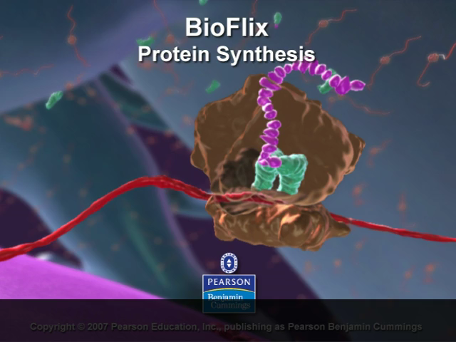
Bioflix Animation: Protein Synthesis

Slide 56
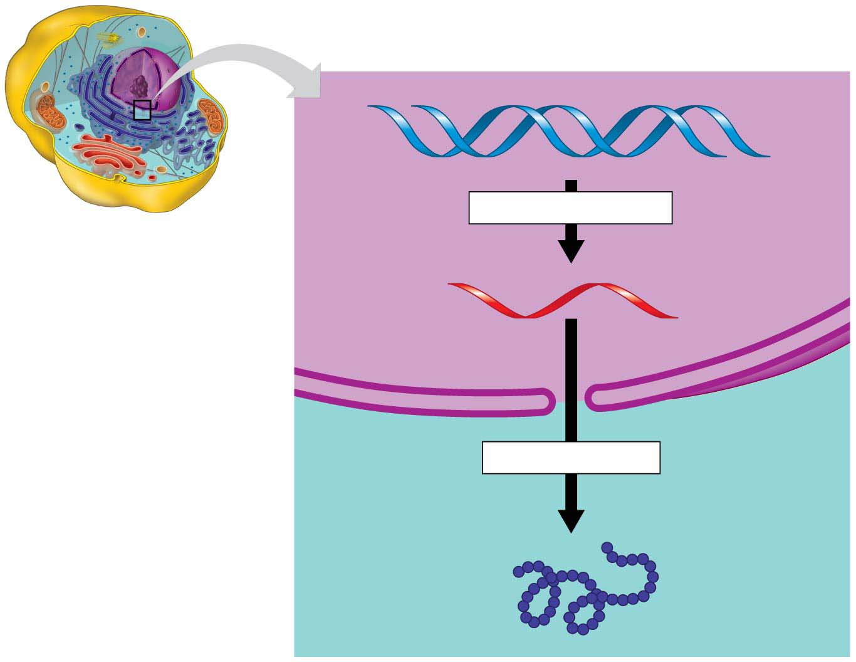
Figure 10.8
DNA
TRANSCRIPTION
Nucleus
RNA
Cytoplasm
TRANSLATION
Protein
Notes:
Figure 10.8 The flow of genetic information in a eukaryotic cell

Slide 57
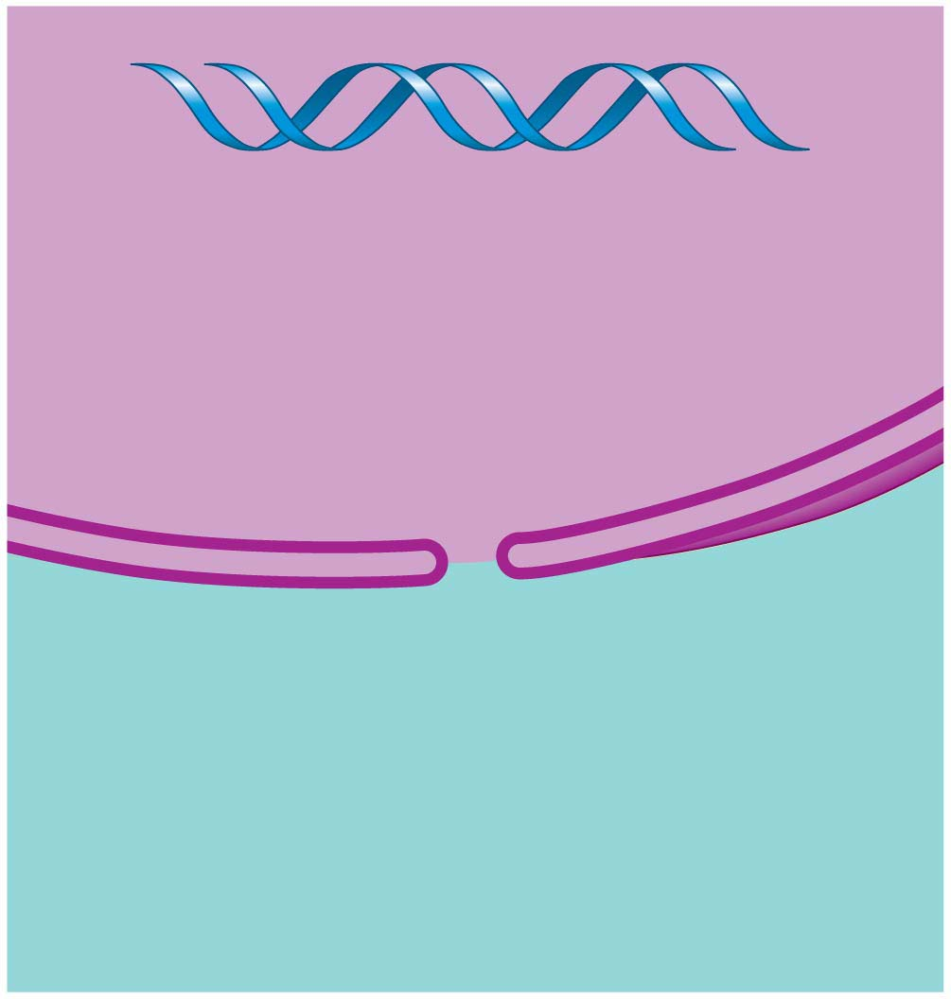
Figure 10.8-1-s1
DNA
Nucleus
Cytoplasm
Notes:
Figure 10.8-1-s1 The flow of genetic information in a eukaryotic cell (part 1, step 1)

Slide 58
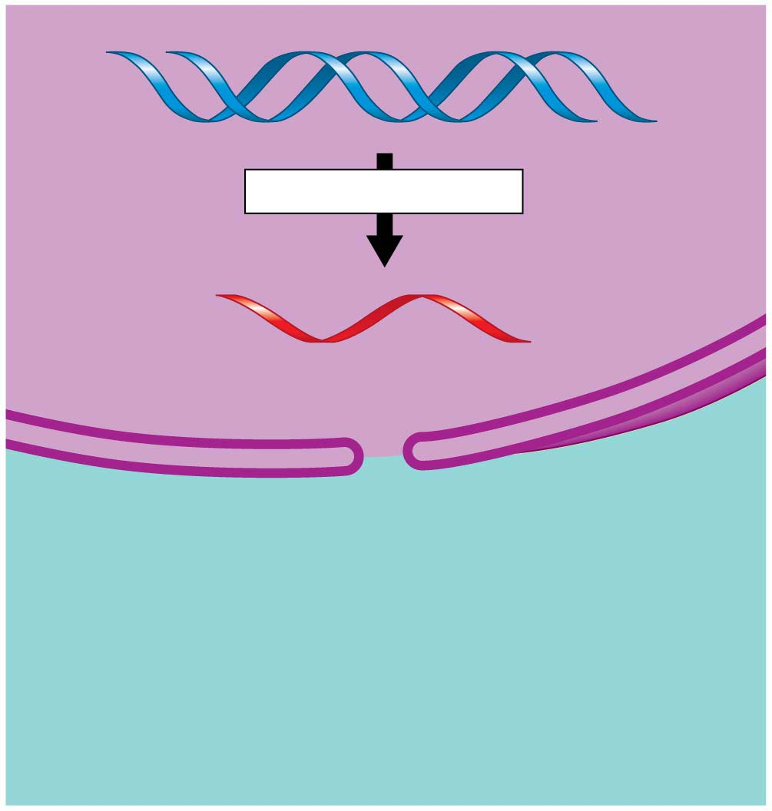
Figure 10.8-1-s2
DNA
TRANSCRIPTION
Nucleus
RNA
Cytoplasm
Notes:
Figure 10.8-1-s2 The flow of genetic information in a eukaryotic cell (part 1, step 2)

Slide 59
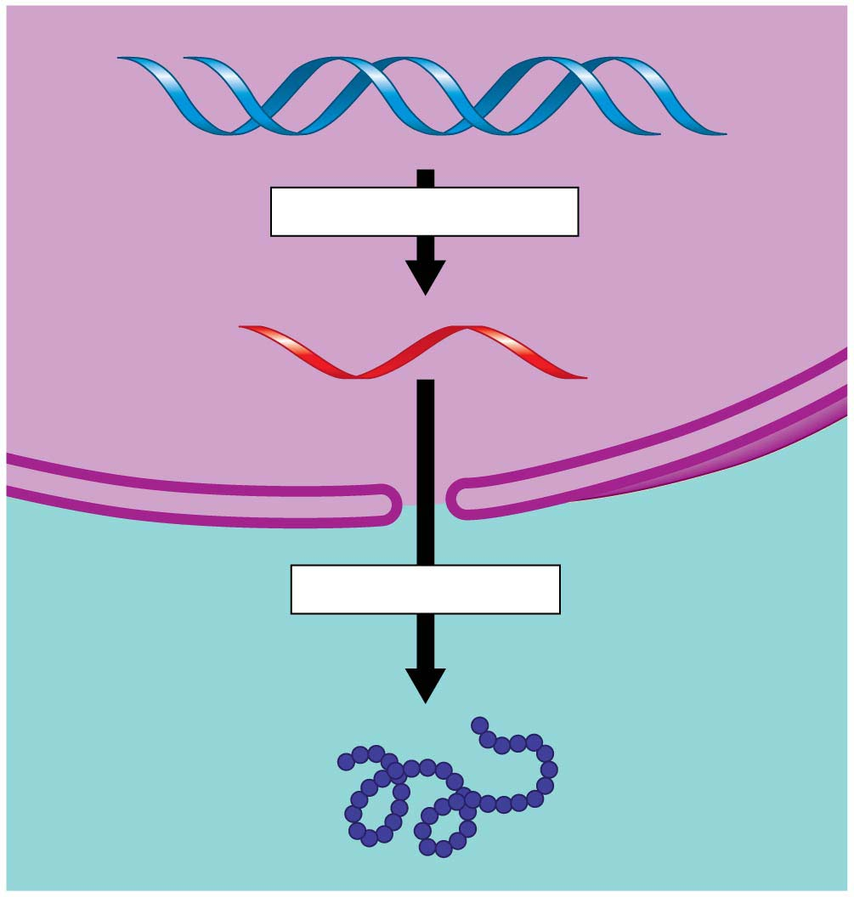
Figure 10.8-1-s3
DNA
TRANSCRIPTION
Nucleus
RNA
Cytoplasm
TRANSLATION
Protein
Notes:
Figure 10.8-1-s3 The flow of genetic information in a eukaryotic cell (part 1, step 3)

Slide 60
From Nucleotides to Amino Acids: An Overview
What is the language of nucleic acids?
  In DNA, it is the linear sequence of nucleotide bases.
  A typical gene consists of thousands of nucleotides in a specific sequence.
When a segment of DNA is transcribed, the result is an RNA molecule
  also a nucleic acid language
The sequence of nucleotides of the RNA molecule dictates the sequence of amino acids of the polypeptide.
Notes:
60
Student Misconceptions and Concerns
1. Beginning college students are often intensely focused on writing detailed notes. The risk is that they miss the overall patterns and the broader significance of the topics discussed. Consider a gradual approach to the subjects of transcription and translation, beginning quite generally and testing comprehension before venturing into the finer mechanics of each process.
2. Consider placing on the board Figure 10.8, noting the sequence, products, and locations of transcription and translation in eukaryotic cells. This reminder can create a quick concept check for students as they learn additional detail.
3. Mutations are often discussed as part of evolution mechanisms. In this sense, mutations may be considered a part of a positive creative process. The dual nature of mutations, potentially deadly yet potentially innovative, should be clarified.
Teaching Tips
1. It has been said that “Everything about an organism is an interaction between the genome and the environment.” You might wish to challenge your students to explain the significance and validity of this statement.
2. The sequential information in DNA and RNA is analogous to the sequential information in the letters of a sentence. This analogy is also helpful when explaining the impact of insertion or deletion mutations that cause a shift in the reading frame.
3. The transcription of DNA into RNA is like a reporter who transcribes a political speech. In both situations, the language remains the same, although in the case of the reporter, it changes form from spoken to written.
4. A parallel can be drawn between the discovery in 1799 of the Rosetta Stone, which provided the key that enabled scholars to crack the previously indecipherable hieroglyphic code, and the cracking of the genetic code in 1961. Consider challenging your students to explain what part of the genetic code is similar to the Rosetta Stone. This could be a short in-class activity for small groups.
5. Another advantage to the use of RNA to direct protein synthesis is that the original code (DNA) remains safe within the nucleus, away from the many potentially damaging chemicals in the cytoplasm. This is like making photocopies of important documents for study, keeping the originals safely stored away (much like how we treat the original U.S. Constitution).
6. The production of proteins is like a machine requiring fuel. The molecular machinery (ribosomes and tRNA) used in many cellular processes also requires an input of energy in the form of ATP.
7. If you were using a train analogy for the assembly of monomers into polymers, at this point the DNA and RNA “trains” are traded in 3 for 1 for the polypeptide “train.” Thus, in general, polypeptides have about 1/3 as many monomers as the mRNA that coded for them. (It might be a good challenge to have your students explain why proteins do not have exactly a third of monomers of the corresponding mRNA. Start and stop codons, for example, are not translated into amino acids.)
8. Many analogies can be developed to represent the selective expression of a gene requiring the deletion of introns. Instructors who only assign some modules of a chapter are treating the chapters like sections of exons and introns, portions to be read and portions to be skipped. Alternately, students who highlight a chapter might be thought of as editing the book into exons, portions to be reviewed, and introns, nonhighlighted sections that will not be studied. Both analogies are imperfect, but may still convey the concept of selective reading.
9. Students might think of the A and P sites as stages in an assembly line. The A site is where a new amino acid is brought in, according to the blueprint of the codon on the mRNA. The P site is where the growing product/polypeptide is anchored as it is being built. To help them better remember details of translation, students might think of the letters for the two sites to mean “A” for addition, where an amino acid is added, and “P” for polypeptide, where the growing polypeptide is located.
10. A simple way to demonstrate the effect of a reading frame shift is to have students compare the following three sentences. The first is a simple sentence. But look what happens when a letter is added (2) or deleted (3). The “reading frame,” or triplet groupings, are re-formed into nonsense.
(1) The big red pig ate the red rag.
(2) The big res dpi gat eth ere dra g.
(3) The big rep iga tet her edr ag.
11. The authors have noted elsewhere that “A random mutation is like a shot in the dark. It is not likely to improve a genome any more than shooting a bullet through the hood of a car is likely to improve engine performance!”
Active Lecture Tips
1. After translation is addressed, consider asking your students (working in small groups) to list all of the places where base pairing is used (in the construction of a DNA molecule during DNA replication, in transcription, and during translation when the tRNA attaches).
2. See the Activity Using a Food Analogy to Think About Protein Synthesis on the Instructor Exchange. Visit the Instructor Exchange in the MasteringBiology instructor resource area for a description of this activity.
3. See the Activity Students Perform a Protein Synthesis Play on the Instructor Exchange. Visit the Instructor Exchange in the MasteringBiology instructor resource area for a description of this activity.
4. See the Media Review: “Learn.Genetics” Genetic Science Learning from the University of Utah on the Instructor Exchange. Visit the Instructor Exchange in the MasteringBiology instructor resource area for a description of this activity.
5. See the Activity Demonstrating a Frame Shift Mutation on the Instructor Exchange. Visit the Instructor Exchange in the MasteringBiology instructor resource area for a description of this activity.

Slide 61
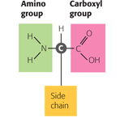
The Monomers of Proteins: Amino Acids
All proteins are made by stringing together a common set of 20 kinds of amino acids.
Every amino acid consists of a central carbon atom bonded to four covalent partners.
side chain: gives that amino acid its special chemical properties.
Notes:
61

Slide 62
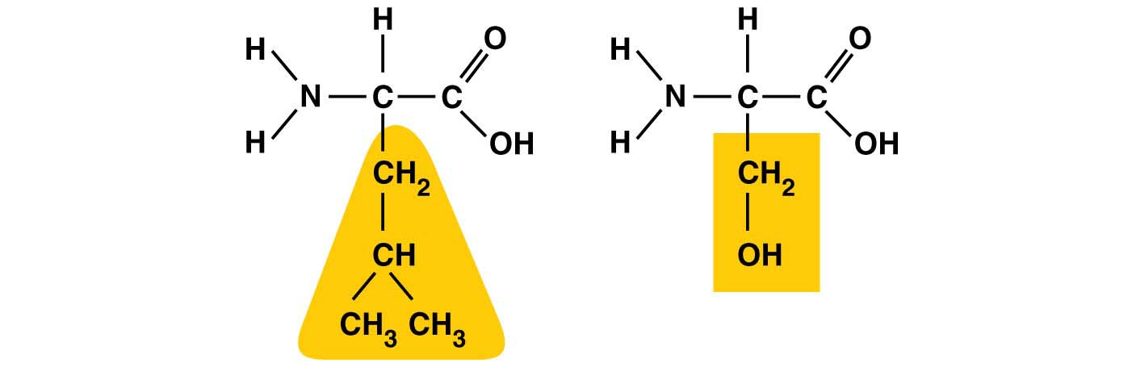
Figure 3.16-2
Hydrophobic
side chain
Hydrophilic
side chain
Leucine
Serine
(b) Examples of amino acids with hydrophobic and hydrophilic
side chains

Slide 63
Structure/Function: Protein Shape
Cells link amino acids together by dehydration reactions,
  forming peptide bonds, and
  creating long chains of amino acids called polypeptides.
  Polypeptides from into proteins
Notes:
63

Slide 64
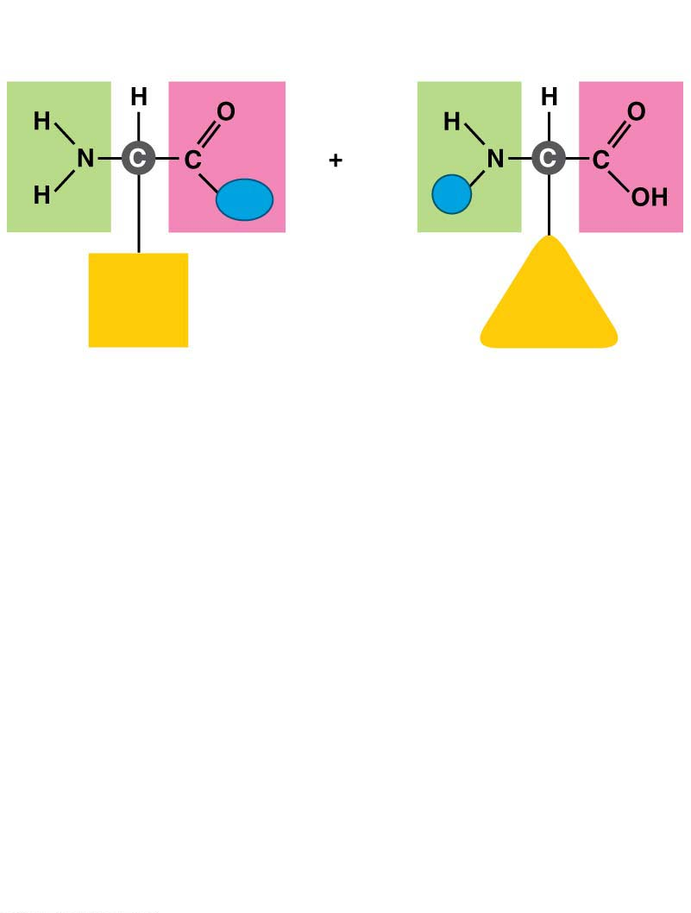
Figure 3.17-s1
Carboxyl
group
Amino
group
OH
H
Side
chain
Side
chain
Amino acid
Amino acid
Notes:
Figure 3.17-s1 Joining amino acids (step 1)

Slide 65
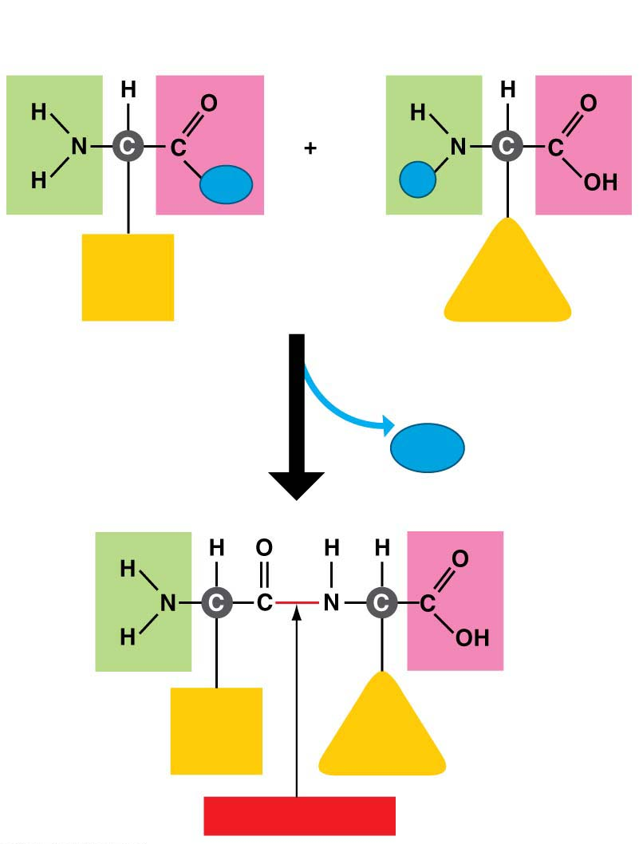
Figure 3.17-s2
Carboxyl
group
Amino
group
OH
H
Side
chain
Side
chain
Amino acid
Amino acid
Dehydration reaction
H₂O
Side
chain
Side
chain
Peptide bond
Notes:
Amino Acids link together to from poly peptides
peptide bond is a dehydration reaction that links amino acids in a covalent bond

Slide 66
Structure/Function: Protein Shape
How is it possible to make the huge variety of proteins found in your body from just 20 kinds of amino acids?
  Like the English alphabet used to make different words by varying the sequent of just 26 letters, proteins use 20 different “letters” (amino acids) to create polypeptides hundreds or thousands of amino acids in length.
Notes:
66

Slide 67
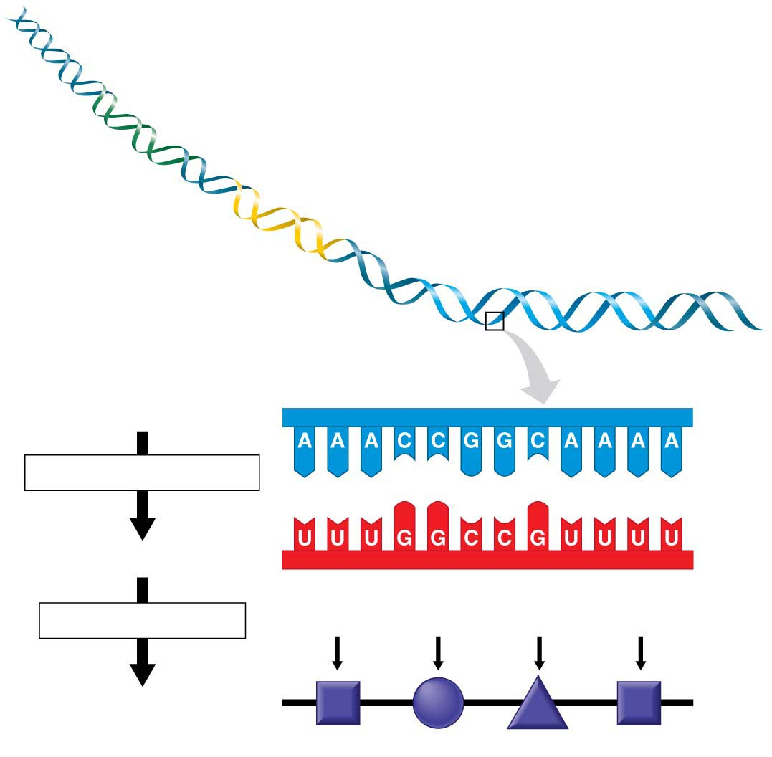
Figure 10.9
Gene 1
Gene 2
DNA molecule
Gene 3
DNA strand
TRANSCRIPTION
RNA
TRANSLATION
Codon
Polypeptide
Amino acid
Notes:
Figure 10.9 Transcription of DNA and translation of codons

Slide 68
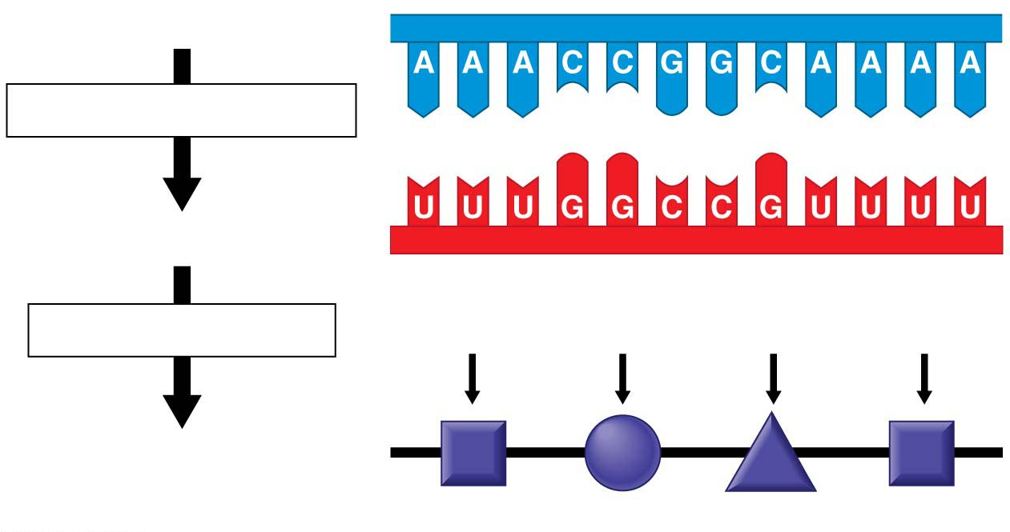
Figure 10.9-1
DNA strand
TRANSCRIPTION
RNA
TRANSLATION
Codon
Polypeptide
Amino acid
Notes:
Figure 10.9-1 Transcription of DNA and translation of codons (part 1: detail)

Slide 69
From Nucleotides to Amino Acids: An Overview
triplet code – every three nucleotides defines an amino acid
codon – three nucleotides (bases) that define the amino acid
Notes:
69
Student Misconceptions and Concerns
1. Beginning college students are often intensely focused on writing detailed notes. The risk is that they miss the overall patterns and the broader significance of the topics discussed. Consider a gradual approach to the subjects of transcription and translation, beginning quite generally and testing comprehension before venturing into the finer mechanics of each process.
2. Consider placing on the board Figure 10.8, noting the sequence, products, and locations of transcription and translation in eukaryotic cells. This reminder can create a quick concept check for students as they learn additional detail.
3. Mutations are often discussed as part of evolution mechanisms. In this sense, mutations may be considered a part of a positive creative process. The dual nature of mutations, potentially deadly yet potentially innovative, should be clarified.
Teaching Tips
1. It has been said that “Everything about an organism is an interaction between the genome and the environment.” You might wish to challenge your students to explain the significance and validity of this statement.
2. The sequential information in DNA and RNA is analogous to the sequential information in the letters of a sentence. This analogy is also helpful when explaining the impact of insertion or deletion mutations that cause a shift in the reading frame.
3. The transcription of DNA into RNA is like a reporter who transcribes a political speech. In both situations, the language remains the same, although in the case of the reporter, it changes form from spoken to written.
4. A parallel can be drawn between the discovery in 1799 of the Rosetta Stone, which provided the key that enabled scholars to crack the previously indecipherable hieroglyphic code, and the cracking of the genetic code in 1961. Consider challenging your students to explain what part of the genetic code is similar to the Rosetta Stone. This could be a short in-class activity for small groups.
5. Another advantage to the use of RNA to direct protein synthesis is that the original code (DNA) remains safe within the nucleus, away from the many potentially damaging chemicals in the cytoplasm. This is like making photocopies of important documents for study, keeping the originals safely stored away (much like how we treat the original U.S. Constitution).
6. The production of proteins is like a machine requiring fuel. The molecular machinery (ribosomes and tRNA) used in many cellular processes also requires an input of energy in the form of ATP.
7. If you were using a train analogy for the assembly of monomers into polymers, at this point the DNA and RNA “trains” are traded in 3 for 1 for the polypeptide “train.” Thus, in general, polypeptides have about 1/3 as many monomers as the mRNA that coded for them. (It might be a good challenge to have your students explain why proteins do not have exactly a third of monomers of the corresponding mRNA. Start and stop codons, for example, are not translated into amino acids.)
8. Many analogies can be developed to represent the selective expression of a gene requiring the deletion of introns. Instructors who only assign some modules of a chapter are treating the chapters like sections of exons and introns, portions to be read and portions to be skipped. Alternately, students who highlight a chapter might be thought of as editing the book into exons, portions to be reviewed, and introns, nonhighlighted sections that will not be studied. Both analogies are imperfect, but may still convey the concept of selective reading.
9. Students might think of the A and P sites as stages in an assembly line. The A site is where a new amino acid is brought in, according to the blueprint of the codon on the mRNA. The P site is where the growing product/polypeptide is anchored as it is being built. To help them better remember details of translation, students might think of the letters for the two sites to mean “A” for addition, where an amino acid is added, and “P” for polypeptide, where the growing polypeptide is located.
10. A simple way to demonstrate the effect of a reading frame shift is to have students compare the following three sentences. The first is a simple sentence. But look what happens when a letter is added (2) or deleted (3). The “reading frame,” or triplet groupings, are re-formed into nonsense.
(1) The big red pig ate the red rag.
(2) The big res dpi gat eth ere dra g.
(3) The big rep iga tet her edr ag.
11. The authors have noted elsewhere that “A random mutation is like a shot in the dark. It is not likely to improve a genome any more than shooting a bullet through the hood of a car is likely to improve engine performance!”
Active Lecture Tips
1. After translation is addressed, consider asking your students (working in small groups) to list all of the places where base pairing is used (in the construction of a DNA molecule during DNA replication, in transcription, and during translation when the tRNA attaches).
2. See the Activity Using a Food Analogy to Think About Protein Synthesis on the Instructor Exchange. Visit the Instructor Exchange in the MasteringBiology instructor resource area for a description of this activity.
3. See the Activity Students Perform a Protein Synthesis Play on the Instructor Exchange. Visit the Instructor Exchange in the MasteringBiology instructor resource area for a description of this activity.
4. See the Media Review: “Learn.Genetics” Genetic Science Learning from the University of Utah on the Instructor Exchange. Visit the Instructor Exchange in the MasteringBiology instructor resource area for a description of this activity.
5. See the Activity Demonstrating a Frame Shift Mutation on the Instructor Exchange. Visit the Instructor Exchange in the MasteringBiology instructor resource area for a description of this activity.

Slide 70
Figure 10.9-1
DNA strand
TRANSCRIPTION
RNA
TRANSLATION
Codon
Polypeptide
Amino acid
Notes:
Figure 10.9-1 Transcription of DNA and translation of codons (part 1: detail)

Slide 71
The Genetic Code
The genetic code is the set of rules that convert a nucleotide sequence in RNA to an amino acid sequence.
Of the 64 triplets,
  61 code for amino acids and
  3 are stop codons, instructing the ribosomes to end the polypeptide.
A given RNA triplet always specifies a given amino acid.
Notes:
71
Student Misconceptions and Concerns
1. Beginning college students are often intensely focused on writing detailed notes. The risk is that they miss the overall patterns and the broader significance of the topics discussed. Consider a gradual approach to the subjects of transcription and translation, beginning quite generally and testing comprehension before venturing into the finer mechanics of each process.
2. Consider placing on the board Figure 10.8, noting the sequence, products, and locations of transcription and translation in eukaryotic cells. This reminder can create a quick concept check for students as they learn additional detail.
3. Mutations are often discussed as part of evolution mechanisms. In this sense, mutations may be considered a part of a positive creative process. The dual nature of mutations, potentially deadly yet potentially innovative, should be clarified.
Teaching Tips
1. It has been said that “Everything about an organism is an interaction between the genome and the environment.” You might wish to challenge your students to explain the significance and validity of this statement.
2. The sequential information in DNA and RNA is analogous to the sequential information in the letters of a sentence. This analogy is also helpful when explaining the impact of insertion or deletion mutations that cause a shift in the reading frame.
3. The transcription of DNA into RNA is like a reporter who transcribes a political speech. In both situations, the language remains the same, although in the case of the reporter, it changes form from spoken to written.
4. A parallel can be drawn between the discovery in 1799 of the Rosetta Stone, which provided the key that enabled scholars to crack the previously indecipherable hieroglyphic code, and the cracking of the genetic code in 1961. Consider challenging your students to explain what part of the genetic code is similar to the Rosetta Stone. This could be a short in-class activity for small groups.
5. Another advantage to the use of RNA to direct protein synthesis is that the original code (DNA) remains safe within the nucleus, away from the many potentially damaging chemicals in the cytoplasm. This is like making photocopies of important documents for study, keeping the originals safely stored away (much like how we treat the original U.S. Constitution).
6. The production of proteins is like a machine requiring fuel. The molecular machinery (ribosomes and tRNA) used in many cellular processes also requires an input of energy in the form of ATP.
7. If you were using a train analogy for the assembly of monomers into polymers, at this point the DNA and RNA “trains” are traded in 3 for 1 for the polypeptide “train.” Thus, in general, polypeptides have about 1/3 as many monomers as the mRNA that coded for them. (It might be a good challenge to have your students explain why proteins do not have exactly a third of monomers of the corresponding mRNA. Start and stop codons, for example, are not translated into amino acids.)
8. Many analogies can be developed to represent the selective expression of a gene requiring the deletion of introns. Instructors who only assign some modules of a chapter are treating the chapters like sections of exons and introns, portions to be read and portions to be skipped. Alternately, students who highlight a chapter might be thought of as editing the book into exons, portions to be reviewed, and introns, nonhighlighted sections that will not be studied. Both analogies are imperfect, but may still convey the concept of selective reading.
9. Students might think of the A and P sites as stages in an assembly line. The A site is where a new amino acid is brought in, according to the blueprint of the codon on the mRNA. The P site is where the growing product/polypeptide is anchored as it is being built. To help them better remember details of translation, students might think of the letters for the two sites to mean “A” for addition, where an amino acid is added, and “P” for polypeptide, where the growing polypeptide is located.
10. A simple way to demonstrate the effect of a reading frame shift is to have students compare the following three sentences. The first is a simple sentence. But look what happens when a letter is added (2) or deleted (3). The “reading frame,” or triplet groupings, are re-formed into nonsense.
(1) The big red pig ate the red rag.
(2) The big res dpi gat eth ere dra g.
(3) The big rep iga tet her edr ag.
11. The authors have noted elsewhere that “A random mutation is like a shot in the dark. It is not likely to improve a genome any more than shooting a bullet through the hood of a car is likely to improve engine performance!”
Active Lecture Tips
1. After translation is addressed, consider asking your students (working in small groups) to list all of the places where base pairing is used (in the construction of a DNA molecule during DNA replication, in transcription, and during translation when the tRNA attaches).
2. See the Activity Using a Food Analogy to Think About Protein Synthesis on the Instructor Exchange. Visit the Instructor Exchange in the MasteringBiology instructor resource area for a description of this activity.
3. See the Activity Students Perform a Protein Synthesis Play on the Instructor Exchange. Visit the Instructor Exchange in the MasteringBiology instructor resource area for a description of this activity.
4. See the Media Review: “Learn.Genetics” Genetic Science Learning from the University of Utah on the Instructor Exchange. Visit the Instructor Exchange in the MasteringBiology instructor resource area for a description of this activity.
5. See the Activity Demonstrating a Frame Shift Mutation on the Instructor Exchange. Visit the Instructor Exchange in the MasteringBiology instructor resource area for a description of this activity.

Slide 72
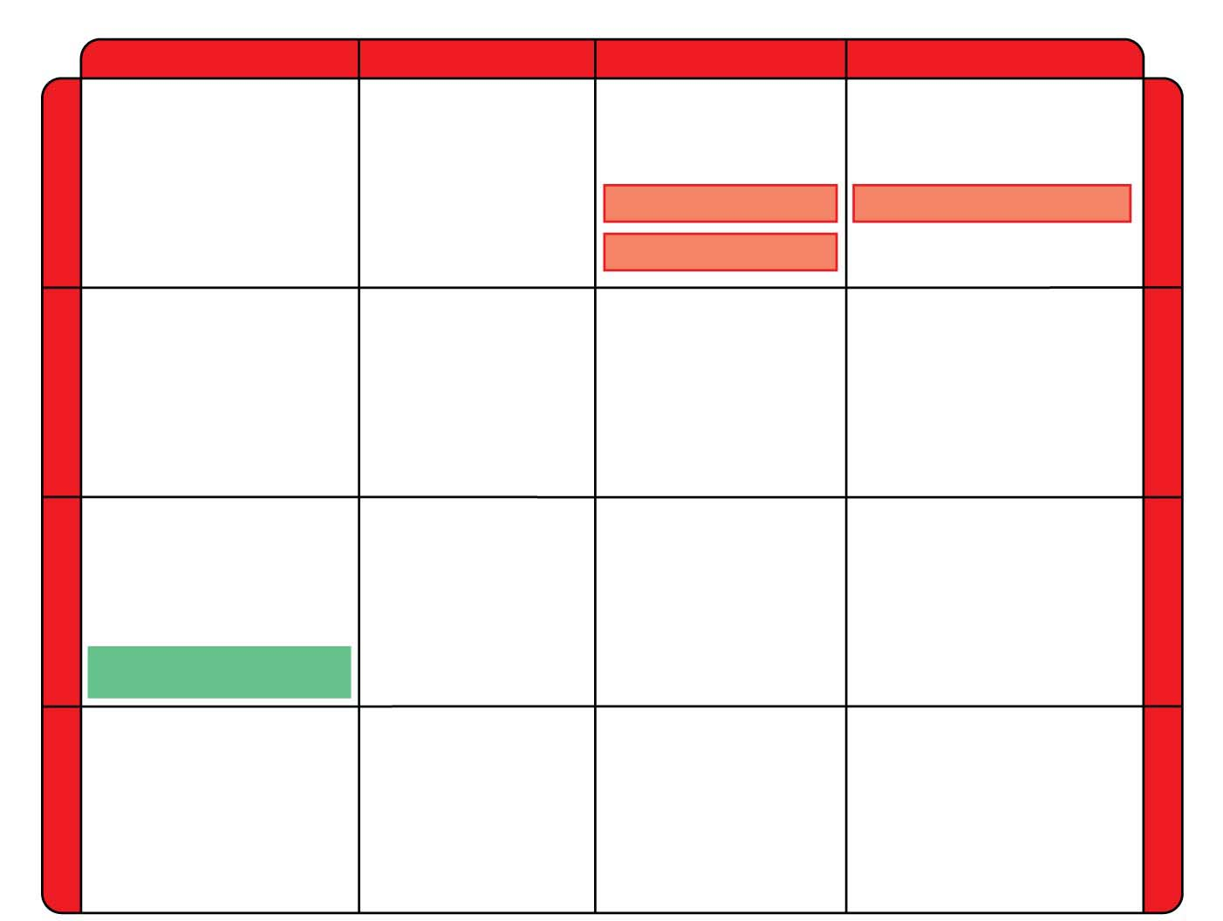
Figure 10.10
Second base of RNA codon
U
C
A
G
UUU
UCU
UAU
UGU
U
Phenylalanine
(Phe)
Tyrosine
(Tyr)
Cysteine
(Cys)
U
UUC
UCC
UAC
UGC
C
Serine
(Ser)
UUA
UCA
UAA
Stop
UGA
Stop
A
Leucine
(Leu)
UUG
UCG
UAG
Stop
UGG
Tryptophan (Trp)
G
CUU
CCU
CAU
CGU
U
Histidine
(His)
C
CUC
CCC
CAC
CGC
C
Leucine
(Leu)
Proline
(Pro)
Arginine
(Arg)
CUA
CCA
CAA
CGA
A
Glutamine
(Gln)
CUG
CCG
CAG
CGG
G
First base of RNA codon
Third base of RNA codon
AUU
ACU
AAU
AGU
U
Asparagine
(Asn)
Serine
(Ser)
A
AUC
Isoleucine
(Ile)
ACC
AAC
AGC
C
Threonine
(Thr)
AUA
ACA
AAA
AGA
A
Lysine
(Lys)
Arginine
(Arg)
AUG
Met or start
ACG
AAG
AGG
G
GUU
GCU
GAU
GGU
U
Aspartic
acid (Asp)
G
GUC
GCC
GAC
GGC
C
Valine
(Val)
Alanine
(Ala)
Glycine
(Gly)
GUA
GCA
GAA
GGA
A
Glutamic
acid (Glu)
GUG
GCG
GAG
GGG
G
Notes:
Figure 10.10 The dictionary of the genetic code, listed by RNA codons

Slide 73
Check Point
An RNA molecule contains the nucleotide sequence CCAUUUACG. Using Figure 10.10, translate this sequence into the corresponding amino acid sequence.
Answer: Pro-Phe-Thr

Slide 74
The Genetic Code
The genetic code is nearly universal, shared by organisms from the simplest bacteria to the most complex plants and animals.
Evidence of a single origin of life and evolution by natural selection
Notes:
74
Student Misconceptions and Concerns
1. Beginning college students are often intensely focused on writing detailed notes. The risk is that they miss the overall patterns and the broader significance of the topics discussed. Consider a gradual approach to the subjects of transcription and translation, beginning quite generally and testing comprehension before venturing into the finer mechanics of each process.
2. Consider placing on the board Figure 10.8, noting the sequence, products, and locations of transcription and translation in eukaryotic cells. This reminder can create a quick concept check for students as they learn additional detail.
3. Mutations are often discussed as part of evolution mechanisms. In this sense, mutations may be considered a part of a positive creative process. The dual nature of mutations, potentially deadly yet potentially innovative, should be clarified.
Teaching Tips
1. It has been said that “Everything about an organism is an interaction between the genome and the environment.” You might wish to challenge your students to explain the significance and validity of this statement.
2. The sequential information in DNA and RNA is analogous to the sequential information in the letters of a sentence. This analogy is also helpful when explaining the impact of insertion or deletion mutations that cause a shift in the reading frame.
3. The transcription of DNA into RNA is like a reporter who transcribes a political speech. In both situations, the language remains the same, although in the case of the reporter, it changes form from spoken to written.
4. A parallel can be drawn between the discovery in 1799 of the Rosetta Stone, which provided the key that enabled scholars to crack the previously indecipherable hieroglyphic code, and the cracking of the genetic code in 1961. Consider challenging your students to explain what part of the genetic code is similar to the Rosetta Stone. This could be a short in-class activity for small groups.
5. Another advantage to the use of RNA to direct protein synthesis is that the original code (DNA) remains safe within the nucleus, away from the many potentially damaging chemicals in the cytoplasm. This is like making photocopies of important documents for study, keeping the originals safely stored away (much like how we treat the original U.S. Constitution).
6. The production of proteins is like a machine requiring fuel. The molecular machinery (ribosomes and tRNA) used in many cellular processes also requires an input of energy in the form of ATP.
7. If you were using a train analogy for the assembly of monomers into polymers, at this point the DNA and RNA “trains” are traded in 3 for 1 for the polypeptide “train.” Thus, in general, polypeptides have about 1/3 as many monomers as the mRNA that coded for them. (It might be a good challenge to have your students explain why proteins do not have exactly a third of monomers of the corresponding mRNA. Start and stop codons, for example, are not translated into amino acids.)
8. Many analogies can be developed to represent the selective expression of a gene requiring the deletion of introns. Instructors who only assign some modules of a chapter are treating the chapters like sections of exons and introns, portions to be read and portions to be skipped. Alternately, students who highlight a chapter might be thought of as editing the book into exons, portions to be reviewed, and introns, nonhighlighted sections that will not be studied. Both analogies are imperfect, but may still convey the concept of selective reading.
9. Students might think of the A and P sites as stages in an assembly line. The A site is where a new amino acid is brought in, according to the blueprint of the codon on the mRNA. The P site is where the growing product/polypeptide is anchored as it is being built. To help them better remember details of translation, students might think of the letters for the two sites to mean “A” for addition, where an amino acid is added, and “P” for polypeptide, where the growing polypeptide is located.
10. A simple way to demonstrate the effect of a reading frame shift is to have students compare the following three sentences. The first is a simple sentence. But look what happens when a letter is added (2) or deleted (3). The “reading frame,” or triplet groupings, are re-formed into nonsense.
(1) The big red pig ate the red rag.
(2) The big res dpi gat eth ere dra g.
(3) The big rep iga tet her edr ag.
11. The authors have noted elsewhere that “A random mutation is like a shot in the dark. It is not likely to improve a genome any more than shooting a bullet through the hood of a car is likely to improve engine performance!”
Active Lecture Tips
1. After translation is addressed, consider asking your students (working in small groups) to list all of the places where base pairing is used (in the construction of a DNA molecule during DNA replication, in transcription, and during translation when the tRNA attaches).
2. See the Activity Using a Food Analogy to Think About Protein Synthesis on the Instructor Exchange. Visit the Instructor Exchange in the MasteringBiology instructor resource area for a description of this activity.
3. See the Activity Students Perform a Protein Synthesis Play on the Instructor Exchange. Visit the Instructor Exchange in the MasteringBiology instructor resource area for a description of this activity.
4. See the Media Review: “Learn.Genetics” Genetic Science Learning from the University of Utah on the Instructor Exchange. Visit the Instructor Exchange in the MasteringBiology instructor resource area for a description of this activity.
5. See the Activity Demonstrating a Frame Shift Mutation on the Instructor Exchange. Visit the Instructor Exchange in the MasteringBiology instructor resource area for a description of this activity.

Slide 75
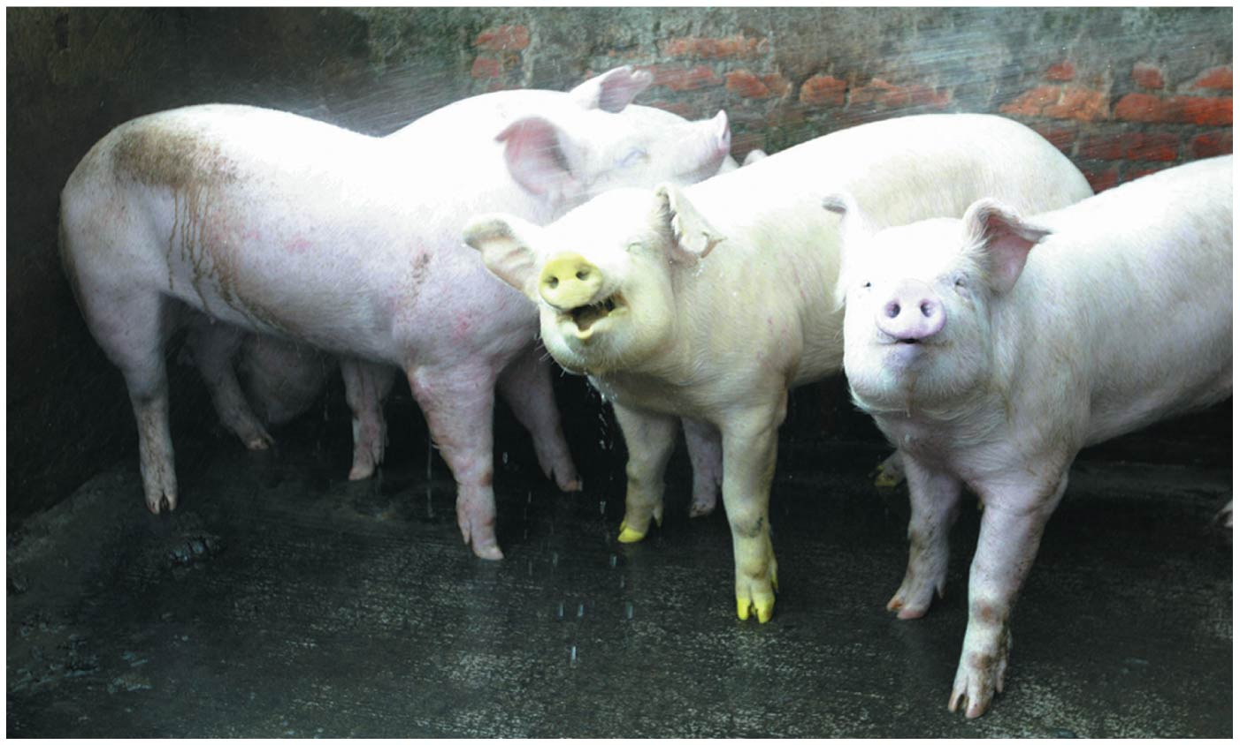
Figure 10.11
Notes:
Figure 10.11 A pig expressing a foreign gene

Slide 76
Pigs with Jellyfish Genes
  Because diverse organisms share a common genetic code, it is possible to program one species to produce a protein from another species by transplanting DNA.
  This allows scientists to mix and match genes from various species—a procedure with many useful genetic engineering applications in agriculture, medicine, and research.

Slide 77
How Does DNA control the Cell?
Transcription – DNA to RNA
DNA
TRANSCRIPTION
Nucleus
RNA
Cytoplasm
TRANSLATION
Protein

Slide 78
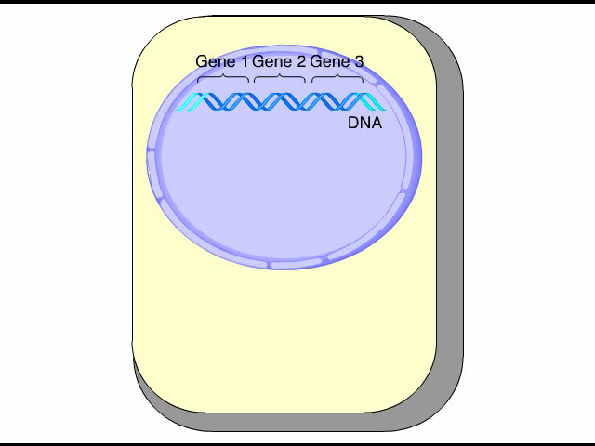
Animation: Transcription

Slide 79
Transcription: From DNA to RNA
Notice that the RNA nucleotides follow the usual base-pairing rules, except that U, rather than T, pairs with A.
The RNA nucleotides are linked by the transcription enzyme RNA polymerase.
© 2013 Pearson Education, Inc.
Notes:
79
Student Misconceptions and Concerns
1. Beginning college students are often intensely focused on writing detailed notes. The risk is that they miss the overall patterns and the broader significance of the topics discussed. Consider a gradual approach to the subjects of transcription and translation, beginning quite generally and testing comprehension before venturing into the finer mechanics of each process.
2. Consider placing on the board Figure 10.8, noting the sequence, products, and locations of transcription and translation in eukaryotic cells. This reminder can create a quick concept check for students as they learn additional detail.
3. Mutations are often discussed as part of evolution mechanisms. In this sense, mutations may be considered a part of a positive creative process. The dual nature of mutations, potentially deadly yet potentially innovative, should be clarified.
Teaching Tips
1. It has been said that “Everything about an organism is an interaction between the genome and the environment.” You might wish to challenge your students to explain the significance and validity of this statement.
2. The sequential information in DNA and RNA is analogous to the sequential information in the letters of a sentence. This analogy is also helpful when explaining the impact of insertion or deletion mutations that cause a shift in the reading frame.
3. The transcription of DNA into RNA is like a reporter who transcribes a political speech. In both situations, the language remains the same, although in the case of the reporter, it changes form from spoken to written.
4. A parallel can be drawn between the discovery in 1799 of the Rosetta Stone, which provided the key that enabled scholars to crack the previously indecipherable hieroglyphic code, and the cracking of the genetic code in 1961. Consider challenging your students to explain what part of the genetic code is similar to the Rosetta Stone. This could be a short in-class activity for small groups.
5. Another advantage to the use of RNA to direct protein synthesis is that the original code (DNA) remains safe within the nucleus, away from the many potentially damaging chemicals in the cytoplasm. This is like making photocopies of important documents for study, keeping the originals safely stored away (much like how we treat the original U.S. Constitution).
6. The production of proteins is like a machine requiring fuel. The molecular machinery (ribosomes and tRNA) used in many cellular processes also requires an input of energy in the form of ATP.
7. If you were using a train analogy for the assembly of monomers into polymers, at this point the DNA and RNA “trains” are traded in 3 for 1 for the polypeptide “train.” Thus, in general, polypeptides have about 1/3 as many monomers as the mRNA that coded for them. (It might be a good challenge to have your students explain why proteins do not have exactly a third of monomers of the corresponding mRNA. Start and stop codons, for example, are not translated into amino acids.)
8. Many analogies can be developed to represent the selective expression of a gene requiring the deletion of introns. Instructors who only assign some modules of a chapter are treating the chapters like sections of exons and introns, portions to be read and portions to be skipped. Alternately, students who highlight a chapter might be thought of as editing the book into exons, portions to be reviewed, and introns, nonhighlighted sections that will not be studied. Both analogies are imperfect, but may still convey the concept of selective reading.
9. Students might think of the A and P sites as stages in an assembly line. The A site is where a new amino acid is brought in, according to the blueprint of the codon on the mRNA. The P site is where the growing product/polypeptide is anchored as it is being built. To help them better remember details of translation, students might think of the letters for the two sites to mean “A” for addition, where an amino acid is added, and “P” for polypeptide, where the growing polypeptide is located.
10. A simple way to demonstrate the effect of a reading frame shift is to have students compare the following three sentences. The first is a simple sentence. But look what happens when a letter is added (2) or deleted (3). The “reading frame,” or triplet groupings, are re-formed into nonsense.
(1) The big red pig ate the red rag.
(2) The big res dpi gat eth ere dra g.
(3) The big rep iga tet her edr ag.
11. The authors have noted elsewhere that “A random mutation is like a shot in the dark. It is not likely to improve a genome any more than shooting a bullet through the hood of a car is likely to improve engine performance!”
Active Lecture Tips
1. After translation is addressed, consider asking your students (working in small groups) to list all of the places where base pairing is used (in the construction of a DNA molecule during DNA replication, in transcription, and during translation when the tRNA attaches).
2. See the Activity Using a Food Analogy to Think About Protein Synthesis on the Instructor Exchange. Visit the Instructor Exchange in the MasteringBiology instructor resource area for a description of this activity.
3. See the Activity Students Perform a Protein Synthesis Play on the Instructor Exchange. Visit the Instructor Exchange in the MasteringBiology instructor resource area for a description of this activity.
4. See the Media Review: “Learn.Genetics” Genetic Science Learning from the University of Utah on the Instructor Exchange. Visit the Instructor Exchange in the MasteringBiology instructor resource area for a description of this activity.
5. See the Activity Demonstrating a Frame Shift Mutation on the Instructor Exchange. Visit the Instructor Exchange in the MasteringBiology instructor resource area for a description of this activity.

Slide 80
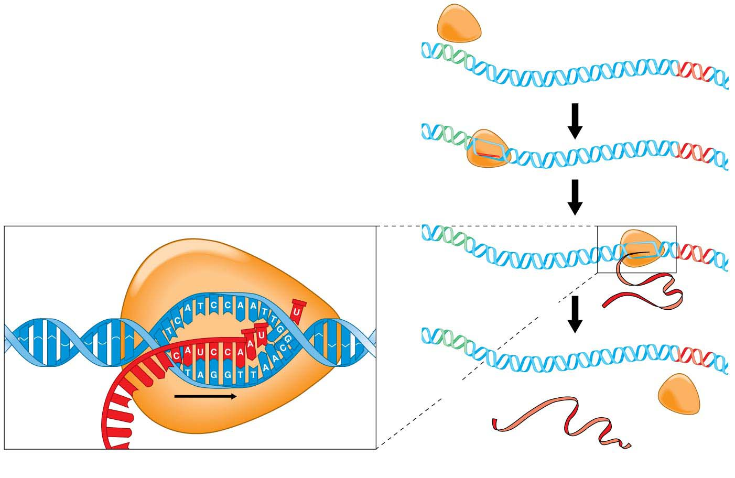
Figure 10.12
RNA polymerase
DNA of gene
Promoter
DNA
1
Initiation
Terminator
DNA
RNA
2
Elongation
RNA nucleotides
RNA polymerase
3
Termination
Growing RNA
Newly
made
RNA
Completed RNA
Direction of
transcription
Template
strand of DNA
RNA
polymerase
(a) A close-up view of transcription
(b) Transcription of a gene
Notes:
Figure 10.12 Transcription

Slide 81
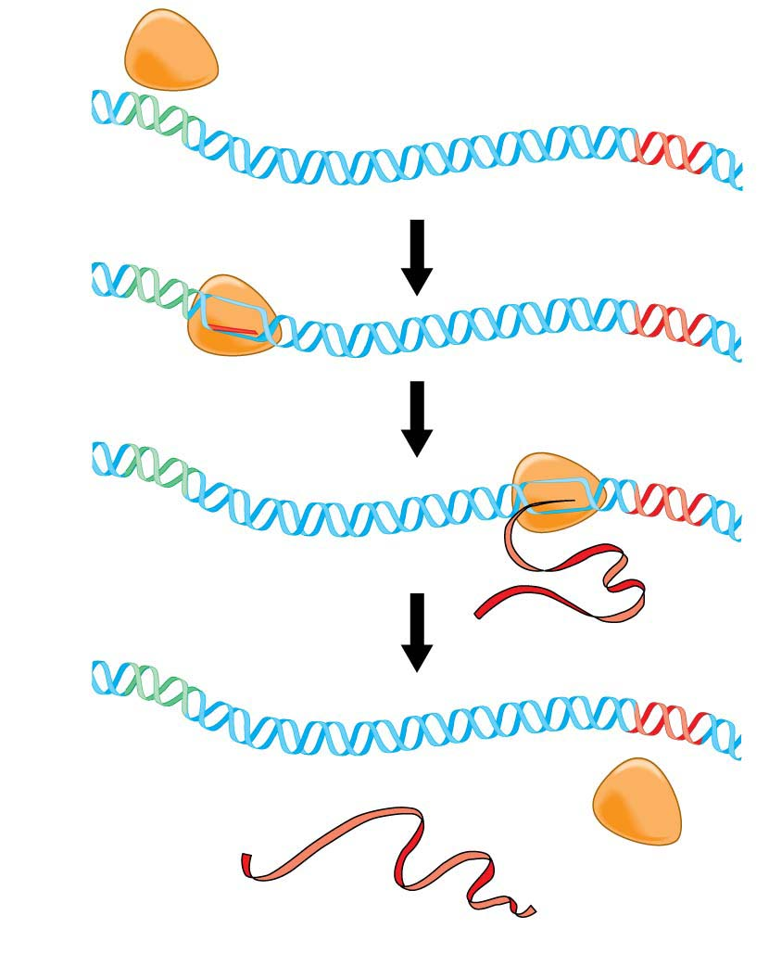
Figure 10.12-2
RNA polymerase
DNA of gene
Promoter
DNA
1
Initiation
Terminator
DNA
RNA
2
Elongation
3
Termination
Growing RNA
Completed RNA
RNA
polymerase
(b) Transcription of a gene
Notes:
Figure 10.12-2 Transcription (part 2: three phases of transcription)

Slide 82
Initiation of Transcription
The “start transcribing” signal is a nucleotide sequence called a promoter, which is
  located in the DNA at the beginning of the gene and
  a specific place where RNA polymerase attaches.
The first phase of transcription, called initiation, is
  the attachment of RNA polymerase to the promoter and
  the start of RNA synthesis.
Notes:
82
Student Misconceptions and Concerns
1. Beginning college students are often intensely focused on writing detailed notes. The risk is that they miss the overall patterns and the broader significance of the topics discussed. Consider a gradual approach to the subjects of transcription and translation, beginning quite generally and testing comprehension before venturing into the finer mechanics of each process.
2. Consider placing on the board Figure 10.8, noting the sequence, products, and locations of transcription and translation in eukaryotic cells. This reminder can create a quick concept check for students as they learn additional detail.
3. Mutations are often discussed as part of evolution mechanisms. In this sense, mutations may be considered a part of a positive creative process. The dual nature of mutations, potentially deadly yet potentially innovative, should be clarified.
Teaching Tips
1. It has been said that “Everything about an organism is an interaction between the genome and the environment.” You might wish to challenge your students to explain the significance and validity of this statement.
2. The sequential information in DNA and RNA is analogous to the sequential information in the letters of a sentence. This analogy is also helpful when explaining the impact of insertion or deletion mutations that cause a shift in the reading frame.
3. The transcription of DNA into RNA is like a reporter who transcribes a political speech. In both situations, the language remains the same, although in the case of the reporter, it changes form from spoken to written.
4. A parallel can be drawn between the discovery in 1799 of the Rosetta Stone, which provided the key that enabled scholars to crack the previously indecipherable hieroglyphic code, and the cracking of the genetic code in 1961. Consider challenging your students to explain what part of the genetic code is similar to the Rosetta Stone. This could be a short in-class activity for small groups.
5. Another advantage to the use of RNA to direct protein synthesis is that the original code (DNA) remains safe within the nucleus, away from the many potentially damaging chemicals in the cytoplasm. This is like making photocopies of important documents for study, keeping the originals safely stored away (much like how we treat the original U.S. Constitution).
6. The production of proteins is like a machine requiring fuel. The molecular machinery (ribosomes and tRNA) used in many cellular processes also requires an input of energy in the form of ATP.
7. If you were using a train analogy for the assembly of monomers into polymers, at this point the DNA and RNA “trains” are traded in 3 for 1 for the polypeptide “train.” Thus, in general, polypeptides have about 1/3 as many monomers as the mRNA that coded for them. (It might be a good challenge to have your students explain why proteins do not have exactly a third of monomers of the corresponding mRNA. Start and stop codons, for example, are not translated into amino acids.)
8. Many analogies can be developed to represent the selective expression of a gene requiring the deletion of introns. Instructors who only assign some modules of a chapter are treating the chapters like sections of exons and introns, portions to be read and portions to be skipped. Alternately, students who highlight a chapter might be thought of as editing the book into exons, portions to be reviewed, and introns, nonhighlighted sections that will not be studied. Both analogies are imperfect, but may still convey the concept of selective reading.
9. Students might think of the A and P sites as stages in an assembly line. The A site is where a new amino acid is brought in, according to the blueprint of the codon on the mRNA. The P site is where the growing product/polypeptide is anchored as it is being built. To help them better remember details of translation, students might think of the letters for the two sites to mean “A” for addition, where an amino acid is added, and “P” for polypeptide, where the growing polypeptide is located.
10. A simple way to demonstrate the effect of a reading frame shift is to have students compare the following three sentences. The first is a simple sentence. But look what happens when a letter is added (2) or deleted (3). The “reading frame,” or triplet groupings, are re-formed into nonsense.
(1) The big red pig ate the red rag.
(2) The big res dpi gat eth ere dra g.
(3) The big rep iga tet her edr ag.
11. The authors have noted elsewhere that “A random mutation is like a shot in the dark. It is not likely to improve a genome any more than shooting a bullet through the hood of a car is likely to improve engine performance!”
Active Lecture Tips
1. After translation is addressed, consider asking your students (working in small groups) to list all of the places where base pairing is used (in the construction of a DNA molecule during DNA replication, in transcription, and during translation when the tRNA attaches).
2. See the Activity Using a Food Analogy to Think About Protein Synthesis on the Instructor Exchange. Visit the Instructor Exchange in the MasteringBiology instructor resource area for a description of this activity.
3. See the Activity Students Perform a Protein Synthesis Play on the Instructor Exchange. Visit the Instructor Exchange in the MasteringBiology instructor resource area for a description of this activity.
4. See the Media Review: “Learn.Genetics” Genetic Science Learning from the University of Utah on the Instructor Exchange. Visit the Instructor Exchange in the MasteringBiology instructor resource area for a description of this activity.
5. See the Activity Demonstrating a Frame Shift Mutation on the Instructor Exchange. Visit the Instructor Exchange in the MasteringBiology instructor resource area for a description of this activity.

Slide 83
RNA Elongation
During the second phase of transcription, called elongation,
  the RNA grows longer
  complementary nucleotides are added according to the base pairing rule
    U to A, C to G
Notes:
83
Student Misconceptions and Concerns
1. Beginning college students are often intensely focused on writing detailed notes. The risk is that they miss the overall patterns and the broader significance of the topics discussed. Consider a gradual approach to the subjects of transcription and translation, beginning quite generally and testing comprehension before venturing into the finer mechanics of each process.
2. Consider placing on the board Figure 10.8, noting the sequence, products, and locations of transcription and translation in eukaryotic cells. This reminder can create a quick concept check for students as they learn additional detail.
3. Mutations are often discussed as part of evolution mechanisms. In this sense, mutations may be considered a part of a positive creative process. The dual nature of mutations, potentially deadly yet potentially innovative, should be clarified.
Teaching Tips
1. It has been said that “Everything about an organism is an interaction between the genome and the environment.” You might wish to challenge your students to explain the significance and validity of this statement.
2. The sequential information in DNA and RNA is analogous to the sequential information in the letters of a sentence. This analogy is also helpful when explaining the impact of insertion or deletion mutations that cause a shift in the reading frame.
3. The transcription of DNA into RNA is like a reporter who transcribes a political speech. In both situations, the language remains the same, although in the case of the reporter, it changes form from spoken to written.
4. A parallel can be drawn between the discovery in 1799 of the Rosetta Stone, which provided the key that enabled scholars to crack the previously indecipherable hieroglyphic code, and the cracking of the genetic code in 1961. Consider challenging your students to explain what part of the genetic code is similar to the Rosetta Stone. This could be a short in-class activity for small groups.
5. Another advantage to the use of RNA to direct protein synthesis is that the original code (DNA) remains safe within the nucleus, away from the many potentially damaging chemicals in the cytoplasm. This is like making photocopies of important documents for study, keeping the originals safely stored away (much like how we treat the original U.S. Constitution).
6. The production of proteins is like a machine requiring fuel. The molecular machinery (ribosomes and tRNA) used in many cellular processes also requires an input of energy in the form of ATP.
7. If you were using a train analogy for the assembly of monomers into polymers, at this point the DNA and RNA “trains” are traded in 3 for 1 for the polypeptide “train.” Thus, in general, polypeptides have about 1/3 as many monomers as the mRNA that coded for them. (It might be a good challenge to have your students explain why proteins do not have exactly a third of monomers of the corresponding mRNA. Start and stop codons, for example, are not translated into amino acids.)
8. Many analogies can be developed to represent the selective expression of a gene requiring the deletion of introns. Instructors who only assign some modules of a chapter are treating the chapters like sections of exons and introns, portions to be read and portions to be skipped. Alternately, students who highlight a chapter might be thought of as editing the book into exons, portions to be reviewed, and introns, nonhighlighted sections that will not be studied. Both analogies are imperfect, but may still convey the concept of selective reading.
9. Students might think of the A and P sites as stages in an assembly line. The A site is where a new amino acid is brought in, according to the blueprint of the codon on the mRNA. The P site is where the growing product/polypeptide is anchored as it is being built. To help them better remember details of translation, students might think of the letters for the two sites to mean “A” for addition, where an amino acid is added, and “P” for polypeptide, where the growing polypeptide is located.
10. A simple way to demonstrate the effect of a reading frame shift is to have students compare the following three sentences. The first is a simple sentence. But look what happens when a letter is added (2) or deleted (3). The “reading frame,” or triplet groupings, are re-formed into nonsense.
(1) The big red pig ate the red rag.
(2) The big res dpi gat eth ere dra g.
(3) The big rep iga tet her edr ag.
11. The authors have noted elsewhere that “A random mutation is like a shot in the dark. It is not likely to improve a genome any more than shooting a bullet through the hood of a car is likely to improve engine performance!”
Active Lecture Tips
1. After translation is addressed, consider asking your students (working in small groups) to list all of the places where base pairing is used (in the construction of a DNA molecule during DNA replication, in transcription, and during translation when the tRNA attaches).
2. See the Activity Using a Food Analogy to Think About Protein Synthesis on the Instructor Exchange. Visit the Instructor Exchange in the MasteringBiology instructor resource area for a description of this activity.
3. See the Activity Students Perform a Protein Synthesis Play on the Instructor Exchange. Visit the Instructor Exchange in the MasteringBiology instructor resource area for a description of this activity.
4. See the Media Review: “Learn.Genetics” Genetic Science Learning from the University of Utah on the Instructor Exchange. Visit the Instructor Exchange in the MasteringBiology instructor resource area for a description of this activity.
5. See the Activity Demonstrating a Frame Shift Mutation on the Instructor Exchange. Visit the Instructor Exchange in the MasteringBiology instructor resource area for a description of this activity.

Slide 84
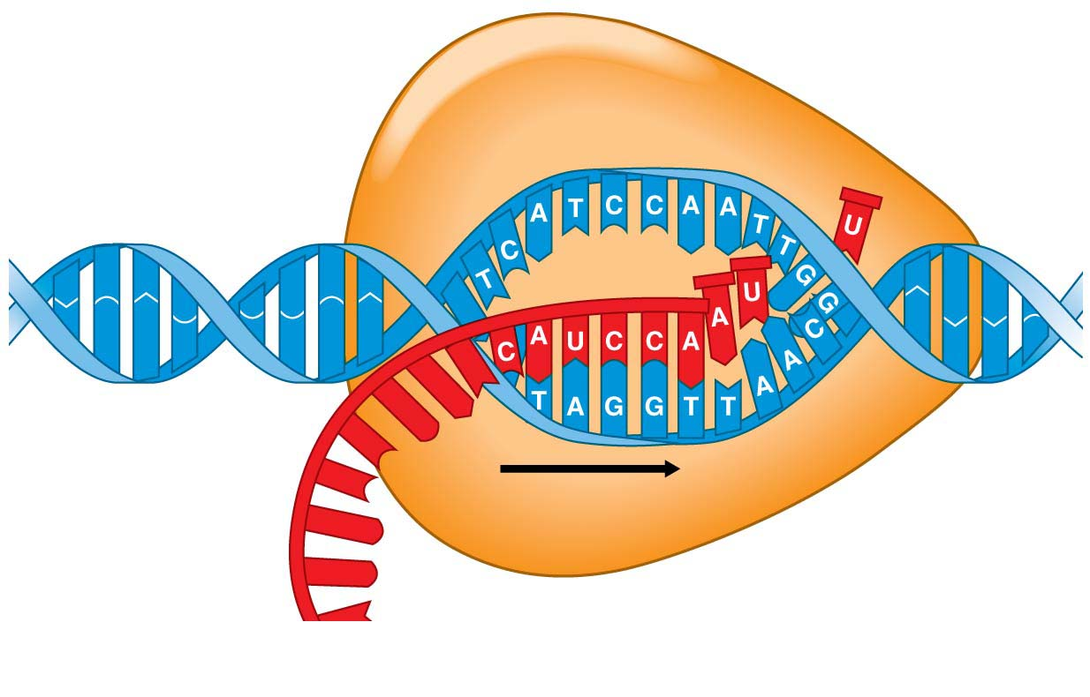
Figure 10.12-1
RNA nucleotides
RNA polymerase
Newly
made
RNA
Direction of
transcription
Template
strand of DNA
(a) A close-up view of transcription
Notes:
Figure 10.12-1 Transcription (part 1: RNA polymerase)

Slide 85
Termination of Transcription
During the third phase of transcription, called termination,
  RNA polymerase reaches a special sequence of bases in the DNA template called a terminator, signaling the end of the gene,
  polymerase detaches from the RNA and the gene, and
  the DNA strands rejoin.
Notes:
85
Student Misconceptions and Concerns
1. Beginning college students are often intensely focused on writing detailed notes. The risk is that they miss the overall patterns and the broader significance of the topics discussed. Consider a gradual approach to the subjects of transcription and translation, beginning quite generally and testing comprehension before venturing into the finer mechanics of each process.
2. Consider placing on the board Figure 10.8, noting the sequence, products, and locations of transcription and translation in eukaryotic cells. This reminder can create a quick concept check for students as they learn additional detail.
3. Mutations are often discussed as part of evolution mechanisms. In this sense, mutations may be considered a part of a positive creative process. The dual nature of mutations, potentially deadly yet potentially innovative, should be clarified.
Teaching Tips
1. It has been said that “Everything about an organism is an interaction between the genome and the environment.” You might wish to challenge your students to explain the significance and validity of this statement.
2. The sequential information in DNA and RNA is analogous to the sequential information in the letters of a sentence. This analogy is also helpful when explaining the impact of insertion or deletion mutations that cause a shift in the reading frame.
3. The transcription of DNA into RNA is like a reporter who transcribes a political speech. In both situations, the language remains the same, although in the case of the reporter, it changes form from spoken to written.
4. A parallel can be drawn between the discovery in 1799 of the Rosetta Stone, which provided the key that enabled scholars to crack the previously indecipherable hieroglyphic code, and the cracking of the genetic code in 1961. Consider challenging your students to explain what part of the genetic code is similar to the Rosetta Stone. This could be a short in-class activity for small groups.
5. Another advantage to the use of RNA to direct protein synthesis is that the original code (DNA) remains safe within the nucleus, away from the many potentially damaging chemicals in the cytoplasm. This is like making photocopies of important documents for study, keeping the originals safely stored away (much like how we treat the original U.S. Constitution).
6. The production of proteins is like a machine requiring fuel. The molecular machinery (ribosomes and tRNA) used in many cellular processes also requires an input of energy in the form of ATP.
7. If you were using a train analogy for the assembly of monomers into polymers, at this point the DNA and RNA “trains” are traded in 3 for 1 for the polypeptide “train.” Thus, in general, polypeptides have about 1/3 as many monomers as the mRNA that coded for them. (It might be a good challenge to have your students explain why proteins do not have exactly a third of monomers of the corresponding mRNA. Start and stop codons, for example, are not translated into amino acids.)
8. Many analogies can be developed to represent the selective expression of a gene requiring the deletion of introns. Instructors who only assign some modules of a chapter are treating the chapters like sections of exons and introns, portions to be read and portions to be skipped. Alternately, students who highlight a chapter might be thought of as editing the book into exons, portions to be reviewed, and introns, nonhighlighted sections that will not be studied. Both analogies are imperfect, but may still convey the concept of selective reading.
9. Students might think of the A and P sites as stages in an assembly line. The A site is where a new amino acid is brought in, according to the blueprint of the codon on the mRNA. The P site is where the growing product/polypeptide is anchored as it is being built. To help them better remember details of translation, students might think of the letters for the two sites to mean “A” for addition, where an amino acid is added, and “P” for polypeptide, where the growing polypeptide is located.
10. A simple way to demonstrate the effect of a reading frame shift is to have students compare the following three sentences. The first is a simple sentence. But look what happens when a letter is added (2) or deleted (3). The “reading frame,” or triplet groupings, are re-formed into nonsense.
(1) The big red pig ate the red rag.
(2) The big res dpi gat eth ere dra g.
(3) The big rep iga tet her edr ag.
11. The authors have noted elsewhere that “A random mutation is like a shot in the dark. It is not likely to improve a genome any more than shooting a bullet through the hood of a car is likely to improve engine performance!”
Active Lecture Tips
1. After translation is addressed, consider asking your students (working in small groups) to list all of the places where base pairing is used (in the construction of a DNA molecule during DNA replication, in transcription, and during translation when the tRNA attaches).
2. See the Activity Using a Food Analogy to Think About Protein Synthesis on the Instructor Exchange. Visit the Instructor Exchange in the MasteringBiology instructor resource area for a description of this activity.
3. See the Activity Students Perform a Protein Synthesis Play on the Instructor Exchange. Visit the Instructor Exchange in the MasteringBiology instructor resource area for a description of this activity.
4. See the Media Review: “Learn.Genetics” Genetic Science Learning from the University of Utah on the Instructor Exchange. Visit the Instructor Exchange in the MasteringBiology instructor resource area for a description of this activity.
5. See the Activity Demonstrating a Frame Shift Mutation on the Instructor Exchange. Visit the Instructor Exchange in the MasteringBiology instructor resource area for a description of this activity.

Slide 86
The Processing of Eukaryotic RNA
In the cells of prokaryotes, which lack nuclei, the RNA transcribed from a gene immediately functions as messenger RNA (mRNA), the molecule that is translated into protein.
The eukaryotic cell
  localizes transcription in the nucleus and
  modifies, or processes, the RNA transcripts in the nucleus before they move to the cytoplasm for translation by ribosomes.
Notes:
86
Student Misconceptions and Concerns
1. Beginning college students are often intensely focused on writing detailed notes. The risk is that they miss the overall patterns and the broader significance of the topics discussed. Consider a gradual approach to the subjects of transcription and translation, beginning quite generally and testing comprehension before venturing into the finer mechanics of each process.
2. Consider placing on the board Figure 10.8, noting the sequence, products, and locations of transcription and translation in eukaryotic cells. This reminder can create a quick concept check for students as they learn additional detail.
3. Mutations are often discussed as part of evolution mechanisms. In this sense, mutations may be considered a part of a positive creative process. The dual nature of mutations, potentially deadly yet potentially innovative, should be clarified.
Teaching Tips
1. It has been said that “Everything about an organism is an interaction between the genome and the environment.” You might wish to challenge your students to explain the significance and validity of this statement.
2. The sequential information in DNA and RNA is analogous to the sequential information in the letters of a sentence. This analogy is also helpful when explaining the impact of insertion or deletion mutations that cause a shift in the reading frame.
3. The transcription of DNA into RNA is like a reporter who transcribes a political speech. In both situations, the language remains the same, although in the case of the reporter, it changes form from spoken to written.
4. A parallel can be drawn between the discovery in 1799 of the Rosetta Stone, which provided the key that enabled scholars to crack the previously indecipherable hieroglyphic code, and the cracking of the genetic code in 1961. Consider challenging your students to explain what part of the genetic code is similar to the Rosetta Stone. This could be a short in-class activity for small groups.
5. Another advantage to the use of RNA to direct protein synthesis is that the original code (DNA) remains safe within the nucleus, away from the many potentially damaging chemicals in the cytoplasm. This is like making photocopies of important documents for study, keeping the originals safely stored away (much like how we treat the original U.S. Constitution).
6. The production of proteins is like a machine requiring fuel. The molecular machinery (ribosomes and tRNA) used in many cellular processes also requires an input of energy in the form of ATP.
7. If you were using a train analogy for the assembly of monomers into polymers, at this point the DNA and RNA “trains” are traded in 3 for 1 for the polypeptide “train.” Thus, in general, polypeptides have about 1/3 as many monomers as the mRNA that coded for them. (It might be a good challenge to have your students explain why proteins do not have exactly a third of monomers of the corresponding mRNA. Start and stop codons, for example, are not translated into amino acids.)
8. Many analogies can be developed to represent the selective expression of a gene requiring the deletion of introns. Instructors who only assign some modules of a chapter are treating the chapters like sections of exons and introns, portions to be read and portions to be skipped. Alternately, students who highlight a chapter might be thought of as editing the book into exons, portions to be reviewed, and introns, nonhighlighted sections that will not be studied. Both analogies are imperfect, but may still convey the concept of selective reading.
9. Students might think of the A and P sites as stages in an assembly line. The A site is where a new amino acid is brought in, according to the blueprint of the codon on the mRNA. The P site is where the growing product/polypeptide is anchored as it is being built. To help them better remember details of translation, students might think of the letters for the two sites to mean “A” for addition, where an amino acid is added, and “P” for polypeptide, where the growing polypeptide is located.
10. A simple way to demonstrate the effect of a reading frame shift is to have students compare the following three sentences. The first is a simple sentence. But look what happens when a letter is added (2) or deleted (3). The “reading frame,” or triplet groupings, are re-formed into nonsense.
(1) The big red pig ate the red rag.
(2) The big res dpi gat eth ere dra g.
(3) The big rep iga tet her edr ag.
11. The authors have noted elsewhere that “A random mutation is like a shot in the dark. It is not likely to improve a genome any more than shooting a bullet through the hood of a car is likely to improve engine performance!”
Active Lecture Tips
1. After translation is addressed, consider asking your students (working in small groups) to list all of the places where base pairing is used (in the construction of a DNA molecule during DNA replication, in transcription, and during translation when the tRNA attaches).
2. See the Activity Using a Food Analogy to Think About Protein Synthesis on the Instructor Exchange. Visit the Instructor Exchange in the MasteringBiology instructor resource area for a description of this activity.
3. See the Activity Students Perform a Protein Synthesis Play on the Instructor Exchange. Visit the Instructor Exchange in the MasteringBiology instructor resource area for a description of this activity.
4. See the Media Review: “Learn.Genetics” Genetic Science Learning from the University of Utah on the Instructor Exchange. Visit the Instructor Exchange in the MasteringBiology instructor resource area for a description of this activity.
5. See the Activity Demonstrating a Frame Shift Mutation on the Instructor Exchange. Visit the Instructor Exchange in the MasteringBiology instructor resource area for a description of this activity.

Slide 87
Start here

Slide 88
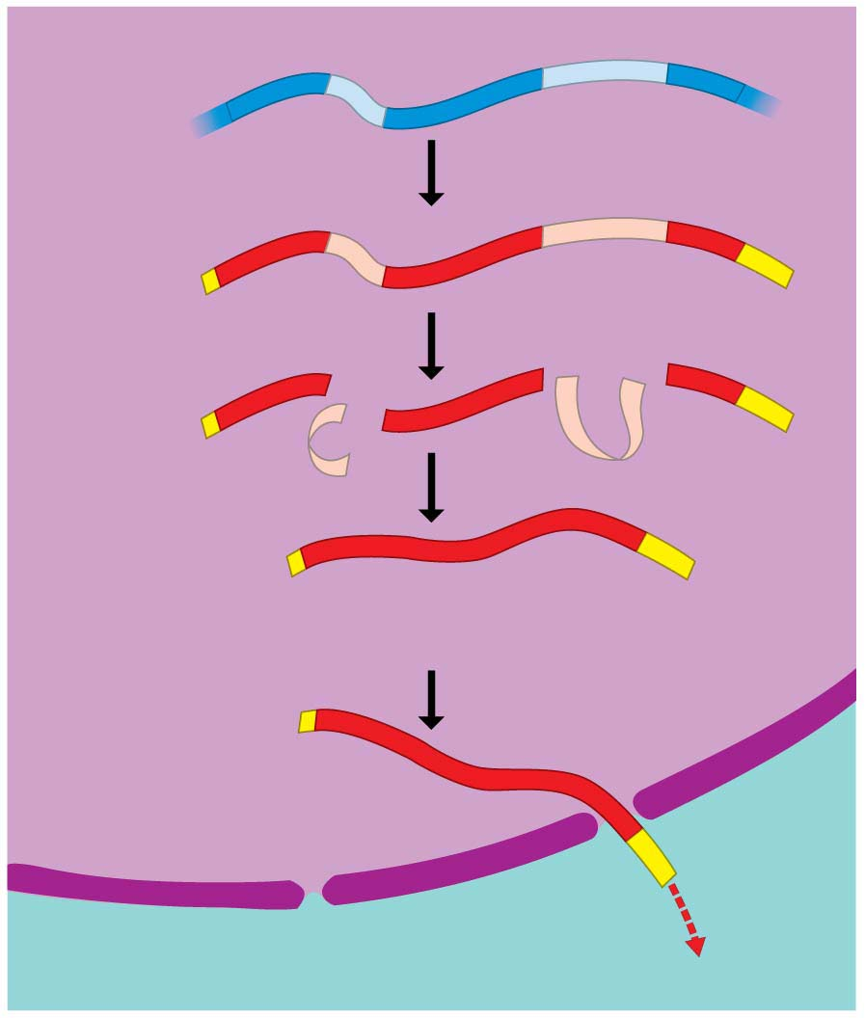
Figure 10.13
Exon
Intron
Exon
DNA
Intron
Exon
Transcription
Addition of cap and tail
RNA
transcript
with cap
and tail
Cap
Introns removed
Tail
Exons spliced together
mRNA
Coding sequence
Nucleus
Cytoplasm
Notes:
Figure 10.13 The production of messenger RNA (mRNA) in a eukaryotic cell

Slide 89
The Processing of Eukaryotic RNA
One kind of RNA processing is the addition of extra nucleotides to the ends of the RNA transcript.
These additions, called the cap and tail, protect the RNA from attack by cellular enzymes and help ribosomes recognize the RNA as mRNA.
Notes:
89
Student Misconceptions and Concerns
1. Beginning college students are often intensely focused on writing detailed notes. The risk is that they miss the overall patterns and the broader significance of the topics discussed. Consider a gradual approach to the subjects of transcription and translation, beginning quite generally and testing comprehension before venturing into the finer mechanics of each process.
2. Consider placing on the board Figure 10.8, noting the sequence, products, and locations of transcription and translation in eukaryotic cells. This reminder can create a quick concept check for students as they learn additional detail.
3. Mutations are often discussed as part of evolution mechanisms. In this sense, mutations may be considered a part of a positive creative process. The dual nature of mutations, potentially deadly yet potentially innovative, should be clarified.
Teaching Tips
1. It has been said that “Everything about an organism is an interaction between the genome and the environment.” You might wish to challenge your students to explain the significance and validity of this statement.
2. The sequential information in DNA and RNA is analogous to the sequential information in the letters of a sentence. This analogy is also helpful when explaining the impact of insertion or deletion mutations that cause a shift in the reading frame.
3. The transcription of DNA into RNA is like a reporter who transcribes a political speech. In both situations, the language remains the same, although in the case of the reporter, it changes form from spoken to written.
4. A parallel can be drawn between the discovery in 1799 of the Rosetta Stone, which provided the key that enabled scholars to crack the previously indecipherable hieroglyphic code, and the cracking of the genetic code in 1961. Consider challenging your students to explain what part of the genetic code is similar to the Rosetta Stone. This could be a short in-class activity for small groups.
5. Another advantage to the use of RNA to direct protein synthesis is that the original code (DNA) remains safe within the nucleus, away from the many potentially damaging chemicals in the cytoplasm. This is like making photocopies of important documents for study, keeping the originals safely stored away (much like how we treat the original U.S. Constitution).
6. The production of proteins is like a machine requiring fuel. The molecular machinery (ribosomes and tRNA) used in many cellular processes also requires an input of energy in the form of ATP.
7. If you were using a train analogy for the assembly of monomers into polymers, at this point the DNA and RNA “trains” are traded in 3 for 1 for the polypeptide “train.” Thus, in general, polypeptides have about 1/3 as many monomers as the mRNA that coded for them. (It might be a good challenge to have your students explain why proteins do not have exactly a third of monomers of the corresponding mRNA. Start and stop codons, for example, are not translated into amino acids.)
8. Many analogies can be developed to represent the selective expression of a gene requiring the deletion of introns. Instructors who only assign some modules of a chapter are treating the chapters like sections of exons and introns, portions to be read and portions to be skipped. Alternately, students who highlight a chapter might be thought of as editing the book into exons, portions to be reviewed, and introns, nonhighlighted sections that will not be studied. Both analogies are imperfect, but may still convey the concept of selective reading.
9. Students might think of the A and P sites as stages in an assembly line. The A site is where a new amino acid is brought in, according to the blueprint of the codon on the mRNA. The P site is where the growing product/polypeptide is anchored as it is being built. To help them better remember details of translation, students might think of the letters for the two sites to mean “A” for addition, where an amino acid is added, and “P” for polypeptide, where the growing polypeptide is located.
10. A simple way to demonstrate the effect of a reading frame shift is to have students compare the following three sentences. The first is a simple sentence. But look what happens when a letter is added (2) or deleted (3). The “reading frame,” or triplet groupings, are re-formed into nonsense.
(1) The big red pig ate the red rag.
(2) The big res dpi gat eth ere dra g.
(3) The big rep iga tet her edr ag.
11. The authors have noted elsewhere that “A random mutation is like a shot in the dark. It is not likely to improve a genome any more than shooting a bullet through the hood of a car is likely to improve engine performance!”
Active Lecture Tips
1. After translation is addressed, consider asking your students (working in small groups) to list all of the places where base pairing is used (in the construction of a DNA molecule during DNA replication, in transcription, and during translation when the tRNA attaches).
2. See the Activity Using a Food Analogy to Think About Protein Synthesis on the Instructor Exchange. Visit the Instructor Exchange in the MasteringBiology instructor resource area for a description of this activity.
3. See the Activity Students Perform a Protein Synthesis Play on the Instructor Exchange. Visit the Instructor Exchange in the MasteringBiology instructor resource area for a description of this activity.
4. See the Media Review: “Learn.Genetics” Genetic Science Learning from the University of Utah on the Instructor Exchange. Visit the Instructor Exchange in the MasteringBiology instructor resource area for a description of this activity.
5. See the Activity Demonstrating a Frame Shift Mutation on the Instructor Exchange. Visit the Instructor Exchange in the MasteringBiology instructor resource area for a description of this activity.

Slide 90
The Processing of Eukaryotic RNA
  Another type of RNA processing is made necessary in eukaryotes by noncoding stretches of nucleotides that interrupt the nucleotides that actually code for amino acids.
    Most genes of plants and animals include such internal noncoding regions, which are called introns.
    The coding regions—the parts of a gene that are expressed—are called exons.
Notes:
90
Student Misconceptions and Concerns
1. Beginning college students are often intensely focused on writing detailed notes. The risk is that they miss the overall patterns and the broader significance of the topics discussed. Consider a gradual approach to the subjects of transcription and translation, beginning quite generally and testing comprehension before venturing into the finer mechanics of each process.
2. Consider placing on the board Figure 10.8, noting the sequence, products, and locations of transcription and translation in eukaryotic cells. This reminder can create a quick concept check for students as they learn additional detail.
3. Mutations are often discussed as part of evolution mechanisms. In this sense, mutations may be considered a part of a positive creative process. The dual nature of mutations, potentially deadly yet potentially innovative, should be clarified.
Teaching Tips
1. It has been said that “Everything about an organism is an interaction between the genome and the environment.” You might wish to challenge your students to explain the significance and validity of this statement.
2. The sequential information in DNA and RNA is analogous to the sequential information in the letters of a sentence. This analogy is also helpful when explaining the impact of insertion or deletion mutations that cause a shift in the reading frame.
3. The transcription of DNA into RNA is like a reporter who transcribes a political speech. In both situations, the language remains the same, although in the case of the reporter, it changes form from spoken to written.
4. A parallel can be drawn between the discovery in 1799 of the Rosetta Stone, which provided the key that enabled scholars to crack the previously indecipherable hieroglyphic code, and the cracking of the genetic code in 1961. Consider challenging your students to explain what part of the genetic code is similar to the Rosetta Stone. This could be a short in-class activity for small groups.
5. Another advantage to the use of RNA to direct protein synthesis is that the original code (DNA) remains safe within the nucleus, away from the many potentially damaging chemicals in the cytoplasm. This is like making photocopies of important documents for study, keeping the originals safely stored away (much like how we treat the original U.S. Constitution).
6. The production of proteins is like a machine requiring fuel. The molecular machinery (ribosomes and tRNA) used in many cellular processes also requires an input of energy in the form of ATP.
7. If you were using a train analogy for the assembly of monomers into polymers, at this point the DNA and RNA “trains” are traded in 3 for 1 for the polypeptide “train.” Thus, in general, polypeptides have about 1/3 as many monomers as the mRNA that coded for them. (It might be a good challenge to have your students explain why proteins do not have exactly a third of monomers of the corresponding mRNA. Start and stop codons, for example, are not translated into amino acids.)
8. Many analogies can be developed to represent the selective expression of a gene requiring the deletion of introns. Instructors who only assign some modules of a chapter are treating the chapters like sections of exons and introns, portions to be read and portions to be skipped. Alternately, students who highlight a chapter might be thought of as editing the book into exons, portions to be reviewed, and introns, nonhighlighted sections that will not be studied. Both analogies are imperfect, but may still convey the concept of selective reading.
9. Students might think of the A and P sites as stages in an assembly line. The A site is where a new amino acid is brought in, according to the blueprint of the codon on the mRNA. The P site is where the growing product/polypeptide is anchored as it is being built. To help them better remember details of translation, students might think of the letters for the two sites to mean “A” for addition, where an amino acid is added, and “P” for polypeptide, where the growing polypeptide is located.
10. A simple way to demonstrate the effect of a reading frame shift is to have students compare the following three sentences. The first is a simple sentence. But look what happens when a letter is added (2) or deleted (3). The “reading frame,” or triplet groupings, are re-formed into nonsense.
(1) The big red pig ate the red rag.
(2) The big res dpi gat eth ere dra g.
(3) The big rep iga tet her edr ag.
11. The authors have noted elsewhere that “A random mutation is like a shot in the dark. It is not likely to improve a genome any more than shooting a bullet through the hood of a car is likely to improve engine performance!”
Active Lecture Tips
1. After translation is addressed, consider asking your students (working in small groups) to list all of the places where base pairing is used (in the construction of a DNA molecule during DNA replication, in transcription, and during translation when the tRNA attaches).
2. See the Activity Using a Food Analogy to Think About Protein Synthesis on the Instructor Exchange. Visit the Instructor Exchange in the MasteringBiology instructor resource area for a description of this activity.
3. See the Activity Students Perform a Protein Synthesis Play on the Instructor Exchange. Visit the Instructor Exchange in the MasteringBiology instructor resource area for a description of this activity.
4. See the Media Review: “Learn.Genetics” Genetic Science Learning from the University of Utah on the Instructor Exchange. Visit the Instructor Exchange in the MasteringBiology instructor resource area for a description of this activity.
5. See the Activity Demonstrating a Frame Shift Mutation on the Instructor Exchange. Visit the Instructor Exchange in the MasteringBiology instructor resource area for a description of this activity.

Slide 91
The Processing of Eukaryotic RNA
Both exons and introns are transcribed from DNA into RNA.
However, before the RNA leaves the nucleus,
  the introns are removed and
  the exons are joined to produce an mRNA molecule with a continuous coding sequence.
This process is called RNA splicing.
Notes:
91
Student Misconceptions and Concerns
1. Beginning college students are often intensely focused on writing detailed notes. The risk is that they miss the overall patterns and the broader significance of the topics discussed. Consider a gradual approach to the subjects of transcription and translation, beginning quite generally and testing comprehension before venturing into the finer mechanics of each process.
2. Consider placing on the board Figure 10.8, noting the sequence, products, and locations of transcription and translation in eukaryotic cells. This reminder can create a quick concept check for students as they learn additional detail.
3. Mutations are often discussed as part of evolution mechanisms. In this sense, mutations may be considered a part of a positive creative process. The dual nature of mutations, potentially deadly yet potentially innovative, should be clarified.
Teaching Tips
1. It has been said that “Everything about an organism is an interaction between the genome and the environment.” You might wish to challenge your students to explain the significance and validity of this statement.
2. The sequential information in DNA and RNA is analogous to the sequential information in the letters of a sentence. This analogy is also helpful when explaining the impact of insertion or deletion mutations that cause a shift in the reading frame.
3. The transcription of DNA into RNA is like a reporter who transcribes a political speech. In both situations, the language remains the same, although in the case of the reporter, it changes form from spoken to written.
4. A parallel can be drawn between the discovery in 1799 of the Rosetta Stone, which provided the key that enabled scholars to crack the previously indecipherable hieroglyphic code, and the cracking of the genetic code in 1961. Consider challenging your students to explain what part of the genetic code is similar to the Rosetta Stone. This could be a short in-class activity for small groups.
5. Another advantage to the use of RNA to direct protein synthesis is that the original code (DNA) remains safe within the nucleus, away from the many potentially damaging chemicals in the cytoplasm. This is like making photocopies of important documents for study, keeping the originals safely stored away (much like how we treat the original U.S. Constitution).
6. The production of proteins is like a machine requiring fuel. The molecular machinery (ribosomes and tRNA) used in many cellular processes also requires an input of energy in the form of ATP.
7. If you were using a train analogy for the assembly of monomers into polymers, at this point the DNA and RNA “trains” are traded in 3 for 1 for the polypeptide “train.” Thus, in general, polypeptides have about 1/3 as many monomers as the mRNA that coded for them. (It might be a good challenge to have your students explain why proteins do not have exactly a third of monomers of the corresponding mRNA. Start and stop codons, for example, are not translated into amino acids.)
8. Many analogies can be developed to represent the selective expression of a gene requiring the deletion of introns. Instructors who only assign some modules of a chapter are treating the chapters like sections of exons and introns, portions to be read and portions to be skipped. Alternately, students who highlight a chapter might be thought of as editing the book into exons, portions to be reviewed, and introns, nonhighlighted sections that will not be studied. Both analogies are imperfect, but may still convey the concept of selective reading.
9. Students might think of the A and P sites as stages in an assembly line. The A site is where a new amino acid is brought in, according to the blueprint of the codon on the mRNA. The P site is where the growing product/polypeptide is anchored as it is being built. To help them better remember details of translation, students might think of the letters for the two sites to mean “A” for addition, where an amino acid is added, and “P” for polypeptide, where the growing polypeptide is located.
10. A simple way to demonstrate the effect of a reading frame shift is to have students compare the following three sentences. The first is a simple sentence. But look what happens when a letter is added (2) or deleted (3). The “reading frame,” or triplet groupings, are re-formed into nonsense.
(1) The big red pig ate the red rag.
(2) The big res dpi gat eth ere dra g.
(3) The big rep iga tet her edr ag.
11. The authors have noted elsewhere that “A random mutation is like a shot in the dark. It is not likely to improve a genome any more than shooting a bullet through the hood of a car is likely to improve engine performance!”
Active Lecture Tips
1. After translation is addressed, consider asking your students (working in small groups) to list all of the places where base pairing is used (in the construction of a DNA molecule during DNA replication, in transcription, and during translation when the tRNA attaches).
2. See the Activity Using a Food Analogy to Think About Protein Synthesis on the Instructor Exchange. Visit the Instructor Exchange in the MasteringBiology instructor resource area for a description of this activity.
3. See the Activity Students Perform a Protein Synthesis Play on the Instructor Exchange. Visit the Instructor Exchange in the MasteringBiology instructor resource area for a description of this activity.
4. See the Media Review: “Learn.Genetics” Genetic Science Learning from the University of Utah on the Instructor Exchange. Visit the Instructor Exchange in the MasteringBiology instructor resource area for a description of this activity.
5. See the Activity Demonstrating a Frame Shift Mutation on the Instructor Exchange. Visit the Instructor Exchange in the MasteringBiology instructor resource area for a description of this activity.

Slide 92
The Processing of Eukaryotic RNA
RNA splicing is believed to play a significant role in humans in allowing our approximately 21,000 genes
to produce many thousands more polypeptides and by varying the exons that are included in the final mRNA.
Notes:
92
Student Misconceptions and Concerns
1. Beginning college students are often intensely focused on writing detailed notes. The risk is that they miss the overall patterns and the broader significance of the topics discussed. Consider a gradual approach to the subjects of transcription and translation, beginning quite generally and testing comprehension before venturing into the finer mechanics of each process.
2. Consider placing on the board Figure 10.8, noting the sequence, products, and locations of transcription and translation in eukaryotic cells. This reminder can create a quick concept check for students as they learn additional detail.
3. Mutations are often discussed as part of evolution mechanisms. In this sense, mutations may be considered a part of a positive creative process. The dual nature of mutations, potentially deadly yet potentially innovative, should be clarified.
Teaching Tips
1. It has been said that “Everything about an organism is an interaction between the genome and the environment.” You might wish to challenge your students to explain the significance and validity of this statement.
2. The sequential information in DNA and RNA is analogous to the sequential information in the letters of a sentence. This analogy is also helpful when explaining the impact of insertion or deletion mutations that cause a shift in the reading frame.
3. The transcription of DNA into RNA is like a reporter who transcribes a political speech. In both situations, the language remains the same, although in the case of the reporter, it changes form from spoken to written.
4. A parallel can be drawn between the discovery in 1799 of the Rosetta Stone, which provided the key that enabled scholars to crack the previously indecipherable hieroglyphic code, and the cracking of the genetic code in 1961. Consider challenging your students to explain what part of the genetic code is similar to the Rosetta Stone. This could be a short in-class activity for small groups.
5. Another advantage to the use of RNA to direct protein synthesis is that the original code (DNA) remains safe within the nucleus, away from the many potentially damaging chemicals in the cytoplasm. This is like making photocopies of important documents for study, keeping the originals safely stored away (much like how we treat the original U.S. Constitution).
6. The production of proteins is like a machine requiring fuel. The molecular machinery (ribosomes and tRNA) used in many cellular processes also requires an input of energy in the form of ATP.
7. If you were using a train analogy for the assembly of monomers into polymers, at this point the DNA and RNA “trains” are traded in 3 for 1 for the polypeptide “train.” Thus, in general, polypeptides have about 1/3 as many monomers as the mRNA that coded for them. (It might be a good challenge to have your students explain why proteins do not have exactly a third of monomers of the corresponding mRNA. Start and stop codons, for example, are not translated into amino acids.)
8. Many analogies can be developed to represent the selective expression of a gene requiring the deletion of introns. Instructors who only assign some modules of a chapter are treating the chapters like sections of exons and introns, portions to be read and portions to be skipped. Alternately, students who highlight a chapter might be thought of as editing the book into exons, portions to be reviewed, and introns, nonhighlighted sections that will not be studied. Both analogies are imperfect, but may still convey the concept of selective reading.
9. Students might think of the A and P sites as stages in an assembly line. The A site is where a new amino acid is brought in, according to the blueprint of the codon on the mRNA. The P site is where the growing product/polypeptide is anchored as it is being built. To help them better remember details of translation, students might think of the letters for the two sites to mean “A” for addition, where an amino acid is added, and “P” for polypeptide, where the growing polypeptide is located.
10. A simple way to demonstrate the effect of a reading frame shift is to have students compare the following three sentences. The first is a simple sentence. But look what happens when a letter is added (2) or deleted (3). The “reading frame,” or triplet groupings, are re-formed into nonsense.
(1) The big red pig ate the red rag.
(2) The big res dpi gat eth ere dra g.
(3) The big rep iga tet her edr ag.
11. The authors have noted elsewhere that “A random mutation is like a shot in the dark. It is not likely to improve a genome any more than shooting a bullet through the hood of a car is likely to improve engine performance!”
Active Lecture Tips
1. After translation is addressed, consider asking your students (working in small groups) to list all of the places where base pairing is used (in the construction of a DNA molecule during DNA replication, in transcription, and during translation when the tRNA attaches).
2. See the Activity Using a Food Analogy to Think About Protein Synthesis on the Instructor Exchange. Visit the Instructor Exchange in the MasteringBiology instructor resource area for a description of this activity.
3. See the Activity Students Perform a Protein Synthesis Play on the Instructor Exchange. Visit the Instructor Exchange in the MasteringBiology instructor resource area for a description of this activity.
4. See the Media Review: “Learn.Genetics” Genetic Science Learning from the University of Utah on the Instructor Exchange. Visit the Instructor Exchange in the MasteringBiology instructor resource area for a description of this activity.
5. See the Activity Demonstrating a Frame Shift Mutation on the Instructor Exchange. Visit the Instructor Exchange in the MasteringBiology instructor resource area for a description of this activity.

Slide 93
Review Transcription: From DNA to RNA
Transcription is the transfer of genetic information from DNA to RNA.
  As with DNA replication, two DNA strands must first separate at the place where the process will start.
  In transcription, however, only one of the DNA strands serves as a template for the newly forming RNA molecule; the other strand is unused.
  The nucleotides that make up the new RNA molecule take their place one at a time along the DNA template strand by forming hydrogen bonds with the nucleotide bases there.
Notes:
93
Student Misconceptions and Concerns
1. Beginning college students are often intensely focused on writing detailed notes. The risk is that they miss the overall patterns and the broader significance of the topics discussed. Consider a gradual approach to the subjects of transcription and translation, beginning quite generally and testing comprehension before venturing into the finer mechanics of each process.
2. Consider placing on the board Figure 10.8, noting the sequence, products, and locations of transcription and translation in eukaryotic cells. This reminder can create a quick concept check for students as they learn additional detail.
3. Mutations are often discussed as part of evolution mechanisms. In this sense, mutations may be considered a part of a positive creative process. The dual nature of mutations, potentially deadly yet potentially innovative, should be clarified.
Teaching Tips
1. It has been said that “Everything about an organism is an interaction between the genome and the environment.” You might wish to challenge your students to explain the significance and validity of this statement.
2. The sequential information in DNA and RNA is analogous to the sequential information in the letters of a sentence. This analogy is also helpful when explaining the impact of insertion or deletion mutations that cause a shift in the reading frame.
3. The transcription of DNA into RNA is like a reporter who transcribes a political speech. In both situations, the language remains the same, although in the case of the reporter, it changes form from spoken to written.
4. A parallel can be drawn between the discovery in 1799 of the Rosetta Stone, which provided the key that enabled scholars to crack the previously indecipherable hieroglyphic code, and the cracking of the genetic code in 1961. Consider challenging your students to explain what part of the genetic code is similar to the Rosetta Stone. This could be a short in-class activity for small groups.
5. Another advantage to the use of RNA to direct protein synthesis is that the original code (DNA) remains safe within the nucleus, away from the many potentially damaging chemicals in the cytoplasm. This is like making photocopies of important documents for study, keeping the originals safely stored away (much like how we treat the original U.S. Constitution).
6. The production of proteins is like a machine requiring fuel. The molecular machinery (ribosomes and tRNA) used in many cellular processes also requires an input of energy in the form of ATP.
7. If you were using a train analogy for the assembly of monomers into polymers, at this point the DNA and RNA “trains” are traded in 3 for 1 for the polypeptide “train.” Thus, in general, polypeptides have about 1/3 as many monomers as the mRNA that coded for them. (It might be a good challenge to have your students explain why proteins do not have exactly a third of monomers of the corresponding mRNA. Start and stop codons, for example, are not translated into amino acids.)
8. Many analogies can be developed to represent the selective expression of a gene requiring the deletion of introns. Instructors who only assign some modules of a chapter are treating the chapters like sections of exons and introns, portions to be read and portions to be skipped. Alternately, students who highlight a chapter might be thought of as editing the book into exons, portions to be reviewed, and introns, nonhighlighted sections that will not be studied. Both analogies are imperfect, but may still convey the concept of selective reading.
9. Students might think of the A and P sites as stages in an assembly line. The A site is where a new amino acid is brought in, according to the blueprint of the codon on the mRNA. The P site is where the growing product/polypeptide is anchored as it is being built. To help them better remember details of translation, students might think of the letters for the two sites to mean “A” for addition, where an amino acid is added, and “P” for polypeptide, where the growing polypeptide is located.
10. A simple way to demonstrate the effect of a reading frame shift is to have students compare the following three sentences. The first is a simple sentence. But look what happens when a letter is added (2) or deleted (3). The “reading frame,” or triplet groupings, are re-formed into nonsense.
(1) The big red pig ate the red rag.
(2) The big res dpi gat eth ere dra g.
(3) The big rep iga tet her edr ag.
11. The authors have noted elsewhere that “A random mutation is like a shot in the dark. It is not likely to improve a genome any more than shooting a bullet through the hood of a car is likely to improve engine performance!”
Active Lecture Tips
1. After translation is addressed, consider asking your students (working in small groups) to list all of the places where base pairing is used (in the construction of a DNA molecule during DNA replication, in transcription, and during translation when the tRNA attaches).
2. See the Activity Using a Food Analogy to Think About Protein Synthesis on the Instructor Exchange. Visit the Instructor Exchange in the MasteringBiology instructor resource area for a description of this activity.
3. See the Activity Students Perform a Protein Synthesis Play on the Instructor Exchange. Visit the Instructor Exchange in the MasteringBiology instructor resource area for a description of this activity.
4. See the Media Review: “Learn.Genetics” Genetic Science Learning from the University of Utah on the Instructor Exchange. Visit the Instructor Exchange in the MasteringBiology instructor resource area for a description of this activity.
5. See the Activity Demonstrating a Frame Shift Mutation on the Instructor Exchange. Visit the Instructor Exchange in the MasteringBiology instructor resource area for a description of this activity.

Slide 94
From Nucleotides to Amino Acids
Central Dogma of Molecular Biology:
  Genetic information in DNA is transcribed into RNA
  then translated into polypeptides,
  which then fold into proteins.
Notes:
94
Student Misconceptions and Concerns
1. Beginning college students are often intensely focused on writing detailed notes. The risk is that they miss the overall patterns and the broader significance of the topics discussed. Consider a gradual approach to the subjects of transcription and translation, beginning quite generally and testing comprehension before venturing into the finer mechanics of each process.
2. Consider placing on the board Figure 10.8, noting the sequence, products, and locations of transcription and translation in eukaryotic cells. This reminder can create a quick concept check for students as they learn additional detail.
3. Mutations are often discussed as part of evolution mechanisms. In this sense, mutations may be considered a part of a positive creative process. The dual nature of mutations, potentially deadly yet potentially innovative, should be clarified.
Teaching Tips
1. It has been said that “Everything about an organism is an interaction between the genome and the environment.” You might wish to challenge your students to explain the significance and validity of this statement.
2. The sequential information in DNA and RNA is analogous to the sequential information in the letters of a sentence. This analogy is also helpful when explaining the impact of insertion or deletion mutations that cause a shift in the reading frame.
3. The transcription of DNA into RNA is like a reporter who transcribes a political speech. In both situations, the language remains the same, although in the case of the reporter, it changes form from spoken to written.
4. A parallel can be drawn between the discovery in 1799 of the Rosetta Stone, which provided the key that enabled scholars to crack the previously indecipherable hieroglyphic code, and the cracking of the genetic code in 1961. Consider challenging your students to explain what part of the genetic code is similar to the Rosetta Stone. This could be a short in-class activity for small groups.
5. Another advantage to the use of RNA to direct protein synthesis is that the original code (DNA) remains safe within the nucleus, away from the many potentially damaging chemicals in the cytoplasm. This is like making photocopies of important documents for study, keeping the originals safely stored away (much like how we treat the original U.S. Constitution).
6. The production of proteins is like a machine requiring fuel. The molecular machinery (ribosomes and tRNA) used in many cellular processes also requires an input of energy in the form of ATP.
7. If you were using a train analogy for the assembly of monomers into polymers, at this point the DNA and RNA “trains” are traded in 3 for 1 for the polypeptide “train.” Thus, in general, polypeptides have about 1/3 as many monomers as the mRNA that coded for them. (It might be a good challenge to have your students explain why proteins do not have exactly a third of monomers of the corresponding mRNA. Start and stop codons, for example, are not translated into amino acids.)
8. Many analogies can be developed to represent the selective expression of a gene requiring the deletion of introns. Instructors who only assign some modules of a chapter are treating the chapters like sections of exons and introns, portions to be read and portions to be skipped. Alternately, students who highlight a chapter might be thought of as editing the book into exons, portions to be reviewed, and introns, nonhighlighted sections that will not be studied. Both analogies are imperfect, but may still convey the concept of selective reading.
9. Students might think of the A and P sites as stages in an assembly line. The A site is where a new amino acid is brought in, according to the blueprint of the codon on the mRNA. The P site is where the growing product/polypeptide is anchored as it is being built. To help them better remember details of translation, students might think of the letters for the two sites to mean “A” for addition, where an amino acid is added, and “P” for polypeptide, where the growing polypeptide is located.
10. A simple way to demonstrate the effect of a reading frame shift is to have students compare the following three sentences. The first is a simple sentence. But look what happens when a letter is added (2) or deleted (3). The “reading frame,” or triplet groupings, are re-formed into nonsense.
(1) The big red pig ate the red rag.
(2) The big res dpi gat eth ere dra g.
(3) The big rep iga tet her edr ag.
11. The authors have noted elsewhere that “A random mutation is like a shot in the dark. It is not likely to improve a genome any more than shooting a bullet through the hood of a car is likely to improve engine performance!”
Active Lecture Tips
1. After translation is addressed, consider asking your students (working in small groups) to list all of the places where base pairing is used (in the construction of a DNA molecule during DNA replication, in transcription, and during translation when the tRNA attaches).
2. See the Activity Using a Food Analogy to Think About Protein Synthesis on the Instructor Exchange. Visit the Instructor Exchange in the MasteringBiology instructor resource area for a description of this activity.
3. See the Activity Students Perform a Protein Synthesis Play on the Instructor Exchange. Visit the Instructor Exchange in the MasteringBiology instructor resource area for a description of this activity.
4. See the Media Review: “Learn.Genetics” Genetic Science Learning from the University of Utah on the Instructor Exchange. Visit the Instructor Exchange in the MasteringBiology instructor resource area for a description of this activity.
5. See the Activity Demonstrating a Frame Shift Mutation on the Instructor Exchange. Visit the Instructor Exchange in the MasteringBiology instructor resource area for a description of this activity.

Slide 95
Translation: The Players
TRANSCRIPTION
Genetic Code: nucleic acid to the protein language
Nucleus
RNA
Cytoplasm
TRANSLATION
Protein
Notes:
95
Student Misconceptions and Concerns
1. Beginning college students are often intensely focused on writing detailed notes. The risk is that they miss the overall patterns and the broader significance of the topics discussed. Consider a gradual approach to the subjects of transcription and translation, beginning quite generally and testing comprehension before venturing into the finer mechanics of each process.
2. Consider placing on the board Figure 10.8, noting the sequence, products, and locations of transcription and translation in eukaryotic cells. This reminder can create a quick concept check for students as they learn additional detail.
3. Mutations are often discussed as part of evolution mechanisms. In this sense, mutations may be considered a part of a positive creative process. The dual nature of mutations, potentially deadly yet potentially innovative, should be clarified.
Teaching Tips
1. It has been said that “Everything about an organism is an interaction between the genome and the environment.” You might wish to challenge your students to explain the significance and validity of this statement.
2. The sequential information in DNA and RNA is analogous to the sequential information in the letters of a sentence. This analogy is also helpful when explaining the impact of insertion or deletion mutations that cause a shift in the reading frame.
3. The transcription of DNA into RNA is like a reporter who transcribes a political speech. In both situations, the language remains the same, although in the case of the reporter, it changes form from spoken to written.
4. A parallel can be drawn between the discovery in 1799 of the Rosetta Stone, which provided the key that enabled scholars to crack the previously indecipherable hieroglyphic code, and the cracking of the genetic code in 1961. Consider challenging your students to explain what part of the genetic code is similar to the Rosetta Stone. This could be a short in-class activity for small groups.
5. Another advantage to the use of RNA to direct protein synthesis is that the original code (DNA) remains safe within the nucleus, away from the many potentially damaging chemicals in the cytoplasm. This is like making photocopies of important documents for study, keeping the originals safely stored away (much like how we treat the original U.S. Constitution).
6. The production of proteins is like a machine requiring fuel. The molecular machinery (ribosomes and tRNA) used in many cellular processes also requires an input of energy in the form of ATP.
7. If you were using a train analogy for the assembly of monomers into polymers, at this point the DNA and RNA “trains” are traded in 3 for 1 for the polypeptide “train.” Thus, in general, polypeptides have about 1/3 as many monomers as the mRNA that coded for them. (It might be a good challenge to have your students explain why proteins do not have exactly a third of monomers of the corresponding mRNA. Start and stop codons, for example, are not translated into amino acids.)
8. Many analogies can be developed to represent the selective expression of a gene requiring the deletion of introns. Instructors who only assign some modules of a chapter are treating the chapters like sections of exons and introns, portions to be read and portions to be skipped. Alternately, students who highlight a chapter might be thought of as editing the book into exons, portions to be reviewed, and introns, nonhighlighted sections that will not be studied. Both analogies are imperfect, but may still convey the concept of selective reading.
9. Students might think of the A and P sites as stages in an assembly line. The A site is where a new amino acid is brought in, according to the blueprint of the codon on the mRNA. The P site is where the growing product/polypeptide is anchored as it is being built. To help them better remember details of translation, students might think of the letters for the two sites to mean “A” for addition, where an amino acid is added, and “P” for polypeptide, where the growing polypeptide is located.
10. A simple way to demonstrate the effect of a reading frame shift is to have students compare the following three sentences. The first is a simple sentence. But look what happens when a letter is added (2) or deleted (3). The “reading frame,” or triplet groupings, are re-formed into nonsense.
(1) The big red pig ate the red rag.
(2) The big res dpi gat eth ere dra g.
(3) The big rep iga tet her edr ag.
11. The authors have noted elsewhere that “A random mutation is like a shot in the dark. It is not likely to improve a genome any more than shooting a bullet through the hood of a car is likely to improve engine performance!”
Active Lecture Tips
1. After translation is addressed, consider asking your students (working in small groups) to list all of the places where base pairing is used (in the construction of a DNA molecule during DNA replication, in transcription, and during translation when the tRNA attaches).
2. See the Activity Using a Food Analogy to Think About Protein Synthesis on the Instructor Exchange. Visit the Instructor Exchange in the MasteringBiology instructor resource area for a description of this activity.
3. See the Activity Students Perform a Protein Synthesis Play on the Instructor Exchange. Visit the Instructor Exchange in the MasteringBiology instructor resource area for a description of this activity.
4. See the Media Review: “Learn.Genetics” Genetic Science Learning from the University of Utah on the Instructor Exchange. Visit the Instructor Exchange in the MasteringBiology instructor resource area for a description of this activity.
5. See the Activity Demonstrating a Frame Shift Mutation on the Instructor Exchange. Visit the Instructor Exchange in the MasteringBiology instructor resource area for a description of this activity.

Slide 96
Translation: Important Players
mRNA – has the code for the polypeptide that it got from DNA (transcription).
transfer RNA (t-RNA) – a shuttle that brings amino acids to the growing polypeptide chain
ribosomes – cellular machine made out of RNA
Notes:
96
Student Misconceptions and Concerns
1. Beginning college students are often intensely focused on writing detailed notes. The risk is that they miss the overall patterns and the broader significance of the topics discussed. Consider a gradual approach to the subjects of transcription and translation, beginning quite generally and testing comprehension before venturing into the finer mechanics of each process.
2. Consider placing on the board Figure 10.8, noting the sequence, products, and locations of transcription and translation in eukaryotic cells. This reminder can create a quick concept check for students as they learn additional detail.
3. Mutations are often discussed as part of evolution mechanisms. In this sense, mutations may be considered a part of a positive creative process. The dual nature of mutations, potentially deadly yet potentially innovative, should be clarified.
Teaching Tips
1. It has been said that “Everything about an organism is an interaction between the genome and the environment.” You might wish to challenge your students to explain the significance and validity of this statement.
2. The sequential information in DNA and RNA is analogous to the sequential information in the letters of a sentence. This analogy is also helpful when explaining the impact of insertion or deletion mutations that cause a shift in the reading frame.
3. The transcription of DNA into RNA is like a reporter who transcribes a political speech. In both situations, the language remains the same, although in the case of the reporter, it changes form from spoken to written.
4. A parallel can be drawn between the discovery in 1799 of the Rosetta Stone, which provided the key that enabled scholars to crack the previously indecipherable hieroglyphic code, and the cracking of the genetic code in 1961. Consider challenging your students to explain what part of the genetic code is similar to the Rosetta Stone. This could be a short in-class activity for small groups.
5. Another advantage to the use of RNA to direct protein synthesis is that the original code (DNA) remains safe within the nucleus, away from the many potentially damaging chemicals in the cytoplasm. This is like making photocopies of important documents for study, keeping the originals safely stored away (much like how we treat the original U.S. Constitution).
6. The production of proteins is like a machine requiring fuel. The molecular machinery (ribosomes and tRNA) used in many cellular processes also requires an input of energy in the form of ATP.
7. If you were using a train analogy for the assembly of monomers into polymers, at this point the DNA and RNA “trains” are traded in 3 for 1 for the polypeptide “train.” Thus, in general, polypeptides have about 1/3 as many monomers as the mRNA that coded for them. (It might be a good challenge to have your students explain why proteins do not have exactly a third of monomers of the corresponding mRNA. Start and stop codons, for example, are not translated into amino acids.)
8. Many analogies can be developed to represent the selective expression of a gene requiring the deletion of introns. Instructors who only assign some modules of a chapter are treating the chapters like sections of exons and introns, portions to be read and portions to be skipped. Alternately, students who highlight a chapter might be thought of as editing the book into exons, portions to be reviewed, and introns, nonhighlighted sections that will not be studied. Both analogies are imperfect, but may still convey the concept of selective reading.
9. Students might think of the A and P sites as stages in an assembly line. The A site is where a new amino acid is brought in, according to the blueprint of the codon on the mRNA. The P site is where the growing product/polypeptide is anchored as it is being built. To help them better remember details of translation, students might think of the letters for the two sites to mean “A” for addition, where an amino acid is added, and “P” for polypeptide, where the growing polypeptide is located.
10. A simple way to demonstrate the effect of a reading frame shift is to have students compare the following three sentences. The first is a simple sentence. But look what happens when a letter is added (2) or deleted (3). The “reading frame,” or triplet groupings, are re-formed into nonsense.
(1) The big red pig ate the red rag.
(2) The big res dpi gat eth ere dra g.
(3) The big rep iga tet her edr ag.
11. The authors have noted elsewhere that “A random mutation is like a shot in the dark. It is not likely to improve a genome any more than shooting a bullet through the hood of a car is likely to improve engine performance!”
Active Lecture Tips
1. After translation is addressed, consider asking your students (working in small groups) to list all of the places where base pairing is used (in the construction of a DNA molecule during DNA replication, in transcription, and during translation when the tRNA attaches).
2. See the Activity Using a Food Analogy to Think About Protein Synthesis on the Instructor Exchange. Visit the Instructor Exchange in the MasteringBiology instructor resource area for a description of this activity.
3. See the Activity Students Perform a Protein Synthesis Play on the Instructor Exchange. Visit the Instructor Exchange in the MasteringBiology instructor resource area for a description of this activity.
4. See the Media Review: “Learn.Genetics” Genetic Science Learning from the University of Utah on the Instructor Exchange. Visit the Instructor Exchange in the MasteringBiology instructor resource area for a description of this activity.
5. See the Activity Demonstrating a Frame Shift Mutation on the Instructor Exchange. Visit the Instructor Exchange in the MasteringBiology instructor resource area for a description of this activity.

Slide 97
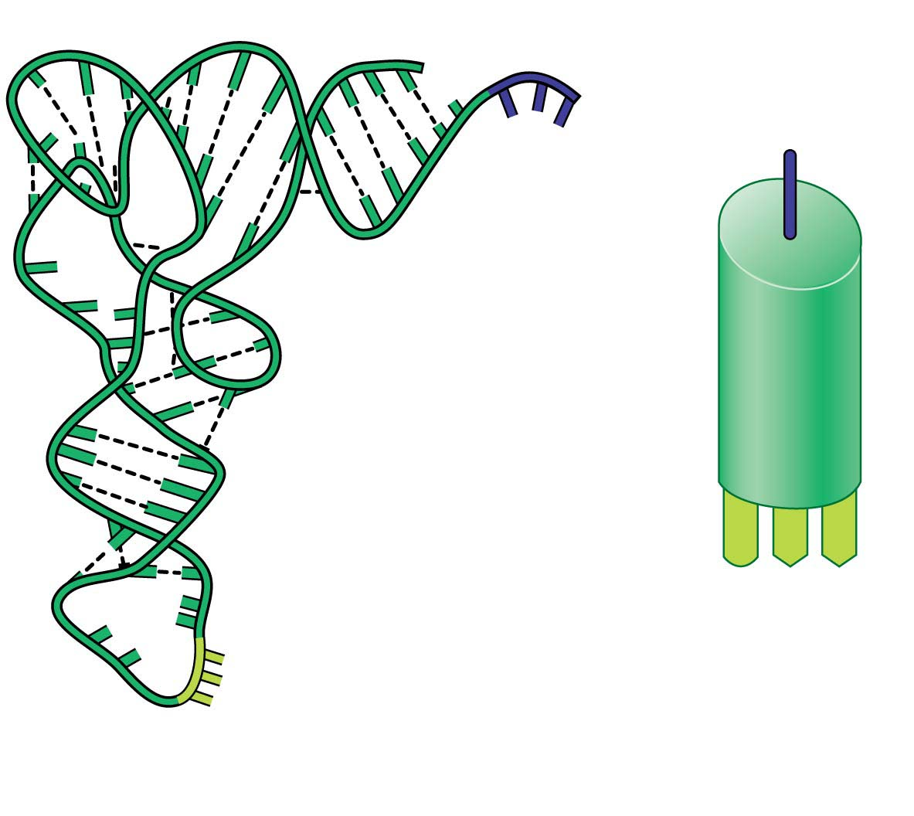
Figure 10.14
Amino acid attachment site
Hydrogen bond
RNA polynucleotide chain
Anticodon
Anticodon
tRNA
(simplified
representation)
tRNA polynucleotide
(ribbon model)
Notes:
Figure 10.14 The structure of tRNA

Slide 98
Transfer RNA (tRNA)
A cell uses a molecular interpreter, a type of RNA called transfer RNA (tRNA), to match amino acids to the appropriate codons to form the new polypeptide.
To perform this task, tRNA molecules must carry out two distinct functions:
  pick up the appropriate amino acids and
  recognize the appropriate codons in the mRNA.
  The unique structure of tRNA molecules enables them to perform both tasks.
Notes:
98
Student Misconceptions and Concerns
1. Beginning college students are often intensely focused on writing detailed notes. The risk is that they miss the overall patterns and the broader significance of the topics discussed. Consider a gradual approach to the subjects of transcription and translation, beginning quite generally and testing comprehension before venturing into the finer mechanics of each process.
2. Consider placing on the board Figure 10.8, noting the sequence, products, and locations of transcription and translation in eukaryotic cells. This reminder can create a quick concept check for students as they learn additional detail.
3. Mutations are often discussed as part of evolution mechanisms. In this sense, mutations may be considered a part of a positive creative process. The dual nature of mutations, potentially deadly yet potentially innovative, should be clarified.
Teaching Tips
1. It has been said that “Everything about an organism is an interaction between the genome and the environment.” You might wish to challenge your students to explain the significance and validity of this statement.
2. The sequential information in DNA and RNA is analogous to the sequential information in the letters of a sentence. This analogy is also helpful when explaining the impact of insertion or deletion mutations that cause a shift in the reading frame.
3. The transcription of DNA into RNA is like a reporter who transcribes a political speech. In both situations, the language remains the same, although in the case of the reporter, it changes form from spoken to written.
4. A parallel can be drawn between the discovery in 1799 of the Rosetta Stone, which provided the key that enabled scholars to crack the previously indecipherable hieroglyphic code, and the cracking of the genetic code in 1961. Consider challenging your students to explain what part of the genetic code is similar to the Rosetta Stone. This could be a short in-class activity for small groups.
5. Another advantage to the use of RNA to direct protein synthesis is that the original code (DNA) remains safe within the nucleus, away from the many potentially damaging chemicals in the cytoplasm. This is like making photocopies of important documents for study, keeping the originals safely stored away (much like how we treat the original U.S. Constitution).
6. The production of proteins is like a machine requiring fuel. The molecular machinery (ribosomes and tRNA) used in many cellular processes also requires an input of energy in the form of ATP.
7. If you were using a train analogy for the assembly of monomers into polymers, at this point the DNA and RNA “trains” are traded in 3 for 1 for the polypeptide “train.” Thus, in general, polypeptides have about 1/3 as many monomers as the mRNA that coded for them. (It might be a good challenge to have your students explain why proteins do not have exactly a third of monomers of the corresponding mRNA. Start and stop codons, for example, are not translated into amino acids.)
8. Many analogies can be developed to represent the selective expression of a gene requiring the deletion of introns. Instructors who only assign some modules of a chapter are treating the chapters like sections of exons and introns, portions to be read and portions to be skipped. Alternately, students who highlight a chapter might be thought of as editing the book into exons, portions to be reviewed, and introns, nonhighlighted sections that will not be studied. Both analogies are imperfect, but may still convey the concept of selective reading.
9. Students might think of the A and P sites as stages in an assembly line. The A site is where a new amino acid is brought in, according to the blueprint of the codon on the mRNA. The P site is where the growing product/polypeptide is anchored as it is being built. To help them better remember details of translation, students might think of the letters for the two sites to mean “A” for addition, where an amino acid is added, and “P” for polypeptide, where the growing polypeptide is located.
10. A simple way to demonstrate the effect of a reading frame shift is to have students compare the following three sentences. The first is a simple sentence. But look what happens when a letter is added (2) or deleted (3). The “reading frame,” or triplet groupings, are re-formed into nonsense.
(1) The big red pig ate the red rag.
(2) The big res dpi gat eth ere dra g.
(3) The big rep iga tet her edr ag.
11. The authors have noted elsewhere that “A random mutation is like a shot in the dark. It is not likely to improve a genome any more than shooting a bullet through the hood of a car is likely to improve engine performance!”
Active Lecture Tips
1. After translation is addressed, consider asking your students (working in small groups) to list all of the places where base pairing is used (in the construction of a DNA molecule during DNA replication, in transcription, and during translation when the tRNA attaches).
2. See the Activity Using a Food Analogy to Think About Protein Synthesis on the Instructor Exchange. Visit the Instructor Exchange in the MasteringBiology instructor resource area for a description of this activity.
3. See the Activity Students Perform a Protein Synthesis Play on the Instructor Exchange. Visit the Instructor Exchange in the MasteringBiology instructor resource area for a description of this activity.
4. See the Media Review: “Learn.Genetics” Genetic Science Learning from the University of Utah on the Instructor Exchange. Visit the Instructor Exchange in the MasteringBiology instructor resource area for a description of this activity.
5. See the Activity Demonstrating a Frame Shift Mutation on the Instructor Exchange. Visit the Instructor Exchange in the MasteringBiology instructor resource area for a description of this activity.

Slide 99
Transfer RNA (tRNA)
A tRNA molecule is made of a single strand of RNA—one polynucleotide chain—consisting of about 80 nucleotides.
  The chain twists and folds upon itself, forming several double-stranded regions in which short stretches of RNA base-pair with other stretches.
Notes:
99
Student Misconceptions and Concerns
1. Beginning college students are often intensely focused on writing detailed notes. The risk is that they miss the overall patterns and the broader significance of the topics discussed. Consider a gradual approach to the subjects of transcription and translation, beginning quite generally and testing comprehension before venturing into the finer mechanics of each process.
2. Consider placing on the board Figure 10.8, noting the sequence, products, and locations of transcription and translation in eukaryotic cells. This reminder can create a quick concept check for students as they learn additional detail.
3. Mutations are often discussed as part of evolution mechanisms. In this sense, mutations may be considered a part of a positive creative process. The dual nature of mutations, potentially deadly yet potentially innovative, should be clarified.
Teaching Tips
1. It has been said that “Everything about an organism is an interaction between the genome and the environment.” You might wish to challenge your students to explain the significance and validity of this statement.
2. The sequential information in DNA and RNA is analogous to the sequential information in the letters of a sentence. This analogy is also helpful when explaining the impact of insertion or deletion mutations that cause a shift in the reading frame.
3. The transcription of DNA into RNA is like a reporter who transcribes a political speech. In both situations, the language remains the same, although in the case of the reporter, it changes form from spoken to written.
4. A parallel can be drawn between the discovery in 1799 of the Rosetta Stone, which provided the key that enabled scholars to crack the previously indecipherable hieroglyphic code, and the cracking of the genetic code in 1961. Consider challenging your students to explain what part of the genetic code is similar to the Rosetta Stone. This could be a short in-class activity for small groups.
5. Another advantage to the use of RNA to direct protein synthesis is that the original code (DNA) remains safe within the nucleus, away from the many potentially damaging chemicals in the cytoplasm. This is like making photocopies of important documents for study, keeping the originals safely stored away (much like how we treat the original U.S. Constitution).
6. The production of proteins is like a machine requiring fuel. The molecular machinery (ribosomes and tRNA) used in many cellular processes also requires an input of energy in the form of ATP.
7. If you were using a train analogy for the assembly of monomers into polymers, at this point the DNA and RNA “trains” are traded in 3 for 1 for the polypeptide “train.” Thus, in general, polypeptides have about 1/3 as many monomers as the mRNA that coded for them. (It might be a good challenge to have your students explain why proteins do not have exactly a third of monomers of the corresponding mRNA. Start and stop codons, for example, are not translated into amino acids.)
8. Many analogies can be developed to represent the selective expression of a gene requiring the deletion of introns. Instructors who only assign some modules of a chapter are treating the chapters like sections of exons and introns, portions to be read and portions to be skipped. Alternately, students who highlight a chapter might be thought of as editing the book into exons, portions to be reviewed, and introns, nonhighlighted sections that will not be studied. Both analogies are imperfect, but may still convey the concept of selective reading.
9. Students might think of the A and P sites as stages in an assembly line. The A site is where a new amino acid is brought in, according to the blueprint of the codon on the mRNA. The P site is where the growing product/polypeptide is anchored as it is being built. To help them better remember details of translation, students might think of the letters for the two sites to mean “A” for addition, where an amino acid is added, and “P” for polypeptide, where the growing polypeptide is located.
10. A simple way to demonstrate the effect of a reading frame shift is to have students compare the following three sentences. The first is a simple sentence. But look what happens when a letter is added (2) or deleted (3). The “reading frame,” or triplet groupings, are re-formed into nonsense.
(1) The big red pig ate the red rag.
(2) The big res dpi gat eth ere dra g.
(3) The big rep iga tet her edr ag.
11. The authors have noted elsewhere that “A random mutation is like a shot in the dark. It is not likely to improve a genome any more than shooting a bullet through the hood of a car is likely to improve engine performance!”
Active Lecture Tips
1. After translation is addressed, consider asking your students (working in small groups) to list all of the places where base pairing is used (in the construction of a DNA molecule during DNA replication, in transcription, and during translation when the tRNA attaches).
2. See the Activity Using a Food Analogy to Think About Protein Synthesis on the Instructor Exchange. Visit the Instructor Exchange in the MasteringBiology instructor resource area for a description of this activity.
3. See the Activity Students Perform a Protein Synthesis Play on the Instructor Exchange. Visit the Instructor Exchange in the MasteringBiology instructor resource area for a description of this activity.
4. See the Media Review: “Learn.Genetics” Genetic Science Learning from the University of Utah on the Instructor Exchange. Visit the Instructor Exchange in the MasteringBiology instructor resource area for a description of this activity.
5. See the Activity Demonstrating a Frame Shift Mutation on the Instructor Exchange. Visit the Instructor Exchange in the MasteringBiology instructor resource area for a description of this activity.

Slide 100
Transfer RNA (tRNA)
anticodon – complements the codon in the mRNA
Amino Acid attaches at other end of the t RNA
Although all tRNA molecules are similar, there are slightly different versions of tRNA for each amino acid (the anticodon is unique)
Notes:
100
Student Misconceptions and Concerns
1. Beginning college students are often intensely focused on writing detailed notes. The risk is that they miss the overall patterns and the broader significance of the topics discussed. Consider a gradual approach to the subjects of transcription and translation, beginning quite generally and testing comprehension before venturing into the finer mechanics of each process.
2. Consider placing on the board Figure 10.8, noting the sequence, products, and locations of transcription and translation in eukaryotic cells. This reminder can create a quick concept check for students as they learn additional detail.
3. Mutations are often discussed as part of evolution mechanisms. In this sense, mutations may be considered a part of a positive creative process. The dual nature of mutations, potentially deadly yet potentially innovative, should be clarified.
Teaching Tips
1. It has been said that “Everything about an organism is an interaction between the genome and the environment.” You might wish to challenge your students to explain the significance and validity of this statement.
2. The sequential information in DNA and RNA is analogous to the sequential information in the letters of a sentence. This analogy is also helpful when explaining the impact of insertion or deletion mutations that cause a shift in the reading frame.
3. The transcription of DNA into RNA is like a reporter who transcribes a political speech. In both situations, the language remains the same, although in the case of the reporter, it changes form from spoken to written.
4. A parallel can be drawn between the discovery in 1799 of the Rosetta Stone, which provided the key that enabled scholars to crack the previously indecipherable hieroglyphic code, and the cracking of the genetic code in 1961. Consider challenging your students to explain what part of the genetic code is similar to the Rosetta Stone. This could be a short in-class activity for small groups.
5. Another advantage to the use of RNA to direct protein synthesis is that the original code (DNA) remains safe within the nucleus, away from the many potentially damaging chemicals in the cytoplasm. This is like making photocopies of important documents for study, keeping the originals safely stored away (much like how we treat the original U.S. Constitution).
6. The production of proteins is like a machine requiring fuel. The molecular machinery (ribosomes and tRNA) used in many cellular processes also requires an input of energy in the form of ATP.
7. If you were using a train analogy for the assembly of monomers into polymers, at this point the DNA and RNA “trains” are traded in 3 for 1 for the polypeptide “train.” Thus, in general, polypeptides have about 1/3 as many monomers as the mRNA that coded for them. (It might be a good challenge to have your students explain why proteins do not have exactly a third of monomers of the corresponding mRNA. Start and stop codons, for example, are not translated into amino acids.)
8. Many analogies can be developed to represent the selective expression of a gene requiring the deletion of introns. Instructors who only assign some modules of a chapter are treating the chapters like sections of exons and introns, portions to be read and portions to be skipped. Alternately, students who highlight a chapter might be thought of as editing the book into exons, portions to be reviewed, and introns, nonhighlighted sections that will not be studied. Both analogies are imperfect, but may still convey the concept of selective reading.
9. Students might think of the A and P sites as stages in an assembly line. The A site is where a new amino acid is brought in, according to the blueprint of the codon on the mRNA. The P site is where the growing product/polypeptide is anchored as it is being built. To help them better remember details of translation, students might think of the letters for the two sites to mean “A” for addition, where an amino acid is added, and “P” for polypeptide, where the growing polypeptide is located.
10. A simple way to demonstrate the effect of a reading frame shift is to have students compare the following three sentences. The first is a simple sentence. But look what happens when a letter is added (2) or deleted (3). The “reading frame,” or triplet groupings, are re-formed into nonsense.
(1) The big red pig ate the red rag.
(2) The big res dpi gat eth ere dra g.
(3) The big rep iga tet her edr ag.
11. The authors have noted elsewhere that “A random mutation is like a shot in the dark. It is not likely to improve a genome any more than shooting a bullet through the hood of a car is likely to improve engine performance!”
Active Lecture Tips
1. After translation is addressed, consider asking your students (working in small groups) to list all of the places where base pairing is used (in the construction of a DNA molecule during DNA replication, in transcription, and during translation when the tRNA attaches).
2. See the Activity Using a Food Analogy to Think About Protein Synthesis on the Instructor Exchange. Visit the Instructor Exchange in the MasteringBiology instructor resource area for a description of this activity.
3. See the Activity Students Perform a Protein Synthesis Play on the Instructor Exchange. Visit the Instructor Exchange in the MasteringBiology instructor resource area for a description of this activity.
4. See the Media Review: “Learn.Genetics” Genetic Science Learning from the University of Utah on the Instructor Exchange. Visit the Instructor Exchange in the MasteringBiology instructor resource area for a description of this activity.
5. See the Activity Demonstrating a Frame Shift Mutation on the Instructor Exchange. Visit the Instructor Exchange in the MasteringBiology instructor resource area for a description of this activity.

Slide 101
Figure 10.14
Amino acid attachment site
Amino Acid
Hydrogen bond
RNA polynucleotide chain
Anticodon
A U C
Anticodon
tRNA
(simplified
representation)
tRNA polynucleotide
(ribbon model)
Notes:
Figure 10.14 The structure of tRNA

Slide 102
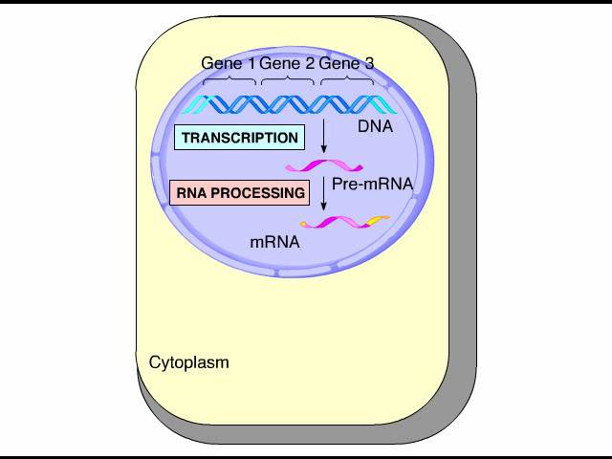
Animation: Translation

Slide 103
Ribosomes
Ribosomes are the organelles in the cytoplasm that
  coordinate the functioning of mRNA and tRNA and
  actually make polypeptides.
  enzyme-like (lower activation energy)
A ribosome consists of two subunits. Each subunit is made up of
  a considerable amount of another kind of RNA, ribosomal RNA (rRNA).
  a few proteins
Notes:
103
Student Misconceptions and Concerns
1. Beginning college students are often intensely focused on writing detailed notes. The risk is that they miss the overall patterns and the broader significance of the topics discussed. Consider a gradual approach to the subjects of transcription and translation, beginning quite generally and testing comprehension before venturing into the finer mechanics of each process.
2. Consider placing on the board Figure 10.8, noting the sequence, products, and locations of transcription and translation in eukaryotic cells. This reminder can create a quick concept check for students as they learn additional detail.
3. Mutations are often discussed as part of evolution mechanisms. In this sense, mutations may be considered a part of a positive creative process. The dual nature of mutations, potentially deadly yet potentially innovative, should be clarified.
Teaching Tips
1. It has been said that “Everything about an organism is an interaction between the genome and the environment.” You might wish to challenge your students to explain the significance and validity of this statement.
2. The sequential information in DNA and RNA is analogous to the sequential information in the letters of a sentence. This analogy is also helpful when explaining the impact of insertion or deletion mutations that cause a shift in the reading frame.
3. The transcription of DNA into RNA is like a reporter who transcribes a political speech. In both situations, the language remains the same, although in the case of the reporter, it changes form from spoken to written.
4. A parallel can be drawn between the discovery in 1799 of the Rosetta Stone, which provided the key that enabled scholars to crack the previously indecipherable hieroglyphic code, and the cracking of the genetic code in 1961. Consider challenging your students to explain what part of the genetic code is similar to the Rosetta Stone. This could be a short in-class activity for small groups.
5. Another advantage to the use of RNA to direct protein synthesis is that the original code (DNA) remains safe within the nucleus, away from the many potentially damaging chemicals in the cytoplasm. This is like making photocopies of important documents for study, keeping the originals safely stored away (much like how we treat the original U.S. Constitution).
6. The production of proteins is like a machine requiring fuel. The molecular machinery (ribosomes and tRNA) used in many cellular processes also requires an input of energy in the form of ATP.
7. If you were using a train analogy for the assembly of monomers into polymers, at this point the DNA and RNA “trains” are traded in 3 for 1 for the polypeptide “train.” Thus, in general, polypeptides have about 1/3 as many monomers as the mRNA that coded for them. (It might be a good challenge to have your students explain why proteins do not have exactly a third of monomers of the corresponding mRNA. Start and stop codons, for example, are not translated into amino acids.)
8. Many analogies can be developed to represent the selective expression of a gene requiring the deletion of introns. Instructors who only assign some modules of a chapter are treating the chapters like sections of exons and introns, portions to be read and portions to be skipped. Alternately, students who highlight a chapter might be thought of as editing the book into exons, portions to be reviewed, and introns, nonhighlighted sections that will not be studied. Both analogies are imperfect, but may still convey the concept of selective reading.
9. Students might think of the A and P sites as stages in an assembly line. The A site is where a new amino acid is brought in, according to the blueprint of the codon on the mRNA. The P site is where the growing product/polypeptide is anchored as it is being built. To help them better remember details of translation, students might think of the letters for the two sites to mean “A” for addition, where an amino acid is added, and “P” for polypeptide, where the growing polypeptide is located.
10. A simple way to demonstrate the effect of a reading frame shift is to have students compare the following three sentences. The first is a simple sentence. But look what happens when a letter is added (2) or deleted (3). The “reading frame,” or triplet groupings, are re-formed into nonsense.
(1) The big red pig ate the red rag.
(2) The big res dpi gat eth ere dra g.
(3) The big rep iga tet her edr ag.
11. The authors have noted elsewhere that “A random mutation is like a shot in the dark. It is not likely to improve a genome any more than shooting a bullet through the hood of a car is likely to improve engine performance!”
Active Lecture Tips
1. After translation is addressed, consider asking your students (working in small groups) to list all of the places where base pairing is used (in the construction of a DNA molecule during DNA replication, in transcription, and during translation when the tRNA attaches).
2. See the Activity Using a Food Analogy to Think About Protein Synthesis on the Instructor Exchange. Visit the Instructor Exchange in the MasteringBiology instructor resource area for a description of this activity.
3. See the Activity Students Perform a Protein Synthesis Play on the Instructor Exchange. Visit the Instructor Exchange in the MasteringBiology instructor resource area for a description of this activity.
4. See the Media Review: “Learn.Genetics” Genetic Science Learning from the University of Utah on the Instructor Exchange. Visit the Instructor Exchange in the MasteringBiology instructor resource area for a description of this activity.
5. See the Activity Demonstrating a Frame Shift Mutation on the Instructor Exchange. Visit the Instructor Exchange in the MasteringBiology instructor resource area for a description of this activity.

Slide 104
Ribosomes
A fully assembled ribosome has
  a binding site for mRNA on its small subunit and
  binding sites for tRNA on its large subunit.
Notes:
104
Student Misconceptions and Concerns
1. Beginning college students are often intensely focused on writing detailed notes. The risk is that they miss the overall patterns and the broader significance of the topics discussed. Consider a gradual approach to the subjects of transcription and translation, beginning quite generally and testing comprehension before venturing into the finer mechanics of each process.
2. Consider placing on the board Figure 10.8, noting the sequence, products, and locations of transcription and translation in eukaryotic cells. This reminder can create a quick concept check for students as they learn additional detail.
3. Mutations are often discussed as part of evolution mechanisms. In this sense, mutations may be considered a part of a positive creative process. The dual nature of mutations, potentially deadly yet potentially innovative, should be clarified.
Teaching Tips
1. It has been said that “Everything about an organism is an interaction between the genome and the environment.” You might wish to challenge your students to explain the significance and validity of this statement.
2. The sequential information in DNA and RNA is analogous to the sequential information in the letters of a sentence. This analogy is also helpful when explaining the impact of insertion or deletion mutations that cause a shift in the reading frame.
3. The transcription of DNA into RNA is like a reporter who transcribes a political speech. In both situations, the language remains the same, although in the case of the reporter, it changes form from spoken to written.
4. A parallel can be drawn between the discovery in 1799 of the Rosetta Stone, which provided the key that enabled scholars to crack the previously indecipherable hieroglyphic code, and the cracking of the genetic code in 1961. Consider challenging your students to explain what part of the genetic code is similar to the Rosetta Stone. This could be a short in-class activity for small groups.
5. Another advantage to the use of RNA to direct protein synthesis is that the original code (DNA) remains safe within the nucleus, away from the many potentially damaging chemicals in the cytoplasm. This is like making photocopies of important documents for study, keeping the originals safely stored away (much like how we treat the original U.S. Constitution).
6. The production of proteins is like a machine requiring fuel. The molecular machinery (ribosomes and tRNA) used in many cellular processes also requires an input of energy in the form of ATP.
7. If you were using a train analogy for the assembly of monomers into polymers, at this point the DNA and RNA “trains” are traded in 3 for 1 for the polypeptide “train.” Thus, in general, polypeptides have about 1/3 as many monomers as the mRNA that coded for them. (It might be a good challenge to have your students explain why proteins do not have exactly a third of monomers of the corresponding mRNA. Start and stop codons, for example, are not translated into amino acids.)
8. Many analogies can be developed to represent the selective expression of a gene requiring the deletion of introns. Instructors who only assign some modules of a chapter are treating the chapters like sections of exons and introns, portions to be read and portions to be skipped. Alternately, students who highlight a chapter might be thought of as editing the book into exons, portions to be reviewed, and introns, nonhighlighted sections that will not be studied. Both analogies are imperfect, but may still convey the concept of selective reading.
9. Students might think of the A and P sites as stages in an assembly line. The A site is where a new amino acid is brought in, according to the blueprint of the codon on the mRNA. The P site is where the growing product/polypeptide is anchored as it is being built. To help them better remember details of translation, students might think of the letters for the two sites to mean “A” for addition, where an amino acid is added, and “P” for polypeptide, where the growing polypeptide is located.
10. A simple way to demonstrate the effect of a reading frame shift is to have students compare the following three sentences. The first is a simple sentence. But look what happens when a letter is added (2) or deleted (3). The “reading frame,” or triplet groupings, are re-formed into nonsense.
(1) The big red pig ate the red rag.
(2) The big res dpi gat eth ere dra g.
(3) The big rep iga tet her edr ag.
11. The authors have noted elsewhere that “A random mutation is like a shot in the dark. It is not likely to improve a genome any more than shooting a bullet through the hood of a car is likely to improve engine performance!”
Active Lecture Tips
1. After translation is addressed, consider asking your students (working in small groups) to list all of the places where base pairing is used (in the construction of a DNA molecule during DNA replication, in transcription, and during translation when the tRNA attaches).
2. See the Activity Using a Food Analogy to Think About Protein Synthesis on the Instructor Exchange. Visit the Instructor Exchange in the MasteringBiology instructor resource area for a description of this activity.
3. See the Activity Students Perform a Protein Synthesis Play on the Instructor Exchange. Visit the Instructor Exchange in the MasteringBiology instructor resource area for a description of this activity.
4. See the Media Review: “Learn.Genetics” Genetic Science Learning from the University of Utah on the Instructor Exchange. Visit the Instructor Exchange in the MasteringBiology instructor resource area for a description of this activity.
5. See the Activity Demonstrating a Frame Shift Mutation on the Instructor Exchange. Visit the Instructor Exchange in the MasteringBiology instructor resource area for a description of this activity.

Slide 105

Figure 10.15
Next amino acid
to be added to
polypeptide
tRNA
binding sites
Growing
polypeptide
P site
A site
tRNA
Large
subunit
mRNA
binding
site
mRNA
Ribosome
Small
subunit
Codons
(a) A simplified diagram of a ribosome
(b) The “players” of translation
Notes:
Figure 10.15 The ribosome

Slide 106

Figure 10.15-1
tRNA
binding sites
P site
A site
Large
subunit
mRNA
binding
site
Ribosome
Small
subunit
(a) A simplified diagram of a ribosome
Notes:
Figure 10.15-1 The ribosome (part 1: ribosome diagram)

Slide 107
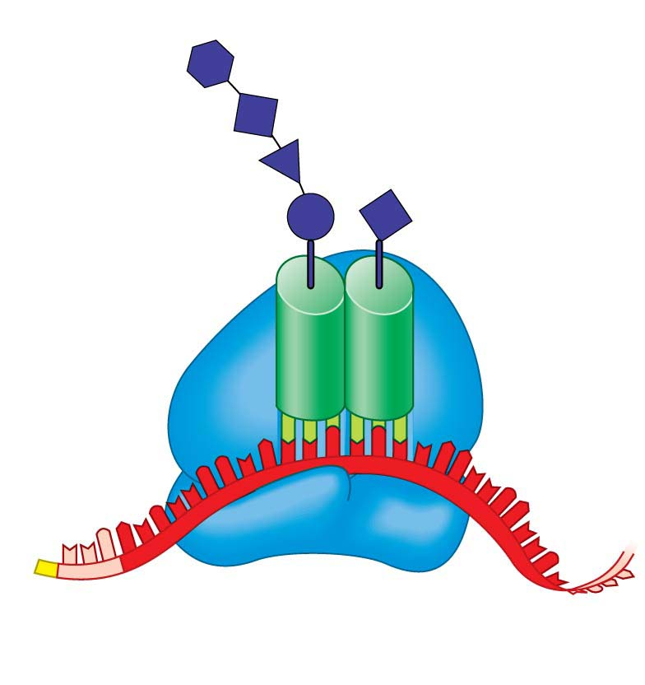
Figure 10.15-2
Next amino acid
to be added to
polypeptide
Growing
polypeptide
tRNA
mRNA
Codons
(b) The “players” of translation
Notes:
Figure 10.15-2 The ribosome (part 2: “players” of translation)

Slide 108
Translation: The Process
Translation is divided into the same three phases as transcription:
  initiation,
  elongation, and
  termination.
Notes:
108
Student Misconceptions and Concerns
1. Beginning college students are often intensely focused on writing detailed notes. The risk is that they miss the overall patterns and the broader significance of the topics discussed. Consider a gradual approach to the subjects of transcription and translation, beginning quite generally and testing comprehension before venturing into the finer mechanics of each process.
2. Consider placing on the board Figure 10.8, noting the sequence, products, and locations of transcription and translation in eukaryotic cells. This reminder can create a quick concept check for students as they learn additional detail.
3. Mutations are often discussed as part of evolution mechanisms. In this sense, mutations may be considered a part of a positive creative process. The dual nature of mutations, potentially deadly yet potentially innovative, should be clarified.
Teaching Tips
1. It has been said that “Everything about an organism is an interaction between the genome and the environment.” You might wish to challenge your students to explain the significance and validity of this statement.
2. The sequential information in DNA and RNA is analogous to the sequential information in the letters of a sentence. This analogy is also helpful when explaining the impact of insertion or deletion mutations that cause a shift in the reading frame.
3. The transcription of DNA into RNA is like a reporter who transcribes a political speech. In both situations, the language remains the same, although in the case of the reporter, it changes form from spoken to written.
4. A parallel can be drawn between the discovery in 1799 of the Rosetta Stone, which provided the key that enabled scholars to crack the previously indecipherable hieroglyphic code, and the cracking of the genetic code in 1961. Consider challenging your students to explain what part of the genetic code is similar to the Rosetta Stone. This could be a short in-class activity for small groups.
5. Another advantage to the use of RNA to direct protein synthesis is that the original code (DNA) remains safe within the nucleus, away from the many potentially damaging chemicals in the cytoplasm. This is like making photocopies of important documents for study, keeping the originals safely stored away (much like how we treat the original U.S. Constitution).
6. The production of proteins is like a machine requiring fuel. The molecular machinery (ribosomes and tRNA) used in many cellular processes also requires an input of energy in the form of ATP.
7. If you were using a train analogy for the assembly of monomers into polymers, at this point the DNA and RNA “trains” are traded in 3 for 1 for the polypeptide “train.” Thus, in general, polypeptides have about 1/3 as many monomers as the mRNA that coded for them. (It might be a good challenge to have your students explain why proteins do not have exactly a third of monomers of the corresponding mRNA. Start and stop codons, for example, are not translated into amino acids.)
8. Many analogies can be developed to represent the selective expression of a gene requiring the deletion of introns. Instructors who only assign some modules of a chapter are treating the chapters like sections of exons and introns, portions to be read and portions to be skipped. Alternately, students who highlight a chapter might be thought of as editing the book into exons, portions to be reviewed, and introns, nonhighlighted sections that will not be studied. Both analogies are imperfect, but may still convey the concept of selective reading.
9. Students might think of the A and P sites as stages in an assembly line. The A site is where a new amino acid is brought in, according to the blueprint of the codon on the mRNA. The P site is where the growing product/polypeptide is anchored as it is being built. To help them better remember details of translation, students might think of the letters for the two sites to mean “A” for addition, where an amino acid is added, and “P” for polypeptide, where the growing polypeptide is located.
10. A simple way to demonstrate the effect of a reading frame shift is to have students compare the following three sentences. The first is a simple sentence. But look what happens when a letter is added (2) or deleted (3). The “reading frame,” or triplet groupings, are re-formed into nonsense.
(1) The big red pig ate the red rag.
(2) The big res dpi gat eth ere dra g.
(3) The big rep iga tet her edr ag.
11. The authors have noted elsewhere that “A random mutation is like a shot in the dark. It is not likely to improve a genome any more than shooting a bullet through the hood of a car is likely to improve engine performance!”
Active Lecture Tips
1. After translation is addressed, consider asking your students (working in small groups) to list all of the places where base pairing is used (in the construction of a DNA molecule during DNA replication, in transcription, and during translation when the tRNA attaches).
2. See the Activity Using a Food Analogy to Think About Protein Synthesis on the Instructor Exchange. Visit the Instructor Exchange in the MasteringBiology instructor resource area for a description of this activity.
3. See the Activity Students Perform a Protein Synthesis Play on the Instructor Exchange. Visit the Instructor Exchange in the MasteringBiology instructor resource area for a description of this activity.
4. See the Media Review: “Learn.Genetics” Genetic Science Learning from the University of Utah on the Instructor Exchange. Visit the Instructor Exchange in the MasteringBiology instructor resource area for a description of this activity.
5. See the Activity Demonstrating a Frame Shift Mutation on the Instructor Exchange. Visit the Instructor Exchange in the MasteringBiology instructor resource area for a description of this activity.

Slide 109
Initiation
Initiation brings together
  mRNA,
  the first amino acid with its attached tRNA, and
  two subunits of the ribosome.
The mRNA molecule has a cap and tail that help the mRNA bind to the ribosome.
Notes:
109
Student Misconceptions and Concerns
1. Beginning college students are often intensely focused on writing detailed notes. The risk is that they miss the overall patterns and the broader significance of the topics discussed. Consider a gradual approach to the subjects of transcription and translation, beginning quite generally and testing comprehension before venturing into the finer mechanics of each process.
2. Consider placing on the board Figure 10.8, noting the sequence, products, and locations of transcription and translation in eukaryotic cells. This reminder can create a quick concept check for students as they learn additional detail.
3. Mutations are often discussed as part of evolution mechanisms. In this sense, mutations may be considered a part of a positive creative process. The dual nature of mutations, potentially deadly yet potentially innovative, should be clarified.
Teaching Tips
1. It has been said that “Everything about an organism is an interaction between the genome and the environment.” You might wish to challenge your students to explain the significance and validity of this statement.
2. The sequential information in DNA and RNA is analogous to the sequential information in the letters of a sentence. This analogy is also helpful when explaining the impact of insertion or deletion mutations that cause a shift in the reading frame.
3. The transcription of DNA into RNA is like a reporter who transcribes a political speech. In both situations, the language remains the same, although in the case of the reporter, it changes form from spoken to written.
4. A parallel can be drawn between the discovery in 1799 of the Rosetta Stone, which provided the key that enabled scholars to crack the previously indecipherable hieroglyphic code, and the cracking of the genetic code in 1961. Consider challenging your students to explain what part of the genetic code is similar to the Rosetta Stone. This could be a short in-class activity for small groups.
5. Another advantage to the use of RNA to direct protein synthesis is that the original code (DNA) remains safe within the nucleus, away from the many potentially damaging chemicals in the cytoplasm. This is like making photocopies of important documents for study, keeping the originals safely stored away (much like how we treat the original U.S. Constitution).
6. The production of proteins is like a machine requiring fuel. The molecular machinery (ribosomes and tRNA) used in many cellular processes also requires an input of energy in the form of ATP.
7. If you were using a train analogy for the assembly of monomers into polymers, at this point the DNA and RNA “trains” are traded in 3 for 1 for the polypeptide “train.” Thus, in general, polypeptides have about 1/3 as many monomers as the mRNA that coded for them. (It might be a good challenge to have your students explain why proteins do not have exactly a third of monomers of the corresponding mRNA. Start and stop codons, for example, are not translated into amino acids.)
8. Many analogies can be developed to represent the selective expression of a gene requiring the deletion of introns. Instructors who only assign some modules of a chapter are treating the chapters like sections of exons and introns, portions to be read and portions to be skipped. Alternately, students who highlight a chapter might be thought of as editing the book into exons, portions to be reviewed, and introns, nonhighlighted sections that will not be studied. Both analogies are imperfect, but may still convey the concept of selective reading.
9. Students might think of the A and P sites as stages in an assembly line. The A site is where a new amino acid is brought in, according to the blueprint of the codon on the mRNA. The P site is where the growing product/polypeptide is anchored as it is being built. To help them better remember details of translation, students might think of the letters for the two sites to mean “A” for addition, where an amino acid is added, and “P” for polypeptide, where the growing polypeptide is located.
10. A simple way to demonstrate the effect of a reading frame shift is to have students compare the following three sentences. The first is a simple sentence. But look what happens when a letter is added (2) or deleted (3). The “reading frame,” or triplet groupings, are re-formed into nonsense.
(1) The big red pig ate the red rag.
(2) The big res dpi gat eth ere dra g.
(3) The big rep iga tet her edr ag.
11. The authors have noted elsewhere that “A random mutation is like a shot in the dark. It is not likely to improve a genome any more than shooting a bullet through the hood of a car is likely to improve engine performance!”
Active Lecture Tips
1. After translation is addressed, consider asking your students (working in small groups) to list all of the places where base pairing is used (in the construction of a DNA molecule during DNA replication, in transcription, and during translation when the tRNA attaches).
2. See the Activity Using a Food Analogy to Think About Protein Synthesis on the Instructor Exchange. Visit the Instructor Exchange in the MasteringBiology instructor resource area for a description of this activity.
3. See the Activity Students Perform a Protein Synthesis Play on the Instructor Exchange. Visit the Instructor Exchange in the MasteringBiology instructor resource area for a description of this activity.
4. See the Media Review: “Learn.Genetics” Genetic Science Learning from the University of Utah on the Instructor Exchange. Visit the Instructor Exchange in the MasteringBiology instructor resource area for a description of this activity.
5. See the Activity Demonstrating a Frame Shift Mutation on the Instructor Exchange. Visit the Instructor Exchange in the MasteringBiology instructor resource area for a description of this activity.

Slide 110
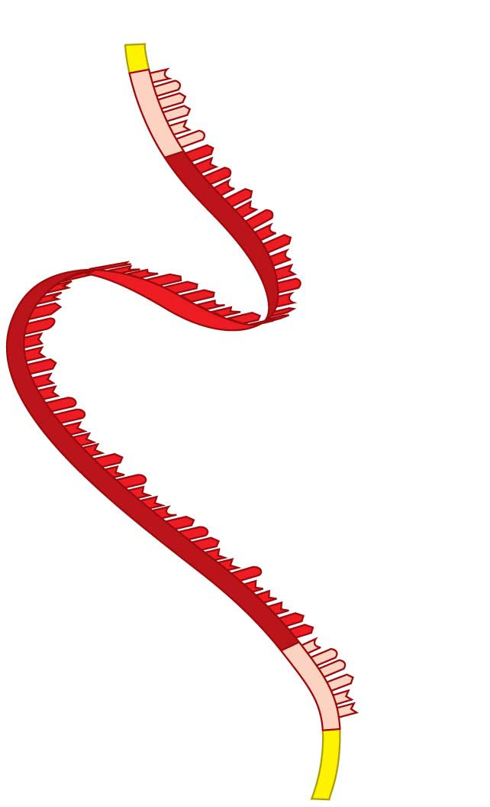
Figure 10.16
Cap
Start of genetic
message
End
Tail
Notes:
Figure 10.16 A molecule of mRNA

Slide 111
Initiation
Initiation occurs in two steps.
  An mRNA molecule binds to a small ribosomal subunit, then a special initiator tRNA binds to the start codon, where translation is to begin on the mRNA.
  A large ribosomal subunit binds to the small one, creating a functional ribosome.
Notes:
111
Student Misconceptions and Concerns
1. Beginning college students are often intensely focused on writing detailed notes. The risk is that they miss the overall patterns and the broader significance of the topics discussed. Consider a gradual approach to the subjects of transcription and translation, beginning quite generally and testing comprehension before venturing into the finer mechanics of each process.
2. Consider placing on the board Figure 10.8, noting the sequence, products, and locations of transcription and translation in eukaryotic cells. This reminder can create a quick concept check for students as they learn additional detail.
3. Mutations are often discussed as part of evolution mechanisms. In this sense, mutations may be considered a part of a positive creative process. The dual nature of mutations, potentially deadly yet potentially innovative, should be clarified.
Teaching Tips
1. It has been said that “Everything about an organism is an interaction between the genome and the environment.” You might wish to challenge your students to explain the significance and validity of this statement.
2. The sequential information in DNA and RNA is analogous to the sequential information in the letters of a sentence. This analogy is also helpful when explaining the impact of insertion or deletion mutations that cause a shift in the reading frame.
3. The transcription of DNA into RNA is like a reporter who transcribes a political speech. In both situations, the language remains the same, although in the case of the reporter, it changes form from spoken to written.
4. A parallel can be drawn between the discovery in 1799 of the Rosetta Stone, which provided the key that enabled scholars to crack the previously indecipherable hieroglyphic code, and the cracking of the genetic code in 1961. Consider challenging your students to explain what part of the genetic code is similar to the Rosetta Stone. This could be a short in-class activity for small groups.
5. Another advantage to the use of RNA to direct protein synthesis is that the original code (DNA) remains safe within the nucleus, away from the many potentially damaging chemicals in the cytoplasm. This is like making photocopies of important documents for study, keeping the originals safely stored away (much like how we treat the original U.S. Constitution).
6. The production of proteins is like a machine requiring fuel. The molecular machinery (ribosomes and tRNA) used in many cellular processes also requires an input of energy in the form of ATP.
7. If you were using a train analogy for the assembly of monomers into polymers, at this point the DNA and RNA “trains” are traded in 3 for 1 for the polypeptide “train.” Thus, in general, polypeptides have about 1/3 as many monomers as the mRNA that coded for them. (It might be a good challenge to have your students explain why proteins do not have exactly a third of monomers of the corresponding mRNA. Start and stop codons, for example, are not translated into amino acids.)
8. Many analogies can be developed to represent the selective expression of a gene requiring the deletion of introns. Instructors who only assign some modules of a chapter are treating the chapters like sections of exons and introns, portions to be read and portions to be skipped. Alternately, students who highlight a chapter might be thought of as editing the book into exons, portions to be reviewed, and introns, nonhighlighted sections that will not be studied. Both analogies are imperfect, but may still convey the concept of selective reading.
9. Students might think of the A and P sites as stages in an assembly line. The A site is where a new amino acid is brought in, according to the blueprint of the codon on the mRNA. The P site is where the growing product/polypeptide is anchored as it is being built. To help them better remember details of translation, students might think of the letters for the two sites to mean “A” for addition, where an amino acid is added, and “P” for polypeptide, where the growing polypeptide is located.
10. A simple way to demonstrate the effect of a reading frame shift is to have students compare the following three sentences. The first is a simple sentence. But look what happens when a letter is added (2) or deleted (3). The “reading frame,” or triplet groupings, are re-formed into nonsense.
(1) The big red pig ate the red rag.
(2) The big res dpi gat eth ere dra g.
(3) The big rep iga tet her edr ag.
11. The authors have noted elsewhere that “A random mutation is like a shot in the dark. It is not likely to improve a genome any more than shooting a bullet through the hood of a car is likely to improve engine performance!”
Active Lecture Tips
1. After translation is addressed, consider asking your students (working in small groups) to list all of the places where base pairing is used (in the construction of a DNA molecule during DNA replication, in transcription, and during translation when the tRNA attaches).
2. See the Activity Using a Food Analogy to Think About Protein Synthesis on the Instructor Exchange. Visit the Instructor Exchange in the MasteringBiology instructor resource area for a description of this activity.
3. See the Activity Students Perform a Protein Synthesis Play on the Instructor Exchange. Visit the Instructor Exchange in the MasteringBiology instructor resource area for a description of this activity.
4. See the Media Review: “Learn.Genetics” Genetic Science Learning from the University of Utah on the Instructor Exchange. Visit the Instructor Exchange in the MasteringBiology instructor resource area for a description of this activity.
5. See the Activity Demonstrating a Frame Shift Mutation on the Instructor Exchange. Visit the Instructor Exchange in the MasteringBiology instructor resource area for a description of this activity.

Slide 112
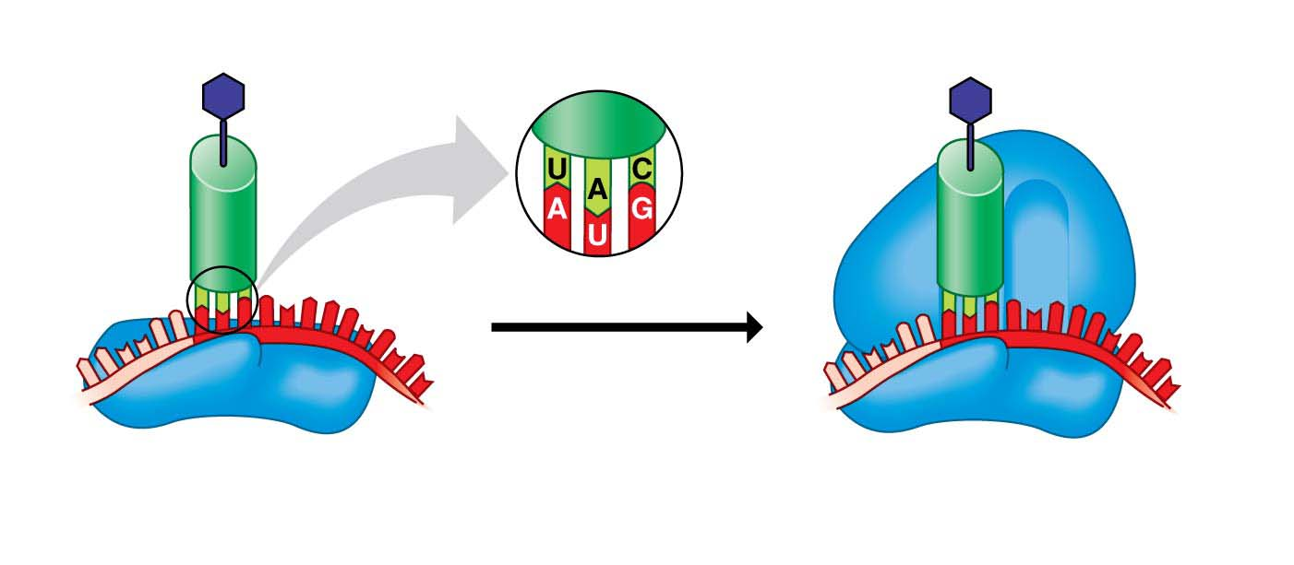
Figure 10.17
Met
Large
ribosomal
subunit
Initiator
tRNA
P site
A site
mRNA
1
2
Start codon
Small
ribosomal
subunit
Notes:
Figure 10.17 The initiation of translation

Slide 113
Elongation
Once initiation is complete, amino acids are added one by one to the first amino acid. Each addition occurs in the three-step elongation process.
  Step 1: Codon recognition. The anticodon of an incoming tRNA molecule, carrying its amino acid, pairs with the mRNA codon in the A site of the ribosome.
Notes:
113
Student Misconceptions and Concerns
1. Beginning college students are often intensely focused on writing detailed notes. The risk is that they miss the overall patterns and the broader significance of the topics discussed. Consider a gradual approach to the subjects of transcription and translation, beginning quite generally and testing comprehension before venturing into the finer mechanics of each process.
2. Consider placing on the board Figure 10.8, noting the sequence, products, and locations of transcription and translation in eukaryotic cells. This reminder can create a quick concept check for students as they learn additional detail.
3. Mutations are often discussed as part of evolution mechanisms. In this sense, mutations may be considered a part of a positive creative process. The dual nature of mutations, potentially deadly yet potentially innovative, should be clarified.
Teaching Tips
1. It has been said that “Everything about an organism is an interaction between the genome and the environment.” You might wish to challenge your students to explain the significance and validity of this statement.
2. The sequential information in DNA and RNA is analogous to the sequential information in the letters of a sentence. This analogy is also helpful when explaining the impact of insertion or deletion mutations that cause a shift in the reading frame.
3. The transcription of DNA into RNA is like a reporter who transcribes a political speech. In both situations, the language remains the same, although in the case of the reporter, it changes form from spoken to written.
4. A parallel can be drawn between the discovery in 1799 of the Rosetta Stone, which provided the key that enabled scholars to crack the previously indecipherable hieroglyphic code, and the cracking of the genetic code in 1961. Consider challenging your students to explain what part of the genetic code is similar to the Rosetta Stone. This could be a short in-class activity for small groups.
5. Another advantage to the use of RNA to direct protein synthesis is that the original code (DNA) remains safe within the nucleus, away from the many potentially damaging chemicals in the cytoplasm. This is like making photocopies of important documents for study, keeping the originals safely stored away (much like how we treat the original U.S. Constitution).
6. The production of proteins is like a machine requiring fuel. The molecular machinery (ribosomes and tRNA) used in many cellular processes also requires an input of energy in the form of ATP.
7. If you were using a train analogy for the assembly of monomers into polymers, at this point the DNA and RNA “trains” are traded in 3 for 1 for the polypeptide “train.” Thus, in general, polypeptides have about 1/3 as many monomers as the mRNA that coded for them. (It might be a good challenge to have your students explain why proteins do not have exactly a third of monomers of the corresponding mRNA. Start and stop codons, for example, are not translated into amino acids.)
8. Many analogies can be developed to represent the selective expression of a gene requiring the deletion of introns. Instructors who only assign some modules of a chapter are treating the chapters like sections of exons and introns, portions to be read and portions to be skipped. Alternately, students who highlight a chapter might be thought of as editing the book into exons, portions to be reviewed, and introns, nonhighlighted sections that will not be studied. Both analogies are imperfect, but may still convey the concept of selective reading.
9. Students might think of the A and P sites as stages in an assembly line. The A site is where a new amino acid is brought in, according to the blueprint of the codon on the mRNA. The P site is where the growing product/polypeptide is anchored as it is being built. To help them better remember details of translation, students might think of the letters for the two sites to mean “A” for addition, where an amino acid is added, and “P” for polypeptide, where the growing polypeptide is located.
10. A simple way to demonstrate the effect of a reading frame shift is to have students compare the following three sentences. The first is a simple sentence. But look what happens when a letter is added (2) or deleted (3). The “reading frame,” or triplet groupings, are re-formed into nonsense.
(1) The big red pig ate the red rag.
(2) The big res dpi gat eth ere dra g.
(3) The big rep iga tet her edr ag.
11. The authors have noted elsewhere that “A random mutation is like a shot in the dark. It is not likely to improve a genome any more than shooting a bullet through the hood of a car is likely to improve engine performance!”
Active Lecture Tips
1. After translation is addressed, consider asking your students (working in small groups) to list all of the places where base pairing is used (in the construction of a DNA molecule during DNA replication, in transcription, and during translation when the tRNA attaches).
2. See the Activity Using a Food Analogy to Think About Protein Synthesis on the Instructor Exchange. Visit the Instructor Exchange in the MasteringBiology instructor resource area for a description of this activity.
3. See the Activity Students Perform a Protein Synthesis Play on the Instructor Exchange. Visit the Instructor Exchange in the MasteringBiology instructor resource area for a description of this activity.
4. See the Media Review: “Learn.Genetics” Genetic Science Learning from the University of Utah on the Instructor Exchange. Visit the Instructor Exchange in the MasteringBiology instructor resource area for a description of this activity.
5. See the Activity Demonstrating a Frame Shift Mutation on the Instructor Exchange. Visit the Instructor Exchange in the MasteringBiology instructor resource area for a description of this activity.

Slide 114

Figure 10.18
Amino acid
Polypeptide
tRNA
P site
mRNA
Anticodon
A
site
Codons
1
Codon recognition
ELONGATION
New peptide
bond
mRNA
movement
2
Peptide bond formation
3
Translocation
Notes:
Figure 10.18 The elongation of a polypeptide

Slide 115
Elongation
Step 2: Peptide bond formation.
  The polypeptide leaves the tRNA in the P site and attaches to the amino acid on the tRNA in the A site.
  The ribosome creates a new peptide bond.
  Now the chain has one more amino acid.
Notes:
115
Student Misconceptions and Concerns
1. Beginning college students are often intensely focused on writing detailed notes. The risk is that they miss the overall patterns and the broader significance of the topics discussed. Consider a gradual approach to the subjects of transcription and translation, beginning quite generally and testing comprehension before venturing into the finer mechanics of each process.
2. Consider placing on the board Figure 10.8, noting the sequence, products, and locations of transcription and translation in eukaryotic cells. This reminder can create a quick concept check for students as they learn additional detail.
3. Mutations are often discussed as part of evolution mechanisms. In this sense, mutations may be considered a part of a positive creative process. The dual nature of mutations, potentially deadly yet potentially innovative, should be clarified.
Teaching Tips
1. It has been said that “Everything about an organism is an interaction between the genome and the environment.” You might wish to challenge your students to explain the significance and validity of this statement.
2. The sequential information in DNA and RNA is analogous to the sequential information in the letters of a sentence. This analogy is also helpful when explaining the impact of insertion or deletion mutations that cause a shift in the reading frame.
3. The transcription of DNA into RNA is like a reporter who transcribes a political speech. In both situations, the language remains the same, although in the case of the reporter, it changes form from spoken to written.
4. A parallel can be drawn between the discovery in 1799 of the Rosetta Stone, which provided the key that enabled scholars to crack the previously indecipherable hieroglyphic code, and the cracking of the genetic code in 1961. Consider challenging your students to explain what part of the genetic code is similar to the Rosetta Stone. This could be a short in-class activity for small groups.
5. Another advantage to the use of RNA to direct protein synthesis is that the original code (DNA) remains safe within the nucleus, away from the many potentially damaging chemicals in the cytoplasm. This is like making photocopies of important documents for study, keeping the originals safely stored away (much like how we treat the original U.S. Constitution).
6. The production of proteins is like a machine requiring fuel. The molecular machinery (ribosomes and tRNA) used in many cellular processes also requires an input of energy in the form of ATP.
7. If you were using a train analogy for the assembly of monomers into polymers, at this point the DNA and RNA “trains” are traded in 3 for 1 for the polypeptide “train.” Thus, in general, polypeptides have about 1/3 as many monomers as the mRNA that coded for them. (It might be a good challenge to have your students explain why proteins do not have exactly a third of monomers of the corresponding mRNA. Start and stop codons, for example, are not translated into amino acids.)
8. Many analogies can be developed to represent the selective expression of a gene requiring the deletion of introns. Instructors who only assign some modules of a chapter are treating the chapters like sections of exons and introns, portions to be read and portions to be skipped. Alternately, students who highlight a chapter might be thought of as editing the book into exons, portions to be reviewed, and introns, nonhighlighted sections that will not be studied. Both analogies are imperfect, but may still convey the concept of selective reading.
9. Students might think of the A and P sites as stages in an assembly line. The A site is where a new amino acid is brought in, according to the blueprint of the codon on the mRNA. The P site is where the growing product/polypeptide is anchored as it is being built. To help them better remember details of translation, students might think of the letters for the two sites to mean “A” for addition, where an amino acid is added, and “P” for polypeptide, where the growing polypeptide is located.
10. A simple way to demonstrate the effect of a reading frame shift is to have students compare the following three sentences. The first is a simple sentence. But look what happens when a letter is added (2) or deleted (3). The “reading frame,” or triplet groupings, are re-formed into nonsense.
(1) The big red pig ate the red rag.
(2) The big res dpi gat eth ere dra g.
(3) The big rep iga tet her edr ag.
11. The authors have noted elsewhere that “A random mutation is like a shot in the dark. It is not likely to improve a genome any more than shooting a bullet through the hood of a car is likely to improve engine performance!”
Active Lecture Tips
1. After translation is addressed, consider asking your students (working in small groups) to list all of the places where base pairing is used (in the construction of a DNA molecule during DNA replication, in transcription, and during translation when the tRNA attaches).
2. See the Activity Using a Food Analogy to Think About Protein Synthesis on the Instructor Exchange. Visit the Instructor Exchange in the MasteringBiology instructor resource area for a description of this activity.
3. See the Activity Students Perform a Protein Synthesis Play on the Instructor Exchange. Visit the Instructor Exchange in the MasteringBiology instructor resource area for a description of this activity.
4. See the Media Review: “Learn.Genetics” Genetic Science Learning from the University of Utah on the Instructor Exchange. Visit the Instructor Exchange in the MasteringBiology instructor resource area for a description of this activity.
5. See the Activity Demonstrating a Frame Shift Mutation on the Instructor Exchange. Visit the Instructor Exchange in the MasteringBiology instructor resource area for a description of this activity.

Slide 116
Elongation
Step 3: Translocation.
  The P site tRNA now leaves the ribosome, and the ribosome moves the remaining tRNA, carrying the growing polypeptide, to the P site.
  The mRNA and tRNA move as a unit.
  This movement brings into the A site the next mRNA codon to be translated, and the process can start again with step 1.
Notes:
116
Student Misconceptions and Concerns
1. Beginning college students are often intensely focused on writing detailed notes. The risk is that they miss the overall patterns and the broader significance of the topics discussed. Consider a gradual approach to the subjects of transcription and translation, beginning quite generally and testing comprehension before venturing into the finer mechanics of each process.
2. Consider placing on the board Figure 10.8, noting the sequence, products, and locations of transcription and translation in eukaryotic cells. This reminder can create a quick concept check for students as they learn additional detail.
3. Mutations are often discussed as part of evolution mechanisms. In this sense, mutations may be considered a part of a positive creative process. The dual nature of mutations, potentially deadly yet potentially innovative, should be clarified.
Teaching Tips
1. It has been said that “Everything about an organism is an interaction between the genome and the environment.” You might wish to challenge your students to explain the significance and validity of this statement.
2. The sequential information in DNA and RNA is analogous to the sequential information in the letters of a sentence. This analogy is also helpful when explaining the impact of insertion or deletion mutations that cause a shift in the reading frame.
3. The transcription of DNA into RNA is like a reporter who transcribes a political speech. In both situations, the language remains the same, although in the case of the reporter, it changes form from spoken to written.
4. A parallel can be drawn between the discovery in 1799 of the Rosetta Stone, which provided the key that enabled scholars to crack the previously indecipherable hieroglyphic code, and the cracking of the genetic code in 1961. Consider challenging your students to explain what part of the genetic code is similar to the Rosetta Stone. This could be a short in-class activity for small groups.
5. Another advantage to the use of RNA to direct protein synthesis is that the original code (DNA) remains safe within the nucleus, away from the many potentially damaging chemicals in the cytoplasm. This is like making photocopies of important documents for study, keeping the originals safely stored away (much like how we treat the original U.S. Constitution).
6. The production of proteins is like a machine requiring fuel. The molecular machinery (ribosomes and tRNA) used in many cellular processes also requires an input of energy in the form of ATP.
7. If you were using a train analogy for the assembly of monomers into polymers, at this point the DNA and RNA “trains” are traded in 3 for 1 for the polypeptide “train.” Thus, in general, polypeptides have about 1/3 as many monomers as the mRNA that coded for them. (It might be a good challenge to have your students explain why proteins do not have exactly a third of monomers of the corresponding mRNA. Start and stop codons, for example, are not translated into amino acids.)
8. Many analogies can be developed to represent the selective expression of a gene requiring the deletion of introns. Instructors who only assign some modules of a chapter are treating the chapters like sections of exons and introns, portions to be read and portions to be skipped. Alternately, students who highlight a chapter might be thought of as editing the book into exons, portions to be reviewed, and introns, nonhighlighted sections that will not be studied. Both analogies are imperfect, but may still convey the concept of selective reading.
9. Students might think of the A and P sites as stages in an assembly line. The A site is where a new amino acid is brought in, according to the blueprint of the codon on the mRNA. The P site is where the growing product/polypeptide is anchored as it is being built. To help them better remember details of translation, students might think of the letters for the two sites to mean “A” for addition, where an amino acid is added, and “P” for polypeptide, where the growing polypeptide is located.
10. A simple way to demonstrate the effect of a reading frame shift is to have students compare the following three sentences. The first is a simple sentence. But look what happens when a letter is added (2) or deleted (3). The “reading frame,” or triplet groupings, are re-formed into nonsense.
(1) The big red pig ate the red rag.
(2) The big res dpi gat eth ere dra g.
(3) The big rep iga tet her edr ag.
11. The authors have noted elsewhere that “A random mutation is like a shot in the dark. It is not likely to improve a genome any more than shooting a bullet through the hood of a car is likely to improve engine performance!”
Active Lecture Tips
1. After translation is addressed, consider asking your students (working in small groups) to list all of the places where base pairing is used (in the construction of a DNA molecule during DNA replication, in transcription, and during translation when the tRNA attaches).
2. See the Activity Using a Food Analogy to Think About Protein Synthesis on the Instructor Exchange. Visit the Instructor Exchange in the MasteringBiology instructor resource area for a description of this activity.
3. See the Activity Students Perform a Protein Synthesis Play on the Instructor Exchange. Visit the Instructor Exchange in the MasteringBiology instructor resource area for a description of this activity.
4. See the Media Review: “Learn.Genetics” Genetic Science Learning from the University of Utah on the Instructor Exchange. Visit the Instructor Exchange in the MasteringBiology instructor resource area for a description of this activity.
5. See the Activity Demonstrating a Frame Shift Mutation on the Instructor Exchange. Visit the Instructor Exchange in the MasteringBiology instructor resource area for a description of this activity.

Slide 117

Figure 10.UN06
Growing
polypeptide
Amino acid
Large ribosomal
subunit
tRNA
mRNA
Anticodon
Codons
Small ribosomal
subunit
MEIOSIS I
Notes:
Figure 10.UN06 Summary of key concepts: translation

Slide 118
Termination
Elongation continues until
  a stop codon reaches the ribosome’s A site,
  the completed polypeptide is freed, and
  the ribosome splits back into its subunits.
Notes:
118
Student Misconceptions and Concerns
1. Beginning college students are often intensely focused on writing detailed notes. The risk is that they miss the overall patterns and the broader significance of the topics discussed. Consider a gradual approach to the subjects of transcription and translation, beginning quite generally and testing comprehension before venturing into the finer mechanics of each process.
2. Consider placing on the board Figure 10.8, noting the sequence, products, and locations of transcription and translation in eukaryotic cells. This reminder can create a quick concept check for students as they learn additional detail.
3. Mutations are often discussed as part of evolution mechanisms. In this sense, mutations may be considered a part of a positive creative process. The dual nature of mutations, potentially deadly yet potentially innovative, should be clarified.
Teaching Tips
1. It has been said that “Everything about an organism is an interaction between the genome and the environment.” You might wish to challenge your students to explain the significance and validity of this statement.
2. The sequential information in DNA and RNA is analogous to the sequential information in the letters of a sentence. This analogy is also helpful when explaining the impact of insertion or deletion mutations that cause a shift in the reading frame.
3. The transcription of DNA into RNA is like a reporter who transcribes a political speech. In both situations, the language remains the same, although in the case of the reporter, it changes form from spoken to written.
4. A parallel can be drawn between the discovery in 1799 of the Rosetta Stone, which provided the key that enabled scholars to crack the previously indecipherable hieroglyphic code, and the cracking of the genetic code in 1961. Consider challenging your students to explain what part of the genetic code is similar to the Rosetta Stone. This could be a short in-class activity for small groups.
5. Another advantage to the use of RNA to direct protein synthesis is that the original code (DNA) remains safe within the nucleus, away from the many potentially damaging chemicals in the cytoplasm. This is like making photocopies of important documents for study, keeping the originals safely stored away (much like how we treat the original U.S. Constitution).
6. The production of proteins is like a machine requiring fuel. The molecular machinery (ribosomes and tRNA) used in many cellular processes also requires an input of energy in the form of ATP.
7. If you were using a train analogy for the assembly of monomers into polymers, at this point the DNA and RNA “trains” are traded in 3 for 1 for the polypeptide “train.” Thus, in general, polypeptides have about 1/3 as many monomers as the mRNA that coded for them. (It might be a good challenge to have your students explain why proteins do not have exactly a third of monomers of the corresponding mRNA. Start and stop codons, for example, are not translated into amino acids.)
8. Many analogies can be developed to represent the selective expression of a gene requiring the deletion of introns. Instructors who only assign some modules of a chapter are treating the chapters like sections of exons and introns, portions to be read and portions to be skipped. Alternately, students who highlight a chapter might be thought of as editing the book into exons, portions to be reviewed, and introns, nonhighlighted sections that will not be studied. Both analogies are imperfect, but may still convey the concept of selective reading.
9. Students might think of the A and P sites as stages in an assembly line. The A site is where a new amino acid is brought in, according to the blueprint of the codon on the mRNA. The P site is where the growing product/polypeptide is anchored as it is being built. To help them better remember details of translation, students might think of the letters for the two sites to mean “A” for addition, where an amino acid is added, and “P” for polypeptide, where the growing polypeptide is located.
10. A simple way to demonstrate the effect of a reading frame shift is to have students compare the following three sentences. The first is a simple sentence. But look what happens when a letter is added (2) or deleted (3). The “reading frame,” or triplet groupings, are re-formed into nonsense.
(1) The big red pig ate the red rag.
(2) The big res dpi gat eth ere dra g.
(3) The big rep iga tet her edr ag.
11. The authors have noted elsewhere that “A random mutation is like a shot in the dark. It is not likely to improve a genome any more than shooting a bullet through the hood of a car is likely to improve engine performance!”
Active Lecture Tips
1. After translation is addressed, consider asking your students (working in small groups) to list all of the places where base pairing is used (in the construction of a DNA molecule during DNA replication, in transcription, and during translation when the tRNA attaches).
2. See the Activity Using a Food Analogy to Think About Protein Synthesis on the Instructor Exchange. Visit the Instructor Exchange in the MasteringBiology instructor resource area for a description of this activity.
3. See the Activity Students Perform a Protein Synthesis Play on the Instructor Exchange. Visit the Instructor Exchange in the MasteringBiology instructor resource area for a description of this activity.
4. See the Media Review: “Learn.Genetics” Genetic Science Learning from the University of Utah on the Instructor Exchange. Visit the Instructor Exchange in the MasteringBiology instructor resource area for a description of this activity.
5. See the Activity Demonstrating a Frame Shift Mutation on the Instructor Exchange. Visit the Instructor Exchange in the MasteringBiology instructor resource area for a description of this activity.

Slide 119
Review: DNA→ RNA→ Protein
The flow of genetic information in the cell moves from DNA to RNA to protein.
In eukaryotic cells, transcription (DNA → RNA) occurs in the nucleus, and the RNA is processed before it enters the cytoplasm.
  Translation (RNA → protein) is rapid. A single ribosome can make an average-sized polypeptide in less than a minute.
  As it is made, a polypeptide coils and folds, assuming its final three-dimensional shape.
Notes:
119
Student Misconceptions and Concerns
1. Beginning college students are often intensely focused on writing detailed notes. The risk is that they miss the overall patterns and the broader significance of the topics discussed. Consider a gradual approach to the subjects of transcription and translation, beginning quite generally and testing comprehension before venturing into the finer mechanics of each process.
2. Consider placing on the board Figure 10.8, noting the sequence, products, and locations of transcription and translation in eukaryotic cells. This reminder can create a quick concept check for students as they learn additional detail.
3. Mutations are often discussed as part of evolution mechanisms. In this sense, mutations may be considered a part of a positive creative process. The dual nature of mutations, potentially deadly yet potentially innovative, should be clarified.
Teaching Tips
1. It has been said that “Everything about an organism is an interaction between the genome and the environment.” You might wish to challenge your students to explain the significance and validity of this statement.
2. The sequential information in DNA and RNA is analogous to the sequential information in the letters of a sentence. This analogy is also helpful when explaining the impact of insertion or deletion mutations that cause a shift in the reading frame.
3. The transcription of DNA into RNA is like a reporter who transcribes a political speech. In both situations, the language remains the same, although in the case of the reporter, it changes form from spoken to written.
4. A parallel can be drawn between the discovery in 1799 of the Rosetta Stone, which provided the key that enabled scholars to crack the previously indecipherable hieroglyphic code, and the cracking of the genetic code in 1961. Consider challenging your students to explain what part of the genetic code is similar to the Rosetta Stone. This could be a short in-class activity for small groups.
5. Another advantage to the use of RNA to direct protein synthesis is that the original code (DNA) remains safe within the nucleus, away from the many potentially damaging chemicals in the cytoplasm. This is like making photocopies of important documents for study, keeping the originals safely stored away (much like how we treat the original U.S. Constitution).
6. The production of proteins is like a machine requiring fuel. The molecular machinery (ribosomes and tRNA) used in many cellular processes also requires an input of energy in the form of ATP.
7. If you were using a train analogy for the assembly of monomers into polymers, at this point the DNA and RNA “trains” are traded in 3 for 1 for the polypeptide “train.” Thus, in general, polypeptides have about 1/3 as many monomers as the mRNA that coded for them. (It might be a good challenge to have your students explain why proteins do not have exactly a third of monomers of the corresponding mRNA. Start and stop codons, for example, are not translated into amino acids.)
8. Many analogies can be developed to represent the selective expression of a gene requiring the deletion of introns. Instructors who only assign some modules of a chapter are treating the chapters like sections of exons and introns, portions to be read and portions to be skipped. Alternately, students who highlight a chapter might be thought of as editing the book into exons, portions to be reviewed, and introns, nonhighlighted sections that will not be studied. Both analogies are imperfect, but may still convey the concept of selective reading.
9. Students might think of the A and P sites as stages in an assembly line. The A site is where a new amino acid is brought in, according to the blueprint of the codon on the mRNA. The P site is where the growing product/polypeptide is anchored as it is being built. To help them better remember details of translation, students might think of the letters for the two sites to mean “A” for addition, where an amino acid is added, and “P” for polypeptide, where the growing polypeptide is located.
10. A simple way to demonstrate the effect of a reading frame shift is to have students compare the following three sentences. The first is a simple sentence. But look what happens when a letter is added (2) or deleted (3). The “reading frame,” or triplet groupings, are re-formed into nonsense.
(1) The big red pig ate the red rag.
(2) The big res dpi gat eth ere dra g.
(3) The big rep iga tet her edr ag.
11. The authors have noted elsewhere that “A random mutation is like a shot in the dark. It is not likely to improve a genome any more than shooting a bullet through the hood of a car is likely to improve engine performance!”
Active Lecture Tips
1. After translation is addressed, consider asking your students (working in small groups) to list all of the places where base pairing is used (in the construction of a DNA molecule during DNA replication, in transcription, and during translation when the tRNA attaches).
2. See the Activity Using a Food Analogy to Think About Protein Synthesis on the Instructor Exchange. Visit the Instructor Exchange in the MasteringBiology instructor resource area for a description of this activity.
3. See the Activity Students Perform a Protein Synthesis Play on the Instructor Exchange. Visit the Instructor Exchange in the MasteringBiology instructor resource area for a description of this activity.
4. See the Media Review: “Learn.Genetics” Genetic Science Learning from the University of Utah on the Instructor Exchange. Visit the Instructor Exchange in the MasteringBiology instructor resource area for a description of this activity.
5. See the Activity Demonstrating a Frame Shift Mutation on the Instructor Exchange. Visit the Instructor Exchange in the MasteringBiology instructor resource area for a description of this activity.

Slide 120

Figure 10.19-s1
1
Transcription
RNA polymerase
Nucleus
mRNA
DNA
Intron
Notes:
Figure 10.19-s1 A summary of transcription and transltion (step 1)

Slide 121

Figure 10.19-s2
1
Transcription
RNA polymerase
Nucleus
mRNA
DNA
Intron
2
RNA processing
Cap
Tail
Intron
mRNA
Notes:
Figure 10.19-s2 A summary of transcription and translation (step 2)

Slide 122

Figure 10.19-s3
1
Transcription
RNA polymerase
Nucleus
mRNA
DNA
Intron
2
RNA processing
Cap
Tail
Intron
mRNA
Amino acid
tRNA
Anticodon
ATP
Enzyme
3
Amino acid
attachment
Notes:
Figure 10.19-s3 A summary of transcription and translation (step 3)

Slide 123

Figure 10.19-s4
1
Transcription
RNA polymerase
Nucleus
mRNA
DNA
Intron
2
RNA processing
Cap
Tail
Intron
mRNA
Amino acid
tRNA
A
Ribosomal
subunits
Codon
Anticodon
ATP
Enzyme
4
Initiation of
translation
3
Amino acid
attachment
Notes:
Figure 10.19-s4 A summary of transcription and translation (step 4)

Slide 124

Figure 10.19-s5
1
Transcription
RNA polymerase
Nucleus
mRNA
DNA
Intron
2
RNA processing
Anticodon
Codon
Cap
Tail
Intron
mRNA
5
Elongation
Amino acid
tRNA
A
Ribosomal
subunits
Codon
Anticodon
ATP
Enzyme
4
Initiation of
translation
3
Amino acid
attachment
Notes:
Figure 10.19-s5 A summary of transcription and translation (step 5)

Slide 125

Figure 10.19-s6
1
Transcription
RNA polymerase
Nucleus
mRNA
DNA
Intron
2
RNA processing
Anticodon
Codon
Cap
Tail
Intron
mRNA
5
Elongation
Polypeptide
Amino acid
Stop
codon
tRNA
A
Ribosomal
subunits
Codon
Anticodon
ATP
Enzyme
4
Initiation of
translation
6
Termination
3
Amino acid
attachment
Notes:
Figure 10.19-s6 A summary of transcription and translation (step 6)

Slide 126
Review: DNA→ RNA→ Protein
Transcription and translation are the processes whereby genes control the structures and activities of cells.
  The flow of information originates with the specific sequence of nucleotides in a DNA gene.
  The gene dictates the transcription of a complementary sequence of nucleotides in mRNA.
  In turn, the information within the mRNA specifies the sequence of amino acids in a polypeptide.
  Finally, the proteins that form from the polypeptides determine the appearance and capabilities of the cell and organism.
Notes:
126
Student Misconceptions and Concerns
1. Beginning college students are often intensely focused on writing detailed notes. The risk is that they miss the overall patterns and the broader significance of the topics discussed. Consider a gradual approach to the subjects of transcription and translation, beginning quite generally and testing comprehension before venturing into the finer mechanics of each process.
2. Consider placing on the board Figure 10.8, noting the sequence, products, and locations of transcription and translation in eukaryotic cells. This reminder can create a quick concept check for students as they learn additional detail.
3. Mutations are often discussed as part of evolution mechanisms. In this sense, mutations may be considered a part of a positive creative process. The dual nature of mutations, potentially deadly yet potentially innovative, should be clarified.
Teaching Tips
1. It has been said that “Everything about an organism is an interaction between the genome and the environment.” You might wish to challenge your students to explain the significance and validity of this statement.
2. The sequential information in DNA and RNA is analogous to the sequential information in the letters of a sentence. This analogy is also helpful when explaining the impact of insertion or deletion mutations that cause a shift in the reading frame.
3. The transcription of DNA into RNA is like a reporter who transcribes a political speech. In both situations, the language remains the same, although in the case of the reporter, it changes form from spoken to written.
4. A parallel can be drawn between the discovery in 1799 of the Rosetta Stone, which provided the key that enabled scholars to crack the previously indecipherable hieroglyphic code, and the cracking of the genetic code in 1961. Consider challenging your students to explain what part of the genetic code is similar to the Rosetta Stone. This could be a short in-class activity for small groups.
5. Another advantage to the use of RNA to direct protein synthesis is that the original code (DNA) remains safe within the nucleus, away from the many potentially damaging chemicals in the cytoplasm. This is like making photocopies of important documents for study, keeping the originals safely stored away (much like how we treat the original U.S. Constitution).
6. The production of proteins is like a machine requiring fuel. The molecular machinery (ribosomes and tRNA) used in many cellular processes also requires an input of energy in the form of ATP.
7. If you were using a train analogy for the assembly of monomers into polymers, at this point the DNA and RNA “trains” are traded in 3 for 1 for the polypeptide “train.” Thus, in general, polypeptides have about 1/3 as many monomers as the mRNA that coded for them. (It might be a good challenge to have your students explain why proteins do not have exactly a third of monomers of the corresponding mRNA. Start and stop codons, for example, are not translated into amino acids.)
8. Many analogies can be developed to represent the selective expression of a gene requiring the deletion of introns. Instructors who only assign some modules of a chapter are treating the chapters like sections of exons and introns, portions to be read and portions to be skipped. Alternately, students who highlight a chapter might be thought of as editing the book into exons, portions to be reviewed, and introns, nonhighlighted sections that will not be studied. Both analogies are imperfect, but may still convey the concept of selective reading.
9. Students might think of the A and P sites as stages in an assembly line. The A site is where a new amino acid is brought in, according to the blueprint of the codon on the mRNA. The P site is where the growing product/polypeptide is anchored as it is being built. To help them better remember details of translation, students might think of the letters for the two sites to mean “A” for addition, where an amino acid is added, and “P” for polypeptide, where the growing polypeptide is located.
10. A simple way to demonstrate the effect of a reading frame shift is to have students compare the following three sentences. The first is a simple sentence. But look what happens when a letter is added (2) or deleted (3). The “reading frame,” or triplet groupings, are re-formed into nonsense.
(1) The big red pig ate the red rag.
(2) The big res dpi gat eth ere dra g.
(3) The big rep iga tet her edr ag.
11. The authors have noted elsewhere that “A random mutation is like a shot in the dark. It is not likely to improve a genome any more than shooting a bullet through the hood of a car is likely to improve engine performance!”
Active Lecture Tips
1. After translation is addressed, consider asking your students (working in small groups) to list all of the places where base pairing is used (in the construction of a DNA molecule during DNA replication, in transcription, and during translation when the tRNA attaches).
2. See the Activity Using a Food Analogy to Think About Protein Synthesis on the Instructor Exchange. Visit the Instructor Exchange in the MasteringBiology instructor resource area for a description of this activity.
3. See the Activity Students Perform a Protein Synthesis Play on the Instructor Exchange. Visit the Instructor Exchange in the MasteringBiology instructor resource area for a description of this activity.
4. See the Media Review: “Learn.Genetics” Genetic Science Learning from the University of Utah on the Instructor Exchange. Visit the Instructor Exchange in the MasteringBiology instructor resource area for a description of this activity.
5. See the Activity Demonstrating a Frame Shift Mutation on the Instructor Exchange. Visit the Instructor Exchange in the MasteringBiology instructor resource area for a description of this activity.

Slide 127
Review: DNA→ RNA→ Protein
Central Dogma of Molecular Biology
  DNA → RNA → protein
  Main way genetic information controls traits
Notes:
127
Student Misconceptions and Concerns
1. Beginning college students are often intensely focused on writing detailed notes. The risk is that they miss the overall patterns and the broader significance of the topics discussed. Consider a gradual approach to the subjects of transcription and translation, beginning quite generally and testing comprehension before venturing into the finer mechanics of each process.
2. Consider placing on the board Figure 10.8, noting the sequence, products, and locations of transcription and translation in eukaryotic cells. This reminder can create a quick concept check for students as they learn additional detail.
3. Mutations are often discussed as part of evolution mechanisms. In this sense, mutations may be considered a part of a positive creative process. The dual nature of mutations, potentially deadly yet potentially innovative, should be clarified.
Teaching Tips
1. It has been said that “Everything about an organism is an interaction between the genome and the environment.” You might wish to challenge your students to explain the significance and validity of this statement.
2. The sequential information in DNA and RNA is analogous to the sequential information in the letters of a sentence. This analogy is also helpful when explaining the impact of insertion or deletion mutations that cause a shift in the reading frame.
3. The transcription of DNA into RNA is like a reporter who transcribes a political speech. In both situations, the language remains the same, although in the case of the reporter, it changes form from spoken to written.
4. A parallel can be drawn between the discovery in 1799 of the Rosetta Stone, which provided the key that enabled scholars to crack the previously indecipherable hieroglyphic code, and the cracking of the genetic code in 1961. Consider challenging your students to explain what part of the genetic code is similar to the Rosetta Stone. This could be a short in-class activity for small groups.
5. Another advantage to the use of RNA to direct protein synthesis is that the original code (DNA) remains safe within the nucleus, away from the many potentially damaging chemicals in the cytoplasm. This is like making photocopies of important documents for study, keeping the originals safely stored away (much like how we treat the original U.S. Constitution).
6. The production of proteins is like a machine requiring fuel. The molecular machinery (ribosomes and tRNA) used in many cellular processes also requires an input of energy in the form of ATP.
7. If you were using a train analogy for the assembly of monomers into polymers, at this point the DNA and RNA “trains” are traded in 3 for 1 for the polypeptide “train.” Thus, in general, polypeptides have about 1/3 as many monomers as the mRNA that coded for them. (It might be a good challenge to have your students explain why proteins do not have exactly a third of monomers of the corresponding mRNA. Start and stop codons, for example, are not translated into amino acids.)
8. Many analogies can be developed to represent the selective expression of a gene requiring the deletion of introns. Instructors who only assign some modules of a chapter are treating the chapters like sections of exons and introns, portions to be read and portions to be skipped. Alternately, students who highlight a chapter might be thought of as editing the book into exons, portions to be reviewed, and introns, nonhighlighted sections that will not be studied. Both analogies are imperfect, but may still convey the concept of selective reading.
9. Students might think of the A and P sites as stages in an assembly line. The A site is where a new amino acid is brought in, according to the blueprint of the codon on the mRNA. The P site is where the growing product/polypeptide is anchored as it is being built. To help them better remember details of translation, students might think of the letters for the two sites to mean “A” for addition, where an amino acid is added, and “P” for polypeptide, where the growing polypeptide is located.
10. A simple way to demonstrate the effect of a reading frame shift is to have students compare the following three sentences. The first is a simple sentence. But look what happens when a letter is added (2) or deleted (3). The “reading frame,” or triplet groupings, are re-formed into nonsense.
(1) The big red pig ate the red rag.
(2) The big res dpi gat eth ere dra g.
(3) The big rep iga tet her edr ag.
11. The authors have noted elsewhere that “A random mutation is like a shot in the dark. It is not likely to improve a genome any more than shooting a bullet through the hood of a car is likely to improve engine performance!”
Active Lecture Tips
1. After translation is addressed, consider asking your students (working in small groups) to list all of the places where base pairing is used (in the construction of a DNA molecule during DNA replication, in transcription, and during translation when the tRNA attaches).
2. See the Activity Using a Food Analogy to Think About Protein Synthesis on the Instructor Exchange. Visit the Instructor Exchange in the MasteringBiology instructor resource area for a description of this activity.
3. See the Activity Students Perform a Protein Synthesis Play on the Instructor Exchange. Visit the Instructor Exchange in the MasteringBiology instructor resource area for a description of this activity.
4. See the Media Review: “Learn.Genetics” Genetic Science Learning from the University of Utah on the Instructor Exchange. Visit the Instructor Exchange in the MasteringBiology instructor resource area for a description of this activity.
5. See the Activity Demonstrating a Frame Shift Mutation on the Instructor Exchange. Visit the Instructor Exchange in the MasteringBiology instructor resource area for a description of this activity.

Slide 128
Mutations
Any change in the nucleotide sequence of a cell’s DNA is called a mutation.
Mutations can involve
  large regions of a chromosome or
  just a single nucleotide pair, as occurs in sickle-cell disease.
Notes:
128
Student Misconceptions and Concerns
1. Beginning college students are often intensely focused on writing detailed notes. The risk is that they miss the overall patterns and the broader significance of the topics discussed. Consider a gradual approach to the subjects of transcription and translation, beginning quite generally and testing comprehension before venturing into the finer mechanics of each process.
2. Consider placing on the board Figure 10.8, noting the sequence, products, and locations of transcription and translation in eukaryotic cells. This reminder can create a quick concept check for students as they learn additional detail.
3. Mutations are often discussed as part of evolution mechanisms. In this sense, mutations may be considered a part of a positive creative process. The dual nature of mutations, potentially deadly yet potentially innovative, should be clarified.
Teaching Tips
1. It has been said that “Everything about an organism is an interaction between the genome and the environment.” You might wish to challenge your students to explain the significance and validity of this statement.
2. The sequential information in DNA and RNA is analogous to the sequential information in the letters of a sentence. This analogy is also helpful when explaining the impact of insertion or deletion mutations that cause a shift in the reading frame.
3. The transcription of DNA into RNA is like a reporter who transcribes a political speech. In both situations, the language remains the same, although in the case of the reporter, it changes form from spoken to written.
4. A parallel can be drawn between the discovery in 1799 of the Rosetta Stone, which provided the key that enabled scholars to crack the previously indecipherable hieroglyphic code, and the cracking of the genetic code in 1961. Consider challenging your students to explain what part of the genetic code is similar to the Rosetta Stone. This could be a short in-class activity for small groups.
5. Another advantage to the use of RNA to direct protein synthesis is that the original code (DNA) remains safe within the nucleus, away from the many potentially damaging chemicals in the cytoplasm. This is like making photocopies of important documents for study, keeping the originals safely stored away (much like how we treat the original U.S. Constitution).
6. The production of proteins is like a machine requiring fuel. The molecular machinery (ribosomes and tRNA) used in many cellular processes also requires an input of energy in the form of ATP.
7. If you were using a train analogy for the assembly of monomers into polymers, at this point the DNA and RNA “trains” are traded in 3 for 1 for the polypeptide “train.” Thus, in general, polypeptides have about 1/3 as many monomers as the mRNA that coded for them. (It might be a good challenge to have your students explain why proteins do not have exactly a third of monomers of the corresponding mRNA. Start and stop codons, for example, are not translated into amino acids.)
8. Many analogies can be developed to represent the selective expression of a gene requiring the deletion of introns. Instructors who only assign some modules of a chapter are treating the chapters like sections of exons and introns, portions to be read and portions to be skipped. Alternately, students who highlight a chapter might be thought of as editing the book into exons, portions to be reviewed, and introns, nonhighlighted sections that will not be studied. Both analogies are imperfect, but may still convey the concept of selective reading.
9. Students might think of the A and P sites as stages in an assembly line. The A site is where a new amino acid is brought in, according to the blueprint of the codon on the mRNA. The P site is where the growing product/polypeptide is anchored as it is being built. To help them better remember details of translation, students might think of the letters for the two sites to mean “A” for addition, where an amino acid is added, and “P” for polypeptide, where the growing polypeptide is located.
10. A simple way to demonstrate the effect of a reading frame shift is to have students compare the following three sentences. The first is a simple sentence. But look what happens when a letter is added (2) or deleted (3). The “reading frame,” or triplet groupings, are re-formed into nonsense.
(1) The big red pig ate the red rag.
(2) The big res dpi gat eth ere dra g.
(3) The big rep iga tet her edr ag.
11. The authors have noted elsewhere that “A random mutation is like a shot in the dark. It is not likely to improve a genome any more than shooting a bullet through the hood of a car is likely to improve engine performance!”
Active Lecture Tips
1. After translation is addressed, consider asking your students (working in small groups) to list all of the places where base pairing is used (in the construction of a DNA molecule during DNA replication, in transcription, and during translation when the tRNA attaches).
2. See the Activity Using a Food Analogy to Think About Protein Synthesis on the Instructor Exchange. Visit the Instructor Exchange in the MasteringBiology instructor resource area for a description of this activity.
3. See the Activity Students Perform a Protein Synthesis Play on the Instructor Exchange. Visit the Instructor Exchange in the MasteringBiology instructor resource area for a description of this activity.
4. See the Media Review: “Learn.Genetics” Genetic Science Learning from the University of Utah on the Instructor Exchange. Visit the Instructor Exchange in the MasteringBiology instructor resource area for a description of this activity.
5. See the Activity Demonstrating a Frame Shift Mutation on the Instructor Exchange. Visit the Instructor Exchange in the MasteringBiology instructor resource area for a description of this activity.

Slide 129

Figure 10.20
Normal hemoglobin DNA
Mutant hemoglobin DNA
mRNA
mRNA
Normal hemoglobin
Sickle-cell hemoglobin
Notes:
Figure 10.20 The molecular basis of sickle-cell disease

Slide 130
Figure 10.10
Second base of RNA codon
U
C
A
G
UUU
UCU
UAU
UGU
U
Phenylalanine
(Phe)
Tyrosine
(Tyr)
Cysteine
(Cys)
U
UUC
UCC
UAC
UGC
C
Serine
(Ser)
UUA
UCA
UAA
Stop
UGA
Stop
A
Leucine
(Leu)
UUG
UCG
UAG
Stop
UGG
Tryptophan (Trp)
G
CUU
CCU
CAU
CGU
U
Histidine
(His)
C
CUC
CCC
CAC
CGC
C
Leucine
(Leu)
Proline
(Pro)
Arginine
(Arg)
CUA
CCA
CAA
CGA
A
Glutamine
(Gln)
CUG
CCG
CAG
CGG
G
First base of RNA codon
Third base of RNA codon
AUU
ACU
AAU
AGU
U
Asparagine
(Asn)
Serine
(Ser)
A
AUC
Isoleucine
(Ile)
ACC
AAC
AGC
C
Threonine
(Thr)
AUA
ACA
AAA
AGA
A
Lysine
(Lys)
Arginine
(Arg)
AUG
Met or start
ACG
AAG
AGG
G
GUU
GCU
GAU
GGU
U
Aspartic
acid (Asp)
G
GUC
GCC
GAC
GGC
C
Valine
(Val)
Alanine
(Ala)
Glycine
(Gly)
GUA
GCA
GAA
GGA
A
Glutamic
acid (Glu)
GUG
GCG
GAG
GGG
G
Notes:
Figure 10.10 The dictionary of the genetic code, listed by RNA codons

Slide 131
Figure 10.20
Normal hemoglobin DNA
Mutant hemoglobin DNA
mRNA
mRNA
Normal hemoglobin
Sickle-cell hemoglobin
Glu
Val
Notes:
Figure 10.20 The molecular basis of sickle-cell disease

Slide 132
Types of Mutations
Mutations within a gene can be divided into two general categories:
  nucleotide substitutions and
  nucleotide deletions or insertions.
Notes:
132
Student Misconceptions and Concerns
1. Beginning college students are often intensely focused on writing detailed notes. The risk is that they miss the overall patterns and the broader significance of the topics discussed. Consider a gradual approach to the subjects of transcription and translation, beginning quite generally and testing comprehension before venturing into the finer mechanics of each process.
2. Consider placing on the board Figure 10.8, noting the sequence, products, and locations of transcription and translation in eukaryotic cells. This reminder can create a quick concept check for students as they learn additional detail.
3. Mutations are often discussed as part of evolution mechanisms. In this sense, mutations may be considered a part of a positive creative process. The dual nature of mutations, potentially deadly yet potentially innovative, should be clarified.
Teaching Tips
1. It has been said that “Everything about an organism is an interaction between the genome and the environment.” You might wish to challenge your students to explain the significance and validity of this statement.
2. The sequential information in DNA and RNA is analogous to the sequential information in the letters of a sentence. This analogy is also helpful when explaining the impact of insertion or deletion mutations that cause a shift in the reading frame.
3. The transcription of DNA into RNA is like a reporter who transcribes a political speech. In both situations, the language remains the same, although in the case of the reporter, it changes form from spoken to written.
4. A parallel can be drawn between the discovery in 1799 of the Rosetta Stone, which provided the key that enabled scholars to crack the previously indecipherable hieroglyphic code, and the cracking of the genetic code in 1961. Consider challenging your students to explain what part of the genetic code is similar to the Rosetta Stone. This could be a short in-class activity for small groups.
5. Another advantage to the use of RNA to direct protein synthesis is that the original code (DNA) remains safe within the nucleus, away from the many potentially damaging chemicals in the cytoplasm. This is like making photocopies of important documents for study, keeping the originals safely stored away (much like how we treat the original U.S. Constitution).
6. The production of proteins is like a machine requiring fuel. The molecular machinery (ribosomes and tRNA) used in many cellular processes also requires an input of energy in the form of ATP.
7. If you were using a train analogy for the assembly of monomers into polymers, at this point the DNA and RNA “trains” are traded in 3 for 1 for the polypeptide “train.” Thus, in general, polypeptides have about 1/3 as many monomers as the mRNA that coded for them. (It might be a good challenge to have your students explain why proteins do not have exactly a third of monomers of the corresponding mRNA. Start and stop codons, for example, are not translated into amino acids.)
8. Many analogies can be developed to represent the selective expression of a gene requiring the deletion of introns. Instructors who only assign some modules of a chapter are treating the chapters like sections of exons and introns, portions to be read and portions to be skipped. Alternately, students who highlight a chapter might be thought of as editing the book into exons, portions to be reviewed, and introns, nonhighlighted sections that will not be studied. Both analogies are imperfect, but may still convey the concept of selective reading.
9. Students might think of the A and P sites as stages in an assembly line. The A site is where a new amino acid is brought in, according to the blueprint of the codon on the mRNA. The P site is where the growing product/polypeptide is anchored as it is being built. To help them better remember details of translation, students might think of the letters for the two sites to mean “A” for addition, where an amino acid is added, and “P” for polypeptide, where the growing polypeptide is located.
10. A simple way to demonstrate the effect of a reading frame shift is to have students compare the following three sentences. The first is a simple sentence. But look what happens when a letter is added (2) or deleted (3). The “reading frame,” or triplet groupings, are re-formed into nonsense.
(1) The big red pig ate the red rag.
(2) The big res dpi gat eth ere dra g.
(3) The big rep iga tet her edr ag.
11. The authors have noted elsewhere that “A random mutation is like a shot in the dark. It is not likely to improve a genome any more than shooting a bullet through the hood of a car is likely to improve engine performance!”
Active Lecture Tips
1. After translation is addressed, consider asking your students (working in small groups) to list all of the places where base pairing is used (in the construction of a DNA molecule during DNA replication, in transcription, and during translation when the tRNA attaches).
2. See the Activity Using a Food Analogy to Think About Protein Synthesis on the Instructor Exchange. Visit the Instructor Exchange in the MasteringBiology instructor resource area for a description of this activity.
3. See the Activity Students Perform a Protein Synthesis Play on the Instructor Exchange. Visit the Instructor Exchange in the MasteringBiology instructor resource area for a description of this activity.
4. See the Media Review: “Learn.Genetics” Genetic Science Learning from the University of Utah on the Instructor Exchange. Visit the Instructor Exchange in the MasteringBiology instructor resource area for a description of this activity.
5. See the Activity Demonstrating a Frame Shift Mutation on the Instructor Exchange. Visit the Instructor Exchange in the MasteringBiology instructor resource area for a description of this activity.

Slide 133

Figure 10.21
Met
Lys
Phe
Gly
Ala
mRNA and protein from a normal gene
Met
Lys
Phe
Ser
Ala
(a) Base substitution
Deleted
Met
Lys
Leu
Ala
(b) Nucleotide deletion
Inserted
Met
Lys
Leu
Trp
Arg
(c) Nucleotide insertion
Notes:
Figure 10.21 Three types of mutations and their effects

Slide 134

Figure 10.21-1
Met
Lys
Phe
Gly
Ala
mRNA and protein from a normal gene
Met
Lys
Phe
Ser
Ala
(a) Base substitution
Notes:
Figure 10.21-1 Three types of mutations and their effects (part 1: base substitution)

Slide 135

Figure 10.21-2
Met
Lys
Phe
Gly
Ala
mRNA and protein from a normal gene
Deleted
Met
Lys
Leu
Ala
(b) Nucleotide deletion
Notes:
Figure 10.21-2 Three types of mutations and their effects (part 2: nucleotide deletion)

Slide 136

Figure 10.21-3
Met
Lys
Phe
Gly
Ala
mRNA and protein from a normal gene
Inserted
Met
Lys
Leu
Trp
Arg
(c) Nucleotide insertion
Notes:
Figure 10.21-3 Three types of mutations and their effects (part 3: nucleotide insertion)

Slide 137
Types of Mutations
Missense mutations involve a single nucleotide and change the amino acid coding.
Nonsense mutations change an amino acid codon into a stop codon (destroys protein).
Mutations involving the deletion or insertion of one or more nucleotides in a gene, called frameshift mutations, often have disastrous effects.
  Adding or subtracting nucleotides may alter the triplet grouping of the genetic message.
  A frameshift mutation most often produces a non-functioning polypeptide.
  Destroys protein function
Notes:
137
Student Misconceptions and Concerns
1. Beginning college students are often intensely focused on writing detailed notes. The risk is that they miss the overall patterns and the broader significance of the topics discussed. Consider a gradual approach to the subjects of transcription and translation, beginning quite generally and testing comprehension before venturing into the finer mechanics of each process.
2. Consider placing on the board Figure 10.8, noting the sequence, products, and locations of transcription and translation in eukaryotic cells. This reminder can create a quick concept check for students as they learn additional detail.
3. Mutations are often discussed as part of evolution mechanisms. In this sense, mutations may be considered a part of a positive creative process. The dual nature of mutations, potentially deadly yet potentially innovative, should be clarified.
Teaching Tips
1. It has been said that “Everything about an organism is an interaction between the genome and the environment.” You might wish to challenge your students to explain the significance and validity of this statement.
2. The sequential information in DNA and RNA is analogous to the sequential information in the letters of a sentence. This analogy is also helpful when explaining the impact of insertion or deletion mutations that cause a shift in the reading frame.
3. The transcription of DNA into RNA is like a reporter who transcribes a political speech. In both situations, the language remains the same, although in the case of the reporter, it changes form from spoken to written.
4. A parallel can be drawn between the discovery in 1799 of the Rosetta Stone, which provided the key that enabled scholars to crack the previously indecipherable hieroglyphic code, and the cracking of the genetic code in 1961. Consider challenging your students to explain what part of the genetic code is similar to the Rosetta Stone. This could be a short in-class activity for small groups.
5. Another advantage to the use of RNA to direct protein synthesis is that the original code (DNA) remains safe within the nucleus, away from the many potentially damaging chemicals in the cytoplasm. This is like making photocopies of important documents for study, keeping the originals safely stored away (much like how we treat the original U.S. Constitution).
6. The production of proteins is like a machine requiring fuel. The molecular machinery (ribosomes and tRNA) used in many cellular processes also requires an input of energy in the form of ATP.
7. If you were using a train analogy for the assembly of monomers into polymers, at this point the DNA and RNA “trains” are traded in 3 for 1 for the polypeptide “train.” Thus, in general, polypeptides have about 1/3 as many monomers as the mRNA that coded for them. (It might be a good challenge to have your students explain why proteins do not have exactly a third of monomers of the corresponding mRNA. Start and stop codons, for example, are not translated into amino acids.)
8. Many analogies can be developed to represent the selective expression of a gene requiring the deletion of introns. Instructors who only assign some modules of a chapter are treating the chapters like sections of exons and introns, portions to be read and portions to be skipped. Alternately, students who highlight a chapter might be thought of as editing the book into exons, portions to be reviewed, and introns, nonhighlighted sections that will not be studied. Both analogies are imperfect, but may still convey the concept of selective reading.
9. Students might think of the A and P sites as stages in an assembly line. The A site is where a new amino acid is brought in, according to the blueprint of the codon on the mRNA. The P site is where the growing product/polypeptide is anchored as it is being built. To help them better remember details of translation, students might think of the letters for the two sites to mean “A” for addition, where an amino acid is added, and “P” for polypeptide, where the growing polypeptide is located.
10. A simple way to demonstrate the effect of a reading frame shift is to have students compare the following three sentences. The first is a simple sentence. But look what happens when a letter is added (2) or deleted (3). The “reading frame,” or triplet groupings, are re-formed into nonsense.
(1) The big red pig ate the red rag.
(2) The big res dpi gat eth ere dra g.
(3) The big rep iga tet her edr ag.
11. The authors have noted elsewhere that “A random mutation is like a shot in the dark. It is not likely to improve a genome any more than shooting a bullet through the hood of a car is likely to improve engine performance!”
Active Lecture Tips
1. After translation is addressed, consider asking your students (working in small groups) to list all of the places where base pairing is used (in the construction of a DNA molecule during DNA replication, in transcription, and during translation when the tRNA attaches).
2. See the Activity Using a Food Analogy to Think About Protein Synthesis on the Instructor Exchange. Visit the Instructor Exchange in the MasteringBiology instructor resource area for a description of this activity.
3. See the Activity Students Perform a Protein Synthesis Play on the Instructor Exchange. Visit the Instructor Exchange in the MasteringBiology instructor resource area for a description of this activity.
4. See the Media Review: “Learn.Genetics” Genetic Science Learning from the University of Utah on the Instructor Exchange. Visit the Instructor Exchange in the MasteringBiology instructor resource area for a description of this activity.
5. See the Activity Demonstrating a Frame Shift Mutation on the Instructor Exchange. Visit the Instructor Exchange in the MasteringBiology instructor resource area for a description of this activity.

Slide 138
Mutagens
Mutations can occur in a number of ways.
  Spontaneous mutations result from random errors during DNA replication or recombination.
  Other sources of mutation are physical and chemical agents called mutagens.
    The most common physical mutagen is high-energy radiation, such as X-rays and ultraviolet (UV) light.
    Chemical mutagens are of various types.
    Because many mutagens can act as carcinogens, agents that cause cancer, you should avoid them as much as possible.
Notes:
138
Student Misconceptions and Concerns
1. Beginning college students are often intensely focused on writing detailed notes. The risk is that they miss the overall patterns and the broader significance of the topics discussed. Consider a gradual approach to the subjects of transcription and translation, beginning quite generally and testing comprehension before venturing into the finer mechanics of each process.
2. Consider placing on the board Figure 10.8, noting the sequence, products, and locations of transcription and translation in eukaryotic cells. This reminder can create a quick concept check for students as they learn additional detail.
3. Mutations are often discussed as part of evolution mechanisms. In this sense, mutations may be considered a part of a positive creative process. The dual nature of mutations, potentially deadly yet potentially innovative, should be clarified.
Teaching Tips
1. It has been said that “Everything about an organism is an interaction between the genome and the environment.” You might wish to challenge your students to explain the significance and validity of this statement.
2. The sequential information in DNA and RNA is analogous to the sequential information in the letters of a sentence. This analogy is also helpful when explaining the impact of insertion or deletion mutations that cause a shift in the reading frame.
3. The transcription of DNA into RNA is like a reporter who transcribes a political speech. In both situations, the language remains the same, although in the case of the reporter, it changes form from spoken to written.
4. A parallel can be drawn between the discovery in 1799 of the Rosetta Stone, which provided the key that enabled scholars to crack the previously indecipherable hieroglyphic code, and the cracking of the genetic code in 1961. Consider challenging your students to explain what part of the genetic code is similar to the Rosetta Stone. This could be a short in-class activity for small groups.
5. Another advantage to the use of RNA to direct protein synthesis is that the original code (DNA) remains safe within the nucleus, away from the many potentially damaging chemicals in the cytoplasm. This is like making photocopies of important documents for study, keeping the originals safely stored away (much like how we treat the original U.S. Constitution).
6. The production of proteins is like a machine requiring fuel. The molecular machinery (ribosomes and tRNA) used in many cellular processes also requires an input of energy in the form of ATP.
7. If you were using a train analogy for the assembly of monomers into polymers, at this point the DNA and RNA “trains” are traded in 3 for 1 for the polypeptide “train.” Thus, in general, polypeptides have about 1/3 as many monomers as the mRNA that coded for them. (It might be a good challenge to have your students explain why proteins do not have exactly a third of monomers of the corresponding mRNA. Start and stop codons, for example, are not translated into amino acids.)
8. Many analogies can be developed to represent the selective expression of a gene requiring the deletion of introns. Instructors who only assign some modules of a chapter are treating the chapters like sections of exons and introns, portions to be read and portions to be skipped. Alternately, students who highlight a chapter might be thought of as editing the book into exons, portions to be reviewed, and introns, nonhighlighted sections that will not be studied. Both analogies are imperfect, but may still convey the concept of selective reading.
9. Students might think of the A and P sites as stages in an assembly line. The A site is where a new amino acid is brought in, according to the blueprint of the codon on the mRNA. The P site is where the growing product/polypeptide is anchored as it is being built. To help them better remember details of translation, students might think of the letters for the two sites to mean “A” for addition, where an amino acid is added, and “P” for polypeptide, where the growing polypeptide is located.
10. A simple way to demonstrate the effect of a reading frame shift is to have students compare the following three sentences. The first is a simple sentence. But look what happens when a letter is added (2) or deleted (3). The “reading frame,” or triplet groupings, are re-formed into nonsense.
(1) The big red pig ate the red rag.
(2) The big res dpi gat eth ere dra g.
(3) The big rep iga tet her edr ag.
11. The authors have noted elsewhere that “A random mutation is like a shot in the dark. It is not likely to improve a genome any more than shooting a bullet through the hood of a car is likely to improve engine performance!”
Active Lecture Tips
1. After translation is addressed, consider asking your students (working in small groups) to list all of the places where base pairing is used (in the construction of a DNA molecule during DNA replication, in transcription, and during translation when the tRNA attaches).
2. See the Activity Using a Food Analogy to Think About Protein Synthesis on the Instructor Exchange. Visit the Instructor Exchange in the MasteringBiology instructor resource area for a description of this activity.
3. See the Activity Students Perform a Protein Synthesis Play on the Instructor Exchange. Visit the Instructor Exchange in the MasteringBiology instructor resource area for a description of this activity.
4. See the Media Review: “Learn.Genetics” Genetic Science Learning from the University of Utah on the Instructor Exchange. Visit the Instructor Exchange in the MasteringBiology instructor resource area for a description of this activity.
5. See the Activity Demonstrating a Frame Shift Mutation on the Instructor Exchange. Visit the Instructor Exchange in the MasteringBiology instructor resource area for a description of this activity.

Slide 139
Mutagens
Although mutations are often harmful, they can also be beneficial, both in nature and in the laboratory.
Mutations are one source of the rich diversity of genes in the living world, a diversity that makes evolution by natural selection possible.
Important for evolution because they are a source of genetic variation
Notes:
139
Student Misconceptions and Concerns
1. Beginning college students are often intensely focused on writing detailed notes. The risk is that they miss the overall patterns and the broader significance of the topics discussed. Consider a gradual approach to the subjects of transcription and translation, beginning quite generally and testing comprehension before venturing into the finer mechanics of each process.
2. Consider placing on the board Figure 10.8, noting the sequence, products, and locations of transcription and translation in eukaryotic cells. This reminder can create a quick concept check for students as they learn additional detail.
3. Mutations are often discussed as part of evolution mechanisms. In this sense, mutations may be considered a part of a positive creative process. The dual nature of mutations, potentially deadly yet potentially innovative, should be clarified.
Teaching Tips
1. It has been said that “Everything about an organism is an interaction between the genome and the environment.” You might wish to challenge your students to explain the significance and validity of this statement.
2. The sequential information in DNA and RNA is analogous to the sequential information in the letters of a sentence. This analogy is also helpful when explaining the impact of insertion or deletion mutations that cause a shift in the reading frame.
3. The transcription of DNA into RNA is like a reporter who transcribes a political speech. In both situations, the language remains the same, although in the case of the reporter, it changes form from spoken to written.
4. A parallel can be drawn between the discovery in 1799 of the Rosetta Stone, which provided the key that enabled scholars to crack the previously indecipherable hieroglyphic code, and the cracking of the genetic code in 1961. Consider challenging your students to explain what part of the genetic code is similar to the Rosetta Stone. This could be a short in-class activity for small groups.
5. Another advantage to the use of RNA to direct protein synthesis is that the original code (DNA) remains safe within the nucleus, away from the many potentially damaging chemicals in the cytoplasm. This is like making photocopies of important documents for study, keeping the originals safely stored away (much like how we treat the original U.S. Constitution).
6. The production of proteins is like a machine requiring fuel. The molecular machinery (ribosomes and tRNA) used in many cellular processes also requires an input of energy in the form of ATP.
7. If you were using a train analogy for the assembly of monomers into polymers, at this point the DNA and RNA “trains” are traded in 3 for 1 for the polypeptide “train.” Thus, in general, polypeptides have about 1/3 as many monomers as the mRNA that coded for them. (It might be a good challenge to have your students explain why proteins do not have exactly a third of monomers of the corresponding mRNA. Start and stop codons, for example, are not translated into amino acids.)
8. Many analogies can be developed to represent the selective expression of a gene requiring the deletion of introns. Instructors who only assign some modules of a chapter are treating the chapters like sections of exons and introns, portions to be read and portions to be skipped. Alternately, students who highlight a chapter might be thought of as editing the book into exons, portions to be reviewed, and introns, nonhighlighted sections that will not be studied. Both analogies are imperfect, but may still convey the concept of selective reading.
9. Students might think of the A and P sites as stages in an assembly line. The A site is where a new amino acid is brought in, according to the blueprint of the codon on the mRNA. The P site is where the growing product/polypeptide is anchored as it is being built. To help them better remember details of translation, students might think of the letters for the two sites to mean “A” for addition, where an amino acid is added, and “P” for polypeptide, where the growing polypeptide is located.
10. A simple way to demonstrate the effect of a reading frame shift is to have students compare the following three sentences. The first is a simple sentence. But look what happens when a letter is added (2) or deleted (3). The “reading frame,” or triplet groupings, are re-formed into nonsense.
(1) The big red pig ate the red rag.
(2) The big res dpi gat eth ere dra g.
(3) The big rep iga tet her edr ag.
11. The authors have noted elsewhere that “A random mutation is like a shot in the dark. It is not likely to improve a genome any more than shooting a bullet through the hood of a car is likely to improve engine performance!”
Active Lecture Tips
1. After translation is addressed, consider asking your students (working in small groups) to list all of the places where base pairing is used (in the construction of a DNA molecule during DNA replication, in transcription, and during translation when the tRNA attaches).
2. See the Activity Using a Food Analogy to Think About Protein Synthesis on the Instructor Exchange. Visit the Instructor Exchange in the MasteringBiology instructor resource area for a description of this activity.
3. See the Activity Students Perform a Protein Synthesis Play on the Instructor Exchange. Visit the Instructor Exchange in the MasteringBiology instructor resource area for a description of this activity.
4. See the Media Review: “Learn.Genetics” Genetic Science Learning from the University of Utah on the Instructor Exchange. Visit the Instructor Exchange in the MasteringBiology instructor resource area for a description of this activity.
5. See the Activity Demonstrating a Frame Shift Mutation on the Instructor Exchange. Visit the Instructor Exchange in the MasteringBiology instructor resource area for a description of this activity.

Slide 140
Viruses and Other Noncellular Infectious Agents
Viruses share some of the characteristics of living organisms, such as having genetic material in the form of nucleic acid packaged within a highly organized structure.
A virus is generally not considered alive because it
  is not cellular and
  cannot reproduce on its own.
Notes:
140
Student Misconceptions and Concerns
1. Students and many parents with young children expect a treatment of antibiotics for many respiratory infections, even though such infections may result from a virus. Students and society in general will benefit from a thorough explanation of the inappropriate use of antibiotics for viral infections and the risks of overuse of antibiotics leading to increased numbers of antibiotic-resistant bacteria.
2. The success of modern medicine has perhaps led to overconfidence in our ability to treat disease. Students often do not understand that there are few successful treatments for viral infections. Instead, the best defense against viruses is prevention by reducing the chances of contacting the virus and the use of vaccines.
3. Many misconceptions about AIDS exist. An excellent resource to learn more about HIV and AIDS can be found at the Centers for Disease Control and Prevention website at http://www.cdc.gov/hiv/.
Teaching Tips
1. Students (and instructors) might enjoy thinking of a prophage as a smudge mark on the master copy of a class handout. The smudge is replicated every time the original is copied!
2. A phage functions like a needle and syringe, injecting a drug. The needle and syringe are analogous to the protein components of the phage. The drug to be injected is analogous to the phage DNA.
3. Viruses can spread throughout a plant by moving through plasmodesmata (not specifically discussed in this chapter). This is like smoke spreading throughout a building by moving through air ducts or open doors between parts of a building.
4. There is an interesting relationship between the speed at which a virus kills or debilitates a host and the extent to which it spreads from one organism to another. This is something to consider for a class discussion. Compare two viral infections. Infection A multiplies within the host, is spread by the host to other people through casual contact, but does not cause its lethal symptoms until 5–10 years after infection. Virus B kills the host within 1–2 days of infection, is easily transmitted, and causes severe symptoms within hours of contact. Which virus is likely to spread the fastest through the human population on Earth? Which might be considered the most dangerous to humans?
5. Students often do not understand the disproportionate distribution of HIV infections and AIDS in our world. Consider an Internet assignment, asking students to identify the regions of the world most affected by HIV-AIDS. The Centers for Disease Control and Prevention has extensive information about AIDS at www.cdd.gov/hiv/.
Active Lecture Tips
1. See the Activity Collecting Student Misconceptions About the Flu Vaccine on the Instructor Exchange. Visit the Instructor Exchange in the MasteringBiology instructor resource area for a description of this activity.

Slide 141

Figure 10.23-1
Protein coat
DNA
Notes:
Figure 10.23-1 Adenovirus (part 1: virus)

Slide 142
Viruses and Other Noncellular Infectious Agents
A virus is
  an infectious particle consisting of little more than “genes in a box,”
  a bit of nucleic acid wrapped in a protein coat, and,
  in some cases, an envelope of membrane.
A virus cannot reproduce on its own. It can multiply only by infecting a living cell and directing the cell’s molecular machinery to make more viruses.
Notes:
142
Student Misconceptions and Concerns
1. Students and many parents with young children expect a treatment of antibiotics for many respiratory infections, even though such infections may result from a virus. Students and society in general will benefit from a thorough explanation of the inappropriate use of antibiotics for viral infections and the risks of overuse of antibiotics leading to increased numbers of antibiotic-resistant bacteria.
2. The success of modern medicine has perhaps led to overconfidence in our ability to treat disease. Students often do not understand that there are few successful treatments for viral infections. Instead, the best defense against viruses is prevention by reducing the chances of contacting the virus and the use of vaccines.
3. Many misconceptions about AIDS exist. An excellent resource to learn more about HIV and AIDS can be found at the Centers for Disease Control and Prevention website at http://www.cdc.gov/hiv/.
Teaching Tips
1. Students (and instructors) might enjoy thinking of a prophage as a smudge mark on the master copy of a class handout. The smudge is replicated every time the original is copied!
2. A phage functions like a needle and syringe, injecting a drug. The needle and syringe are analogous to the protein components of the phage. The drug to be injected is analogous to the phage DNA.
3. Viruses can spread throughout a plant by moving through plasmodesmata (not specifically discussed in this chapter). This is like smoke spreading throughout a building by moving through air ducts or open doors between parts of a building.
4. There is an interesting relationship between the speed at which a virus kills or debilitates a host and the extent to which it spreads from one organism to another. This is something to consider for a class discussion. Compare two viral infections. Infection A multiplies within the host, is spread by the host to other people through casual contact, but does not cause its lethal symptoms until 5–10 years after infection. Virus B kills the host within 1–2 days of infection, is easily transmitted, and causes severe symptoms within hours of contact. Which virus is likely to spread the fastest through the human population on Earth? Which might be considered the most dangerous to humans?
5. Students often do not understand the disproportionate distribution of HIV infections and AIDS in our world. Consider an Internet assignment, asking students to identify the regions of the world most affected by HIV-AIDS. The Centers for Disease Control and Prevention has extensive information about AIDS at www.cdc.gov/hiv/.
Active Lecture Tips
1. See the Activity Collecting Student Misconceptions About the Flu Vaccine on the Instructor Exchange. Visit the Instructor Exchange in the MasteringBiology instructor resource area for a description of this activity.

Slide 143
The Process of Science:
Do Flu Vaccines Protect the Elderly?
Observation: Vaccination rates among the elderly rose from 15% in 1980 to 65% in 1996.
Question: Do flu vaccines decrease the mortality rate as a result of the flu among those elderly people who receive them?
Hypothesis: Elderly people who were immunized would have fewer hospital stays and deaths during the winter after vaccination.
Notes:
143
Student Misconceptions and Concerns
1. Students and many parents with young children expect a treatment of antibiotics for many respiratory infections, even though such infections may result from a virus. Students and society in general will benefit from a thorough explanation of the inappropriate use of antibiotics for viral infections and the risks of overuse of antibiotics leading to increased numbers of antibiotic-resistant bacteria.
2. The success of modern medicine has perhaps led to overconfidence in our ability to treat disease. Students often do not understand that there are few successful treatments for viral infections. Instead, the best defense against viruses is prevention by reducing the chances of contacting the virus and the use of vaccines.
3. Many misconceptions about AIDS exist. An excellent resource to learn more about HIV and AIDS can be found at the Centers for Disease Control and Prevention website at http://www.cdc.gov/hiv/.
Teaching Tips
1. Students (and instructors) might enjoy thinking of a prophage as a smudge mark on the master copy of a class handout. The smudge is replicated every time the original is copied!
2. A phage functions like a needle and syringe, injecting a drug. The needle and syringe are analogous to the protein components of the phage. The drug to be injected is analogous to the phage DNA.
3. Viruses can spread throughout a plant by moving through plasmodesmata (not specifically discussed in this chapter). This is like smoke spreading throughout a building by moving through air ducts or open doors between parts of a building.
4. There is an interesting relationship between the speed at which a virus kills or debilitates a host and the extent to which it spreads from one organism to another. This is something to consider for a class discussion. Compare two viral infections. Infection A multiplies within the host, is spread by the host to other people through casual contact, but does not cause its lethal symptoms until 5–10 years after infection. Virus B kills the host within 1–2 days of infection, is easily transmitted, and causes severe symptoms within hours of contact. Which virus is likely to spread the fastest through the human population on Earth? Which might be considered the most dangerous to humans?
5. Students often do not understand the disproportionate distribution of HIV infections and AIDS in our world. Consider an Internet assignment, asking students to identify the regions of the world most affected by HIV-AIDS. The Centers for Disease Control and Prevention has extensive information about AIDS at www.cdc.gov/hiv/.
Active Lecture Tips
1. See the Activity Collecting Student Misconceptions About the Flu Vaccine on the Instructor Exchange. Visit the Instructor Exchange in the MasteringBiology instructor resource area for a description of this activity.

Slide 144
The Process of Science:
Do Flu Vaccines Protect the Elderly?
Experiment: Tens of thousands of people over the age of 65 were followed during the ten flu seasons of the 1990s.
Results: People who were vaccinated had a
  27% less chance of being hospitalized during the next flu season and
  48% less chance of dying.
Notes:
144
Student Misconceptions and Concerns
1. Students and many parents with young children expect a treatment of antibiotics for many respiratory infections, even though such infections may result from a virus. Students and society in general will benefit from a thorough explanation of the inappropriate use of antibiotics for viral infections and the risks of overuse of antibiotics leading to increased numbers of antibiotic-resistant bacteria.
2. The success of modern medicine has perhaps led to overconfidence in our ability to treat disease. Students often do not understand that there are few successful treatments for viral infections. Instead, the best defense against viruses is prevention by reducing the chances of contacting the virus and the use of vaccines.
3. Many misconceptions about AIDS exist. An excellent resource to learn more about HIV and AIDS can be found at the Centers for Disease Control and Prevention website at http://www.cdc.gov/hiv/.
Teaching Tips
1. Students (and instructors) might enjoy thinking of a prophage as a smudge mark on the master copy of a class handout. The smudge is replicated every time the original is copied!
2. A phage functions like a needle and syringe, injecting a drug. The needle and syringe are analogous to the protein components of the phage. The drug to be injected is analogous to the phage DNA.
3. Viruses can spread throughout a plant by moving through plasmodesmata (not specifically discussed in this chapter). This is like smoke spreading throughout a building by moving through air ducts or open doors between parts of a building.
4. There is an interesting relationship between the speed at which a virus kills or debilitates a host and the extent to which it spreads from one organism to another. This is something to consider for a class discussion. Compare two viral infections. Infection A multiplies within the host, is spread by the host to other people through casual contact, but does not cause its lethal symptoms until 5–10 years after infection. Virus B kills the host within 1–2 days of infection, is easily transmitted, and causes severe symptoms within hours of contact. Which virus is likely to spread the fastest through the human population on Earth? Which might be considered the most dangerous to humans?
5. Students often do not understand the disproportionate distribution of HIV infections and AIDS in our world. Consider an Internet assignment, asking students to identify the regions of the world most affected by HIV-AIDS. The Centers for Disease Control and Prevention has extensive information about AIDS at www.cdc.gov/hiv/.
Active Lecture Tips
1. See the Activity Collecting Student Misconceptions About the Flu Vaccine on the Instructor Exchange. Visit the Instructor Exchange in the MasteringBiology instructor resource area for a description of this activity.

Slide 145

Figure 10.UN07
Notes:
Figure 10.UN07 Summary of key concepts: types of mutation

Slide 146

Figure 10.UN08
35
30
25
20
Number of pediatric deaths
15
10
5
0
2007
2008
2009
2010
2011
2012
2013
Notes:
Figure 10.UN08 Process of science, question 14 (flu deaths)

