Slide 1
Biol-12 Exam4 Review PPT
The last exam will cover new material from pdf Chapter 11 on Cancer, pdf Chapter 12 on Biotechnology and Ch4 Beyond Mendel (75%). The exam will also have review material from other units (25%). The exam will be worth 75 points max. You can write notes on both sides of a 3x5 card and use it on the exam. The exam will be held on Thursday, Dec 13th, starting at regular class time, 3:30 pm. You have until 5:30 to finish the exam. If you need more time, we can walk over to ZH-127.

Slide 2
The Genetic Basis of Cancer
What is cancer?
Cancer includes a variety of diseases
normal gene regulation fails
cells escape control of the cell cycle
mitosis becomes uncontrolled
mutations accumulate in somatic cells
Notes:
2

Slide 3
Benign Tumor vs Cancer
Are all tumors cancerous?
Benign tumor
cells that escape control of the cell cycle
cells are in one place – forming a mass
usually less deadly
Cancer (metastatic tumor)
cells that escape control of the cell cycle
cells that have or will move from the place of origin
can metastasize – move to a new location in the body

Slide 4
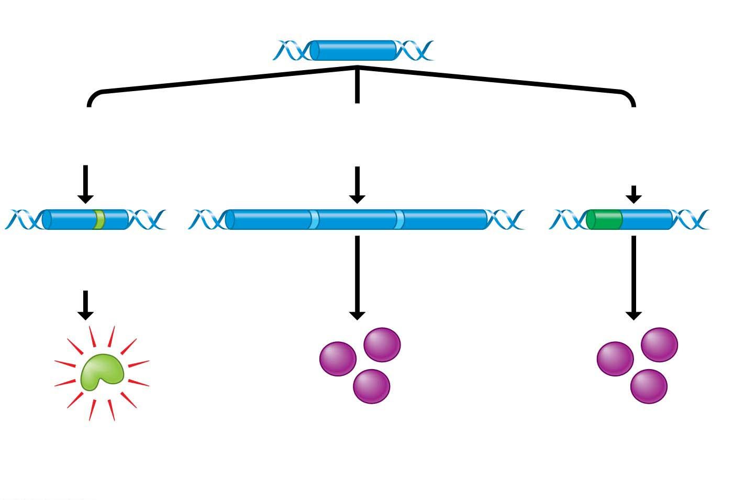
Figure 11.16
Proto-oncogene
DNA
Mutation within
the gene
Multiple copies
of the gene
Gene moved to
new DNA position,
under new controls
Oncogene
New promoter
Hyperactive
growth-stimulating
protein
Normal growth-stimulating
protein in excess
Notes:
Proto-oncogene - Activates cell division
oncogene – activates cell division too much

Slide 5
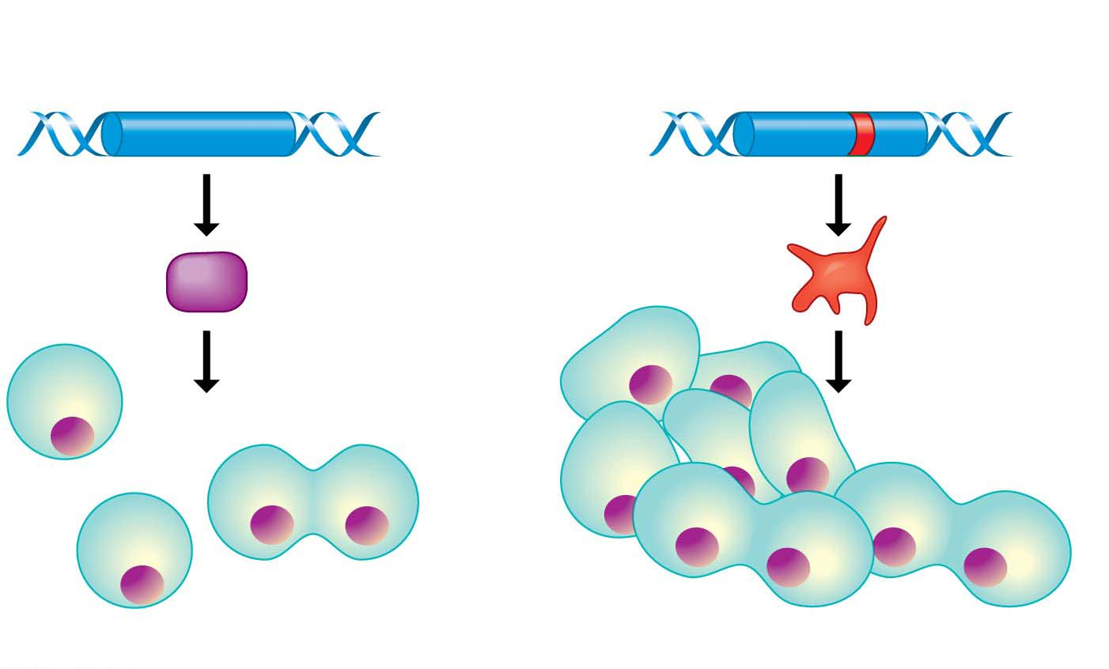
Figure 11.17
Tumor-suppressor gene
Mutated tumor-suppressor gene
Defective,
nonfunctioning
protein
Normal growth-
inhibiting protein
Cell division
under control
Cell division not
under control
(a) Normal cell growth
(b) Uncontrolled cell growth (cancer)
Notes:
Figure 11.17 Tumor-suppressor genes

Slide 6
What name is given to a gene that causes cancer?
oncogene
promoter
repressor
homeotic gene

Slide 7
What is the normal function of a proto oncogene?
increases cell growth
regulates cell division
cellular repair
copies RNA

Slide 8
When referring to cell division, oncogenes are most like ________ while tumor suppressor genes are most like ________.
the brakes on a car... the gas pedal on a car
the steering wheel on a car... the gas pedal on a car
the brakes on a car... the steering wheel on a car
the gas pedal on a car... the brakes on a car

Slide 9
The Progression of a Cancer
Nearly 150,000 Americans will be stricken by cancer of the colon (the main part of the large intestine) this year.
Colon cancer, like many cancers,
is a gradual process and
is produced by more than one mutation.
Notes:
9

Slide 10
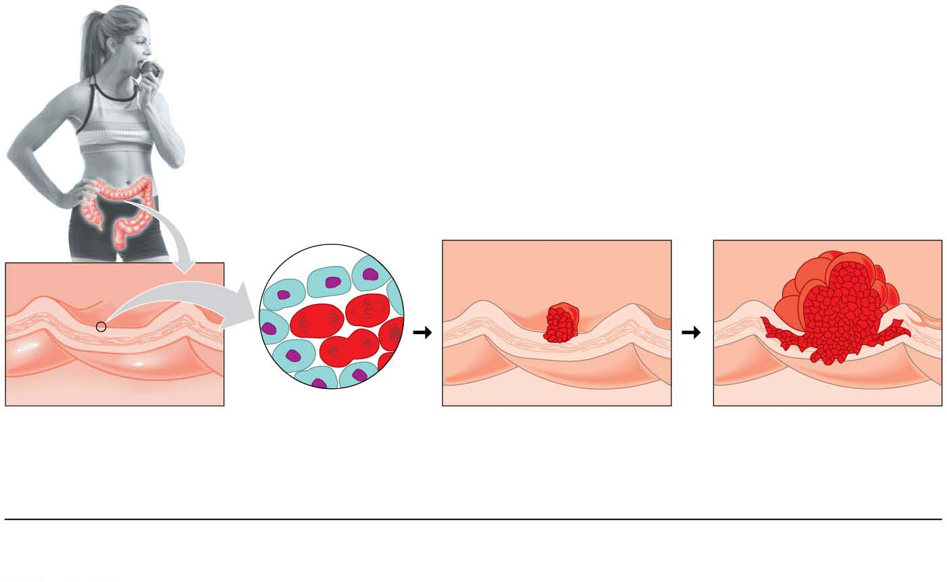
Figure 11.19
Colon wall
Colon wall
1
2
3
1
2
3
Cellular changes:
Increased
cell division
Growth of
benign tumor
Growth of
malignant tumor
DNA changes:
Oncogene activated
Tumor-suppressor
gene inactivated
Second tumor-suppressor
gene inactivated
Notes:
Figure 11.19 Stepwise development of colon cancer

Slide 11
The Progression of a Cancer
The development of a malignant tumor is accompanied by a gradual accumulation of mutations that
convert proto-oncogenes to oncogenes and
knock out tumor-suppressor genes.
Notes:
11
Student Misconceptions and Concerns
1. Students typically have little background knowledge of cancer at the cellular level. Consider creating your own pretest to inquire about your students’ entering knowledge of cancer. For example, ask students if all cancers are genetic (yes, all cancers are based on genetic errors and are the main subject of this chapter). In addition, ask students if exposure to a virus can lead to cancer (yes, as noted in the text).
2. Students often conclude falsely that most breast cancer is associated with known mutations in the breast cancer genes BRCA1 and BRCA2. However, the vast majority of breast cancer has no known inherited association.
3. Many students do not appreciate the increased risk of skin cancer and premature aging associated with the use of tanning beds.
Teaching Tips
1. Tumor-suppressor genes function like the repressor in the E. coli lactose operon. The lac operon is expressed and cancers appear when their respective repressors do not function.
2. The production of a vaccine (Gardasil) against a virus known to contribute to cervical cancer has helped students become aware of the risks of HPV exposure. The following website of the National Cancer Institute describes the risks of HPV infection (www.cancer.gov/cancertopics/factsheet/Risk/HPV).
3. Students who have had a leg, hip, or back X-rayed may recall that a lead apron was placed over their abdominal and pelvic region. The lead apron is to prevent the irradiation of the patient’s gonads, which could cause mutations that would be inherited.
4. Exposure to carcinogens early in life generally carries greater risks than the same exposure later in life. This is because damage in early life has more time to accumulate additional mutations, potentially leading to disease.
5. Nearly one in five deaths in the United States results from the use of tobacco. Additional information on the risks of tobacco can be found at the website of the American Cancer Society (www.cancer.org/cancer/cancercauses/tobaccocancer/index).
Active Lecture Tips
1. See the Media Review: “Losing Control of a Car Relates to Unregulated Cell Division” on the Instructor Exchange. Visit the Instructor Exchange in the MasteringBiology instructor resource area for a description of this activity.

Slide 12
Please read the paragraph below to answer the following questions.
Jim has become particularly interested in the genetic basis of cancer and has spent considerable time reading published papers about oncogenes. He learned that as early as 1972 researchers suggested that mutations in proto-oncogenes caused by carcinogens can convert the proto-oncogenes to oncogenes. He asked you to answer a couple of questions about this because he did not have a sufficient biology background.

Slide 13
Jim learned that viruses can sometimes cause cancer and wants to know why. You tell him that ________.
A) a human cell can acquire an oncogene from a virus
B) a human cell can acquire a carcinogen from a virus
C) a prion can cause cancer
D) a human cell can acquire a proto-oncogene from a virus

Slide 14
Jim came across an advertisement for an herbal supplement that claimed to cure lung cancer by targeting precancerous cells in the lungs. If this claim were true, which of the following is a possible mechanism by which it may act?
A) The supplement would stimulate translation of growth factors
B) The supplement would increase mutation rates in proto-oncogenes.
C) The supplement would restrict the transcription of oncogenes.
D) The supplement would inhibit the production of tumor suppressor proteins.

Slide 15
Jim learned that some cancer cells produce more growth-stimulating proteins than others. What would you give him as a plausible explanation?
Proto-oncogenes may have mutated to become oncogenes in these cells.
This may result from vitamin C and vitamin E deficiencies.
Tumor suppressor genes may have been activated in these cells.
Mutations in homeotic genes may be responsible.

Slide 16
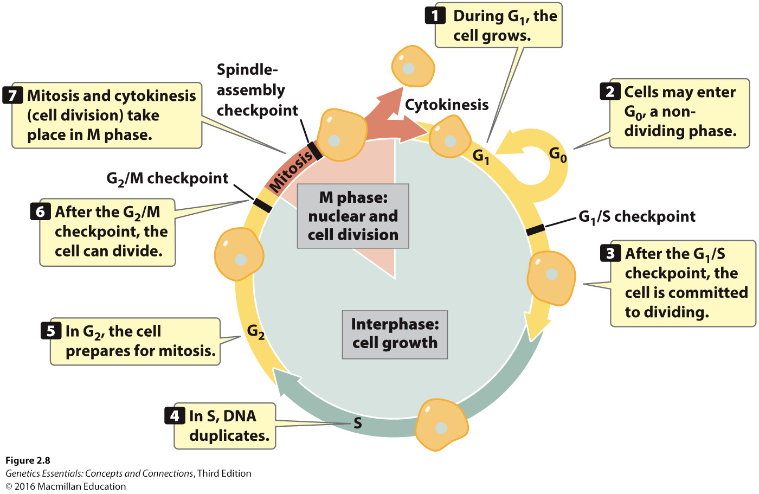
Notes:
Figure 2.9 The cell cycle consists of interphase and M phase.

Slide 17
Inherited Cancer
Multiple genetic changes are required to produce a cancer cell.
This helps explain the observation that cancers can run in families.
An individual inheriting an oncogene or a mutant version of a tumor-suppressor gene is one step closer to accumulating the necessary mutations for cancer.
Geneticists are therefore devoting much effort to identifying inherited cancer mutations so that predisposition to certain cancers can be detected early in life.
Notes:
17

Slide 18
Inherited Cancer
About 15% of colorectal cancers involve inherited mutations.
There is also evidence that inheritance plays a role in 5–10% of patients with breast cancer, a disease that strikes one out of every eight American women.
Notes:
18
Student Misconceptions and Concerns
1. Students typically have little background knowledge of cancer at the cellular level. Consider creating your own pretest to inquire about your students’ entering knowledge of cancer. For example, ask students if all cancers are genetic (yes, all cancers are based on genetic errors and are the main subject of this chapter). In addition, ask students if exposure to a virus can lead to cancer (yes, as noted in the text).
2. Students often conclude falsely that most breast cancer is associated with known mutations in the breast cancer genes BRCA1 and BRCA2. However, the vast majority of breast cancer has no known inherited association.
3. Many students do not appreciate the increased risk of skin cancer and premature aging associated with the use of tanning beds.
Teaching Tips
1. Tumor-suppressor genes function like the repressor in the E. coli lactose operon. The lac operon is expressed and cancers appear when their respective repressors do not function.
2. The production of a vaccine (Gardasil) against a virus known to contribute to cervical cancer has helped students become aware of the risks of HPV exposure. The following website of the National Cancer Institute describes the risks of HPV infection (www.cancer.gov/cancertopics/factsheet/Risk/HPV).
3. Students who have had a leg, hip, or back X-rayed may recall that a lead apron was placed over their abdominal and pelvic region. The lead apron is to prevent the irradiation of the patient’s gonads, which could cause mutations that would be inherited.
4. Exposure to carcinogens early in life generally carries greater risks than the same exposure later in life. This is because damage in early life has more time to accumulate additional mutations, potentially leading to disease.
5. Nearly one in five deaths in the United States results from the use of tobacco. Additional information on the risks of tobacco can be found at the website of the American Cancer Society (www.cancer.org/cancer/cancercauses/tobaccocancer/index).
Active Lecture Tips
1. See the Media Review: “Losing Control of a Car Relates to Unregulated Cell Division” on the Instructor Exchange. Visit the Instructor Exchange in the MasteringBiology instructor resource area for a description of this activity.

Slide 19
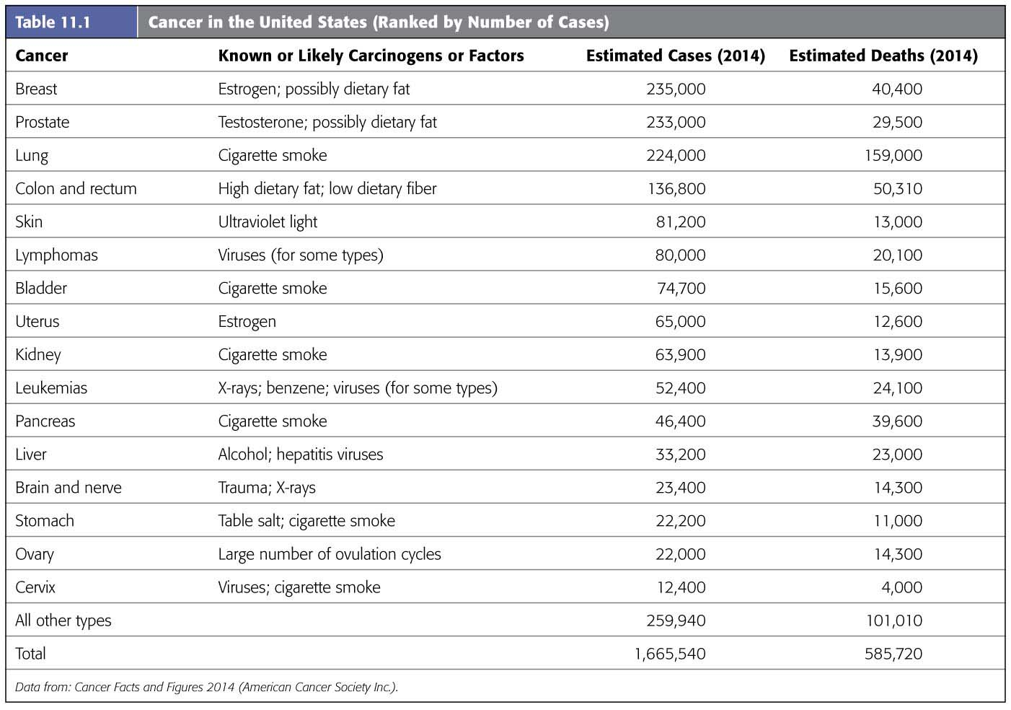
Table 11.1
Notes:
Table 11.1 Cancer in the United States

Slide 20
Cancer Risk and Prevention
Some food choices significantly reduce a person’s cancer risk, including eating
20–30 g of plant fiber daily,
less animal fat, and
cabbage and its relatives, such as broccoli and cauliflower.
Determining how diet influences cancer has become an important focus of nutrition research.
Notes:
20
Student Misconceptions and Concerns
1. Students typically have little background knowledge of cancer at the cellular level. Consider creating your own pretest to inquire about your students’ entering knowledge of cancer. For example, ask students if all cancers are genetic (yes, all cancers are based on genetic errors and are the main subject of this chapter). In addition, ask students if exposure to a virus can lead to cancer (yes, as noted in the text).
2. Students often conclude falsely that most breast cancer is associated with known mutations in the breast cancer genes BRCA1 and BRCA2. However, the vast majority of breast cancer has no known inherited association.
3. Many students do not appreciate the increased risk of skin cancer and premature aging associated with the use of tanning beds.
Teaching Tips
1. Tumor-suppressor genes function like the repressor in the E. coli lactose operon. The lac operon is expressed and cancers appear when their respective repressors do not function.
2. The production of a vaccine (Gardasil) against a virus known to contribute to cervical cancer has helped students become aware of the risks of HPV exposure. The following website of the National Cancer Institute describes the risks of HPV infection (www.cancer.gov/cancertopics/factsheet/Risk/HPV).
3. Students who have had a leg, hip, or back X-rayed may recall that a lead apron was placed over their abdominal and pelvic region. The lead apron is to prevent the irradiation of the patient’s gonads, which could cause mutations that would be inherited.
4. Exposure to carcinogens early in life generally carries greater risks than the same exposure later in life. This is because damage in early life has more time to accumulate additional mutations, potentially leading to disease.
5. Nearly one in five deaths in the United States results from the use of tobacco. Additional information on the risks of tobacco can be found at the website of the American Cancer Society (www.cancer.org/cancer/cancercauses/tobaccocancer/index).
Active Lecture Tips
1. See the Media Review: “Losing Control of a Car Relates to Unregulated Cell Division” on the Instructor Exchange. Visit the Instructor Exchange in the MasteringBiology instructor resource area for a description of this activity.

Slide 21
Ch12 DNA Technology
Biol10
11.20.18
See pdf Ch12

Slide 22
Definitions
What is recombinant DNA?
a DNA molecule made by combining two different DNA molecules
What is a GMO?
an organism carrying a gene that was acquired by artificial means
Defines the term "transgenic organism”
an organism containing a gene from another species

Slide 23
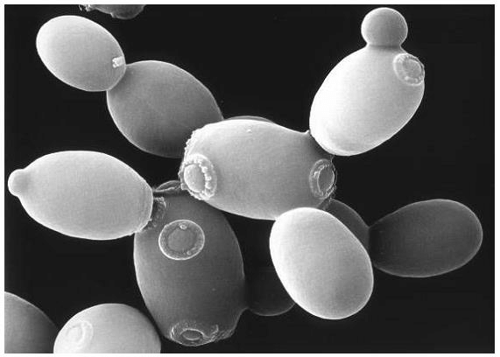
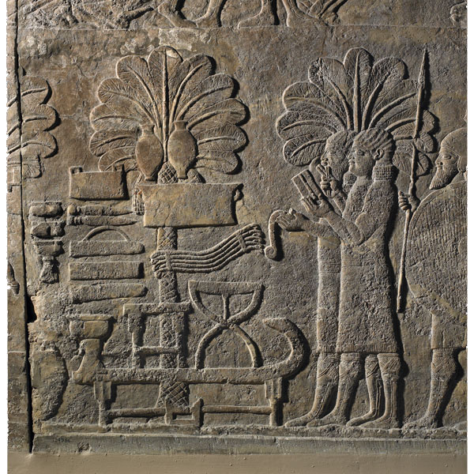
Early Genetic Manipulation
dates back to the dawn of civilization
yeast to make bread and beer and selectively bred livestock.
Date palms - one of the oldest domesticated plants
selective breeding 8000 years ago by humans
Saccharomyces cerevisiae
Notes:
23
There is archaeological evidence of date cultivation in Arabia from the 6th millennium BCE.

Slide 24
Genetic Engineering
Scientists have
genetically engineered bacteria to mass-produce a variety of useful chemicals, from cancer drugs to pesticides, and
transferred genes from bacteria to plants and from one animal species to another.
Notes:
24

Slide 25
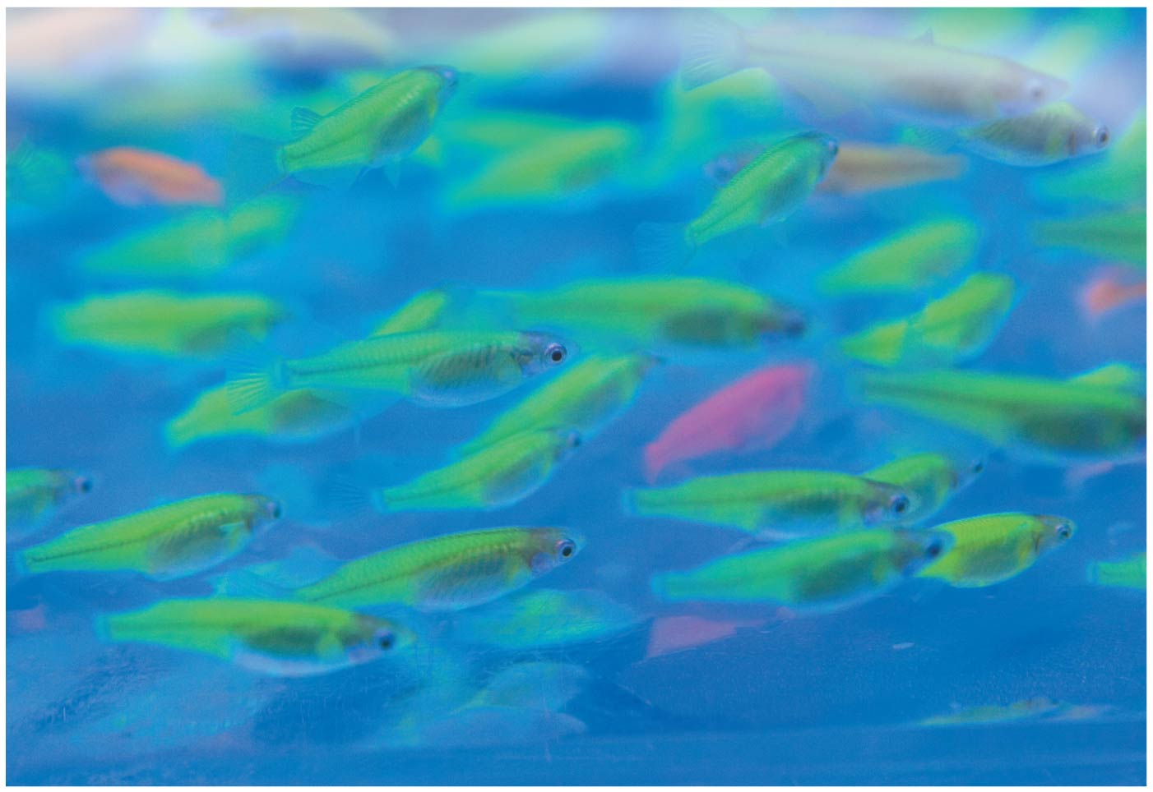
Glowing fish produced by transferring a gene for a fluorescent protein from jellyfish
Let’s go look at some fluorescent fish

Slide 26
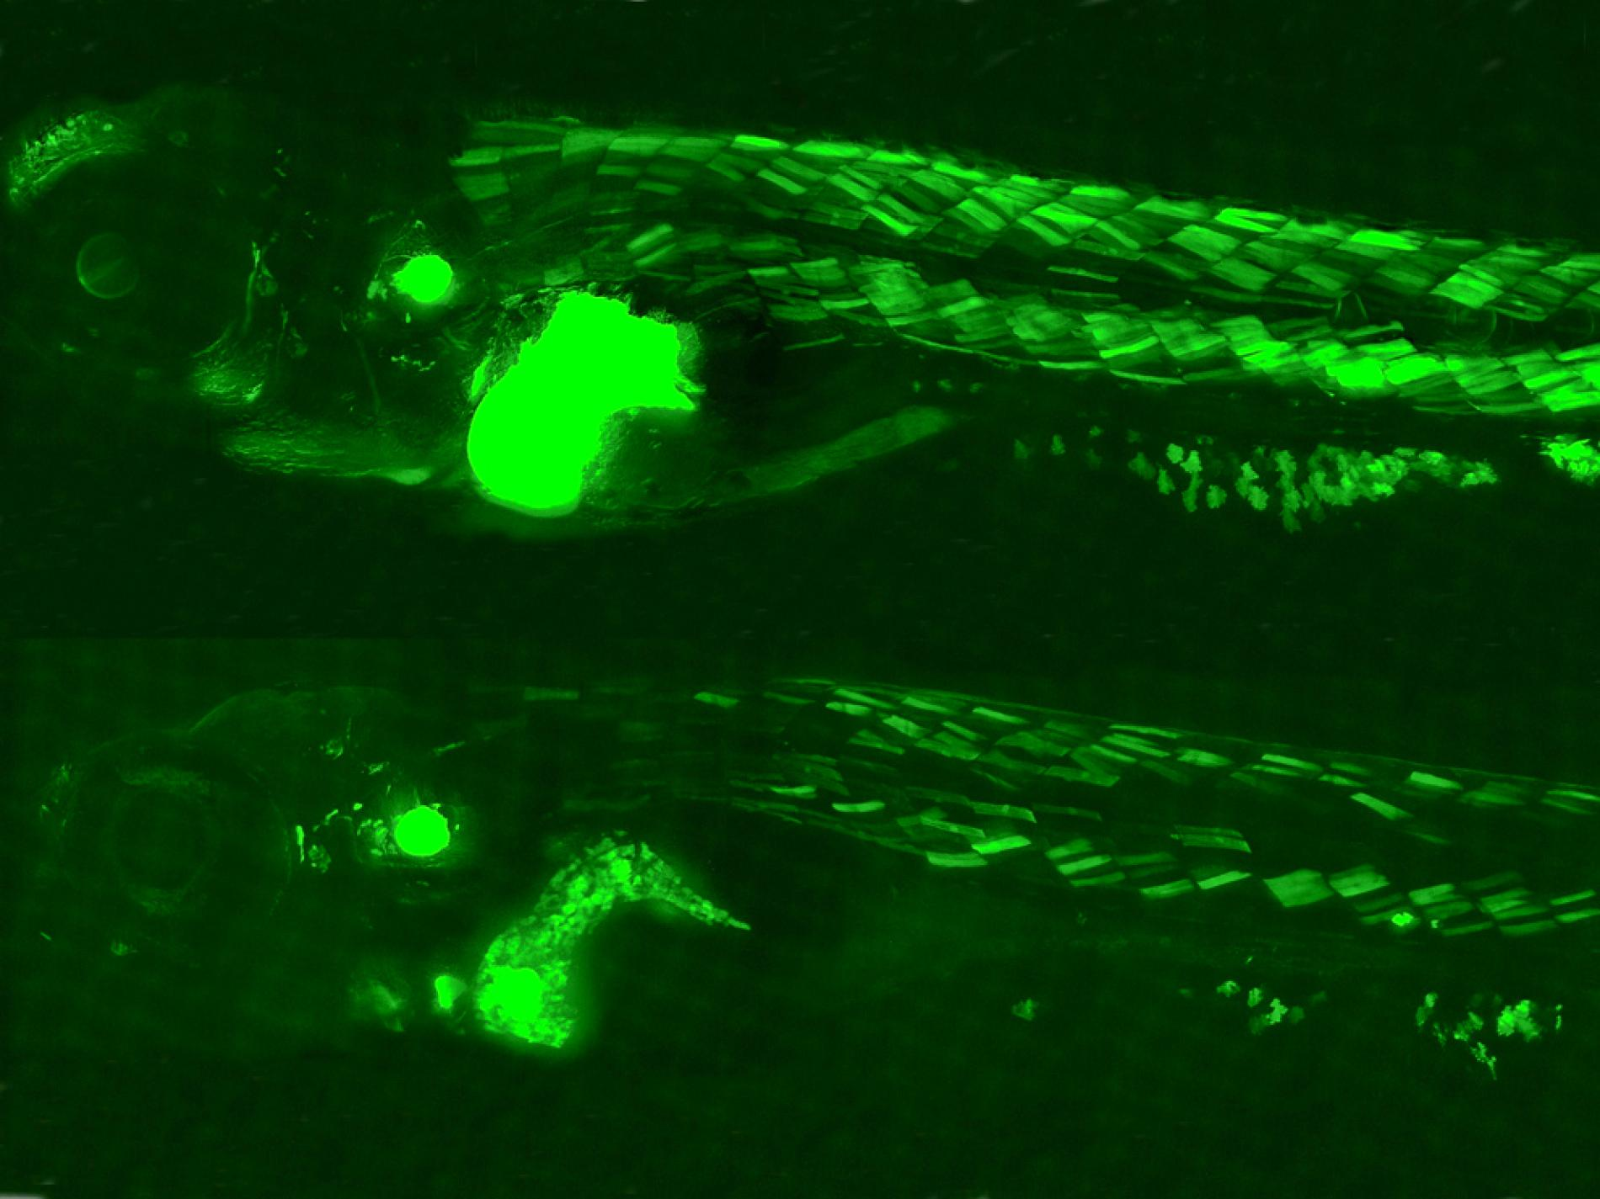
Endocrine Toxin Indicator
GFP is expressed when the toxin is processed in the fish organ
Notes:
https://news.nationalgeographic.com/news/2012/04/120423-fish-glowing-pollution-bpa-environment-science/

Slide 27
Glow Cats in class Exercise –

Slide 28
Recombinant DNA Techniques
Bacteria are the workhorses of modern biotechnology.
To manipulate genes in the laboratory, biologists often use bacterial plasmids, which are small, circular DNA molecules that duplicate separately from the larger bacterial chromosome.
Notes:
28
Student Misconceptions and Concerns
1. Student comprehension of restriction enzymes and many other aspects of recombinant DNA techniques depends upon a comfortable understanding of basic molecular genetics. Consider addressing Chapter 12 after an exam that addresses the content in Chapters 10 and 11.
2. The genetic engineering of organisms can be controversial, creating various degrees of social unease and resistance. Yet many debates about scientific issues are confused by misinformation. This provides an opportunity for you to ask students to research an issue before taking firm positions. Students might debate whether a food or drug made from GM/transgenic organisms should be labeled as such, or discuss the risks and advantages of producing GM organisms. Consider starting class with a headline addressing one of these issues. The recent process of FDA approval for raising genetically engineered salmon (AquAdvantage) for food might be particularly useful and relevant.
3. The fact that the technologies described in this chapter can be used to swap genes between prokaryotes and eukaryotes reveals the fundamental similarities in genetic mechanisms shared by all forms of life. This very strong evidence of common descent is evidence of evolution that may be missed by your students.
4. Using gene therapy to “fix” genetic problems relies on a thorough understanding of the roles of genes and alleles. Students might benefit from a discussion of the extent to which we as a society might want to consider directing our own genetics.
Teaching Tips
1. Annual flu vaccinations are a common example of using vaccines to prevent diseases that cannot be easily cured. However, students might not understand why many people receive the vaccine every year. A new annual vaccine is necessary because the flu viruses keep evolving.
2. The origin of the name “restriction enzymes” may be of interest. In nature, these enzymes protect bacterial cells against foreign DNA. Thus, these enzymes “restrict” the invasion of foreign genetic material.
3. Students might think you are just making a bad joke by noting that laboratory synthesized genes are “designer genes,” but this is a common term. Search the Internet using the keywords “designer genes,” and many scientific (and unscientific) sites will be found.
4. Separating marker ink using paper chromatography is a simple experiment that approximates some of what occurs in gel electrophoresis. Consider doing this as a class demonstration while addressing electrophoresis. Cut a large piece of filter paper into a rectangle or square. Use markers to color large dots about 2 cm away from the edge of the paper. Separate the dots from each other by 3–4 cm. Place the paper on edge, dots down, into a beaker containing about 1 cm of ethanol or isopropyl alcohol (50% or higher will do). The dots should not be in contact with the pool of alcohol in the bottom of the beaker. As the alcohol is drawn up the filter paper by capillary action, the alcohol will dissolve the ink dots. As the alcohol continues up the paper, the ink follows. Not all of the ink components move at the same speed, based on their size and chemical properties. If you begin the process at the start of class, you should have some degree of separation by the end of a 50-minute period. Experiment with the technique a day or two before class to fine-tune the demonstration, and experiment with different types of ink. (Save and air-dry these samples for your class.) Consider using brown, green, and black markers, as these colors are often made by color combinations.
5. Roundup Ready Corn, a product of Monsanto, is resistant to the herbicide Roundup. The general strategy for farmers is to spray fields of Roundup Ready Corn with the herbicide Roundup, killing weeds but not the corn. A search of the Internet will quickly reveal the controversy associated with this and other genetically modified organisms (GMOs), which can encourage interesting discussions and promote critical thinking skills.
6. As gene therapy technology expands, our ability to modify the genome in human embryos through in vitro fertilization permits genetic modification at the earliest stages of life. Future generations of humans, like our crops today, may include those with and without a genetically modified ancestry. The benefits and challenges of these technologies raise issues many students have never considered. Our students, and the generations soon to follow, may face the potential of directed human evolution.
7. Ethical, legal, and social issues related to the Human Genome Project are directly addressed at the Department of Energy Human Genome website at http://web.ornl.gov/sci/techresources/Human_Genome/elsi/index.shtml.
8. The Biology and Society end-of-chapter textbook questions address some of the issues raised in this chapter section.
Active Lecture Tips
1. As you begin to address genetic engineering and GMO foods, ask students to work in small groups to discuss what they know about genetically engineered food. Have each group create a list of statements that can be short or long, reflecting their impressions of the technology. The results may surprise you and help you address some common misunderstandings and concerns.
2. If you have already addressed basic transcription and translation in your course, consider asking small groups of students in your class to explain the following. DNA technology is primarily used to produce proteins. Why aren’t lipids and carbohydrates typically produced by these processes?

Slide 29
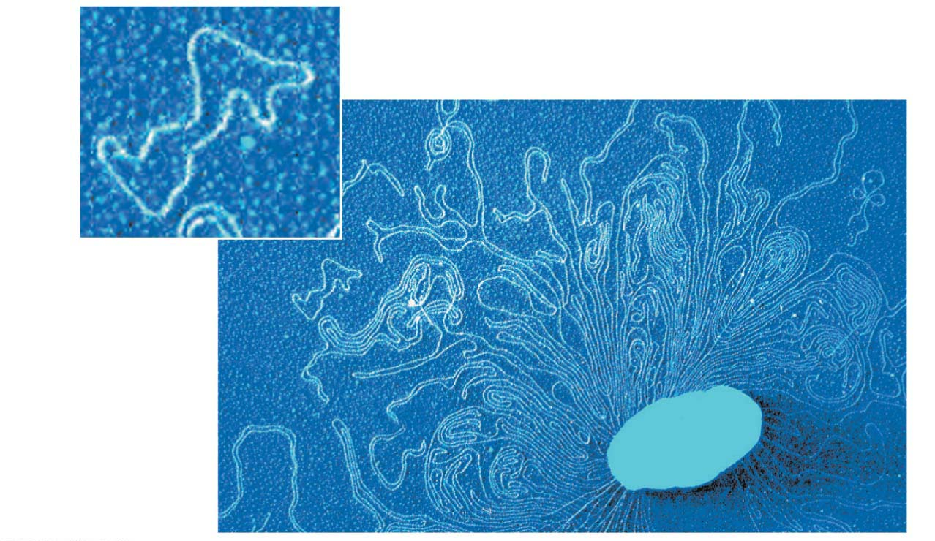
Figure 12.2
Plasmids
Bacterial
chromosome
Remnant of
bacterium
Colorized TEM
Notes:
Figure 12.2 Bacterial plasmids

Slide 30
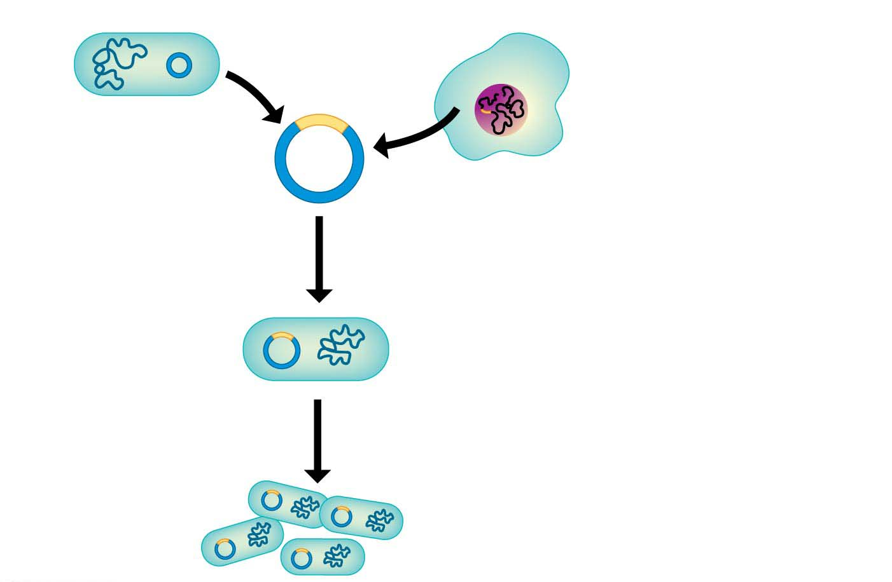
Figure 12.3-1
Bacterium
Cell containing gene
of interest
Bacterial
chromosome
Plasmid
1
Gene inserted
Into plasmid
Recombinant
DNA (plasmid)
Gene of
interest
DNA of chromosome
(“foreign” DNA)
2
Plasmid put into
bacterial cell
Recombinant
bacterium
3
Host cell grown
In culture to form
a clone of cells
Notes:
Figure 12.3-1 Using recombinant DNA technology to produce useful products (part 1: recombinant bacterium)
Insulin as the example

Slide 31
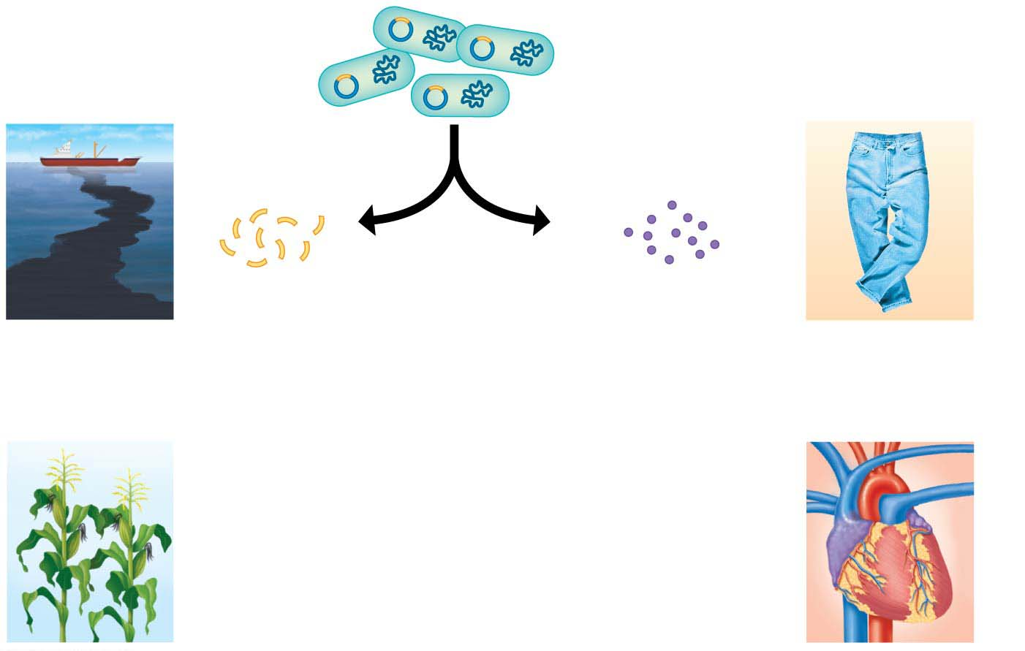
Figure 12.3-2
Clone of cells
containing the
gene of interest
Some uses
of genes
Some uses
of proteins
4
The gene
and protein
of interest
are isolated
from the
bacteria.
Genes may
be inserted
into other
organisms.
Harvested
proteins may
be used
directly
Genes for
cleaning up
toxic waste
Protein for
“stone-washing”
jeans
Protein for
dissolving
clots
Gene for pest
resistance
Notes:
Figure 12.3-2 Using recombinant DNA technology to produce useful products (part 2: useful products)

Slide 32
Cutting and Pasting DNA with Restriction Enzymes
Recombinant DNA is produced by combining two ingredients:
a bacterial plasmid and
the gene of interest.
To understand how these DNA molecules are spliced together, you need to learn how enzymes cut and paste DNA.
Notes:
32
Student Misconceptions and Concerns
1. Student comprehension of restriction enzymes and many other aspects of recombinant DNA techniques depends upon a comfortable understanding of basic molecular genetics. Consider addressing Chapter 12 after an exam that addresses the content in Chapters 10 and 11.
2. The genetic engineering of organisms can be controversial, creating various degrees of social unease and resistance. Yet many debates about scientific issues are confused by misinformation. This provides an opportunity for you to ask students to research an issue before taking firm positions. Students might debate whether a food or drug made from GM/transgenic organisms should be labeled as such, or discuss the risks and advantages of producing GM organisms. Consider starting class with a headline addressing one of these issues. The recent process of FDA approval for raising genetically engineered salmon (AquAdvantage) for food might be particularly useful and relevant.
3. The fact that the technologies described in this chapter can be used to swap genes between prokaryotes and eukaryotes reveals the fundamental similarities in genetic mechanisms shared by all forms of life. This very strong evidence of common descent is evidence of evolution that may be missed by your students.
4. Using gene therapy to “fix” genetic problems relies on a thorough understanding of the roles of genes and alleles. Students might benefit from a discussion of the extent to which we as a society might want to consider directing our own genetics.
Teaching Tips
1. Annual flu vaccinations are a common example of using vaccines to prevent diseases that cannot be easily cured. However, students might not understand why many people receive the vaccine every year. A new annual vaccine is necessary because the flu viruses keep evolving.
2. The origin of the name “restriction enzymes” may be of interest. In nature, these enzymes protect bacterial cells against foreign DNA. Thus, these enzymes “restrict” the invasion of foreign genetic material.
3. Students might think you are just making a bad joke by noting that laboratory synthesized genes are “designer genes,” but this is a common term. Search the Internet using the keywords “designer genes,” and many scientific (and unscientific) sites will be found.
4. Separating marker ink using paper chromatography is a simple experiment that approximates some of what occurs in gel electrophoresis. Consider doing this as a class demonstration while addressing electrophoresis. Cut a large piece of filter paper into a rectangle or square. Use markers to color large dots about 2 cm away from the edge of the paper. Separate the dots from each other by 3–4 cm. Place the paper on edge, dots down, into a beaker containing about 1 cm of ethanol or isopropyl alcohol (50% or higher will do). The dots should not be in contact with the pool of alcohol in the bottom of the beaker. As the alcohol is drawn up the filter paper by capillary action, the alcohol will dissolve the ink dots. As the alcohol continues up the paper, the ink follows. Not all of the ink components move at the same speed, based on their size and chemical properties. If you begin the process at the start of class, you should have some degree of separation by the end of a 50-minute period. Experiment with the technique a day or two before class to fine-tune the demonstration, and experiment with different types of ink. (Save and air-dry these samples for your class.) Consider using brown, green, and black markers, as these colors are often made by color combinations.
5. Roundup Ready Corn, a product of Monsanto, is resistant to the herbicide Roundup. The general strategy for farmers is to spray fields of Roundup Ready Corn with the herbicide Roundup, killing weeds but not the corn. A search of the Internet will quickly reveal the controversy associated with this and other genetically modified organisms (GMOs), which can encourage interesting discussions and promote critical thinking skills.
6. As gene therapy technology expands, our ability to modify the genome in human embryos through in vitro fertilization permits genetic modification at the earliest stages of life. Future generations of humans, like our crops today, may include those with and without a genetically modified ancestry. The benefits and challenges of these technologies raise issues many students have never considered. Our students, and the generations soon to follow, may face the potential of directed human evolution.
7. Ethical, legal, and social issues related to the Human Genome Project are directly addressed at the Department of Energy Human Genome website at http://web.ornl.gov/sci/techresources/Human_Genome/elsi/index.shtml.
8. The Biology and Society end-of-chapter textbook questions address some of the issues raised in this chapter section.
Active Lecture Tips
1. As you begin to address genetic engineering and GMO foods, ask students to work in small groups to discuss what they know about genetically engineered food. Have each group create a list of statements that can be short or long, reflecting their impressions of the technology. The results may surprise you and help you address some common misunderstandings and concerns.
2. If you have already addressed basic transcription and translation in your course, consider asking small groups of students in your class to explain the following. DNA technology is primarily used to produce proteins. Why aren’t lipids and carbohydrates typically produced by these processes?

Slide 33
Animation: Restriction Enzymes

Slide 34
Figure 12.4-s1
Recognition site (recognition sequence)
for a restriction enzyme
DNA
1
A restriction enzyme cuts the
DNA into fragments.
Restriction
enzyme
Sticky end
Sticky end
Notes:
Figure 12.4-s1 Cutting and pasting DNA (step 1)

Slide 35
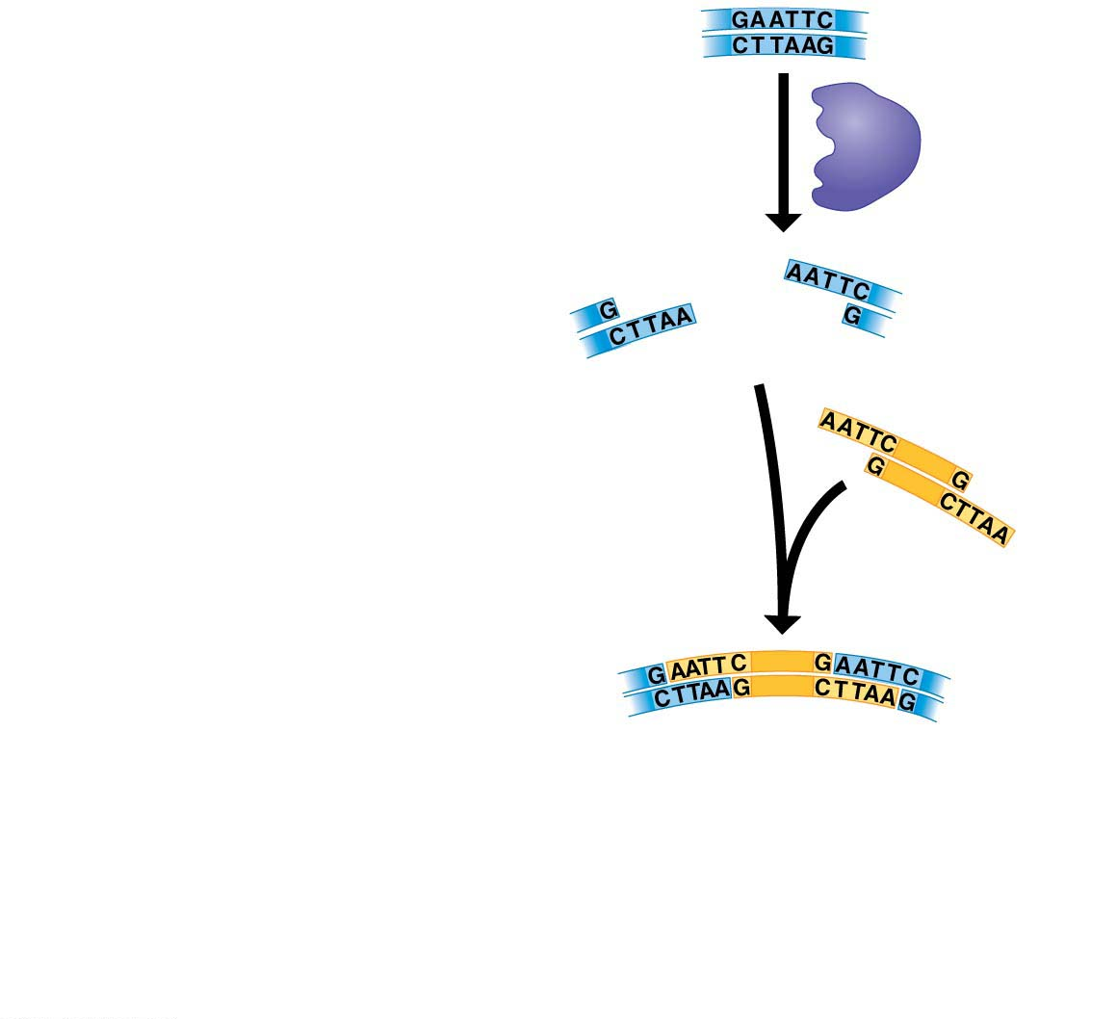
Figure 12.4-s2
Recognition site (recognition sequence)
for a restriction enzyme
DNA
1
A restriction enzyme cuts the
DNA into fragments.
Restriction
enzyme
Sticky end
Sticky end
2
A DNA fragment is added from
another source.
3
Fragments stick together by
base pairing.
Notes:
Figure 12.4-s2 Cutting and pasting DNA (step 2)

Slide 36
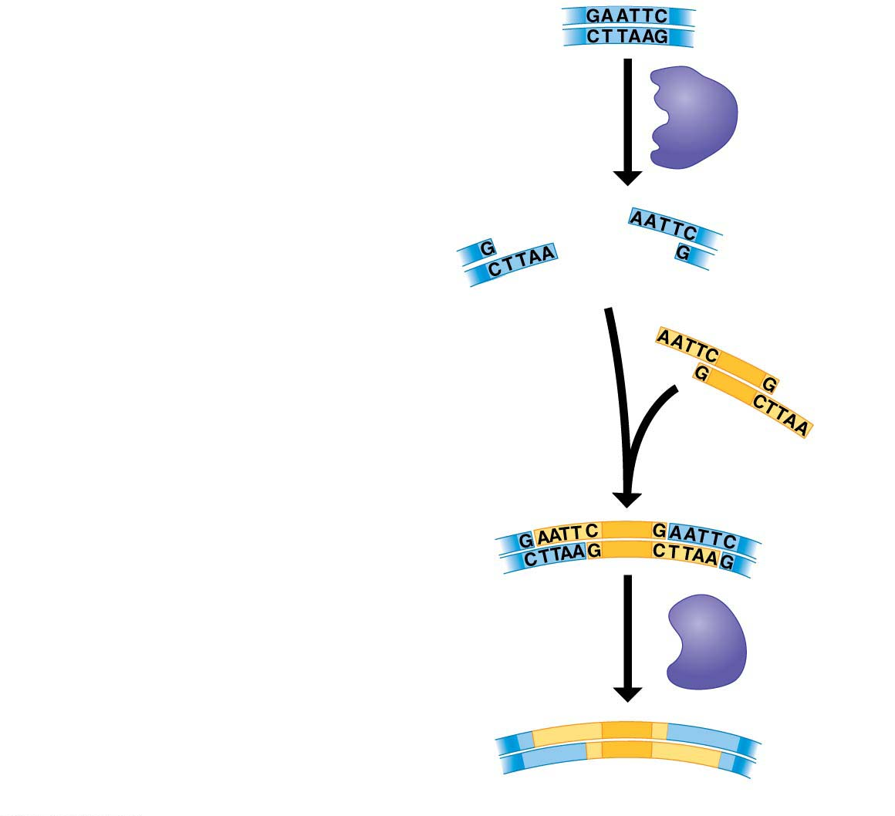
Figure 12.4-s3
Recognition site (recognition sequence)
for a restriction enzyme
DNA
1
A restriction enzyme cuts the
DNA into fragments.
Restriction
enzyme
Sticky end
Sticky end
2
A DNA fragment is added from
another source.
3
Fragments stick together by
base pairing.
4
DNA ligase joins the fragments
into strands.
DNA
ligase
Recombinant DNA molecule
Notes:
Figure 12.4-s3 Cutting and pasting DNA (step 3)

Slide 37
What if you added GFP from jellyfish to the bacterial plasmid?
The cell would fluoresce...

Slide 38
HindIII is a restriction enzyme that cuts the DNA sequence AAGCTT between the two A bases. How many times would HindIII cut the following DNA molecule?
GTAAGCTTCGACAAGCTTGCTGA
2

Slide 39
A DNA fragment with a sticky end that reads -ATTCG will bind with another DNA fragment with a sticky end that reads ________.

Slide 40
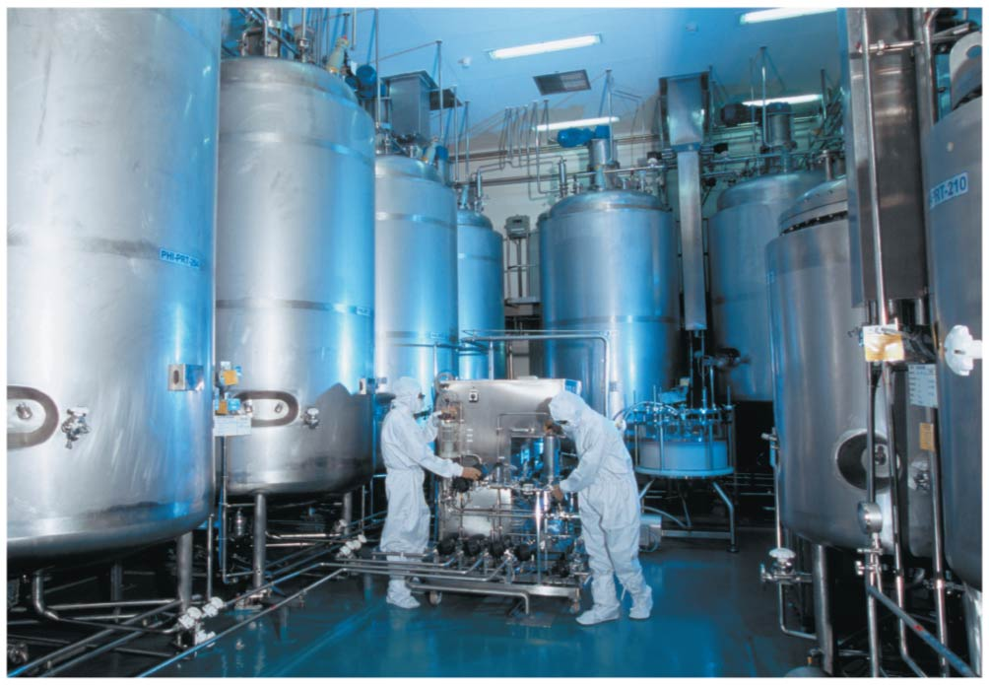
Figure 12.7
Pharmaceutical Applications
gene for a desired protein into a bacterium or yeast,
grow cultures in large vats
produce large amounts of proteins otherwise impossible to synthesis
Notes:
Figure 12.7 A factory that produces genetically engineered insulin

Slide 41
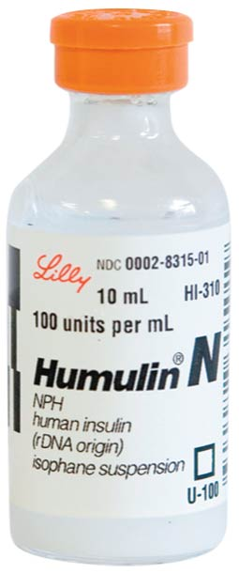
Figure 12.6
Human insulin produced in E. coli cells.
Notes:
Figure 12.6 Humulin, human insulin produced by genetically modified bacteria

Slide 42
Pharmaceutical Applications
Humulin is human insulin produced by genetically modified bacteria.
insulin is a protein made in the pancreas.
we cannot synthesize insulin unless a cell is involved
originally diabetics used insulin from cows and pigs.
The meat industry couldn’t keep up...
In 1978, scientists working at a biotechnology company chemically synthesized DNA fragments and linked them to form the two genes that code for the two polypeptides that make up human insulin.
Notes:
42
Student Misconceptions and Concerns
1. Student comprehension of restriction enzymes and many other aspects of recombinant DNA techniques depends upon a comfortable understanding of basic molecular genetics. Consider addressing Chapter 12 after an exam that addresses the content in Chapters 10 and 11.
2. The genetic engineering of organisms can be controversial, creating various degrees of social unease and resistance. Yet many debates about scientific issues are confused by misinformation. This provides an opportunity for you to ask students to research an issue before taking firm positions. Students might debate whether a food or drug made from GM/transgenic organisms should be labeled as such, or discuss the risks and advantages of producing GM organisms. Consider starting class with a headline addressing one of these issues. The recent process of FDA approval for raising genetically engineered salmon (AquAdvantage) for food might be particularly useful and relevant.
3. The fact that the technologies described in this chapter can be used to swap genes between prokaryotes and eukaryotes reveals the fundamental similarities in genetic mechanisms shared by all forms of life. This very strong evidence of common descent is evidence of evolution that may be missed by your students.
4. Using gene therapy to “fix” genetic problems relies on a thorough understanding of the roles of genes and alleles. Students might benefit from a discussion of the extent to which we as a society might want to consider directing our own genetics.
Teaching Tips
1. Annual flu vaccinations are a common example of using vaccines to prevent diseases that cannot be easily cured. However, students might not understand why many people receive the vaccine every year. A new annual vaccine is necessary because the flu viruses keep evolving.
2. The origin of the name “restriction enzymes” may be of interest. In nature, these enzymes protect bacterial cells against foreign DNA. Thus, these enzymes “restrict” the invasion of foreign genetic material.
3. Students might think you are just making a bad joke by noting that laboratory synthesized genes are “designer genes,” but this is a common term. Search the Internet using the keywords “designer genes,” and many scientific (and unscientific) sites will be found.
4. Separating marker ink using paper chromatography is a simple experiment that approximates some of what occurs in gel electrophoresis. Consider doing this as a class demonstration while addressing electrophoresis. Cut a large piece of filter paper into a rectangle or square. Use markers to color large dots about 2 cm away from the edge of the paper. Separate the dots from each other by 3–4 cm. Place the paper on edge, dots down, into a beaker containing about 1 cm of ethanol or isopropyl alcohol (50% or higher will do). The dots should not be in contact with the pool of alcohol in the bottom of the beaker. As the alcohol is drawn up the filter paper by capillary action, the alcohol will dissolve the ink dots. As the alcohol continues up the paper, the ink follows. Not all of the ink components move at the same speed, based on their size and chemical properties. If you begin the process at the start of class, you should have some degree of separation by the end of a 50-minute period. Experiment with the technique a day or two before class to fine-tune the demonstration, and experiment with different types of ink. (Save and air-dry these samples for your class.) Consider using brown, green, and black markers, as these colors are often made by color combinations.
5. Roundup Ready Corn, a product of Monsanto, is resistant to the herbicide Roundup. The general strategy for farmers is to spray fields of Roundup Ready Corn with the herbicide Roundup, killing weeds but not the corn. A search of the Internet will quickly reveal the controversy associated with this and other genetically modified organisms (GMOs), which can encourage interesting discussions and promote critical thinking skills.
6. As gene therapy technology expands, our ability to modify the genome in human embryos through in vitro fertilization permits genetic modification at the earliest stages of life. Future generations of humans, like our crops today, may include those with and without a genetically modified ancestry. The benefits and challenges of these technologies raise issues many students have never considered. Our students, and the generations soon to follow, may face the potential of directed human evolution.
7. Ethical, legal, and social issues related to the Human Genome Project are directly addressed at the Department of Energy Human Genome website at http://web.ornl.gov/sci/techresources/Human_Genome/elsi/index.shtml.
8. The Biology and Society end-of-chapter textbook questions address some of the issues raised in this chapter section.
Active Lecture Tips
1. As you begin to address genetic engineering and GMO foods, ask students to work in small groups to discuss what they know about genetically engineered food. Have each group create a list of statements that can be short or long, reflecting their impressions of the technology. The results may surprise you and help you address some common misunderstandings and concerns.
2. If you have already addressed basic transcription and translation in your course, consider asking small groups of students in your class to explain the following. DNA technology is primarily used to produce proteins. Why aren’t lipids and carbohydrates typically produced by these processes?

Slide 43
Pharmaceutical Applications
In 1978, scientists working at a biotechnology company chemically synthesized DNA fragments and linked them to form the two genes that code for the two polypeptides that make up human insulin.
They then inserted these artificial genes into E. coli host cells.
Under proper growing conditions, the transgenic bacteria cranked out large quantities of the human protein.
In 1982, Humulin hit the market as the world’s first genetically engineered pharmaceutical product.
Notes:
43
Student Misconceptions and Concerns
1. Student comprehension of restriction enzymes and many other aspects of recombinant DNA techniques depends upon a comfortable understanding of basic molecular genetics. Consider addressing Chapter 12 after an exam that addresses the content in Chapters 10 and 11.
2. The genetic engineering of organisms can be controversial, creating various degrees of social unease and resistance. Yet many debates about scientific issues are confused by misinformation. This provides an opportunity for you to ask students to research an issue before taking firm positions. Students might debate whether a food or drug made from GM/transgenic organisms should be labeled as such, or discuss the risks and advantages of producing GM organisms. Consider starting class with a headline addressing one of these issues. The recent process of FDA approval for raising genetically engineered salmon (AquAdvantage) for food might be particularly useful and relevant.
3. The fact that the technologies described in this chapter can be used to swap genes between prokaryotes and eukaryotes reveals the fundamental similarities in genetic mechanisms shared by all forms of life. This very strong evidence of common descent is evidence of evolution that may be missed by your students.
4. Using gene therapy to “fix” genetic problems relies on a thorough understanding of the roles of genes and alleles. Students might benefit from a discussion of the extent to which we as a society might want to consider directing our own genetics.
Teaching Tips
1. Annual flu vaccinations are a common example of using vaccines to prevent diseases that cannot be easily cured. However, students might not understand why many people receive the vaccine every year. A new annual vaccine is necessary because the flu viruses keep evolving.
2. The origin of the name “restriction enzymes” may be of interest. In nature, these enzymes protect bacterial cells against foreign DNA. Thus, these enzymes “restrict” the invasion of foreign genetic material.
3. Students might think you are just making a bad joke by noting that laboratory synthesized genes are “designer genes,” but this is a common term. Search the Internet using the keywords “designer genes,” and many scientific (and unscientific) sites will be found.
4. Separating marker ink using paper chromatography is a simple experiment that approximates some of what occurs in gel electrophoresis. Consider doing this as a class demonstration while addressing electrophoresis. Cut a large piece of filter paper into a rectangle or square. Use markers to color large dots about 2 cm away from the edge of the paper. Separate the dots from each other by 3–4 cm. Place the paper on edge, dots down, into a beaker containing about 1 cm of ethanol or isopropyl alcohol (50% or higher will do). The dots should not be in contact with the pool of alcohol in the bottom of the beaker. As the alcohol is drawn up the filter paper by capillary action, the alcohol will dissolve the ink dots. As the alcohol continues up the paper, the ink follows. Not all of the ink components move at the same speed, based on their size and chemical properties. If you begin the process at the start of class, you should have some degree of separation by the end of a 50-minute period. Experiment with the technique a day or two before class to fine-tune the demonstration, and experiment with different types of ink. (Save and air-dry these samples for your class.) Consider using brown, green, and black markers, as these colors are often made by color combinations.
5. Roundup Ready Corn, a product of Monsanto, is resistant to the herbicide Roundup. The general strategy for farmers is to spray fields of Roundup Ready Corn with the herbicide Roundup, killing weeds but not the corn. A search of the Internet will quickly reveal the controversy associated with this and other genetically modified organisms (GMOs), which can encourage interesting discussions and promote critical thinking skills.
6. As gene therapy technology expands, our ability to modify the genome in human embryos through in vitro fertilization permits genetic modification at the earliest stages of life. Future generations of humans, like our crops today, may include those with and without a genetically modified ancestry. The benefits and challenges of these technologies raise issues many students have never considered. Our students, and the generations soon to follow, may face the potential of directed human evolution.
7. Ethical, legal, and social issues related to the Human Genome Project are directly addressed at the Department of Energy Human Genome website at http://web.ornl.gov/sci/techresources/Human_Genome/elsi/index.shtml.
8. The Biology and Society end-of-chapter textbook questions address some of the issues raised in this chapter section.
Active Lecture Tips
1. As you begin to address genetic engineering and GMO foods, ask students to work in small groups to discuss what they know about genetically engineered food. Have each group create a list of statements that can be short or long, reflecting their impressions of the technology. The results may surprise you and help you address some common misunderstandings and concerns.
2. If you have already addressed basic transcription and translation in your course, consider asking small groups of students in your class to explain the following. DNA technology is primarily used to produce proteins. Why aren’t lipids and carbohydrates typically produced by these processes?

Slide 44
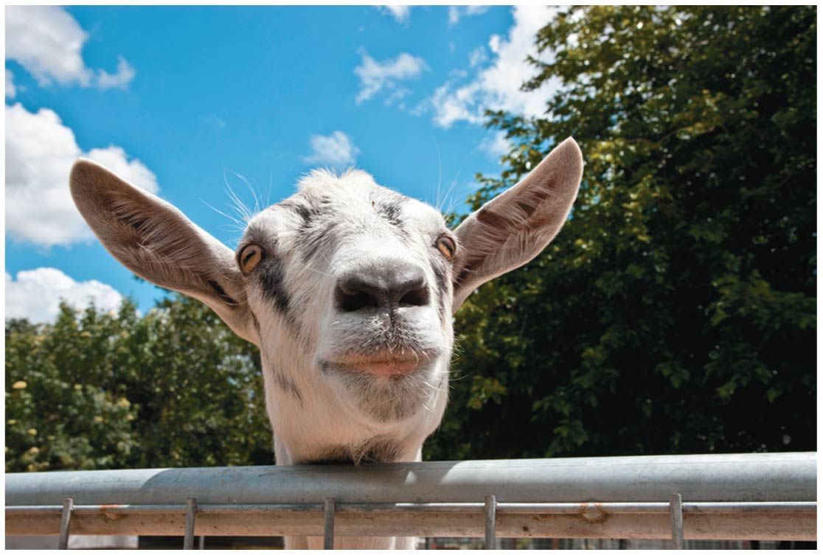
Figure 12.8
Notes:
Figure 12.8 A genetically modified goat -

Slide 45
Genetically Modified Organisms in Agriculture
Since ancient times, people have selectively bred agricultural crops to make them more useful.
Today, DNA technology is quickly replacing traditional breeding programs as scientists work to improve the productivity of agriculturally important plants and animals.
Notes:
45
Student Misconceptions and Concerns
1. Student comprehension of restriction enzymes and many other aspects of recombinant DNA techniques depends upon a comfortable understanding of basic molecular genetics. Consider addressing Chapter 12 after an exam that addresses the content in Chapters 10 and 11.
2. The genetic engineering of organisms can be controversial, creating various degrees of social unease and resistance. Yet many debates about scientific issues are confused by misinformation. This provides an opportunity for you to ask students to research an issue before taking firm positions. Students might debate whether a food or drug made from GM/transgenic organisms should be labeled as such, or discuss the risks and advantages of producing GM organisms. Consider starting class with a headline addressing one of these issues. The recent process of FDA approval for raising genetically engineered salmon (AquAdvantage) for food might be particularly useful and relevant.
3. The fact that the technologies described in this chapter can be used to swap genes between prokaryotes and eukaryotes reveals the fundamental similarities in genetic mechanisms shared by all forms of life. This very strong evidence of common descent is evidence of evolution that may be missed by your students.
4. Using gene therapy to “fix” genetic problems relies on a thorough understanding of the roles of genes and alleles. Students might benefit from a discussion of the extent to which we as a society might want to consider directing our own genetics.
Teaching Tips
1. Annual flu vaccinations are a common example of using vaccines to prevent diseases that cannot be easily cured. However, students might not understand why many people receive the vaccine every year. A new annual vaccine is necessary because the flu viruses keep evolving.
2. The origin of the name “restriction enzymes” may be of interest. In nature, these enzymes protect bacterial cells against foreign DNA. Thus, these enzymes “restrict” the invasion of foreign genetic material.
3. Students might think you are just making a bad joke by noting that laboratory synthesized genes are “designer genes,” but this is a common term. Search the Internet using the keywords “designer genes,” and many scientific (and unscientific) sites will be found.
4. Separating marker ink using paper chromatography is a simple experiment that approximates some of what occurs in gel electrophoresis. Consider doing this as a class demonstration while addressing electrophoresis. Cut a large piece of filter paper into a rectangle or square. Use markers to color large dots about 2 cm away from the edge of the paper. Separate the dots from each other by 3–4 cm. Place the paper on edge, dots down, into a beaker containing about 1 cm of ethanol or isopropyl alcohol (50% or higher will do). The dots should not be in contact with the pool of alcohol in the bottom of the beaker. As the alcohol is drawn up the filter paper by capillary action, the alcohol will dissolve the ink dots. As the alcohol continues up the paper, the ink follows. Not all of the ink components move at the same speed, based on their size and chemical properties. If you begin the process at the start of class, you should have some degree of separation by the end of a 50-minute period. Experiment with the technique a day or two before class to fine-tune the demonstration, and experiment with different types of ink. (Save and air-dry these samples for your class.) Consider using brown, green, and black markers, as these colors are often made by color combinations.
5. Roundup Ready Corn, a product of Monsanto, is resistant to the herbicide Roundup. The general strategy for farmers is to spray fields of Roundup Ready Corn with the herbicide Roundup, killing weeds but not the corn. A search of the Internet will quickly reveal the controversy associated with this and other genetically modified organisms (GMOs), which can encourage interesting discussions and promote critical thinking skills.
6. As gene therapy technology expands, our ability to modify the genome in human embryos through in vitro fertilization permits genetic modification at the earliest stages of life. Future generations of humans, like our crops today, may include those with and without a genetically modified ancestry. The benefits and challenges of these technologies raise issues many students have never considered. Our students, and the generations soon to follow, may face the potential of directed human evolution.
7. Ethical, legal, and social issues related to the Human Genome Project are directly addressed at the Department of Energy Human Genome website at http://web.ornl.gov/sci/techresources/Human_Genome/elsi/index.shtml.
8. The Biology and Society end-of-chapter textbook questions address some of the issues raised in this chapter section.
Active Lecture Tips
1. As you begin to address genetic engineering and GMO foods, ask students to work in small groups to discuss what they know about genetically engineered food. Have each group create a list of statements that can be short or long, reflecting their impressions of the technology. The results may surprise you and help you address some common misunderstandings and concerns.
2. If you have already addressed basic transcription and translation in your course, consider asking small groups of students in your class to explain the following. DNA technology is primarily used to produce proteins. Why aren’t lipids and carbohydrates typically produced by these processes?

Slide 46
Genetically Modified Organisms in Agriculture
In the United States today, more than 80% of the corn crop, more than 90% of the soybean crop, and about 75% of the cotton crop are genetically modified.
Notes:
46
Student Misconceptions and Concerns
1. Student comprehension of restriction enzymes and many other aspects of recombinant DNA techniques depends upon a comfortable understanding of basic molecular genetics. Consider addressing Chapter 12 after an exam that addresses the content in Chapters 10 and 11.
2. The genetic engineering of organisms can be controversial, creating various degrees of social unease and resistance. Yet many debates about scientific issues are confused by misinformation. This provides an opportunity for you to ask students to research an issue before taking firm positions. Students might debate whether a food or drug made from GM/transgenic organisms should be labeled as such, or discuss the risks and advantages of producing GM organisms. Consider starting class with a headline addressing one of these issues. The recent process of FDA approval for raising genetically engineered salmon (AquAdvantage) for food might be particularly useful and relevant.
3. The fact that the technologies described in this chapter can be used to swap genes between prokaryotes and eukaryotes reveals the fundamental similarities in genetic mechanisms shared by all forms of life. This very strong evidence of common descent is evidence of evolution that may be missed by your students.
4. Using gene therapy to “fix” genetic problems relies on a thorough understanding of the roles of genes and alleles. Students might benefit from a discussion of the extent to which we as a society might want to consider directing our own genetics.
Teaching Tips
1. Annual flu vaccinations are a common example of using vaccines to prevent diseases that cannot be easily cured. However, students might not understand why many people receive the vaccine every year. A new annual vaccine is necessary because the flu viruses keep evolving.
2. The origin of the name “restriction enzymes” may be of interest. In nature, these enzymes protect bacterial cells against foreign DNA. Thus, these enzymes “restrict” the invasion of foreign genetic material.
3. Students might think you are just making a bad joke by noting that laboratory synthesized genes are “designer genes,” but this is a common term. Search the Internet using the keywords “designer genes,” and many scientific (and unscientific) sites will be found.
4. Separating marker ink using paper chromatography is a simple experiment that approximates some of what occurs in gel electrophoresis. Consider doing this as a class demonstration while addressing electrophoresis. Cut a large piece of filter paper into a rectangle or square. Use markers to color large dots about 2 cm away from the edge of the paper. Separate the dots from each other by 3–4 cm. Place the paper on edge, dots down, into a beaker containing about 1 cm of ethanol or isopropyl alcohol (50% or higher will do). The dots should not be in contact with the pool of alcohol in the bottom of the beaker. As the alcohol is drawn up the filter paper by capillary action, the alcohol will dissolve the ink dots. As the alcohol continues up the paper, the ink follows. Not all of the ink components move at the same speed, based on their size and chemical properties. If you begin the process at the start of class, you should have some degree of separation by the end of a 50-minute period. Experiment with the technique a day or two before class to fine-tune the demonstration, and experiment with different types of ink. (Save and air-dry these samples for your class.) Consider using brown, green, and black markers, as these colors are often made by color combinations.
5. Roundup Ready Corn, a product of Monsanto, is resistant to the herbicide Roundup. The general strategy for farmers is to spray fields of Roundup Ready Corn with the herbicide Roundup, killing weeds but not the corn. A search of the Internet will quickly reveal the controversy associated with this and other genetically modified organisms (GMOs), which can encourage interesting discussions and promote critical thinking skills.
6. As gene therapy technology expands, our ability to modify the genome in human embryos through in vitro fertilization permits genetic modification at the earliest stages of life. Future generations of humans, like our crops today, may include those with and without a genetically modified ancestry. The benefits and challenges of these technologies raise issues many students have never considered. Our students, and the generations soon to follow, may face the potential of directed human evolution.
7. Ethical, legal, and social issues related to the Human Genome Project are directly addressed at the Department of Energy Human Genome website at http://web.ornl.gov/sci/techresources/Human_Genome/elsi/index.shtml.
8. The Biology and Society end-of-chapter textbook questions address some of the issues raised in this chapter section.
Active Lecture Tips
1. As you begin to address genetic engineering and GMO foods, ask students to work in small groups to discuss what they know about genetically engineered food. Have each group create a list of statements that can be short or long, reflecting their impressions of the technology. The results may surprise you and help you address some common misunderstandings and concerns.
2. If you have already addressed basic transcription and translation in your course, consider asking small groups of students in your class to explain the following. DNA technology is primarily used to produce proteins. Why aren’t lipids and carbohydrates typically produced by these processes?

Slide 47
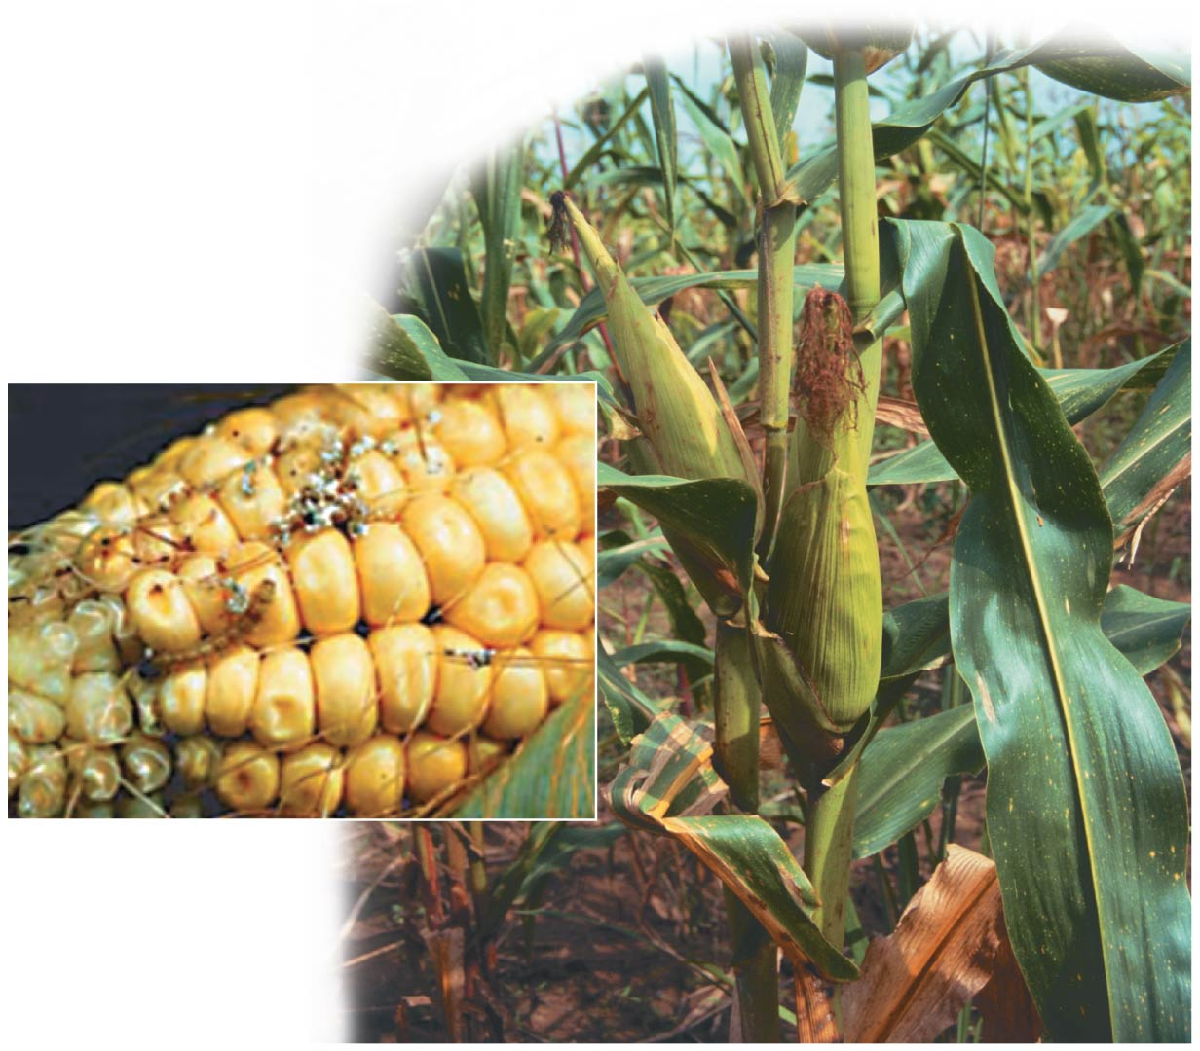
GM Corn - resists attack by an insect (moth larva) called the European corn borer.
reduces the need for chemical insecticides.
Notes:
Figure 12.9 Genetically modified corn

Slide 48
Genetically Modified Organisms in Agriculture
Genetic engineers are targeting agricultural animals as well as plant crops.
A gene that causes the development of larger muscles and transfer it to other cattle or even to chickens. – not yet approved by US Food and Drug Administration (FDA)
Notes:
48
Student Misconceptions and Concerns
1. Student comprehension of restriction enzymes and many other aspects of recombinant DNA techniques depends upon a comfortable understanding of basic molecular genetics. Consider addressing Chapter 12 after an exam that addresses the content in Chapters 10 and 11.
2. The genetic engineering of organisms can be controversial, creating various degrees of social unease and resistance. Yet many debates about scientific issues are confused by misinformation. This provides an opportunity for you to ask students to research an issue before taking firm positions. Students might debate whether a food or drug made from GM/transgenic organisms should be labeled as such, or discuss the risks and advantages of producing GM organisms. Consider starting class with a headline addressing one of these issues. The recent process of FDA approval for raising genetically engineered salmon (AquAdvantage) for food might be particularly useful and relevant.
3. The fact that the technologies described in this chapter can be used to swap genes between prokaryotes and eukaryotes reveals the fundamental similarities in genetic mechanisms shared by all forms of life. This very strong evidence of common descent is evidence of evolution that may be missed by your students.
4. Using gene therapy to “fix” genetic problems relies on a thorough understanding of the roles of genes and alleles. Students might benefit from a discussion of the extent to which we as a society might want to consider directing our own genetics.
Teaching Tips
1. Annual flu vaccinations are a common example of using vaccines to prevent diseases that cannot be easily cured. However, students might not understand why many people receive the vaccine every year. A new annual vaccine is necessary because the flu viruses keep evolving.
2. The origin of the name “restriction enzymes” may be of interest. In nature, these enzymes protect bacterial cells against foreign DNA. Thus, these enzymes “restrict” the invasion of foreign genetic material.
3. Students might think you are just making a bad joke by noting that laboratory synthesized genes are “designer genes,” but this is a common term. Search the Internet using the keywords “designer genes,” and many scientific (and unscientific) sites will be found.
4. Separating marker ink using paper chromatography is a simple experiment that approximates some of what occurs in gel electrophoresis. Consider doing this as a class demonstration while addressing electrophoresis. Cut a large piece of filter paper into a rectangle or square. Use markers to color large dots about 2 cm away from the edge of the paper. Separate the dots from each other by 3–4 cm. Place the paper on edge, dots down, into a beaker containing about 1 cm of ethanol or isopropyl alcohol (50% or higher will do). The dots should not be in contact with the pool of alcohol in the bottom of the beaker. As the alcohol is drawn up the filter paper by capillary action, the alcohol will dissolve the ink dots. As the alcohol continues up the paper, the ink follows. Not all of the ink components move at the same speed, based on their size and chemical properties. If you begin the process at the start of class, you should have some degree of separation by the end of a 50-minute period. Experiment with the technique a day or two before class to fine-tune the demonstration, and experiment with different types of ink. (Save and air-dry these samples for your class.) Consider using brown, green, and black markers, as these colors are often made by color combinations.
5. Roundup Ready Corn, a product of Monsanto, is resistant to the herbicide Roundup. The general strategy for farmers is to spray fields of Roundup Ready Corn with the herbicide Roundup, killing weeds but not the corn. A search of the Internet will quickly reveal the controversy associated with this and other genetically modified organisms (GMOs), which can encourage interesting discussions and promote critical thinking skills.
6. As gene therapy technology expands, our ability to modify the genome in human embryos through in vitro fertilization permits genetic modification at the earliest stages of life. Future generations of humans, like our crops today, may include those with and without a genetically modified ancestry. The benefits and challenges of these technologies raise issues many students have never considered. Our students, and the generations soon to follow, may face the potential of directed human evolution.
7. Ethical, legal, and social issues related to the Human Genome Project are directly addressed at the Department of Energy Human Genome website at http://web.ornl.gov/sci/techresources/Human_Genome/elsi/index.shtml.
8. The Biology and Society end-of-chapter textbook questions address some of the issues raised in this chapter section.
Active Lecture Tips
1. As you begin to address genetic engineering and GMO foods, ask students to work in small groups to discuss what they know about genetically engineered food. Have each group create a list of statements that can be short or long, reflecting their impressions of the technology. The results may surprise you and help you address some common misunderstandings and concerns.
2. If you have already addressed basic transcription and translation in your course, consider asking small groups of students in your class to explain the following. DNA technology is primarily used to produce proteins. Why aren’t lipids and carbohydrates typically produced by these processes?

Slide 49
Genetically Modified Organisms in Agriculture
AquAdvantage is a trade name for Atlantic salmon that have been genetically modified to reach market size in half the normal time (18 months vs. 3 years).
The US Food and Drug Administration (FDA) approved AquAdvantage salmon in 2015
The first GM animal approved for consumption in the United States.
Notes:
49
Student Misconceptions and Concerns
1. Student comprehension of restriction enzymes and many other aspects of recombinant DNA techniques depends upon a comfortable understanding of basic molecular genetics. Consider addressing Chapter 12 after an exam that addresses the content in Chapters 10 and 11.
2. The genetic engineering of organisms can be controversial, creating various degrees of social unease and resistance. Yet many debates about scientific issues are confused by misinformation. This provides an opportunity for you to ask students to research an issue before taking firm positions. Students might debate whether a food or drug made from GM/transgenic organisms should be labeled as such, or discuss the risks and advantages of producing GM organisms. Consider starting class with a headline addressing one of these issues. The recent process of FDA approval for raising genetically engineered salmon (AquAdvantage) for food might be particularly useful and relevant.
3. The fact that the technologies described in this chapter can be used to swap genes between prokaryotes and eukaryotes reveals the fundamental similarities in genetic mechanisms shared by all forms of life. This very strong evidence of common descent is evidence of evolution that may be missed by your students.
4. Using gene therapy to “fix” genetic problems relies on a thorough understanding of the roles of genes and alleles. Students might benefit from a discussion of the extent to which we as a society might want to consider directing our own genetics.
Teaching Tips
1. Annual flu vaccinations are a common example of using vaccines to prevent diseases that cannot be easily cured. However, students might not understand why many people receive the vaccine every year. A new annual vaccine is necessary because the flu viruses keep evolving.
2. The origin of the name “restriction enzymes” may be of interest. In nature, these enzymes protect bacterial cells against foreign DNA. Thus, these enzymes “restrict” the invasion of foreign genetic material.
3. Students might think you are just making a bad joke by noting that laboratory synthesized genes are “designer genes,” but this is a common term. Search the Internet using the keywords “designer genes,” and many scientific (and unscientific) sites will be found.
4. Separating marker ink using paper chromatography is a simple experiment that approximates some of what occurs in gel electrophoresis. Consider doing this as a class demonstration while addressing electrophoresis. Cut a large piece of filter paper into a rectangle or square. Use markers to color large dots about 2 cm away from the edge of the paper. Separate the dots from each other by 3–4 cm. Place the paper on edge, dots down, into a beaker containing about 1 cm of ethanol or isopropyl alcohol (50% or higher will do). The dots should not be in contact with the pool of alcohol in the bottom of the beaker. As the alcohol is drawn up the filter paper by capillary action, the alcohol will dissolve the ink dots. As the alcohol continues up the paper, the ink follows. Not all of the ink components move at the same speed, based on their size and chemical properties. If you begin the process at the start of class, you should have some degree of separation by the end of a 50-minute period. Experiment with the technique a day or two before class to fine-tune the demonstration, and experiment with different types of ink. (Save and air-dry these samples for your class.) Consider using brown, green, and black markers, as these colors are often made by color combinations.
5. Roundup Ready Corn, a product of Monsanto, is resistant to the herbicide Roundup. The general strategy for farmers is to spray fields of Roundup Ready Corn with the herbicide Roundup, killing weeds but not the corn. A search of the Internet will quickly reveal the controversy associated with this and other genetically modified organisms (GMOs), which can encourage interesting discussions and promote critical thinking skills.
6. As gene therapy technology expands, our ability to modify the genome in human embryos through in vitro fertilization permits genetic modification at the earliest stages of life. Future generations of humans, like our crops today, may include those with and without a genetically modified ancestry. The benefits and challenges of these technologies raise issues many students have never considered. Our students, and the generations soon to follow, may face the potential of directed human evolution.
7. Ethical, legal, and social issues related to the Human Genome Project are directly addressed at the Department of Energy Human Genome website at http://web.ornl.gov/sci/techresources/Human_Genome/elsi/index.shtml.
8. The Biology and Society end-of-chapter textbook questions address some of the issues raised in this chapter section.
Active Lecture Tips
1. As you begin to address genetic engineering and GMO foods, ask students to work in small groups to discuss what they know about genetically engineered food. Have each group create a list of statements that can be short or long, reflecting their impressions of the technology. The results may surprise you and help you address some common misunderstandings and concerns.
2. If you have already addressed basic transcription and translation in your course, consider asking small groups of students in your class to explain the following. DNA technology is primarily used to produce proteins. Why aren’t lipids and carbohydrates typically produced by these processes?

Slide 50
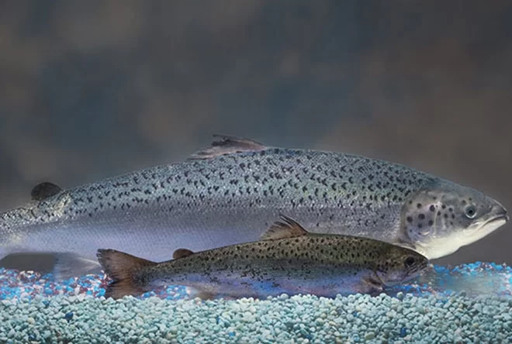

Slide 51
Transgenic animals are currently used ________.
to produce potentially useful proteins, example spider goats...
as a food source, but only Canada
both A and B are correct
none of the above are correct

Slide 52
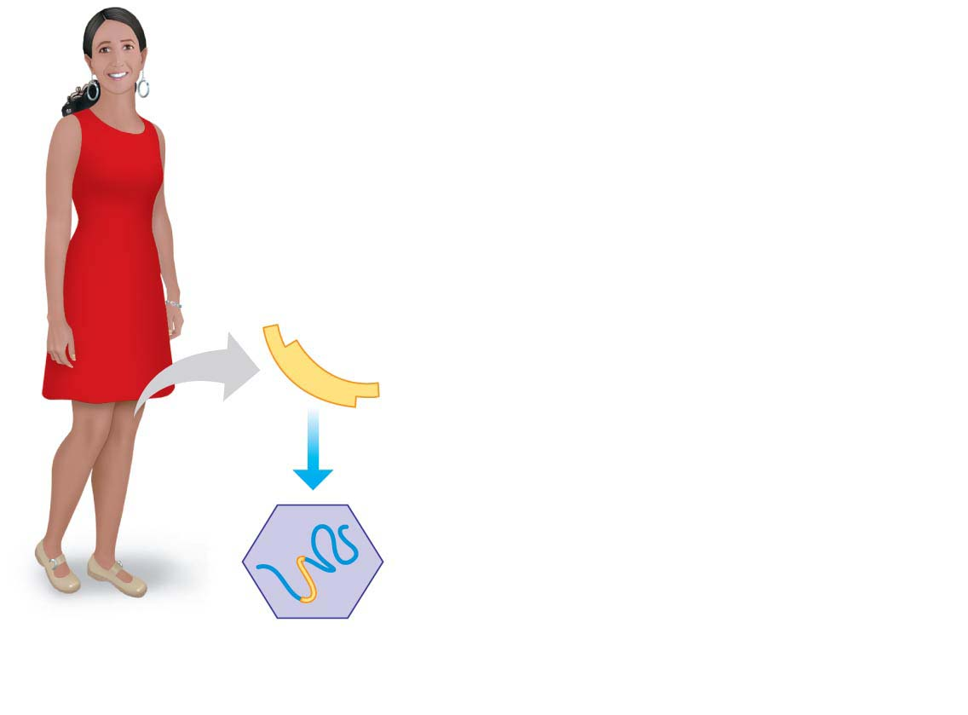
Figure 12.11-1
Human Gene Therapy
Normal
human gene
1
An RNA version is
inserted into a virus
RNA genome of virus
Inserted human RNA
Healthy
person
Notes:
Figure 12.11-1 One approach to human gene therapy (part 1: virus with inserted human RNA)

Slide 53
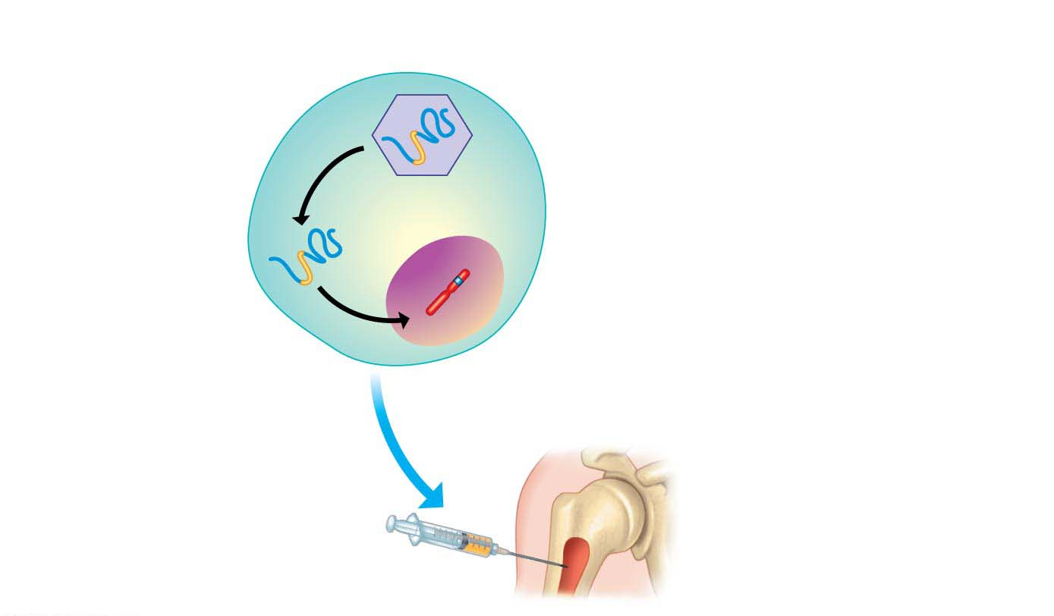
Figure 12.11-2
2
Bone marrow
cells are infected
3
Viral DNA inserts into
the cell’s chromosome
Human chromosome
Bone marrow
cell from the patient
Bone of person
with disease
4
The engineered
cells are injected
Bone marrow
Notes:
Figure 12.11-2 One approach to human gene therapy (part 2: engineered bone marrow cells)

Slide 54
Human Gene Therapy
The promise of gene therapy thus far exceeds actual results, but there have been some successes.
Notes:
54

Slide 55
Human Gene Therapy
From 2000 to 2011, gene therapy also cured 22 children with severe combined immunodeficiency (SCID), a fatal inherited disease caused by a defective gene that prevents development of the immune system, requiring patients to remain isolated within protective “bubbles.”
The treatment cured the patients of SCID, but there have been some serious side effects:
Four of the treated patients developed leukemia, and one died after the inserted gene activated an oncogene, creating cancerous blood cells.
Notes:
55

Slide 56
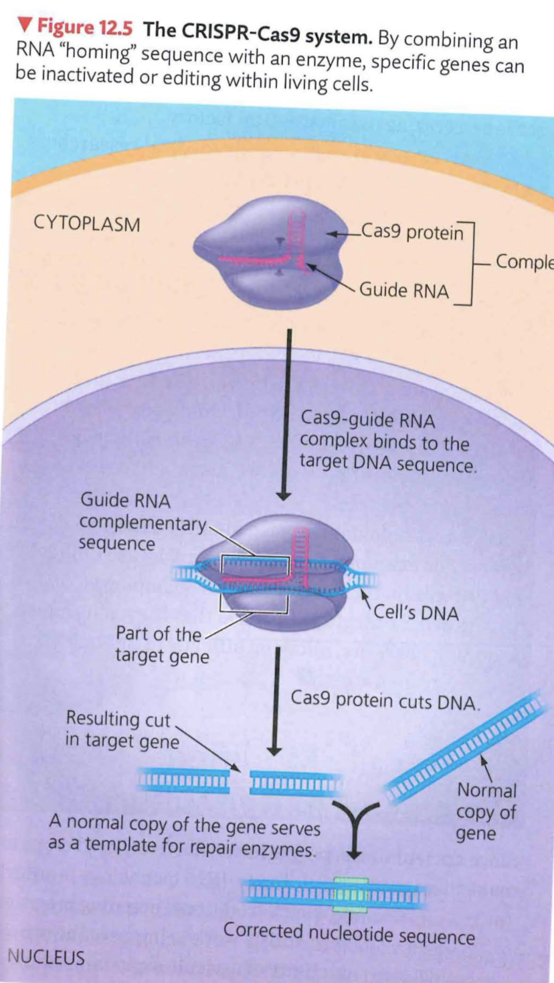
CRISPR-CAS9
Crispr-Cas9 – can the DNA of living multicellular organisms
original function
immune system of bacteria
recognizes and cuts virus DNA
Tool to accurately manipulate the DNA of multicellular eukaryotes.

Slide 57
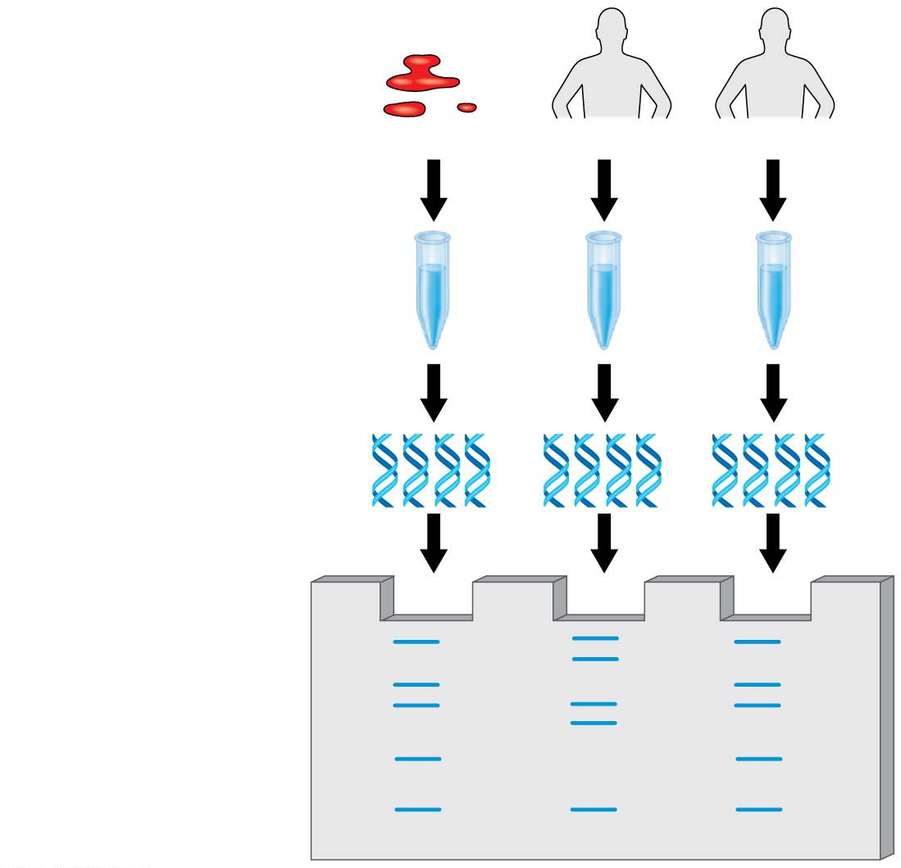
Figure 12.12
Crime scene
Suspect 1
Suspect 2
1
DNA isolated
2
DNA amplified
3
DNA compared
Notes:
Figure 12.12 Overview of DNA profiling

Slide 58
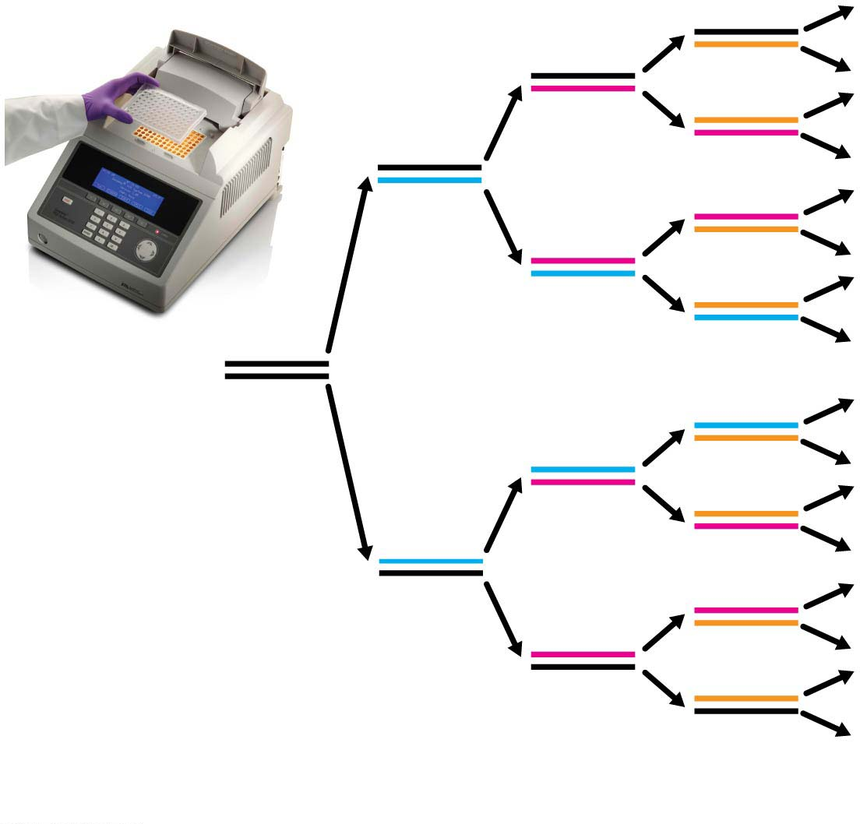
Figure 12.13
Initial
DNA
segment
1
2
4
8
Number of DNA molecules
Notes:
Figure 12.13 DNA amplification by PCR

Slide 59
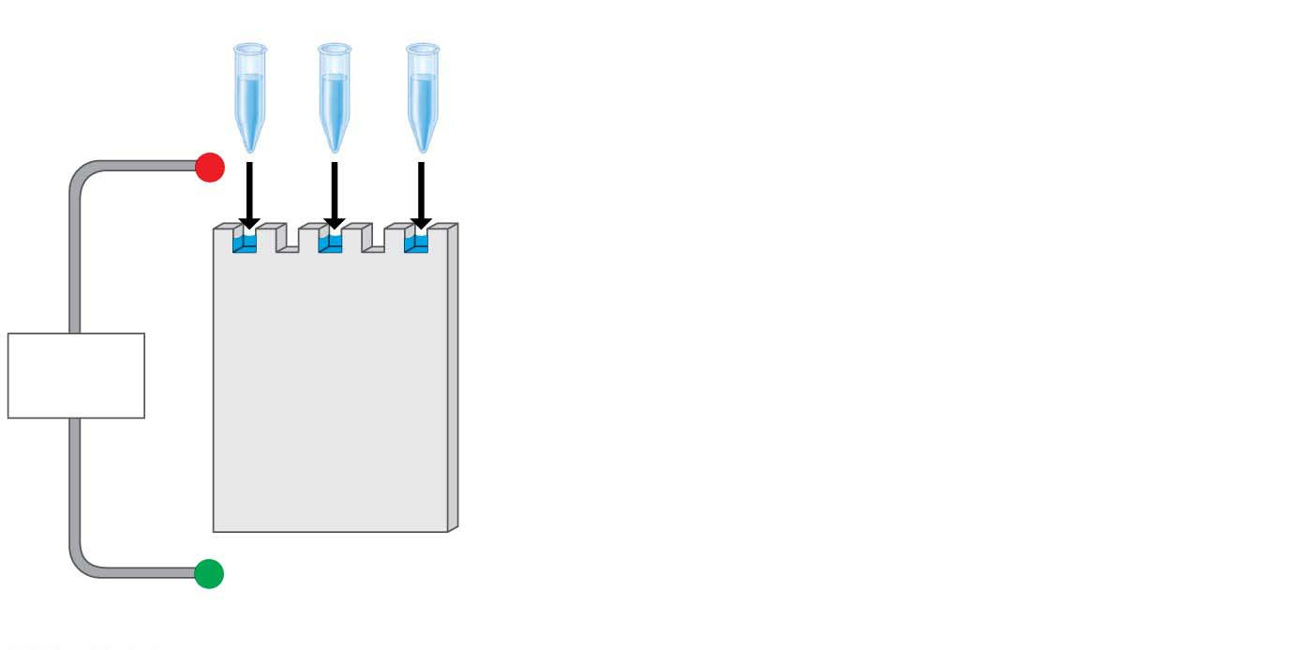
Figure 12.5-s1
Mixture of DNA
fragments of
different sizes
−
Power
source
+
Notes:
Figure 12.5-s1 Gel electrophoresis of DNA molecules (step 1)

Slide 60
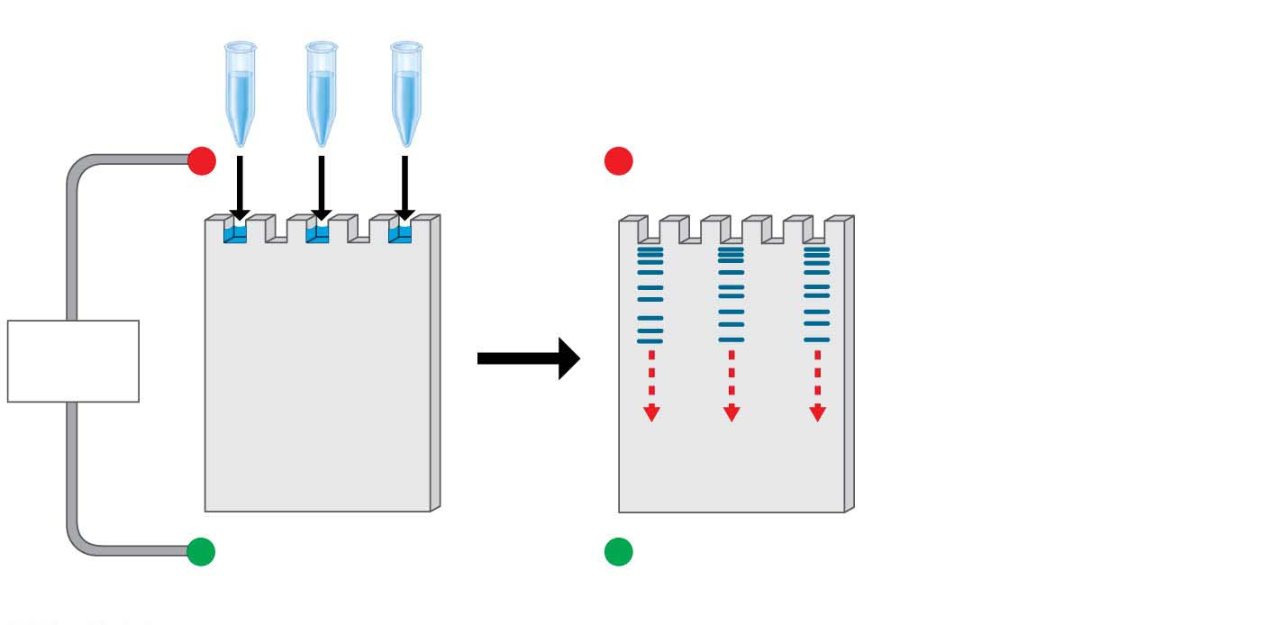
Figure 12.5-s2
Mixture of DNA
fragments of
different sizes
−
−
Power
source
+
+
Notes:
Figure 12.5-s2 Gel electrophoresis of DNA molecules (step 2)

Slide 61
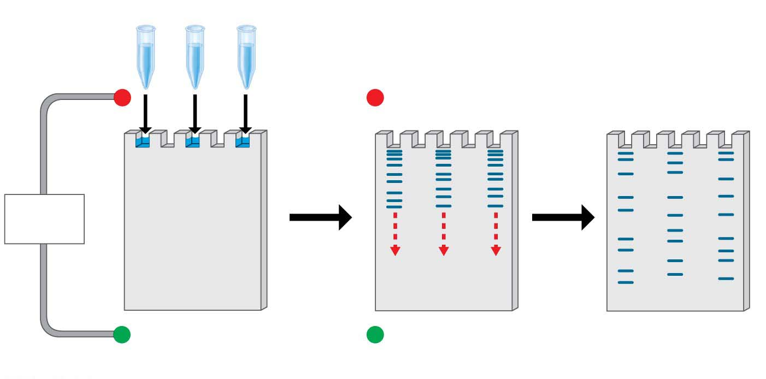
Figure 12.5-s3
Mixture of DNA
fragments of
different sizes
Band of longest
(slowest) fragments
−
−
Power
source
+
+
Band of shortest
(fastest) fragments
Notes:
Figure 12.5-s3 Gel electrophoresis of DNA molecules (step 3)

Slide 62
Short Tandem Repeat (STR) Analysis
How do you prove that two samples of DNA come from the same person?
Repetitive DNA
makes up much of the DNA that lies between genes in humans and
consists of nucleotide sequences that are present in multiple copies in the genome.
Notes:
62
Student Misconceptions and Concerns
1. Television programs might lead some students to expect that DNA profiling is quick and easy. Ask students to consider why DNA profiling actually takes many days or weeks to complete.
2. Students might expect DNA profiling for criminal investigations to involve an analysis of the entire human genome. Consider explaining why such an analysis is unrealistic and unnecessary.
3. The many forms of DNA technology discussed in this chapter provide powerful evidence of evolution. Although not addressed regularly in this chapter, consider reminding students that these techniques continue to reinforce and inform our understandings of the common descent of life on Earth.
Teaching Tips
1. Although the statistical odds of a DNA-profiling match can exceed one in 10 billion, the odds of a mistake in the collecting and testing procedures can be much greater. This is an important distinction. An error as simple as mislabeling a sample can confuse the results. Unfortunately, the odds of human error will vary and are difficult to determine.
2. In PCR, the product becomes another master copy. Imagine that while you are photocopying, every copy is used as a master at another copy machine. (This would require many copy machines.)
3. Students might need a little more practice understanding the products of restriction enzymes. Consider the two words, equilibrium and equalibrium. Imagine that a mutation produced the spelling error in the second word. If we used a “restriction enzyme” that splits these words between “u” and “i,” how will the fragments compare in size and number?
equilibrium = equ ilibri um (three fragments of three, six, and two letters)
equalibrium = equalibri um (two fragments of nine and two letters)
Active Lecture Tips
1. In most legal cases, the probability of two people having identical DNA profiles can be one in 10 billion or more. However, eyewitness testimony has been a standard part of the justice system. If you want to make the point about the unreliability of eyewitnesses in a trial, compared to techniques such as genetic profiling, consider this exercise. Arrange for a person who is not well known to the class to run into your classroom, take something you have placed near you (perhaps a bag, stack of papers, box), and leave quickly. You need to take care that no one in the class is so alarmed as to do something dangerous. Once the “thief” is gone, tell the class that this was planned but not to speak. Have them each write a description of the person, including height, hair color, clothing, facial hair, behavior, and so on. Many students will be accurate, but some will likely get details wrong. This is also an effective exercise to demonstrate the need for large sample sizes and accurate recording devices for good scientific technique.

Slide 63
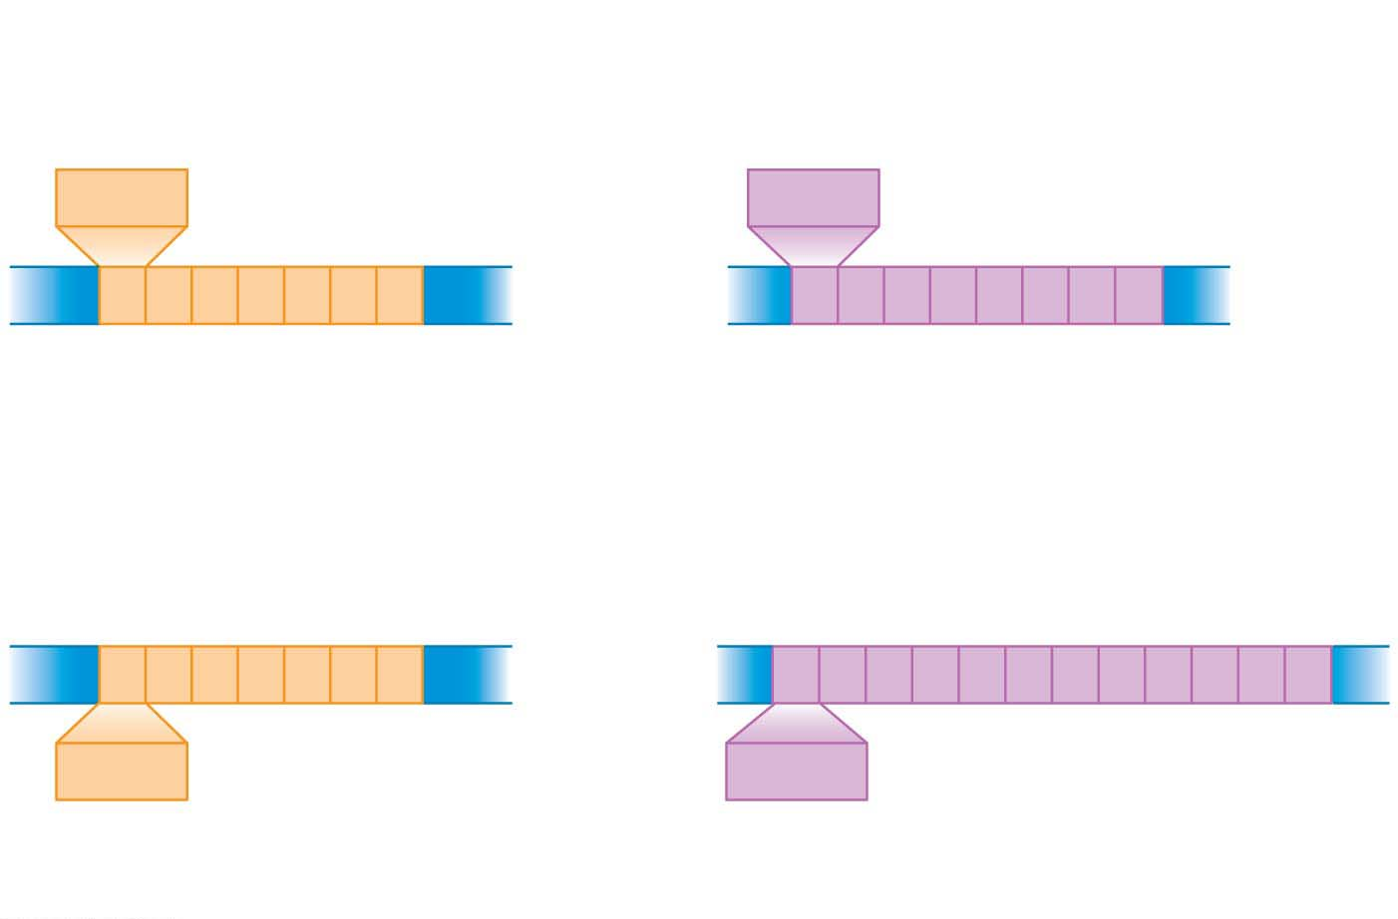
Figure 12.14
Crime scene DNA
STR site 1
STR site 2
AGAT
GATA
Same number of
short tandem repeats
Different numbers of
short tandem repeats
AGAT
GATA
Suspect’s DNA
Notes:
Figure 12.14 Short tandem repeat (STR) sites

Slide 64
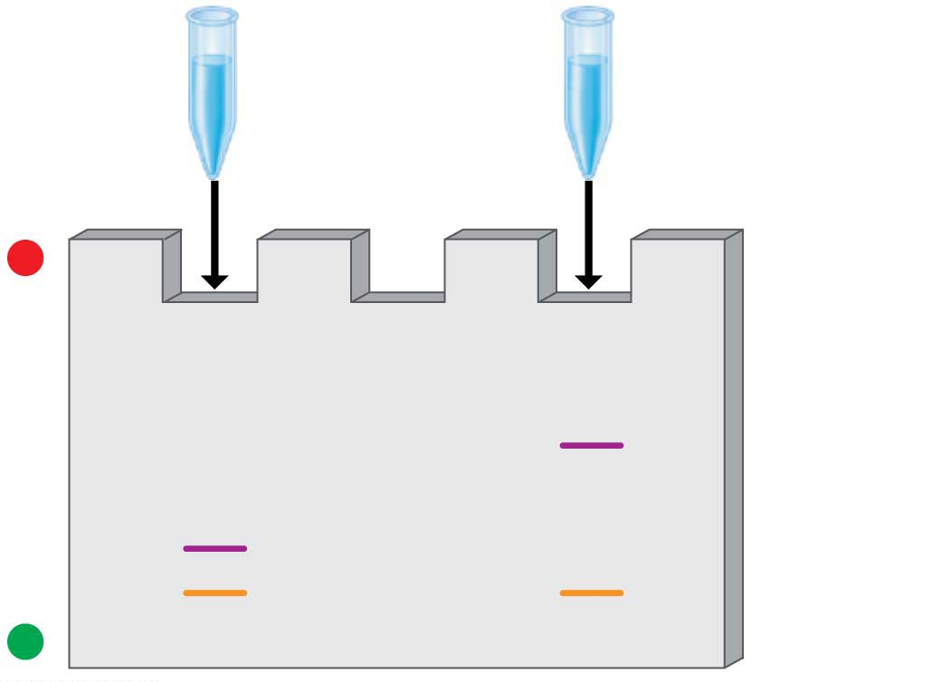
Figure 12.15
Amplified
crime scene
DNA
Amplified
suspect’s
DNA
−
Longer
fragments
Shorter
fragments
+
Notes:
Figure 12.15 Visualizing STR fragment patterns

Slide 65
Short Tandem Repeat (STR) Analysis
DNA profiling can provide evidence of either guilt or innocence.
As of 2014, lawyers at the Innocence Project, a nonprofit legal organization located in New York City, have helped to exonerate more than 310 convicted criminals in 35 states, including 18 who were on death row.
The average sentence served by those who were exonerated was 14 years.
Notes:
65

Slide 66
Short Tandem Repeat (STR) Analysis
In nearly half of these cases, DNA profiling has also identified the true perpetrators.
Figure 12.16 presents some data from a real case in which STR analysis proved a convicted man innocent and also helped identify the true perpetrator.
error rate 1 in 10 billion chance of a mistake
Notes:
66

Slide 67
Short Tandem Repeat (STR) Analysis
In forensic cases using STR analysis with the 13 standard markers, the probability of two people having identical DNA profiles is somewhere between one chance in 10 billion and one in several trillion.
Thus, despite problems that can still arise from insufficient data, human error, or flawed evidence, genetic profiles are now accepted as compelling evidence by legal experts and scientists alike.
Notes:
67

Slide 68
The process of making multiple copies of a gene by inserting it into a host genome and culturing the host is an example of ________.
^{A) gene cloning}
^{C) STR analysis}
^{B) PCR}
D) whole -genome shotgun method

Slide 69
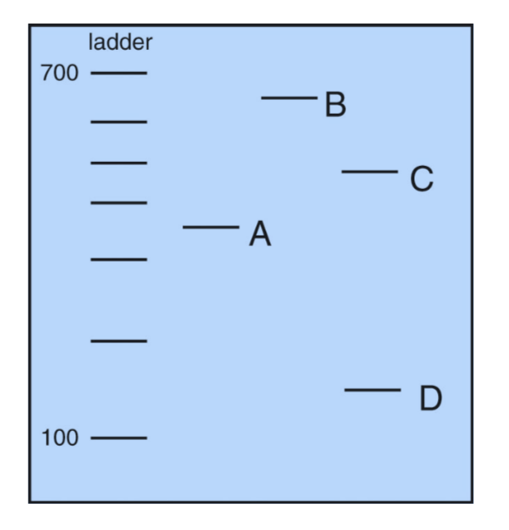

Slide 70
DNA Sequencing
Researchers can exploit the principle of complementary base pairing to determine the complete nucleotide sequence of a DNA molecule, a process called DNA sequencing.
In one standard procedure, the DNA is first cut into fragments, and then each fragment is sequenced.
Notes:
70
Student Misconceptions and Concerns
1. There are 24 chromosomes in the human genome. Students might initially find this confusing, as it is common knowledge that humans have 23 pairs of chromosomes. Consider making the statement that we have 24 different types of chromosomes and asking your students to explain why this is true.
2. The similarities of the genotypes and phenotypes of members of a human family tree are expected and understood by most students. Yet for many students, these same relationships are often poorly extrapolated to phylogenetic relationships of other groups. The use of genomics to test phylogenetic relationships is an enormously powerful tool used in modern systematics. Genomics is a significant test of the other overwhelming types of evidence for evolution.
Teaching Tips
1. The first targets of genomics were prokaryotic pathogenic organisms. Consider asking your students in class to suggest why this was a good choice. Students may note that the genomes of these organisms are smaller than eukaryotes and that many of these organisms are of great medical significance.
2. The authors note that there are about 3 billion nucleotide pairs in the human genome. There are about 3 billion seconds in about 95 years. This simple reference might add meaning to the significance of these large numbers.
3. The main U.S. Department of Energy Office website in support of the Human Genome Project is found at genomics.energy.gov.
4. The website for the National Center for Biotechnology Information is www.ncbi.nlm.nih.gov. The center, established in 1988, serves as a national resource for biomedical information related to genomic data.
5. Challenge students to explain why a complete understanding of an organism’s genome and the resulting proteins produced is still not enough to understand the full biology of an organism. Challenge them to consider the role of the environment in development and physiology. (One striking example of the influence of the environment is that the sex of some reptiles is determined not by genetics, but by egg incubation temperature!)
6. With a better understanding of the diverse and still unknown roles of many sections of DNA, consider discussing some of the difficulties of “resurrecting” extinct organisms from incomplete DNA sequences.
Active Lecture Tips
1. See the Activity Personal Genomics: Would You Give Your DNA Away? on the Instructor Exchange. Visit the Instructor Exchange in the MasteringBiology instructor resource area for a description of this activity.
2. See the Media Review: “Learn.Genetics” Genetic Science Learning Center from the University of Utah on the Instructor Exchange. Visit the Instructor Exchange in the MasteringBiology instructor resource area for a description of this activity.

Slide 71
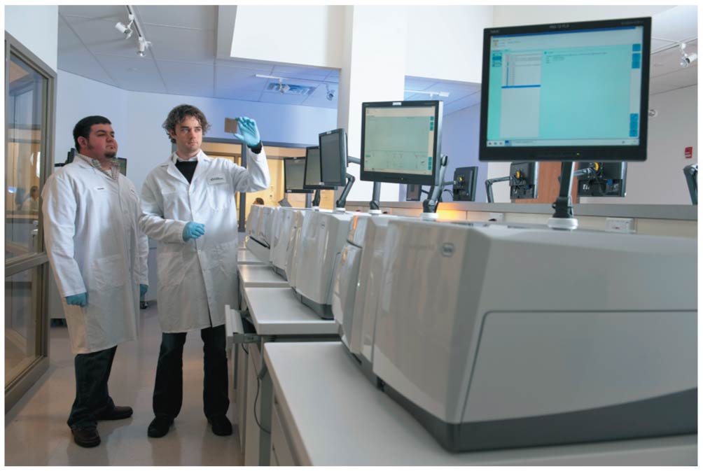
Figure 12.18
Notes:
Figure 12.18 A DNA sequencer

Slide 72
Genomics
Genomics is the study of complete sets of genes (genomes).
The first targets of genomics research were bacteria, which have relatively little DNA.
Notes:
72
Student Misconceptions and Concerns
1. There are 24 chromosomes in the human genome. Students might initially find this confusing, as it is common knowledge that humans have 23 pairs of chromosomes. Consider making the statement that we have 24 different types of chromosomes and asking your students to explain why this is true.
2. The similarities of the genotypes and phenotypes of members of a human family tree are expected and understood by most students. Yet for many students, these same relationships are often poorly extrapolated to phylogenetic relationships of other groups. The use of genomics to test phylogenetic relationships is an enormously powerful tool used in modern systematics. Genomics is a significant test of the other overwhelming types of evidence for evolution.
Teaching Tips
1. The first targets of genomics were prokaryotic pathogenic organisms. Consider asking your students in class to suggest why this was a good choice. Students may note that the genomes of these organisms are smaller than eukaryotes and that many of these organisms are of great medical significance.
2. The authors note that there are about 3 billion nucleotide pairs in the human genome. There are about 3 billion seconds in about 95 years. This simple reference might add meaning to the significance of these large numbers.
3. The main U.S. Department of Energy Office website in support of the Human Genome Project is found at genomics.energy.gov.
4. The website for the National Center for Biotechnology Information is www.ncbi.nlm.nih.gov. The center, established in 1988, serves as a national resource for biomedical information related to genomic data.
5. Challenge students to explain why a complete understanding of an organism’s genome and the resulting proteins produced is still not enough to understand the full biology of an organism. Challenge them to consider the role of the environment in development and physiology. (One striking example of the influence of the environment is that the sex of some reptiles is determined not by genetics, but by egg incubation temperature!)
6. With a better understanding of the diverse and still unknown roles of many sections of DNA, consider discussing some of the difficulties of “resurrecting” extinct organisms from incomplete DNA sequences.
Active Lecture Tips
1. See the Activity Personal Genomics: Would You Give Your DNA Away? on the Instructor Exchange. Visit the Instructor Exchange in the MasteringBiology instructor resource area for a description of this activity.
2. See the Media Review: “Learn.Genetics” Genetic Science Learning Center from the University of Utah on the Instructor Exchange. Visit the Instructor Exchange in the MasteringBiology instructor resource area for a description of this activity.

Slide 73
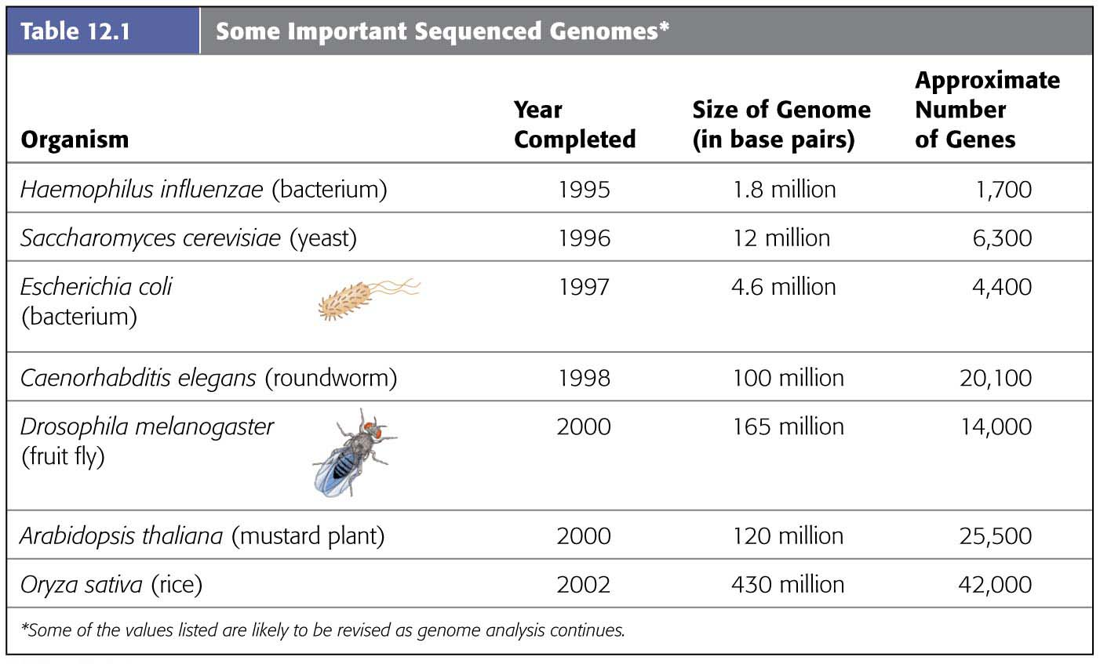
Table 12.1-1
Notes:
Table 12.1-1 Some important sequenced genomes (part 1)

Slide 74
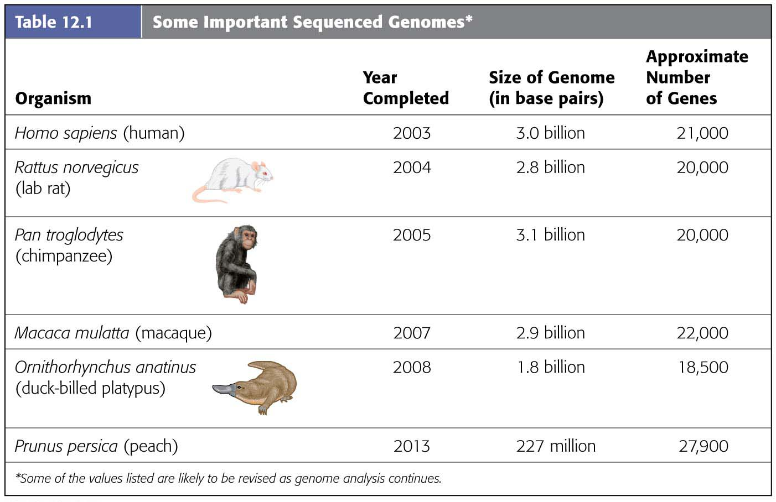
Table 12.1-2
Notes:
Table 12.1-2 Some important sequenced genomes (part 2)

Slide 75
The Human Genome
Begun in 1990, the Human Genome Project was a massive scientific endeavor to
determine the nucleotide sequence of all the DNA in the human genome and
identify the location and sequence of every gene.
Notes:
75
Student Misconceptions and Concerns
1. There are 24 chromosomes in the human genome. Students might initially find this confusing, as it is common knowledge that humans have 23 pairs of chromosomes. Consider making the statement that we have 24 different types of chromosomes and asking your students to explain why this is true.
2. The similarities of the genotypes and phenotypes of members of a human family tree are expected and understood by most students. Yet for many students, these same relationships are often poorly extrapolated to phylogenetic relationships of other groups. The use of genomics to test phylogenetic relationships is an enormously powerful tool used in modern systematics. Genomics is a significant test of the other overwhelming types of evidence for evolution.
Teaching Tips
1. The first targets of genomics were prokaryotic pathogenic organisms. Consider asking your students in class to suggest why this was a good choice. Students may note that the genomes of these organisms are smaller than eukaryotes and that many of these organisms are of great medical significance.
2. The authors note that there are about 3 billion nucleotide pairs in the human genome. There are about 3 billion seconds in about 95 years. This simple reference might add meaning to the significance of these large numbers.
3. The main U.S. Department of Energy Office website in support of the Human Genome Project is found at genomics.energy.gov.
4. The website for the National Center for Biotechnology Information is www.ncbi.nlm.nih.gov. The center, established in 1988, serves as a national resource for biomedical information related to genomic data.
5. Challenge students to explain why a complete understanding of an organism’s genome and the resulting proteins produced is still not enough to understand the full biology of an organism. Challenge them to consider the role of the environment in development and physiology. (One striking example of the influence of the environment is that the sex of some reptiles is determined not by genetics, but by egg incubation temperature!)
6. With a better understanding of the diverse and still unknown roles of many sections of DNA, consider discussing some of the difficulties of “resurrecting” extinct organisms from incomplete DNA sequences.
Active Lecture Tips
1. See the Activity Personal Genomics: Would You Give Your DNA Away? on the Instructor Exchange. Visit the Instructor Exchange in the MasteringBiology instructor resource area for a description of this activity.
2. See the Media Review: “Learn.Genetics” Genetic Science Learning Center from the University of Utah on the Instructor Exchange. Visit the Instructor Exchange in the MasteringBiology instructor resource area for a description of this activity.

Slide 76
The Human Genome
At the completion of the project,
more than 99% of the genome had been determined to 99.999% accuracy,
about 3 billion nucleotide pairs were identified,
about 21,000 genes were found, and
about 98% of the human DNA was identified as noncoding.
Notes:
76
Student Misconceptions and Concerns
1. There are 24 chromosomes in the human genome. Students might initially find this confusing, as it is common knowledge that humans have 23 pairs of chromosomes. Consider making the statement that we have 24 different types of chromosomes and asking your students to explain why this is true.
2. The similarities of the genotypes and phenotypes of members of a human family tree are expected and understood by most students. Yet for many students, these same relationships are often poorly extrapolated to phylogenetic relationships of other groups. The use of genomics to test phylogenetic relationships is an enormously powerful tool used in modern systematics. Genomics is a significant test of the other overwhelming types of evidence for evolution.
Teaching Tips
1. The first targets of genomics were prokaryotic pathogenic organisms. Consider asking your students in class to suggest why this was a good choice. Students may note that the genomes of these organisms are smaller than eukaryotes and that many of these organisms are of great medical significance.
2. The authors note that there are about 3 billion nucleotide pairs in the human genome. There are about 3 billion seconds in about 95 years. This simple reference might add meaning to the significance of these large numbers.
3. The main U.S. Department of Energy Office website in support of the Human Genome Project is found at genomics.energy.gov.
4. The website for the National Center for Biotechnology Information is www.ncbi.nlm.nih.gov. The center, established in 1988, serves as a national resource for biomedical information related to genomic data.
5. Challenge students to explain why a complete understanding of an organism’s genome and the resulting proteins produced is still not enough to understand the full biology of an organism. Challenge them to consider the role of the environment in development and physiology. (One striking example of the influence of the environment is that the sex of some reptiles is determined not by genetics, but by egg incubation temperature!)
6. With a better understanding of the diverse and still unknown roles of many sections of DNA, consider discussing some of the difficulties of “resurrecting” extinct organisms from incomplete DNA sequences.
Active Lecture Tips
1. See the Activity Personal Genomics: Would You Give Your DNA Away? on the Instructor Exchange. Visit the Instructor Exchange in the MasteringBiology instructor resource area for a description of this activity.
2. See the Media Review: “Learn.Genetics” Genetic Science Learning Center from the University of Utah on the Instructor Exchange. Visit the Instructor Exchange in the MasteringBiology instructor resource area for a description of this activity.

Slide 77
Can an insurance company require you to disclose information from a genetic test?
No, The Genetic Information Nondiscrimination Act of 2008 prevents discrimination based on genetic information
No, Title II provides similar protections in employment
No, Title I of the act prohibits insurance companies from requesting or requiring genetic information during an application for health insurance.
All of the above are accurate.

Slide 78
Safety and Ethical Issues
Strict laboratory safety procedures have been designed to
protect researchers from infection by engineered microbes and
prevent microbes from accidentally leaving the laboratory.
In addition, strains of microbes to be used in recombinant DNA experiments are genetically crippled to ensure that they cannot survive outside the laboratory and certain obviously dangerous experiments have been banned.
Notes:
78

Slide 79
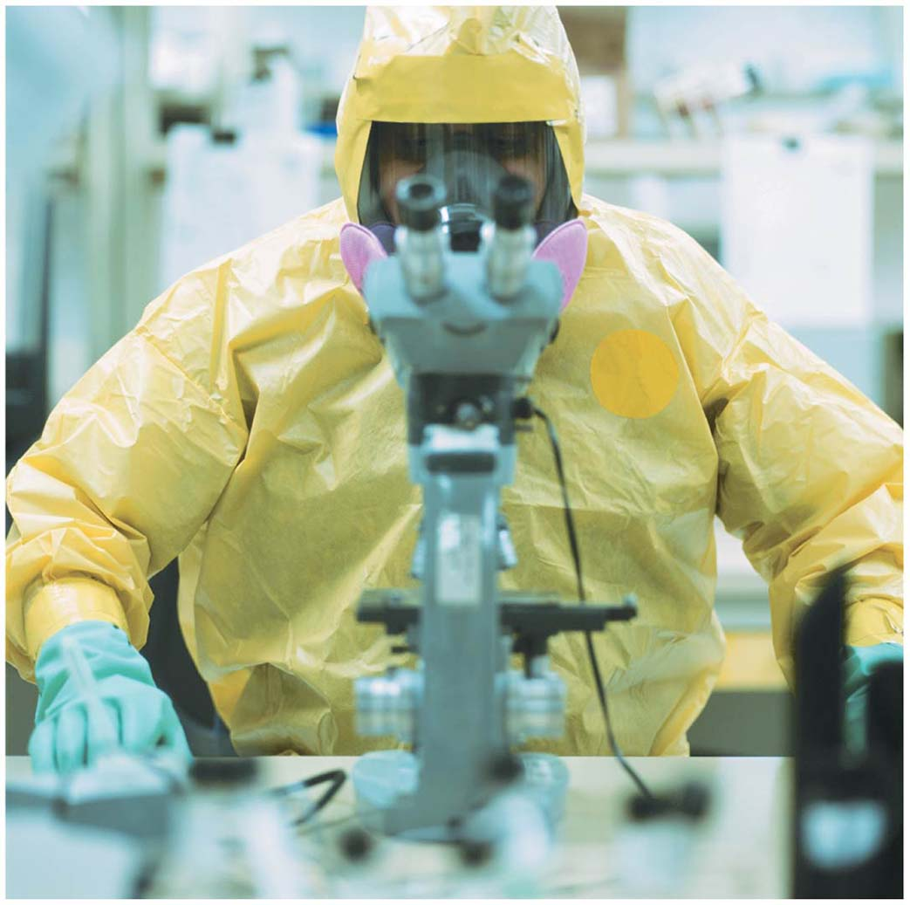
Figure 12.24
Notes:
Figure 12.24 Maximum-security laboratory

Slide 80
The Controversy over Genetically Modified Foods
Genetically modified (GM) foods account for a significant percentage of several staple crops in the United States, Argentina, and Brazil.
Controversy about the safety of these foods is an important political issue.
Notes:
80

Slide 81
Corn crops are susceptible to damage by different species of corn borer, an insect (a type of arthropod) that feeds and lives on corn plants. It is estimated that corn borers may cause up to $1 billion of damage a year to corn crops. Because of pests like the corn borer, researchers have created genetically modified pest-resistant crops. One type of pest-resistant crop, Bt corn, expresses a bacterial toxin that kills corn borers if they consume the toxin. While Bt corn has been planted and used in the United States since 1996, some researchers and members of the public continue to worry about negative effects of the Bt toxin on other animals, including arthropods and humans. In order to investigate the effects of Bt toxins on other animals, researchers conducted experiments where they fed arthropods Bt corn or non-Bt corn. A summary of the effects of eating Bt corn on single species of corn borer, mite, and beetle are shown in the figure below.

Slide 82
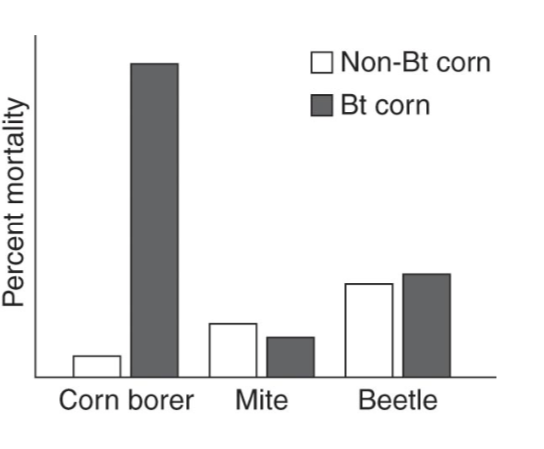

Slide 83
What can you conclude from the data in the graph?
Beetles are more likely to survive than mites when fed Bt corn.
Bt corn affects the mortality of all three arthropods equally.
Mites have the highest percent mortality of the arthropods studied.
Corn borers are less likely to survive if they eat Bt corn compared to non-Bt corn.

Slide 84
Based on the data in the graph, do you think Bt corn is having its intended effect?
Yes, because Bt corn selectively killed corn borers that ate it while the beetles and mites were unaffected when eating the Bt corn as compared to the non-Bt corn.
Yes, because Bt corn affected the mortality of all three arthropods equally.
No, because Bt corn was designed to kill all arthropods that ate it, and only the corn borers were killed after eating the Bt corn.
No, because corn borer percent mortality increased when corn borers ate Bt corn; if Bt corn was effective, then percent mortality should have decreased.

Slide 85
One of your local newscasters sees these data and announces on the news that "Bt toxins are safe because they have no negative effects on any arthropods except for the corn borers." Do you agree with that statement?
No, because more mites and beetles died after eating Bt corn than after eating non-Bt corn.
No, because these data were obtained from testing Bt on two species of mites and beetles; perhaps other arthropods may respond differently to Bt.
Yes, because the data clearly show that the Bt toxin is harmless to arthropods other than the corn borer.
Yes, because only the corn borer was affected when eating the Bt corn.

Slide 86
Compound Heterozygosity
CF1 – blue allele – normal CF protein
CF2 – orange allele – non-functional CF protein
CF3 – green allele – non-functional CF protein
homozygote
no disease
heterozygote
no disease
heterozygote
cystic fibrosis
homozygote
cystic fibrosis

Slide 87
The disease cystic fibrosis (CF) is considered a 'recessive disease', because you need at least one functional transmembrane CR protein to have normal lung function. However, this disease does not follow classic concepts of dominance. A heterozygote without disease can have one normal CF allele (blue protein) and one nonfunctional CF allele (orange protein). A heterozygote can also have two non-functional CF proteins (orange and green) and have the disease. In cystic fibrosis the heterozygote can have CF or be normal. Cystic fibrosis is said to have ___________________.
Compound heterozygosity
C) Incomplete dominance
B) Heterozygous recessivity
D) Mixed dominance

Slide 88
If a female Drosophila that is heterozygous for a recessive X-linked mutation is crossed to a wild-type male, what proportion of female progeny will have the mutant phenotype?
A) 100% B) 0% C) 33% D) 25% E) 50%

Slide 89
Previously Covered Chapters
Do the review quizzes on Canvas under the ‘Quizzes’ section
Read the ‘Exam 4 & Final Review’
Let me know if you have questions.
sandra.namoff@chaffey.edu

